Slide 1


Nature-Based Solutions Course outline
Olivia Ollikainen
Project Coordinator
Department of Environmental and biological Sciences & Centre of Continuous Learning

Slide 2


ENABLS overview
Education and Nature-Based Solutions: Enable society to bend the curve for biodiversity
Horizon Europe – project
11 entitites from 8 EU countries (DE, NL, AT, FI, LT, GR, CZ, BE)
UEF team: Department of environmental and biological sciences & Centre of continuous learning

Slide 3
Nature-Based Solutions
”Actions that protect, sustainably manage and restore natural or modified ecosystems that address societal challenges effectively and adaptively, simultaneously providing human well-being and biodiversity benefits.” (IUCN 2016)
Four core ideas (Sowińska-Świerkosz & García, 2022):
Are inspired and powered by nature
Address (societal) challenges or resolve problems
Provide multiple services/benefits, including biodiversity gain
Are of high effectiveness and economic efficiency

Slide 4
Three broad categories of NBS actions
Minimal or no intervention
Nature protection and conservation
Management approaches that involve some intervention
Sustainable management, insect hotels, nest boxes, management of grazing animals…
Extensive and intrusive management of ecosystems, including the creation of new ones
Creating green areas, blue infrastructure…

Slide 5
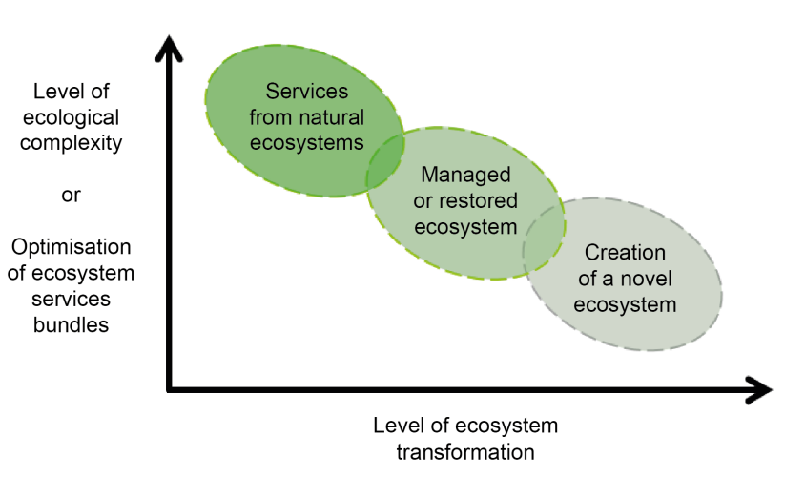
Three broad categories of NBS actions
The relationship between ecological complexity and ecosystem services optimisation, and the level of engineering ecosystems.
(IUCN 2020. Adapted from Balian, Eggermont & Le Roux (2014))

Slide 6

Introduction
Course will be part of the Biodiversity Education Network and is piloted in January 2025. Course is in English (for the purpose of eNaBlS project and our department's English master's degree program)
Course extent 2 sc (54 hours), Evaluation pass/fail.
Course objectives: After completing the course student will be able to...
define what Nature-Based Solutions are and what criteria they must meet.
recognize the significance of Nature-Based Solutions in addressing various societal problems.
identify examples of Nature-Based Solutions implemented in Finland and around the globe.
apply their knowledge to envision what Nature-Based Solutions could look like in their own local environment.

Slide 7


Approach to NBS in this course
Problem-oriented thinking
Human well-being and bd gain is part of all modules (challenge, but also solution and goal)
Human well-being and biodiversity benefits
Societal challenges
Nature-Based Solutions
Society in harmony with nature
Climate change
DRR
Tradition
Livelihood
Development
Disaster risk reduction
Sosio-economic development
Food security
Water security
Environmental degredation and biodiversity loss

Slide 8


Course modules
Module 3: Food production and water management (13 h)
… to local approach.
Instructions and course objectives (1 h)
Module 4: Socio-economic development (19 h)
Module 2: Environmental risks (13 h)
1
Module 1: Introduction:
Basic knowledge (5h)
Module 5: Conclusion (3 h)
From global scale…

Slide 9

Course contents
Instructions and course objectives (1 h)
Orientation and activation
Course objectives
Structure
Evaluation criteria
Tools and resources
Pre-assignment: setting personal learning goals/ views on nbs before taking the course
Module 1: Introduction (9h)
1.1 MUST KNOW-contents
Introduction to the course content (course’s viewpoint)
What are NBS (Short video lecture, Oksana)
IUCN (International Union for Conservation of Nature) materials
Criteria and core features
ENaBlS materials and visuals
1.2 Tasks
Multiple-choice quiz
Writing task (get to know NBS around the globe)

Slide 10
Course modules
Module 2: Environmental risks (14 h)
2.1 Climate change and DRR
Wetland and peatland restoration (Teemu Tahvanainen)
Water economy, peatland ecology,
Case example: paludiculture
2.2 Biodiversity loss / Healthy ecosystems
Forests and biodiversity (Tuomo Takala and Hannes Pasanen)
Resistant seedling material (Elina Oksanen, EPSO)
Saimaa ringed seal photoID (research viewpoint)
Invasive species (theory and background)
2.3 Tasks
Multiple-choice quiz
Combining hazard to solution/ ecosystem task
Module 3: Food production & water management (14 h)
3.1 Food production
Agriculture
BSAG (regenerative farming)
Crop wild relatives (Elina Oksanen)
Leguminous plants
Food waste management, technology (Antton Oksanen)
New cultivation techniques, Case example: Strawberry cultivation (Harri Kokko)
3.2 Water management
Protective belts around waterbodies
Freshwater mussel (Jouni Taskinen)
LIFE Revives project videos and material (Heidi Kunttu)
Biological cleaning of waste- and stormwater, sedimentation tanks, technology (Sidra Iftekhar)
3.3 Tasks
Multiple-choice quiz

Slide 11
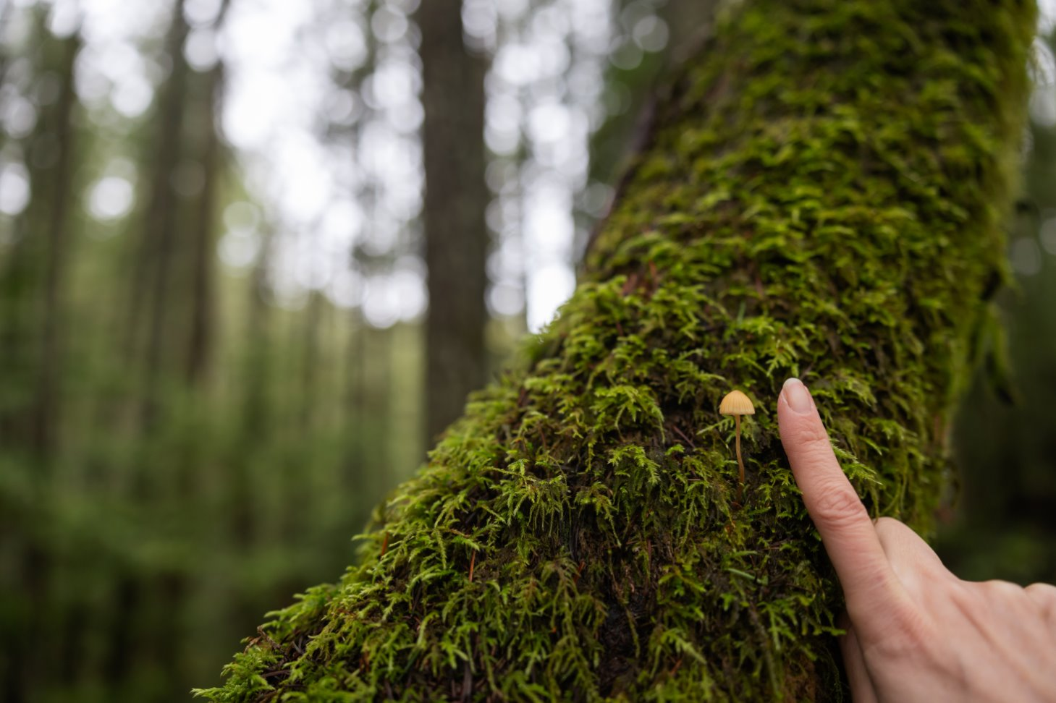
Course modules
Module 4: Socio-economic/cultural development (14 h)
4.1 Urban management
People working with nature (Bottom-up approach)
Urban parks, Kuopio city case (Oksana Skaldina)
MUST project (Valtteri Aaltonen)
Green roofs and green urban areas, technology (Antton Oksanen)
4.2 Local knowledge
MKN : wetland restoration, invasive species, landscape walks
Deepening the connection between people and community (Case example: Saimaa ringed seal, Kaarina Tiainen SLL)
Villi vyöhyke ry (meadows and other pioneer work)
4.3 Human health
Remediation of contaminated land, technology (Antton Oksanen)
4.4 Tasks
Multiple-choice quiz and writing task
Module 5: Conclusion (2 h)
5.1 Self-evaluation
Knowledge and attitudes towards NBS after taking the course
5.2 Course feedback

Slide 12
What are we expecting from the collaboration?
Diverse material for the course (teaching videos, interviews, informative texts, pictures of your work). Videos are expected to be 5-10 minutes long.
Keep in mind that the course is basic knowledge of NBS and 2 study credits (54 h of work)
Do not worry about slideshow layout, colours etc. Olivia will build the course platform, edit and combine everything together.
Most important thing is to priovide us accurate, up-to-date and science-based knowledge and ideas about NBS in your area of expertise.
Schedule: Course material must be ready in the end of December 2024. We are piloting this course to test group (university students) and course is ready to launch in January 2025.
Questions about material access rights and contract details (e.g. compensation) will be discussed.

Slide 13


Contact and sending the materials
Project members
Supervisor
Elina Oksanen
Professor
Email. elina.oksanen@uef.fi
Oskari Ylikoski
University Teacher
Email. oskari.ylikoski@uef.fi
Project sites
Biodiversity.now
eNaBlS
Olivia Ollikainen
Project Coordinator
Email. olivia.ollikainen@uef.fi
Tiina Pyrstöjärvi
Continuous Learning Specialist
Email. tiina.pyrstojarvi@uef.fi
Tiina Ynnilä
Continuous Learning Specialist
Email. tiina.ynnila@uef.fi

Slide 14
Presentation references
IUCN, 2016. Nature-based solutions to address global societal challenges. https://serval.unil.ch/resource/serval:BIB_93FD38C8836B.P001/REF ​
IUCN 2020. Global Standard for Nature-based Solutions. A User-Friendly Framework For the verification, Design and Scaling Up of NbS, 1st Edition, IUCN, Gland, Switzerland.​
Barbara Sowińska-Świerkosz & Joan García, 2022. What are Nature-based solutions (NBS)? Setting core ideas for concept clarification. Elsevier https://doi.org/10.1016/j.nbsj.2022.100009

