Slide 1
PowerPoint instructions

Slide 2
PowerPoint instructions
The purpose of this slideshow is to guide you to make a proper, clear, visual slide show.
Practice the things explained in the instructions to a new slideshow.
The most important thing is to use clear, good English, images and colors so you get the show to be more interesting.
You can use PowerPoint desktop program or Office 365 versions.
So let's start the slideshow

Slide 3
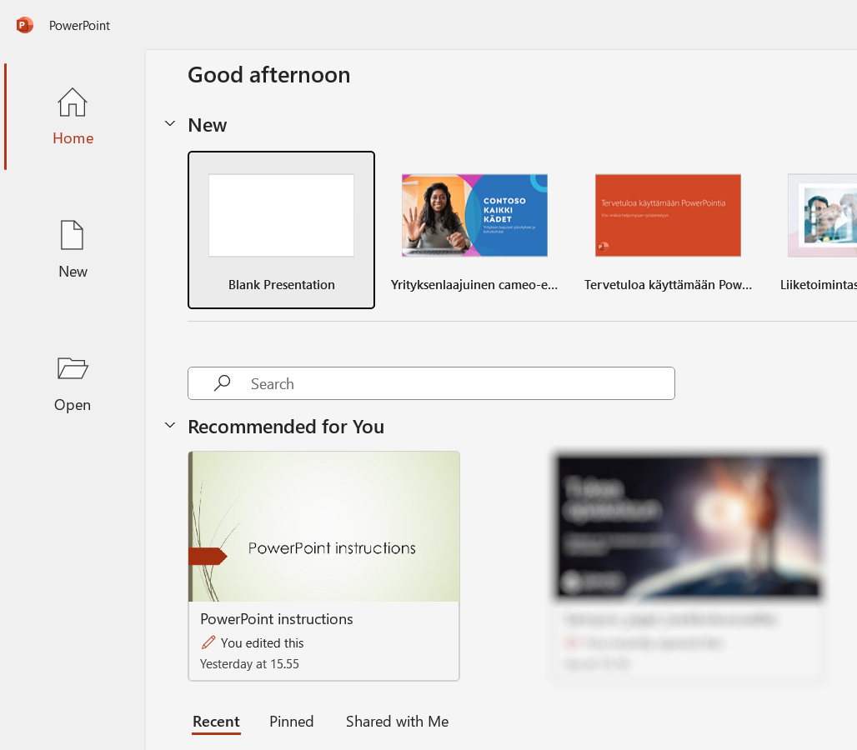
Start of a slideshow
Start PowerPoint
Select Empty slide show from the starting window (the theme is selected later)
By default, the title slide opens up

Slide 4
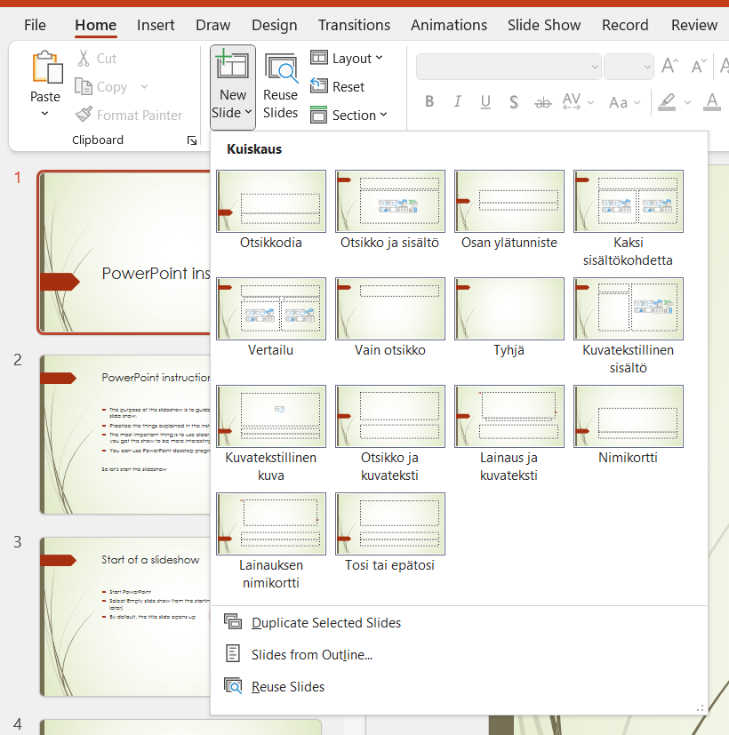
Slide structures
You can use layouts for slides.
The layout has placeholders for written text
Placeholders can be in a heading or a list
Heading and content (most common)
Two content items
Title/Heading only
Empty
The slide layout can be changed with the Layout button in the Home tab from the ribbon.
Notes:
Apologies for the Finnish text on the layouts – they did not change when the language in PP was changed to English.

Slide 5
Adding a new slide
Slides in PowerPoint can be compared to the pages in Word
A new slide is added from the Home tab → New Slide button
At the same time, choose a suitable slide layout, for example Title and contents

Slide 6
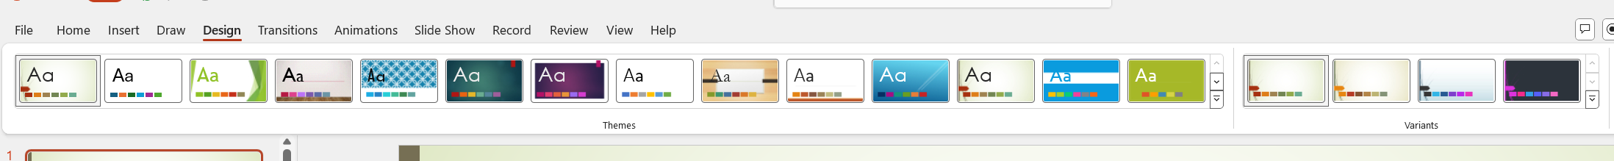
Themes
You can choose a theme for the slides, i.e. a "colorful" background
Themes can be found on the Design tab
The theme affects the whole show, so it’s a good idea to select one at the beginning of the slide show or not at all
Themes also have color variants, which can be selected on the right side of the themes
The theme can be changed if necessary

Slide 7
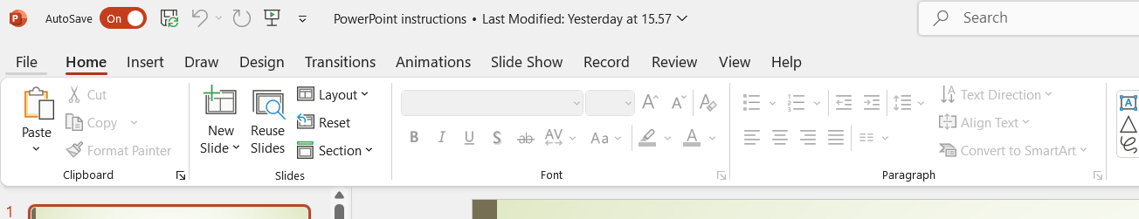
Text slides
Text is added to a specific location, a drawn object or a text box
Edit text in the same way as in Word
Text in list format (bullet points)
Indentations
Press the Increase list level button (left indentation)
The bullet point changes in the indentation
Font size changes in indentation

Slide 8
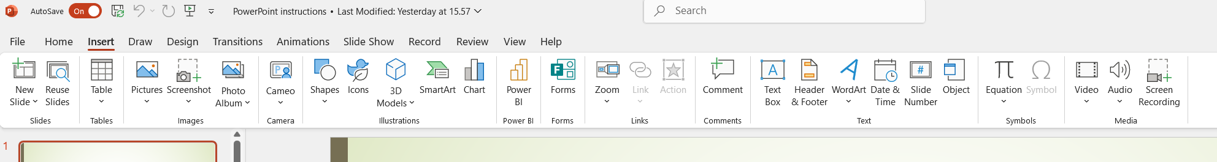
Text box
You can add a text box by clicking the Text box button on the Insert tab
Click the text box on to the slide and write the text in it
You can place the text box anywhere and it can be rotated and moved.
This has been made with a text box.

Slide 9

Pictures and shapes
This is a shape. The text can be edited by double clicking the shape/text.
Images
Added in the same way as in Word
Copied from the internet
A saved image is added from the computer
Copying an image from another program
Edited in the same way as in Word
Shapes
Add in the same way as in Word
Insert tab → Shapes
Select the appropriate shape and draw it on to the slide
Created with AI on 2.10.2024.

Slide 10
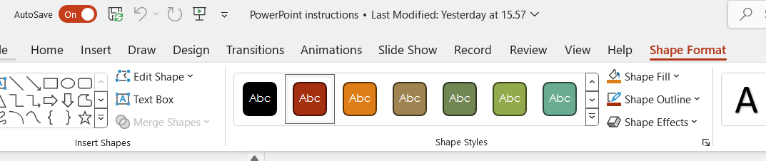
Colors for objects
The theme gives objects (shapes, SmartArt..) a color scheme.
If necessary, you can change the colors almost without limits.
Basic editing is done with the style selections of the shape.
Click on the shape, select Shape Format tab and then a suitable color from Shape Styles.
You can find more editing possibilities:
Shape fill
Shape outline
Shape effects
Do nopte that this tab is only visible after selecting the shape.

Slide 11
WordArt and SmartArt
Building A
A 101
Building B
B 201
B 202
Building C
C 301
C 302
A 102
SmartArt
Various types of charts, diagrams, etc.
Insert → SmartArt
Select the appropriate shape and drag the shape on to the slide
Type in the Type here box next to SmartArt
WordArt
Various text formats
Insert → WordArt
Choose a format
In the box that opens, type the text
You can edit it later in the same way as shapes
This is a WordArt object

Slide 12
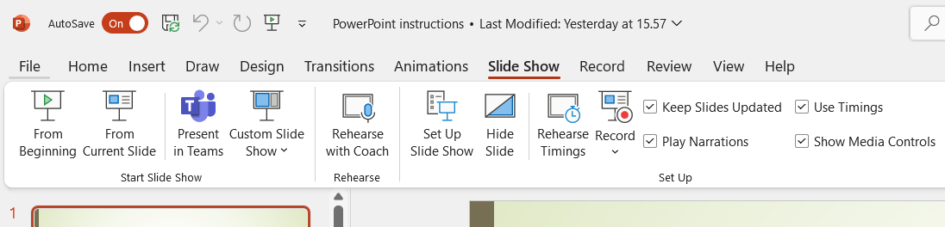
Presentation 1/3
Use a slideshow when you want to give a presentation to an "audience" at full screen size and use effects in your presentation
Launching a slideshow
Press the F5 key, or
Click the slideshow button on top left or bottom right of the Power Point window, or
Select the Slide Show tab → From Beginnig or From Current Slide
Moving from one slide to another
To move to the next slide, click the mouse or press, for example, the space bar
You can also use the arrow keys to move "forwards and backwards" in the presentation
To stop the presentation (end)
Press the ESC key

Slide 13
Presentation 2/3
Transitions
refer to effects "in between" the slides
Transitions are selected from the Transitions tab
Click on the slide in the left margin and select the appropriate transition
Each slide can have a different transition between it and the next, or the same transition can be used for the whole presentation
To use a transition with all slides, select the transitions and click Apply To All on the right side of the ribbon
Each transition may have other options too, like the duration of the transition.
Transitions, as well as the whole presentation, can also be timed to run automatically

Slide 14
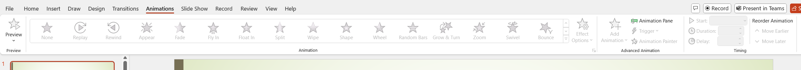
Presentation 3/3
Continuous presentation
The presentation automatically starts from the beginning
Select the Slideshow tab → Configure the slideshow → Repeat the presentation until ESC is pressed
Animations
Animations are applied to differet objects of the slide and pace out the presentation.
They regulate the content that is presented on the slide.
They can be added to all the objecs on the slide or to specific parts.
Like transitions, animations have options that can be tuned.

