Slide 1
Combustion theory
Esko Tiainen, Karelia-ammattikorkeakoulu

Slide 2
Principles of combustion
The chemical reaction is usually associated with thermal phenomena. (Combustion, dissolution, phase changes)
Reaction has a certain “heat content” , enthalpy H. As a unit of energy in kilojoules, kJ.
The heat content decreases in the heat-releasing reaction (exothermic reaction) and increases in the heat-binding reaction (endothermic reaction).
The heat of reaction is ΔH, the difference between the enthalpies of the product materials and the starting materials.
ΔH can be reported with the reaction equation.

Slide 3
Example
+390 kJ energy into the environment.
ΔH = -390kJ exothermic
-178 kJ energy from the environment.
ΔH = +178kJ endothermic

Slide 4
The heat of reaction is calculated from the energy content of the substances, ie the heat of formation ΔH_{f}
aA + bB → cC + dD

Slide 5
For hydrogen:
ΔH = -572 kJ
2 moles, or about 4 g of hydrogen, release about 572 kJ of energy as heat during combustion.

Slide 6
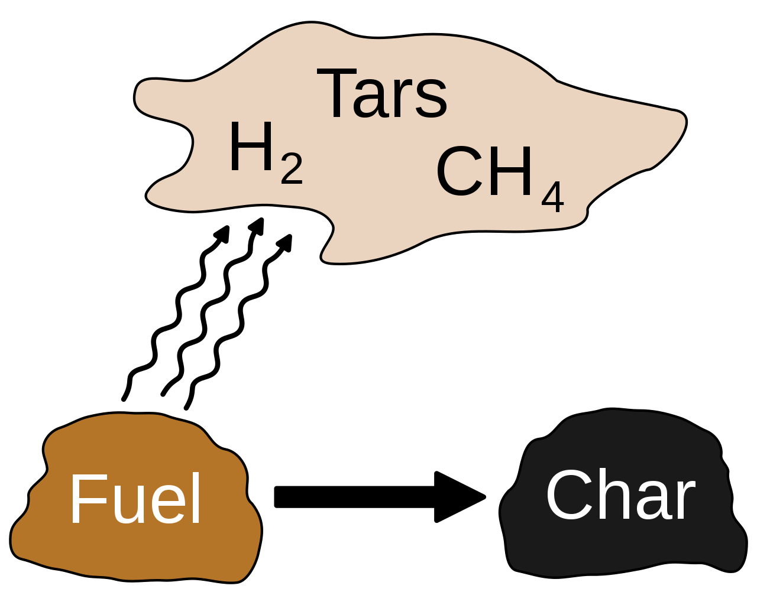
Combustion process
In combustion, the elements and molecules contained in the fuel react with oxygen, converting chemical energy into thermal energy.
Combustion proceeds as a chain reaction in which free radicals break the covalent bonds of fuel molecules, producing more radicals.

Slide 7
Combustion process
Oxygen is usually from the air about O2 21% by volume and N2 79% by volume. Ratio N2/O2 = 3,76.
The amount of heat released during fuel combustion is called the calorific value.
Combustible material is converted to the gas phase through both gasification reactions and pyrolysis (heating without oxygen or fire).

Slide 8
Stages of combustion
1. Initial warming and drying
When a fuel particle enters a hot atmosphere, the temperature of the particle first rises and the water (residual moisture) contained in it evaporates. The temperature rise of the particle slows down momentarily as the water evaporates. During drying, gaseous components also evaporate from the fuel particle.
2. Ignition
The solid ignites, causing the gaseous components to burn around the particle. The combustion of the gaseous components takes 0.2-0.5 s.

Slide 9
Stages of combustion
3. Pyrolysis
Pyrolysis is not the combustion of fuel, but the decomposition of matter as the temperature rises. Liquid pyrolysis products are complex mixtures of alcohol, oil and tar as well as water. Gaseous products are often hydrogen, methane, carbon monoxide as well of carbon dioxide.
4. Combustion and gasification of residual coal
A solid fuel that does not change its state in pyrolysis is called
char. Residual carbon is oxidized through either gasification or combustion reactions.

Slide 10
Combustion reactions:
C + O2 → CO2 ∆H298 = -393.5 kJ / mol
C + ½ O2 → CO ∆H298 = -110.5 kJ / mol
The gasification:
C + CO2 → 2CO ∆H298 = 172.5 kJ / mol
C + H2O → CO + H2 ∆H298 = 131.3 kJ / mol
C + 2H2 → CH4 ∆H298 = -74.8 kJ / mol
In an oxygen-rich atmosphere, direct reaction with oxygen dominates combustion, while under low-oxygen conditions, the importance of gasification reactions is emphasized.

Slide 11
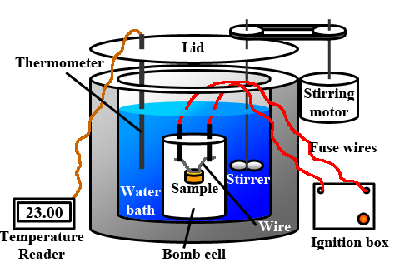
Calorific value
Higher heating value HHV (or calorific value) is determined by bringing all the products of combustion back to the original pre-combustion temperature, and in particular condensing any vapor produced.

Slide 12
Calorific value
Lower heating value LHV is determined by subtracting the heat of vaporization of the water from the higher heating value. This treats any H2O formed as a vapor. Calculations assume that the water component of a combustion process is in vapor state at the end of combustion, as opposed to the HHV. It is useful in comparing fuels where condensation of the combustion products is impractical.

Slide 13
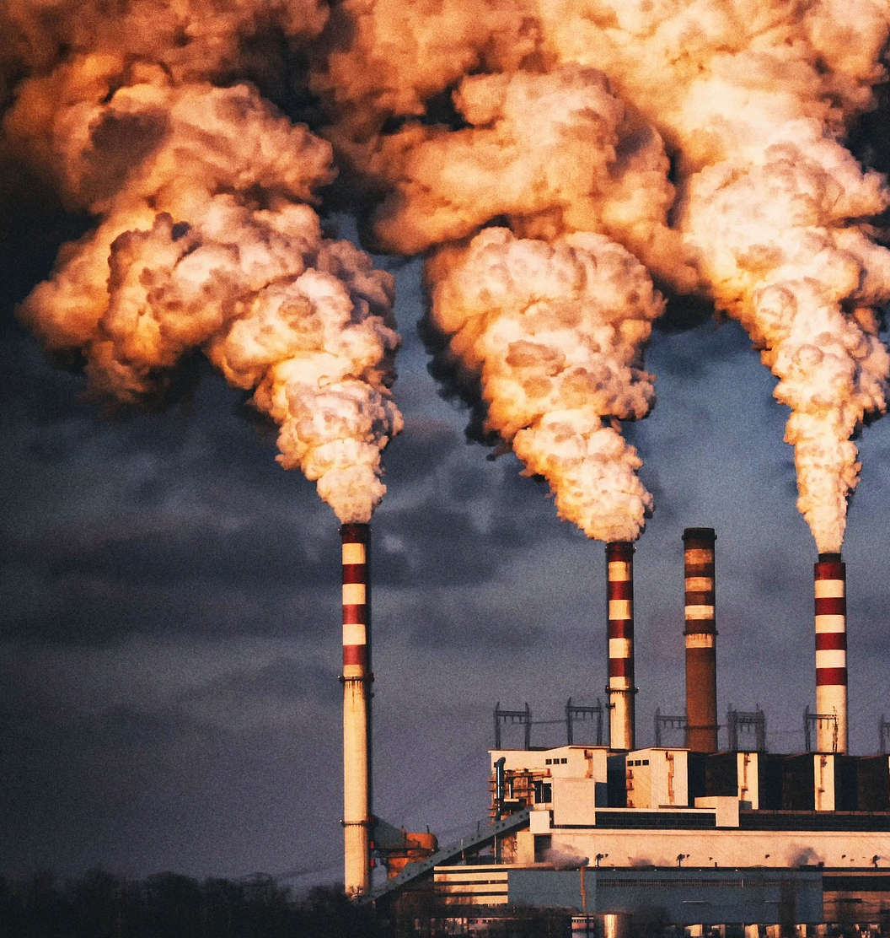
The flue gases
Flue gases (or smokegases) are gases leaving the combustion process. Flue gas calculations consider the amounts of substances needed and generated in combustion process.
Kuvituskuva: Pixabay

Slide 14
The flue gases
The most common reactions:
C + O₂ → CO₂ Complete combustion of coal.
2C + O₂ → 2CO Carbon monoxide is produced if there is not enough oxygen.
2H₂ + O₂ → 2H₂O The product of hydrogen combustion is water.
S + O₂ → SO₂ The sulfur contained in the fuel burns easily
N + O₂ → NO_{x} Formation of nitrogen oxides.

Slide 15
Flue gases: CO2, H2O, N2, O2, SOx, NOx
Ash, residual carbon
Fuel: C, H, N, O, S,
Air: O2, N2, H2O
λ>1
Ash is formed if the fuel contains compounds of metals, silicon or phosphorus. Slag = molten ash.
The main components of coal and peat ash are SiO2, Al2O3 and Fe2O3
The components of wood ash are CaO, K2O and MgO.
Carbon monoxide is always produced when a carbonaceous substance burns. If there is enough oxygen, then CO will be converted to CO2.

Slide 16
The flue gas calculations
The reaction equations can be used to calculate the oxygen demand and the theoretical air demand. In practice, an excess of air is required, for which the air factor λ is used.
For gaseous substances λ is 1-1,2. For solidsubstances λ is up to more than 2.
L = the amount of air to be used
L_{theory} = theoretical air volume

Slide 17
Example
Calculate the amount of air required to burn ethanol (in NTP) when n(ethanol) = 1 mol and λ = 1.1?
n(O2) = 3* n(C2H5OH) = 3 * 1 mol = 3 mol
NTP state: 3 mol * 22,4 dm³ / mol = 67,2 dm³.
The air contains 21% oxygen, so the theoretical air volume is 67,2 dm³ / 0,21 = 320 dm³.
The required air volume L = λ * L_{theor} = 1.1 * 320 dm3 = 352 dm³ of air is needed.

Slide 18
Example
One mole of methane CH4 burns completely with an air factor of λ = 1.0. The combustion air is dry.
CH₄ + 2O₂ → CO₂ + 2H₂O
Ratio N₂/O₂ = 79%/21% = 3,76
 |  |  | Fluegases
 | n [mol] | n_{O2}/n_{CH4} | n_{CO2}/n_{CH4} | n_{H2O}/n_{CH4} | n_{N2}/n_{CH4}
CH₄ | 1 | 2 | 1 | 2
N₂ 3,76* n_{O2}/n_{CH4}= 3,76* 2 |  |  |  |  | 7,52
 |  |  | 1 | 2 | 7,52

Slide 19
Example
Mass of dry butane C₄H₁₀ is 93,68 g. Relative humidity (RH) of combustion air is 40%, pressure of air is 98730 Pa and temperature is 22 degrees Celsius. Calculate theoretical energy using ΔH. Calculate fluegas emissions if λ = 1.5?
ΔH=4*(-393,15 kJ/mol)+5*(-241,81 kJ/mol)-(-126,15kJ/mol)-0 = -2655,5 kJ/mol
-2655,5 kJ/mol/58,12 g/mol = -45,7 kJ/g
From 93,68 g gives 4280 kJ energy.
$$C_{4}H_{10}+6,5O_{2}→4{CO}_{2}+5H_{2}O$$

Slide 20
Saturated air pressure when T = 22 degrees Celsius or 295,15 K is 2640 Pa.
If RH is 40% then water vapor partial pressure is 0,40*2640 Pa = 1056 Pa.
Mole fraction of water vapour is $y_{H2O}=\frac{P_{h}}{P_{tot}}=\frac{1056 Pa}{98730 Pa}=0,0107$
Combustion air demand is calculated using dry air
$$\frac{n_{H2O}}{n_{ik}}=\frac{y_{H2O}}{{1−y}_{H2O}}=\frac{0,0107}{1−0,0107}=0,0108$$
Where $\frac{n_{H2O}}{n_{ik}}$ is a relation between moisture air and dry air.

Slide 21
Fluegas emissions if λ = 1.5 and fuel has no water
$$C_{4}H_{10}+6,5O_{2}→4{CO}_{2}+5H_{2}O$$
 |  |  | Fluegases
 | nC₄H₁₀ | n_{O2}/nC₄H₁₀ | n_{CO2}/nC₄H₁₀ | n_{H2O}/nC₄H₁₀ | n_{N2}/nC₄H₁₀ | n_{O2}/nC₄H₁₀ | n_{H2O} /air
C₄H₁₀ | 1 | 6,5 | 4 | 5
λ = 1,5 |  | +50% |  |  | +50% | +50%
n [mol] | 1,61 | 74,75 | 6,44 | 8,05 | 59,02 | 5,23 | 0,807

Slide 22
Fluegas emissions, λ = 1.5
n_{CO2} = 4*n_{C4H10}= 6,44 mol
n_{H2O} = 5*n_{C4H10}= 8,05 mol
n_{O2} = 6,5*n_{C4H10}*0,50 = 5,23 mol (50%)
n_{N2} = 3,76*n_{O2}*1,50 = 59,05 mol (150%)
Theoretical air demand L_{theor} = 6,5*n_{C4H10}/ 0,21
The required air L = λ * L_{theor} = 74,75 mol
Water vapor from combustion air is $\frac{n_{H2O}}{n_{ik}}$ * L = 0,807 mol
Total mass of emissions is about 2300 g.

