Slide 1
Introduction to waste incineration
Waste to energy in eastern Finland
Esko Tiainen
Karelia-ammattikorkeakoulu

Slide 2
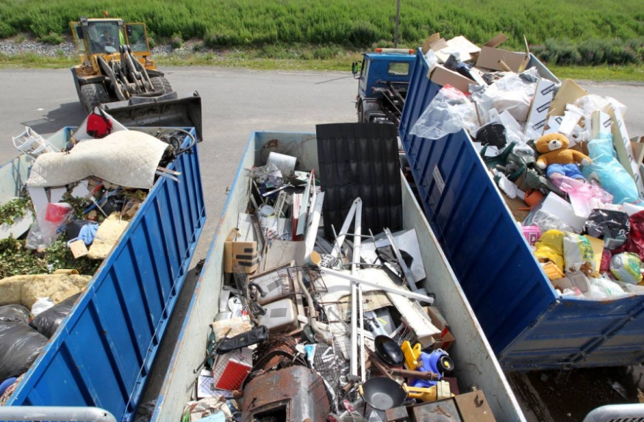
- All waste was transported to Kontiosuo landfill until 2017.
- Concrete, metals, wood and garden waste is still recycled there by citizen.
- Biowaste is transported to Kitee Biokymppi →biogas.
- Mixed waste is transported to Riikinvoima, new eco powerplant → energy and heat.
Kuva: Esko Tiainen

Slide 3
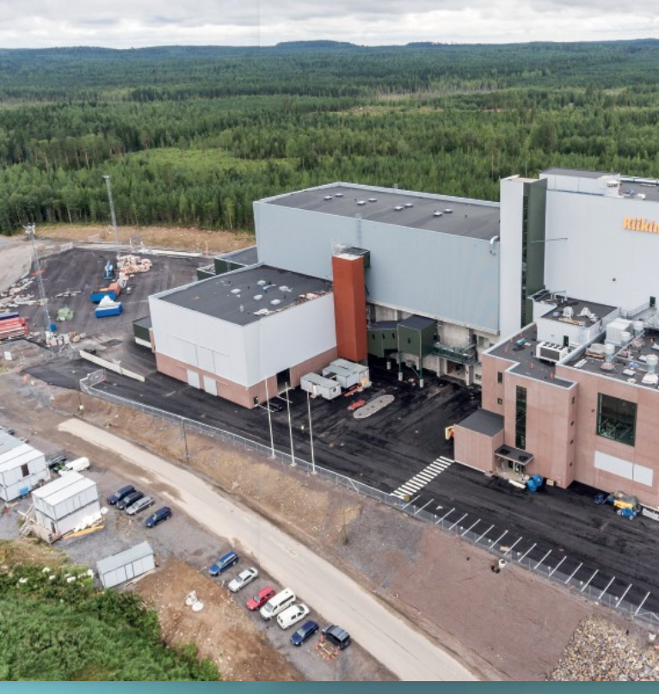
Riikinvoima Ekovoimalaitos (Ecopowerplant) produces environmentally friendly energy for heating and illumination of homes at Eastern Finland.
Supplier was Andritz from Austria.
https://www.youtube.com/watch?v=Zr2m7VK_z_w&feature=youtu.be
Kuva: Riikinvoima Oy

Slide 4
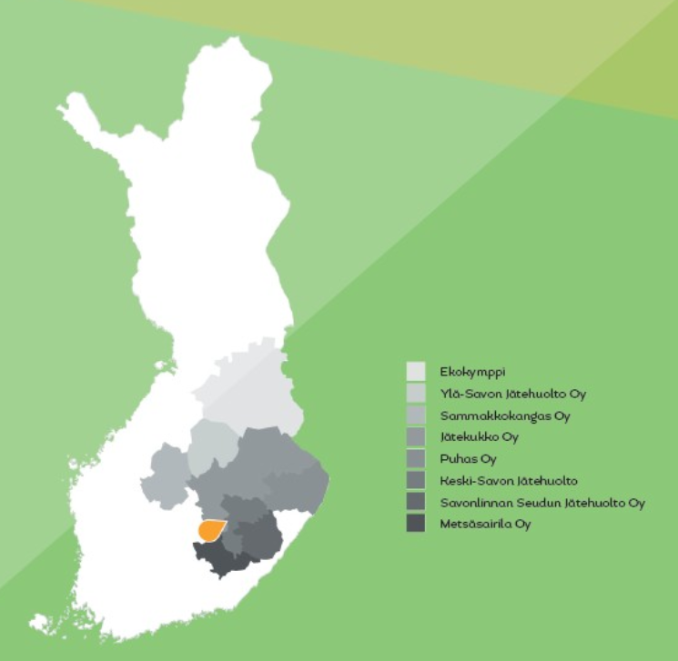
Kuva: Riikinvoima Oy
In this area lives 640 000 citizens.
Waste management companies are owned by 57 municipalities.

Slide 5

- Riikinvoima is owned by eight municipal waste management companies and Varkauden Aluelämpö Oy.

Slide 6
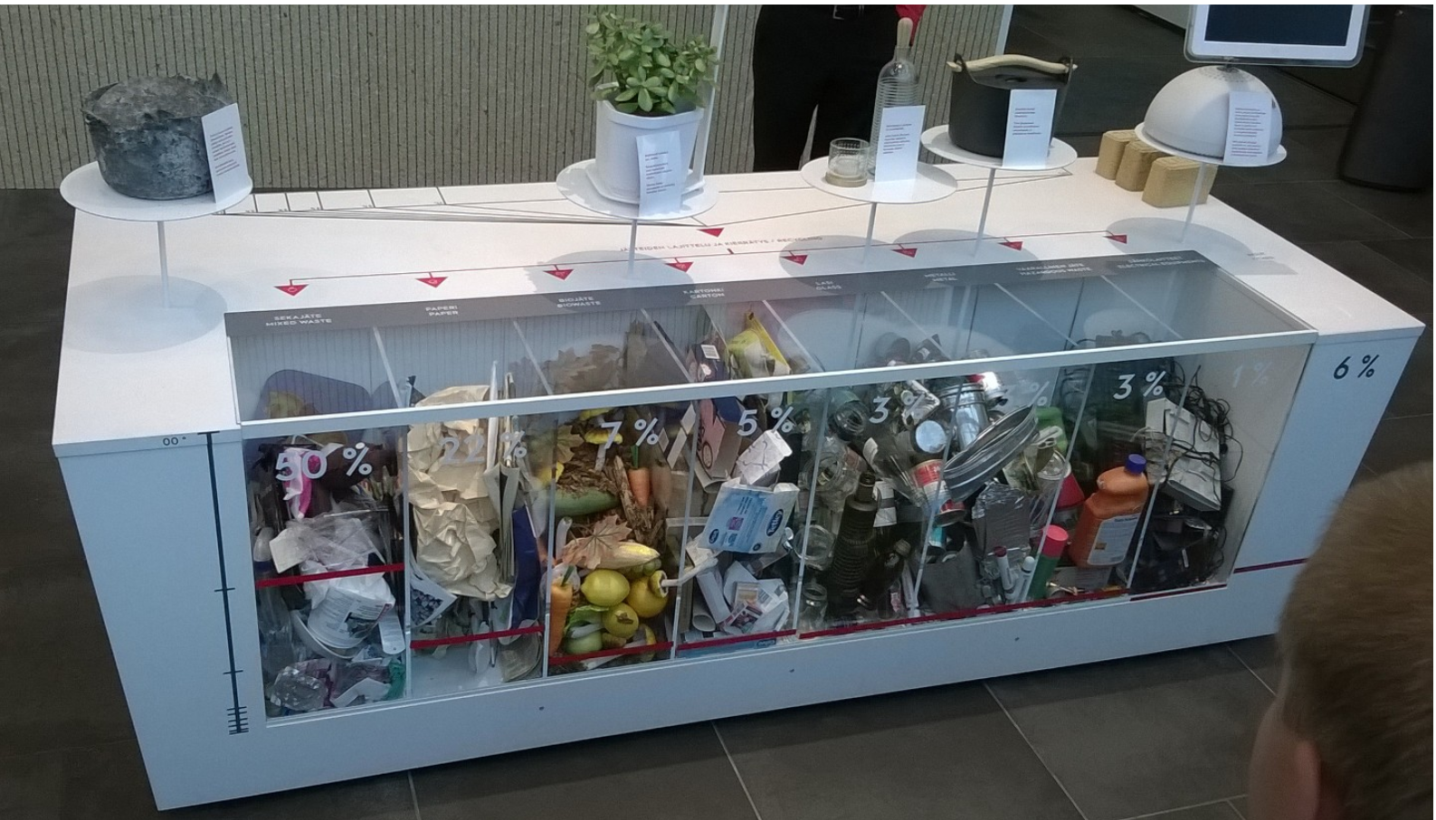
Kuva: Esko Tiainen
- Waste incineration capacity about 145 000 tons of municipal waste per year = fuel input about 54 MW
- Incineration technology is Circulated Fluidized Bed, CFB
- Distric heating /year 180 GWh
- Electricity generation /year 90 GWh

Slide 7
Ekovoimalaitos save the environment by replacing the use of fossil fuels.
Replacement of coal and fuel oil of municipal waste to reduce carbon dioxide emissions by up to 100 000 – 200 000 tonnes per year.
The landfilled waste is another important environmental factor. Harmful methane emissions will be reduced. Methane is more than 20 times harmful for the atmosphere than carbon dioxide.

Slide 8
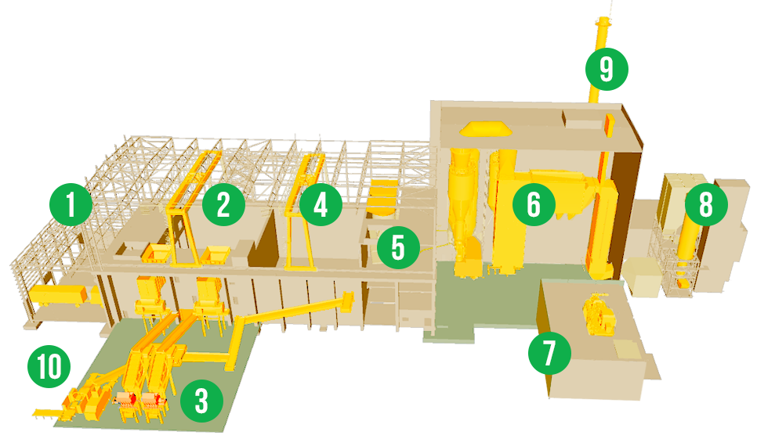
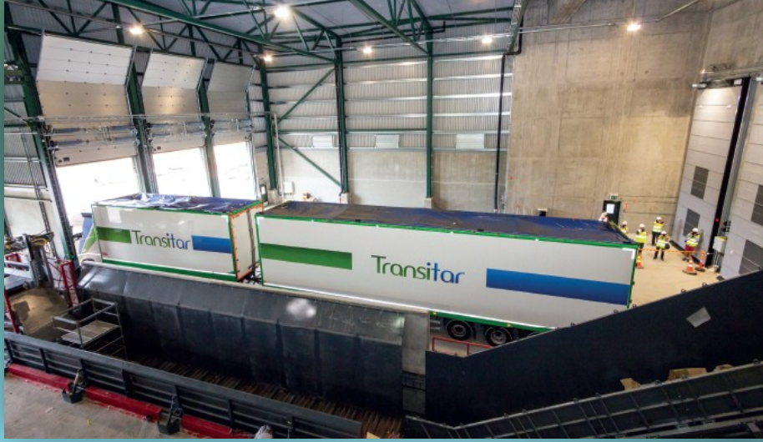
https://www.youtube.com/watch?v=IGGYhAopM-o
Kuva: Riikinvoima Oy
1. Receiving waste.
Kuva: Esko Tiainen

Slide 9
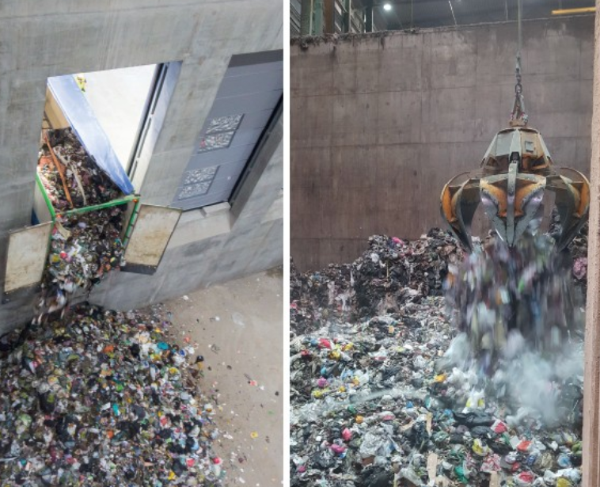
Kuva: Riikinvoima Oy
2. Waste storage, almost 8000 tons,
8 m³ grab.
Kuva: Esko Tiainen

Slide 10
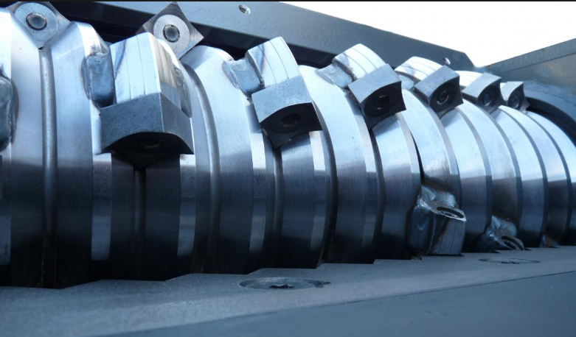
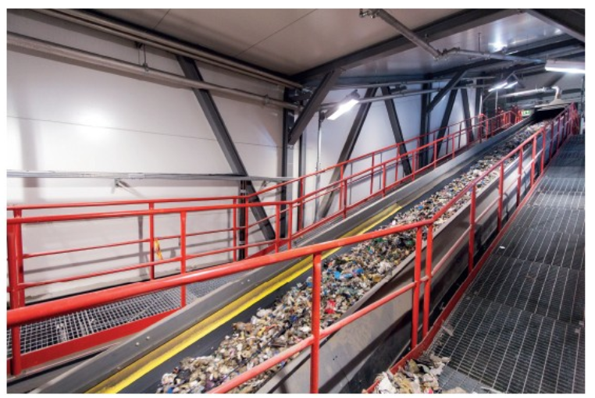
Kuva: Esko Tiainen
Kuva: Riikinvoima Oy
3-5. Waste handling, crushing and metal seperation.
Kuva: Esko Tiainen

Slide 11
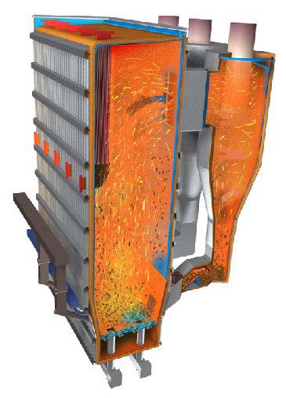
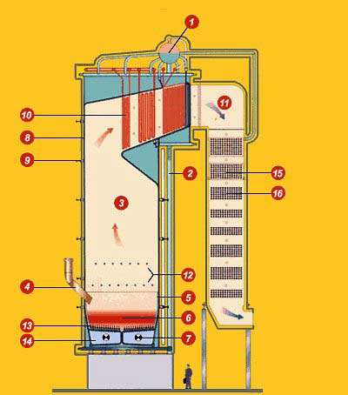
Kuva: Riikinvoima Oy
6. Circulated Fluidized Bed, CFB.
Crushed waste burns more efficiently and produces a higher vapor value.
Efficiency is better than in grate boiler.
The emissions in the FCB are lower.

Slide 12
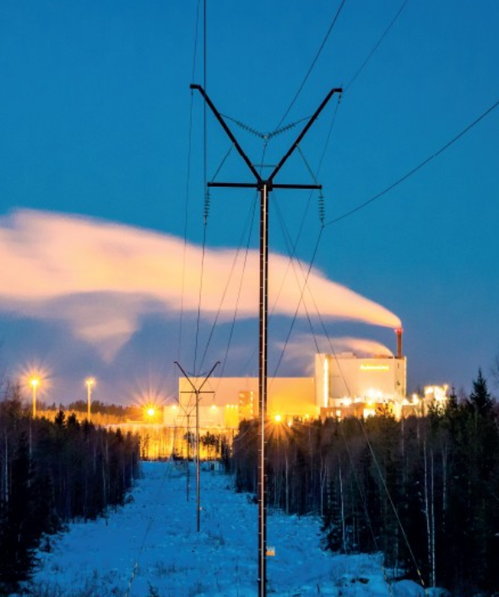
Kuva: Riikinvoima Oy
7. Steam turbine and heat exchangers. District heating is used in the city of Varkaus.
Kuva: Riikinvoima Oy

Slide 13
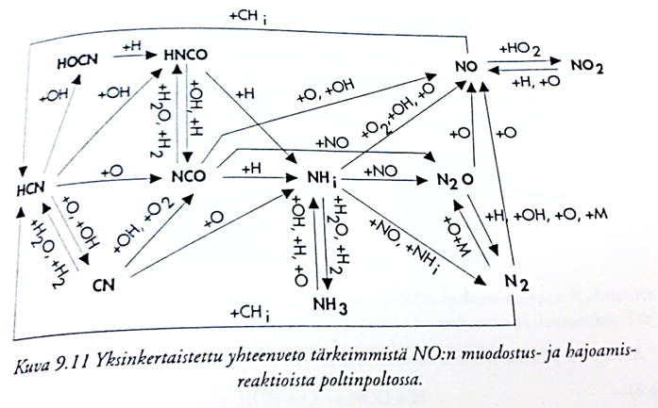
A simplified summary of the main nitrogen oxides formation and decomposition reactions in combustion.

Slide 14
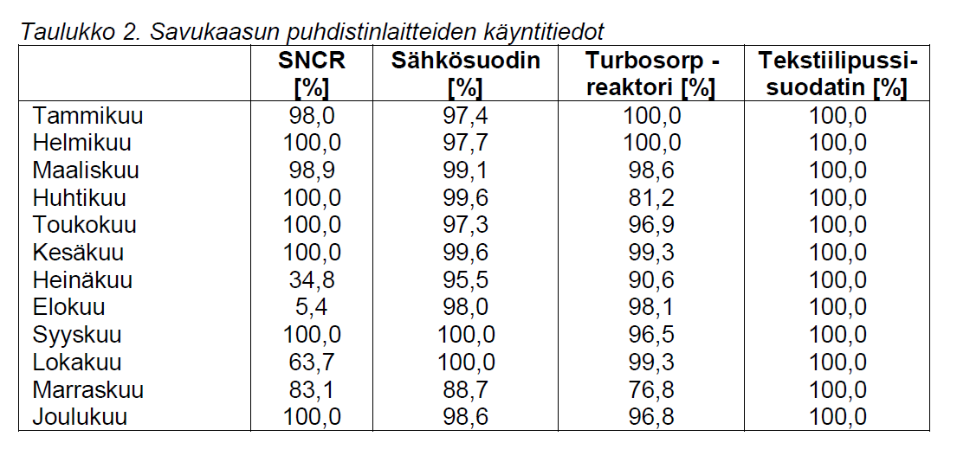
Kuva: Riikinvoima Oy
8-9. Flue gas cleaning.
SNCR=Selective Non-Catalytic Reduction. Ammonia (NH3) is injected about 25% aqueous solution in the furnace. In high temperature ammonia reacts with nitrogenoxide and produces nitrogen gas N2 and water.
Turbosorp. The flue gas flows through a reactor, which can be either a fabric filter or an electrostatic precipitator. Water is also injected to lower the flue gas temperature and achieve higher separation performance.
https://www.youtube.com/watch?time_continue=59&v=I7_2pPWjT98

Slide 15
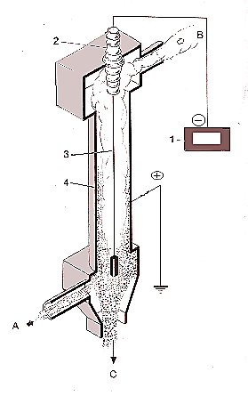
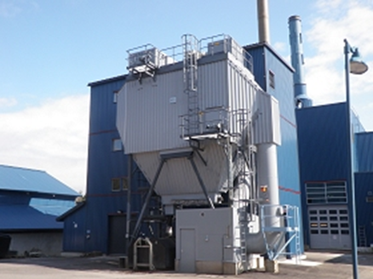
Electrostatic precipitator/filter
The particles are ionized and separated in the electric field.
Good separation (0,1 µm), low flowrate, T → 450 ºC.
The voltage between the electrodes is usually 35-70 kV.
A gas to be cleaned in
B cleaned gas out
C separated particles
1 DC power supply
2 insulator
3 anode
4 cathode

Slide 16
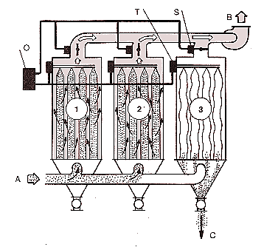
Filter separator
A gas in
B cleaned gas out
C dust removal
Cell 1 and 2 in the separation phase
Cell 3 in cleaning stage

Slide 17
Kuva: Ekovoimalaitoksen materiaali- ja energiavirrat

Slide 18
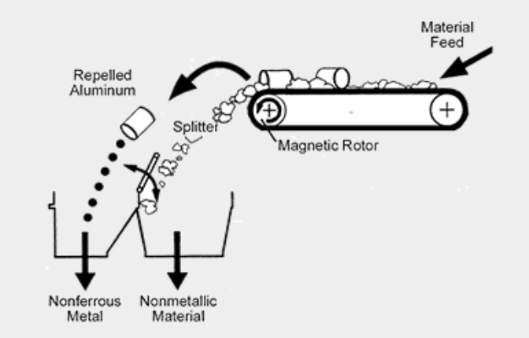
Metal ja ash fraction
- Metals are separeted with electromagnet and eddy current separator.
- The process produces 4 different ash fractions → environmental construction.
https://youtu.be/4EvqleRFXfE

Slide 19
Eddy current separator is the magnetic rotor. Construction allows the rotor to spin independently and at a much higher speed than the belt. When a piece of nonferrous metal, such as aluminum, passes over the separator, the magnets inside the rotor rotate past the aluminum at high speed. This forms eddy currents in the aluminum which in turn create a magnetic field around the piece of aluminum. The polarity of that magnetic field is the same as the rotating magnet, causing the aluminum to be repelled away from the magnet.
https://yle.fi/uutiset/3-10718848

Slide 20
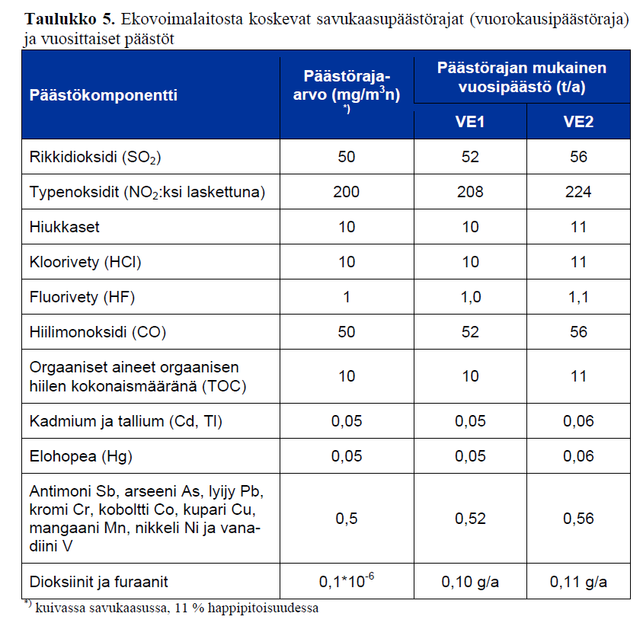

Slide 21
Sources:
http://riikinvoima.fi/
Riikinnevan Ekovoimalaitos Ympäristövaikutusten arviointiselostus Marraskuu 2012
RIIKINVOIMA OY EKOVOIMALAITOS Ympäristöluvan mukainen vuosiraportti 2017
http://www.dingsmagnets.com/industries/aluminum-can-recycling/index.html

