Slide 1
Gender segregation in education and working life
CC BY-SA 4.0​
except Roleplay-logo and illustration by Karin Niemi: CC BY-ND 4.0​

Slide 2
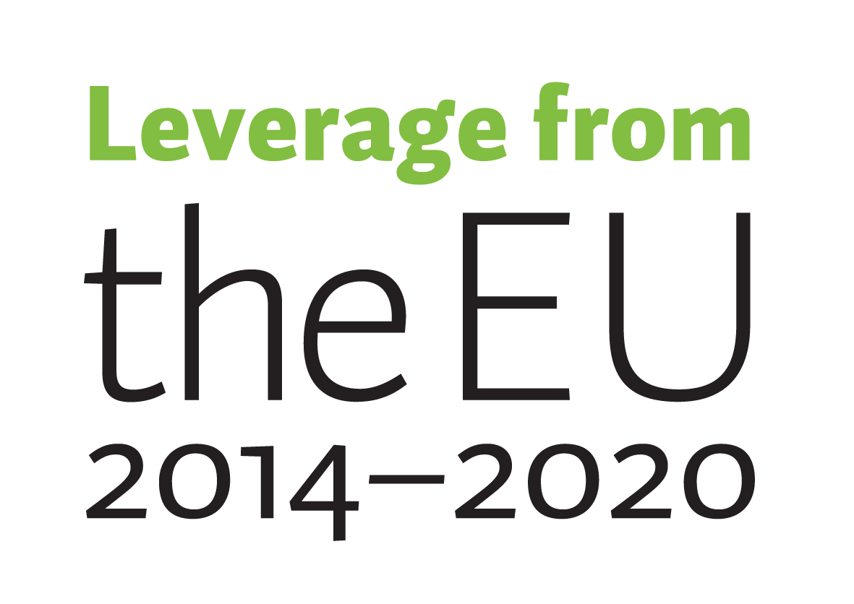
Roleplay-project
Gender segregation in education and working life remains strong in Finland. This material has been developed and produced in a project called Roleplay (2020-2022) that provided 1) gender awareness training for teaching and counselling professionals and 2) tools to identify and mitigate gender segregation. The project was funded by the European Social Fund and implemented by LAB University of Applied Sciences and Outward Bound Finland.
​

Slide 3
Concepts of gender segregation
Gender segregation means segregation of jobs, work tasks and educational or professional fields or sectors to women´s and men´s jobs and fields. Horizontal segregation refers to segregation of educational and professional fields and vertical segregation to segregation of position or status at labour market (gender gap in leading positions or pay for example).
Gender equality refers to equal rights, responsibilities and opportunities of women and men. Formal equality means non-discrimination and equal rights and treatment. Actual equality is about de facto equality between different situations and their outcomes.
Gender diversity refers to everyone´s own experience about their gender and diversity of expressing gender within the society. Some experience themselves clearly as women or men, some identify to both genders and some people do not define themselves with the binary categorization at all.
Reference: Finnish institute for health and welfare - https://thl.fi/fi/web/sukupuolten-tasa-arvo/sukupuoli/tasa-arvosanasto

Slide 4
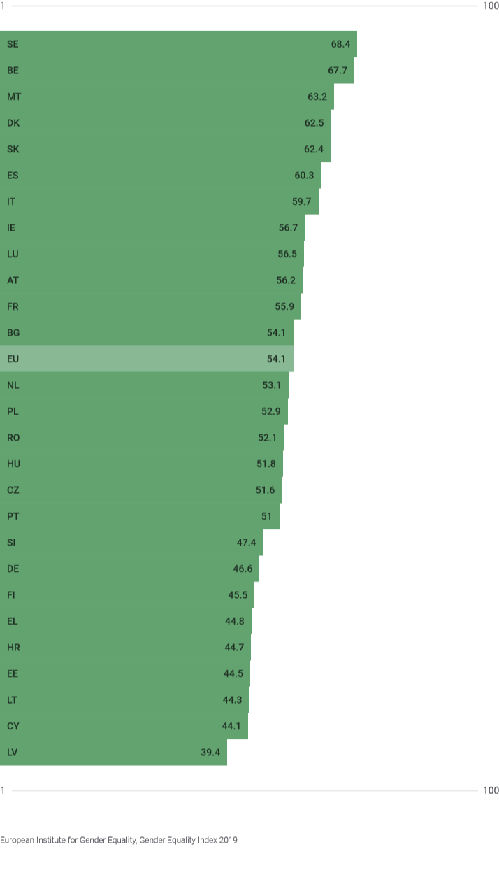
Segregation of knowledge
Source: European Institute of Gender Equality (EIGE). Gender Equality Index.
Percentage of tertiary students studying education, health and welfare, humanities and arts (%)
Finland: women 51 %, men 18 %
EU: women 43 %, men 21 %
EIGE. Gender Equality Index 2021. Source: Eurostat, Education statistics, 2019. 2018. ED5 - Short-cycle tertiary education N/A. educ_enrl5, educ_uoe_enrt03.

Slide 5
What causes gender segregation? 1/2
Socialisation to gender
Gender roles, norms and stereotypes
Factors related to education and career choices
Push and pull factors of different professional fields and occupations
Perceived similarity and feeling of belonging
School performance and study choices
Role models, social support, peers, counselling
Knowledge, experiences and images of different professional fields
Self-efficacy
Utility value (how the task, such as school subject, relates to future goals)
Meaning of work to oneself
Working life
Gender equality and attitudes
Changing working life

Slide 6
What causes gender segregation? 2/2
Hobbies are connected to gender-atypical choices (Saari & Lahtinen 2019)
Normative control of friends shape values and choices (Leaper 2015; Hoikkala 2019; OECD 2015)
Peer pressure and norms: younger make more typical choices (Saari & Lahtinen 2019)
Gendered experiences: gendered skills from hobbies and leisure time (OECD 2015)​
Perceptions of skills and school performance are gendered (TAT 2017; OECD PISA-research 2018)
Interest in a professional field is affected by sense of similarity and belonging (Rommes ym. 2007; Master ym. 2015; Cheryan & Plaut 2010), lack of confidence (Vainionpää ym. 2020), anticipating non-equal treatment (Microsoft 2017), and image of the field as unfamiliar and distant (Vainionpää ym. 2020)

Slide 7
Interest might be aroused by a positive experience and a bit of encouragement
"In high school we had a week when we could try something like archery or horseriding, but I went welding for a week. […] The welding teacher said that you shoud become a welder. For sure I wouldn't have applied to a welding programme at vocational school unless someone said that I'm good at welding. "
Translated from the original Finnish citation. Reference: SEGLI-hanke , Tanhua Inkeri 2019. Miksi sukupuoli vaikuttaa alavalintaan. https://www.kaikkienduuni.fi/miksi-sukupuoli-vaikuttaa-alavalintaan.

Slide 8
Why is segregation in education and working life a problem?​
Narrows the choices of individuals​
Maintains and reinforces stereotypes​​
Sectoral segregation in the labor market​
Gender pay gap​
More inflexible working life​
Diversity is a competitive advantage: gendered professions may weaken the response to customer needs. Via diversity, products may better meet the needs of both men and women
Labor shortage​
Unemployment​
Regional development

Slide 9
Why gender-aware approach?
Gender neutrality often leads to gender blindness when the importance and effects of gender are not identified and recognized​
Gender neutrality may inadvertently or intentionally lead to discrimination​
Gender neutrality is a worthwhile approach especially when talking about people in general (e.g. gender-neutral professional titles)​
Gender-sensitive approach can identify and take into account gender diversity and the different needs, roles and experiences of the sexes and promote equality: the current world is not equal, gender still matters​

Slide 10
How to mitigate segregation
Recognise and break down your own and others´stereotypes towards gender and occupations
Provide young people opportunities to try different skills, roles, hobbies, study fields and occupations in practice
Provide information about different educational and career choices
Add diverse gender roles and norms in your speech​​
Bring out role models who have made gender-atypical career choices and/or questioned gender norms
Support and enhance self-efficacy and self-knowledge (strengths, weaknesses, interests) of young people
Provide support, counselling or mentors for students studying in a gender-atypical field
Check communication: is communication gender-aware and diverse?​​​
Develop a more equal organisational culture

Slide 11
References
Cheryan & Plaut 2010. Explaining Underrepresentation: A Theory of Precluded Interest. Sex Roles, 63:7-8, 475-488.​
Criado-Perez, Caroline 2020. Näkymättömät naiset. Helsinki: WSOY. (Available in English: Invisible Women).
Eccles 2015. Gendered Socialization of STEM Interests in the Family. International Journal of Gender, Science and Technology 7:2.
European Institute of Gender Equality (EIGE). Gender Equality Index: Compare countries. https://eige.europa.eu/gender-equality-index/2021/compare-countries/knowledge/2/bar
EIGE 2018. Study and work in the EU: Set apart by gender. Luxembourg: Publications Office of the European Union, 2018. https://op.europa.eu/en/publication-detail/-/publication/92fb36e5-a67d-11e8-99ee-01aa75ed71a1​
Hoikkala 2019. Mikä työntää pois, mikä vetää puoleensa? Epätyypillisiä valintoja tehneet nuoret ammatillisessa koulutuksessa. Teoksessa Lahtinen, J. (toim.) 2019. ”Mikä ois mun juttu” – nuorten koulutusvalinnat sosialisaatiomaisemien kehyksissä :Purkutalkoot-hankkeen loppuraportti. Valtioneuvoston kanslia: Valtioneuvoston selvitys- ja tutkimustoiminnan julkaisusarja 2019:68. ​
Kessels 2015. Bridging the Gap by Enhancing the Fit: How Stereotypes about STEM Clash with Stereotypes about Girls. International Journal of Gender, Science and Technology: http://genderandset.open.ac.uk/index.php/genderandset/article/viewFile/392/687
Lahtinen, J. (toim.) 2019. ”Mikä ois mun juttu” – nuorten koulutusvalinnat sosialisaatiomaisemien kehyksissä :Purkutalkoot-hankkeen loppuraportti. Valtioneuvoston kanslia: Valtioneuvoston selvitys- ja tutkimustoiminnan julkaisusarja 2019:68. ​
Leaper 2015. Do I Belong?: Gender, Peer Groups, and STEM Achievement. International Journal of Gender, Science and Technology, Vol.7, No.2.
Master, Cheryan & Meltzoff 2015. Computing Whether She Belongs: Stereotypes Undermine Girls’ Interest and Sense of Belonging in Computer Science. Journal of Educational Psychology 108:3, 424–437.
Microsoft 2017. Why Europe’s girls aren’t studying STEM. ​https://news.microsoft.com/europe/features/dont-european-girls-like-science-technology/
OECD 2015. The ABC of Gender Equality in Education: Aptitude, Behaviour, Confidence. PISA, OECD Publishing. http://dx.doi.org/10.1787/9789264229945-en
Opetushallitus. Sukupuolitietoinen opetus ja ohjaus. https://www.oph.fi/fi/koulutus-ja-tutkinnot/sukupuolitietoinen-opetus-ja-ohjaus​
Rommes, Overbeek, Scholte, Engels & De Kemp 2007. ‘I’m Not Interested In Computers’: Gender-based occupational choices of adolescents. Information, Community and Society 10:3, 299-319.
Saari & Lahtinen 2019. Koulutusvalintojen tilastollista tarkastelua. Teoksessa Lahtinen, J. (toim.) 2019. ”Mikä ois mun juttu” – nuorten koulutusvalinnat sosialisaatiomaisemien kehyksissä :Purkutalkoot-hankkeen loppuraportti. Valtioneuvoston kanslia: Valtioneuvoston selvitys- ja tutkimustoiminnan julkaisusarja 2019:68. ​
TAT 2017. Kun koulu loppuu – Nuorten tulevaisuusraportti. https://www.tat.fi/wp-content/uploads/2017/05/Kun-koulu-loppuu-nuorten-tulevaisuusraportti-2017_tiivistelm%C3%A4_19052017.pdf
THL Tasa-arvotiedon keskus: https://thl.fi/fi/web/sukupuolten-tasa-arvo​
Vainionpää, Iivari, Kinnula & Zeng 2020. "IT is not for me - Women's Discourses on IT and IT Careers“. Research Papers. 39. https://aisel.aisnet.org/ecis2020_rp/39

