Slide 1


BILLY Biomateriaaliosaamisen lisääminen yritysten tarpeisiin Increasing biomaterials know-how to meet the needs of companies
06/2024

Slide 2
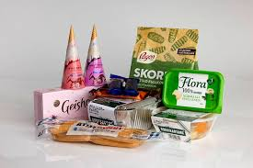
PACKAGES AND PACKAGING
Packaging laboratory at LUT behind the project
A package; what surrounds the product/content
1. Contains the product
2. Protects the product or the surroundings
3. Is informative and helps to sell the product
4. May be functional

Slide 3
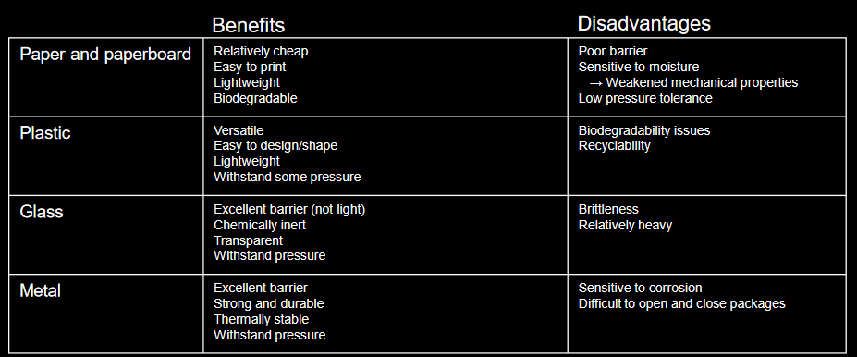
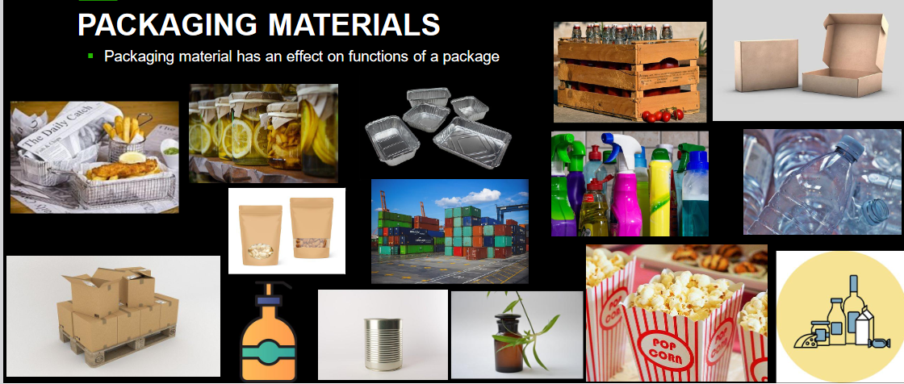
MOST COMMON PACKAGING MATERIALS AND THEIR PROPERTIES

Slide 4
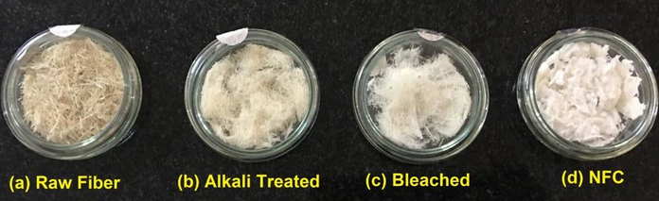
WOOD FIBER-BASED MATERIALS IN PACKAGING
Strong and light
Suitable in many packaging needs and designs
Rigid, flexible
Natural light barrier. Other barrier properties can be obtained for example by combining with other materials,e.g. plastic, aluminum
Coating, lamination
Material properties depend also on the combination of the materials
Can save space during transport and storage
Presentable and promote sales
Printable; makes product presentation easy
”Green”
Renewable, bio-degradable (if coated, coatings sometimes aren’t)
Recyclable, suitable for energy production as waste

Slide 5
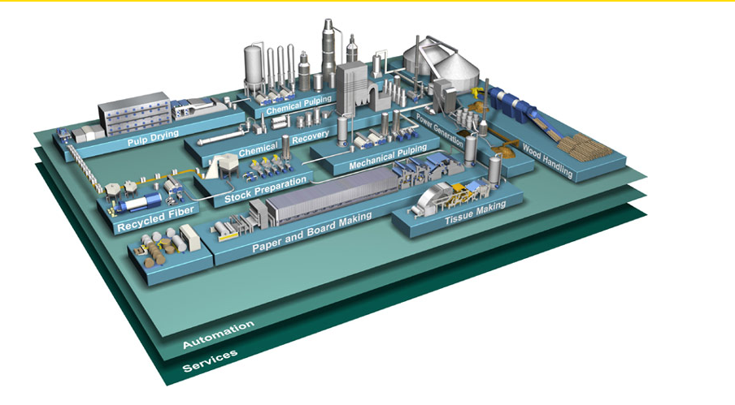
PAPER/BOARD MANUFACTURING PROCESS
Don’t forget!!!

Slide 6
PAPER/BOARD MANUFACTURING PROCESS
Wood handling: log intake, debarking, bark handling, chipping, screening
Pulping: raw material (wood or recycled fibers) to pulp
Stock preparation: pulps, fillers and chemicals are mixed and proportioned
Web forming, pressing, drying
In paperboard manufacturing, each ply is made separately with a forming section
The different plies are brought together before wet pressing
Bonding between the plies is formed during wet pressing
Finishing: calendaring, coating, reeling, sheeting

Slide 7
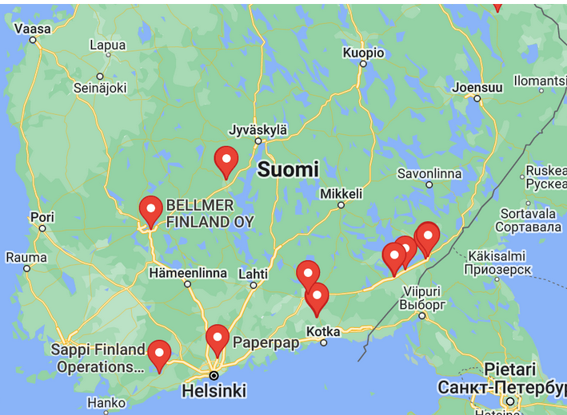
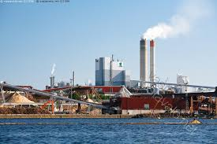
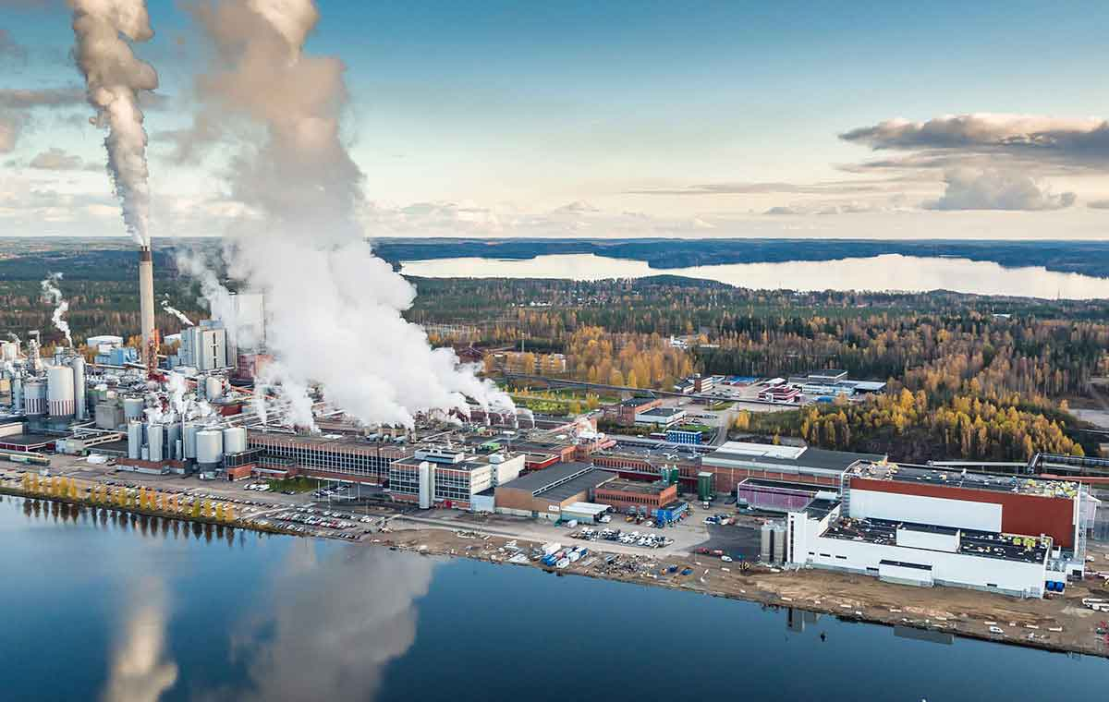
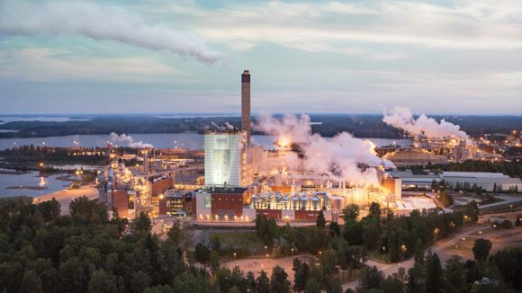
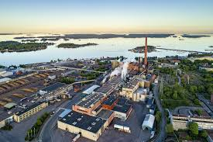
South Karelia's forest industry
Southeast Finland is Europe's most significant forest industry cluster and the core area of forest research.
UPM and Stora Enso have focused their forest research in South Karelia.
The bioeconomy is developing strongly in South Karelia: the world's first biorefinery was opened in Lappeenranta in 2015.
UPM Lappeenranta
Stora Enso Imatra
Metsä Fibre Joutseno
Kotkamills Kotka

Slide 8
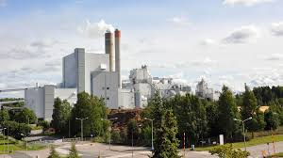
Case example: UPM Kaukas
Kaukas mills in Lappeenranta form a unique bioforest industry integrator
Produces pulp, magazine paper, sawn timber, energy, biofuels, biochemicals and pharmaceutical products from renewable raw materials.
UPM's largest R&D centre and UPM Forest's Eastern Finland wood sourcing management and Lappeenranta Forest Services Office.
About 1,000 UPM employees and nearly 500 employees of our subcontractors work in Kaukas.

