Slide 1
Bioplastics
Liisa Lehtinen, Turku AMK

Slide 2
What are bioplastics?
Bio-based
Bioplastics
e.g. bio-based PE, PET, PA, PTT
Bioplastics
e.g. pla, pha, PBS, starch blends
Conventional plastics
e.g. PE, PP, PET
Bioplastics
e.g. pBAT, PCL
Non-biodegradable
Biodegradable
https://www.european-bioplastics.org/
Fossile-based

Slide 3
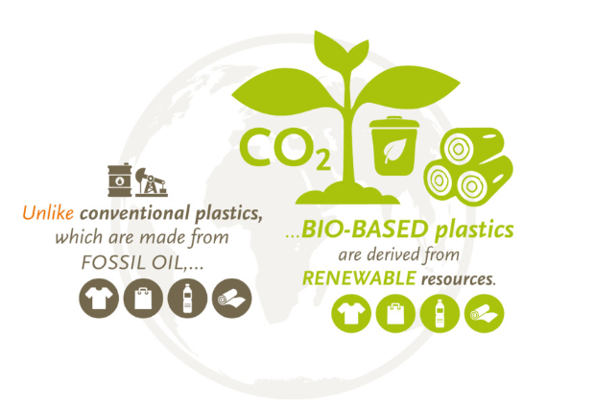
Biobased rawmaterials
Raw materials from:
grain
corn
wood
milk
oils and fats
sugar cane
inject shells
algae, …
Modified natural polymers, like:
starch
cellulose
lignin
lactic acid
casein
citosan
…
picture: https://www.european-bioplastics.org/

Slide 4
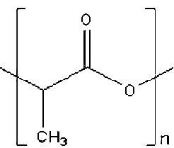
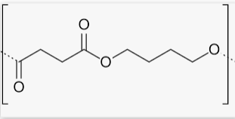
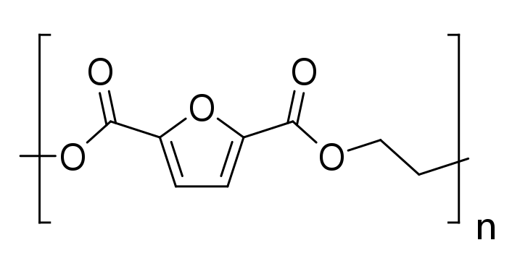
Bio-based plastics, Exaples of grouping
Polyesters
PLA, Polylactic acid
PBS, Polybutylene succinate
PEF, Polyethylene furanoate
Bio-Polyolefins
PP, Polypropylene
HDPE, Polyethylene
Other bio-based or oil-based
PA, polyamide
PET, polyethylene terefthalate
PC, polycarbonate
Based on raw material
Starch-based
PLA
Cellulose-based
Cellofan
Viscose
Lignin-based
Protein-based
Citosan
Casein
Produced by bacteria
BHA, Polyhydroxyalkanoate,
BHB, Polyhydroxybutyrate
BHBV, Poly(3-hydroxy-butyrate-co-3-hydroxyvalerate)
PLA, Polylactic acid

Slide 5
Biodegradable plastics: Definitions and some standards
Biodegradadable
ISO 17088: Requirement of full biodegradation of the material < 6 months
EN 17033: Biodegradable mulch films for use in agriculture and horticulture
Compostable packaging
EN 13432: < 12 weeks in industrial composting
EN 14995:2006 Plastics, other than packaging
ASTM D6400, plastics
ASTM D6868, paper+plastics
National standards for home composting
Oxodegradable
Additive-mediated fragmentable plastics (versus “truly” biodegradable plastics)
Kuvaehdotus:
esim. compostable merkki, DIN geprüft-merkki, OK compost -merkki

Slide 6
Brief history of biolastics
1500’s casein, a recipe for milk-based material
Shellac from the shell of Kerria lacca - insect
1862: Cellulose- based Parkesin was presented at London World Exhibition, later called celluloid
1905, production of rayon (viscose) was started in France. It was the first cellulose-based regenerated fibre
1921 Sarvis, the 1st Finnish plastics company at Tampere. It produced milk-based galalith (casein) and used even 30 000-40 000 liters milk daily
1930´s Scotch-cellulose tape
1932: PLA (polylaktidi, polylactid acid), development was stopped at 1950’s at industrial scale because of cheap oil
1936, cellofan production started 1936 at the Karelian Isthmus by Kuitu Oy
1943-44 Säteri Oy started viscose production at Valkeakoski
1956 Säteri Oy started also cellulose film production
Kohvakka, Lehtinen; Hyvä, paha muovi

Slide 7
Brief history of bioplastics
1950 trend: Syntetic plastics production started its continuous growth, small collapses only at 1970’s (oil crises) and at 2000’s (financial crises)
1960´s: PHA (polyhydroxyalkanoate, polyhydroksialkanoaatti), PHB (polyhydroxybutyrate, polyhydroksibutyraatti) the 1st plastics produced by microbies and bacteria
1973 Oil Crises: New era for biobased plastics, which ended 1980
1980 War between Iran and Irak: over production of cheap oil
1990 Novamont: biodegradable blend of bio- and oil-based plastics
1990’s trend: effords to enhance the processability and performance of biodegradable plastics by oil-based raw material
2001 Cargill and Dow Chemicals in USA started PLA-production. Fear of GMO in Europe hinders interest
2000’s trend: implats and reinforcements
2010’s trend: Climate change + plastics pollution have increased the interest towards bioplastics, typically aggressive marketing of start-ups.
Kohvakka, Lehtinen; Hyvä, paha muovi

Slide 8
Pros and Cons of Bioplastics
PROS | CONS
Reduce the use of fossil-fuels ans reliance on non-renewable resources Manufacturing process can use remarkably less energy and produce less greenhouse gasses Some are biodegradable and/or compostable Some can be recycled together with oil-based plastics Some are non-toxic and safe for medical and internal use | Higher manufacturing cost as long as production volumes are low Composting may require industrial process All are not recyclable Some may interfere plastics recycling processes All are not biodegradable May release methane in land-fills – more dangerous greenhouse gas than CO₂ Not sitable for many product Use of sugar or starch as raw material may increase food price Bioplastic do not change customer behaviour
Source: Vuorinen Jyrki, Muovien megatrendit ja tulevaisuus

Slide 9
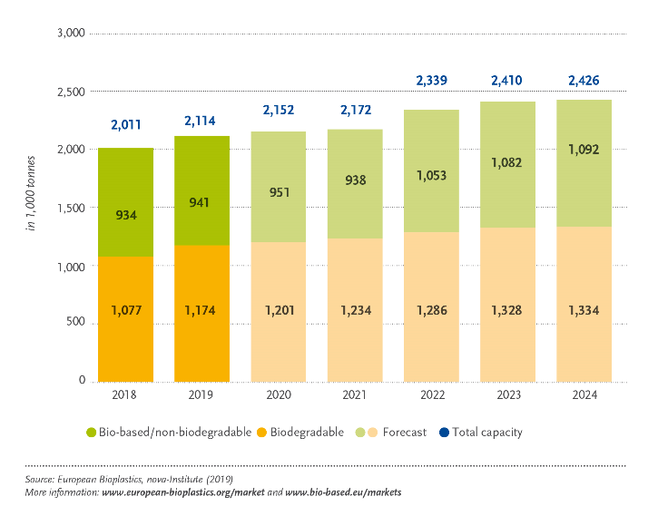
Global production capasities of bioplastics
To be expected by 2024: only 15 % capasity increase!

Slide 10
Global plastics demand 2018
https://www.plasticseurope.org/en/resources/market-data; https://www.european-bioplastics.org/market/

Slide 11
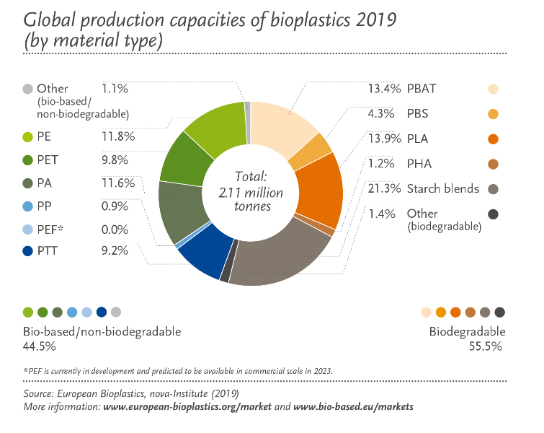
Global production capasities of bioplastics in 2019 per material type
https://www.european-bioplastics.org/

Slide 12
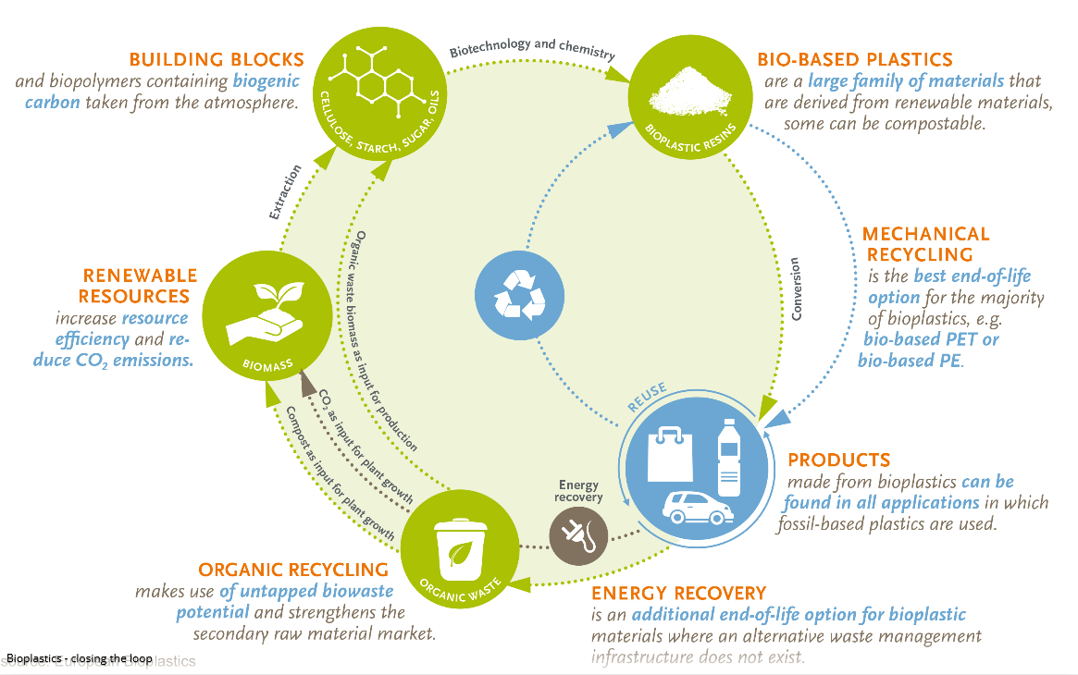
Bioplastics in Circular Economy Problematic issues
Biobased plastics
Compostable plastics
Biodegradable plastics
https://www.european-bioplastics.org/bioplastics/waste-management/

Slide 13
Task
Based on what you read, draw a min-map of your thoughs and findings.
Documenting:
Take a picture of your mind-map and return it in format of jpg, pdf or similar. You can also use a mind-map program, for instance, Mind Map Editor. But remember, the content is what matters!

