Slide 1
CASE: Digibale 2018-2020
More efficient use and life cycle management for feed bales

Slide 2
The project information
The project is funded by the Rural Development Program for Mainland Finland.
The project is managed and led by HAMK Bio Research Unit. The project is implemented by HAMK Bio, HAMK Tech and HAMK Smart Research Units, and Natural Resources Institute Finland.
The project is one of twelve EIP Innovation Projects in Finland and part of the EU EIP-AGRI network.

Slide 3
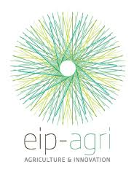
EIP-agri innovation groups
Innovation groups i.e. farmers, companies and researchers together, improve efficiency, productivity and sustainability of primary production.
EIP combines practical perspective and needs of farmers and knowledge of researchers.
The groups try to solve known existing challenges/problems together and give the information freely for common use.
EIP-funding always covers 100% of the cost – EIP is rather new way of funding in Finland – only 12 projects have been funded during this program period (2014-2020).

Slide 4
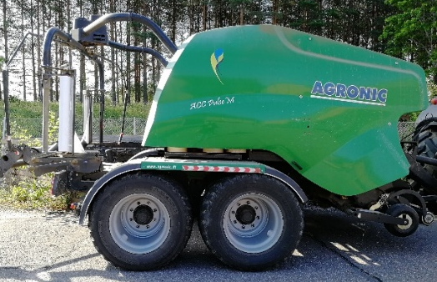
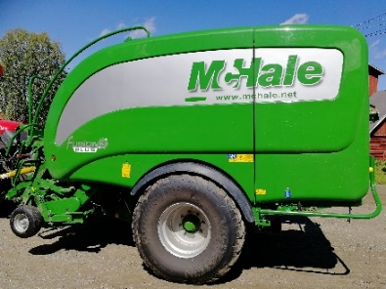
The project innovation group
A total of 4 dairy farmers and baling contractors
Baler makers involved at the moment: Kuhn, Agronic and McHale
Häme University of Applied Sciences
HAMK Bio, Ilpo Pölönen, project manager and idea
HAMK Tech, Katariina Penttilä, automation and measuring technique
HAMK Smart, Antti Juntunen, software and architecture
Luke (Natural Resources Institute)
Antti Suokannas, Agricultural technologies
In steering group Piippo Oyj
Manufacturing and marketing of binding net
Exports nets to over 40 countries

Slide 5
What do farmers want from the Digibale?
Improvement/automation of bale storage managment
At the moment farmers marked amount of bales from the field parcel (somewhere)
File info stored in different ways than at the moment
At the moment spray paint + booklet by hand is time demanding
Digitization would be extremely important
Bookkeeping of crops is required by the law
Digitization and cloud services would help a lot
Real time documentation in the cloud would be great, it would save lot of time and work
Bales and their chemical composition, dry matter, feeding value!
Field parcel data, crop level in dry matter, D-value
Bale trade in the web

Slide 6
The objectives of the project
Uses existing RFID technology to identify bales
Bale identification and tracking are required for a variety of reasons. In Finland, variation between bales is large.
Field parcels are small, hilly, forest on side of them, soil type changes, etc.
Marking of bales is undeveloped i.e. spray, color of cover plastic etc.
Bales are a common way to store feed (except bigger farms)
Sends the bale information to the cloud directly from the baler
Attaches unique information about baling time to the bales (sensors + open data)
Creates a digital bale warehouse and bale bookkeeping and farmer interface. Bale bookkeeping can include information about bales, such as:
Abnormalities, preservative depletion, unclean bale, etc.
Time of baling and weather conditions such as temperature and humidity
Silage analysis results
Baling area
Sensors information such as bale weight and dry matter content

Slide 7
The objectives of the project
Managing bales in the cloud, adding attributes, information, statistics, and reporting
Pilot a bale exchange, online store for bales and baling plastic
farmers can buy and sell bales
visualize bale features
Maximize the feed use of bales
for example, devoid of normal bales are fed first

Slide 8
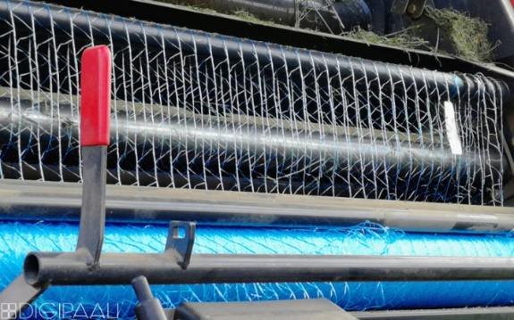
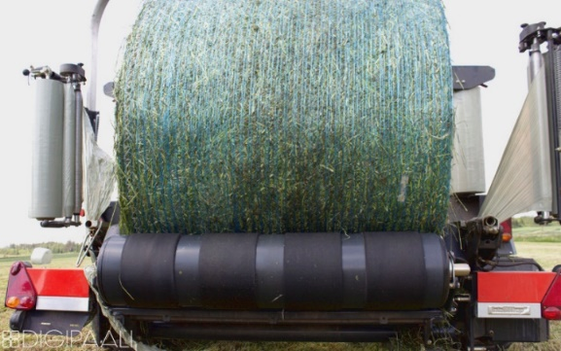
Digibale solution
RFID-tag built in the binding net to individualize every bale
Advantages:
Proven technology in different circumstances, durable
RFID-reading distance greater than qr- or barcode
Visibility not needed
Safe under the plastic
Tags are inexpensive and the price lowers
Fast reading
Disadvantages
No visibility, needs reader

Slide 9
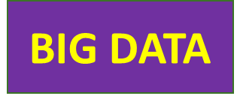
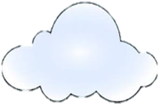
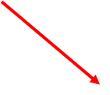
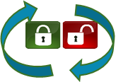
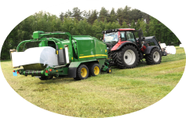
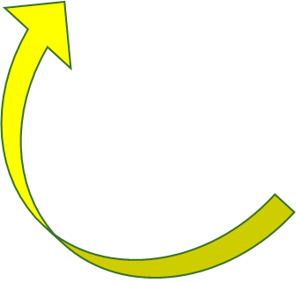
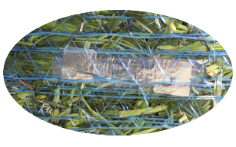
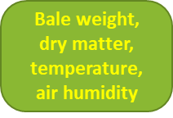
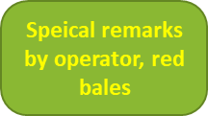
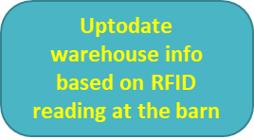
Digibale
Peltolohkot.fi
BALE DATABASE
€ Webstore of bales €
(+used plastics)
Open data
Own farm information
by identification process
Digibaler unit
Farm management and planning
Digibale unit sends individual data of bales
Date time
GPS-path and dropping point
Air temp and RH
Special remarks by operator
Weight sensor
Dry matter sensor
Data combined form other sources
D-value (digestibility of organic matter)
Weather station information from open source
Field parcel info e.g. area
Lab results afterwards, straigtht to database
Basic report based on sensor data
Values, tables, graphics calculated from a digital database

Slide 10
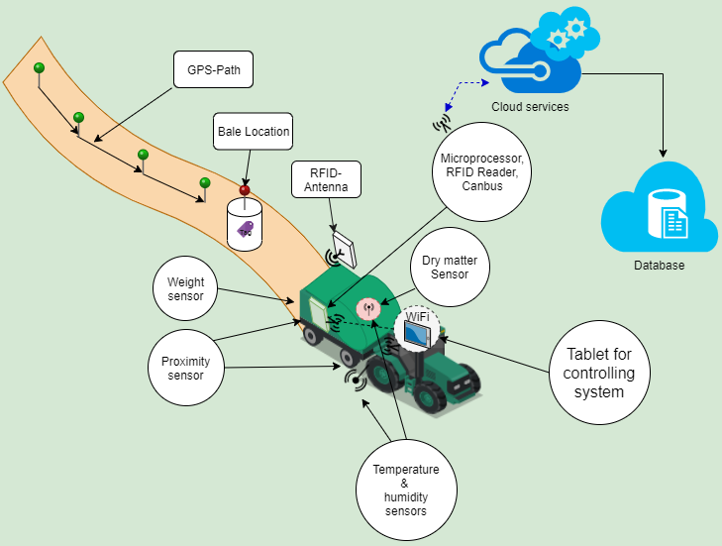
Digibale

Slide 11
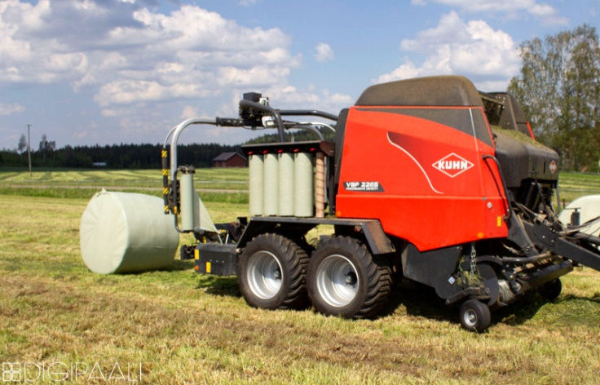
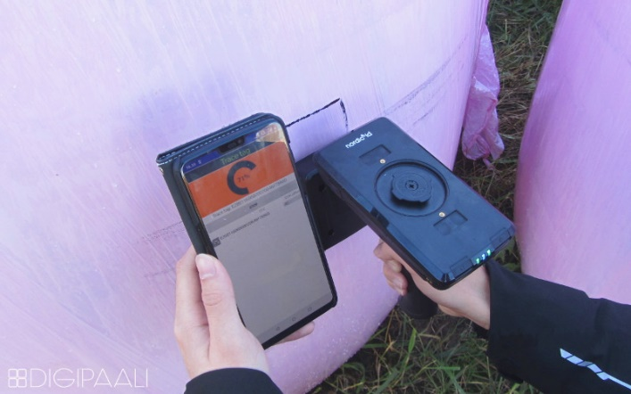
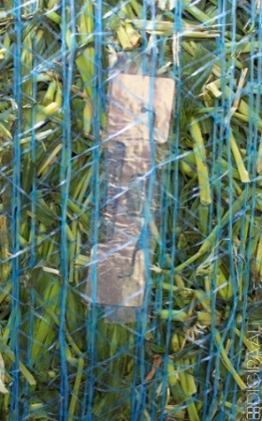
Digibale equipment

Slide 12
More information about the Digibale
www.digipaali.fi
www.facebook.com/Digipaali
video in finnish

