Slide 1
Towards circular packaging
2-3 credits
Soile Kallinen
Haaga-Helia UAS

Slide 2
Learning objectives
Student is familiar with the terminology and the role of packaging affecting packaging design
Student knows the environmental impact of packages, legal requirements and producer´s responsibilities which affect packaging design
Student is familiar with life cycle approach of packages
Student has knowledge of some green package design frameworks
Student understands the connection of packaging and circular economy and is familiar with the current challenges
Student is familiar with reusable transport packages and their role in reducing greenhouse gas emissions
Student is familiar with some green packaging producers and green package innovations

Slide 3
Contents
Packaging terminology
Role of packaging
Environmental impact of packaging
Legal requirements and producer´s responsibility
Green packaging and design
5. Challenges for packages in the Circular economy
Life Cycle Analysis of the package
Reusable transport packaging
Green package innovations
Guidebooks for packaging design
Green package producers

Slide 4
Packaging terminology

Slide 5

1. Primary package
Sales package, consumer package
Sales packaging is intended to be used
to pack a product for sale.
Examples:
- milk cartons, cereal packaging,
detergent bottles,
food cans, paint pots and food tins
Photo: Sulapac cosmetics package is fully biodegradable and made of
wooden fibre and biocomposite material.
Annemari Sinikorpi JAMK

Slide 6
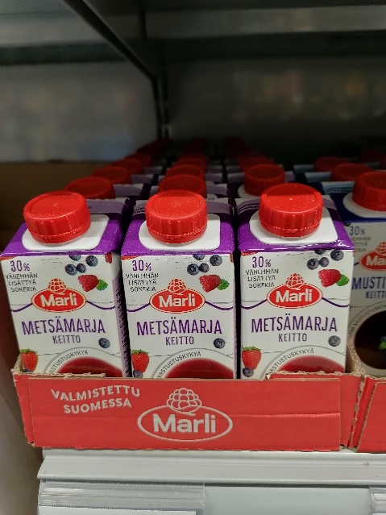
2. Secondary package
Store package, retail package,
grouped package, ready-to-sell store package
Grouped packaging comprises packaging used for
product collation in addition to sales packaging.
Group packaging may either be used at the point of sale
or a product line may be sold collated in grouped packaging.
Grouped packaging containing products packed in sales packaging may be intended for use by consumers or firms. Examples include corrugated cardboards trays, display racks, and plastic or cardboard wrapping material, such as packs for grouping together beer cans.
Photo: Cardboard tray
Soile Kallinen
Photo: Secondary package
for milk. Soile Kallinen

Slide 7
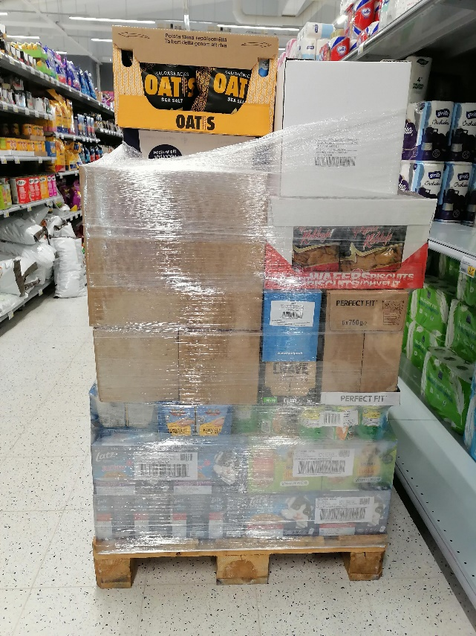
3. Tertiary package
Transport package
Transport packaging comprises packaging used to
transport products in addition to sales and
grouped packaging.
https://rinkiin.fi/for-firms/packaging-statistics/
Packaging intended to contain one or more articles or packages
or bulk material for the purposes of handling and/or distribution
packaging.
The American Society for Testing and Materials (ASTM)
https://www.reusablepackaging.org/sustainability/
Photo: Wooden pallet
filled with group packages.
Plastic wrapping has been
added to keep products
stable during the transport.
Soile Kallinen

Slide 8
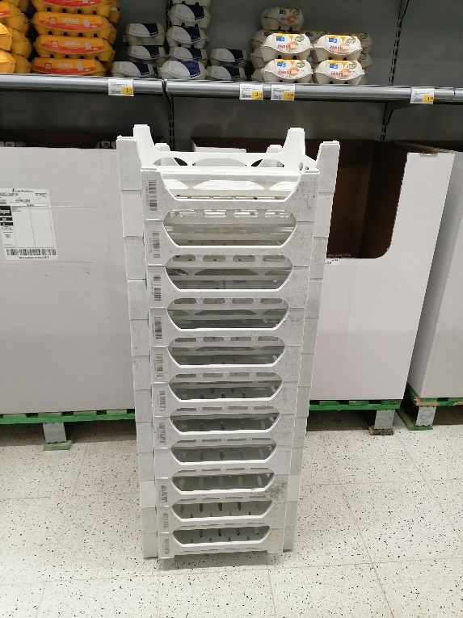
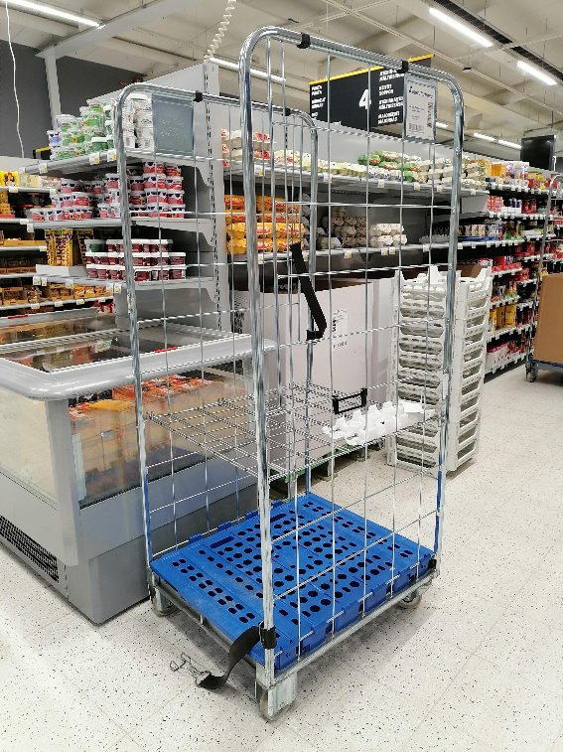
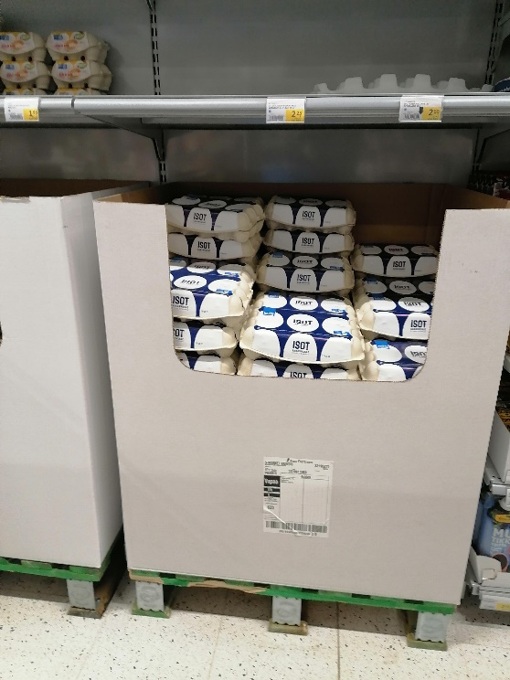
3. Transport package
Examples: wooden, plastic or corrugated
cardboard pallets, metal roller cages,
corrugated cardboard, plastic or wooden
boxes or crates, plastic pallet hood covers
and metal or plastic strapping.
Note! Containers with a volume of over 1000 litres used in road, rail, sea or air freight are not classified as packaging.
Photos: various types of
transport packages.
Soile Kallinen

Slide 9
Coordination of package measures for transport
Good package design responds to requirements for logistics :
- Finnish logistical systems are based on dimensional co-ordination and modules
SFS 5352 Packages. Coordination of package measures. Principles, terminology, rules and measures consists of guidelines for developing coordination of the package, transport, material handling and warehousing based on the module measures of 600 mm x 400 mm
The standard defines the measure module, which is used in the transportation chain related to packages, unit loads, pallets, rollers, containers, transportation equipment, loading and unloading equipment and coordination of the use of warehousing space.
It also defines the rules for multimodules and derived measure applications.
      Suomen Standardisoimisliitto SFS https://sales.sfs.fi/fi/index/tuotteet/SFS/SFS/ID2/5/2258.html.stx

Slide 10
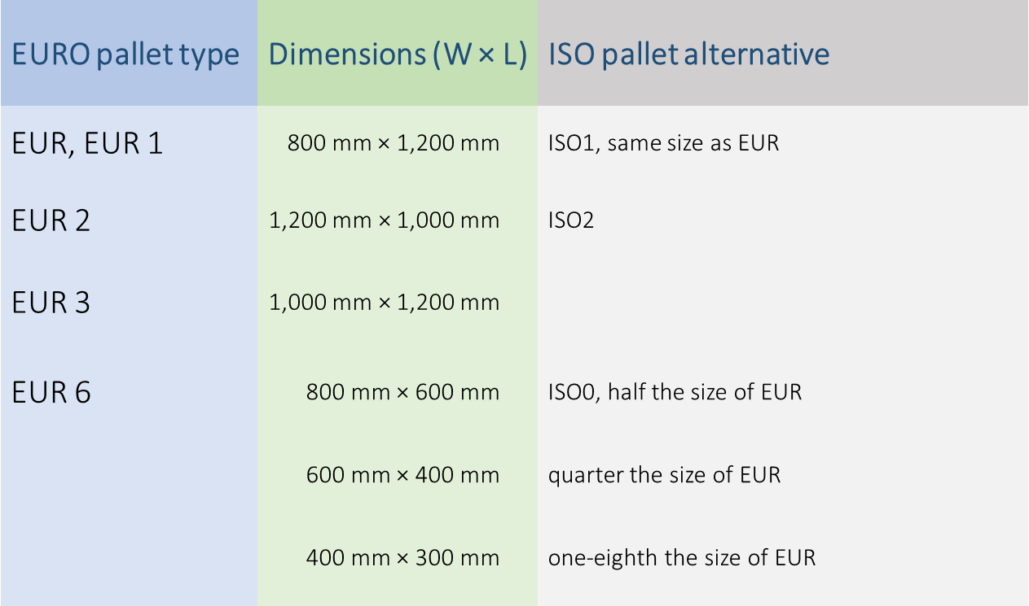
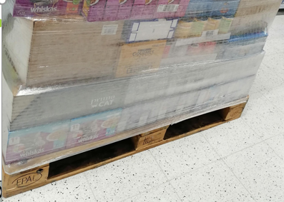
EURO Pallet types and dimensions
The EUR-pallet, also Euro-pallet or
EPAL-pallet, is the standard European
pallet as specified by the
European Pallet Association (EPAL).
Photo: EUR pallet. Soile Kallinen
https://www.epal-pallets.org/eu-en/

Slide 11
Coordination of package measures for transport
Modules of packages fitting to EUR pallet can be found in
Efficient foodservice response – Pakkausopas, pages 5 and 10
https://docplayer.fi/722716-Efr-efficient-foodservice-response-pakkausopas.html
It is important to design sales packages that fit to the logistical system :
-> efficiency is also environmental friendly
-> no “empty air “ is transported if packages are designed based on the modular system
-> light packages reduce fuel consumption etc.

Slide 12
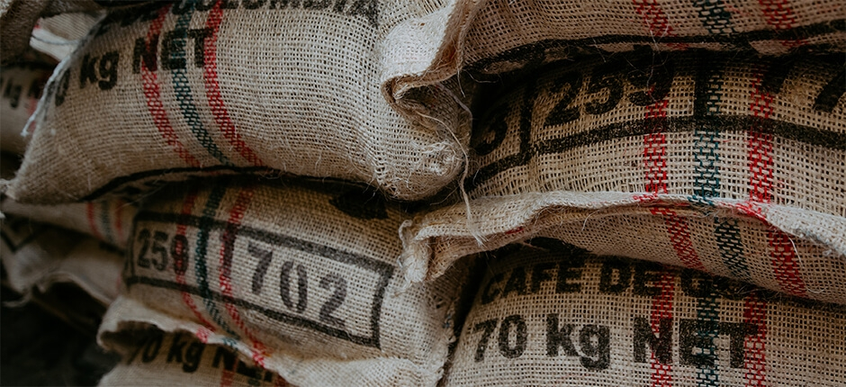
4. Industrial package
Package used for the transportation
or storage of commodities, the contents
of which are not meant for retail sale without being repackaged.
- The definition does not address material of construction and capacity,
since the capacities of packages used for industrial purposes
can range from a few ounces to many thousands of gallons,
and such packages are produced from a wide range of
materials, including metal, wood and plastics.
- American Society for Testing and Materials (ASTM)
https://www.reusablepackaging.org/sustainability/

Slide 13
Role of packaging

Slide 14
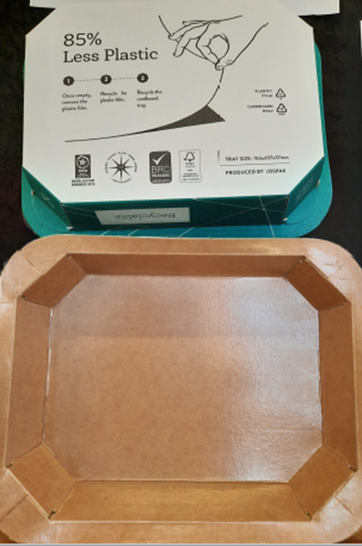
Packaging protects both the product and the environment
Packaging protects the content from contamination and breakage
Package protects the environment from the content
Packaging also improves hygiene and safety
Packaging provides information about the product
Packaging makes the use of the product easier.
Hygiene
Temperature
Radiation
Light
Humidity
Photo: JOSPAK food package
reduces 85 % plastics use.
Renewable and recyclable.
Annemari Sinikorpi JAMK

Slide 15
The correct packaging size reduces waste
Rye bread´s carbon footprint:
96-98 % production chain
2-4 % production of package
1-1.5 % packaging waste
management
The environmental impact of packaging:
packaging accounts for less than five percent of the total
environmental impact of a packet of cold meats or rye bread.
Packing product in packaging that are the right size is important.
For example, if households waste food, this causes climate change and eutrophication.
Consumer´s role: customer can reduce the quantity of waste by buying number of
products or food products based on real need, you can reduce the quantity of waste.
https://rinkiin.fi/for-households/packaging-and-the-environment-2/
MTT Raportti 14: Elintarvikkeiden ympäristövaikutukset (2011) (MTT Agrifood Research Finland, Report 14: Environmental effects of packing alternatives of food products, 2011)

Slide 16
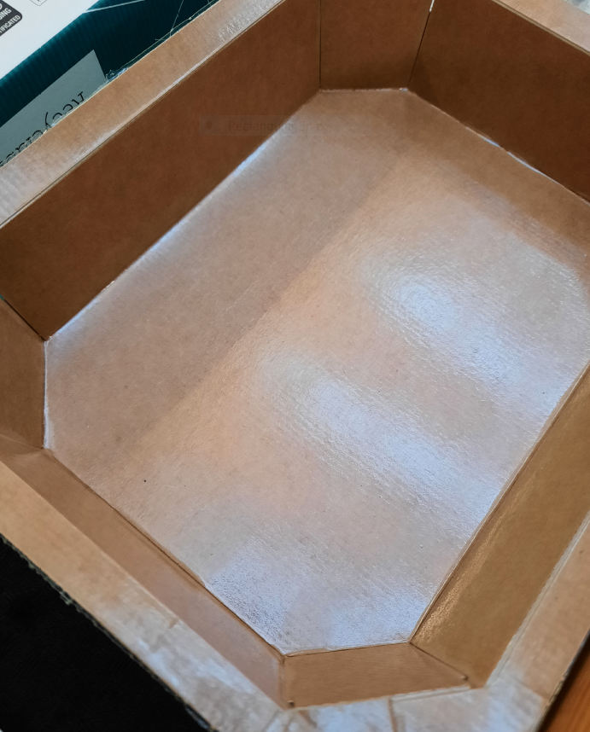
Packaging maintains product quality
Packaging have a beneficial impact on the environment.
Without appropriate packaging, there would actually be more waste.
Products are packed to ensure that they remain undamaged and
retain their good quality from the factory to the end user.
If a food product was not packed properly and it went bad before
it was used, the energy and materials used in its production
would be completely wasted.
Packaging also protects the environment from the content. It is important to pack substances such as chemicals and gases in appropriate packaging so that they can be transported and stored safely.
            https://rinkiin.fi/for-households/packaging-and-the-environment-2/
Photo: JOSPAK food package
reduces 85 % plastics use.
Renewable and recyclable.
Annemari Sinikorpi JAMK

Slide 17
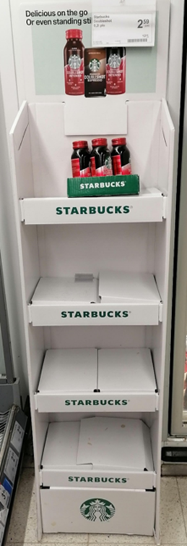
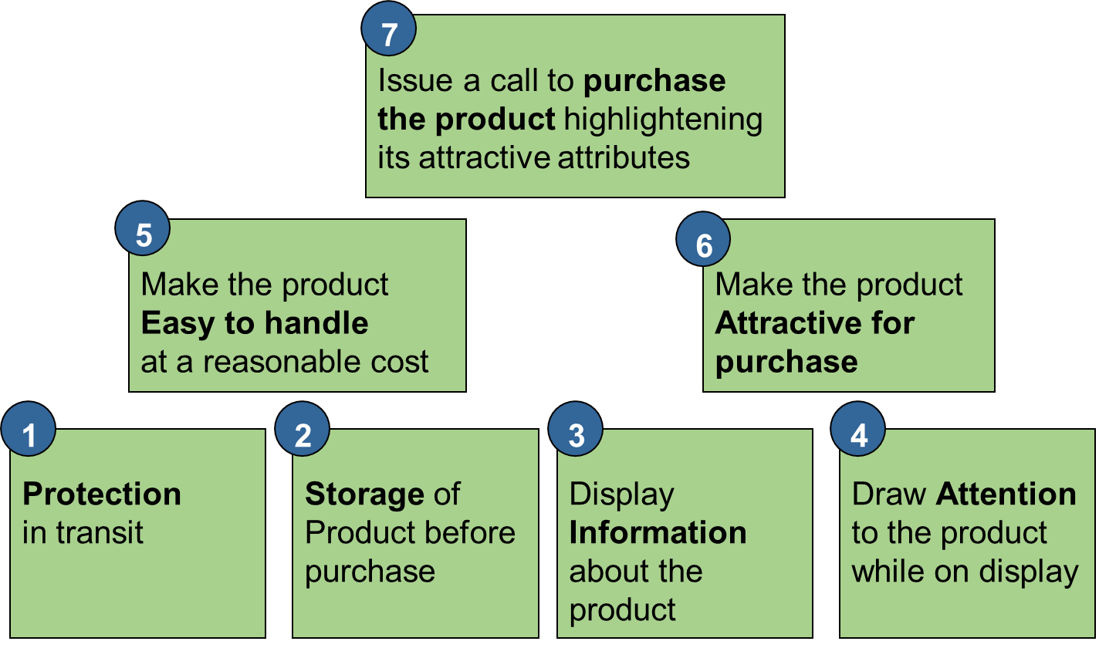
Functions of package
Package needs to :
fulfill logistics reguirements
enhance the sales
Photo: Grouped
package can
enhance sales.
Soile Kallinen

Slide 18
Environmental impact of packaging: beverage packages

Slide 19
Material inputs during the product´s lifecycle- milk
One package of (1 litre of milk) weights 30 grams.
Packaging production and waste treatment consume 440 grams of natural resources during the life cycle.
-> Over 14 times more
natural resources are
needed for one package

Slide 20
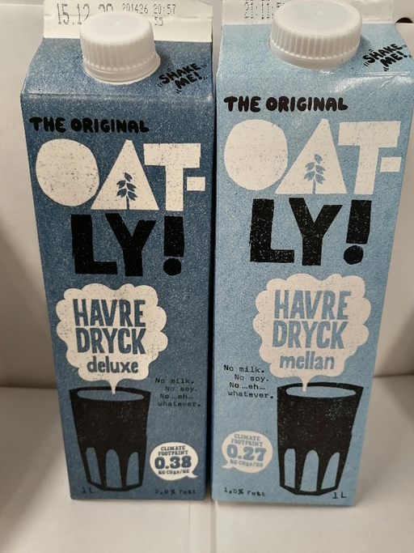
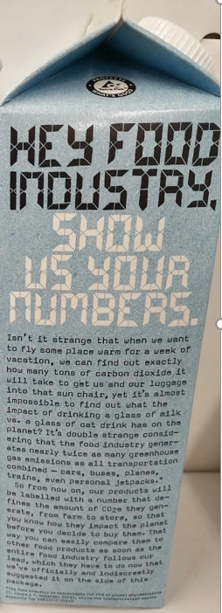
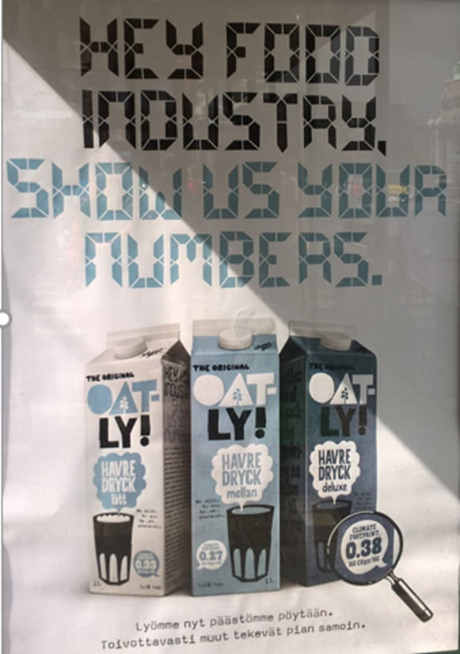
Package informs of
CO 2 eq. emissions
Photo. Poster of Oatly oat milk
” Oatly reveals the
Greenhouse gas emissions (GHG´s).
Hopefully the others do the same.”
Soile Kallinen

Slide 21
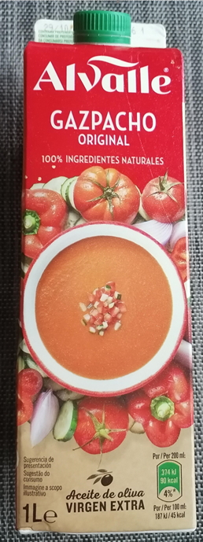
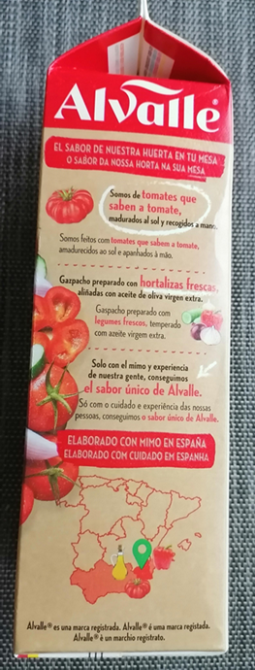
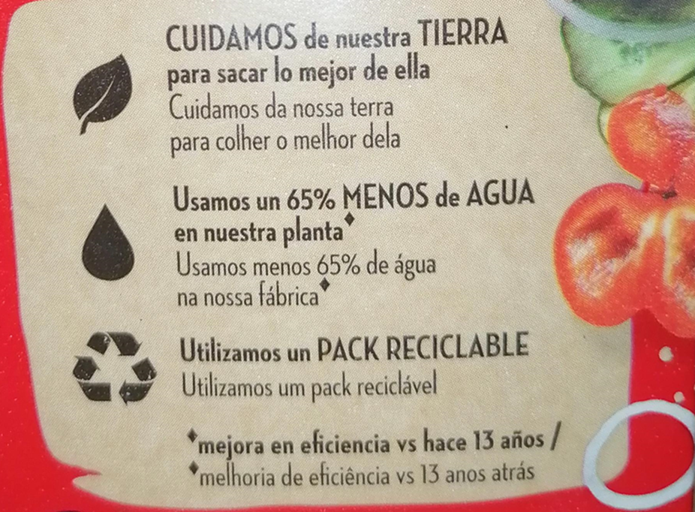
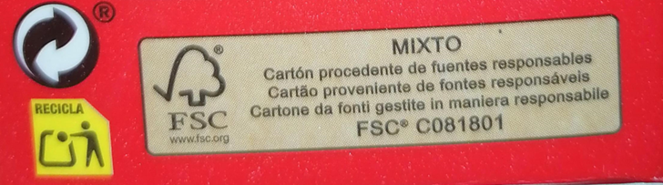

Package can inform of use of resources
- We take care of the Earth by taking out
better of it
- We use 65 % less water in our plant *
- We use recyclable packages
improved efficiency during 13 years
Package material is FSC cardboard from certified sustainable forestry
Use of local vegetable ingredients
in Spain
Photos: by Soile Kallinen

Slide 22
EU regulation related to packaging

Slide 23
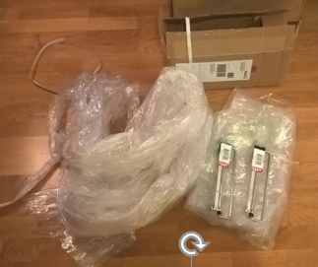
Overpackaging results in…
Wastage
Excessive costs
Resource overuse and misuse
Environmental degradation due to landfills
Photo: In e-commerce with few standard
package size options, lot of plastics can be used
to protect the product, however here you see
the case of overpackaging. Soile Kallinen

Slide 24
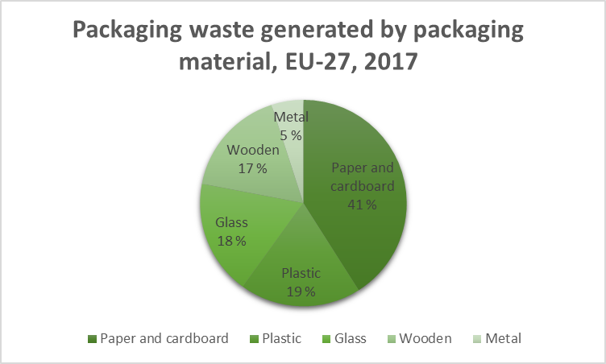
Packaging waste by material EU-27, 2017
Statistics of packaging waste
are collected in European Union
Paper and cardboard is most
collected packaging material
The objective in the European
Strategy for Plastics to ensure
that by 2030 all plastic packaging
placed on the Union market is
re-usable or easily recycled.
https://eur-lex.europa.eu/eli/dir/2019/904/oj
https://ec.europa.eu/eurostat/statistics-explained/index.php?title=File:Packaging_waste_generated_by_packaging_material,_EU-27,_2017_(%25).png

Slide 25
EU Directive of packaging and packaging waste
The packaging design should be in accordance with on the following EU directive :
European Parliament and Council Directive 94/62/EC of 20 December 1994 on packaging and packaging waste
The differing national measures concerning the management of packaging and packaging waste should be harmonized in order, on the one hand, to prevent any impact thereof on the environment or to reduce such impact, thus providing a high level of environmental protection, and, on the other hand, to ensure the functioning of the internal market and to avoid obstacles to trade and distortion and restriction of competition within the Community;
Best means of preventing the creation of packaging waste is to reduce the overall volume of packaging;
The reduction of waste is essential for the sustainable growth specifically called for by the Treaty on European Union;
The Directive should cover all types of packaging placed on the market and all packaging waste; whereas; therefore, Council Directive 85/339/EEC of 27 June 1985 on containers of liquids for human consumption (4) should be repealed;
Packaging has a vital social and economic function and therefore measures provided for in this Directive should apply without prejudice to other relevant legislative requirements affecting quality and transport of packaging or packaged goods;
In line with the Community strategy for waste management set out in Council resolution of 7 May 1990 on waste policy (5) and Council Directive 75/442/EEC of 15 July 1975 on waste (6), the management of packaging and packaging waste should include as a first priority, prevention of packaging waste and, as additional fundamental principles, reuse of packaging, recycling and other forms of recovering packaging waste and, hence, reduction of the final disposal of such waste.

Slide 26
EU directive for packaging and packaging waste
Production, use, recovery or disposal all have impact to the environment
Producers and supply chains aim at sustainable development and minimise the environmental impact- including the package during its whole life cycle
EU directive 94/62/EC relates to packages and packaging waste. It consists of reguirements that the package should fulfill before launching it to the market:
  Quality and amount of package waste, reuse, recovery (recycling, recovery as energy) and proper disposal concerning the environment and considering the efficiency and limiting the use of dangerous and toxic ingredients (heavymetals)
It is important that the package design is not contradictionary to package waste regulation of European Union or country specific regulation
Package solutions (especially packages for wholesale) must not be contradictional to other legal issues. If the package design increases the amount of packaging material, it has consequences to the transportation efficiency and emissions. The companies need to consider carefully packaging solutions through their corporate responsibility programs.

Slide 27
EU directives for reducing plastics in packages
SUP directive (Single-Use-Plastics)
Directive (EU) 2019/904 of the European Parliament and of the Council of 5 June 2019
on the reduction of the impact of certain plastic products on the environment
Single-Use-Plastics packages should be reduced
https://eur-lex.europa.eu/eli/dir/2019/904/oj#d1e810-1-1
Brochure of EU plastics strategy
https://ec.europa.eu/environment/circular-economy/pdf/plastics-strategy-brochure.pdf

Slide 28
Producer responsibility to consumer packaging
Producer responsibility for packaging applies to firms which pack products in Finland or import packed products for the Finnish market and which have a turnover of EUR 1 million or more.
A firm which must meet producer responsibility packaging obligations is responsible for the entire process of collection and recycling of their packaging waste as well as all related costs.
The law also stipulates the national targets for producer responsibility and the requirements for recycling and reusing packaging materials that must be implemented in Finland.
https://rinkiin.fi/for-firms/producer-responsibility/

Slide 29
Producer´s responsibility for collecting consumer packaging
The new Waste Act will increase packaging producers’ responsibilities
A new waste law is currently being prepared Finland, and its aim is to improve circular economy and get waste recycled instead of it ending up in energy production.
The law is based on the EU’s Waste Directive, which obliges an increasing proportion of waste to be recycled.
https://verkkolehti.rinkiin.fi/the-new-waste-act-will-increase-packaging-producers-
responsibilities?lang=en
Case : Fazer renews its packaging responsibly
https://verkkolehti.rinkiin.fi/fazer-renews-its-packaging-responsibly?lang=en

Slide 30
Changes to package reporting and fees 2021
Companies need to report their packaging materials more accurately
From 2021 onwards, consumer and B2B packaging, single-use and reusable packaging as well as the materials used in multi-material packaging will be reported separately, while data for exports will no longer need to be reported.
Single-use packaging and reusable packaging are reported separately
This might mean changes to package design to avoid multi-material packaging
https://verkkolehti.rinkiin.fi/companies-to-report-their-packaging-materials-more-accurately?lang=en#8d9b50ff
Changes to the 2021 recycling fees for packaging
Recycling fees for plastic, fibre and plastic packaging will go up next year, while the fees for metal and glass packaging and Rinki’s customer fees will remain unchanged.
The aim is to reduce the use of plastics as a packaging material in package design
https://verkkolehti.rinkiin.fi/changes-to-the-2021-recycling-fees-for-packaging?lang=en#e5c4d7d3

Slide 31
Life cycle approach of the package design
- Case Tetra Pak

Slide 32
Definition of life cycle assessment
Life cycle assessment measures and assesses all stages of a product´s lifecycle so the environmental impacts of a single product during its whole life cycle, cradle-to-grave.
All the stages of the product life-cycle are interdependent:
-> one stage leads to the other
LCA provides a comprehensive and holistic view of the product or process
        Grant 2018, 265
LCA can be applied to life cycle of the package as well
Stages of package life cycle : design, materials, production, transportation, usage, recycling (and avoiding landfill)

Slide 33
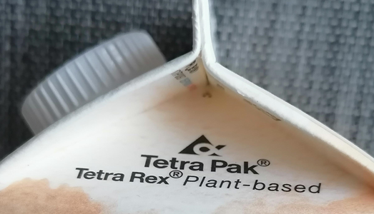
Carbon footprint of Tetra Pak package during its life cycle
Photo: Soile Kallinen
The carbon footprint of a product is the sum of all greenhouse gases emitted during its life cycle. This includes the sourcing of raw materials used, the production, distribution, consumption, transportation and end-of-life treatment of the product.
Tetra Pak produces different types of packages that are filled and distributed in various locations around the world. The end-of-life treatment also varies from case to case depending on local recycling conditions as well as the choices made by the end consumer. To calculate the exact footprint of each of these combinations is challenging.
Cradle-to-Gate results for carton packages from the Carton CO2 calculator show the carbon footprint of cartons under European conditions up to the moment when the packaging material leaves the factory.
Impacts associated with sourcing and transporting raw materials to plants, converting the materials into packaging material, are areas that Tetra Pak controls directly. Measures also enable customers to make informed climate choices when choosing their packaging.
The LCA report: Comparative Life Cycle Assessment of Tetra Pak® carton packages and alternative packaging systems for liquid food on the Nordic market provides a good example of LCA reporting
  https://assets.tetrapak.com/static/se/documents/sustainability-downloads/lca%20nordic%20final%20report.pdf

Slide 34

LCA examples of environmental impact of food packaging systems of Tetra Pak
Also other life cycle assessments (LCAs) have been made,
investigating the environmental impact of food packaging systems.
LCAs were undertaken by independent scientific institutes,
using the internationally-accepted standard method
(the ISO 14040 series of standards).
Example package types studied :
  Wine containers
  Beverage containers
  Food containers
  Read more from the source below

Slide 35
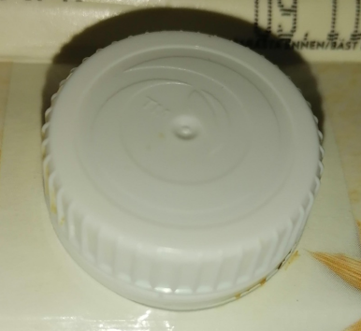
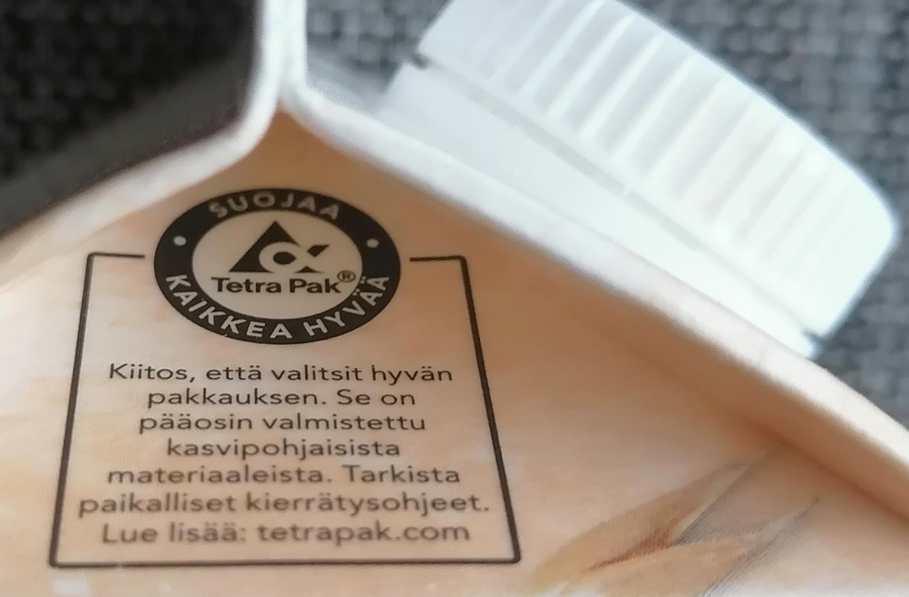



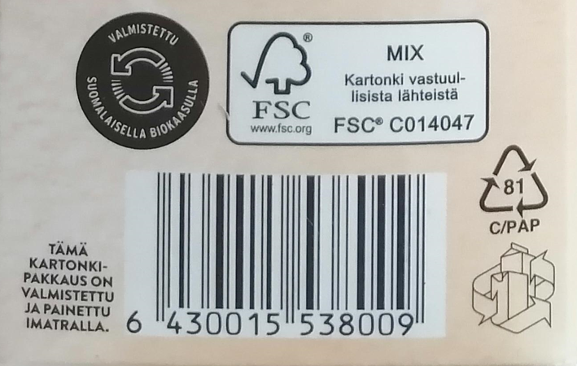

Example of
Tetra Pak and
Aito oat milk
The brand of Tetra Rex is based on plant-based materials
The cup TM is made of
sugar cane side streams
Carton is sourced from FSC certified forests,
energy source for production is Finnish biogas,
the package producer is near to oat milk production site.

Slide 36


Tetra Pak and life cycle of Aito oat milk package
Recycling
Recyclable
Compostable
Green design
* Consider the whole life cycle
Avoid:
Incineration
Landfilling
Materials
Recyclable
Compostable
Light
Cup biobased plastic
Responsibly sourced carton (FSC forestry)
Usage
Storing
Return
Manufacturing
Use sustainable energy
(e.g. biogas)
Transportation
Short distance to Fazer
Less energy use
Less fuel
Picture created by Soile Kallinen
Notes:
To measure and drive environmental performance, it is important to look at the package's whole lifecycle. Tetra Pak uses the Life Cycle Assessment, which enables to assess the entire impact of the packages from raw material, manufacturing to transport, use and disposal .
1. TREE. Tetra Pak only buys paperboard from suppliers who ensure that their wood comes from known and acceptable sources. Tetra Pak publishes a Forestry Guideline which explains : "to guarantee that all the wood fibre we use is traceable from tree to store, that it comes from responsibly managed forests.
2.PAPER ROLL.Tetra Pak packages have FSC certification label, which says to customers, that packaging material comes from responsibly managed forests and other controlled sources. At the moment 97% of paper comes from certified sources. The goal is to reach 100%.
3.FACTORY. Tetra Pak goal is to minimize energy use and water waste. Company claims that in past 8 years production has increase by 30% and energy use has dropped.
4.DELIVERY.Company tries to make production and distribution more effective.Tetra Pak customers use their equipment to pack own products.
5.CONSUMERS.At this stage we should think how do we handle package from the store to recycling stage. How do we store products and ho w do we treat packages to make them as recycleble as possible.
6.RECYCLING.About 73% of Tetra Pak is fully recycleble. To increase recycling company is cooperating with customers, public authorities, local associations and NGOs

Slide 37
Green package design

Slide 38
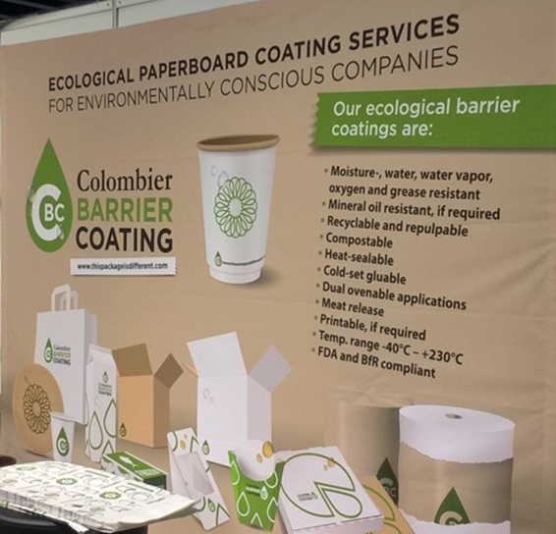
Environmental view to package design
* Packaging is not designed to be waste
  - Re-use systems
  - Packaging materials are reused, recycled or recovered as energy
  - Durability, reusable and recyclable materials,
  end-user requirements, regulations
* Material efficiency of packaging
  - As little as possible for as much as necessary
* Better product design makes plastics recycling easier
  - Saving 77-120 EUR for each tonne of plastic waste collected
  (Ellen McArthur Foundation 2016)
Photo: non-plastic Bio Barrier is suitable for all kinds of paper and board
and creates an effective barrier against moisture, oil, grease and heat.
Colombier barrier coating: https://colombierbarriercoating.com/
A stand in Chembio Fair 2020. Soile Kallinen

Slide 39

Drivers of green packaging
Savings :
- 20-30 % savings through better sourcing
- 40-50 % through redesign and re-engineering
Reduce costs by recycling and reusing waste packaging material
Eliminate excessive costs by removing
unnecessary packaging of some goods
The public demand for the use of safe and appropriate materials
that will benefit the environment
Increase in customer satisfaction through having clean neighborhoods
6. Enhanced goodwill and perception as a socially and environmentally
responsible organisation to end users
Photo: Sulapac green cosmetics package is waterproof and oilproof.
Annemari Sinikorpi JAMK
Emmet & Sood 2010, 142-145

Slide 40
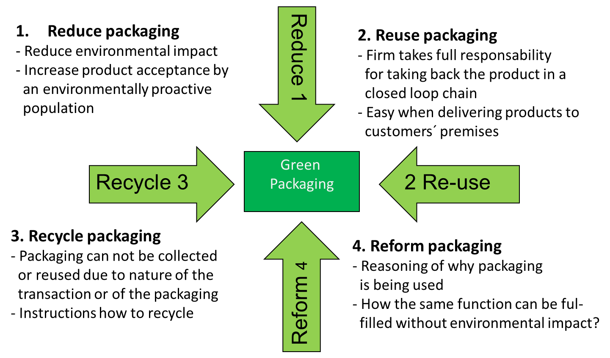
Green packaging key differentiators

Slide 41
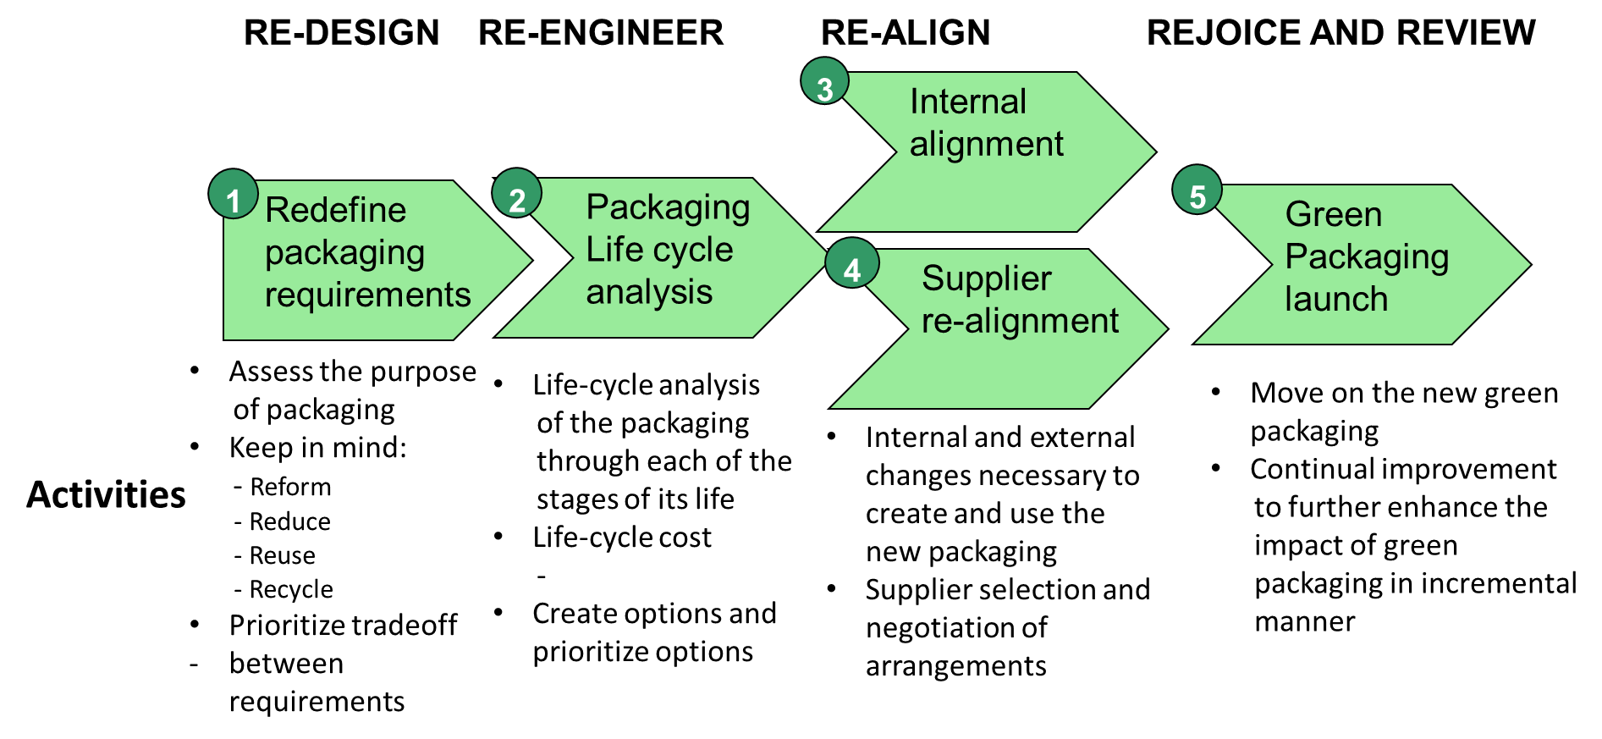
Towards green packaging

Slide 42
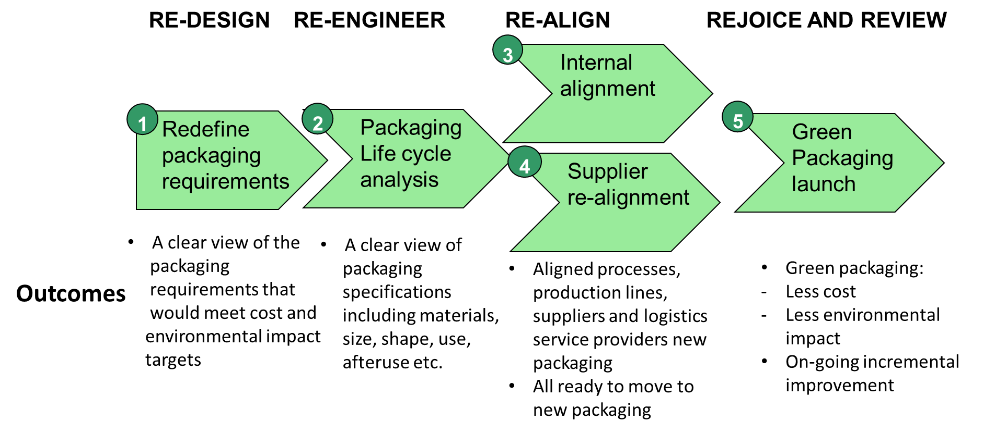
Towards green packaging

Slide 43
Challenges of packages in the Circular economy

Slide 44
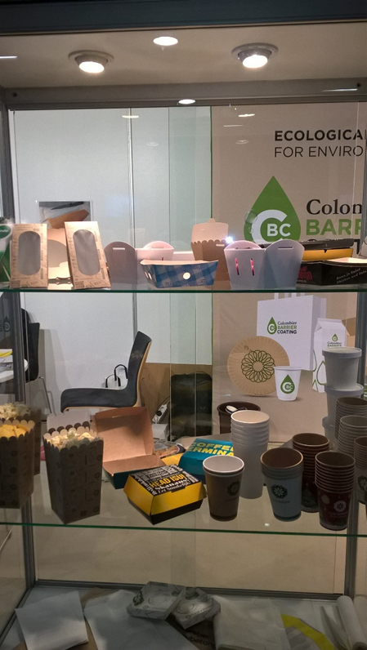
Factors to be considered in the circular package design
Is the package recyclable ?
  Not all the materials are suitable for recycling
  The more material layers in the package,
  the more challenging they are to process
Is the package safe ?
  Safety comes first
  Hygiene, contamination can not be risked
Is the package traceable ?
  Sometimes it is hard to track the origin of the packaging material and its contents
  That is why especially food packages have limits for reuse
  Total black packages are hard to identify -> grey or other color instead
Photo: various green packages
with non-plastic Bio Barrier
Colombier barrier coating:
A stand in Chembio Fair 2020.
Soile Kallinen

Slide 45
Reusable transport packaging

Slide 46

Reusable package reducing environmental impact
The reuse of industrial and transport packaging is one of the most
environmentally efficient practices available to businesses.
Industrial and transport packaging reuse:
Reduces energy consumption. Reuse saves energy by reducing raw material acquisition requirements, limiting production of new packagings and eliminating much of the transportation-related impacts associated with each of these functions.
Reduces solid waste production. Solid wastes are generated during each phase of the production process, from the extraction of raw materials to the fabrication of new packagings. Most of these wastes are reduced or eliminated when industrial packagings are reused.
Reduces atmospheric and waterborne emissions. Atmospheric and waterborne wastes are generated as part of the production process. Significant portions of such wastes are eliminated by packaging reuse.
Photo: Reusable transport package for eggs.
Soile Kallinen

Slide 47
Reusable transport package
Reusable transport packaging generally includes:
  pallets, bins, tanks, intermediate bulk containers (IBCs), reusable plastic containers (RPCs) and other hand-held containers and totes, trays and dunnage
Reusable package moves products efficiently and safely through supply chains.
Packages are designed for lasting use in a system that ensures their effective recovery and return for continuous purpose.
Typical uses involve the transport of raw materials, commodities, ingredients or parts to facilities for the manufacture or processing of goods, and then for the shipment of finished goods to distribution centers or warehouses in route to commercial markets such as wholesale or retail outlets.
Reusable transport packaging products are largely designed for business-to-business applications, although the growth of e-commerce and home delivery applications is opening opportunities for the effective use of reusable packaging for transporting merchandise to households.

Slide 48
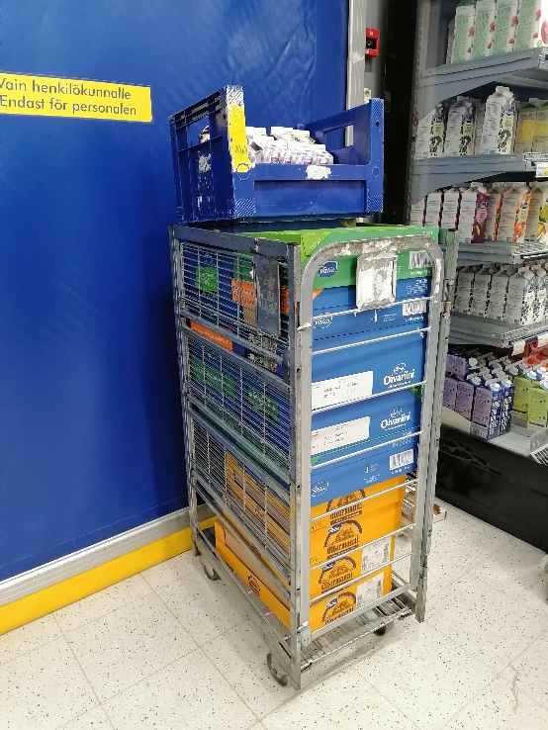
Reusable transport package
Reusable transport packaging is constructed of durable materials
such as metal, plastic or wood and is designed to achieve
multiple uses through rigorous operations and logistics systems.
Reusable transport packaging is composed of recyclable materials
that can be recovered, refurbished or re-manufactured.
The contrast to reusable packaging is single-use or one-way packaging, such as a corrugated box, which is design for one-time use before it is disposed and recycled or land-filled.
Photo: Metal roller cage.
Signs of use.
Soile Kallinen

Slide 49
Reusable pallets and CO2 eq. emissions
Light pallet material can reduce fuel consumption, energy and CO2 eq.emissions
Example: 5 pallets (without products) delivered from Helsinki to Utsjoki:
Pallet type 1200 x 800 cm Weight Distance Energy usage CO2 eq. emissions
(1 pallet)
Reusable wooden pallet 25 kilos 1295 km 185 MJ 11,7 kg
Reusable pallet,
corrugated cardboard 4 kilos 1295 km 29,5 MJ 1,9 kg
  CO2 calculations based on emission calculator
https://eschenker.dbschenker.com/app/nges-portal/emission-calculator/emission- view?language_region=en-US_FI

Slide 50
Requirements for reusable transport package
Reusable transport packaging generally meets four requirements to be considered “reusable” :
The packaging is designed for reuse in the same or similar application,
or for another purposeful packaging use in a supply chain.
2. The packaging is highly durable to function properly in its original
condition for multiple trips and its lifetime is measured in years.
During its useful life, the packaging is repeatedly recovered, inspected,
repaired if necessary, and reissued into the supply chain for reuse.
The packaging operates in a system that prevents it from solid waste,
and a process is in place for the recovery and recycling of the product
at its end of life.

Slide 51
Green package innovations

Slide 52
Package Heroes – project for sustainable food packages
The project of Package-Heroes studies and develops packaging solutions, which address simultaneously food protection and the global and increasing concern of plastic packaging waste.
More scientific knowledge is needed about the environmental effects of different materials and solutions and about consumer preferences.
Package-Heroes is a research project funded by the Strategic Research Council functioning under the Academy of Finland. The project finishes by the end of 2023.
Package Herous are VTT Technical Research Centre of Finland Ltd. , LUKE Natural Resources Institute Finland, LUT University and Åbo Academy
See the video clip “Saving the world through better packaging solutions” https://www.packageheroes.fi/en/

Slide 53
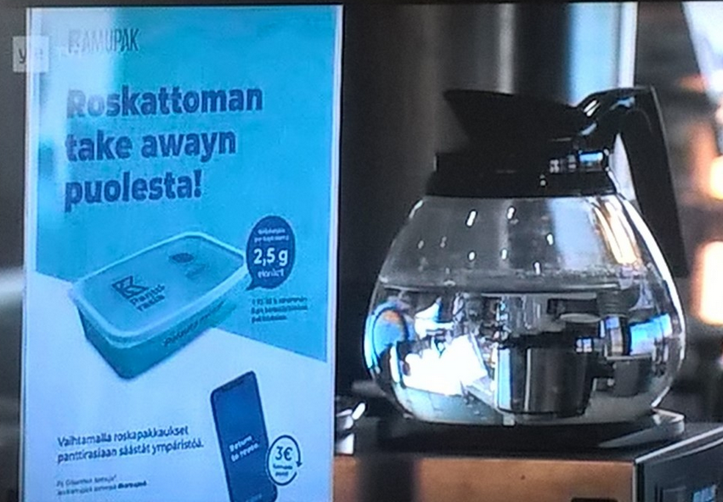
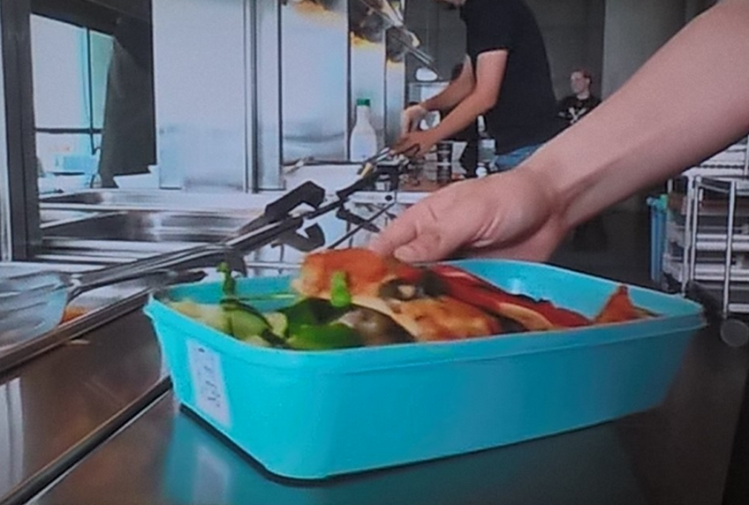
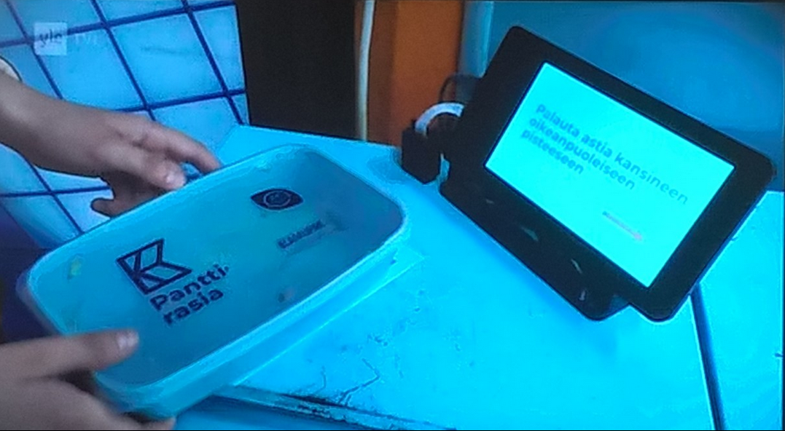
Example of reusable takeaway package
Kamupak : By creating an incentive system customers are encouraged to use resusable takeaway packages.Package development took years before the launch.

Slide 54
Guidebooks for green package design

Slide 55
Self-assessment tool for package recyclability
Packaging recyclability roadmap
It is an online information tool aimed at users to self-assess the recyclability of packaging and a roadmap based on the following recyclability critical control points:
- design, labelling, collection and sorting
It brings together best practices by the Extended Producer Responsibility Alliance (EXPRA) membership as well as information on how to best reduce the environmental impact of packaging while optimising its resource efficiency.
The toolkit covers the most-frequently used materials for packaging:
- aluminium, glass, paper, plastic, steel and wood
  https://www.packaging4recycling.eu/
Start the analysis of various types of packaging materials
  https://www.packaging4recycling.eu/choice.php

Slide 56
Guidebooks for package design (in Finnish)
EFR Efficient Foodservice Response Pakkausopas (in Finnish)
ECR Finland Efficient Consumer Response
The guidebook consists of detailed information of how role of packaging, types of packages, modules and sizes, legal reguirements, logistics requirements etc. should be considered in the package design
The guidebook has good photo illustrations, so it is informative even thought it is in Finnish
https://docplayer.fi/722716-Efr-efficient-foodservice-response-pakkausopas.html
Opas kierrätyskelpoisen muovipakkauksen suunnitteluun (In Finnish)
Suomen Uusiomuovi Oy
The guidebook consists of detailed information how package should be designed considering recycling
The guidebook has good photo illustration, so it is informative even though it is in Finnish
https://www.uusiomuovi.fi/fin/yritykselle/kierratyskelpoinen_muovipakkaus

Slide 57
Green package producers and a task

Slide 58
Package producers for green innovations
Esbottle (carbonboard based bottle) https://www.esbottle.com
Jospak (The Cardboard Tray for Sustainable Food Industry) https://jospak.com
Huhtamäki (sustainable food packages) www.huhtamaki.com
Kamupak (digital deposit system for reusable packaging) https://en.kamupak.fi/
Kotkamills (various innovative package materials) https://kotkamills.com
Repack (reusable fibre-based packages for e-commerce) https://www.originalrepack.com
Stora Enso (various green package solutions) https://www.storaenso.com/en
Sulapac (biocomposite package for cosmetics) https://www.sulapac.com
Suomen Uusiomuovi; The Finnish Plastics Recycling Ltd. Used plastic packaging http://www.uusiomuovi.fi/fin/in_english/

Slide 59
Task for green package producers and packaging
Select one of the green package producers from the list presented earlier
Get familiar with their package offering and material use
Prepare a presentation of the company and its package innovations
  Which purposes packages have been designed for?
  Which material the packages are made of?
  What are benefits from environmental perspective ?
Present your findings to others (power point slides and company´s websites)

Slide 60
Sources and links
Climate Change Benefits of Industrial and Transport Packaging Reuse (Revised 2011) http://www.reusablepackaging.org/sustainability/
Emmet & Sood 2010 : Green Supply Chains – Action Manifesto. Chapter 7
Eurostat packaging waste by materials EU-27, 2017 statistics
https://ec.europa.eu/eurostat/statistics-explained/index.php?title=File:
Packaging_waste_generated_by_packaging_material,_EU-27,_2017_(%25).png
David B. Grant, Alexander Trautrims & Chee Yew Wong 2017: Sustainable Logistics and Supply Chain Management
MTT Raportti 14: Elintarvikkeiden ympäristövaikutukset (2011) (MTT Agrifood Research Finland, Report 14: Environmental effects of packing alternatives of food products
Package Heroes – project for sustainable food packages
https://www.packageheroes.fi/en/
Packaging protects both the product and the environment
https://rinkiin.fi/for-households/packaging-and-the-environment-2/
Rinki collects packaging statistics from more than 4,000 companies
https://rinkiin.fi/for-firms/packaging-statistics/

Slide 61
Sources and links
Tetra Pak : http://www.tetrapak.com
Comparative Life Cycle Assessment of Tetra Pak® carton packages and alternative packaging systems for liquid food on the Nordic market. Final report commissioned by Tetra Pak International SA. Heidelberg, April 2017.
https://assets.tetrapak.com/static/se/documents/sustainability-
downloads/lca%20nordic%20final%20report.pdf
Tetra Pak Sustainable packages
https://www.tetrapak.com/sustainability/food/customer-focus/sustainable-packages
See the video clip there too
What is reusable packaging ? RPA Reusable Packaging Association
http://reusables.org/why-choose-reusables/what-is-reusable-packaging

Slide 62
Green package assignment
Learning objectives
The objective of this task is to make you to understand green features of packages and the circular economy. You will study packaging materials and especially new innovative solutions of packages, recycling labels and other ecolabels etc.
Your task
Each team will select the field of industry, which applies green solutions of packaging. Analyse a sales package of green features. Consider carefully your choice: quite often a green product requires also a green package.
For example, new sustainable package solutions might be found in food packages, beverage packages, packaging for organic or vegan products, green household detergents, environmental-friendly cosmetics etc. relevant products that require green packaging solutions.

Slide 63
Green package assignment
Step 1. Definitions
Firstly, each team member will search a definition of the environmental friendly package.
You might find terms of sustainable package, green package, reusable package etc. The definition could even be related to a specific product (e.g. sustainable food package). Write down your sources (the author and the year).
Step 2. Analysing the sales package
Secondly, each team member will search information about a package solution of that particular field of business. Each team member collects / takes photos of the chosen package (especially about green symbols and packaging information).

Slide 64
Green package assignment
Step 2 continues.
Each team member analyses first individually own package as follows:
a. The packaging material. Study the material/materials used and think of reasons for those.
b. Reduction of the packaging material. Analyse if the package size has been reduced.
c. Recyclability/Reusability of the package. Look for recycling labels and study the meaning of those labels.
d. Other possible ecolabels or other green standards. Study the meaning of those.
e. Guidelines for after use. Study how well the package consists of information for the user
to bring the package back to the closed loop system.
f. Other findings. Write down any other findings of your package to support the circular system.

Slide 65
Green package assignment
Step 3. Compare findings in your team
When all team members have analysed their own packages according to a-f, it is time to wrap up your results in your team.
Team analyses the findings of each team member. Indicate the package and the company in your power point presentation later.
Consider how you will present the findings: similarities, differences… Start your presentation by the suitable definition of the package. Compare features of various packages based on the criteria chosen by you. You can create table charts for a compact information. End your slide show by concluding which package has the most green features.

Slide 66
Green package assignment
Outcome
Prepare power point slides consisting of the definition of packages and common green features of your chosen type of packages.
Remember to add in-text-references to your slides. The minimum font size is 20. Add names of team members to the first slide. Add the list of sources to the end.
Present your findings in class.
Presentation time for each team is approximately 25 minutes and time for discussion after the presentation is around 5 minutes.

