Slide 1
Circular product design 3-5 credits
Soile Kallinen / Haaga-Helia UAS

Slide 2
Learning objectives
Student is familiar with the role of product design in the circular economy
Student has knowledge about product inertia, eco-design and circular design
Student learns principles of circular product design
Student understands the cradle-to-cradle approach
Student knows the role of customer centricity in design
Student learns to design the product using elements of Circular Design Play Cards which relate to features of circular design
Student knows the circular design process

Slide 3
Circular product design
Defining a circular product, theory
- Design for environment / Circular design / eco-design
- Principle of Product Inertia
Principles of Circular product design
3. Cradle-to-Cradle approach
Customer centric product design
Circular design process
6. Assignment guidelines for circular product design

Slide 4
Product lifetime expectanties
0-2 years 3-4 years 5-6 years 7-10 years 10 + years
Electric toothbrush Kettle Camera Television Boiler
Mobile phone MP3 Player Landline phone Fridge/ Freezer Kitchen units
Clothing Toaster Lamp Cooker Wardrope
Shoes Computer Power tools Sofa
Cushions Vacuum-cleaner Carpet
Suit Washing machine Bed
Microwave
Curtains
Printer Owen Fridge/Freezer
Computer Washing machine
Camera Television
Mobile phone Microwave
In UK
In Brazil
Product life-time expectancies in UK (Cox et al. 2013) and in Brazil (Echegaray 2016)
dr. C.A. Bakker & ir. C.S.C.Schuit 2017.The Long View. Exploring Product Lifetime Extensions https://www.oneplanetnetwork.org/sites/default/files/the_long_view_2017.pdf

Slide 5
Defining a circular design, theory

Slide 6
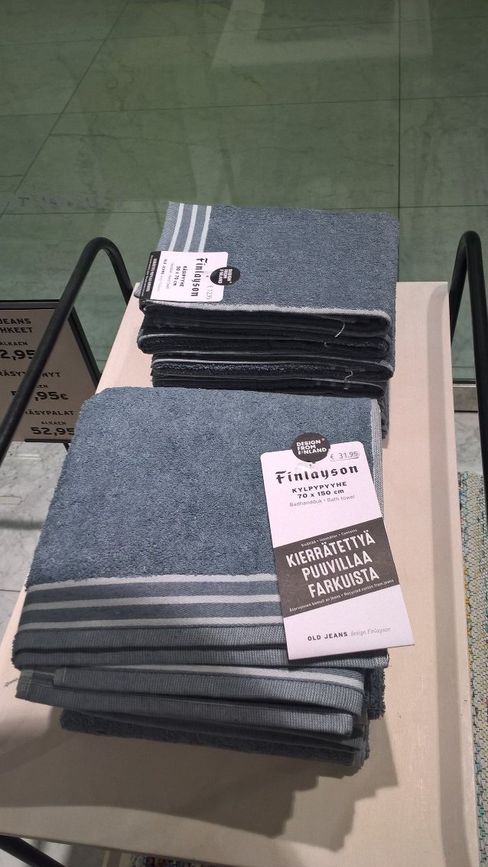
Product design
Product design can be thought as
the characteristics or features of a
product or service
that determine its ability to meet
the needs of the user.
Source: Bozarth & Handfield 2019, 473
Photo: Finlayson towels from recyclable jeans (40 %) and
60% of virgin cotton.
Soile Kallinen

Slide 7
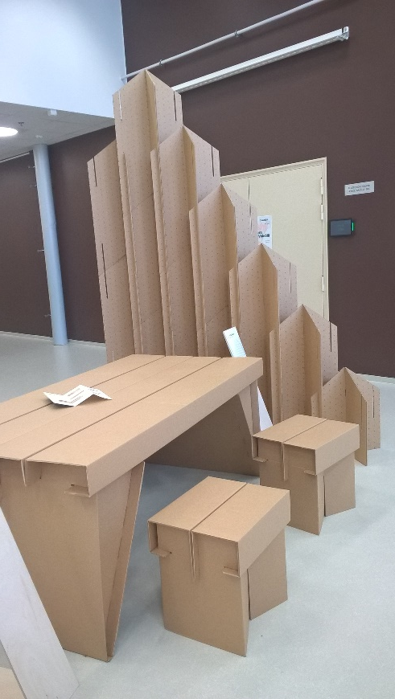
Circular design
Design for environment/Eco-design/Circular design can be achieved by:
Selection of materials
Minimising water footprint
Minimising energy footprint
Design for cleaner production
Design for sustainable consumption
Design for circular economy (sustainable logistics)
.
Source: Grant et al. 2017, 122
Photo: furniture made
of cardboard. ReHome
project in LAB Lahti.
Soile Kallinen

Slide 8
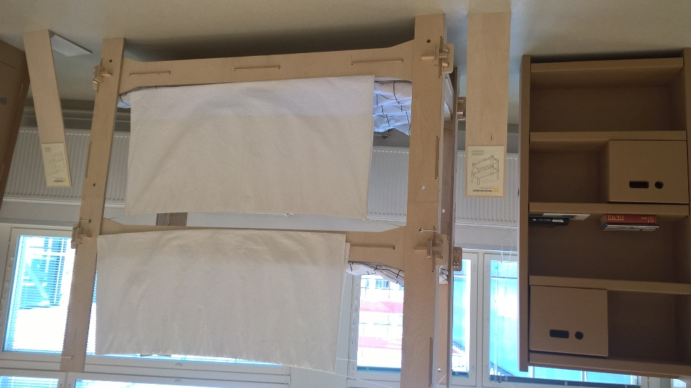
Product design in a Circular economy
In a circular economy,
the environmental and economical value of materials is preserved
as long as possible by keeping them back in the economic system,
either by lengthening the life of the products formed from them or
by looping them back in the system to be reused.
No waste
- Products and materials reused
and cycled indefinitely
Source: den Hollander, Bakker, Hultink 2017, 517
Photo: furniture made of cardboard. ReHome
project in LAB Lahti. Soile Kallinen

Slide 9
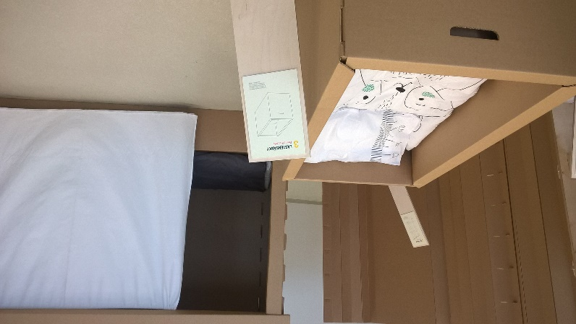
Stahel 2010, principle for circular design
Do not repair what is not broken
Do not remanufacture something that can be repaired
Do not recycle a product that can be remanufactured
Replace or treat only the smallest possible part
in order to maintain the existing value of
the technical system
Source: den Hollander, Bakker, Hultink 2017, 519
Photo: furniture made of cardboard.
ReHome project in LAB Lahti.
Soile Kallinen

Slide 10
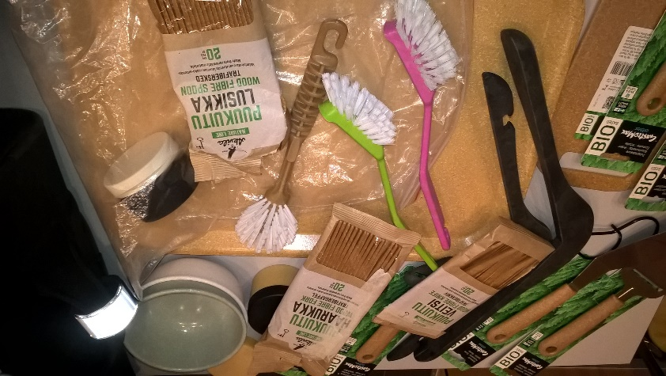
Inertia principle
Photo: wooden composite products
(Stora Enso ) Soile Kallinen
Inertia principle is to keep the product in state,
or in state as close as possible to the original product,
for as long as possible, thus minimizing and ideally eliminating
environmental costs when performing interventions to preserve or restore the product´s added economic value over time.
- Source: den Hollander, Bakker, Hultink 2017, 519

Slide 11
Circular Product Design
Circular product design encompasses both design for product integrity and design for recycling
Circular Product Design
Design for Product Integrity
Design for Recycling
Design for product integrity 2. Design for recycling
aiming at preventing and reversing aiming at preventing and reversing
obsolescence at a product or a obsolescence at a material level
component level
* Design for :
long use, extended use or recovery
Source: den Hollander, Bakker, Hultink 2017, 521

Slide 12
Typology of design approaches for product Integrity
Circular product design encompasses both design for product integrity and design for recycling
Design for Product Integrity
Long use
Extended use
Recovery
Resisting obsolescence: Postponing obsolescence: Reversing obsolescence:
design approaches for long use design approaches for extended use design approaches for recovery
- Design for Physical Durability - Design for Maintenance - Design for Recontextualising
- Design for Emotional Durability - Design for Upgrading - Design for Repair
- Design for Refurbishment
- Design for Remanufacture
Source: den Hollander, Bakker, Hultink 2017, 521

Slide 13
Principles of circular product design

Slide 14
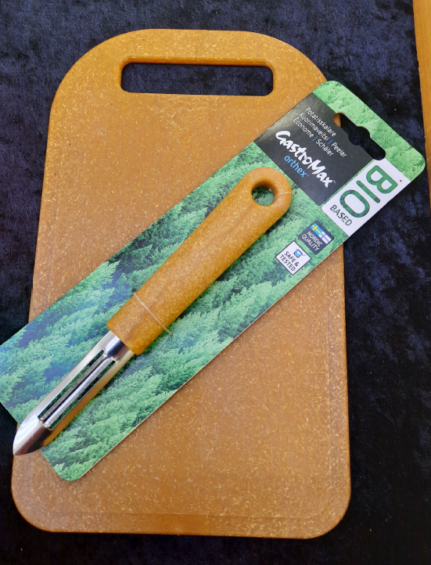
Guidebook: Circular Economy Business Models for the Manufacturing industry
The guidebook Circular Economy Business Models for the Manufacturing industry - Circular Economy Playbook for Finnish SMEs provides information about circular product design :
Customer focus on the design :
- Design solutions to deliver customer solutions pp. 35-40
Guidelines for the circular product design :
- Design products for circularity pp. 41-43
Photo: Biocomposite
products by Stora Enso
for daily use
Annemari Sinikorpi JAMK
Sitra. Circular Economy Playbook for Manufacturing industry. Playbook for Finnish SMEs
https://teknologiateollisuus.fi/sites/default/files/inline-files/20180919_Circular%20Economy
%20Playbook%20for%20Manufacturing_v1%200.pdf

Slide 15
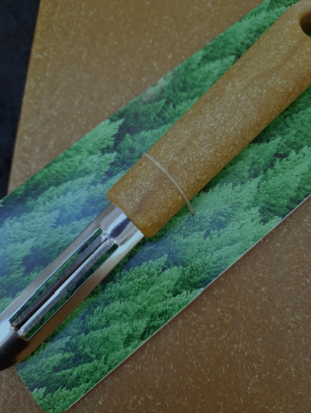
Three drivers of design in the Circular Economy
Customer-centricity. The user/customer in the core of the design
Sustainability. Sustainable solutions and sustainable utilisation of materials
Technology. With the new technology it is easier to respond to new reguirements
Photo: Biocomposite
product by Stora Enso
for daily use
Annemari Sinikorpi JAMK
Source: Sitra Circular Economy business models for the manufacturing industry, 12
https://teknologiateollisuus.fi/sites/default/files/inline-files/20180919_Circular%20Economy%20Playbook%20for%20Manufacturing_v1%200.pdf

Slide 16
Life cycle thinking in design
Life cycle thinking means minimising environmental impacts along the whole life cycle and comparing alternatives against each other are key for sustainable product design.
Consider the whole life cycle in the design process from production to use phase to end-of-life, because more than 80% of the environmental impact of a product is determined at the design stage.
Life cycle assessment (LCA) is a method allows assessing products and services, and the process itself is described trough ISO 14040 and 14044. After defining the scope and boundaries of the analysis, the inventory and impact of products can be modelled. For this, data from environmental databases is available (e.g. resource depletion, CO2 emissions)
Example metrics:
% of renewable, recycled or reused material in product
# of different components in product design
Sitra. Circular Economy Playbook for Manufacturing industry. Playbook for Finnish SMEs, 41.
https://teknologiateollisuus.fi/sites/default/files/inline-files/20180919_Circular%20Economy
%20Playbook%20for%20Manufacturing_v1%200.pdf

Slide 17
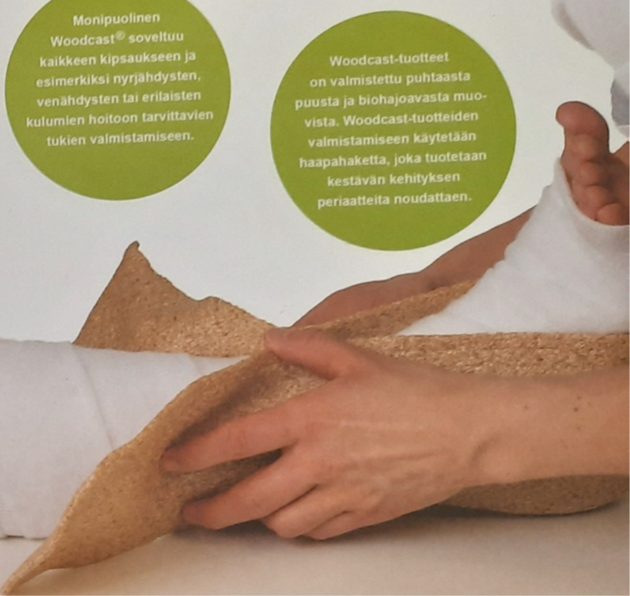
Design products for circularity
Design products for long life cycles and sustainable material use
• Understand the environmental impact throughout product life cycle
• Design products that are durable, easy to repair and upgrade,
and use materials sustainably
Follow circular design principles in product design
• Perform life cycle assessment (LCA) to understand
and avoid environmental impact in design
• Use environmental databases and tools to model
environmental impact of products
• Develop product passports to give guidance
on usage throughout product life cycle
Photo: Woodcast made from wood and biobased plastics, for plastering.
Non-toxic, disposed as biowaste or energy
Annemari Sinikorpi JAMK
Sitra. Circular Economy Playbook for Manufacturing industry. Playbook for Finnish SMEs, 36.
https://teknologiateollisuus.fi/sites/default/files/inline-files/20180919_Circular%20Economy
%20Playbook%20for%20Manufacturing_v1%200.pdf; Ethica

Slide 18
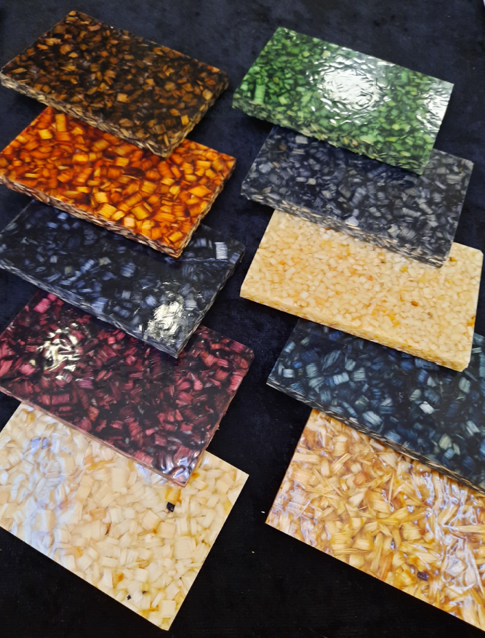
Circular design criteria
- Develop and apply circular design criteria such as :
• Design for a longer life through upgrading,
reuse, refurbishment and remanufacture
• Design based on sustainable and minimal resource
use and enabling high-quality recycling of materials
• Enabling cleaner material cycles though substitution
of hazardous substances
Photo: Wood composite
material is waterproof.
E.g. a sink can be produced
from this material.
Annemari Sinikorpi JAMK
Sitra. Circular Economy Playbook for Manufacturing industry. Playbook for Finnish SMEs, 41
https://teknologiateollisuus.fi/sites/default/files/inline-files/20180919_Circular%20Economy
%20Playbook%20for%20Manufacturing_v1%200.pdf

Slide 19
Seven aspects for circular design by Sitra
Design out waste
Use less resources for producing a product
1
Design for upgrading and
modularity
Allow exhange of components of updates or upgrades (e.g. standardise connections)
2
Design for reuse, repair,
refurbishment, remanufacturing
Allow for dissassembly through using e.g. reversible connections
3
Design based on the sustainable
resources
Use renewable or recyclable materials
4
Design for minimal resource use
along lifecycle
Make sure the product is efficient in use stage (e.g. no resource intensive supplies )
5
6
Design enabling high quality
recycling of materials
Limit the number of different materials, use recyclable ones and make them separable
Design for cleaner material cycles
Substitute hazardous substances in products
7
Sitra. Circular Economy Playbook for Manufacturing industry. Playbook for Finnish SMEs, 42
https://teknologiateollisuus.fi/sites/default/files/inline-files/20180919_Circular%20Economy
%20Playbook%20for%20Manufacturing_v1%200.pdf

Slide 20
Design in the circular economy by Ethica
1. A long lifetime. The product is designed to be durable and long lasting.
2. Easy maintenance and repairability. The product is designed so that the customer,
the manufacturer or the partner of the manufacturer can easily repair the product.
3. Consistency. The parts of the product are kept consistent for a long time, so that they can
be changed and fixed easily. Also various product lines are designed to be consistent.
4. Upgrading. Components of the product are easy to be upgraded to a newer version.
5. Modularity. The product is designed so, that it is easy to repair and upgrade it.
The components are easy to be detached and changed.
Instead of minimising negative environmental impacts,
positive environmental impacts are the core of design !
Source: Ethica Kiertotalousopas (Ethica CE Guidebook in Finnish), page 8

Slide 21
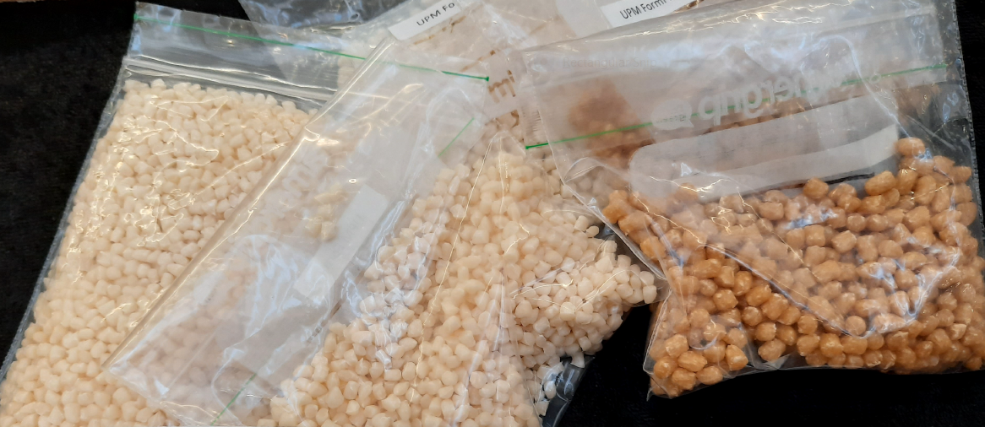
Circular Design Play Cards for design strategies
In learning material of circularclassroom.com you find Circular Design Play Cards
which help you to explore different design strategies :
Dematerialization
Dissassembly
Product, Service System
Longevity
Life Cycle Thinking
Recyclability
Repair
Remanufacture
Modularity
Photo: 3D printable biocomposite material by UPM
(cellulose fibre and biobased polymer)
Annemari Sinikorpi JAMK
https://circularclassroom.com/wp-content/uploads/2018/09/Module_3_Design_and_Creativity_EN.pdf, page 19

Slide 22
Video about Circular design
Circular Design Webinar by Ethica & Finnish Design Forum Finland 4.6.2020
Duration: 1 hour
Topics : Butterfly diagram, Circular design and design tools
Circular product examples : Lidl, Mud jeans, Houdini, Tierra, Philips, Finnish Design Shop
https://www.youtube.com/watch?v=G3RWj-zF8-g

Slide 23
Product example
Stora Enso represents one of the manufacturers of
biocomposite materials for various products and packages
Company has various renewable material
innovations using wooden fibre and other renewable
materials to replace non-renewable fossil-based
materials like plastics
Wooden fibre as material is durable and easy to process
Pine and spruce are from sustainable forestry in
Scandinavia
- Other material component is biobased polymere
The combination of wood and polymere allows
the carbon footprint reduction up to 80 %
compared to plastics
Photo: Various biocomposite products by Stora Enso. Soile Kallinen

Slide 24
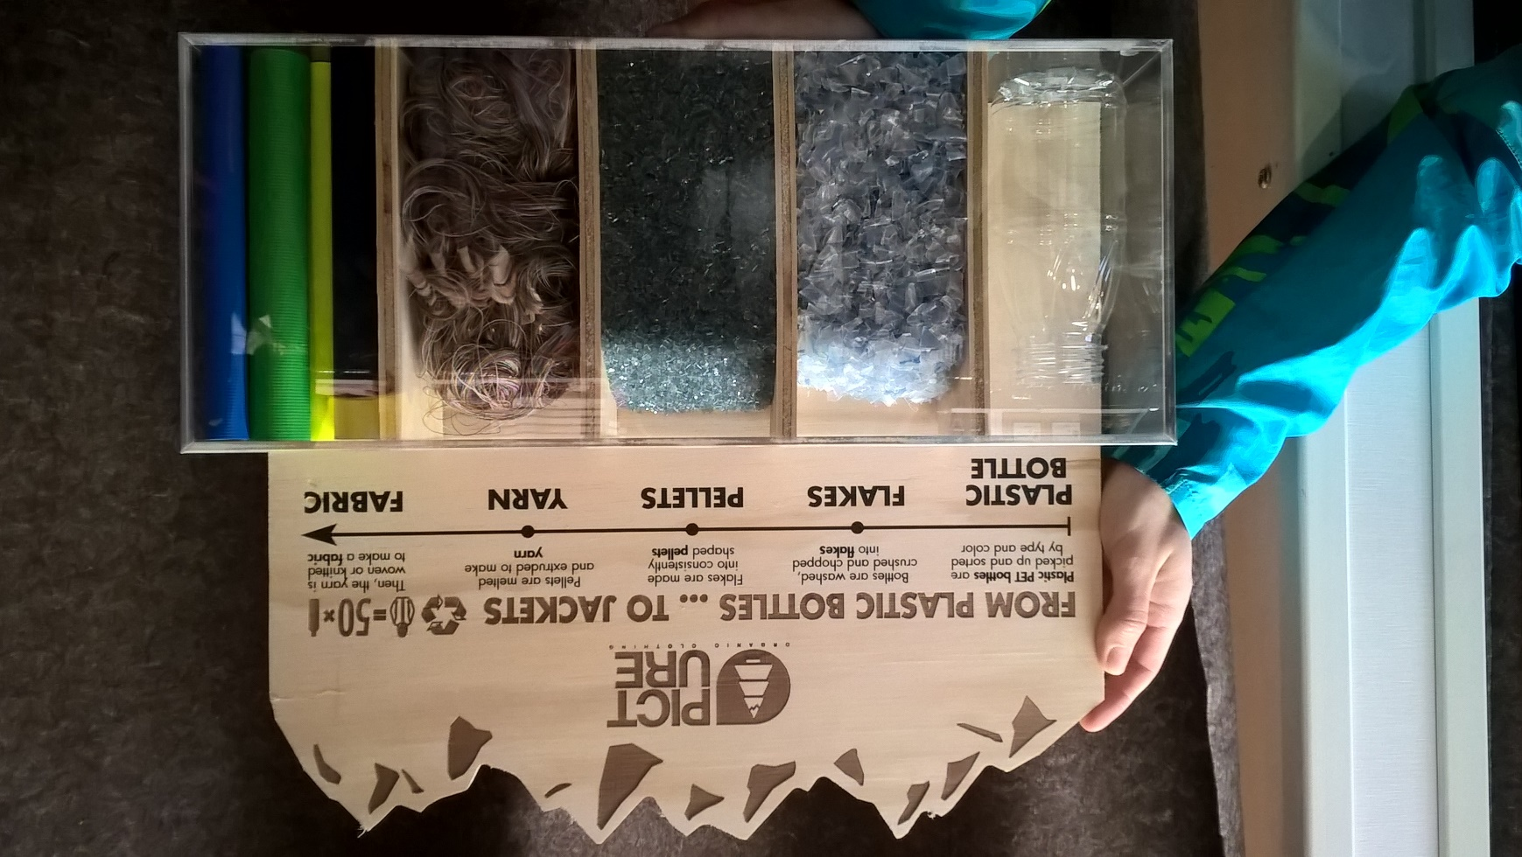
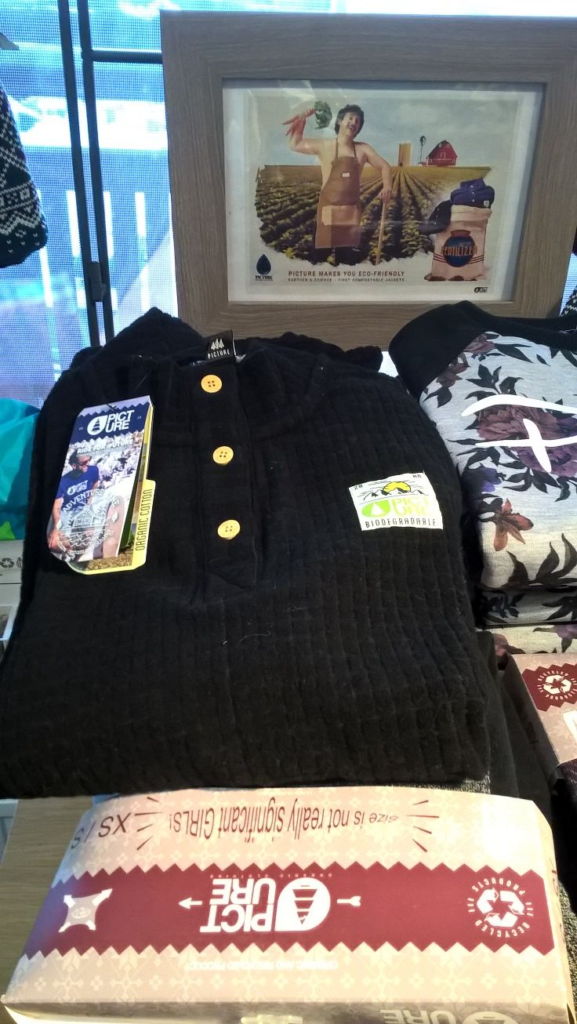
Product example
Photo: The shirt can be made from plastic bottles.
Soile Kallinen
Photo: Biodegradable shirt.
Soile Kallinen

Slide 25
Cradle-to-cradle approach

Slide 26
Cradle to cradle approach
- In 2002 William McDonough and Michael Braungart presented an integration of design and science that provides enduring benefits for society from safe materials, water and energy in circular economies and eliminates the concept of waste.
- Design framework characterized by three principles derived from nature:
Everything is a resource for something else. In nature, the “waste” of
one system becomes food for another.
2. Everything can be designed to be disassembled and safely returned
to the soil as biological nutrients,
or re-utilized as high quality materials for new products as
technical nutrients without contamination.
http://www.mcdonough.com/cradle-to-cradle/

Slide 27
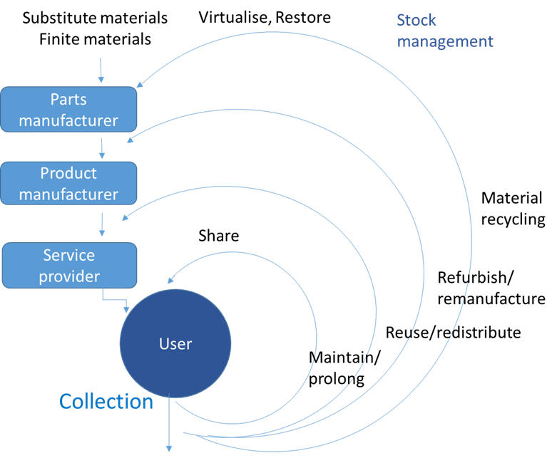
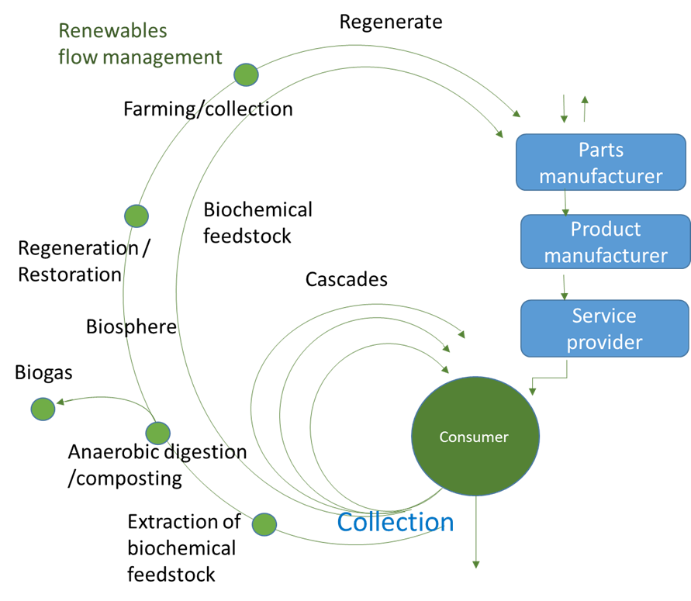
Cradle to Cradle approach
Virtualise, Restore
Regenerative approach to sustainable development based on
central principles:
- Value materials as nutrients for safe, continuous cycling
- Maintain continuous flows of biological and technical nutrients
- Power all operations with 100% renewable energy
- Regard water as a precious resource
- Celebrate diversity in social and natural systems
Product is nutrition for next round in a closed loop
- waste equals food
Two cycles
Biological metabolism (regeneration) – renewable materials
Technical metabolism (restoration) – non-renewable materials
Technical metabolism (restoration)
Sources: McDonoughin ja Braungartin Cradle to cradle (2002) and The Upcycle (2013)
http://www.mcdonough.com/cradle_to_cradle.htm
https://www.linkedin.com/pulse/what-cradle-teaches-us-sustainable-development-hanne-tine-ring-hansen
Biological metabolism (regeneration)

Slide 28
Circular Economy and Butterfly diagram
Adapted from https://www.ellenmacarthurfoundation.org/circular-economy/infographic and
Bianchini, A., Rossi, J. & Pellegrini, M. 2019 https://www.mdpi.com/2071-1050/11/23/6614/htm

Slide 29
Circular
Economy
and
Biological
Cycles
Renewables
flow management
Regenerate
Renewables
Substitute materials
Farming/collection
Parts manufacturer
Biochemical
feedstock
Product
manufacturer
Regeneration /
Restoration
Cascades
Biosphere
Service provider
Biogas
Consumer
Cycles for
renewable materials
Anaerobic digestion
/composting
Extraction of
biochemical
feedstock
Collection
Minimise systematic leakage
and negative externatilies
Adapted from https://www.ellenmacarthurfoundation.org/circular-economy/infographic and
Bianchini, A., Rossi, J. & Pellegrini, M. 2019 https://www.mdpi.com/2071-1050/11/23/6614/htm

Slide 30
Virtualise, Restore
Circular
Economy
and
Technical
Cycles
Substitute materials
Finite materials
Stock
management
Recycling is the most
energy intensive
and the last resource
of technical cycle
of circular economy
Parts manufacturer
Product
manufacturer
Material
recycling
Share
Service provider
Refurbish/
remanufacture
User
Cycles for
non-renewable materials
Reuse/redistribute
Maintain/
prolong
Collection
Minimise systematic leakage
and negative externatilies
Adapted from https://www.ellenmacarthurfoundation.org/circular-economy/infographic

Slide 31
Cradle to Cradle certified product standard
Cradle to Cradle Certified Product Standard is rooted in the Cradle to Cradle® design principles established by William McDonough and Dr. Michael Braungart
Standard requirements are developed through a stakeholder engagement process with input from technical experts, market leaders and the public. Version 4 of the Cradle to Cradle Certified Product Standard is currently in development and is anticipated to be completed at the end of 2020 or early 2021
Cradle to Cradle Certified™ Product Standard is a globally recognized measure of safer, more sustainable products made for the circular economy, a transformative pathway for designing and making products with a positive impact on people and planet
Examples of Cradle to Cradle Certified products: fragrances to flooring, t-shirts, jeans, water bottles and window treatments
To receive certification, products are assessed for environmental and social performance across five critical sustainability categories: material health, material reuse, renewable energy and carbon management, water stewardship, and social fairness.
A product is assigned an achievement level (Basic, Bronze, Silver, Gold, Platinum) for each category. A product’s lowest category achievement also represents its overall certification level.
The standard encourages continuous improvement over time by awarding certification on the basis of ascending levels of achievement and requiring certification renewal every two years
https://www.c2ccertified.org/get-certified/product-certification

Slide 32
Cradle to Cradle Certified™ Assessment Categories
Each Cradle to Cradle Certified - certification level represents achievement across five critical performance categories:
The material Health category helps to ensure products are made using chemicals that are as safe as possible for humans and the environment by leading designers and product developers through a process of inventorying, assessing and optimizing material chemistries. As a step towards full certification, manufacturers may also earn a separate Material Health Certificate for products that meet Cradle to Cradle Certified™ material health requirements.
Material Reutilization category aims to eliminate waste by helping to ensure products remain in perpetual cycles of use and reuse from one product use cycle to the next.
Renewable Energy & Carbon Management category helps to ensure products are manufactured using renewable energy so that the impact of climate changing greenhouse gases due to the manufacturing of the product is reduced or eliminated.
Water Stewardship category helps ensure water is recognized as a valuable resource, watersheds are protected, and clean water is available to people and all other organisms.
Social Fairness category aims to design business operations that honor all people and natural systems affected by the manufacture of a product.
https://www.c2ccertified.org/get-certified/product-certification

Slide 33
Cradle to Cradle certification process and examples of c2c certificates
Certification process
https://www.c2ccertified.org/get-certified/product-certification-process
Case of certification. Setting a standards for water-smart denim Z Star RAW jeans
https://s3.amazonaws.com/c2c-website/resources/C2C_Gstar_RAW_Case_Study_2020.pdf
Certification at Tarkett
Material assessment : material health, product circularity, renewable energy and climate requirements, water stewardship, social fairness
https://media.tarkett-image.com/docs/BR_INT_CRADLE_TO_CRADLE.pdf

Slide 34
Legal issues related to materials and waste

Slide 35
EU Waste Framework Directive
Directive 2008/98/EC sets the basic concepts and definitions related to waste managament, such as definitions of waste, recycling, recovery. It explains when waste ceases to be waste and becomes a secondary raw material (so called end-of-waste criteria), and how to distinguish between waste and by-products.
The Directive lays down some basic waste management principles: it requires that waste be managed without endangering human health and harming the environment, and in particular without risk to water, air, soil, plants or animals, without causing a nuisance through noise or odours, and without adversely affecting the countryside or places of special interest.

Slide 36
EU Waste Framework Directive
Waste legislation and policy of the EU Member States shall apply as a priority order the following waste management hierarchy.
Product
(non-waste)
Waste
Prevention
Preparing for re-use
Recycling
Recovery
Disposal
During the product design process keep in mind the
waste hierarchy and avoid disposal !

Slide 37
EU SUP directive for reducing plastics
SUP directive (Single-Use-Plastics)
Directive (EU) 2019/904 of the European Parliament and of
the Council of 5 June 2019
on the reduction of the impact of certain plastic products on the environment
https://eur-lex.europa.eu/eli/dir/2019/904/oj#d1e810-1-1
Brochure A European strategy for plastics in a circular economy.
https://ec.europa.eu/environment/circular-economy/pdf/plastics-strategy-brochure.pdf

Slide 38
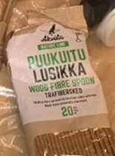
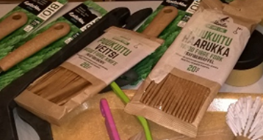
Product alternatives for single-use-plastics
The SUP Directive imposes EU wide market restriction measures (bans) on the single-use plastics products for which suitable alternatives are readily available, such as:
•cotton bud sticks
•cutlery (forks, knives, spoons, and chopsticks)
•beverage stirrers
•straws
•plates (including paper plates with plastic lining)
Photos: wood fibre
spoons, knifes and forks
by Stora Enso.
Soile Kallinen

Slide 39
Design out hazardous materials
In a circular economy materials need to be recycled – not hazardous substances
https://www.syke.fi/en-US/Research__Development/Consumption_and_production/In_a_circular_economy_materials_need_to_(43333)
Managing materials and chemical cycles
Limiting hazardous substances through product design
In eco-design, the emphasis should be on the re-usability, reparability and recyclability of a product, as well as the choice of non-toxic materials. A well-designed products may be recyclable in modular parts, with the content of each part duly considered.
Additives used in materials, such as colorants in plastics, hinder their reuse.
https://helda.helsinki.fi/bitstream/handle/10138/187404/SYKE _PolicyBrief_kiertotalous_EN.pdf?sequence=1&isAllowed=y

Slide 40
REACH
REACH (EC 1907/2006) aims to improve the protection of human health and the environment through the better and earlier identification of the intrinsic properties of chemical substances.
This is done by the four processes of REACH, namely the registration, evaluation, authorisation and restriction of chemicals.
REACH also aims to enhance innovation and competitiveness of the EU chemicals industry.

Slide 41
ROHS
Directive 2011/65/EU of the European Parliament and of the Council of 8 June 2011
on the restriction of the use of certain hazardous substances in electrical and electronic equipment
Article 1
This Directive lays down rules on the restriction of the use of hazardous substances in electrical and electronic equipment (EEE) with a view to contributing to the protection of human health and the environment, including the environmentally sound recovery and disposal of waste EEE.

Slide 42
Customer centric design

Slide 43
Design solutions to deliver customer outcome
Customer-centric design: Centre development process around customer needs and the functional requirements, rather than the physical device. This way innovative solutions and product-as-a-service models are promoted
Smart and connected solutions: Consider how to develop smart products using new technologies such as sensors and big data that enable to deliver better outcomes for the customer through e.g. enhanced functionality
Improved customer-centricity through more frequent interaction and more customised solution
Sitra. Circular Economy Playbook for Manufacturing industry. Playbook for Finnish SMEs, 36-37
https://teknologiateollisuus.fi/sites/default/files/inline-files/20180919_Circular%20Economy
%20Playbook%20for%20Manufacturing_v1%200.pdf

Slide 44
Customer centric design
Design Thinking is a methodology for customer-centric design.
It is an iterative process using a broad set of design methods
The aim is to frame opportunities and innovate in close collaboration with customers and other relevant stakeholders.
Through the customer interaction, Design Thinking is especially relevant when designing customer experiences and user interfaces for new solutions
Sitra. Circular Economy Playbook for Manufacturing industry. Playbook for Finnish SMEs, 37
https://teknologiateollisuus.fi/sites/default/files/inline-files/20180919_Circular%20Economy%20Playbook%20for%20Manufacturing_v1%200.pdf

Slide 45
Designing customer centric solutions
Ability to put customer needs and requirements at the center of product design
• Understanding of user journeys and needs
• Ability to integrate digital applications into product design
• Development of complete product lifecycle solutions and services
Engage customers and partners in solution co-creation
• Perform iterative design and rapid prototyping to test, fail, learn and rebound quickly
• Manage an open ecosystem of customers and partners, and engage in open innovation
Use big data and develop smart product
Sitra. Circular Economy Playbook for Manufacturing industry. Playbook for Finnish SMEs, 36
https://teknologiateollisuus.fi/sites/default/files/inline-files/20180919_Circular%20Economy%20Playbook%20for%20Manufacturing_v1%200.pdf

Slide 46
Circular design process

Slide 47
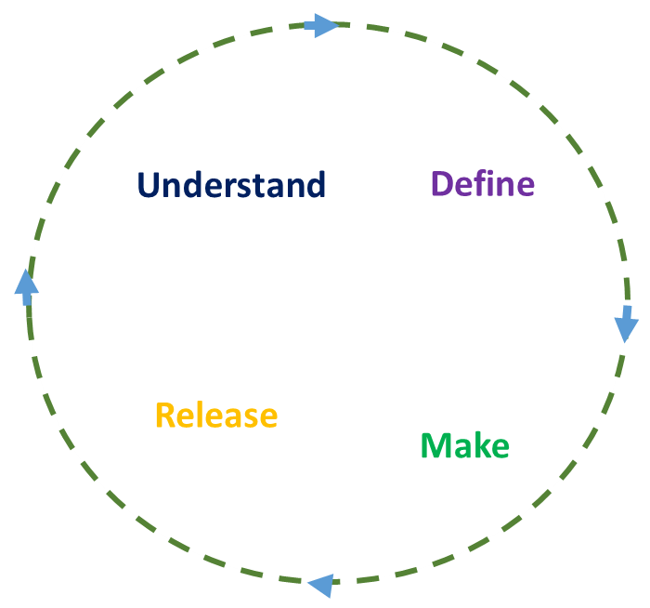
Circular design process
The circular design process comprises four stages
and it is informed by approaches such as
design thinking and human-centered design.
Designing is an iterative process that never finishes.
- You should constantly be testing and refining as you understand
how your users interact with your design, and how it fits within
the wider system.
Circular design process from https://www.ellenmacarthurfoundation.org/explore/circular-design

Slide 48
Circular design process, four stages
Understand
Get to know the user and the system
Define
Put into words the design challenge
and your intention as the designer
Make
Ideate, design, and prototype as many iterations
and versions as you can
Release
Launch your design into the wild and build
your narrative
Create loyalty in customers and deepen investment
from stakeholders by telling a compelling story
Circular design process adapted from https://www.ellenmacarthurfoundation.org/explore/circular-design

Slide 49
Assignment for circular product design

Slide 50
Assignment: Design the circular product
Learning objectives
The goal of this assignment is to understand the life cycle of a product and how it can be adapted to the circular economy. This requires to think about the product from the beginning to the end of life, considering functionality and material choices. Students also learn the circular design process.
Task: Design a product based on principles of circular economy
Select one case product from the source below and design according to features of circular economy: Circular classroom, Module 3 Design and Creativity, Workbook 3, 11. https://circularclassroom.com/educators/
Follow the steps of Circular design process: Understand-Define-Make-Release
https://www.ellenmacarthurfoundation.org/explore/circular-design
3. Understand stage study the problem, user needs and environmental impacts: describe first
what are major negative environmental impacts of that product in general.
4. Define and Make stage: Apply design play cards about different design strategies and elements
fit to the green product You can use many cards (many circular economy features).
Design play cards for circular design, Circular classroom Module 3 Design and Creativity, Workbook 3, 19.
https://circularclassroom.com/educators/
5. Release stage: Present your new circular product design.

Slide 51
Sources
A European strategy for plastics in a circular economy.
https://ec.europa.eu/environment/circular-economy/pdf/plastics-strategy-brochure.pdf
dr. C.A. Bakker (TU Delft) and ir. C.S.C.Schuit (TU Delft). UN environment. 2017.
The Long View. Exploring Product Lifetime Extensions https://www.oneplanetnetwork.org/sites/default/files/the_long_view_2017.pdf
Bianchini, A., Rossi, J. & Pellegrini, M. 2019. Overcoming the Main Barriers of Circular Economy Implementation through a New Visualization Tool for Circular Business Models. Department of Industrial Engineering, University of Bologna. URL: https://www.mdpi.com/2071-1050/11/23/6614/htm
Bozarth & Handfield 2019:Introduction to Operations and Supply Chain Management. 5th edition. Pearson Education Limited.
www.circular classroom.com. Module 3 for Design and Creativity. Circular classroom, Workbook 3, pages 11 and 19. https://circularclassroom.com/educators/
Marcel C. den Hollander, Conny A. Bakker, Erik Jan Hultink 2017: Product Design in a Circular Economy. Development of a Typology of Key Concepts and Terms. Journal of Industrial ecology. pp. 517-525
Ellen McArthur
https://www.ellenmacarthurfoundation.org/circular-economy/what-is-the-circular-economy
https://www.circulardesignguide.com/
Circular design process https://www.ellenmacarthurfoundation.org/explore/circular-design

Slide 52
Sources
Ethica
www. ethica.fi; Ethica Kiertotalousopas (Ethica Circular Economy Guidebook in Finnish)
EU plastics strategy
https://ec.europa.eu/environment/circular-economy/pdf/plastics-strategy-brochure.pdf
David B. Grant, Alexander Trautrims & Chee Yew Wong 2017: Sustainable Logistics and Supply Chain Management
Kraaijenhagen Christina, van Oppen Cécile & Bocken Nancy. 2018. Circular Business – Collaborate and Circulate
William McDonough & Michael Braungart 2002: Cradle to Cradle: Remaking the Way We Make Things
Sitra
Circular Economy Business Models for the Manufacturing industry. Circular Economy Playbook for Finnish SMEs.
https://teknologiateollisuus.fi/sites/default/files/inlinefiles/20180919_Circular%20Economy%
20Playbook%20for%20Manufacturing_v1%200.pdf
Unfolding the Single-Use Plastics Directive - Policy briefing. May 2019–Zero Waste Europe
https://zerowasteeurope.eu/downloads/unfolding-the-single-use-plastics-directive/

