Slide 1
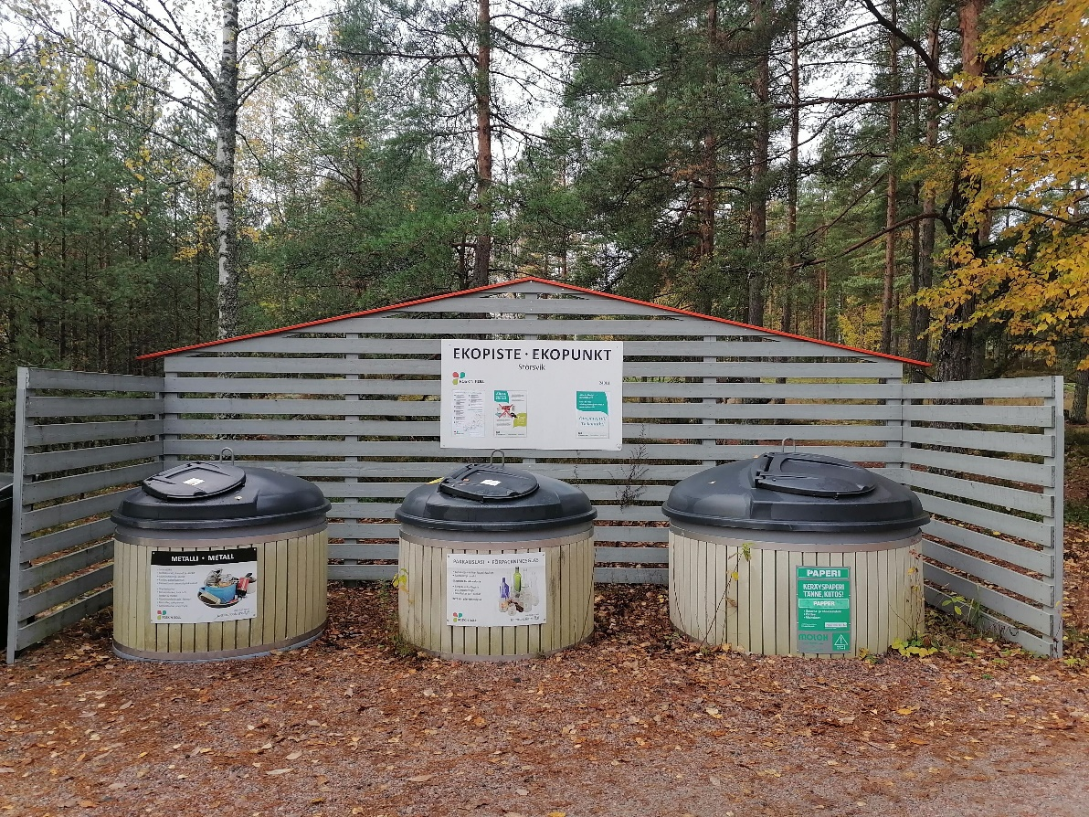
Collecting and recycling 2-3 cr
Soile Kallinen
Haaga-Helia UAS
Photo: municipal collection system
of metal, glass and paper.
Photo illustration by Soile Kallinen

Slide 2
Learning objectives
Student understands terminology related to collecting and recycling
Student is familiar with the role of collecting and recycling in the circular economy
Student has knowledge about typical packaging materials recycled in European Union
Student understands the recycling process and stakeholders in the process
Student knows the current challenges in recycling
- Student is familiar with some recycling companies

Slide 3
Recycling and collecting
Definitions
Circular Economy System and Recycling
Collecting
Recycling process
Recycling statistics of packaging materials
Producer`s extended responsibility to collect
Challenges in recycling
Some recycling companies
Figure. Recycling symbol
https://www.recycling.com/downloads/recycling-symbol/

Slide 4
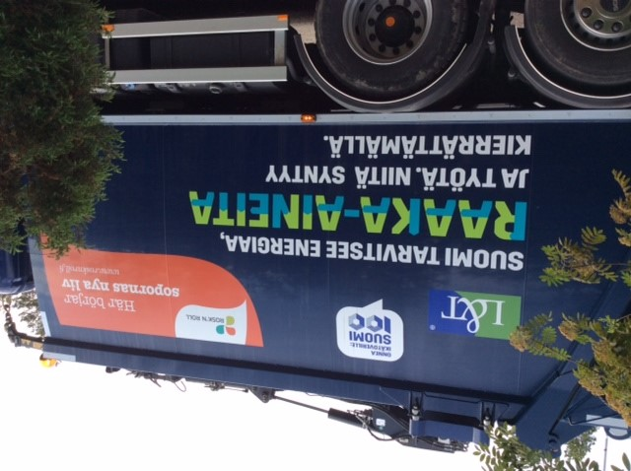
” Finland needs energy, raw materials and work. Those are created by recycling ” L & T recycling company
Recycling is important
Photo illustration by Soile Kallinen

Slide 5
Survey results about take-back and recycling
Take-back
For 87% of companies the share of products taken back from customers in dedicated return schemes at end-of-life is less than 5%. Few companies have dedicated take-back schemes as disposing products at their end of life is often seen as the customer’s responsibility.
Recycling
40% of companies recycle over 80% of products at end-of-life. Nevertheless, 28% say that they recycle less than 5% of products. Product recycling rates are high for most companies. However, some companies do not recycle their product at all.
Source Sitra: Circular economy business models for the manufacturing industry
Circular Economy Playbook for Finnish SMEs, 23
https://teknologiateollisuus.fi/fi/circular-economy-playbook

Slide 6
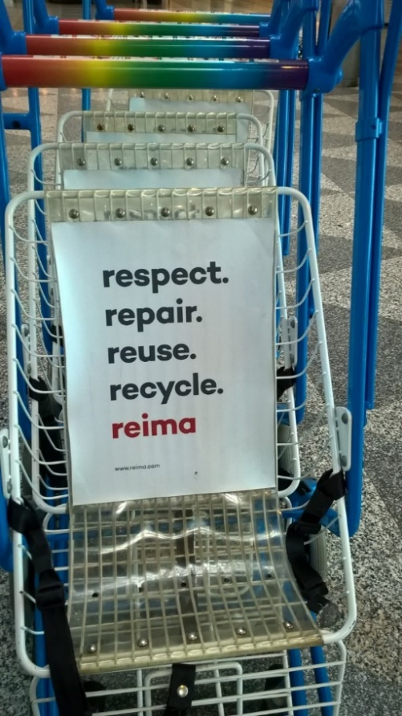
Definition of recycling
Recycling is the process of collecting and
processing materials that would otherwise
be thrown away as trash and turning them
into new products.
Recycling can benefit your community
and the environment.
Source : Recycling basics
https://www.epa.gov/recycle/recycling-basics
Example of Reima´s
Hierarchy of products.
Photo illustration by
Soile Kallinen

Slide 7
Another definition of recycling
Figure: Recycling symbol
https://www.recycling.com/downloads/recycling-symbol/
Recycling means using waste materials as raw material to manufacture new products. For example, corrugated cardboard boxes or carton packaging can be turned into paper roll cores, or beverage cans into new beverage cans.
Source : https://rinkiin.fi/for-firms/packaging-statistics/

Slide 8
Other terms related to recycling
Recycled-content product - The product was manufactured with recycled materials either collected from a recycling program or from waste recovered during the normal manufacturing process. The label will sometimes include how much of the content was from recycled materials.
Post-consumer content - Very similar to recycled content, but the material comes only from recyclables collected from consumers or businesses through a recycling program.
Recyclable product - Products that can be collected, processed and manufactured into new products after they have been used. These products do not necessarily contain recycled materials. Remember not all kinds of recyclables may be collected in your community so be sure to check with your local recycling program before you buy.
Figure:
https://www.recycling.com/downloads/recycling-symbol/
Source: Recycling basics
https://www.epa.gov/recycle/recycling-basics

Slide 9
Recovery and recycling
One definition of Recovery :
Recovery of usable resources or energy
from waste or by-products. Source; Sitra, 24
“The aim is to recover and recycle wastes to levels that make sense i.e. to the point where there is a net environmental benefit and it is economically and technically feasible”
Figure: Recycling symbol
https://unicode-table.com/en/267B/
6th Environment Action Program,
EU Commission, December 2000

Slide 10
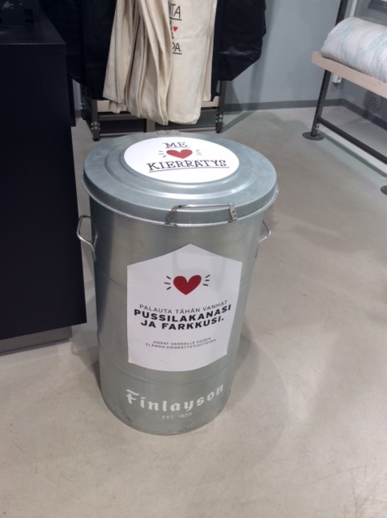
Collection
Collection means the collection of waste at a reception point provided by the property holder, municipality, producer, distributor or other party, for on-site treatment or for the purpose of transportation for treatment, including preliminary sorting and temporary storage of waste.
https://rinkiin.fi/for-firms/packaging-statistics/
Photo: Collection point
of Finlayson shop.
Photo illustration by Soile Kallinen

Slide 11
Example of collection point
Various small electronics and energy sources
can be collected and separated efficiently :
Mobile phones
Small electrical devices
Various energy saving bulbs, LEDbulbs
Batteries and small chargers
Ink cartridges
Photo: Collection point
at Prisma Supermarket.
Photo illutration by Soile Kallinen

Slide 12
Example of collecting and selling clothing brands
Emmy´s business idea is to sell high quality used clothing brands.
The collection container is made of cardboard
Consumers are encouraged with easy collection procedure and economical point of view :
” We sell your clothes”
1. Pack your clothes and add the filled form
2. Emmy takes photos of clothes
3. Up to 60 % of the sales price is returned to customer´s account

Slide 13
Recycling process
Recycling process involves the dismantling and disintegration of a product and its constituent components and the subsequent reprocessing of the product´s materials.
Product inertia and recycling :
Recycling is the least preferred option given that it involves destruction of a product´s integrity
Source: den Hollander, Bakker, Hultink 2017, 519

Slide 14
Design for recycling
Circular product design encompasses both design for product integrity and design for recycling
Circular Product Design
Design for Product Integrity
Design for Recycling
Design for product integrity 2. Design for recycling
aims at preventing and reversing aims at preventing and reversing
obsolescence at a product or a obsolescence at a material level
component level
* Design for :
long use, extended use or recovery
Source: den Hollander, Bakker, Hultink 2017, 521

Slide 15
Recovery processes incorporated in the supply chain
Landfill
Incinerate ?
Recycle
Source
T
T
Materials
Pre-treatment?
Hazardous
waste?
Cannibalize
Manufacture
T
T
T
Parts
No reuse
value
Refurbish
Assemble
Reuse
value
T
Gatekeeper
(RTN´s testing)
Remanufacture
T
T
T
Products
T
?
Start of
process
Market
(eg Retail store/s)
Clean & repair
T
Customize
Recovery
Supply chain
T
= Potential transportation involved
Adapted from the source: McKinnon et al 2015, 340

Slide 16
Circular Economy and Butterfly diagram
Adapted from https://www.ellenmacarthurfoundation.org/circular-economy/infographic and
Bianchini, A., Rossi, J. & Pellegrini, M. 2019 https://www.mdpi.com/2071-1050/11/23/6614/htm

Slide 17
Circular
Economy
and
Biological
Cycles
Renewables
flow management
Regenerate
Renewables
Substitute materials
Farming/collection
Parts manufacturer
Biochemical
feedstock
Product
manufacturer
Regeneration /
Restoration
Cascades
Biosphere
Service provider
Biogas
Consumer
Cycles for
renewable materials
Anaerobic digestion
/composting
Extraction of
biochemical
feedstock
Collection
Minimise systematic leakage
and negative externatilies
Adapted from https://www.ellenmacarthurfoundation.org/circular-economy/infographic and
Bianchini, A., Rossi, J. & Pellegrini, M. 2019 https://www.mdpi.com/2071-1050/11/23/6614/htm

Slide 18
Virtualise, Restore
Circular
Economy
and
Technical
Cycle
Substitute materials
Finite materials
Stock
management
Recycling is the most
energy intensive
and the last resource
of technical cycle
of circular economy
Parts manufacturer
Product
manufacturer
Material
recycling
Share
Service provider
Refurbish/
remanufacture
User
Cycles for
non-renewable materials
Reuse/redistribute
Maintain/
prolong
Collection
Minimise systematic leakage
and negative externatilies
Adapted from https://www.ellenmacarthurfoundation.org/circular-economy/infographic

Slide 19
Recycling process involves collaboration
See video clip http://www.youtube.com/watch?v=6yfh9xY28l4
Nokia We Recycle - The recycling process in action
Transport
Transport
Re-manufacturers
Processors
Sorters
Raw material /
Component supplies
Transport
Retailers
End users
Refuse
collectors
Internal
Warehouse
Or
Wholesaler
Primary
Manu-
Facturer
Transport
Transport
Transport
Source : Adapted from Bloomberg, Lemay, Hannah 2002, 202

Slide 20
Roles of participants in the recycling system
Collector: picks up the material and then gathers the recyclable material. Then the collector delivers it to the recycling recovery center
Sorter: separates materials into homogenous groups. Once sorted, these materials are sent to the appropiate processor
Processor: purchases one type of recyclable item (e.g. paper, glass, aluminium) and transforms it into a secondary material. Then the secondary raw material is sent to a remanufacturer.
Remanufacturers: takes fresh raw materials and combines them with secondary raw materials. Once remanufacturing is completed, the result is a product that contains recycled materials.
Challenge : How to encourage customers to return the used product ?
Source : Bloomberg, Lemay, Hannah 2002, 202

Slide 21
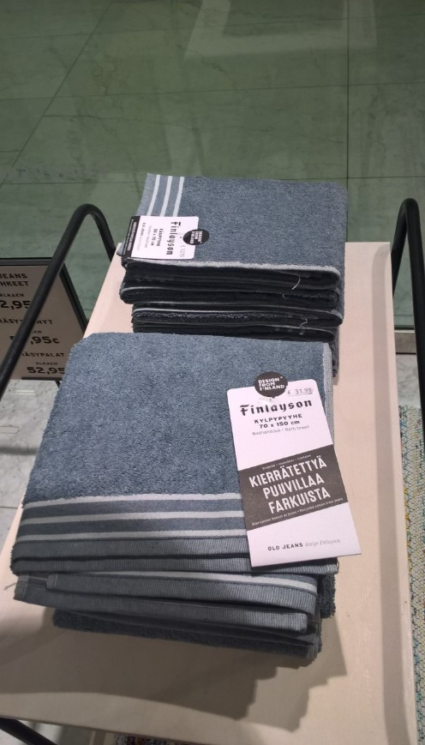
Example of collection and new product (Finlayson)
Collection of old used jeans
at Finlayson´s own shop
can be used as material
for a new towel
A poster in the shop: customers are encouraged to return old jeans
A Collection point is near the cashier
A new towel is made of 40 % recycled jeans and 60 % cotton
Photo illustration: Soile Kallinen

Slide 22
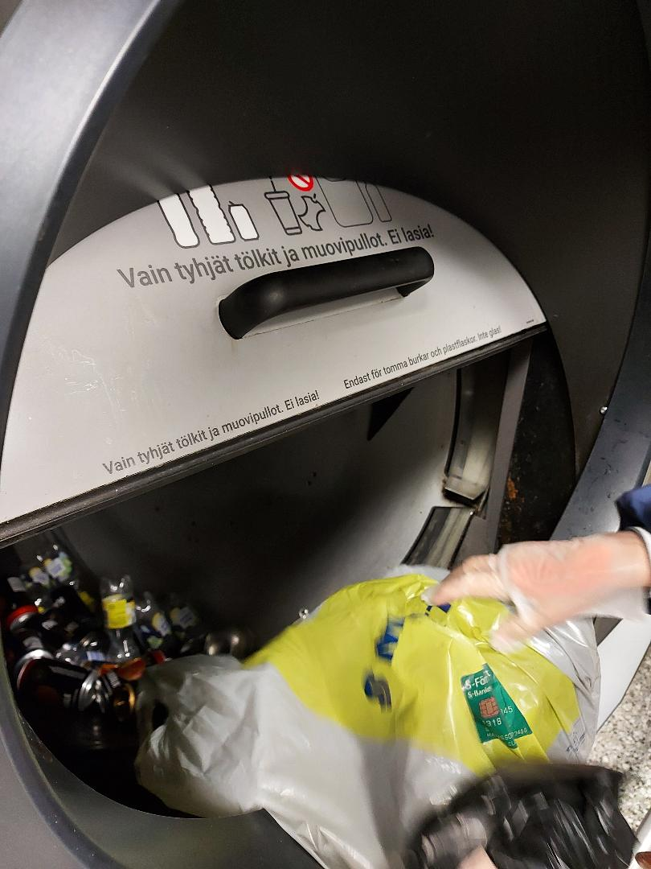
Importance of technology in collecting
Vantaa Tammisto Citymarket supermarket
as a collection point:
- Tomra´s new bottle return system
provides efficiency for the collection
and easiness for the user to return.
You can return 100 bottles or aluminium
cans to the machine at the same time and
thanks to smart identification system your
bottles are tracked
Photos: Tomra vending machine in
K-Citymarket Tammisto
Gloria Mnguni, Haaga-Helia UAS

Slide 23
EU statistics of packaging waste
Development of all packaging waste generated, recovered and recycled, EU, 2007-2016
https://ec.europa.eu/eurostat/statistics-explained/index.php/Packaging_waste_statistics

Slide 24
Packaging statistics in European Union
Packaging waste by
packaging material
EU-27 in total in 2017
Source : https://ec.europa.eu/eurostat/statistics-explained/index.php?title=File:Packaging_waste_generated_by_packaging_material,_EU-27,_2017_(%25).png
Paper and
cardboard

Slide 25
Packaging statistics in EU countries
2. Treatment of packaging waste 2017 (% share of tonnes) in European countries
recycling, incineration at waste incinerators with energy recovery,
energy recovery and other forms of recovery
3. Recovery and recycling rate for packaging waste in 2017
Recovery rate % and recycling rate % in EU-27 countries
4. Recycling rate for all packaging waste in 2017 (%)
Recycling rates in various EU countries and EU target 55 %
5. Recovery rate for all packaging waste in 2017 (%)
Recovery rates in various countries and EU target 60 %
See more details. Source : https://ec.europa.eu/eurostat/statistics-explained/index.php/Packaging_waste_statistics#Waste_generation_by_packaging_material

Slide 26
Producer responsibility to consumer packaging
Producer responsibility for packaging applies to firms which pack products in Finland or import packed products for the Finnish market and which have a turnover of EUR 1 million or more.
A firm which must meet producer responsibility packaging obligations is responsible for the entire process of collection and recycling of their packaging waste as well as all related costs.
The law also stipulates the national targets for producer responsibility and the requirements for recycling and reusing packaging materials that must be implemented in Finland.

Slide 27
Changes to package reporting and fees 2021
Companies need to report their packaging materials more accurately
From 2021 onwards, consumer and B2B packaging, single-use and reusable packaging as well as the materials used in multi-material packaging will be reported separately, while data for exports will no longer need to be reported.
Single-use packaging and reusable packaging are reported separately
This might mean changes to package design to avoid multi-material packaging
https://verkkolehti.rinkiin.fi/companies-to-report-their-packaging-materials-more-accurately?lang=en#8d9b50ff
Changes to the 2021 recycling fees for packaging
Recycling fees for plastic, fibre and plastic packaging will go up next year, while the fees for metal and glass packaging and Rinki’s customer fees will remain unchanged.
The aim is to reduce the use of plastics as a packaging material in package design
https://verkkolehti.rinkiin.fi/changes-to-the-2021-recycling-fees-for-packaging?lang=en#e5c4d7d3

Slide 28
Challenges in recycling
Not all materials can be recycled
Role of toxic or hazardous materials
Hard to recycle mixed and multimaterials
Hard to recycle materials that are not clean
Limited opportunities to recycle some packaging materials
for food industry (hygiene issue)
Hard to identify materials
Conclusions of presentations of Chembio Fair 12.3.2020

Slide 29
Some recycling companies
Kuusakoski
https://www.kuusakoski.com/en/global/
Remeo
https://remeo.fi/remeo-in-english/
L&T
https://www.lt.fi/en/
Stena recycling
https://www.stenarecycling.com/
Photo: L&T collecting household waste.
Photo illustration by Soile Kallinen
Task: In small groups or individually
Study recycling companies and their field of expertise
Introduce the company
Explain their specialisation area
Analyse their information related to circular economy
Prepare power point presentation
Present your findings

Slide 30
Useful sources
Bloomberg, Lemay, Hannah 2002: Logistics. Prentice Hall
Chembio Fair in Helsinki Fair Center 12.3.2020
Marcel C. den Hollander, Conny A. Bakker, Erik Jan Hultink 2017: Product Design in a Circular Economy.
Development of a Typology of Key Concepts and Terms. Journal of Industrial ecology. pp. 517-525
Alan McKinnon Alan, Michael Browne, Maja Piecyk & Anthony Whiteing 2015: Green logistics. Improving the
environmental sustainability of logistics. 3rd edition. CPI Group (UK) Ltd, Croydon.
Packaging waste statistics. https://ec.europa.eu/eurostat/statistics-explained/index.php/Packaging_waste_statistics
Pullojen palautus kassillinen kerrallaan? Täysin uudenlainen pullonpalautusautomaatti Suomeen, lajittelu hoituu paineilmalla. Talouselämä 13.8.2020.
Recycling basics. United States Environmental Protection Agengy. https://www.epa.gov/recycle/recycling-basics
Rinki collects packaging statistics from more than 4,000 companies. https://rinkiin.fi/for-firms/packaging-statistics/
Sitra: Circular economy business models for the manufacturing industry
Circular Economy Playbook for Finnish SMEs. https://teknologiateollisuus.fi/fi/circular-economy-playbook

