Slide 1


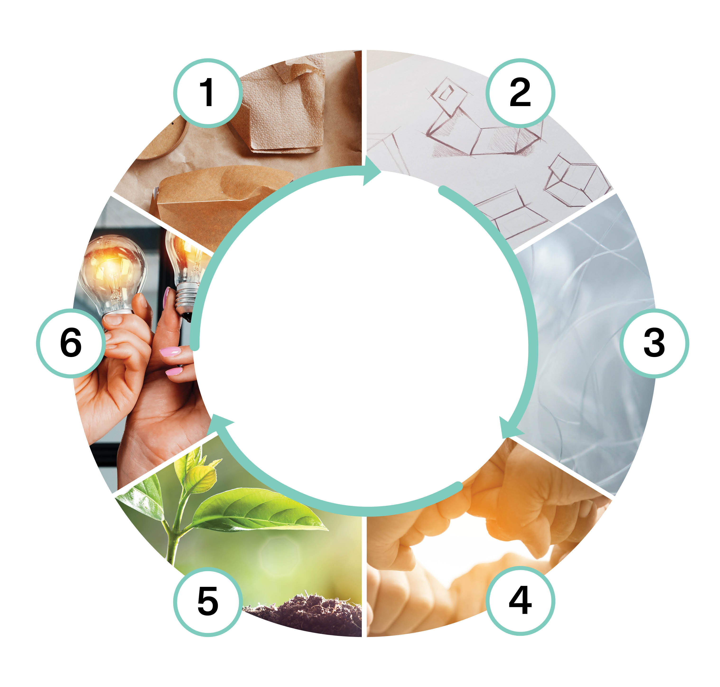

Circular Economy and Business (5 cr)
Implementation of the course as part of the Packaging Value Chain Circular Economy Expert -training (30 cr)
Markus Jähi
This work is licenced under Creative Commons ByAttribution-Non-commercial-Share-alike 4.0 licence https://creativecommons.org/licenses/by/4.0/

Slide 2
Content
Circular economy business models in the operating environment of the packaging value chain. Opportunities and challenges of circular economy in business. Digital tools as part of sustainable solutions.
Key questions:
What are the circular economy business models?
How different circular economy business models can be utilized in the packaging value chain?
What opportunities do digital tools offer to circular packaging business?

Slide 3
Learning outcomes
Student
can name and understands circular economy business models in the operating environment of the packaging value chain
can recognize the opportunities and challenges of circular economy business models
knows the possibilities of digital tools in business as part of more sustainable solutions

Slide 4
Assessment criteria (1/2)
Assessment criteria, satisfactory (1-2)
  can identify and define circular economy business models
  can recognize the opportunities and challenges of circular economy business models from their own perspective
  names the possibilities of digital tools in business as part of more sustainable solutions
Assessment criteria, good (3-4)
  analyses and understands circular economy business models in the operating environment of the packaging value chain, makes plans
  compares the opportunities and challenges of circular economy business models from both their own and the local community's perspective
  knows the possibilities of digital tools in business as part of more sustainable solutions

Slide 5
Assessment criteria (2/2)
Assessment criteria, excellent (5)
  comprehensively understands circular economy business models in the operating environment of the packaging value chain, and acts responsibly and committedly, considering the requirements and needs of the community and their own field
  analyzes the opportunities and challenges of circular economy business models in their professional field, justifies their choices and tries different methods
  evaluates and applies the possibilities of various digital tools in business as a part of more sustainable solutions

Slide 6
Pedagogical approach
Max. 30 students
The course implementation includes one face-to-face meeting of 7–8 hours and two remote meetings of 2–3 hours.
Knowledge is built communally and independently: communal learning / working in networks and individual learning independent of time and place.
The course contains group and individual assignments. In addition to independent tasks, students have the opportunity for communal learning and peer feedback through face-to-face and remote meetings. The course is designed to be completed in 5–6 weeks.

Slide 7
Learning assignment descriptions
Circular economy business opportunities
Circular economy business models in the packaging value chain
Capabilities required by the circular economy
Implementing the circular economy transition in practice
Summarizing task: business model analysis

Slide 8
1. Circular economy business opportunities
(1/2)
Introductory assignment: What different aspects does a successful circular economy business require?
  Everyone in the group should tell each other about a successful example of a circular economy business. Others note things that made the example a successful business on the collaboration platform. Finally, the group arranges the notes into suitable themes.
Literature assignment:
  Read chapters 1-2 (pp. 14-44) from the course reading Sustainable growth with circular economy business models – A playbook for businesses" https://www.sitra.fi/en/publications/sustainable-growth-with-circular-economy-business-models/
Individual assignment: answer the following questions as an online text on the learning platform based on the reading:
  1a) Key lessons: briefly describe what were the three most important lessons in the reading assignment for you, and justify why exactly these?

Slide 9
1. Circular economy business opportunities
(2/2)
  1b) Value chain inefficiencies: consider how the value chain inefficiencies described on p. 39 appear in your work: choose the two most important inefficiencies and describe how they manifest themselves in your work/workplace?
  Total length of answers 300-600 words.
Group assignment: discuss in a group the inefficiencies addressed in the reading (p. 39 from) from the point of view of the packaging value chain:
  Write down the examples of inefficiencies you identify on the collaboration platform. Try to find at least 2-3 examples of each inefficiency.
  Identify the 2 categories that you think have the biggest impact on the packaging value chain.

Slide 10
2. Circular economy business models in the packaging value chain (1/3)
Introductory assignment: which circular economy business models can be identified in the packaging value chain?
  In the group, think about what kinds of examples of different circular economy business models can be identified in relation to the packaging value chain and why?
  Enter examples of current models and those you can expect to appear in the future on the collaboration platform.
  You can also name companies if you recognize them. Try to find at least one example for each business model.
Literature assignment :
  Read chapter 3 (pp. 45-85) from the course reading ”Sustainable growth with circular economy business models – A playbook for businesses https://www.sitra.fi/en/publications/sustainable-growth-with-circular-economy-business-models/

Slide 11
2. Circular economy business models in the packaging value chain (2/3)
Individual assignment: answer the following questions as an online text on the learning platform based on the reading:
  2a) Key lessons: briefly describe what were the three most important lessons in the reading assignment for you, justify why exactly these?
  2b) General challenges of business models: think about how the general challenges of business models described on p. 79-80 can be seen in your work/workplace, are any of these a special bottleneck that prevents the transition to a new type of business?
  Total length of answers 300-600 words.

Slide 12
2. Circular economy business models in the packaging value chain (3/3)
Group assignment: discuss in your group the possibilities of remanufacturing for the packaging business based on the visiting lecture by VTT.
  Enter three new business opportunities related to packaging that you have come up with on the collaboration platform: customer need, what kind of packaging, who (what kind of company) would manufacture it, what would be the novelty, and would it require product and/or material development?

Slide 13
3. Capabilities required by the circular economy (1/3)
Introductory assignment: What capabilities are prerequisites for circular economy business in the packaging value chain?
  As a group, think about which are the most important circular economy capabilities in the packaging value chain? Where are the most important development needs? And how could the capabilities be concretely developed?
Literature assignment:
  Read chapter 4 (pp. 86-110) from the course reading ”Sustainable growth with circular economy business models – A playbook for businesses” https://www.sitra.fi/en/publications/sustainable-growth-with-circular-economy-business-models/

Slide 14
3. Capabilities required by the circular economy (2/3)
Individual assignment: answer the following questions as an online text on the learning platform based on the reading:
  3a) Key lessons: briefly describe what were the three most important lessons in the reading assignment for you, and justify why exactly these?
  3b) Circular economy metrics: think about which circular economy metrics described in the table on p. 94 could be suitable for your own workplace/job? Why exactly measuring these things would support the transition to a circular economy?
  Total length of answers 300-600 words.

Slide 15
3. Capabilities required by the circular economy (3/3)
Group assignment: based on lectures and course readings, discuss in the group about technologies related to the circular economy and the opportunities they bring to the packaging value chain.
  Choose the three future technologies that you think are the most important for the packaging value chain and justify why you think these are the most important, and what role you think they will play.
  Compile your answers on the collaboration platform.

Slide 16
4. Implementing the circular economy transition in practice (1/2)
Literature assignment:
  Read chapter 5 + summary (pp. 111-132) from the course reading ”Sustainable growth with circular economy business model – A playbook for businesses"
Individual assignment: answer the following questions as an online text on the learning platform based on the reading:
  4a) Approaches to circular economy change implementation: consider which of the approaches to circular economy change presented in the reading (test and validate vs. vision and roadmap) would be a better approach for the organization you work in? Explain why the model you chose would be better and why the other one would not?

Slide 17
4. Implementing the circular economy transition in practice (2/2)
  4b) Finally: carefully familiarize yourself with the summary of the reading on p. 130 and, if necessary, review content from previous chapters. After this, briefly reflect on the entire course and justify which three things, in the light of what you have learned, would be ones that you could implement in your own work.
  Total length of answers 300-600 words.

Slide 18
5. Summarizing task: business model analysis (1/2)
Analyze the business model of a circular economy company by using the Business Model Canvas tool.
  You can familiarize yourself with the tool, for example, through:
    https://www.varma.fi/ajankohtaista/uutiset-ja-artikkelit/artikkelit/2021-q3/testaa-ja-kehita-liikeideaasi-business-model-canvas--tyokalun-avulla/
    https://www.youtube.com/watch?v=QoAOzMTLP5s&t=2s
The analysis is conducted as a group work and reported as a slide set.
The evaluation criteria are 1) the comprehensiveness and relevance of the analysis, 2) the versatility and application of the source material, and 3) the clarity and readability of the report.

Slide 19
5. Summarizing task: business model analysis (2/2)
Steps of the business model analysis:
    Find information about your target company and briefly describe the current state of the company's circular economy business and challenges and opportunities of the company's circular economy business.
      Which circular economy business model or models does the company follow?
    After that, draw up an analysis of the company's circular economy business using the business model canvas.
      Fill in the "compartments" of the canvas in the following order: vision, value proposition, customer “side”, implementation “side”, earning logic.
    Highlight the three most important things about the business model of your target company and justify why exactly these are the most relevant?
    Then consider how the company should develop and expand its circular economy business in the future.
      What kind of opportunities for this do you recognize based on your analysis and course readings?
    Finally, self-assess your own success in the assignment in terms of the final result and teamwork.

Slide 20
The training was funded by EU’s The Recovery and Resilience Facility (RRF), that is the centrepiece of NextGenerationEU. The funding was awarded by SECLE (The Service Centre for Continuous Learning and Employment). It promotes the development of competences of working-age population and the availability of skilled labour. It is steered by the Ministry of Education and Culture, as well as the Ministry of Economic Affairs and Employment.

