Slide 1
Circular economy and packaging
Noora Markkanen, TAMK

Slide 2
Learning outcomes
Student is familiar with the role of packaging in waste management and has knowledge about sustainable packaging solutions.
Student understands the connection of packaging and circular economy and is familiar with the current challenges. ​

Slide 3
Implementation
3 x 3h lectures
After each lectures independent work with two home assignments and a weekly test
Material: articles, videos etc.
Language: English
Partly in a classroom, partly online

Slide 4
Introduction to circular economy and packaging
Circular economy
Packaging
Packaging waste and recyclability
Opportunities of circular economy for packaging

Slide 5
Get familiar with terminology
PRE-ASSIGNMENT – VIRTUAL LEARNING ENVIRONMENT
Read the Global Commitment report by the Ellen MacArthur Foundation from page 9 onwards.
Explain the following terms.
For missing terms please utilise other sources.
Link to the report:
https://www.ellenmacarthurfoundation.org/assets/downloads/13319-Global-Commitment-Definitions.pdf
Reuse
Composting
Material recycling
Reusable packaging
Recyclable packaging
Compostable packaging
Post-consumer recycled content
Renewable material
Renewable content
Upcycling
Downcycling
End-of-life (EoL)
Notes:
Timing: 60min
Grading: pass / fail
Can be built into a virtual learning environment with open ended questions.
This works as a pre-assignment that needs to be done before the first lecture.

Slide 6
Circular economy
Circular economy is a new economic model that aims at replacing the current linear take-make-dispose model
As the population and consumption are growing the world doesn’t have resources for the linear consumption model
Circular economy is based on thinking where resources are used efficiently, flows well-designed and materials given a new life – in other words materials are circulating
The three principles of circular economy
Design out waste and pollution
Keep products and materials in use
Regenerate natural systems

Slide 7
Youtube: Re-thinking Progress: The Circular Economy
Watch the video:
https://youtu.be/zCRKvDyyHmI
Notes:
https://www.youtube.com/watch?v=zCRKvDyyHmI

Slide 8
Five business models of circular economy by Sitra, 2016
Extending the life-cycle
Product as a service
Sharing platforms
Renewability
Resource efficiency and recycling
Notes:
Extending the life-cycle: prolonging use phase, repairing and renovation
Product as a service: leasing and renting services, service provider takes care of the costs and risks and the consumer pays about the service
Sharing platforms: digital platforms for pursuing efficient use of products and resources
Renewability: eco-design, renewable raw materials and moving away from fossil materials
Resource efficiency and recycling: technological innovations enable resource efficiency, side streams work as new raw materials

Slide 9
Case: RePack
Problem: Online shopping packaging is rarely reused and while the online trading is increasing also the amount of packaging waste is increasing.
Solution: Reusable postal packaging as a service. Packaging can be used up to 20 times.
Revenue logic: Based on leasing contracts, where online stores are RePack’s customers. Stores pay RePack each time when a consumer chooses RePack delivery. Consumer pays an additional fee up to 4€ for the special packaging.
Benefits to customers: Branding opportunity and raising customer commitment.
Benefits to consumer: Consumer receives a voucher for each returned packaging product which can be used in any RePack’s collaboration online store.
Notes:
Finnish, small size company, established in 2011

Slide 10
Pair discussion
What kind of company examples you know?
Extending the life-cycle
Product as a service
Sharing platforms
Renewability
Resource efficiency and recycling
Notes:
10min in pairs. If you wish, go through in bigger discussion.

Slide 11
Packaging
Packaging is extremely important in our every-day life but a consumer rarely knows its actual function
Packaging has many functions
Protection
Preservation
Containment
Source of product information
Selling the product

Slide 12
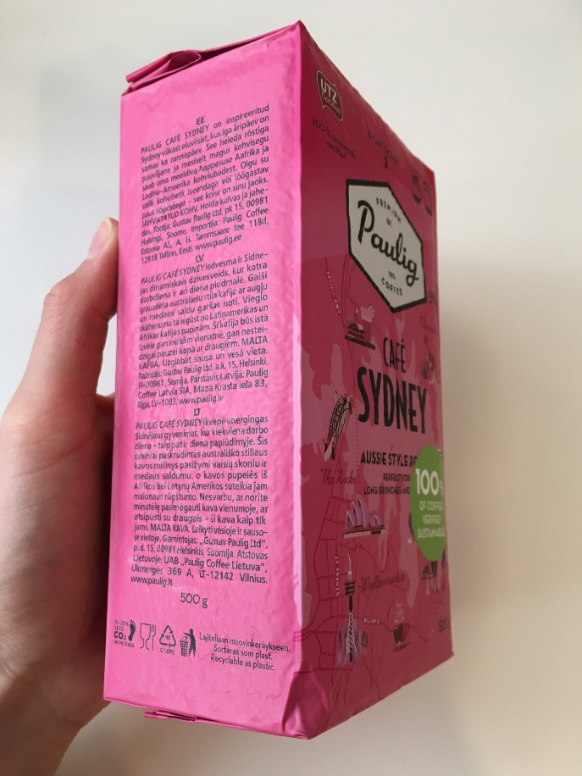
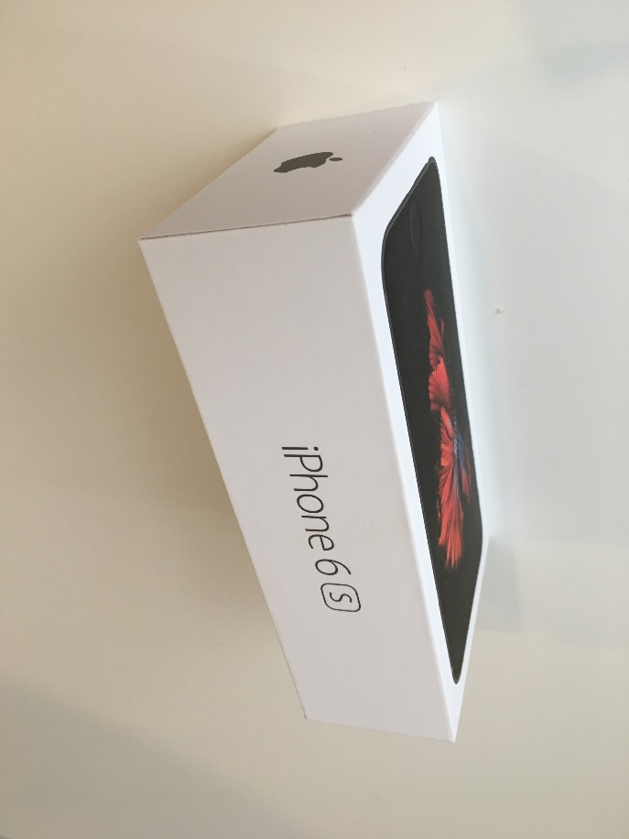
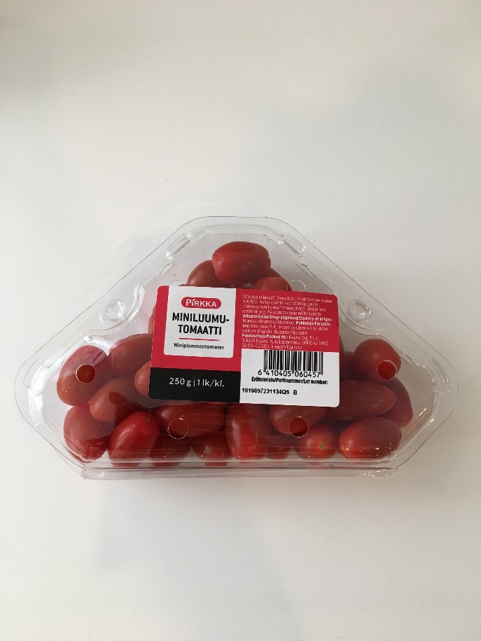
Packaging
@Noora Markkanen
@Noora Markkanen
@Noora Markkanen
Notes:
Basic commodity deliveries from factories to consumers rely on packaging
Packaging protects electronic equipment during the delivery chain from potential damage
Packaging prevents spoilage, extends self-life and minimizes food wastage
Increasing mail deliveries linked with Internet shopping requires robustness to survive from the delivery system and handling steps

Slide 13
Legislative, technical and marketing requirements (1/2)
Legislation increases the amount of information needed in packaging
Regulation (EU) No 1169/2011 — food information to consumers
Link to the material:
https://eur-lex.europa.eu/legal-content/EN/AUTO/?uri=celex:32011R1169
Notes:
Mechanical: tensile strength, deformability, elastic modulus

Slide 14
Legislative, technical and marketing requirements (2/2)
Food contact requirements
Technical requirements
Mechanical properties
Colour
Physical properties
Barrier properties
Packaging plays a vital role when choosing a product – directly linked to sales and revenue
Notes:
Mechanical: tensile strength, deformability, elastic modulus

Slide 15
Global picture of packaging
Packaging consumption is growing
The world packaging market is estimated to reach US $1000 billion market value by 2023
In 2016, each person theoretically consumed packaging for $115 – in reality the consumption is unequally distributed in the world
Highest growth rate is in Asia and driven by China and India
Notes:
Growing consumption: growing population, product availability, traditional markets moving towards pre-packed products, diversification of the retail landscape
Other: Eastern Europe, Central and South America, the Middle East and Africa

Slide 16
Global picture of packaging
Food is the biggest market using packaging
Consumption and waste creation go hand in hand
Which of the materials are easy to recycle? Which of the materials have working treatment methods beyond Finland?
Notes:
Asia creates most of the packaging waste and cardboard is the most typical packaging waste type

Slide 17
Global picture of packaging waste
Quality of waste treatment varies from country to country
Packaging waste problems have become visible – especially through social media
Even local problems can become global
Countries have their own systems for end-of-life treatment – through globalization also systems may need to be unified
Globalization has changed the context
Best practice sharing: technology, producer’s responsibility, deposit systems etc.
Multinational players: packaging providers, recycling companies, suitability for recycling
Market of packaging waste
Notes:
Local problems become global – packaging leaking into environment, mostly coming from certain areas but affects the whole world

Slide 18
Packaging waste in Europe
Paper and cardboard are the biggest fraction also in Europe
Recycling rate for all packaging waste was around 67% in 2016
Germany reported the highest amounts of packaging waste generated per inhabitant whereas Croatia reported the lowest in 2016
Directive 94/62/EC on packaging and packaging waste was amended in May 2018

Slide 19
European legislation regarding packaging waste
Some countries has introduced landfill bans or high taxes which have direct impact on increasing the recycling rates
Revised waste legislation set a common EU target for recycling 70% of packaging waste by 2030
Specific recycling targets for packaging materials:
Paper and cardboard: 85 %
Ferrous metals: 80 %
Aluminum: 60 %
Glass: 75 %
Plastic: 55 %
Wood: 30 %
EU Circular Economy Package
Notes:
EU Circular Economy Package consists of many documents, including eg. the Circular Economy Action Plan, EU Strategy for Plastics in the Circular Economy etc.

Slide 20
Extended Producer Responsibility EPR
Policy approach that extends producer’s responsibility to stand for the whole life-cycle
EPR shifts the waste management costs or waste collection partially or entirely from local governments to producers
EPR has been introduced for packaging by most of the EU Member States
In Finland, producers or producer groups are obliged to organize regional collection points for waste of this type
metals
glass
fibre packaging
deposit beverage packaging
There are five official producer groups in Finland, which have the same service company Suomen Pakkauskierrätys RINKI Oy

Slide 21
Packaging waste in Finland
Source separation, local municipalities, public waste collection areas, retailers
EU Directive 94/62/EC on packaging and packaging waste
Finnish legislation
Government Decree on Packaging and Packaging Waste (518/2014)
Government Decree on a return system for beverage containers (526/2013)
Current recycling rates are met in each packaging category
2030 targets are also met except for plastic and wood
Notes:
Waste management is organised by local municipalities
Target for plastic 55% and for wood 30%

Slide 22
Challenges of packaging recyclability
Packaging design
Raw materials and their compatibility
Local recycling solutions and infrastructure
Human activities and source separation
Lack of communication
Manufacturers and end-users
Information for consumers
Manufacturers and recyclers
Manufacturers from different sectors

Slide 23
Economic aspects
Price of recycled materials compared to virgin materials is a key driver for increasing the performance of the recycling chain
Specialised sorting technologies exist but require investments
Needed investments increase costs for recycling and may even affect the whole recycling chain
The value of recycled materials varies
Without proper end-market there is no point of using resources for creating recycled materials
Notes:
Pointless use of resources also creates environmental impacts (energy, water, wastewaters etc.)

Slide 24
Class assignment: Opportunities of circular economy for packaging
The link the circular economy system diagram (the ”butterfly diagram” by Ellen MacArthur foundation):
https://kumu.io/ellenmacarthurfoundation/educational-resources#circular-economy-educational-resources/key-for-general-resources-map/systems-map
Notes:
Form groups of 3-4 people
What are the opportunities of circular economy for packaging? Consider all the different steps in the butterfly diagram. Remember to include into your analysis who need to be involved in the value chain and whether the redesign requires some changes in the relationships (who is customer, user etc.) (20min)
Choose one packaging type for redesigning. Who will use it? Why it is better? What is the circular economy angle? Describe the relationship with different actors (customers, service-providers etc.) (20min)
Go through the redesigning results in class. (30min)
Total duration: 70min

Slide 25
Circular packaging example
HOME ASSIGNMENT – VIRTUAL LEARNING ENVIRONMENT
Find a packaging example that fits the concept of circular economy
Create a Power Point slide with a picture of that packaging and brief information about the circular economy aspect
Add your slide into virtual learning environment
Notes:
Timing: 60min
Grading: 5p

Slide 26
EU Circular Economy Package – new recycling targets (1/3)
HOME ASSIGNMENT – VIRTUAL LEARNING ENVIRONMENT
Get familiar with the EU Circular Economy Package
Read chapter 4 from Deloitte’s study
Links to the materials:
http://ec.europa.eu/environment/circular-economy/index_en.htm
https://www2.deloitte.com/content/dam/Deloitte/my/Documents/risk/my-risk-blueprint-plastics-packaging-waste-2017.pdf
Notes:
Note: Deloitte study is about plastics but works well also for other products
Timing: reading and finding information 60min, answering questions 60min
Grading: 5p

Slide 27
EU Circular Economy Package – new recycling targets (2/3)
HOME ASSIGNMENT – VIRTUAL LEARNING ENVIRONMENT
Choose a specific packaging (plastic stand-up pouch, milk cartoon, chocolate bar wrapping etc.)
Find information regarding your chosen product and fill out the template
What actions need to be taken that recycling rates can be increased within EU?
Submit your file into virtual learning environment.
Notes:
Note: Deloitte study is about plastics but works well also for other products
Timing: reading and finding information 60min, answering questions 60min
Grading: 5p

Slide 28
EU Circular Economy Package – new recycling targets (3/3)
Product:
 | Current situation | Actions need to be taken
Legislation
Typical end-of-life treatment
Waste collection
Product design
Consumer guidance
Notes:
Timing: reading and finding information 60min, answering questions 60min
Grading: 5p

Slide 29
Introduction to circular economy and packaging
WEEKLY TEST – VIRTUAL LEARNING ENVIRONMENT
According to EMF, packaging is recyclable when it is technically recyclable. W
Design outside streams and pollution is one of the basic principles of circular economy. W
Extension of the life-cycle can be done by repairing products. R
Packaging needs to be robust to function in diverse logistic conditions. R
Africa is one of the biggest packaging consumption markets. W
Rigid plastic is the most common packaging waste type. W
EU target for recycling packaging waste is 80% by 2030. W
Finland has already met the 2030 packaging recycling targets. W
Communication is a challenge in packaging recyclability. R
Recycling materials is always the best choice from environmental aspect. W
Notes:
Timing: 20min
Grading: 1p per each question
Can be built into a virtual learning environment with automatically correcting questions.

Slide 30
Towards circularity with packaging design choices
Packaging meaningful in purchasing decision
Sustainable packaging
Circularity through design

Slide 31
Homework discussion
What did you learn regarding EU Circular Economy Package?
What actions need to be taken that recycling rates can be increased within EU?
What is the most important thing for increasing the recycling rates in general?
What is the most important thing for increasing the recycling rates for your chosen product?
Notes:
Utilise pair – group – share technique for going through the home assignment.
Timing: 30-45min

Slide 32
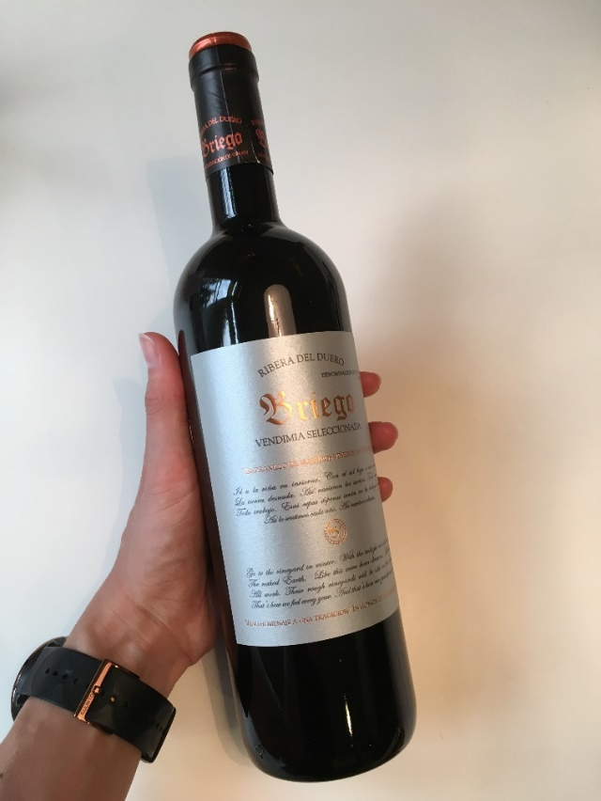
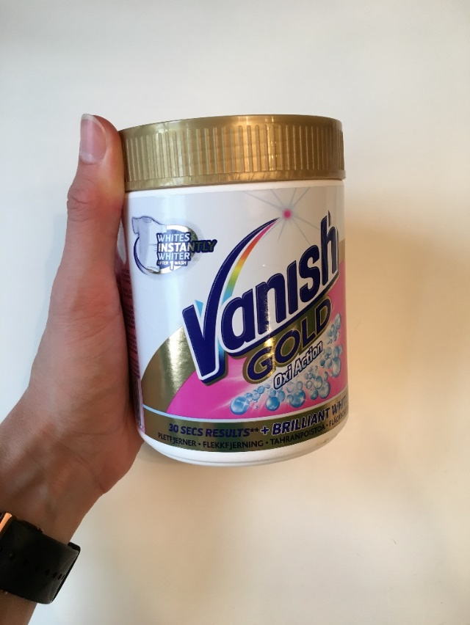
Packaging has a significant role in the purchasing decision
@Noora Markkanen
@Noora Markkanen
Notes:
Without label most of the wine bottles would look the same. If you’re not an expert on wines you make the decision based on the label.
When Vanish was brough into the market it was the only pink product and therefore extremely visible on the washing detergent shelf.
There are also additional labels that stand out from the shelf being used for raising the attention.

Slide 33
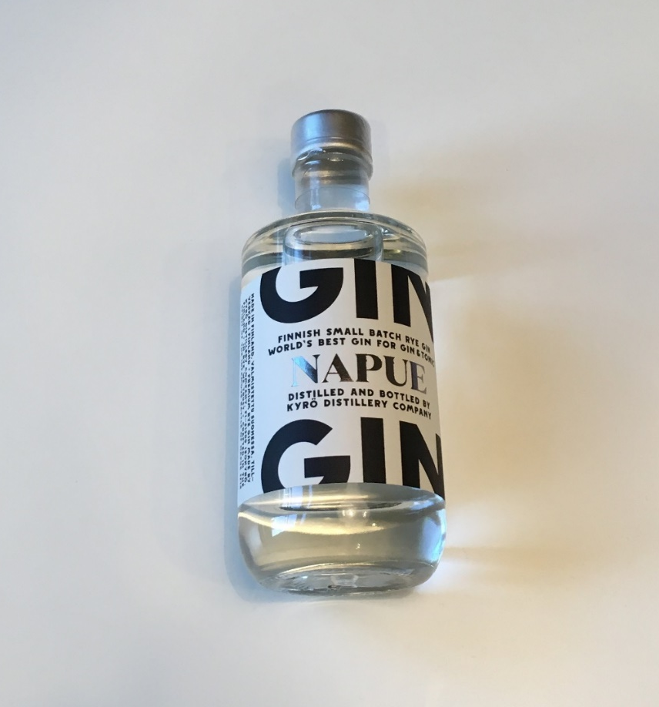
Packaging trends
Authenticity
Personalization
Digital printing
Smart packaging
Sustainability
@Noora Markkanen
Notes:
Recent packaging trends are authenticity (Kyrö’s Napue Gin), personalization (Coca Cola’s bottles with names on those), digital printing (design can vary from product to product), smart packaging (temperature, additional information about production location etc.) and sustainability.

Slide 34
What is a sustainable packaging?
There are many aspects in design that can make a packaging sustainable
Raw materials
Biobased sources
Certified sources
Post-consumer recycled sources
Composition (components and lightweighting)
Visuals
Supporting sustainability at the consumption phase
Designed for end-of-life
Notes:
Visuals: printing decreases the level of recycled materials and using multiple colors creates significant environmental impacts in the printing process
Consumption phase: packaging can guide the consumer to recycle it and the packaging design can simplify the separation for the consumer

Slide 35
Many faces of sustainable packaging
What is the ultimate sustainable packaging option?
No simple answer – it is important to choose the best possible option for a certain purpose
biobased
fossil-based
LCA
E-o-L
GHG
land-use
post-consumer recycled content
plastic leakage
raw materials
Notes:
What indicator to use?
LCA, which doesn’t eg. have an impact category for plastic leakage?
Biobased films might look better from GHG emission point of view but what about the land-use questions?
Is it important to put focus on raw material origin such as utilizing renewable raw materials such as cardboard with the cost of food safety?
Or is it better to use plastics for maintaining barrier properties and simultaneously create more not so well recycled waste fraction?

Slide 36
Packaging materials
Packaging materials are integral part of the brand
New materials
How to get into markets (e.g. technology)
Must create value for end-user and the manufacturing value chain
Examples
Sulapac www.sulapac.com/
Paptic www.paptic.com
Notes:
Case Paptic: https://www.youtube.com/watch?v=7-pOQ9luy9g#action=share
Case Sulapac: https://www.sulapac.com/wp-content/uploads/2018/12/sulapac_film_v011_final.webm
Paptic: material feels reminds textile, is manufactured like paper and has the properties of plastic. Therefore it is great material for shopping bags and it enables reusing the bag for multiple times.
Sulapac: Packaging material that biodegrades, has excellent barrier properties and can be used with existing plastic manufacturing machinery

Slide 37

Are packaging types circular by design?
@Noora Markkanen
Notes:
Glass is crushed and melted so the label is burned from the glass surface. Suitable for glass recycling.

Slide 38

Are packaging types circular by design?
@Noora Markkanen
Notes:
Suitable for plastic recycling. Why?

Slide 39
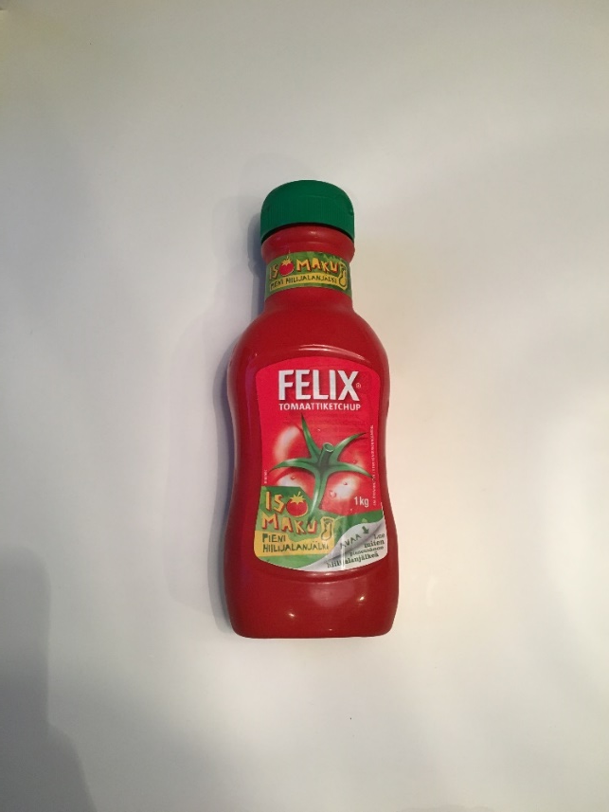
Are packaging types circular by design?
@Noora Markkanen
Notes:
Bottle made from PP, capsule made from PET. Needs to be separated for recycling. Requires consumer activity.

Slide 40
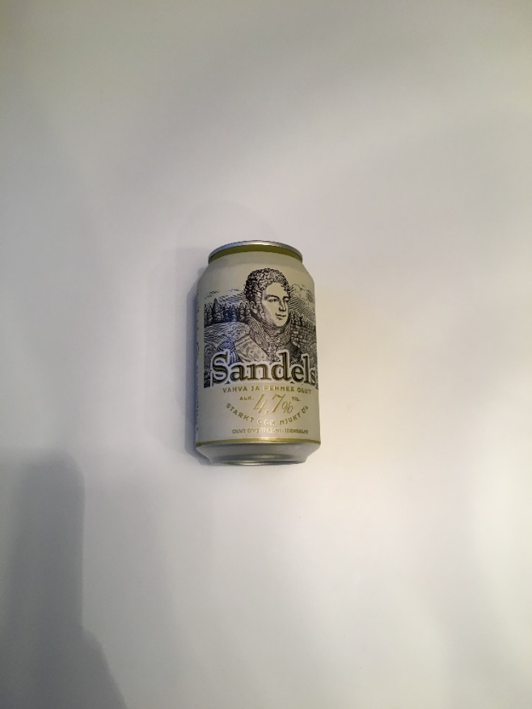
Are packaging types circular by design?
@Noora Markkanen
Notes:
One of the most efficiently recyclable products.

Slide 41
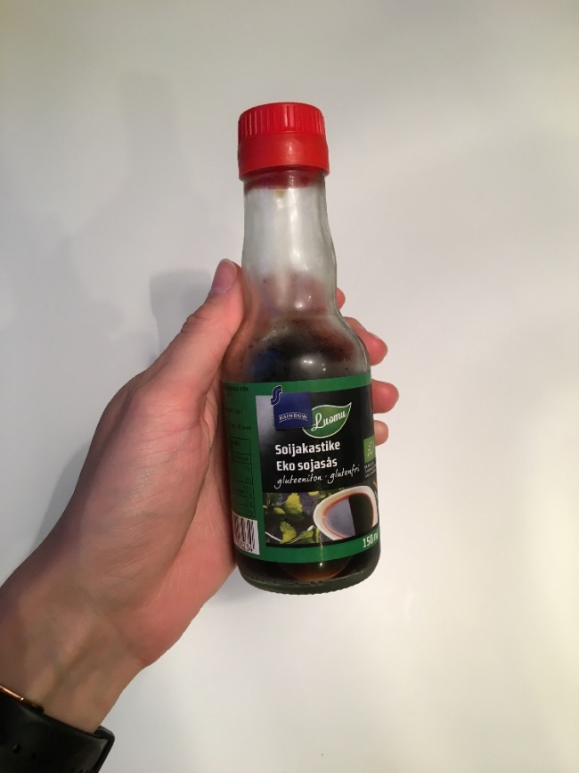
Are packaging types circular by design?
@Noora Markkanen
Notes:
Bottle from glass, capsule from plastic. Needs to be separated by the consumer.

Slide 42
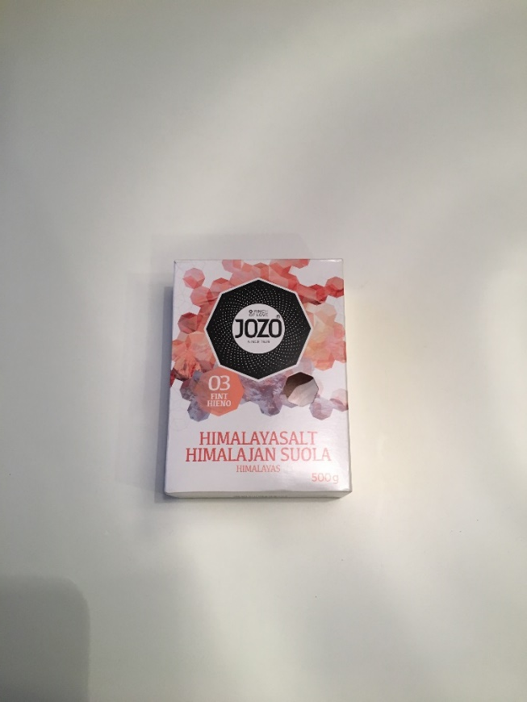
Are packaging types circular by design?
@Noora Markkanen
@Noora Markkanen
Notes:
Cardboard packaging with plastic see-through whole. How to deal with that?

Slide 43
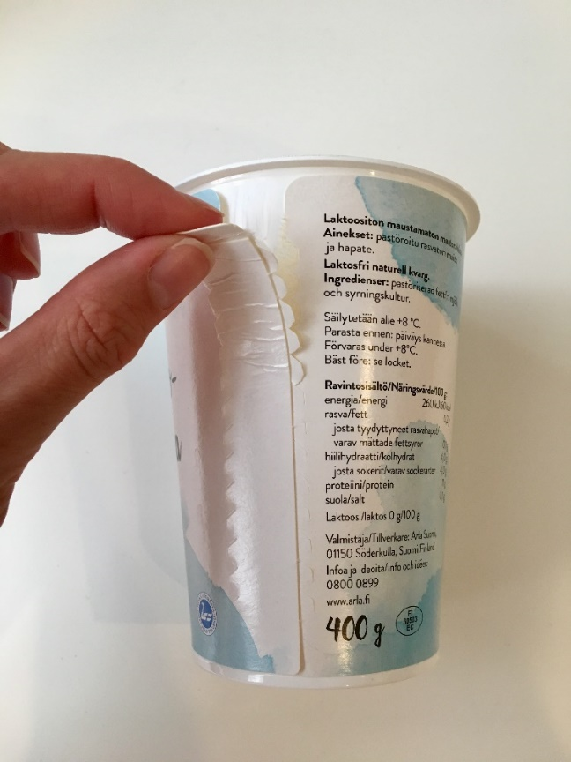
Are packaging types circular by design?
@Noora Markkanen
Notes:
Plastic cup with cardboard label. Requires activity from consumer. If not properly recycled a plastic cup with a plastic label would have been better and suitable for plastic recycling.

Slide 44
Diversity affects packaging recyclability
Complexity of materials
Multi-material packaging
Multilayer packaging
Small format packaging such as lids and tear-offs
Dark or black plastics
Waste collection schemes
Scattered nature of waste flows
Impurities when waste streams mixed – the importance of source separation

Slide 45
Class assignment: cases Paptic and Sulapac
What are the
Strengths
Weaknesses
Opportunities
Threats?
Notes:
Form 8 groups
Provide each group a flipchart or paper and pen
Provide then 15 min to find information about the companies
Groups visit 4 stations where they consider the given task (10min each)
In the end the groups (Paptic and Sulapac) form two discussion forums where they go through the main aspects (15min)
Total duration: 70min

Slide 46
The On-Pack Recycling Label scheme
HOME ASSIGNMENT – VIRTUAL LEARNING ENVIRONMENT
The On-Pack Recycling Label Ltd (OPRL) is a not-for-profit company that runs the On-Pack Recycling Label scheme. Get familiar with the company and its activities https://www.oprl.org.uk/about-oprl/ and answer the following questions.
What are the strengths in the OPRL scheme?
Analyze the consumer guidance of OPRL versus Finnish packaging guidance.
What is the role of guarantors?
Go through the current members. What kind of companies are represented? Analyze company size, market share and field of business.
OPRL works only in UK. Would it be better to have international recycling schemes? Why? Why not?
Notes:
Timing: information search and reading 60min, answering questions 30min
Grading: 1p for each question. If low quality, then 0,5p for each.
Can be built into a virtual learning environment with open end questions.

Slide 47
Reuse and refill
HOME ASSIGNMENT – VIRTUAL LEARNING ENVIRONMENT
Read the article by Chris Sherwin, the Founder of Reboot Innovation.
Link: https://www.designweek.co.uk/issues/14-20-january-2019/chris-sherwin-why-recycling-isnt-enough-to-fix-the-plastics-problem/
Find a packaging example that fits into the reuse and refill category
Create a Power Point slide with a picture of that packaging and brief information about the packaging functionality
Include into your slide also the pros and the cons of that packaging
Add your slide into virtual learning environment
Notes:
Timing: 60min
Grading: 5p

Slide 48
Towards circularity with packaging design choices
WEEKLY TEST – VIRTUAL LEARNING ENVIRONMENT
Pink color was the selling point for Vanish. R
Multicolor printing is one of the recent packaging trends. W
Packaging visuals can affect the packaging sustainability. R
Sustainability of packaging can be measured in a unified way. W
New packaging materials might have challenges when entering the market eg. through technological issues. R
Different plastic materials need to be separated when placed into recycling bin. R
Packaging solutions might need consumer activity to work. R
Multilayer packaging is always suitable for plastic recycling. W
Black plastics are not suitable for mechanical recycling. R
Source separation is important for an efficient recycling system. R
Notes:
Timing: 20min
Grading: 1p per each question
Can be built into a virtual learning environment with automatically correcting questions.

Slide 49
Plastic packaging
Plastic materials
Benefits of plastic
Plastic packaging waste

Slide 50
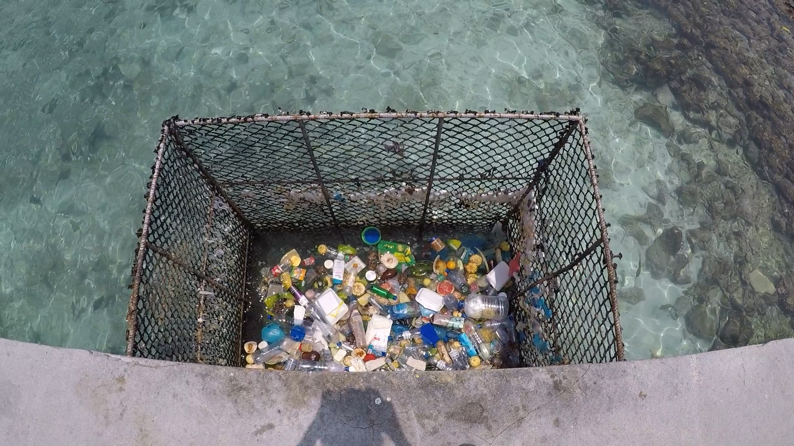
Image of plastics
@Noora Markkanen

Slide 51
Plastic as a material
Polymers consist of monomers
Two main categories:
Thermoplastics – 85% of all plastics
Thermosets – 15% of all plastics
Specific properties are reached by adding certain substances:
Plasticisers
Fillers
Additives
The composition of plastics is highly dependent on the customer’s requirements which increases the complexity and causes challenges in the end-of-life treatment processes
Requirements are e.g. food contact applications, shape, appearance, weight, volume, durability etc.
Notes:
Plastics contain carbon and hydrogen elements and may also contain oxygen, nitrogen, chlorine or fluorine.
Plasticisers are used for modifying the rheological characteristics of the resin
Fillers are used for modifying certain properties and reducing manufacturing costs
Additives are used for dying, stabilization etc.

Slide 52
Global market share of the most used resins and main applications by Deloitte, 2017
Link to the Deloitte study, p. 9
https://www2.deloitte.com/content/dam/Deloitte/my/Documents/risk/my-risk-blueprint-plastics-packaging-waste-2017.pdf
Notes:
Thermoplastics: PP, LDPE, HDPE, PVC, PET, PS
Thermosets: polyurethane

Slide 53
Bioplastics
A family of materials with different properties and applications
Materials that are biobased, biodegradable or feature both properties
Terminology is slightly confusing for general public
Biodegradability and compostability are not the same
There are certain standards used for informing consumers about biodegradability and compostability
Discuss with the person next to you to define few bioplastic packaging products
Notes:
Compostability requires biodegradability within a certain time frame and conditions and cannot leave any harmful residues behind

Slide 54
Bioplastics by European Bioplastics, 2016
Links:
https://www.european-bioplastics.org/bioplastics/
http://docs.european-bioplastics.org/publications/fs/EuBP_FS_What_are_bioplastics.pdf

Slide 55
Plastic demand by sectors in 2014 by Deloitte, 2017
Link to the Deloitte study, p. 10
https://www2.deloitte.com/content/dam/Deloitte/my/Documents/risk/my-risk-blueprint-plastics-packaging-waste-2017.pdf

Slide 56
Why plastic packaging?
Lightweight material
Flexibility
Durability
Hygienic material
Barrier properties
Convenient for the user
Notes:
Lightweight: Eg. Glass: environmental impacts are higher for glass due to energy intensive process and material weight. The glass cullet is transported to UK for recycling.

Slide 57
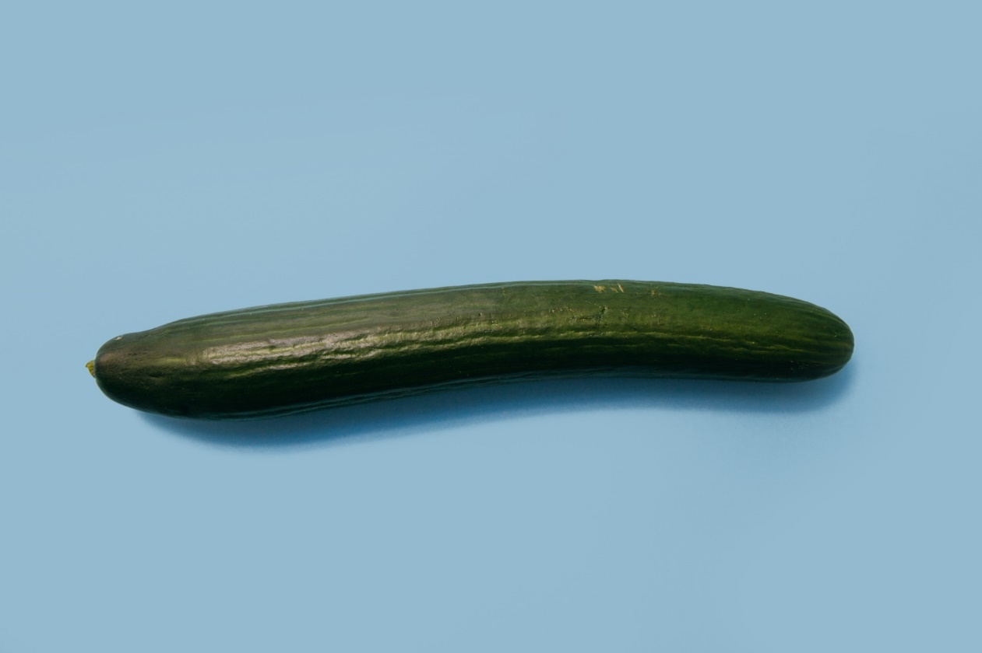
Role of plastic packaging in protecting and preserving food – case cucumber
@Charles Deluvio, Unsplash
Notes:
Plastics are great for food packaging because of their barrier properties. Use of plastic covers can also decrease the need for preservatives. Food waste has significant environmental impacts and food waste prevention is an integral part of the EU Circular Economy Package. Cucumber became one of the examples when talking about avoiding unnecessary packaging.

Slide 58
Plastic packaging globally
Plastic production has increased and is expected to continue increasing
In EU there are 48 million tons of plastics used yearly
40% of plastics used in EU are used for packaging
In 2014, the following EU member states accounted for approximately 65% of the plastic demand in EU and also had the highest plastic packaging waste generation (in brackets)
Germany 24,6% (19%)
Italy 14,3% (14%)
France 9,6% (13%)
Spain 7,7% (9%)
United-Kingdom 7,5% (14%)

Slide 59
2013 global plastic packaging streams by Ellen MacArthur Foundation and McKinsey & Company, 2016
Link to the report, p. 21
https://www.ellenmacarthurfoundation.org/assets/downloads/publications/NPEC-Hybrid_English_22-11-17_Digital.pdf
Notes:
Explain what cascaded recycling means

Slide 60
Plastic packaging waste (1/2)
Only around 14% of plastic packaging is recycled in global scale
Collection rates vary significantly depending the resins and packaging shapes (eg. PET bottles and PET household films)
End-of-life treatment for plastics is rather complicated when compared to more homogenous materials
Plastic packaging waste sorting and recycling vary between countries because of different collection schemes, the level of contamination and thus the quality of recycled materials
Finland: RINKI and Fortum
Local authorities can be in charge
Private actors such as soft drink manufacturers can provide collection for plastics
Note! Collection itself is not enough – there needs to be logistics for utilizing the material for recycling and also a market for recycled material.
Notes:
What are examples of homogenous materials? Glass and metals
Case China: Since 1992, China has imported 106 million metric tons of plastic waste, or 45 percent of all plastic waste. In 2016, China imported two-thirds of the world’s plastic waste. In November 2017 China announced that it won’t be accepting plastic waste anymore. That shocked the market.

Slide 61
Plastic packaging waste (2/2)
Part of the collected materials are exported outside EU, which simultaneously means lost business opportunity for EU recyclers
Case China and closed doors
Notes:
What are examples of homogenous materials? Glass and metals
Case China: Since 1992, China has imported 106 million metric tons of plastic waste, or 45 percent of all plastic waste. In 2016, China imported two-thirds of the world’s plastic waste. In November 2017 China announced that it won’t be accepting plastic waste anymore. That shocked the market.

Slide 62
Cascaded recycling
Cascaded recycling is often considered as the optimal option especially when contamination occurs
E.g. around 80% of recycled PET bottles are turned into polyester fibres for carpet, clothing and other non-packaging applications
Should only be the alternative pathway
However, closed-loop recycling is not feasible for all plastic types because of their inherent properties and characteristics
Notes:
What are examples of homogenous materials? Glass and metals

Slide 63
Challenges of plastic packaging waste
Technicalities of plastic materials define the ability for recovering
Recyclability of plastics is highly connected to quality issues
Plastics are often contaminated during waste collection process. What kind of contaminants?
Contaminated batch is likely to end up in energy recovery or landfill
increases costs
when used for new products it may lead into increasing the negative image of recycled plastics from raw material purchasing point of view
Biodegradable plastics are contaminants in plastic recycling process
High quality requirements from end-users create significant challenges to recyclers – e.g. case food contact
Notes:
Contaminants: Biowaste, paper, metals etc. but also other plastic types. Even low levels of contamination can ruin the batch eg. by changing technical properties such as adhesion etc.
High requirements from end-users: contamination poses a challenge and also different additives that are not allowed in specific applications cannot be removed in mechanical recycling

Slide 64
Recycling solutions for plastic packaging waste
Mechanical recycling
Mainstream
Lower costs
Used for separating plastics
End-product: plastic pellets
Multi-materials, additives and impurities cause challenges
Technical properties of plastics often decrease with the process
Chemical recycling
Rare
Expensive
Used for melting down plastics
End-product: oil
Multi-materials, additives and impurities don’t cause challenges
Technical properties can be re-created through processing oil into plastics

Slide 65
What is the solution? Who is responsible?
Role of design – without fundamental redesign 30% of plastic packaging will never be reused or recycled
All actors in the value chain matter – strengths and needs need to be considered in each stage in the value chain
Redesign of plastic packaging and improving soring and reprocessing systems play vital role in the road towards circular economy
Demand for packaging providers is high – urge for design innovations that have the needed properties but are simultaneously offering superior recycling properties

Slide 66
Role of consumer
Consumers have an important role
Plastic packaging must be properly managed at source
It is important to have comprehensive collection of plastic packaging available also in public spaces
Notes:
Even we had all the solutions existing it is in the end the value choice of the consumer to make sure that the source separation works.
Proper source separation: remember the impacts of contaminants.
One third of bottled beverages are consumed away from home

Slide 67
Class assignment: Actors and their role for pursuing circular economy
All these actors in the plastic value chain have a role for pursuing circular economy:
Packaging supplier
Brand owner
Retailer
Packaging designer (responsible of visuals and choosing packaging technologies)
Consumer
Form groups
Each group have their own paper to work with.
How your actor can pursue circular economy and improve plastic packaging circularity? You have 20min for discussion and writing down your outcome.
Time to circulate and comment other outcomes. You have 10 min for each.
Return into you original paper and look through the comments. Summarize the outcome. You have 5 min.
Present your conclusions for others in few sentences. Total time for presenting conclusions 5-10min.
Total duration: 75min plus preparation = 90min
Notes:
Start by explaining who the actors are, what is the typical way they work with other actors and what are the power relationships OR provide a short explanation on paper.
Form groups
Provide them flip boards or paper
Give 20min for the first discussion
After first session each group will circulate as long as they’ve visited all flip boards. Reserve 4 x 10min for this.
Groups return into their original papers for going through comments and summarizing. Students have 5min.
Close the exercise by going through the summarized conclusions. This takes 5-10min.

Slide 68
Closing the loop on plastic packaging materials: What is quality and how does it affect their circularity?
HOME ASSIGNMENT – VIRTUAL LEARNING ENVIRONMENT
Think about soda bottle, meat packaging, frozen strawberries plastic bag, butter case and shampoo bottle. What kind of technical properties those plastic packaging applications need?
Article states that phasing all multi-layered products out may not always be feasible. Explain why? Remember to consider the raw material efficiency, packaging properties and economic aspects.
It is mentioned that even though revised regulation and new business models are becoming more popular in the road towards circular economy the technicalities are often overlooked or not properly accounted. Give examples of the mentioned technicalities (in the article) and explain why those might work as barriers in change.
Why coloured plastics often have lower market value?
Describe the benefits and challenges of PLA. Remember to consider the whole value chain.
Notes:
Timing: reading article 60min, answering questions 60min
Grading: 1p for each question. If low quality, then 0,5p for each.
Can be built into a virtual learning environment with open end questions.
p.1398: Multilayer packaging description and features.
P. 1395: Technicalities
p. 1398: Coloured plastics
P. 1399: PLA: answer links into origin, recycling, composting, niche and therefore not justified for sorting investment

Slide 69
Ellen MacArthur Foundation: The New Plastics Economy (1/2)
HOME ASSIGNMENT – VIRTUAL LEARNING ENVIRONMENT
Get familiar with the EMF The New Plastics Economy by watching the video (Link: https://vimeo.com/168011130) and searching for more information from the Internet. Find the list of the current members of the New Plastics Economy Global Commitment.
Notes:
Link to the video: https://vimeo.com/168011130
Timing: information search and reading 60min, answering questions 30h
Grading: 1p for each question. If low quality, then 0,5p for each.
Can be built into a virtual learning environment with open end questions.

Slide 70
Ellen MacArthur Foundation: The New Plastics Economy (2/2)
HOME ASSIGNMENT – VIRTUAL LEARNING ENVIRONMENT
Answer the questions
What is the New Plastics Economy?
What the Global Commitment signatory stands for?
What industries are presented on the signatory list? How those are linked with plastic packaging?
What Finnish companies are on the signatory list? How those are linked with plastic packaging?
Analyse the importance of these kind of initiatives for pursuing circular economy.
Notes:
Link to the video: https://vimeo.com/168011130
Timing: information search and reading 60min, answering questions 30h
Grading: 1p for each question. If low quality, then 0,5p for each.
Can be built into a virtual learning environment with open end questions.

Slide 71
Plastic packaging
WEEKLY TEST – VIRTUAL LEARNING ENVIRONMENT
Biobased and biodegradable stand for the same thing. W
PET can be bioplastic. R
Biodegradable plastics are always made from biobased sources. W
Biodegradable plastics are problematic in plastic recycling process. R
Source separation is not important in plastic packaging recycling. W
Lightweight material and barrier properties are benefits of plastic packaging. R
Chemical recycling is used for separating plastics. W
Technical properties of plastics often decrease in mechanical recycling process. R
Closed-loop recycling is the best option for all plastic materials. W
Packaging designers are responsible of increasing the plastic packaging recycling rates. W
Notes:
Timing: 20min
Grading: 1p per each question
Can be built into a virtual learning environment with automatically correcting questions.

Slide 72
References
All4pack. 2018. Market key figures, challenge & perspectives of worldwide packaging. Accessed 19.6.2019. https://www.all4pack.com/Media/All-4-Pack-Medias/Files/FicheMarche_Emballage_Monde
Amblem, A. and Amblem. H. 2012. Packaging technology : fundamentals, materials and processes. Chapter 3. Packaging functions. Woodhead Publishing Limited. Cambridge, UK.
Deloitte. 2017. Deloitte Sustainability – Blueprint for plastics packaging waste: Quality sorting & recycling. Accessed 18.6.2019. https://www2.deloitte.com/content/dam/Deloitte/my/Documents/risk/my-risk-blueprint-plastics-packaging-waste-2017.pdf
Ellen MacArthur Foundation. 2018. The New Plastics Economy. Global Commitment. Accessed 18.6.2019. https://www.ellenmacarthurfoundation.org/assets/downloads/13319-Global-Commitment-Definitions.pdf
Ellen MacArthur Foundation. 2011. Re-thinking progress: The Circular Economy. Accessed 18.6.2019. https://www.youtube.com/watch?v=zCRKvDyyHmI
Ellen MacArthur Foundation. 2017. The New Plastics Economy: Rethinking the future of plastics & catalysing action. Accessed 18.6.2019. https://www.ellenmacarthurfoundation.org/publications/the-new-plastics-economy-rethinking-the-future-of-plastics-catalysing-action#purchase-options
European Bioplastics. 2016. What are bioplastics? Material types, terminology and labels – an introduction. Accessed 5.6.2019. http://docs.european-bioplastics.org/2016/publications/fs/EUBP_fs_what_are_bioplastics.pdf

Slide 73
References
European Commission. 2019. Circular economy. Implementation of the Circular Economy Action Plan. Accessed 19.6.2019. http://ec.europa.eu/environment/circular-economy/index_en.htm
Grumezescu, A. & Holban, A. 2018. Food Packaging and Preservation. Handbook of Food Bioengineering, Volume 9. London: United Kingdom. Accessed 5.6.2019. https://www-sciencedirect-com.libproxy.tuni.fi/book/9780128115169/food-packaging-and-preservation
Hahladakis, J. and Iacovidou, E. 2018. Closing the loop on plastic packaging materials: What is quality and how does it affect their circularity? Science of the Total Environment. 630: 1394-1400. Accessed 20.5.2019. https://www.researchgate.net/profile/John_Hahladakis/publication/323613394_Closing_the_loop_on_plastic_packaging_materials_What_is_quality_and_how_does_it_affect_their_circularity/links/5ac35c8945851584fa77f261/Closing-the-loop-on-plastic-packaging-materials-What-is-quality-and-how-does-it-affect-their-circularity.pdf?origin=publication_detail
Pirkanmaan ELY-keskus. 2019. Pakkaukset ja pakkausjätteet. Accessed 19.6.2019. https://www.ymparisto.fi/download/noname/%7BC68C61B1-E9B0-46F4-BE13-D4359943C586%7D/119813
Plastics Europe. 2018. Plastics – the Facts 2018. Accessed 18.6.2019. https://www.plasticseurope.org/download_file/view/2367/179
Quantis, 2018. Tackling the visible and invisible to close the plastic loop. Accessed 5.6.2019. https://quantis-intl.com/ocean-plastics/

Slide 74
References
Schweitzer, J.-P., Petsinaris, F. and Gionfra, C. (2018) Justifying plastic pollution: how Life Cycle Assessments are misused in food packaging policy. Institute for European Environmental Policy (IEEP), Brussels. A study by Zero Waste Europe and Friends of the Earth Europe for the Rethink Plastic Alliance. https://ieep.eu/uploads/articles/attachments/d028bd51-4f3d-48e2-8573-72bd33697dcf/Shortcomings%20of%20LCA%20in%20food%20packaging%20policy%20-%20Unwrapped%20Packaging%20and%20Food%20Waste%20IEEP%202018.pdf?v=63690511118
Sherwin, Chris, 2019. Chris Sherwin: why recycling isn’t enough to fix the plastics problem. Accessed 5.6.2019. https://www.designweek.co.uk/issues/14-20-january-2019/chris-sherwin-why-recycling-isnt-enough-to-fix-the-plastics-problem/
Sitra. 2017. Reusable postal packaging as a service. Accessed 19.6.2019. https://www.sitra.fi/caset/uudelleenkaytettavat-postipakkaukset-palveluna/
UNEP, 2014. Valuing Plastics: The Business Case for Measuring, Managing and Disclosing Plastic Use in the Consumer Goods Industry.

