Slide 1


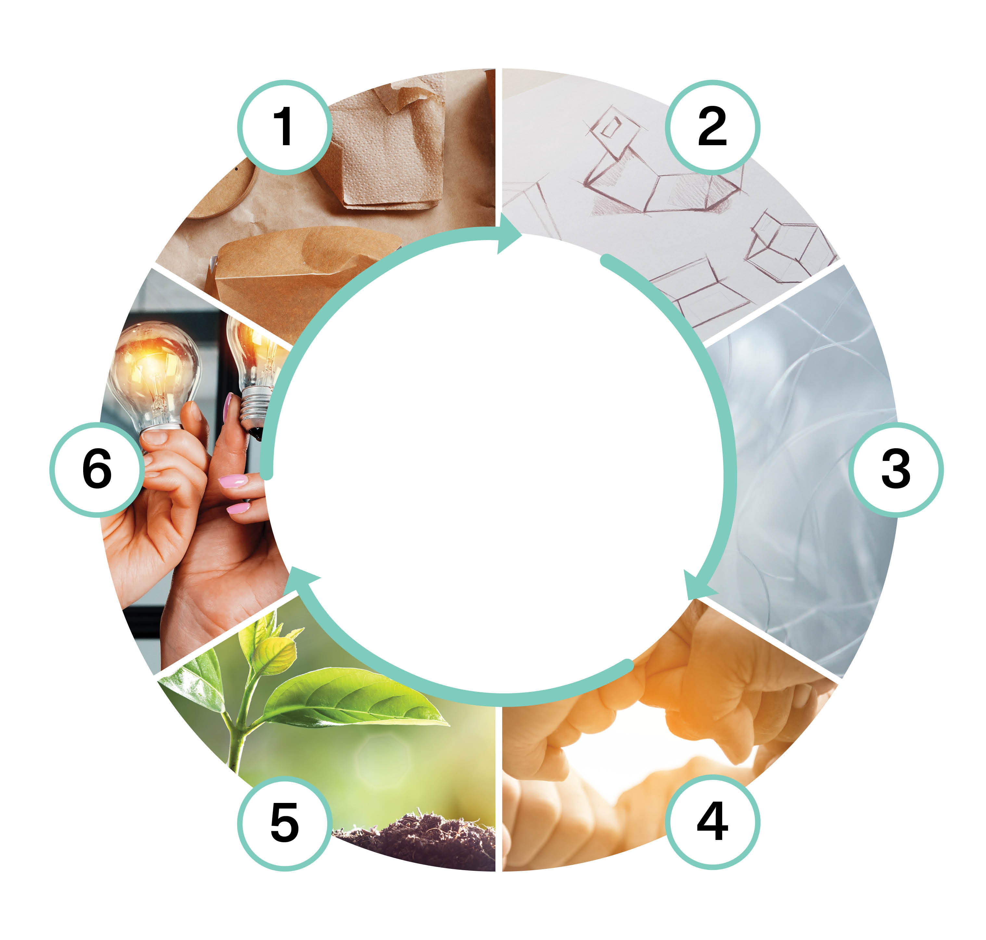

Consumer and citizen committment (5 cr)
Implementation of the course as part of Packaging Value Chain Circular Economy Expert -training (30 cr)
Eveliina Asikainen
Nina Kukkasniemi
This work is licenced under Creative Commons ByAttribution-Non-commercial-Share-alike 4.0 licence https://creativecommons.org/licenses/by/4.0/

Slide 2
Content
Citizens as participants of circular economy
  Relationship between packaging, circular economy, and society
  Designing communication and interest group participation, as well as the effective use of communication and committment methods and the evaluation of their impact
Consumers as participants of circular economy:
  Consumer behavior
  Consumer communication and committment
  Value creation and circular economy
Key questions
  What is the relationship between society and circular economy of packaging?
  How to recognize and use effective citizen committment methods?
  How does the interaction between a consumer and the package direct the consumer behavior?
  How can packaging be used to commit the consumer to circular economy?
  How to create value while taking into account the needs of the various interest groups?

Slide 3
Learning outcomes
The student
  understands the social aspects of circular economy: the basics of circular economy and its benefits to society
  can evaluate the impact of communication and committment campaigns and knows the basis for design
  reflects the imapact possibilities of packaing through their own role as a consumer
  recognises methods used to direct consumer behavior towards circular economy
  understands various value creation logics

Slide 4
Assessment criteria (1/2)
Assessment criteria, satisfactory (1-2)
  names the principles and benefits of circular economy to society
  can describe the impact of communication and committment campaigns
  looks at the impact possibilities of packaging through their own role as a consumer
  knows different methods to include consumers into circular economy
  recognises previously learned value creationg logics in circular economy
Assessment criteria, good (3-4)
  explains the social aspects of circular economy
  can evaluate the impact of communication and committment campaigns
  looks at and evaluates the packaging impact possibilities through various consumer groups
  can choose methods to direct consumer behavior towards circular economy and justify their choices
  understands and applies different value creation logics taking into account the needs of different interest groups

Slide 5
Assessment criteria (2/2)
Assessment criteria, excellent (5)
  widely understands the social impact of circular economy: the principles and benefits of circular economy to society
  analyses and compares the impact of communication and committment campaings and knows how to act responsibly and with committment to community while taking into account the demands and needs of their field
  tries new methods of consumer impact of packaging materials while developing both their own and their group’s communication skills
  combines creatively solutions and develops new methods to direct consumer behavior towards circular economy

Slide 6
Pedagogical approach
Max 30 students
Altogether 1 x face-to-face meeting 7-8h, 1-2 online meetings 2-3h
Community, working in networks + independent study flexible of time and place
The course is designed to be implemented within 5-6 weeks. Each example implementation contains one face-to-face meeting (7-8h) and 1-2 online meetings (2-3h)

Slide 7
Learning assignment descriptions
Consumer behavior and circular economy
Interest groups as actors in circular economy – role play
Consumer’s roles in circular economy
Value creation and customer committment
Circular economy and society
Citizens as actors in circular economy
Final assignment of the course

Slide 8
Consumer behavior and circular economy
PART 1: This task focuses on looking at yourself as a consumer of circular economy of packages. The aim is to step into a consumer’s shoes and look at the actions from that viewpoint. Try to leave your professional self in the background.
Shoot short videos where you tell about your experiences as a consumer in different situations. Try to explain the situation as you would in your everyday life.
The impact of pacaging on your decision to buy in the store
Your package recycling habits and what affects them
Package use experiences and factors affecting the experiences
Recycling packages to use and your committment to it
What did I realise about acting as a consumer in the circular economy
PART 2: Group discussions (4-5 people/group: exchanging experiences and thoughts in the group. How committed are you for package circular economy in different stages of use? In the group discussion, you can return to your professional role and also consider this from the company viewpoint: how to commit consumers? Are there common denominators?

Slide 9
2. Interest groups as actors in circular economy – role play 1/7 Introduction
In this part, take on the role in society and look at the relationship between circular economy and society from that viewpoint.
The task happens through role play. Part of it is done individually, part in groups, and the whole process takes about six weeks. The actions in online and classroom meetings are important, but in order for them to be successful, you also need to work between the meetings. Start by reading the instructions.
The aim of the role play is to look at the possibilities, restrictions and risks of promoting circular economy from the viewpoint of different actors. In the role play, each group represents an actor in circular economy.

Slide 10
2. Interest groups as actors in circular economy – role play 2/7 Case description
Using reusable packages in selling ready-to-eat food
A regulation is being planned, which would enable the use of refillable packages when buying ready-to-eat food at a grocery store counter. A member of your organization has been invited into the expert group, which outlines the plan. In the first stage of the role play, you prepare for the first meeting of the expert group. In the second stage, you prepare a campaign, where you highlight your important viewpoints to citizens and other parties involved.
The preparation takes place in the Flinga for each group. The members can work independently in Flinga. It would be good to meet at least once during the preparation in order to create the Future vision. Flinga also contains links and materials to be used to plan the future vision.
The result of the planning (desired future for your group) as well as the main messages of the campaign will be shared with everybody in the Moodle discussion forum.

Slide 11
2. Interest groups as actors in circular economy – role play 3/7 Roles 1/2
NGO aiming at a ZeroWasteWorld - you can name the organization yourself. You aim at ending waste, getting rid of packaging and are very skeptical of the agenda behind EU. You feel it is quite insufficient. Your financial resources are scarce, but you have money through a project funded information campaign.
An Industrial Research Institute, VTT Technical Research Centre of Finland. Your aim is to produce knowledge to resolve challenges which industries face in the ecological transition. You provide testing environments and services and promote more sustainable industries through research. You are funded by government, an EU project, and industries. You took part in the Package Heroes project.
An agency or research institute in charge of security (e.g. TUKES) Your viewpoint is food and product safety. You also wish to strongly implement the EU agenda of packaging security, as seen on TUKES webpages.

Slide 12
2. Interest groups as actors in circular economy – role play 4/7 Roles 2/2
Plastics Industry Association (national or European). Your aim is to guarantee the persistence and success of plastics industries in any circumstances. You advocate all initiatives, which serve this purpose. You are a strong and well-financed lobby towards politicians, but are also interested in producing information to general public to advance your goals. Here is an example of one European organization CEFIC and their materials on chemical recycling
Commerce federation, EuroCommerce, viewpoint aims to ensure the benefits for the commerce and merchants. Promoting sustainability is also a part of your agenda, but it only one viewpoint amongst e.g. economy, employment, and purchasing power.
National well-established NGO on Nature Protection Your main concern is how plastic waste affects ecosystems, animal and human health. You have plenty of individual members and an institutional position. For example, you are usually asked to give statements in legislative processes, and you belong to the International Union of Nature Conservation.

Slide 13
2. Interest groups as actors in circular economy – role play 5/7 Progress of role play
The group
prepares the future vision for their interest group by xx (about 2 weeks)
In the next face-to-face meeting
presents their vision to the others (week after submitting the task)
studies the future visions of others
negotiates with the other groups about the common goal and ways to achieve it
In the two weeks following the face-to-face meeting
evaluates the achieved negotiation result from their viewpoint and outlines a communication campaign in order to highlight their own vision

Slide 14
2 Interest groups as actors in circular economy – role play 6/7 Guidance for the vision of the organization
Outline the desired future for your organization regarding the task given by using digital post-it notes. Refine it into a graph or a text maximum 300 words.
1 Start by recognizing your organization’s values and goals. You should read the organization’s (or a real-world organization close to it) webpages and communication. Each member of the group writes their own opinions in Flinga. It’s a good idea to add your initials in the note, so you remember who wrote what, OR each member can choose a different color for their notes. In this part of the task, it is good to recognize the comments, so you can later discuss and summarize them.
2 In a SWOT analysis think about your organization’s relationship with the proposed regulation change: Using reusable packages in selling ready-to-eat food. What opportunities does this offer? What are the threats? What strengths does your organization have to act as an agent of change? What weaknesses does your organization have to encounter this change? As a result of the SWOT analysis, write your organization’s viewpoint to change (agent of change, follower, defender), and thoughts about collaboration partners and goals important to you when the change happens.
3 When forming the vision for the future use the Sitra megatrends and future possibilities. You should check out the megatrends on Sitra website. The images show how different futures are possible. Some, however, are more desirable than others and the different actors see different futures differently, depending on their viewpoint.

Slide 15
2. Interest groups as actors in circular economy – role play 7/7 Negotiation, communications campaign and reflection
1 Negotiation in face-to-face meeting
The future vision you submitted acts as your starting point in the face-to-face meeting. The aim of the negotiation is to find out what things different parties agree on and where do they disagree. Each group presents their preferred vision (about 3 min). After that, the groups have about 20 min to plan their negotiation strategy and choose a negotiator. After the negotiation, the groups have about 30 min to plan their influence and involvement campaign in Flinga. This is supported by the presentation.
2 Campaigning and lobbing to highlight your view.
Outline a campaign to make citizens and decision makers support your view. In the outline, describe the following:
What do you try to achieve with the campaign?
What kinds of citizens and interest groups do you wish to involved?
How do you intend to get them committed?
What media will you use? What actions have you planned?
Outline the campaign in Flinga. Submit its structure and core messages as a slide show or a short video into the discussion forum and pitch your idea to the other groups in the online meeting.
3 Reflection. Discuss what did you learn through the role play in the online meeting.
.

Slide 16
3. Consumer’s roles in circular economy (1/2)
This part focuses on the various consumer roles in circular economy, not just when it comes to packaging. You go through various roles and think about yourself as a consumer from various viewpoints. Do not focus on packaging in this task, but think about choices you make as a consumer in general. Through understanding the bigger picture, you will try to find things which may help you when you think about packaging solutions.

Slide 17
3. Consumer’s roles in circular economy (2/2)
Create a mind map – me as a consumer
Read the website European Environment Agency. 2022.Enabling consumer choices for a circular economy. https://www.eea.europa.eu/publications/influencing-consumer-choices-towards-circularity/enabling-consumer-choices-towards-a
Create a mind map of yourself as a consumer. What concrete actions do you take as a consumer, and what do you find important? Also describe in writing how you evaluate your own consumer behavior from the viewpoint of circular economy, what affects your choices/habits as a consumer. Think especially how social institutions affect your choices: home and family (your background), school & work place (premises, colleagues), media, society, megatrends… etc? Did you learn something about yourself and your habits as a consumer?
Read: Onali, A. 2023. Sitä ei voi kiertää. Ylioppilaslehti. https://ylioppilaslehti.fi/2023/11/sita-ei-voi-kiertaa/
Note different business models of circular economy, as wells the different consumer roles in circular economy (buyer, maintainer, repairer, seller, distributor/partner, sorter and/or recycler, borrower, renter, doner, swapper). Give examples and think about how committed you are to the different models: 1. Circulating raw materials, 2. Recovering resources, 3. Extending the life cycle, 4. Product as a service, 5. Distribution channels (for more information, see (ESIMERKKI…)
Submit your mind map and analysis through the discussion forum. Study the mind maps of other students and compare them to yours. Comment on at least two other mind maps/analysis – did you learn anything new? Did you get an insight you wish to share with others and which you can use professionally?

Slide 18
4. Value creation and consumer committment (1/3)
The following report may come in hand when doing this task: Gapgemini Research institute. Circular economy for a sustainable future. How organizations can empower consumer and transition to a circular economy. https://www.capgemini.com/insights/research-library/circular-economy-for-a-sustainable-future/
Format of the task: Combine your answers, i.e. write the answers to PART 1, PART 2 and PART 3 into same document (e.g. Word, PDF, PPT file, or directly into Moodle.)
PART 1: Benefits and challenges of reuse models. Open the materials from Ellen MacArthur foundation: "Reuse – Rethinking Packaging". https://www.ellenmacarthurfoundation.org/reuse-rethinking-packaging Start by reading about reuse models. Begin with the four reuse models from pages 7.11. Find and list the benefits (value creation) and challenges (value destruction) for the consumers. Think about the following: are they real? Do you see more benefits or challenges for the consumer?
Table: benefits and challenges for the consumer:
Reuse model | Model benefits (value promise) | Model challenges (value destruction) | My reflection and additions as a consumer
Name of the model | Benefit 1 Benefit 2 | Challenge 1 | Personal experiences of benefits and challenges as a consumer
Modified from the materials created in the PackAlliance project (European alliance for innovation training & collaboration towards future packaging) funded by Erasmus+ (2019-2022) 612212-EPP-1-2019-1-ES EPPKA2-KA

Slide 19
4. Value creation and consumer committment (2/3)
Economical – the customer saves e.g. money or time.
Functional – the product/service is useful, works as intended, e.g. extends shelf life
Ecological/ethical – the product/service promotes environmental attitudes/goals.
Social – the product/service promotes social interaction and commitment.
Symbolic – the product/service promotes expression of identity and social togetherness.
Emotional – the product/service creates emotions, such as curiosity, novelty value, wow-effect, thirst for knowledge.
PART 2: Cost-benefit analysis of an interesting example
Choose a package connected to your work, which takes into account circular economy (you can choose either a single-use or reusable packaging solution), or a product or a service you are using right now, which inspires you as a consumer and which includes elements of circular economy (e.g. food and drinks, personal hygiene products or housekeeping products, fashion and clothes, consumer electronics…) Explain how the solution fulfils/would fulfil your needs and what benefits/value would you gain.
Ranta, V., Keränen, J., Aarikka-Stenroos, L. 2020. How B2B suppliers articulate customer value propositions in the circular economy: Four innovation-driven value creation logics. Industrial MarketingManagement, 87, 2020, 291-305. https://doi.org/10.1016/j.indmarman.2019.10.007
Read the article by Ranta et al, and the value propositions. Think especially about benefit elements.
NOTE: At this part of the task: think about this from your own consumer viewpoint. What value is created for you, as a consumer, and by whom (different supply/value chain actors)? As a consumer, do you create value to a company or other party in the value chain? How committed are you to use this product or service and why?

Slide 20
4. Value creation and consumer committment (3/3)
PART 3: Return to thinking about the topic from a professional viewpoint.
How do the packaging solutions connected to your work create value to the consumer? What ideas can you take into practice (think about the ideas you got while working on the task and write a few paragraphs worth of notes about them.)

Slide 21
5. Circular economy and society
This part focuses on the effects of circular economy on society and concepts of circular economy. The final report of Package Heroes project is a good example on how circular economy is used to reach societal goals and what kind of negotiation, guidance, and encouragement does it require to bring circular economy into the processes of production, packing, consuming, and waste management, as well as the everyday lives of the citizens.
The materials cover
basics of circular economy
benefits of circular economy for society from the viewpoints of climate goals and employment
futures thinking and foresight
The section includes an interactive text about a strong representative of circular economy thinking, Ellen MacArthur, and how she discovered the limitedness of resources through sailing. The text is missing some terms. Fill them in. You may already know the concepts, but the task and the related vocabulary allow you to review them and ensure you know how to use them. There is also a discussion forum where we can discuss the terms of circular economy together, as well as the relationship between circular economy and society.
The gap filling exercise was published earlier as a part of the Kiertotalouskoulu materials.
Do the task individually, and you can discuss your observations in the discussion forum.

Slide 22
6. Citizens as actors in circular economy
1/2
This part looks at the citizens’ possibilities to act in circular economy, other than as consumers. Citizens can, either locally or through networks, create communities which promote circular economy. On the other hand, municipalities, companies, and other institutions can offer citizens opportunities for engagement and action, and support their actions financially, through communication, or various structures. The Master’s Thesis by Tiina Vermaete offers a good example on how municipalities can support citizens and citizen groups in circular economy.
When thinking about involving citizens of a municipality or similar, it is important to think about their role in it. Are they service users, where they are mostly just informed about the desired ways of doing things, or can they take on the role of a creator, whose opinion is at least asked? The introduction to this section focuses on different models of inclusion, especially when it comes to creating new working models.

Slide 23
6. Citizens as actors in circular economy
2/2
PART 1: Get to know the theme by reading Tiina Vermaete’s thesis about involving citizens into circular economy in the town of Nokia, as well as the materials about the ways of inclusion.
PART 2: Media monitoring about citizen inclusion and participation in circular economy
In the discussion forum
  Using digital or printed media, find an example of a project or an established practice, where citizens are activated to take part in circular economy or where citizen groups actively develop circular economy practices.
  Place the example into the most suitable level of inclusion (informing, hearing, interaction, consulting, collaborative development). Justify why your example suits this level.
  Comment on at least two other students’ submissions.
After the deadline, the teacher combines the messages and connects the examples mentioned into the theories of inclusion covered in the materials.

Slide 24
7. Final assignment for the course
Think about the key questions of the course from the viewpoint of your own work role. Choose at least three core questions for more detailed analysis. Write a short, 1-2, page report (or other similar, e.g. graph, image, video), where you think about and list things you can have an effect on in your work role (or the company you represent can have an impact on). The viewpoint may be, for example, observations about aspects where society guides the possibilities to get consumers and citizens more committed. Or what kinds of tools or influencing opportunities have you recognized, and which could be used by companies.
The final assignment focuses on the key questions of the course:
  What is the relationship between society and circular economy of packaging?
  How to recognize and use effective citizen commitment methods?
  How does the interaction between a consumer and the package direct the consumer behavior?
  How can packaging be used to commit the consumer to circular economy?
  How to create value while taking into account the needs of the various interest groups?

Slide 25
The training has been funded by the European Union's Recovery and Resilience Facility (RRF), which is the key instrument of the EU's Recovery Facility (NextGenerationEU). The financing has been granted by the Service Centre for Continuous Learning and Employment. The Service Centre promotes the competence development of working-age people and the availability of skilled labour. The operations of the Service Centre are overseen by the Ministry of Education and Culture and the Ministry of Economic Affairs and Employment.

