Slide 1
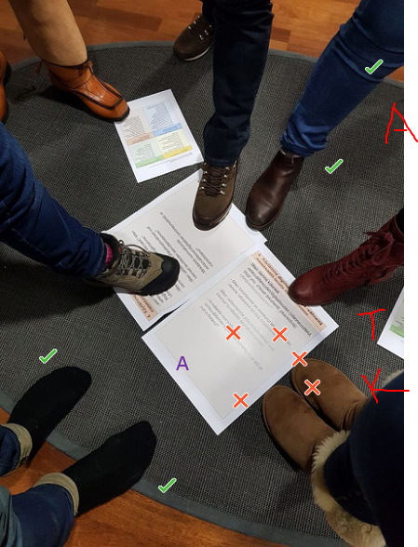
Digital quality carpet
@Centria UAS/eAMK project/ Irja Leppisaari, Asko Mentu and Satu Hangasmaa

Slide 2
This PowerPoint presents the digital quality carpet and how a group can use it to collaborate via Skype.
First, let’s take a look at the kind of situations in which a digital quality carpet can be used.
The case used as an example is a group of students thinking about reaching their objectives in eGroup mentoring.
Next, we will use an example to illustrate how a digital quality carpet is used in a collaboration and finish with showing how a digital quality carpet works with Skype.
More detailed instructions for collaborating via Skype are available on video (in Finnish) on the website Evolving digital mentoring.

Slide 3
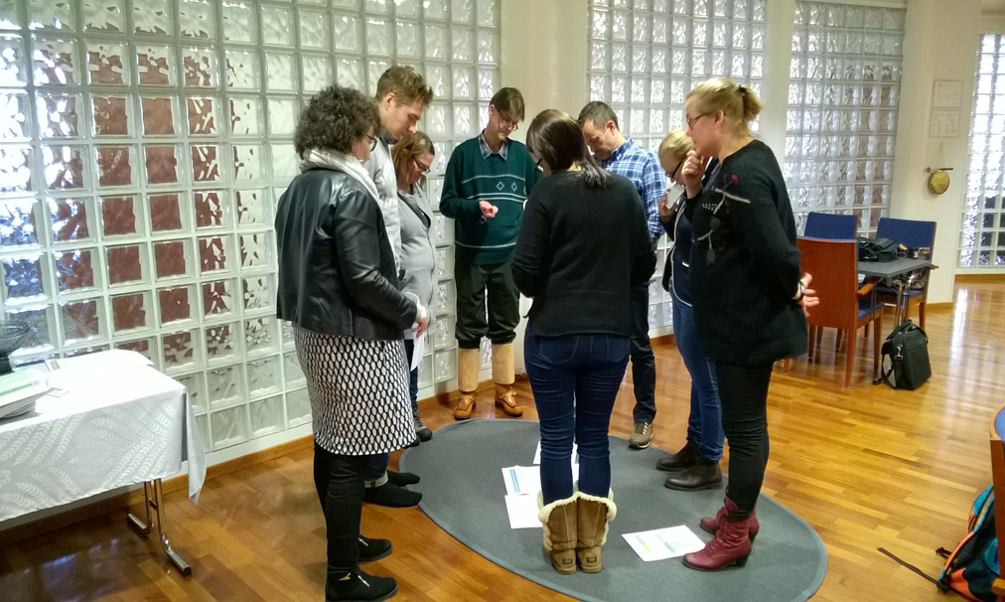
What is this all about?
The digital quality carpet was developed in the eMentoring training by three universities of applied sciences that acted as a test platform in 2018–2019 in the eAMK project.
The tool is intended to help with communal reflection in different contexts, such as supporting the planning of intended learning outcomes and continuous assessment.
The group, team or community can use the tool to review its development needs and whether its objectives have been met.
The tool can also be adapted for use in self-assessment as well as peer and expert assessment, such as when assessing meta skills in working life projects.

Slide 4
Evaluation carpet
DIGITAL QUALITY CARPET (Leppisaari, 2018c; eMentoring training) 1. The OBJECTIVES we set have been realised | 2. OUR INTERACTION works well
How have the learning objectives we set (see the mentoring agreement) been realised? Which topics have we already discussed and, based on our assessment, which topics should we discuss? How have we assessed our own activities and those of our pair/group? What have we learned from the assessments? Which objectives do we need to specify and/or what more objectives do we need to set based on our assessments? | What kind of atmosphere do we have as a pair/group? How was trust built between us? How do we maintain our interaction? Which methods do we use to strengthen our (virtual) presence? How have we taken advantage of each other’s diversity/differences?
3. We have found an OPERATING MODEL and MENTORING METHODS that support our learning | 4. We use DIGITAL METHODS and TOOLS in a meaningful way in mentoring
What kind of an operating model for mentoring have we built? How does it support the objectives we have set? Which mentoring methods/techniques have we used? How have they supported us in reaching our objectives? How have we taken advantage of the different roles of a mentor? What kind of observations have we made on a functioning role of actor? How do we take advantage of peer mentoring? How do we deepen our skills in the use of mentoring methods? | How have we experienced the digital approach (video conferences, blogs and other similar shared documents, instant messaging) in our mentoring? How have our activities succeeded in the technical sense? How have we solved our technical problems? How have the communication tools we selected supported us in reaching our objectives? What kind of interaction has the digital operating environment made possible?

Slide 5
An example of 'defining the distance' (the idea for work adapted from ‘Oppiminen ja Ryhmätyöskentely’ @ Ideapakka.fi 2017)
The sentences with objectives (themes 1–4) and the assessment questions for each objective have been entered into the PowerPoint template The centre of the circle means that 100% of the objective has been met.
Discuss the three issues below with regard to each slide (themes 1–4). You have roughly 10 min to discuss one theme and illustrate its objective. 1 - Start with placing yourself at the point where you believe you currently are in relation to the stated objective. Everyone uses their own marking method based on agreement. Give reasons for your location. Why did you select this point, meaning this distance? Ask further questions from each other. What kind of a message does the arrangement send to your group? 2 - Next, everyone should move as close to the objective as each of you wants to be at the end of the eGroup mentoring. Everyone makes a new mark using the marking method agreed earlier. Make general observations on how the situation will look at that time. What kind of a message does the arrangement send to your group? 3 - Enter the results of your assessment in the empty space on your slide. Think about the assessment questions from the evaluation carpet that open up the sentence with the objective below in more detail. Discuss. Consider what factors prevent you from coming closer to the objective. Think about how you could overcome these obstacles/turn them into opportunities.

Slide 6
Instructions for the digital quality carpet work on Skype
1. The group secretary saves the PowerPoint file Digitaalinen laatumatto (Digital quality carpet) to his/her own computer.
2. The secretary creates a Skype meeting invitation for their own group for collaboration.
3. Edit the Skype meeting settings: In the More options menu (three dots at the bottom), give everyone the right to use the annotation tools in the PowerPoint presentations (“Anyone can use annotations in a PowerPoint presentation?” -> Everyone).
4. Present the Digital quality carpet PowerPoint file you saved (Present PowerPoint files…).
5. The edit tools should be visible to all participants, i.e. a pen icon in the top right corner of the screen as well as arrow buttons at the bottom that make it possible to move forward and back in the presentation.
6. Do your self-assessment one slide at a time (4 themes) by using the annotation tools to mark the distances. In 'defining the distance‘ you mark how far you are from the centre of the circle on the right side of the slide by using the marking methods you have agreed on together. Agree on a separate colour and shape for each member of the group that the members use for all themes.
7. Enter your joint observations and development needs from the perspective of the theme being discussed into the empty comment area on each slide.
8. The secretary saves the file. To be safe, save the output after each slide. The information is saved by selecting the pen icon -> three dots -> Save as. ​
9. Attach the output from your group to your blog or other similar workspace.​

Slide 7
Arviointimatto
DIGITAL QUALITY CARPET (Leppisaari, 2018c) 1. The OBJECTIVES we set have been realised
- How have the learning objectives we set (see the mentoring agreement) been realised? - Which topics have we already discussed and, based on our assessment, which topics should we discuss? - How have we assessed our own activities and those of our pair/group? What have we learned from the assessments? - Which objectives do we need to specify and/or what more objectives do we need to set based on our assessments? | - take the distance in relation to the centre of the circle
Digital quality carpet @Centria UAS/eAMK project: Irja Leppisaari, Asko Mentu and Satu Hangasmaa “Defining the distance” adapted from ‘Oppiminen ja Ryhmätyöskentely’ @ Ideapakka.fi 2017
we will check that the goals are not too broad, we will focus them
we will do evaluation together after each session
we will return to the summary in the beginning of each session
IL
IL

Slide 8
Evaluation carpet
DIGITAL QUALITY CARPET (Leppisaari, 2018c) 4. We use DIGITAL METHODS and TOOLS in a meaningful way in mentoring | Digital quality carpet @Centria UAS/eAMK project: Irja Leppisaari, Asko Mentu and Satu Hangasmaa “Defining the distance” adapted from ‘Oppiminen ja Ryhmätyöskentely’ @ Ideapakka.fi 2017
How have we experienced the digital approach (video conferences, blogs and other similar shared documents, instant messaging) in our mentoring? How have our activities succeeded in the technical sense? How have we solved our technical problems? How have the communication tools we selected supported us in reaching our objectives? What kind of interaction has the digital operating environment made possible? | - take the distance in relation to the centre of the circle

Slide 9
More information can be found at the Evolving digital mentoring website: https://www.eamk.fi/en/ecosystems2/digital-mentoring/

