Slide 1
MODULE 5
Working with PEOPLE – Communication in Business
Ethical Food Entrepreneurship (EFE) Programme

Slide 2
Communication in Business
01
The Value of Relationships and Empathy
In the food sector, people are what make it all happen. It is imperative therefore that you understand the value of relationship-building and communication as an entrepreneur.
In this module, we bring you on a logical journey of why? & how? and aim to empower you with the knowledge and skills to become a strong empathetic communicator in an ethical manner.
02
Ethical Thinking
03
How we interact with Stakeholders and Fairtrade
04
Opportunities via Telling your story
05
The Power of Networks in Food Business

Slide 3
01
The Value of Relationships and Empathy

Slide 4
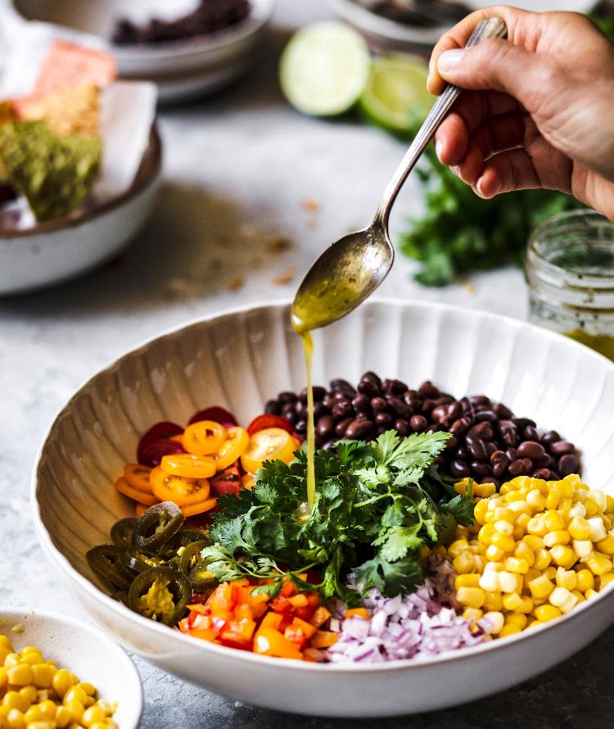
Building Strong Relationships…
Building strong relationships within your business can be seen as the key to ethical business success. Strong relationships are a cornerstone of all businesses but by fostering trust, collaboration, and empathy with employees, customers, suppliers, and the community, your business can create a positive impact, drive sustainable growth, and maintain a strong reputation in the marketplace thus ensuring your business will be acting in an ethical manner.

Slide 5
TRUST & TRANSPARENCY
1
Good relationships are built on trust & transparency, both within your business & externally. Ethical businesses should prioritise open communication, honesty & integrity, which fosters trust and strengthens relationships
EMPLOYEE ENGAGEMENT & RETENTION
2
Prioritising empathy & fostering positive relationships with your employees, leads to higher levels of engagement & job satisfaction. Staff then feel valued, supported, and understood, which enhances their commitment to your business and reduces turnover rates.
Here are some common ways to BUILD STRONG RELATIONSHIPS inside and outside your business
COLLABORATION & TEAMWORK
3
Understanding the power of collaboration & teamwork and having shared goals, will create an environment where individuals feel comfortable sharing their ideas & working together. This cultivates a sense of unity leading to improved productivity.

Slide 6
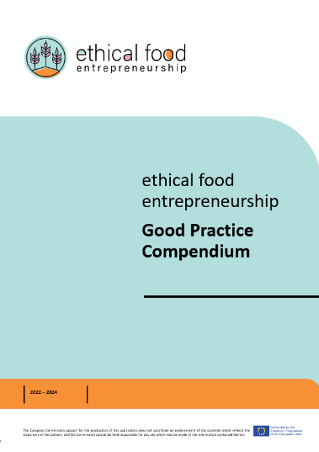
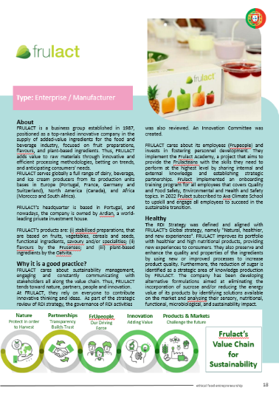
Be Inspired…
In our compendium of good practices, a Portuguese case study FRULACT demonstrates how transparency & trust with their partners and employee relationships are crucial to their business model.
Read all about them here: The Good Practice Compendium - Ethical Food Entrepreneurship (ethical-food.eu)

Slide 7
CUSTOMER LOYALTY & SATISFACTION
4
By understanding and empathising with customers' needs and concerns, you can provide tailored solutions, exceptional customer service, and a positive overall experience. This leads to customer loyalty, repeat business, and positive recommendations.
SUPPLIER AND PARTNER RELATIONSHIPS
5
The basis of an ethical business is to extend your values to your suppliers & partners & to build fair & ethical sourcing practices and mutually beneficial partnerships with those that share your values. This will enhance your credibility & reputation in a sustainable way.
Here are some common ways to BUILD STRONG RELATIONSHIPS inside and outside your business
COMMUNITY ENGAGEMENT AND SOCIAL IMPACT:
6
As an ethical business it is a good idea to recognise your role in the broader community & actively engage in initiatives that contribute to social and environmental well-being. As a result, you will build a good relationship & reputation within the community.

Slide 8
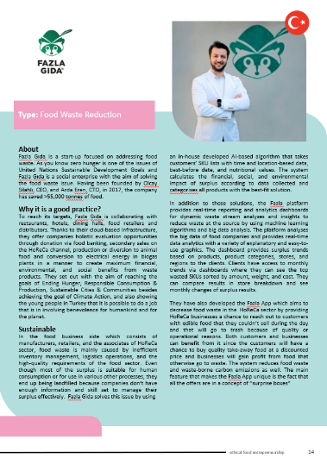
Be Inspired…
One of our case studies FAZLA GIDA is a Turkish start-up that is helping a network of businesses reach a common goal. This is achieved through extensive collaboration & support & the use of innovative technology.
Read all about them here: The Good Practice Compendium - Ethical Food Entrepreneurship (ethical-food.eu)

Slide 9
Empathy…
In Module 3 we discussed empathy from a consumer’s perspective and how by understanding the consumer or end user’s needs and wants you can better innovate and solve problems that exist for them.
However, empathy plays a vital role in the people side of the business, and it is often critical in guiding ethical decision-making processes.

Slide 10
Empathy in Business
UNDERSTAND
The Cambridge Dictionary defines Empathy as “the ability to share someone else’s feelings or experiences by imagining what it would be like to be in that person’s situation.”
Consequently, empathy is critical when building strong relationships in an ethical business. When discussing strong relationships above you will have noticed several verbs kept popping up…understand, recognise, trust, extend, engage…these are all action words revolving around empathy.
TRUST
RECOGNISE
ENGAGE
EXTEND

Slide 11
The benefit or VALUE of Empathy in your Business
Understand Stakeholder Perspectives: including employees, customers, suppliers & the community, and then make informed decisions.
Consider the Human Impact: when the well-being, rights, and dignity of individuals is considered it leads to more ethical outcomes.
Promoting Ethical Organisational Culture: When leaders and decision-makers exhibit empathy, it sets an example for others within the organisation to follow.
Stakeholder Trust and Reputation: Empathy plays a crucial role in building and maintaining trust with stakeholders. When decision-makers demonstrate empathy, they are perceived as trustworthy, caring & considerate.
Ethical Innovation & Sustainability: Empathy-driven innovation promotes sustainable practices, responsible product development, and long-term value creation.

Slide 12
Learner Exercise - Reflection
Description
Feelings
What happened?
What were your thinking and feelings?
Using Gibb’s Reflective Cycle analyse your actions to date, in terms of your level of empathy and the quality of your relationships in your business both internally and externally.
This will help you make improvements continuously.
Gibbs Reflective
Cycle
Action Plan
Evaluation
It if arose again, what would you do?
What was the good and bad about the experience?
Conclusion
Description
What else could you have done?
What sense can you make of the situation?

Slide 13
02
Ethical Thinking and Fairtrade

Slide 14
Ethical Thinking
Ethical thinking serves as a foundation for responsible leadership. Ethical business leaders prioritise ethical decision-making, consider stakeholder interests, set ethical standards, and serve as role models for ethical behaviour. They foster an ethical culture and climate, promote ethical communication, and uphold their business’s reputation. Through ethical thinking, responsible business leaders contribute to the overall success, sustainability, and positive impact, not only on their business, but on wider society.

Slide 15
Caring is Part of Ethical Leadership
Care ethics focuses on the fact that we are all connected and have a responsibility to care for one another. We need to care because leadership is at its core about relationships.
Source

Slide 16
What do ethical leaders think about?
1
They are guided by a desire to have a positive impact.
2
They think about what’s best for others and seek mutual benefit.
They think about ways to demonstrate their values in day-to-day leadership, even when faced with challenges
3

Slide 17
Ethical Thinking & Responsible Leadership
2
3
4
1
Ethical Decision-Making
Setting Ethical Standards
Ethical Communi-cation
Stakeholder Orientation

Slide 18
Ethical Thinking → Responsible Leadership
In the last section, we discussed EMPATHY and how empathy can make you & your business more ethical. By developing empathy, you are simultaneously THINKING ETHICAL and similarly reaping value from your actions as a responsible leader not just for you & your business but for all stakeholders including the community and the environment…the 3 Ps of People, Planet and Profit again ☺

Slide 19
1. Ethical Decision-making
Ethical thinking can provide you as a leader with the framework to make responsible and ethical decisions. It involves considering the moral implications and potential consequences of your actions on stakeholders, society, and the environment. You as an Ethical leader can prioritise values such as integrity, accountability, and fairness and integrate them into their decision-making processes
ACCOUNTABILITY
INTEGRITY
FAIRNESS

Slide 20
2. Stakeholder Orientation
Ethical thinking in leadership emphasises the consideration of diverse stakeholder perspectives and interests. As a responsible leader, you recognise that your decisions and actions impact various stakeholders, including employees, customers, communities, and the environment. It is good to actively seek input from stakeholders and take their concerns into account when making decisions, striving for outcomes that promote the greater good.

Slide 21
Author and motivational speaker Simon Sinek has gained the reputation as a Leadership Expert. In this short video, he discusses the importance of actively seeking the input of employees to build on your business’s culture.
Building a Culture Together - YouTube

Slide 22
3. Setting Ethical Standards
Ethical leaders set clear ethical standards and expectations within their business or organisation. You can communicate and act as a role model to reinforce the importance of ethical behaviour and integrity at all levels. By establishing a culture of ethics, you can lead & create an environment where responsible decision-making and behaviour are valued and supported

Slide 23
4. Ethical Communication
Ethical thinking will guide you as a leader in your communication practices. As a responsible leader, you must prioritise transparency, honesty, and respectful communication. You must ensure that information is shared openly and accurately, promoting trust and understanding among stakeholders. It is important to encourage open dialogue and create a safe space for discussions on ethical issues and concerns.

Slide 24
Further interesting reading:
Differences Between Modern and Traditional Ethical Thinking - Owlcation
Ethics in the workplace: ethical intelligence and how to achieve it | HRZone
Responsible leadership | ACCA Global
The Greatest Leadership Article I’ve Ever Read (forbes.com)
5 Fundamentals of Leadership - Leadership Development | Simon Sinek - YouTube

Slide 25
03
How we Interact with Stakeholders & Fairtrade

Slide 26
Who are your stakeholders?
In order to provide a starting point to explore how you as a food business can interact with your stakeholders in an ethical and responsible manner...you must first identify who the stakeholders are.
Then you can start to interact, build relationships, promote transparency, & address the concerns and interests of various stakeholders within your circle.
Generally, stakeholders will include:
1
The Public
2
Employees
3
Suppliers/ Distributors
4
Regulatory Authorities

Slide 27
Group 1: The Public
This group is a big one and often more challenging to interact with as it is a very diverse group. It includes:
Local Communities
Consumers
Potential Consumers
Topics or subjects they may be interested in include:
Local Community initiatives/programs
Food Origin, Ingredients, Processes
Nutritional Information, Allergens
Health & Safety information
Environmental & Sustainability initiatives
Social Responsibility or charitable partnerships

Slide 28
Ways to Interact with the Public :
Website: Maintain an informative and user-friendly website that provides detailed information about your food business, products, and values. It is also a great space to share engaging and educational content related to your sustainability efforts, community involvement, and any other topics that may be of interest to the public.
Social Media Presence: Establish and maintain an active presence on social media platforms relevant to your target audience. Engage with followers by sharing relevant content, responding to comments/messages, and addressing any concerns or enquiries. Social media provides an opportunity to reach a wide audience, share updates, and showcase the values and offerings of your food business.
Public Events, community gatherings, or local festivals allow you to connect with the public directly & to engage in face-to-face interactions, share product samples, and build relationships with potential customers and local communities. It also demonstrates your commitment to supporting local initiatives and fosters goodwill.

Slide 29
Ways to Interact with the Public :
Customer Feedback and Reviews: Encourage customers to provide feedback and reviews about their experiences with your food business or products. Actively listen to their comments, respond to their questions/concerns, and use their feedback to improve your products and services. Positive customer reviews and testimonials can serve as powerful endorsements and help build trust with the wider public.
Surveys and Market Research help to gather insights into public preferences, needs, and expectations. This information can help shape your communication strategies, product development, and overall business approach to better meet the needs of the public.
Responsible Advertising and Marketing campaigns need to be accurate and ethical for your food business. Avoid misleading claims or deceptive practices and focus on promoting the unique qualities of your products, such as sustainability, nutritional benefits, or fairtrade practices. Transparent and responsible advertising builds trust with the public.

Slide 30
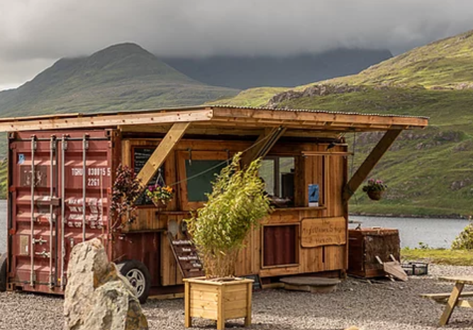
Be Inspired by THE MISUNDERSTOOD HERON…
This is a prime example of how a small ethical food business can make such an impact via good and clear communication. They only sell innovative, fresh, local, and seasonal food, and constantly communicate this (their website, Instagram and Facebook pages. Now the word has spread organically…see some reviews:
John and Sally McKennas' Guides
Lonely Planet List | Food&Wine (foodandwine.ie)
Leenane Georgina Campbell Guides (ireland-guide.com)
MISUNDERSTOOD HERON, - Tripadvisor
Visit Misunderstood Heron with Discover Ireland
How a food business in the West of Ireland has taken flight (irishtimes.com)
Restaurant review: The Misunderstood Heron - Independent.ie

Slide 31
Group 2: Employees
This group can vary in size depending on the stage and size of your business. Regardless of size, a good standard of internal communication and engagement with employees in your food business is critical at all levels.
Topics or subjects they may be interested in include:
A positive work environment
An inclusive workplace culture,
How to share information or ideas
How can they be involved in decision-making processes.
Company values
How to give feedback

Slide 32
Ways to Interact with Employees:
Open and Transparent Communication Channels allow employees to express their thoughts, concerns, and ideas. This can be achieved through regular team meetings, suggestion boxes, anonymous feedback mechanisms, or dedicated communication platforms, such as internal social networks or chat applications or even a simple kitchen noticeboard. Ensure that important information is easily accessible and readily available to all employees.
Two-Way Communication where employees are encouraged to actively participate in discussions. Encourage managers and leaders to listen attentively to employee input, ideas, and suggestions, and provide timely and constructive feedback.
Training and Development Opportunities can empower employees to enhance their skills and knowledge. You should work to provide opportunities for professional growth, mentorship programs, or cross-functional projects to encourage continuous learning and career advancement.

Slide 33
Ways to Interact with Employees:
Recognition and Rewards: Implement recognition programs that celebrate and appreciate employee contributions and achievements. Recognise individuals or teams for their efforts, whether it's through verbal appreciation, public recognition, or tangible rewards. This fosters a sense of value, belonging, and motivation among employees.
Employee Engagement Activities and events, such as team-building exercises, volunteer opportunities, or wellness programs help foster a sense of camaraderie, collaboration, and overall well-being among employees.
Leadership Visibility and Accessibility: Encourage leaders and managers to be visible and accessible to employees. Foster an environment where employees feel comfortable approaching their supervisors or leaders to discuss concerns, seek guidance, or share ideas.

Slide 34
Remember, effective internal communication and engagement require a consistent and ongoing effort. It's essential to create a culture where employees feel valued, heard, and empowered to contribute to the success of your ethical food business. Regularly assess the effectiveness of communication strategies and adapt them based on employee feedback and evolving business needs.

Slide 35
Group 3: Suppliers & Distributors
For this group, you and your food business have the opportunity to develop ethical and sustainable supplier relationships. It is also deemed ethical and sustainable to support small-scale or local producers and to use seasonal produce.
Interaction and communication can revolve around topics such as:
fair trade practices,
responsible sourcing,
traceability and
accountability in the supply chain

Slide 36
Building Relationships with Suppliers & Distributors:
Supplier Selection Process: Implement a thorough supplier selection process that includes evaluating their ethical practices, sustainability initiatives, and adherence to industry standards. Consider factors such as fairtrade certifications, environmental stewardship, labour practices, and product quality.
Transparent Communication: Foster open and transparent communication with suppliers and distributors. Regularly communicate your expectations, provide guidelines or updates on your requirements or changes, and address any concerns or issues promptly. Establish channels for ongoing dialogue and collaboration to ensure mutual understanding and alignment.
Collaboration & Training: Collaborate with suppliers and distributors to enhance their understanding of your ethical standards & practices. Offer training workshops, or resources to help them meet your expectations. Foster an environment where knowledge sharing and continuous improvement are encouraged.

Slide 37
Ways to Interact with Employees:
Building Relationships with Suppliers & Distributors:
Supplier Audits and Assessments: Conduct regular audits and assessments to evaluate suppliers' compliance with quality, ethical and sustainability standards. This may involve site visits, inspections, or third-party certifications. Provide constructive feedback and work together with suppliers to address any identified areas for improvement while also building trust and respect.
Fair Pricing and Payment Terms: Ensure fair pricing and payment terms for suppliers and distributors. Avoid practices that may exploit suppliers or compromise their ability to maintain ethical practices. Establish transparent negotiations and contracts that support fair compensation and mutually beneficial relationships.

Slide 38
Fairtrade
The concept of Fairtrade is a broad one, incorporating ethical and more equitable trading relationships between producers, traders, and consumers, and promoting sustainable development. Fair prices are just one aspect of this, helping some of the most disadvantaged growers to benefit from trade. Workers’ rights, attention to health and safety, and capacity building are other issues that are encouraged by the movement.
Within the EU, consumers will be familiar with the ‘Fairtrade’ consumer label on goods and foodstuffs. Such products have been certified by Fairtrade International as meeting internationally-agreed social, environmental (but not necessarily organic), and economic standards.

Slide 39
Case Study – Coffee
Attention for ethical sourcing began with cash crops such as coffee, sugar and cocoa. These high value crops are typically produced by smallholding farmers in the Global South with little access to resources and power within the market. The large-scale production of these products results in price volatility. Fairtrade was started in response to the dire struggles of Mexican coffee farmers following the collapse of world coffee prices in the late 80s and now works with 758,474 coffee farmers globally ensuring minimum prices.
READ: About coffee - Fairtrade Foundation

Slide 40
Communication Errors
1
Greenwashing
So, by now, we hope you realise how important Good Communication with all stakeholders is to your food business. The key word here is GOOD!
Sometimes businesses make unethical decisions and communication errors, that can impact their brand, consumer or supplier trust, and even be in breach of regulations.
You may have heard of some of these terms…
2
Mislabelling
3
Food Fraud
4
False Food Claims
5
Lack of engagement

Slide 41
1. Greenwashing
Going green is good for business. Consumers are often willing to pay more for eco-friendly products than other comparable products on the market, according to market research.
However, not all environmental claims are created equally. “Greenwashing” is a form of misinformation often used to entice an aspiring green consumer. Companies promising to be sustainable, biodegradable, or environmentally conscious sometimes fail to meet the promises they make to consumers.

Slide 42
Greenwashing…
Greenwashing can sometimes be as obvious as an outright lie or as murky as a stretched truth and difficult to discern. Take carbon offsets, for example. To negate their own emissions, some companies send money to programs like tree planting projects that theoretically offset carbon pumped into the atmosphere by planting more trees to suck it up. But drought and wildfires have destroyed some of these forests, and critics say offsets give companies permission to continue polluting.
Source

Slide 43
Greenwashing could slow our progress towards meeting climate and social goals.
World Economic Forum

Slide 44
2. Mislabelling
Mislabelling occurs when a food product’s label does not accurately reflect its ingredients. It can happen by accident when a facility’s HACCP and other safety processes are not fully understood; however, there is a persistent problem with mislabelling on purpose which is food fraud. Either way, having incomplete or incorrect information on the labels is dangerous to consumers. The greatest danger related to mislabelling is exposing consumers to common allergens

Slide 45
3. Food Fraud
Food fraud refers to the deliberate deception or misrepresentation of food products for economic gain. It involves adulterating, substituting, or mislabelling food products with the intention to deceive consumers, businesses, or regulatory authorities.
Food fraud can occur at various stages of the supply chain, from sourcing ingredients to processing, packaging or distribution. Examples of food fraud include diluting or substituting ingredients, misrepresenting the place of origin, counterfeiting high-value products, or selling expired or adulterated food.

Slide 46
4. False Food Claims
On the other hand, false food claims involve making misleading or false statements about a food product's attributes, characteristics, or benefits. This practice is deceptive marketing where businesses make unsupported claims or exaggerate the qualities of their products to mislead consumers. This can include overstating health benefits, misrepresenting nutritional content, using vague or ambiguous language, or employing misleading visuals or packaging. These claims may be designed to influence consumer perception, create a competitive advantage, or increase sales.

Slide 47
In this short witty video, Doctor Mike Varshavski points out some of the ways food labels can be misleading or how some food products make claims in a deceptive manner.
Top 10 Misleading Food Label Claims | Nutrition Labels BUSTED!!! - YouTube

Slide 48
5. Lack of engagement
We have discussed above how to interact or engage with the various stakeholders of your food business. However, if one fails to actively engage with its stakeholders, including consumers, employees, local communities, and regulatory authorities, it can be seen as poor communication. Engaging stakeholders allows for understanding their concerns, needs, and expectations, and fosters better decision-making and relationship-building.
Keep all lines of communication OPEN & ACTIVE!!

Slide 49
Further interesting reading:
Europe targets greenwashing and eco-labelling for food - META (eeb.org)
Nestlé accused of irresponsible marketing with “fake” nutrition claims on KitKat cereals (nutritioninsight.com)
False labelling hides the truth about superfoods | Pursuit by The University of Melbourne (unimelb.edu.au)
EU register of health claims (europa.eu)
Are you being fooled by food labels? - BBC Food

Slide 50
04
Opportunities via Telling your Story

Slide 51
Communicating via Storytelling
Communication is the imparting or exchanging of information by speaking, writing or using some other medium
Oxford Dictionary

Slide 52
The Power of Storytelling…
Storytelling has psychological superpowers which make it a powerful marketing tool:
Emotion: When you hear a story and feel a personal connection, which isn’t just theoretical; it’s based on some fascinating neuroscience facts. While hearing a story, many more areas of your brain activate and become engaged.

Slide 53
The Power of Storytelling…
A listener makes an emotional connection with a story, and the message is considered genuine and so it also establishes the teller as a trusted entity. It encourages the listener’s active imagination and involves a two-way interaction between a storyteller and listeners.
A story empowers listeners to visualise vivid, sensory elements of the story based on the storyteller’s performance and their own experiences and understandings.
We want you to learn how to tell your ethical food story!

Slide 54
What Stories do…
human life
connection
engagement
Stories define the very essence of human life
People begin to feel a connection
Common values are identified, and messages are communicated
Themes like family, provenance, friendship, our history and others are common to every nation – messages with global reach
A compelling story can give the customer or supplier or even employees the incentive they need to become more engaged with your business.
common values
messages

Slide 55
WATCH - The Power of Storytelling…
Storytelling is an essential communication tool. It can make complex data accessible and sell successfully.
In this short video, we learn:
The benefits of powerful storytelling
How to improve your basic storytelling skills
How to use storytelling to build relationships
The Power of Storytelling | eLearning Course - YouTube

Slide 56
WATCH - The Next Evolution in Food Systems
This short video demonstrates how easy it is to tell a story. It doesn’t have to be long but with simple animation and a well-paced dialogue. It describes where we came from, where we are now and what the future could look like. It is the full HOOK-LINE & SINKER to get the audience engaged.
Agroecology - the next evolution in food systems - YouTube

Slide 57
Creating a Brand Story…
An image or perception is made up of facts, feelings, and interpretations, from everything you do…each element of your food business or food products, from the food origin, the food processing methods, the food products journey to your own personal story, to even your distribution methods.
Your story isn’t just what you tell people, it’s also what they believe about you based on the signals or messages that your produce or service/experience sends.

Slide 58
You understand and appreciate the need for ethical food…now you want to sell it…so, it is important to tell your stakeholders the story of how you got here and what you have achieved and involve them in the journey!

Slide 59
Elements in Creating a brand story…
Start with the Personal Story: Your and your business’s history.
Your Passion Story: What you love about the journey, what drives you & the business.
The Personality Story: What is the customer or stakeholder experience ahead of them?
The Customer Story: What do other customers say about your offerings?
Bring all the story elements together

Slide 60
Using Storytelling in your marketing - Storyteller to StorySeller
This video by Timir Naha talks about storytelling as a marketing tool or business storytelling and ways to give storytelling presentations. Basically, how to tell marketing stories that are effective for your ethical food business.
Storytelling marketing | Business storytelling | Storytelling presentation - YouTube

Slide 61
BE INSPIRED – One of our Good Practice Case studies tells their story…
Irish Siblings Niamh & Ruairi tell their business story. They start with their past, then their passion and their journey to where they are today but also where they want their business, Biasol to go in the future.
Read all about them here: The Good Practice Compendium - Ethical Food Entrepreneurship (ethical-food.eu)
Siblings turn brewers’ spent grain into food supplement - YouTube

Slide 62
A great example of Sharing a Story and creating a picture…Ireland
This short Discover Ireland video uses Irish Celebrity Chef Rachel Allen to tell Ireland’s food story…From farm to fork and sea to shore, Ireland is renowned for its fresh, local and organic produce and Rachel creates a great picture. The story has a beginning (her personal story), a middle (our heritage story) and an end (what the audience should expect now and, in the future) and she creates that emotional connection with the audience.
A Taste of Ireland: From Farm to Fork - YouTube

Slide 63
Learner Exercise
Draft your story.
Using the elements mentioned above think about your journey and how you could make that an interesting story to your audience / stakeholders.
Think about the media you would like to use to share it
Who could you share it with

Slide 64
05
The Power of Networks in Food Business

Slide 65
Alone we can do so little. Together we can do so much.
Helen Keller

Slide 66
What is Professional Networking?
Professional networking is about making and utilising contacts to add value to your business, customers and clients. The goal of professional networking is to create a pool of people and information that can directly increase the quality of your product or service, decrease customer attrition, and add value to customers and clients.

Slide 67
Building a Professional Network
Reviewing & updating network goals
Networking is perhaps more crucial than ever, as an established relationship can differentiate one entrepreneur from another thereby providing a competitive advantage. Professional networking involves building a network of contacts, colleagues, associates, suppliers & others ensuring that a pool of contacts is available to tap into when required. Professional networking requires a disciplined and planned approach & is a two-way process.
STEP 05
Undertaking networking activities
STEP 04
Building a professional network involves 5 steps.
Preparing your networking plan
STEP 03
Identifying what and who you need to know
STEP 02
Identifying networking goals
STEP 01

Slide 68
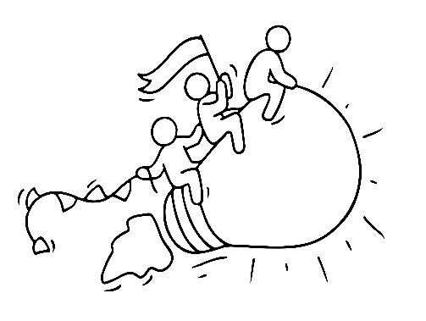
How Networking is beneficial…
Networking will be very useful at the start of your business when you are less well-connected.
Networking keeps you in touch with opportunities. You can turn to more people for help and advice.
Effective networkers are more likely to be offered opportunities.
Networking allows you to contribute something to others and build your reputation – people buy people.

Slide 69
Types of Networking
Networking is an effective low-cost method of connecting with those who can support you to grow your business through referrals and introductions, to develop sales, collaboration opportunities, and contacts.
Types of business networking
Strong Contact Networks (typically paid-for networks that focus on referral business in the network, e.g. BNI: Business Network International | Business Networking
Casual contact networks - your attendance is optional – e.g. Chamber of Commerce networking events in your area
Online networks - Welcome to Open Food Network LinkedIn or Facebook groups
Professional Associations - Tipperary Food Producers Network - 37 Food Businesses in Tipp

Slide 70
SPOTLIGHT on Tipperary Food Producers - Ireland
This is a community of food and beverage producers working together in a network to promote the very best food Tipperary has to offer. Creating nutritious and healthy products in a sustainable food system is what binds them.
Their vibrant network of dedicated producers includes cheesemakers and bee-keepers, fruit farmers and cider makers, butchers and bakers, and sauce and jam makers. The integrity that they offer with their products makes them stand out both nationally and internationally.

Slide 71
In this video, you will discover 10 networking strategies that aim to help you to start enjoying networking even if you are shy.
10 Simple Ways To Improve Your Networking Skills - How To Network With People Even If You're Shy! - YouTube

Slide 72
Learner Exercise
Get the wheels in motion…Research the networking platforms that you can access in your
Area/region/country
Sector (food/ agrifood)
Online specific, that are relevant to your business
Then calculate, how much time can you set aside to network each month?

Slide 73
Remember to check out the EFE Sharing & Mentoring Platform – Result 4
Home - Ethical Food Entrepreneurship (ethical-food.eu)
The primary goal of the platform is to form an intergenerational link between aspiring ethical food entrepreneurs.
The sharing part of this platform will involve the facilitation and creation of appropriate channels for the exchange of information and the coordination between educators and learners and peers-to-peer networking, to lead to synergies promoting the transition to the circular model.

Slide 74
You have just completed the penultimate module…in the final module, we look to the FUTURE & recap the main elements that are critical to the sustainability of your enterprise & to the future of the planet.

