Slide 1
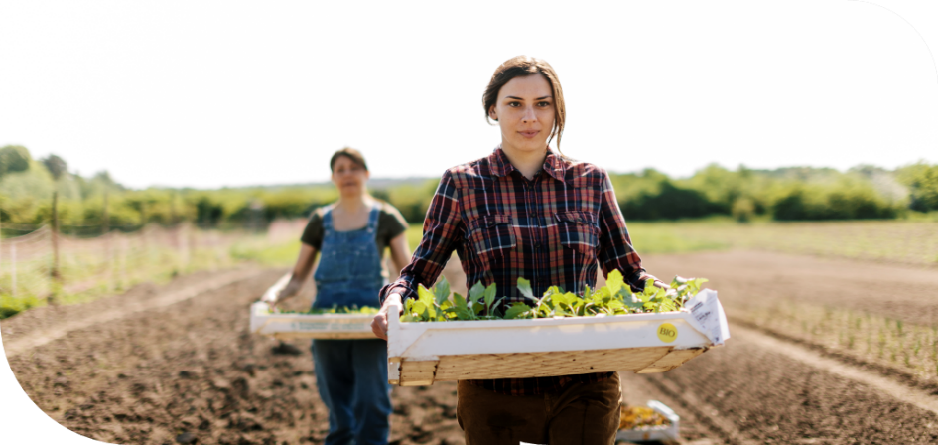

EDUCATORS GUIDE
to Drivers & Enablers for the Innovation of Ethical Foods
2022 - 2023
Published: 2023

Slide 2

authors
Elsa Ramalhosa
Gozdegul Baser
Ermelinda Pereira
Evla Mutlu
Anna-Maria Saarela
edited by:
Paula Whyte
– Instituto Politécnico de Bragança (IPB), Portugal.
– Antalya Bilim University (ABU), Turkey.
– Instituto Politécnico de Bragança (IPB), Portugal.
– Antalya Bilim University (ABU), Turkey.
– Savonia University of Applied Science (SUAS), Finland.
– Momentum, Ireland.
This document can be cited as Ramalhosa, E., Başer, G., Pereira, E., Mutlu, E., Saarela, A. M. (2023). Educator's Guide to Drivers & Enablers for the Innovation of Ethical Foods
2

Slide 3


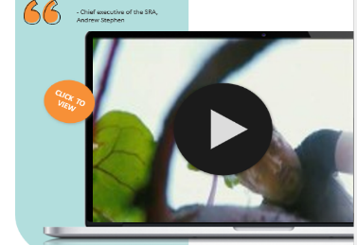



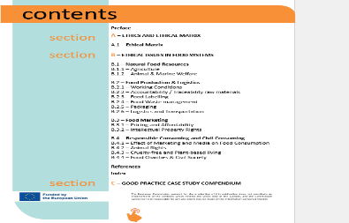
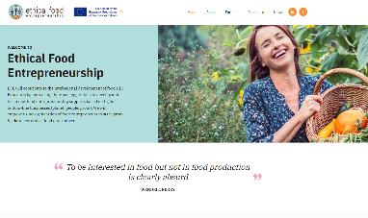
HOW TO USE THIS INTERACTIVE GUIDE
The EFE Educator's guide is an online interactive set of resources and additional learning links. This content provides a deeper, self-guided learning opportunity featuring explainers & insight of what Ethical & Sustainable Food Businesses and Innovation is or should be through-out Europe. We invite you to use these links and to explore and engage with the content and delve deeper into the subject matter.
INTERACTIVE CONTENT IS IDENTIFIED IN THIS GUIDE BY THESE ICONS & ALL LINKS ARE IN THE COLOUR ORANGE
CLICK TO VIEW
CLICK
TO VIEW
DEEPER LEARNING - Click to find out more about our case studies
TOP TIP
To return to the Educator-guide - use the click to go back option in your browser
FAST AND EASY NAVIGATION
Jump to a case study of choice by clicking on the interactive table of contents
Click to go back

Slide 4

contents
Preface
A – ETHICS AND ETHICAL MATRIX 8
A.1 – Ethical Matrix 10
B – ETHICAL ISSUES IN FOOD SYSTEMS 13
B.1 – Natural Food Resources 16
B.1.1 – Agriculture 17
B.1.2 – Animal & Marine Welfare 24
B.2 – Food Production & Logistics 25
B.2.1 – Working Conditions 29
B.2.2 – Accountability / Traceability raw materials 31
B.2.3 – Food Labelling 33
B.2.4 – Food Waste management 38
B.2.5 – Packaging 40
B.2.6 – Logistics and Transportation 43
B.3 – Food Marketing 46
B.3.1 – Pricing and Affordability 46
B.3.2 – Intellectual Property Rights 48
B.4 - Responsible Consuming and Civil Consuming 50
B.4.1 – Effect of Marketing and Media on Food Consumption 52
B.4.2 – Animal Rights 55
B.4.3 – Cruelty-free and Plant-based living 57
B.4.4 – Food Charities & Civil Society 60
Conclusion 61
References 62
section
section
4

Slide 5


Preface – Why?
The world’s growing food demand, climate change related resource constraints and the inability of agriculture to meet this demand push humankind to develop more sustainable systems. The need for sustainable and ethical practices have become a challenge that the European Union (EU) and the United Nations (UN) are encouraging us all to tackle.
According to European Commission (n.d.-a), the food and drinks sector is the union’s largest manufacturing industry, creating a significant trade surplus with its competitive advantage. This high value-added industry is dominated by SMEs; however, SMEs have been slow to respond - because they lack the professional capacity, skills or awareness - to initiate an innovative shift in business development, production and marketing of ethical and sustainable food.
The project Ethical Food Entrepreneurship - EFE (Figure 1) aims to initiate a change in this regard. It is intended to encourage/promote potential entrepreneurs to take that leap with support and knowledge.
Figure 1 – Logo of Erasmus + EFE Project …Food for People – Planet - Profit
The concept of ethical food is based on three pillars:
consideration of people (the consumer and the employees),
the planet (centred on environmental sustainability) and
animals (mainly concerned with animal rights and welfare).
EFE will significantly promote the professional development of food Higher Education Institution (HEI) Educators by increasing their pedagogic skills to develop and teach new food entrepreneurship supports based on triple-bottom-line (People-Planet-Profit) businesses. A new generation of food entrepreneurs will be empowered to begin and develop new ethical food enterprises.
5

Slide 6
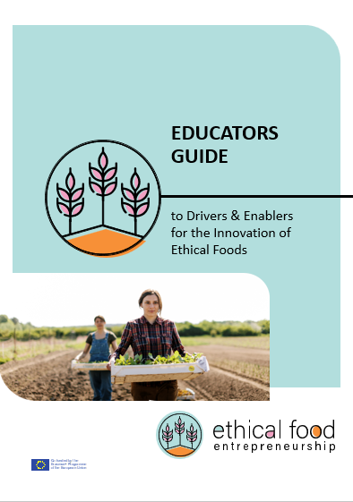

Preface - Continued
Under the EFE project, several guides will be prepared. One of these is the "Educators Guide to Drivers and Enablers for Innovation of Ethical Foods", and it will meet the need of food innovation and technology educators who have little/no exposure to food entrepreneurship to date. Their understanding of the business opportunities arising from ethical/clean foods will be increased, ensuring a more multidisciplined approach that will benefit both the students and SMEs they support.
The educator’s guide to ethical food entrepreneurship is structured to introduce terminology, theories, evaluation methods, case studies, videos, podcasts, and other resources that educators can benefit from. The order of the topics in this guide is an example of the order that might be followed by the instructors to teach the course.
There are two main chapters or sections, namely;
“Ethics and Ethical Theories”, and
“Ethical Issues in Food Ecosystem”
As indicated by Costa (2018:13), learning outcomes of food ethics can be the students’ awareness of food-related ethical issues, and the ability to contribute to food ethics-related discussions. Accordingly, good practices in various regions are gathered and shared as case studies.

Slide 7









Partners
The Ethical Food Entrepreneurship project brings together partners from Finland, Turkey, Portugal, Ireland, and Denmark. Despite our different specialisations (food science and nutrition, technology and innovation, knowledge-transfer, food-incubation, entrepreneurship training, and digital learning), the partners share the need to introduce new training tools and strategies focused on food sector sustainability and ethical food practices in our HEI and Vocational Education and Training (VET) bodies.
By collaborating as six partners from five different countries, we leverage significant benefits which will allow us to produce a set of educational resources that are transnational, and timely (enabling a quicker route to market) yet make a long-lasting contribution to the food sector in the EU through educating the next generation of ethical food entrepreneurs.
The Graphic below contains links to all of our partner’s websites for more information. The production of this guide was co-created by Antalya Bilim University and Instituto Politécnico de Bragança. However, all partners supported and contributed to this guide with content and case studies from their respective regions, Finland, Turkey, Portugal, Ireland, and Denmark.
MEET OUR TEAM
FINLAND
TURKEY
PORTUGAL
www.revalorise.eu
IRELAND
IRELAND
DENMARK

Slide 8
A
Ethics and the Ethical Theories

Slide 9
A
Ethics and Ethical Theories
The aim of this chapter is to provide students with the ability to understand the basics of ethics, morality, and the difference between ethical theories and perspectives of well-known philosophers in ethics studies. Students are also expected to understand the rationale behind ethical theories and to gain the ability to analyse an ethical issue from different perspectives.
Ethical theories are commonly defined in three categories:
Consequentialist theories (Teleology): Utilitarianism, Hedonism, Egoism
Non-consequentialist theories (Deontology): Kantian (Duty-based Ethics), Theology, Social Contract
Agent-based theories: Virtue Ethics
Consequentialist theories focus on the outcome of the action. Utilitarianism which is associated with Jeremy Bentham (1948), means that actions should cause “the greatest good for the greatest number”. Actions according to utilitarianism may result in less harm and maximum benefit for a greater number of people, as the result is important in this approach.
Also known as deontological theories, Immanuel Kant is one of the most associated philosophers of non-consequentialist theories. Kant’s theory emphasises doing the right thing, such as telling the truth and taking these right actions as duties. According to this theory, one should act the right way while respecting others’ autonomy, and as long as one acts in line with the duty, they are deemed to act in an ethical way.
The Virtue Theory, influenced by Plato and Aristotle, emphasises virtue, improving one’s own personality and aiming to have a moral character. Virtues include courage, generosity, honesty, fairness, being just, or simply being a good person.
One of the approaches to linking virtue theory to food ethics is inspired by Thompson (2018) about farmers’ position where agrarianism requires a shift to systematic and complex agricultural methods. As indicated by the author, agricultural values that a farmer has, play a critical role in the process.
9

Slide 10
A.1. Ethical Matrix
As proposed by Mepham (2000), the ethical matrix is a practical approach looking for respect for well-being, autonomy, and fairness in an issue. The items of the matrix have originated from utilitarianism, deontological ethics, and the social contract theory. The matrix aims to list all possible agents (humans, organisations, animals, biota) directly or indirectly involved in the situation, and consider the well-being, autonomy and fairness of each agent in a matrix.
The Ethical Matrix manual defines the representation of three components;
respect for well-being represents getting the greatest good such as utilitarianism,
autonomy represents a deontological perspective as one must consider the agent affected by the situation, and
fairness represents the quest for justice, referring to Rawls’s (1972) study “A Theory of Justice”.
An example of an ethical matrix, adapted from Bentham (2013), is using pesticides in agriculture. After listing the agents affected (such as farmers, government, consumers, soil, residents of the area, and the environment of the area), the matrix is applied to these agents individually. Considering the farmer’s side, the ethical matrix can be implemented as below.
This method covers different agents and emphasises the necessity of a comprehensive understanding of an ethical issue from different perspectives.
Wellbeing | Economic wellbeing of the farmer depends on the high productivity and the high number of sales with a good price. In order to increase the economic well-being, farmers may prefer to use a method to eliminate undesired insects in agriculture.
Autonomy | Farmer should have the right to make the decision about farming method he/she practices, as well as using pesticides or not.
Fairness | Farmers need to receive a fair income in line with their efforts. Using excessive pesticides may potentially pollute the soil and groundwater of the area, which may eventually result in decreased yield.
10

Slide 11
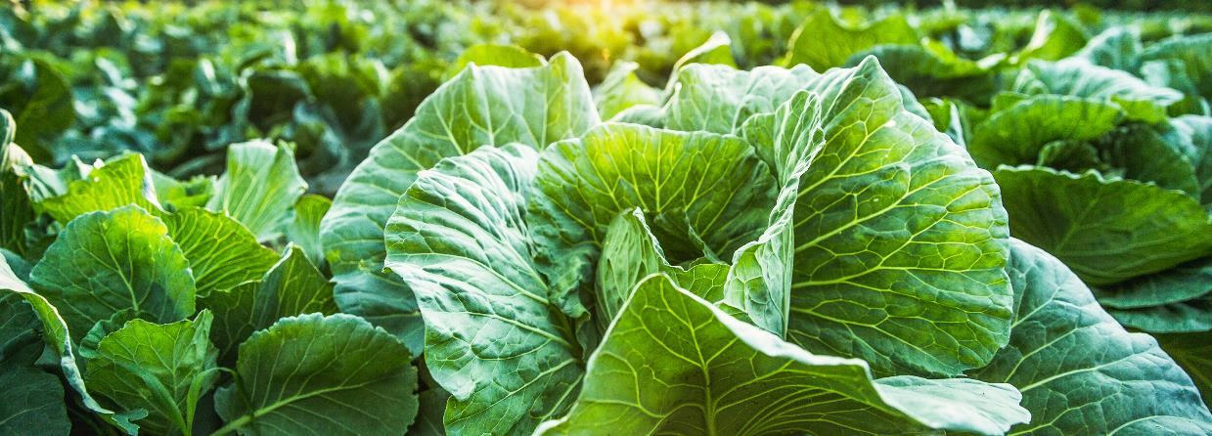

Individual Learner Assignment Suggestion:
After defining these theories, food-related ethical issues can be discussed from different perspectives.
Students may be asked to assess an ethical issue with the Ethical Matrix approach. Some of the subjects would be;
Long working hours in fine-dining restaurants
Immigrants working in the restaurant business without social security
Unhealthy food being marketed to children
Open buffet service and food waste management
One of the food safety scandals and recall process
Video Suggestions:
Ethics Unwrapped - Beyond Business Ethics - UT Austin (utexas.edu)
McCombs School of Business’s Ethics Unwrapped playlist on “Utilitarianism” (2018), Deontology (2018), Hedonism (2018), Virtue Ethics (2018) and other concepts such as Moral Myopia, Bounded Ethicality etc.
Introduction to Ethics - YouTube
Wireless Philosophy’s Introduction to Ethics playlist on several theories such as Consequentialism (2018) or other practical issues such as Killing Animals for Food (2014).
Podcast Suggestions:
BBC Radio 4 - In Our Time, Philosophy
Philosophy Podcast Series on “Utilitarianism” (2015), “Kant’s Categorical Imperative” (2021), “Virtue” (2002).
Publication Suggestions:
Ferraro, F. (2017) Ritual Slaughtering vs. Animal Welfare: A Utilitarian Example of Moral Conflict Management. In The Routledge Handbook of Food Ethics. Rawlinson, M. C., Ward, C. (Eds.). Routledge.
Rush, E. (2012) Ethics of food security. In Food security in Australia (pp. 35-48). Springer, Boston, MA.
Chignell, A., Cuneo, T., Halteman, M. C. (2016). Philosophy Comes to Dinner: Arguments about the Ethics of Eating. Routledge: New York.

Slide 12


A Movie Suggestion:
The Platform (Original name: El hoyo) is a Spanish movie directed by Galder Gaztelu-Urrutia, released in 2019. The movie is set in a vertical building, with residents on each floor. Residents are fed by a platform full of food at the top. The platform stops at each floor for a limited time and moves down to the next platform. Top-floor residents eat as much as they can, resulting in conflict with lower levels. The morality of actions and motivations of characters can be discussed from different ethical perspectives. A debate on the morality of residents’ reaction to hunger can lead to the distinction between Utilitarianism and Kantian Ethics (or Teleology vs Deontology).
Ford and Richardson’s (1994) and later O’Fallon and Butterfield’s (2013) meta-analysis on ethical decision-making literature reveals two pillars affecting the decision. First is the individual factors such as personality, demographics, beliefs, employment, and second is the situational factors such as group influence, the effect of authority, position in the organisation, the existence of a corporate policy on ethics, organisational structure, organisational culture, rewards and sanctions etc. Further details are discussed in the articles. These basic categories can be useful discussion points for the movie as well. Learners can discuss the individual and situational factors affecting the action of residents.
This movie can also be assessed for food insecurity and food distribution problems (distributional justice), a preliminary approach to the next section.
This Movie is currently available to watch on Netflix

Slide 13
B
Ethical Issues in Food Ecosystem

Slide 14
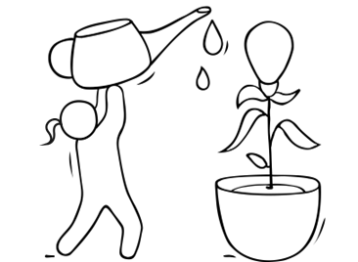
B
Ethical Issues in Food Ecosystem
Aim: to provide students with the ability to address existing and upcoming ethical concerns at every step of the food industry such as marketing, producing, pricing, logistics, packaging, serving etc.
Accordingly, one should understand the food ecosystem as a complex and dynamic organism and to increase student awareness of the roles of the parties or stakeholders directly or indirectly included in policy-making, such as government, consumer, farmer, manufacturer, and restaurateur.
In order to comprehend the complexity of the system (Figure 1), it is recommended that students are taken on field trips or guest speakers can be invited during the course. The list of some potential partners includes:
Farms: active participation of students in harvesting, planting, milking, collecting the eggs or other activities to understand the scope of business, the difficulties and problems during the process.
Cooperatives: an important agent to set the prices, balance the supply, set quality, to market the region or members.
Waste Management Facilities: depending on the country, students can be taken to centres collecting, separating, reusing, and recycling facilities.
Food Wholesalers: to understand the expectations of wholesalers and suppliers.
Environmental Activists: students should understand the environmental concerns from the perspective of authorities but also the activists as well. Activists may be an individual or non-governmental organisation, who are willing to be guest speakers for instance.
Other companies in food-related industries such as biofuel, agrochemicals, seeds, nutritionists, restaurants, catering, etc.
Governmental bodies related to the food industry.
Non-governmental organisations other than cooperatives, which are active in the area.
14

Slide 15

Understanding the Food Ecosystem
Ecosystem Functions
soil fertility
nutrient cycling
water provision
Air quality
biodiversity
insects/pest control
Climate
Non-Renewables
minerals
ancient ground water
Environmental Penalties
water use, soil degradation, eutrophication, GHG emissions, biodiversity loss, deforestation, pollution, resource use, excess packaging, excess infrastructure, landfill
Health Penalty
illness
obesity
malnutrition
starvation
Yield Loss
intrinsic inefficiency
pests & pathogens
resource deficiency
weather
Post-Harvest Loss
poor storage
infestation
over-production
over-buying
quality controls
Food Waste
excess consuming
eating habits
poor food literacy
1
Animal & Crop
2
3
4
Land
Product
Process
People
Inputs
fertilisers agrochemicals
fossil fuels
irrigation
machinery
seeds
Farmers
Landowners
Agri-centres
Agri-Industry
Processors
Distributers
Traders
Retailers
Food outlets
Consumers
External Factors
Governments/Policy-makers, international bodies, markets, lobbyists, NGOs, universities, media, culture, consumer awareness
Figure 1: Food Agri-Ecosystem, Adapted from Röös et al. (2018)

Slide 16
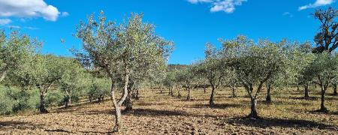

B.1. Natural Food Resources
B.1.1. Agriculture
Aim: Learner to gain the ability to address existing and upcoming ethical concerns in food production.
Agriculture and the food system include farming, resource management, food processing, logistics, and consumption. All of these components must follow ethical values and norms.
Sustainable agriculture must be performed to guarantee food security. As Food and Agriculture Organisation of the United Nations [FAO] (2003) mentions, "Food security exists when all people, at all times, have physical, social and economic access to sufficient, safe and nutritious food which meets their dietary needs and food preferences for an active and healthy life. Household food security is the application of this concept to the family level, with individuals within households as the focus of concern.". On the other hand, "Food insecurity exists when people do not have adequate physical, social or economic access to food as defined above" (FAO, 2003). Thus, it is essential to combat hunger and provide sufficient food for all.
In the FAO's Constitution, ethical values are already embedded.
Excerpt from the Preamble to FAO's Constitution
"raising levels of nutrition and standards of living of the people under their respective jurisdictions;
securing improvements in the efficiency of the production and distribution of all food and agricultural products;
bettering the condition of rural populations;
and thus, contributing towards an expanding world economy and ensuring humanity's freedom from hunger."
So, it is essential to obtain raw materials of high quality for everybody.
The learners are asked to watch the following series of videos and to discuss the theme of Sustainability afterward. EC AV PORTAL (europa.eu)
16

Slide 17

B.1. Natural Food Resources
B.1.1. Agriculture
Agriculture can damage ecosystems if it is not practiced sustainably.
To obtain more information on the 'Farm to Fork' strategy, please click here
In line with the 'Farm to Fork' strategy (European Union [EU], 2020), the EU proposed actions for the food production sectors that include the following quantifiable targets for 2030:
50% cut in the use and risk of chemical pesticides and in the use of more hazardous pesticides;
at least 20% reduced use of fertilizers;
50% cut in EU sales of antimicrobials for farmed animals and in aquaculture;
at least 25% area is to be organically farmed and a significant increase in organic aquaculture.
"Other roadmaps and policy initiatives will include measures for sustainable production in the farm animal and fish and seafood sectors, animal welfare and plant health" (EU, 2020).
In this way, sustainable agriculture is farming in a sustainable way to meet society's needs. It is essential to guarantee the future and the development of future generations. Thus, it is important to:
practice business processes and farming activities that seek to reduce the carbon footprint. Farming activities must minimise climate change, land degradation & deforestation and manage water to prevent its scarcity and pollution. Several activities can be implemented, such as permaculture, intercropping, crop rotation, etc. Implementing new green business models linked to carbon sequestration is essential, as they will help guarantee the climate neutrality objective;
follow environmentally friendly methods, allowing the production of crops and livestock without damaging humans or natural ecosystems. It is essential to preserve the soil, water, biodiversity and natural resources;
guarantee good working & living conditions for those that work & live on the farm or in neighbouring areas.
17

Slide 18

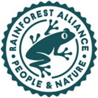


B.1. Natural Food Resources
B.1.1. Agriculture
Numerous sustainability standards and certification systems exist. To obtain more information on certification systems, please click here.
Some Examples of Certifications are:
If sustainability standards and certification systems are mentioned by food producers, the rules must be strictly followed.
Organic certification: This verifies that the farm or handling facility complies with the organic regulations. After being certified, the enterprises can sell, label, and represent the products as organic. For more information click here
This is the Organic production logo of the European Union.
Rainforest Alliance: this is an essential tool to support sustainable agricultural production and supply chain. The certificate holders maximise their practices' positive social, environmental, and economic impact.
This is the Rainforest Alliance logo.
Fair Trade: Fair trade is a global movement involving a network of producers, enterprises, consumers, and organisations that put people and the planet first. Choosing Fair Trade Certified™ goods support responsible companies, empower farmers, workers, and fishers, and protect the environment. It is a world-changing way of performing business.
GLOBALG.A.P.: It is the internationally recognised standard for farm production. It is available for three scopes of production: Crops, Livestock, and Aquaculture. It covers the following topics: Food safety and traceability; Environment (including biodiversity); Workers' health, safety and welfare; Animal welfare; Includes Integrated Crop Management (ICM), Integrated Pest Control (IPC), Quality Management System (QMS), and Hazard Analysis and Critical Control Points (HACCP). The consumer label of GLOBALG.A.P. is the GGN label.
The learners are asked to watch the following videos and to discuss them after:
Our New Certification Program Is Here! – YouTube
The Fair Trade Difference - YouTube
18

Slide 19
B.1. Natural Food Resources
B.1.1. Agriculture
A Code of Ethics:
Establishing a "Code of Ethics" is quite challenging because science performs research, stakeholders make market-based policies, and ethics are often left to everyone's personal responsibility. However, we need to institutionalise ethics in the food system, and the development of ethics committees by for instance colleges, universities, and research agencies is a step in the right direction. Nevertheless, the most critical ethical issues agriculture faces are represented below in Figure 2.
Food Safety versus Food Security: As mentioned before, the Food and Agriculture Organisation (FAO, 2006) defines food security as "the situation in which people have physical and economic access to sufficient safe and nutritious food, in line with dietary needs and food preferences and to allow an active and healthy life. Food self-sufficiency is defined as the extent to which a country can satisfy its food needs from its domestic production".
Safety of Food
Animals’ Treatment
Chemicals
Ethical issues: Agriculture
Farm Management
Sustainability
Trade Agreements
Sharing of Information
Figure 2 – Ethical issues that Agriculture is facing (Adapted from Burkhardt et al., 2005).
19

Slide 20
B.1. Natural Food Resources
B.1.1. Agriculture
The EU food system has developed its capacity to ensure high food security and self-sufficiency. So, the European Union has evolved into the concept of insecurity. This is mainly linked to food that leads to health issues rather than a lack of access to food, and to production and transport costs and governance more than a lack of resources. Thus, food safety is related to modern food production, and in which way the clients are exposed to additives, pathogens and other hazards. Inspection and transparency of how food is produced must be included here.
Accordingly, the use of areas where the environment poses a threat to the safety of food should be avoided. Contaminated sites, those near dirty water sources such as discharge of wastewater from industrial production or runoff from agricultural land with high faecal material or chemical residues must be prohibited. Furthermore, assessing the suitability of water used in agriculture is essential. It cannot pose a hazard, for example, in crop irrigation, rinsing activities, etc.
The application of pesticides and other chemicals has always been controversial. In some situations, farmers want to use products to combat pests or to increase productivity. However, some of these chemicals pose health problems. Moreover, the application of pesticides may promote the death of native species, for example, honeybees that are essential to pollination. However, it is crucial to control pests and diseases of animals and plants to guarantee food safety.
Furthermore, farmers need to use seeds more adapted to climate change. Thus, it would be advantageous to assist in registering seed varieties, including those for organic farming, and to facilitate the access to traditional and locally-adapted species.
Furthermore, food must always be produced under hygienic conditions. It is essential to follow Good Agricultural Practices (GAPs) and/or Good Hygiene Practices (GHPs) to minimise the occurrence and levels of hazards in the food chain.
Genetically modified organisms (GMO) – in Food Production ​
GMO is another hot subject, since there are contradicting views on specifically recombinant DNA (rDNA) technology, which "has allowed scientists to move genes across species’ boundaries, to create traits in plants, animals, and microorganisms that could never be accomplished using traditional crossbreeding techniques." (Burkhardt, 2001). European Academies Science Advisory Council (2013) claims "there is a wide range of opportunities in prospect for improving agricultural productivity and efficiency, environmental quality and human health, by using all available technologies where appropriate". On the other hand, some researchers emphasize the potential side effects on biodiversity, contamination of non-GMO with GMOs, financial pressure on farmers by monopolized seed producers (Glaab & Partzsch, 2018). However, the discussions should be case specific, and every product should be evaluated based on its conditions (Burkhardt, 2001), considering agricultural, biodiversity, cultural, and legislative differences.​
20

Slide 21

B.1. Natural Food Resources
B.1.1. Agriculture
Other Important considerations:
Animal Treatment: This subject includes the use of animals for meat and poultry or lab experiments, the extensive production of animal feed, and the impact of the production on the environment. Animal rights and welfare must also be included here. For more information on this topic, please read sections B.1.2 & B.4.2.
Chemicals: Pesticide residues in food can be harmful to people's health. Furthermore, pesticide exposure on workers must be considered. Pesticides contaminate water via infiltration, surface runoff and drift. They can also accumulate in the soil and adversely affect soil life. Furthermore, the use of pesticides also reduces biodiversity.
The EU has strict criteria for the authorisation of pesticides. Despite attempts to reach global harmonised standards, maximum residue levels vary widely from country to country.
To avoid pesticides, an Integrated Pest Management System can be used, which consists of the following elements:
Synthetic pesticides
Biopesticides
Ex. Pesticides based on natural products
Biological solutions
Ex. Natural enemies, pheromone traps
Mechanical solutions
Ex. Trapping or weeding
Prevention
Ex. Crop rotation,
intelligent crop combinations
Figure 3 - Elements of Integrated Pest Management (Source: Pesticide Atlas, n.d.)
21

Slide 22

B.1. Natural Food Resources
B.1.1. Agriculture
Important considerations - continued:
Integrated Pest Management System: The EU wants to promote greater use of safe alternative ways of protecting harvests from pests and diseases (EU, 2020). Thus, Integrated Pest Management will encourage the use of alternative control techniques, such as crop rotation and mechanical weeding, and will be one of the main tools in reducing the use of, and dependency on, chemical pesticides in general, and the use of more hazardous pesticides in particular (EU, 2020).
It is also necessary to reduce the use of some nutrients (especially nitrogen and phosphorus) in the environment. In fact, not all nutrients applied in agriculture are efficiently absorbed by plants, being a significant source of air, soil and water pollution (EU, 2020).
Farm Management: It is related to agriculture's general social and economic role in society. The average size of farms, relative market shares of different-sized farms, number of people employed in farming, and whether or not farms are owner-operated are subjects that must be addressed in this topic (Burkhardt et al., 2005). The human rights of farmworkers should also be included here. Farm workers often face horrible and unsafe conditions, are poorly paid, and often do not have health insurance.
Sustainability: There is a significant concern about how crop and livestock productions are managed: locally, nationally and globally. Agricultural practices that destroy the soil, result in chemical runoff to aquifers, and unconsciously harm wildlife are not sustainable. If we do not have a healthy environment, the future of food production may be at risk, especially as the world population continues to rise.
The EU farmers should try to reduce methane emissions from livestock (European Commission, n.d.-b). Growers can use renewable energy and anaerobic digesters to produce biogas. Wastes and residues, such as manure, and sewage, wastewater and municipal waste can be used to produce biogas. Solar panels can also be installed in farmhouses and barns. Those types of investments should be spotlighted.
It is also necessary to find out more sustainable and innovative feed additives. It is essential to decrease the dependency on feed materials that are critical (e.g. soya grown on deforested land) by promoting other vegetable proteins as well as alternative feed materials, namely insects, marine feedstocks (e.g. algae) and by-products (e.g. fish waste).
Trade Agreements: It is a question of fairness in how rules are set, who sets the rules and who benefits versus those pushed out of the market. The ethical issues are related to human rights and the fair distribution of resources.
Sharing information to help each other helps the entire industry and the world. For example, warning a fellow farmer of a parasite or pest issue versus letting it ruin their farm too, is unethical.
22

Slide 23
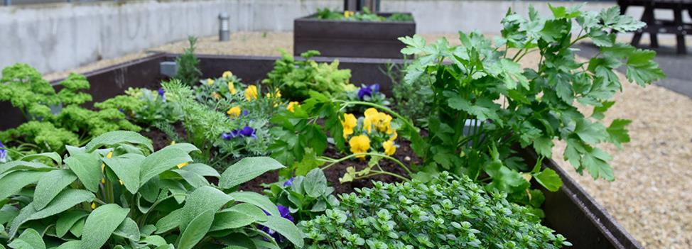
Relevant Case Studies to examine:
Carne d’Erva: discuss the topic of regenerative agriculture.
Frulact: discuss the topic of promoting agricultural best practices.
Individual Learner Assignment Suggestion:
Practical Activity 1:
Students can be asked to watch the following video and to discuss the adopted methodologies
Practical Activity 2:
The students are asked to choose one of the topics above (B.1.1. Agriculture) and find one scientific article about that subject. They should present it orally to their colleagues.
.
Practical Activity 3:
Read the article: Tisenkopfs T., Kilis E., Grivins M., Adamsone‑Fiskovica A. (2019). Whose ethics and for whom? Dealing with ethical disputes in agri-food governance. Agriculture and Human Values, 36, 353–364. The case studies presented may be discussed.
Publication Suggestions:
Burkhardt J., Comstock G., Hartel P.G., Thompson P.B., Chrispeels M.J., Muscoplat C.C., Streiffer R. (2005). Agricultural Ethics. CAST – Council for Agricultural Science and Technology, 29, p. 12 (ISSN 1070-0021).
Chrispeels M.J., Mandoli D.F. (2003). Agricultural Ethics. Plant Physiology, 132, 4–9.
Codex Alimentarius (2011). General Principles of Food Hygiene - CXC 1-1969. Adopted in 1969. Amended in 1999. Revised in 1997, 2003, 2020. Editorial corrections in 2011.
Commission Delegated Regulation (EU) 2020/691 of 30 January 2020, supplementing Regulation (EU) 2016/429 of the European Parliament and of Council as regards rules for aquaculture establishments and transporters of aquatic animals.
EU (2020). Farm to Fork Strategy - For a fair, healthy and environmentally-friendly food system. https://web.archive.org/web/20210504164007/https://ec.europa.eu/food/sites/food/files/safety/docs/f2f_action-plan_2020_strategy-info_en.pdf
FAO (2003). Trade reforms and food security. Commodity Policy and Projections Service - Commodities and Trade Division. https://www.fao.org/3/y4671e/y4671e00.htm#Contents
FAO (2006). Food Security. Policy Brief. June, Issue 2.
23

Slide 24

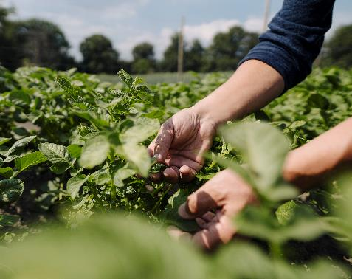
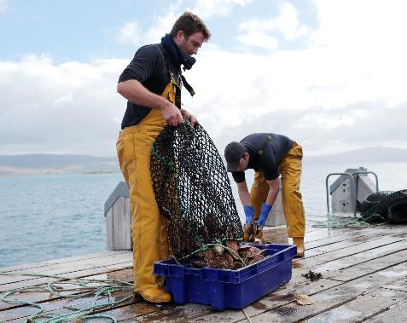
B.1. Natural Food Resources
B.1.2. Animal & Marine Welfare
Aim: Learner to understand the importance of Animal & Marine Welfare in ethical food production
Animals are a food source, but they must be treated well. Unethical treatment leads to lower-quality products, meaning it's worth investing in treating animals better. Concern about the use of steroids and hormones to boost growth and production must also be taken into account.
Increased animal welfare helps preserve biodiversity, improves animal health and the quality of meat, so reduces the need for medication. Furthermore, the citizens request this for moral reasons as well..
To obtain more information on how to handle animals, please click here
Sustainable fishing also protects biodiversity in the ocean and freshwater wildlife. Several fish and invertebrate species are consumed as food, while others are harvested for economic reasons (ex. oysters that produce pearls used in jewellery manufacturing) (National Geographic, n.d.). The demand for seafood and the use of modern technologies have led to fishing practices that are depleting some fish and shellfish populations. Overfishing consists of taking wildlife from the sea faster than populations can reproduce (National Geographic, n.d.). Thus, this kind of practice must be prohibited. Another problem is bycatch. It involves the accidental capture of species such as birds, sea turtles, etc. (National Geographic, n.d.). Purse seining and longlining may favour bycatch. Thus, it is urgent to employ sustainable fishing practices.
The learners are asked to watch the following video and to discuss it after:
Profit vs. ethics: Saving livestock from the slaughterhouse | - YouTube
24

Slide 25
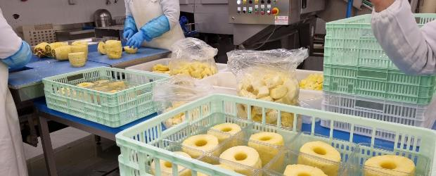
B.2. Food Production & Logistics
Aim: Learner to know the importance of maintaining good food manufacturing facilities, in terms of infrastructures and practices.
It is essential to follow effective food hygiene practices to prevent foodborne illnesses, foodborne injuries, and food spoilage. Actors involved are; farmers, importers, manufacturers and processors, warehouse/logistics operators, food handlers, and consumers, and they are responsible for ensuring that food is safe and suitable for consumption.
The main objective of a Food Business Operator [FBO] is to provide safe food. For some FBOs, it is enough to fulfill the WHO 5 keys to Safer Food.
The WHO 5 keys to Safer Food are:
keep clean,
separate raw and cooked,
cook thoroughly,
keep food at safe temperatures and
use safe water and raw materials.
FBOs need to be aware of hazards that may affect their food, Good Hygiene Practices [GHPs] being the foundation of any effective control of hazards associated with their businesses.
Nevertheless, in some situations, the implementation of GHPs may be insufficient to ensure food safety due to the complexity of the food operation and/or specific hazards associated with the product or process, technological advances, or end-use of the product. In these cases, when there are significant hazards that GHPs are not controlling, they should be considered in the Hazard Analysis and Critical Control Points [HACCP] plan. Thus, GHPs are the basis of all food hygiene systems to support the production of safe and suitable food.
To obtain more information on what must be considered in food manufacturing facilities, please click here
Definitions:
Food hygiene: All conditions and measures necessary to ensure the safety and suitability of food at all stages of the food chain (Codex Alimentarius, 2011).
Hazard: A biological, chemical or physical agent in food with the potential to cause an adverse health effect (Codex Alimentarius, 2011).
Good Hygiene Practices [GHPs] are the fundamental measures and conditions applied at any step within the food chain to provide safe and suitable food (Codex Alimentarius, 2011).
25

Slide 26
B.2. Food Production & Logistics
Further Considerations:
It is essential that the facilities where food products are prepared must allow the effective separation of product circuits that may contain allergens from those that cannot.
In addition, enterprises that produce Halal products must be Halal certified according to Codex Alimentarius Commission (Halal Certification Authority [HCA], 2022). Thus, it is essential to comply with the production rules of this certification scheme strictly. Furthermore, a kosher premise is a place where food is sold, cooked, or eaten that satisfies the requirements of Jewish law.
For example, concerning the Halal certification, the auditors will (HCA, 2022):
Inspect the inward storage, preparation, packing and finished goods storage areas;
See the production lines;
Perform laboratory testing if required;
Examine all the material in storage;
Ensure that the machinery is solely for Halal use;
Ensure no contamination with porcine or non-Halal goods;
Review documentation requested in the Halal Assurance Procedures Manual; and
Discuss the plan with Management.
Managing Hazards:
"A HACCP system identifies and enhances control of significant hazards, where necessary, over that achieved by the GHPs that have been applied by the establishment" (Codex Alimentarius, 2011). The objective of the HACCP system is to control the Critical Control Points [CCPs]. For each CCP, critical limits and corrective actions will be implemented when the limits established are not met. Thus, HACCP gives a consistent and verifiable control beyond that achieved by implementing GHPs.
To obtain more information on HACCP system, please click here
Definitions:
HACCP System: The development of a HACCP plan and the implementation of the procedures in accordance with that plan (Codex Alimentarius, 2011).
HACCP Plan: Documentation or set of documents, prepared in accordance with the principles of HACCP to ensure control of significant hazards in the food business (Codex Alimentarius, 2011).
26

Slide 27
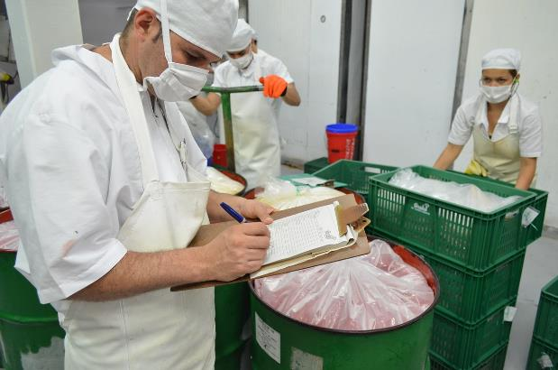
B.2. Food Production & Logistics
Further Considerations:
To make the processes during food production and manufacturing more sustainable, it is important to reduce water consumption, adopt energy sources with low carbon or zero carbon, promote waste recovery and reduce the emission of greenhouse gases. Thus, it is important to perform the following tasks:
the production processes must be reviewed frequently;
good practices for equipment operation must be implemented;
energy losses must be diminished, and flows with thermal potential must be reused;
the use of fossil energy resources must be reduced, and the percentage of incorporation of energy from renewable sources must increase.
Another point to consider is the training of the personnel. It is essential to promote the training of operators so that they can carry out food operations correctly and safely.
27

Slide 28
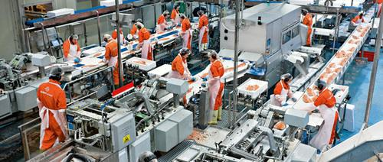
Individual Learner Assignment Suggestion:
Some Relevant case studies include:
BiaSol, Helsinki Mills,
FoodSpace
Practical Activity 1:
Students must choose a food product and/or service and describe how the facilities should be designed, as well as Good Hygiene / Manufacturing Practices.
Practical Activity 2:
The students are asked to create a HACCP plan for a food product and/or service they have chosen.
Practical Activity 3:
Read through some of the case studies presented here and select any that exhibit:
an efficient use of resources,
those with specific claims or labels and
those that foster personnel development
Publication Suggestions:
Codex Alimentarius (2011). General Principles of Food Hygiene - CXC 1-1969. Adopted in 1969. Amended in 1999. Revised in 1997, 2003, 2020. Editorial corrections in 2011.
Halal Certification Authority [HCA] (2022). https://halalauthority.org/certification/

Slide 29
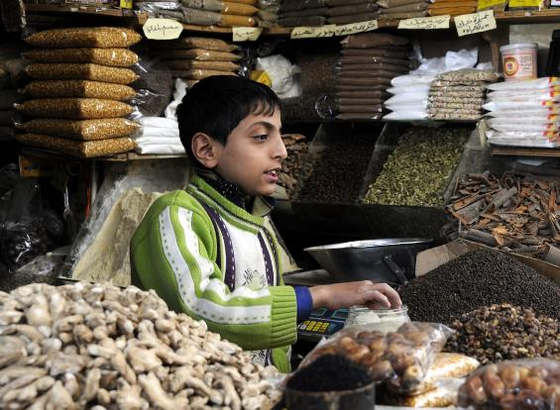
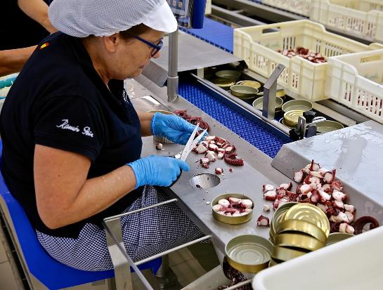
B.2. Food Production & Logistics
B.2.1. Working Conditions
Aim: Learner to recognise the Importance of Suitable Working conditions in Food Production Facilities
Child labour, proper salaries, the abuse of working hours, occupational safety, social rights for the workers, and gender equality are some of the ethical concerns in food manufacturing, delivering or selling businesses. According to the International Labour Organisation’s [ILO] (2021) report on Child Labour, there are 160 million children working worldwide, while 4.7% work in hazardous roles. According to the report, 72.1 % of child labour is caused by children helping families with work.
Difficulties for women working in the food sector should be addressed under the title of gender equality. Although women are expected to work in the kitchen in a household, commercial kitchens are dominated by men. Steavenson (2021) addresses this issue in the Financial Times. During the interview with the best female chef of 2017, Ana Ros, the necessity of categorising best chef rewards into genders is questioned.

Slide 30
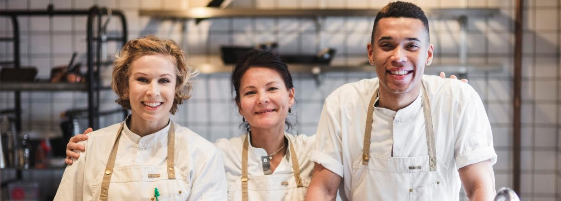
Individual Learner Assignment Suggestion:
Practical Activity 1:
Discuss the gender equality issues in kitchens and give applicable suggestions for the solution. Some beneficial resources indicating the problem are shared below.
Practical Activity 2:
In order to empathise with the people getting minimum wage, students can be asked to find the cheapest way to eat three meals in one day, and vlog their experience.
Publication Suggestions:
Rosalie Platzer (2011) Women Not in the Kitchen: A Look at Gender Equality in the Restaurant Industry (core.ac.uk)
Deirdre Falvey (2021) Why are there so few women chefs? – The Irish Times
Carley Thornell (2018) Kitchens Have a Gender Inequality Problem, Can It Be Fixed? (upserve.com)
Rawlinson, M.C. (2017) Women’s Work: ethics, home cooking, and sexual politics of food. In The Routledge Handbook of Food Ethics. Editors: Rawlinson, M. C. and Ward, C.
Useful Resources:
European Agency for Safety & Health at Work - Information, statistics, legislation and risk assessment tools. (europa.eu)
5th Global Conference on the Elimination of Child Labour - Conference Report
30

Slide 31
B.2. Food Production & Logistics
B.2.2. Accountability/traceability of raw materials
Aim: To know the importance of traceability in guaranteeing safe food production.
Unsafe products can be obtained when insufficient product information is given to the consumers and/or incorrect practices are applied. Such situations can cause disease or produce products unsuitable to be consumed. Insufficient product information about the allergens present in food can also result in illness or potential death for allergic consumers (Codex Alimentarius, 2011).
Thus, appropriate information must ensure (Codex Alimentarius, 2011):
adequate and accessible information is available to the next FBO in the food chain or the consumer;
consumers are able to handle, store, process, prepare and display the product safely and correctly;
consumers can identify allergens present in foods; and
the lot or batch can be easily identified and removed/returned if necessary.
Consumers must be well informed on food hygiene so that they can: (Codex Alimentarius, 2011):
be aware of the importance of reading and understanding the label;
make informed choices appropriate to the individual, including about allergens; and
prevent contamination and growth or survival of foodborne pathogens by storing, preparing and using the food correctly.
In this way, it is important to provide the following information (Codex Alimentarius, 2011):
Lot Identification and Traceability: If it is necessary to do a product recall or to perform a correct stock rotation, the lots must be identified. Thus, each container must have the producer and the lot identified. Furthermore, a traceability system should be conceived and implemented.
Product information: To use the products safely and correctly, all products must have information explaining how they must be stored and handled.
Product Labelling: Processed foods should be labelled with storage instructions to enable food to be handled, displayed, stored and used for the product safely. For more information, consult the section related to labelling.
31

Slide 32

Individual Learner Assignment Suggestion:
Practical Activity 1:
Ask students to analyse the labels of various food packaging and check if traceability is guaranteed. Discuss the method used by the food producer.
Practical Activity 2:
Ask the students to investigate new digital technologies that can be used in food traceability
Publication Suggestions:
Codex Alimentarius (2011). General Principles of Food Hygiene - CXC 1-1969. Adopted in 1969. Amended in 1999. Revised in 1997, 2003, 2020. Editorial corrections in 2011.
FDA announces some of the food & beverage recalls from the market, for several purposes, such as potential microbial contamination, undeclared materials (allergens, gluten, etc.).Please check the list of recalls; Recalls, Market Withdrawals, & Safety Alerts | FDA
A Hint for Activity 2:
Blockchain
Internet of Things [IoT]
QR Codes

Slide 33
B.2. Food Production & Logistics
B.2.3. Food Labelling
Aim: To understand the importance of food labelling.
Labelling means any words, particulars, trademarks, brand name, pictorial matter or symbol relating to food and placed on any packaging, document, notice, label, ring or collar accompanying or referring to such food (Regulation (EU) No 1169/2011).
Consumer health and interests always should be fulfilled. The final consumer must be able to make informed choices and safely use food, with particular regard to health, economic, environmental, social and ethical considerations. It is why labelling is essential.
National legislation on labelling must be scrupulously followed. In the European Union, any food intended for supply to the final consumer or mass caterers shall be accompanied by food information following Regulation (EU) No 1169/2011 of the European Parliament and of the Council of 25 October 2011.
Food information shall not be misleading, and it must not raise doubts about what concerns (Regulation (EU) No 1169/2011):
to the characteristics of the food and, in particular, to its nature, identity, properties, composition, quantity, durability, country of origin or place of provenance, method of manufacture or production;
attributing to the food effects or properties that it does not have;
alluding that the food possesses special characteristics when in fact, all similar foods contain such properties, in particular by emphasising the presence or absence of certain ingredients and/or nutrients;
suggesting, through the appearance, description or pictorial representations, the presence of a particular food or an ingredient, while in reality, a component naturally present or an ingredient generally used in that food has been substituted with a different component or a different ingredient.
Food information shall be accurate, clear and easy to understand for the consumer.
The FBO responsible for the food information shall be the operator under whose name or business name the food is marketed or if that operator is not established in the Union, the importer into the Union market.
To obtain more information on labelling, namely the mandatory particulars, please click here
33

Slide 34
B.2. Food Production & Logistics
B.2.3. Food Labelling
The food information on the package must appear in a language easily understood by the consumers.
It is important to avoid possible misunderstanding between 'use by' and 'best before' dates, which may lead to food waste. So, the consumers should have more information on this subject.
"Regarding distance selling, the mandatory food information, except the date of minimum durability or the 'use by' date, shall be available before the purchase is concluded and shall appear on the material supporting the distance selling or be provided through other appropriate means clearly identified by the FBO" (Regulation (EU) No 1169/2011). Furthermore, all mandatory particulars shall be available at the time of delivery (Regulation (EU) No 1169/2011).
Allergens
It is fundamental to inform the consumers of the presence of allergens. Labels serve this purpose.
To obtain more information on allergens, please click here
The name of the substance or product considered an allergen shall be emphasised through a typeset that clearly distinguishes it from the rest of the list of ingredients (Regulation (EU) No 1169/2011).
A different font, style or background colour can be used to make the distinction. In the absence of a list of ingredients, the indication of the substance or product considered an allergen shall comprise the word 'contains' followed by the name of the substance or product (Regulation (EU) No 1169/2011).
Nutritional declaration of the product: The mandatory nutrition declaration shall include the following (Regulation (EU) No 1169/2011):
energy value; and
the amounts of fat, saturates, carbohydrates, sugars, protein and salt.
"Where appropriate, a statement indicating that the salt content is exclusively due to naturally occurring sodium may appear close to the nutrition declaration" (Regulation (EU) No 1169/2011).
Nevertheless, some foods are exempted from the requirement of the mandatory nutrition declaration. To obtain more information on this topic, please click here
34

Slide 35
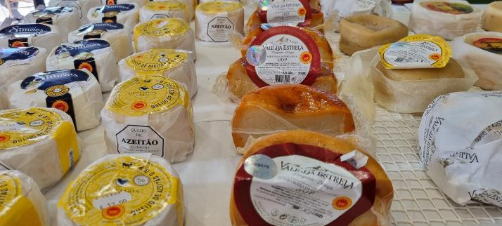
B.2. Food Production & Logistics
B.2.3. Food Labelling
The content of the nutrition declaration is mandatory and should include the amounts of one or more of the following (Regulation (EU) No 1169/2011):
(a) mono-unsaturates;
(b) poly-unsaturates;
(c) polyols;
(d) starch;
(e) fibre;
(f) vitamins (such as Vitamins A, D, E, K and C, Thiamin, Riboflavin, Niacin, Vitamin B6, Folic acid, Vitamin B12 and Biotin) or minerals present in significant amounts, as indicated in Part A, Annex XIII of Regulation (EU) No 1169/2011.
The energy value and the amount of nutrients shall be expressed per 100 g or per 100 ml.
In addition, the values may be described per portion and/or per consumption unit; however, the portion or consumption unit must be easily recognisable by the consumer (Regulation (EU) No 1169/2011). It is necessary to provide that information on the label and the number of portions or units contained in the package (Regulation (EU) No 1169/2011).
"Where a nutrition and/or health claim is made for a nutrient, the amount of that nutrient shall be declared" (Regulation (EU) No 1169/2011)
Additives
Food additives that are added to the food must be designated in the ingredients list by the name of the category they belong.
Additives must be identified by their specific name or, if appropriate, E number.
To obtain more information on additives, please click here.
Nowadays, consumers look for authentic, fresh, lower-salt and clean-label ingredients.
Consumers look forward to an additive-free lifestyle. Nevertheless, this is a challenging topic for the food industry that must guarantee food safety through other means than preservatives. The demand for new preservatives based on natural products has recently grown.
35

Slide 36
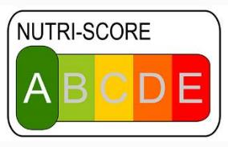
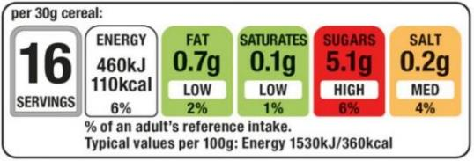

B.2. Food Production & Logistics
B.2.3. Food Labelling
Functional foods
Healthy diets consist of eating nutritious foods and identifying the mechanisms by which foods modulate metabolism and health. Functional foods may be defined as any food that positively impacts an individual's health, physical performance, or state of mind, in addition to its nutritious value. To be considered functional foods, these products must be consumed regularly and have a beneficial, well-identified and scientifically proven effect on the individual's health, in addition to their well-known nutritional qualities (Pinto, 2010).
Nutraceuticals often incorporate extracts produced from food, synthesised substances or plants. Thus, a product isolated or purified from food is obtained but is presented to the consumer with the same appearance as medicines. As a result, the consumer is exposed to a much higher dose of bioactive compounds than he/she would normally ingest through his/her diet (Pinto, 2010).
These nutraceuticals can help in fighting diseases such as obesity, cardiovascular diseases, cancer, osteoporosis, arthritis, diabetes, cholesterol etc. since they include healthy components such as dietary fibre, prebiotics, probiotics, polyunsaturated fatty acids and antioxidants.
It is important to mention that nutraceuticals can be classified into two groups: potential nutraceuticals and established nutraceuticals. A potential nutraceutical can become an established one, only after efficient clinical data on its health and medical benefits are obtained (Das et al., 2012).
In line with the 'Farm to Fork' strategy, the EU proposed actions for food consumption which include increased customer awareness about food choices for healthy and sustainable diets, having front-of-pack labelling of food, facilitating taxation to change to healthy and sustainable eating habits, setting goals to reduce food waste, including 'use by' and 'best before' dates.
One current approach to labelling is the Nutri-score (Figure 4), in which a 5-step colour and letter scale provides an overview of the nutritional quality of the food, however, it has some flaws and can be misleading. A global standardised food labelling system is required.
Figure 4 –Example of a Traffic Light Label or Nutri-score system. (Wikimedia)
It is needed, in the future, to propose a sustainable food labelling framework to empower consumers to make sustainable food choices.
36

Slide 37
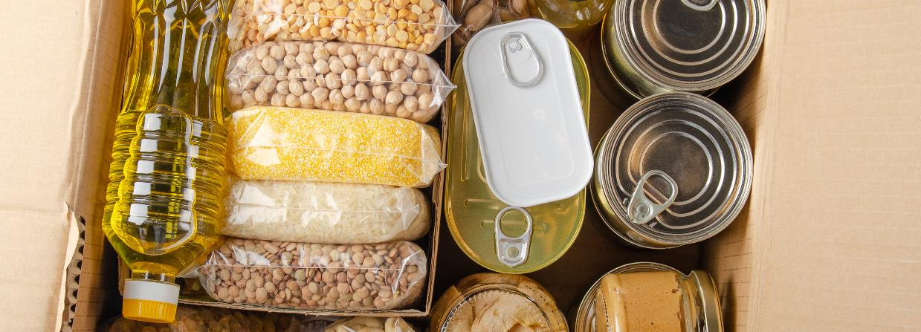
Individual Learner Assignment Suggestion:
Case studies worth checking out:
Cream of the Crop
FruLact
Camile Thai
Practical Activity 1:
Ask students to watch this video and discuss the link between food labelling and food waste.
Practical Activity 2:
Ask students to analyse the labels of various food packaging and check if all mandatory particulars are mentioned.
Practical Activity 3:
The students are asked to study the ingredients lists of various food packaging to check the existence of allergens and additives and to discuss their findings.
Practical Activity 4:
The students are asked to consult the RASFF Window - Search (europa.eu) to check the existence of food fraud in their country
Publication Suggestions:
Das L., Bhaumik E., Raychaudhuri U., Chakraborty R. (2012). Role of nutraceuticals in human health. Journal of Food Science and Technology, 49(2), 173-183.
Pinto J.F. (2010). Nutracêuticos e Alimentos Funcionais. Lidel. p. 3-10.
Regulation (EU) No 1169/2011 of the European Parliament and of the Council of 25 October 2011 on the provision of food information to consumers, amending Regulations (EC) No 1924/2006 and (EC) No 1925/2006 of the European Parliament and of the Council, and repealing Commission Directive 87/250/EEC, Council Directive 90/496/EEC, Commission Directive 1999/10/EC, Directive 2000/13/EC of the European Parliament and of the Council, Commission Directives 2002/67/EC and 2008/5/EC and Commission Regulation (EC) No 608/2004 (consolidated version of 01 January 2018).
37

Slide 38
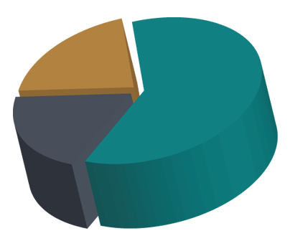
B.2. Food Production & Logistics
B.2.4. Food Waste Management
Aim: To understand the importance of food waste management.
According to FAO’s report in 2013, global food waste is 1.3 billion tonnes per year. The wasted food is higher in developed countries (Buzby and Hyman, 2012), such as the food waste in the US is estimated to be 30 to 40 % (Food and Drug Administration [FDA], 2021).
Food waste is an issue that affects all aspects of society, producers, growers, retail, hospitality, consumers and those who experience food poverty, with roughly one-third of all food produced going to waste. Considering the hunger that the world is facing, food waste management becomes essential. There are several theories and methods, suggesting a more sustainable food production and consumption, such as the 3Rs (Reduce-Reuse-Recycle), producing biofuels (such as biodiesel, biogas), composting food leftovers, compound extraction of food waste for industrial use, etc.
In Figure 5, the three main categories of food waste are represented.
20% unavoidable food waste
60%
avoidable food waste
20%
potentially avoidable food waste
Figure 5 - The 3 Main Categories of Food Waste (Source- SUSTAIN)
38

Slide 39
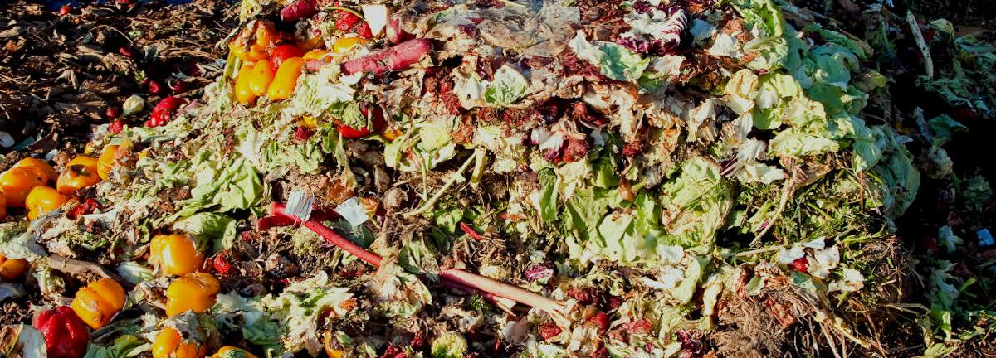
Good Practices of Zero Waste:
Silo London, is established with the idea of having a bin-free restaurant and ended up being the first zero-waste restaurant in the world.
Nãm, Turning spent coffee grinds into growing material for mushrooms
Individual Learner Assignment Suggestion:
Practical Activity 1:
Ask students to sort their home waste into 5 categories (paper, plastic, glass, metal, other) for a week, make a short video or a presentation about your experience.
Practical Activity 2:
Ask students to go Dumpster Diving for one day (group work can be better) and make a short video or a presentation about their experience. (Disclaimer: this can be seen as a high-risk activity, discuss with your organisation’s governance committee prior to initiating this activity)
Practical Activity 3:
The students are asked to try making compost at home and make a short video or a presentation about their experience. (Optional)
Site Visit Suggestions:
Waste Recycling Facilities can be visited to understand the regional capabilities regarding waste reduction, recycling and reuse.
A kitchen with a proper waste sorting system can be visited.
The garbage dump (landfill) can be visited.
39

Slide 40

B.2. Food Production & Logistics
B.2.5. Packaging
Aim: To understand the importance of packaging, as well as the advantages of using biodegradable materials and to understand the difference between active packaging and intelligent packaging.
The lifestyle of the consumer is changing. They look forward to clean, high quality, fresh, minimally-processed and ready-to-eat products, which also must have an extended shelf-life. Thus, packaging technology needs to modernise. Packaging is required to protect the food, to minimise contamination, give information by labelling.
Food packaging performs three essential functions: containment, quality preservation and protection from environmental, physical and microbiological factors.
Where used, packaging materials or gases may also be the source of toxic contaminants that threaten the safety of consumers, therefore packaging materials should meet proper storage and usage conditions. Any reusable packaging should be suitably durable, easy to clean, and where necessary disinfectable (Codex Alimentarius, 2011).
Packaging companies are trying to find increasingly sustainable solutions with less environmental impact throughout the life cycle of products, reducing the amount of the material used and promoting the usage of recycled materials that meet the principles of the circular economy. There is an increasing demand for alternative materials, such as cellulose, bioplastics, etc., or bulk sales, to reduce the packaging used to contain products. However, bulk sales cannot offer safety and food waste reduction, traceability and quality control to the final consumer, identification of the food with its producer or the possibility of having a communication surface for promotions or marketing.
The EU intends to reduce plastic contamination, highlighting the "European Strategy for Plastics in the Circular Economy" (Figure 6), in which an ambitious goal is established for the year 2030, in which all packaging must be reusable, recyclable or compostable. Heavier packages have a more significant carbon footprint because packages that weigh more require a greater amount of raw materials in their production and a higher cost of transport and energy consumption.
EFFECTIVE
EFFICIENT
Figure 6. The main principles of the EU Strategy for Plastics in the Circular Economy (www.foodinnovation.how)
Fit for purpose
Materials, energy, water
SUSTAINABLE PACKAGING
SAFE
CYCLIC
Renewable and/or recyclable
Non-polluting &
non-toxic
40

Slide 41

B.2. Food Production & Logistics
B.2.5. Packaging
Intelligent packaging technology and active packaging are emerging technologies within the food packaging field that intend to increase the shelf-life of the products, guarantee food safety and reduce waste.
What are the main differences between intelligent packaging technology and active packaging?
Intelligent packaging technology is described as "the science and technology that introduce the communication tools for a food packaging system to monitor changes in the internal and external environmental conditions of the system as well as the packaged food to communicate the status of the system to the stakeholders of the supply chain including producers, retailers and consumers" (Firouz et al., 2021).
Active packaging is defined as "packaging in which subsidiary constituents have been deliberately included in or on either the packaging material or the package headspace to enhance the performance of the package system" (Firouz et al., 2021).
In developing and manufacturing active systems, the requirements and standards of different regulatory agencies (such as the European Food Safety Authority (EFSA, European Union) or Food and Drug Administration (FDA, USA)) must be followed.
Nevertheless, using this kind of packaging raises challenges linked to consumer acceptance, environmental safety concerns and marketability. Furthermore, the active packaging systems' major hurdle is the active materials' capability to preserve their original characteristics. Nanotechnology is an emerging approach that can be applied to overcome this challenge. Moreover, consumers demand safe antimicrobial materials thus, the present trend is to find out natural antimicrobials and biopolymers.
To obtain more information on alternatives to plastics and intelligent/active packaging, click here
Definition
Intelligent packaging is an innovation in food packaging that can monitor the quality of food products for consumers.
Water 'packaged' in edible Seaweed based ‘plastic’ film.
41

Slide 42


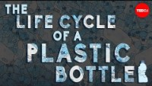

Website Here
Individual Learner Assignment Suggestion:
A thought provoker!
What really happens to the plastic you throw away - Emma Bryce - YouTube
CLICK TO VIEW
Practical Activity 1:
Ask students to analyse various food packaging and see what they are made out of. They should discuss the degree of degradability of the materials used.
Practical Activity 2:
Ask students to consult the RASFF portal to check the existence of problems in packaging.
Practical Activity 3:
The students are asked to choose one of the topics above and find one scientific article about that subject. They should present it orally to their colleagues.
Publication Suggestions:
Asgher M., Qamar S.A., Bilal M. & Iqbal H.M.N. (2020). Bio-based active food packaging materials: sustainable alternative to conventional petrochemical-based packaging materials. Food Research International, 137, 109625 (p. 12).
Bhargava N., Sharanagat V.S., Mor R.S. & Kumar K. (2020). Active and intelligent biodegradable packaging films using food and food waste-derived bioactive compounds: A review. Trends in Food Science & Technology, 105, 385-401
Codex Alimentarius (2011). General Principles of Food Hygiene - CXC 1-1969. Adopted in 1969. Amended in 1999. Revised in 1997, 2003, 2020. Editorial corrections in 2011.
Firouz M.S., Mohi-Alden K. & Omid M. (2021). A critical review on intelligent and active packaging in the food industry: Research and development. Food Research International, 141, 110113 (p. 24).
42

Slide 43
B.2. Food Production & Logistics
B.2.6. Logistics / Transportation
According to the United States Environmental Protection Agency (EPA), 27% of greenhouse gas emissions are due to transportation and burning fossil oil specifically in 2020. Accordingly, this part focuses on the transportation of raw materials, animals and products.
Transporting animals (Animal welfare and rights)
The welfare requirements of animals must always be strictly followed, and the legislation must be complied with. No person shall transport animals or cause animals to be transported in a way likely to cause injury or undue suffering to them. In the EU, the technical rules mentioned in Annex I of Council Regulation (EC) No 1/2005 must be strictly followed.
Considering the Council Regulation (EC) No 1/2005 of 22 December 2004 on the protection of animals during transport and related operations and amending Directives 64/432/EEC and 93/119/EC and Regulation (EC) No 1255/97, the following conditions in the transport of animals shall be complied with:
a) all necessary arrangements must be made in advance to minimise the length of the journey and meet animals' needs during the journey;
b) the animals are fit for the journey;
c) the means of transport are designed, constructed, maintained and operated to avoid injury and suffering and ensure the safety of the animals;
d) the loading and unloading facilities are adequately designed, constructed, maintained and operated to avoid injury and suffering and ensure the safety of the animals;
e) the personnel handling animals are trained or competent as appropriate for this purpose and carry out their tasks without using violence or any method likely to cause unnecessary fear, injury or suffering;
f) the transport is carried out without delay to the place of destination, and the welfare conditions of the animals are regularly checked and appropriately maintained;
g) sufficient floor area and height is provided for the animals, appropriate to their size and the intended journey;
h) water, feed and rest are offered to the animals at suitable intervals and are appropriate in quality and quantity to their species and size.
The transporters, keepers and assembly centres must comply with the legislation.
43

Slide 44

B.2. Food Production & Logistics
B.2.6. Logistics / Transportation
Short food supply chains
Consumers, policymakers, researchers, food producers and suppliers are very interested in guaranteeing the sustainability of food chains. Short food supply chains [SFSC] have appeared as an excellent alternative to globalised food chains.
SFSC represents an alternative food system that aims to achieve sustainability goals.
The SFSC sustainability goals are represented in the following figure:
Thus, SFSC is a value-based supply chain that includes social, health and environmental values and implications. The most intuitive and frequently cited feature of SFSC is geographical proximity, that is, the closeness between producers and consumers, which may be measured by political boundaries, that is, in terms of regions or countries, distance, or time (Zepeda and Leviten-Reid, 2004).
To obtain more information on short food supply chains (SFSC), please click here
Good Governance
Corporate ethics
Accountability
Participation
Economic
Resilience
Vulnerability
Product quality
and information
Local economy
SFSC
sustainability
goals
Environment
Atmosphere
Water
Soil/Land
Biodiversity
Raw-materials
Energy
Animal welfare
Social well-being
Decent livelihood
Labour rights
Equity
Human safety and health
Cultural diversity
Figure 7 - SFSC sustainability goals (Adapted from Paciarotti and Torregiani, 2021).
44

Slide 45
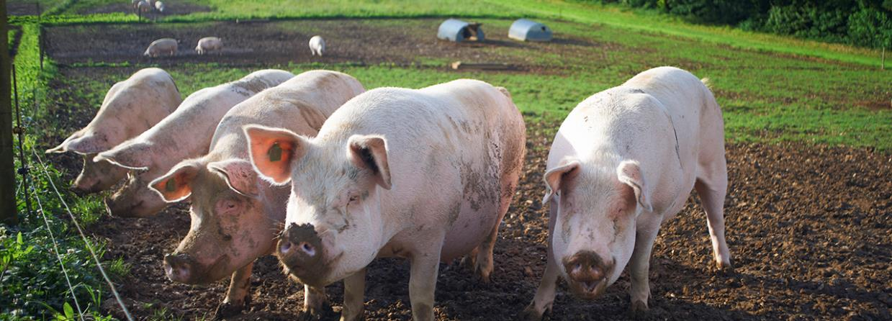


Case Studies:
That demonstrate how to run successful businesses using Short Food Supply Chains…
Loam
FoodSpace
Nolla
Individual Learner Assignment Suggestion:
Practical Activity 1:
The students are asked to see the following video:
SMARTCHAIN Smart Solutions in Short Food Supply Chains - Bing video
and discuss if SFSC exists in their city.
Publication Suggestions:
Council Regulation (EC) No 1/2005 of 22 December 2004 on the protection of animals during transport and related operations and amending Directives 64/432/EEC and 93/119/EC and Regulation (EC) No 1255/97 (consolidated version of 14 December 2019).
The European Food Information Council [EUFIC] (2021) Food Facts for Healthy Choices
Paciarotti C. & Torregiani F. (2021). The logistics of the short food supply chain: A literature review. Sustainable Production and Consumption, 26, 428-442.
Regulation (EC) No 1305/2013 of the European Parliament and of the Council of 17 December 2013 on support for rural development by the European Agricultural Fund for Rural Development (EAFRD) and repealing Council Regulation (EC) No 1698/2005 (consolidated version of 30 June 2022);
Slow Food (2013), Slow Food's Contribution to the Debate on the Sustainability of the Food System
CLICK TO VIEW
Website Here
45

Slide 46
B.3. Food Marketing
B.3.1. Pricing & Affordability
Aim: Learner understands the importance of Pricing & Affordability
Food pricing and affordability are quite important topics in today’s world as there is an increase in global food demand. The UN Food and Agriculture Organisation (FAO, 2009) expects global food demand to rise by 60%-100% by 2050. Rising populations and higher urbanisation are the two leading reasons for the increase in global demand. In more detailed terms, the FAO estimates that by 2050, to satisfy the demands of this growing and wealthier population with an increased meat demand, food production will have to increase by at least 50%: from 8.4 billion tonnes today to 13.5 billion tonnes to provide for a projected population of 9.7 billion in 2050. This rise is expected to cause an increase in food prices.
To support the competitiveness of European Union countries in the food and drinks industry, the Commission established the High-Level Forum for a Better Functioning Food Supply Chain in 2015 (European Commission, n.d., Forum for a better-functioning food supply chain). The forum addresses fair trade practices and price fluctuations. The Forum’s 2019 report, emphasises the changing demands in the food industry; globalisation of the supply chain which results in increased transportation and storage costs; leads to a demand for local food products – Gastro-nationalism – supported by increased e-commerce serving directly to the customer. Accordingly, the forum recommends some actions for the future, such as “the urgency to shift to more sustainable food systems”, the need for R&D studies and stimulating high value-added jobs in the sector (European Commision High Level Forum, 2019).
Besides the increase in global demand for food, pricing and affordability are also important considerations for a healthy and balanced diet. Malnutrition, and therefore unhealthy eating habits could be the result of high food prices. Price and affordability can be key barriers to accessing sufficient, safe, nutritious food to meet dietary needs and food preferences for an active and healthy life (Herforth et al., 2020).
Food pricing is quite important, as there should be fair trade prices so that food is more affordable to a vast group of people. Fair-trade price is the price that to be paid regardless of the market price. "As long as the trade price is above the fair-trade price, it allows traders and producers to negotiate higher prices depending on the quality and other attributes. However, a range of inter-related factors influence food prices, including political, economic, socio-cultural and environmental factors at local, national and international levels" (The Economic Times, 2023).
Climate variability, economic slowdowns and downturns are the major drivers for unstable food prices. The COVID-19 pandemic made the pathway of food price instability even steeper.
Suggested Video: Please check out this video about the State of Food Security and Nutrition in the World in 2022, published by FAO
46

Slide 47
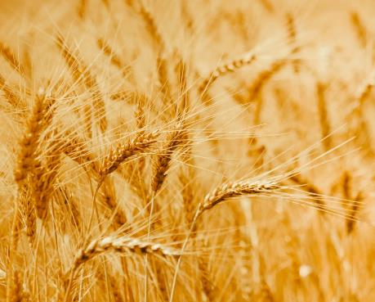
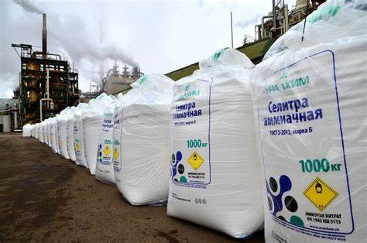
B.3. Food Marketing
B.3.1. Pricing & Affordability
In addition to many factors as mentioned above, the wars may also cause food insecurity, price fluctuations and inflation. Scarcity in basic commodities such as wheat, edible oils, or fertilisers, may result in global crisis. Regarding Russia - Ukraine War, a major challenge would be accessing fertilisers which can reduce food production all around the world (Worldbank, Commodity Markets Outlook, 2022). For instance, "Russia and Belarus are major fertiliser exporters, accounting for 38% of potassic fertilisers, 17% of compound fertilisers, and 15% of nitrogenous fertilisers" (Worldbank, n.d.-a).
Diet costs have risen in recent months, with food price inflation above 5% in many countries as a result of the COVID-19 pandemic, climate shocks, the war in Ukraine among other factors. Urgent action is needed to address food insecurity in 2022 (Worldbank, n.d.-b). Consequently, there seems to be an uncertain future for food supply and prices. This uncertainty could affect the affordability of food to millions of people from all over the world. Higher prices could impact access to healthy food, causing an increase in poverty. To make healthy diets cheaper, agricultural policies, research, and development need to shift toward a diversity of nutritious foods (Herforth et al., 2020).
47

Slide 48
B.3. Food Marketing
B.3.2. Intellectual Property Rights
"Intellectual property [IP] refers to creations of the mind in literary and artistic works, designs, symbols, names and images used in commerce" (World Intellectual Property Organisation [WIPO], n.d.). According to WIPO, IP is classified as patents, copyright and trademarks, and the idea is protected by law which enables owners to gain recognition or financial benefits. However, IP is an issue in the food sector.
Since the taste of a food is subjective, protection of the taste may be a difficult issue. For instance, the Court of Justice of the European Union (2018) decides to reject IP rights since "the taste of a food product cannot be classified as a ‘work’ and consequently is not eligible for copyright protection under the Directive". The subjectivity would lead to legal uncertainty, which means decision-makers may not be able to clearly define the scope of the protection (Saunders and Flugge, 2021).
Intellectual Property Protection for food can be classified as follows:
Trade Secrets
Trade secret protection eases knowledge transfer, supports commercial ethics and helps with economic development (Saunders and Flugge, 2021). For instance, Coca-Cola’s formula and taste are a trade secret and protected more than 130 years, only the company knows how to make the product (Cola Cola,2020).
Copyrights
Copyright "is a type of intellectual property that protects original works of authorship as soon as an author fixes the work in a tangible form of expression" (United States Copyright Office, n.d.). To be eligible for protection, a piece of creative work should be both original and preserved in a concrete form, such as being recorded or conserved in some stable physical format (Cornell Law School, 2020). Protection of recipes, as referred by United States Copyright Office (n.d), list of ingredients is not legally protected but a recipe or formula which is defined by a substantial literary expression, such as a cookbook, copyright protection becomes possible.
Utility and Design Patents
A patent is "an exclusive right granted for an invention" which means it is the right to a product or process that usually offers a new way of doing things or a new technical solution that is published in a patent application (World Intellectual Property Organisation, n.d.)
48

Slide 49

B.3. Food Marketing
B.3.2. Intellectual Property Rights
Patents discussed further:
a) Utility Patent Protection
A utility patent is a “process, machine, manufacture, or composition of matter" that is new or an improvement (United States Patent and Trademark Office, 2016). Considering recipes or food products, the process must include preparation or if the product is a combination of ingredients for legal protection (Arons, 2015).
Recipe and food utility models are possible such as: a recipe for instant stuffing mix, a method for making a microwaveable sponge cake, burrito on a stick, cereal coated with dry milk, a process for making fruit ganache, yogurt cream cheese, microwaveable sponge cake, sugarless baked goods, an egg substitute, processes for making fried baked potato pieces, low-fat potato chips, frozen popsicles, and battered foods (Saunders and Flugge, 2021).
b) Design Patent Protection
Design patents protect how an article appears, such as new, original, and ornamental design (Saunders and Flugge, 2021). Food designs protections may include packaging, arrangement or the display (Brown, 2022), such as design of o cookie, a package, The Heinz's Dip and Squeeze ketchup packet.
Trademarks and Trade Dress
"A trademark is any name, phrase or symbol that functions as a brand, that is, it tells the public that there is a particular source or manufacturer for products or services" (Kattwinkel, 2017). They drive competition by giving a product or company a corporate identity and marketing advantage, accordingly start-ups use this right to establish their identity (Halt et. al., 2017).
Trade dress refers to "design and shape of the materials in which a product is packaged" (Cornell Law School, n.d.). In another words, it is the in general commercial appearance of an item or benefit that demonstrates or recognizes the source of the item or benefit and distinguishes it from those of others (International Trademark Association, n.d.). As Saunders and Flugge example (2021); Pepperidge Farm’s Milano Cookies, Carvel’s Fudgie the Whale Ice, Cream Cake, Dairy Queen ice cream curl on top, Hershey’s kisses, Hershey’s chocolate bar.
Publication Suggestions:
https://www.reuters.com/article/us-eu-copyright-netherlands-food-idUSKCN1NI1IN
49

Slide 50
B.4. Responsible Consuming & Civil Society
Aim: Learner to understand what Responsible Consumption is…
Who is a responsible consumer? It is a question of debate whether people are responsible consumers as they consume food. A socially responsible consumer is a “consumer basing his or her acquisition, usage, and disposition of products on a desire to minimise or eliminate any harmful effects and maximise the long-run beneficial impact on society” (Mohr et al., 2001, p. 47). In today’s world, responsible food consumption is critical for many reasons. Firstly, household food consumption is responsible for more than 60% of global greenhouse gas emissions and 50-80% of total resource use (Ivanova et al., 2016). Secondly, environmental sustainability is an important fact for the world’s future.
Environmentally Sustainable Food Consumption [ESFC] can be defined as the use of food products “that respond to basic needs and bring a better quality of life, while minimising the use of natural resources, toxic materials and emissions of waste and pollutants over the life cycle, so as not to jeopardise the needs of future generations” (Oslo Roundtable on Sustainable Production and Consumption, 1994). It is possible to combine the two concepts and state that a responsible consumer is a person who is also caring for environmental sustainability at all stages from farm to fork.
There are a lot of different consumers with different preferences and choices related to culture and food consumption habits. Eating habits, defined as conscious and repeat behaviours overs certain diets (Rivera Medina et. al., 2020) are hard to change. Food preferences are also subject to the marketing of food to influence changes in food preferences and cultural values underpinning food behaviours (Cairns, 2019). Considering the efforts to change into a more sustainable consumption habit, many people already have positive attitudes (Vermeir et.al., 2020).
Sustainable and responsible consumption goals, mainly cover production as well. Several organisations publish a list of the goals, covering a broad area. The focus is on choosing, using, and disposing of goods to protect resources and people (Salonen, 2013) in a world where moral rights are sacrificed to economic growth (Bauman, 2008).
50

Slide 51

B.4. Responsible Consuming & Civil Society
Four environmentally responsible consumption behaviours can be listed:
reduce (save energy and water),
reuse (e.g., plastic bags, bottles),
recycle, and
purchase organic products.
All stakeholders in food sector have responsibility. For example, "producers need to grow more food while reducing negative environmental impacts such as soil, water and nutrient loss, greenhouse gas emissions and degradation of ecosystems and consumers must be encouraged to shift to nutritious and safe diets with a lower environmental footprint" (FAO, n.d.-b).
Responsible food consumption should also include decreasing food losses and food waste which may be land, water, energy and other inputs (FAO, 2011). Sustainable consumption and production can also contribute to the transition towards green economies (UN, n.d.). Green consumption is another expression that covers "environmentally responsible behaviour characterised by advocating nature and protecting the ecology" which is closely associated with sustainable consumerism (Yue, et.al., 2020). Food losses could be during agricultural production, harvest operation, processing, storage, transportation, distribution and consumption.
The COVID-19 pandemic offered countries an opportunity to build recovery plans that would reverse current trends and change our consumption and production patterns toward a more sustainable future. Sustainable consumption and production can also contribute substantially to poverty alleviation and the transition towards low-carbon and green economies.
As responsible consumers, we should also be very sensitive in food consumption if we want to leave a sustainable environment to our grandchildren.
Music Suggestions:
Some songs to increase ethical sensitivity;
Queen - Is this the World We Created...? (Official Lyric Video) - YouTube
In The Ghetto Elvis Presley With Lisa Marie Presley - YouTube
51

Slide 52

B.4. Responsible Consuming
B.4.1. The Effect of Marketing and Media
The Effect of Marketing and Media on Food Consumption
Marketing has a pervasive impact on our life. The American Marketing Association [AMA] (2017) defines marketing as activities, institutions, and processes for creating, communicating, delivering, and exchanging services of value. Creating customer value is the major purpose of marketing via well-established customer relations in the long run.
Customer relations are established via many different practices. These practices take place as a result of the marketing processes which include product, price, promotion, place, people, physical evidence and process. Promotion includes advertising, sales promotion, digital marketing and all other types of campaigns to create a positive influence on customers in order to convince them to act in favour of the product or service, ending with the purchasing decision.
Food marketing is a specific area where marketing endeavours concentrate on promoting food. That may result in an increase in food consumption or a change in food choices.
"Food consumption is variably affected by a whole range of factors including food availability, food accessibility and food choice, which in turn may be influenced by geography, demography, disposable income, urbanisation, globalisation, marketing, religion, culture and consumer attitudes" (Kearney, 2010). Food consumption is different in different societies, however, the impact of food marketing on food consumption is inevitable. For example, the role of TFCs (Transnational Food Corporations) and the growth of supermarkets in developing countries, lie at the very centre of food consumption patterns.
Figure 8 – The Brand Positioning Quad – Emotional Vs Rational Thinking (www.foodinnovation.how)
How the brand
Makes me look
What the product
Does to me
symbols
Essence
Brand
personality
facts
How the brand makes me feel
How I would describe the product
Emotional
Rational
52

Slide 53
B.4. Responsible Consuming
B.4.1. The Effect of Marketing and Media
Today, there are many food trends and drivers as it has been in the past. For instance, in 1945, Americans were drinking more milk than carbonated soft drinks, where 50 years later, carbonated beverages are preferred over milk due to advertising (Kearney, 2010).
Initiatives on changing food consumption behaviours for a more sustainable future may need improvements (Hedin et.al., 2019). On the other side, variety in food products with less seasonal dependence, manufacturing capacity increased over the past 50 years, which lead to decrease in food prices (Kearney, 2010). As a result of improved food accessibility, increased competition in the market, increases the interest in food marketing.
Food marketing may have an influence on individual food choices and decision-making via advertisements, packaging, sales promotion and distribution alternatives. However, the influence of marketing on adults’ food selection is an issue of individual responsibility and personal choice. Adults are assumed to be competent consumers. Concerning children as young consumers, parents’ influence on children’s food intake plays a central role. Children and young consumers are exposed to high levels of sales promotion and advertising, especially for ultra-processed foods. This may be one of the triggering reasons for obesity. We need to question is this targeted advertising ethical.
For instance, children's exposure to unhealthy food marketing is an issue that needs legislative restrictions (Smith et.al., 2019; Taillie et.al., 2019). Although parents are accepted to be the primary agent to buy the food, and role models for the eating behaviours of the children (Golan & Crow, 2004), some governments and non-profit organisations work on raising the awareness on a market level as well. WHO (2010) published "Set of recommendations on the marketing of foods and non-alcoholic beverages to children" to avoid misleading marketing efforts at an earlier stage.
Individual learning Material Suggestion:
Supermarkets may increase the consumption of junk food especially for children with the help of food marketing.
https://goodsense.co.nz/junk-food-marketers-culpable-for-childhood-obesity/
It is quite important to provide a healthy diet to children and to lessen the impacts of food marketing on children. A Webinar Towards a childhood free from unhealthy food marketing by the European Public Health Alliance
53

Slide 54
B.4. Responsible Consuming
B.4.1. The Effect of Marketing and Media
Food marketing involves all types of promotion that may influence consumers. Menu preparation is accepted as an important tool to convince customers to decide on a specific food.
A Menu is considered to be a way of promoting the restaurant and influencing customer choice. Parkin and Attwood (2022) suggest using menu design to change eating habits by promoting plant-based diets, which would result in decreased carbon footprint.
In today’s world, healthy life, sustainability and environmental protection have become popular and important. People want to consume as much as they need and follow a healthy diet. Adding sustainability to this desire creates increased awareness of the customer. Ethical consumerism movement is one of the approaches supported by non-profit organisations such as Ethical Consumer organisation. Consumers with an awareness of sustainable food necessities and NGOs play a major role in the shift towards more sustainable food. As stated by Simeone and Scarpato (2020), consumers’ social environment has an effect on their decision making and these social networks are also a way to change consumer's purchasing behaviours.
As a result, some food companies provide consumers with sustainability reports, plant-based alternatives, carbon footprint calculations. While acting more responsibly, the main objective of these companies are profit naturally, though the "moral questions will arise however in the way money is made" (Early, 2020).
How sales promotions effect the consumer is explained by Hawkes (2009) below:
Sales promotions increases the sales on short term.
Increased sales due to sales promotions do not necessarily lead to changes consumption behaviours.
Sales promotions can encourage consumers to change their consumption patterns.
The extent of the effect of promotions on consumption varies among different foods.
The effect depends on the type of sales promotion and the characteristics of the consumer.
Food marketing can evolve to green marketing concepts. Green marketing deals with sustainability and long-term well-being of the stakeholders. The concept is defined as "The holistic management process responsible for identifying, anticipating and satisfying the needs of customers and society, in a profitable and sustainable way" (Peattie and Charter, 1992).
We need green marketing and ethical food marketing so that we will have healthy, sustainable food for our future generations. Therefore, all food marketing experts have a responsibility to think about our future generations and our planet.
Suggested Video: Children are the focus of marketers and marketers claim that they want to help parents to make healthy choices, please watch this video Introduction to Food Marketing to Youth - YouTube
54

Slide 55
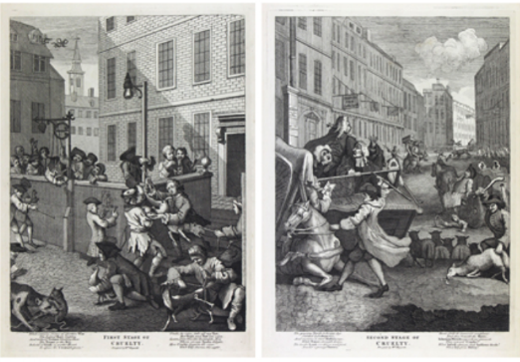
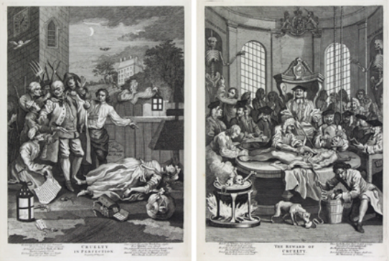
B.4. Responsible Consuming
B.4.2. Animal Rights
Animal rights concerns are older than one can imagine. On one hand, these concerns address animal cruelty, torture, and experimentation; and on the other hand, the discussion is extended to using animal products in the diet, shifting to a plant-based approach.
Hinduism, the oldest religion known to us, has the Ahimsa doctrine, which is a non-violence act towards humans and animals as well. Accordingly, some Hindus, some Buddhists, all believers of Jainism, a religion also based on Hinduism - are vegetarians. The debate has also been carried to the present on philosophical perspective. Pythagoras suggested a cruelty-free diet in ancient Greece around BC 500. In the 19th century, Traïni (2016) refers in detail, to British activists who had a pioneering influence on the animal rights movement. Jeremy Bentham in 1823, indicated that“... the question is not, Can they reason? nor, Can they talk? but, Can they suffer?” when we question if one should torment an animal. These activist movements against animal cruelty, inspired the establishment of non-profit organisations in other countries, as some still exist today, defending animal rights (Traïni, 2016).
Another relevant concept "anti-speciesism" criticises our discriminative approach to animals based on their species. An example of species-based discrimination would be feeding a specific domesticated fish, not having the desire to eat that fish as the owner perceives that specific type to be taken care of; on the other hand, eating another type of appetizing fish that is perceived as a commodity, an appetizing meal, most probably fed and killed by a for-profit party. As PETA (n.d.) indicates “...puppies and kittens are ‘friends’, cows and chickens are ‘food’, and rats and mice are ‘pests’.” based on our misguided belief in speciesism.
Four Stages of Cruelty is a famous series of paintings by William Hogarth, released in 1751, as an expression of stages of cruelty.
“The central character, Tom Nero, is a ward of the parish of St. Giles. Left to his own devices, and without proper moral instruction, the plates in the series show in visceral detail the development of cruelty in the young man, beginning with the tormenting and torture of animals in his youth, to hardheartedness as a young man, to murder as an adult, and finally to the aftermath of his execution at Tyburn, where justice will inflict its own cruelties on Nero's corpse” (Sanders of Oxford: Antique Prints & Maps, n.d.)
55

Slide 56
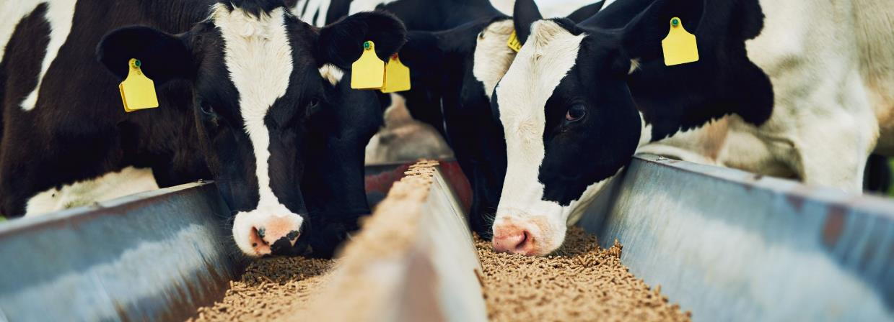
Individual Learner Assignment Suggestion:
One of the remarkable criticisms in the area, links feminism and vegetarianism. Carol Adams (2015) in “The Sexual Politics of Meat” claims that exploitation of female animals, reflects female exploitation. In her study, she gives examples from history how meat consumption is associated with strong, valiant masculinity.
Practical Activity 1:
Instigate a class debate where students discuss the link between plant-based approaches, masculinity and feminism.
Some people may find this subject extreme; however, we are promoting critical thinking and want to establish debating and communication skills among the students. Choose an alternative yet thought provoking topic, if you prefer.
56

Slide 57
B.4. Responsible Consuming
B.4.3. Cruelty-Free & Plant-Based Living
Plant-based approaches - veganism, vegetarianism and their variations – are gaining more popularity due to increasing awareness about animal rights and environmental concerns. The root of the plant-based approach is related to animal cruelty discussions, which can be traced back to Hinduism and Ancient Greece philosophers as discussed in the “Animal Rights” section of this manual. Starting as an ethical concern on animal rights, individual movements became more organised over time, and non-profit organisations were established to protect animal rights in the 19th century (Traïni, 2016), such as Band of Hope, Bands of Mercy, and the Swiss League Against Animal Testing.
There is a quest for the ethical treatment of animals, intensified by climate change and greenhouse gas emissions. Reduced animal products are resulting in a decrease in greenhouse gas emissions. According to Scarborough et al. (2014) “moving from a high meat diet to a low meat diet would reduce an individual’s carbon footprint by 920 kg CO₂ every year, moving from a high meat diet to a vegetarian diet would reduce the carbon footprint by 1,230 kg CO₂/year, and moving from a high meat diet to a vegan diet would reduce the carbon footprint by 1,560 kg CO₂/year”.
Increasing awareness about animal rights, and sustainability issues, is resulting in an increasing number of people shifting to environmentally friendly diets. Animal product manufacturers face the consequences of this demand shift in the market. Tesco estimates a 300% increase in vegan meat by 2025 (BBC News, 2020). Fast food restaurants (Burger King’s plant-based whooper, McDonald’s McPlant burger, KFC’s Beyond Chicken Fries and so on) updated their menu with plant-based items, tasting just like meat. A plant-based meat substitute manufacturer, Beyond Meat was established by Ethan Brown in 2009 with the mission of creating “delicious, nutritious, sustainable protein” without sacrificing animals (Beyond Meat, n.d.) The company offers plant-based meatballs, chicken, sausages, steak etc.
Plant-based diets are preferred not only for environmental sustainability or for animal rights and health purposes. Increased fruit and vegetable consumption results in high fibre intake, which lowers the risk associated with colon-cancer (Mettlin et al., 1981; Jenkins et al., 2001), lung cancer (Voorrips et al, 2000); colorectal cancer (Terry et al. 2001), breast cancer (Gandini et al. 2000). Some studies refer to specific vegetables for their protective effect from cancer, such as brassicas (van Poppel et al., 1999), garlic (Fleischauer and Arab, 2001; Galeone et al., 2006). Other nutritional facts for vegetarian meals are also discussed by Phillips (2005).
57

Slide 58
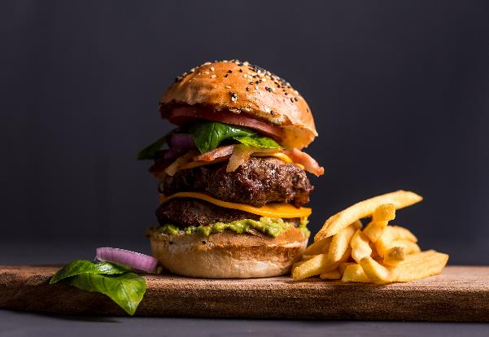
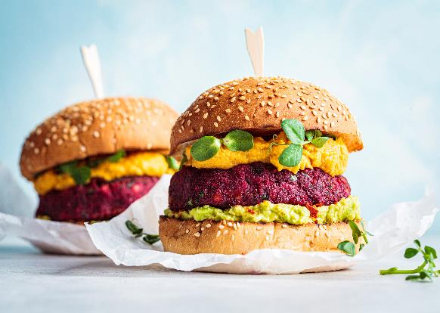
B.4. Responsible Consuming
B.4.3. Cruelty-Free & Plant-Based Living
High consumption of processed meat, which “refers to meat that has been transformed through salting, curing, fermentation, smoking, or other processes to enhance flavour or improve preservation” (Bouvard et al., 2015), is also associated with an increased risk of pancreatic cancer (Larsson and Wolk, 2012), colorectal, colon and rectal cancers (Chan et al., 2011; Santarelli et al., 2008; World Cancer Research Fund International, n.d.), lung cancer (Cross et al., 2007; Lam et al., 2009) and some other cancers as well. The method of cooking the meat also affects the carcinogen compounds, as panfrying, grilling, or barbecuing in high temperatures results in a high amount of some carcinogens (Bouvard et al., 2015). Accordingly, organisations raising awareness about cancer and processed meat consumption – such as the American Institute of Cancer Research (Smith, 2019), and the Cancer Council of Australia (n.d.) - suggest reducing red meat consumption and avoiding processed meat products as much as possible.
On the other hand, vegetarians and vegans may lack some of the nutrients, which requires consumers to be educated about nutritional values. Plant-based diets may cause Vitamin B12 (Pawlak et al., 2013; Phillips 2005) deficiency. This requires a consumer profile that pays attention to the nutritional value of food, who reads, researches and has an interest in food literacy.
Animal-Based Versus Plant-Based
58

Slide 59

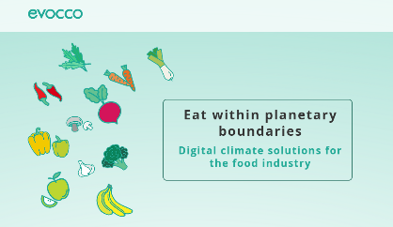
Individual Learner Assignment Suggestion:
Website Here
Practical Activity 1:
Creating a meat-like taste for a meat substitute brings some ethical concerns as well. Alvaro (2019) discusses this issue and questions the morality of lab-grown meat. The author addresses virtue ethics and the motivation and characteristics of the individual. Discuss the issue in class as a Group Activity.
Practical Activity 2:
In order to raise awareness, students can be asked to:
Search for vegan recipes and calculate the price or carbon footprint for one portion.
Search for the ingredients of vegan meat substitutes.
Practical Activity 3:
Students can work in groups and create their own Code of Ethics for a specific food sector, each group can handle a different sector. By presenting in the class, the groups can address similar codes, merge similar ones and make a final list of codes.
Publication Suggestions:
Earle, M., Hodson, G., Dhont, K., & MacInnis, C. (2019). Eating with our eyes (closed): Effects of visually associating animals with meat on anti-vegan/vegetarian attitudes and meat consumption willingness. Group Processes & Intergroup Relations, 22(6), 818–835. https://doi.org/10.1177/1368430219861848
Nobis, N. (2002) Vegetarianism and Virtue: Does Consequentialism Demand Too Little? Social Theory and Practice, 28 (1), pp. 135-156.
TIP: use the Evocco App or similar to help calculate a foods carbon footprint
59

Slide 60
B.4. Responsible & Civil Society
B.4.4. Food Charities and Civil Society
The relationship between food poverty and food charity became relevant as world hunger is a growing and neglected issue. Although being more institutionalised and common, the benefits of food charity, in the long run, are questioned. One of the criticisms emphasises the neglected role of government in food justice (Riches and Silvasti, 2014). Another study claims that food charities can exacerbate social injustice through a lack of communication between food providers and receivers, poor accessibility to aid, and distribution of low-nutrition foods (Poppendieck, 1998). Since people have the right to food, governmental policies should address the disadvantages of food charity, analyse the underlying reasons for food insecurity, and make a long-term sustainable programme. A socially and ecologically innovative, approach for a more collaborative solution is required (Vlaholias-West et al., 2018).
Homeless people are a part of people having food insecurity. The reintegration of homeless people into society is a complex process involving housing, employment and social inclusion as well. Formal and informal relationships are recognised to be major components of the process, which gives autonomy, security, normality and social capital to sustain their life (Tosi, 2007). The diversity in individual stories and requirements requires a comprehensive reintegration model and follow-up visits. Accordingly, feeding homeless people can be considered as a short-term plan, that only postpones the problem.
Class Debate Suggestion:
The question is: does food charity really help with poverty?
One of the groups will defend the idea that food charity helps with poverty, while the opposing group will defend the idea that food charity is not a solution to poverty.
60

Slide 61
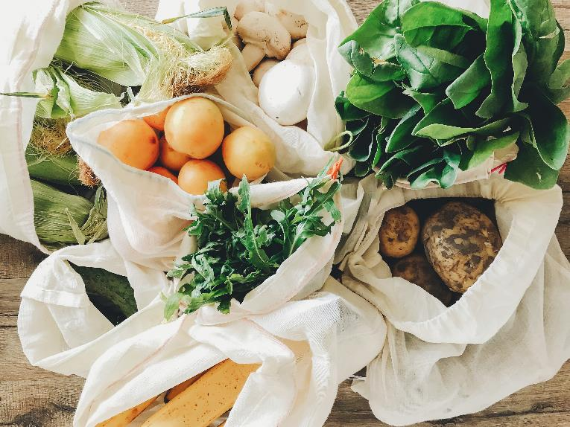
Conclusions and Final Remarks
The aim of this manual is to provide material that we consider helpful for HEI & VET educators and relevant stakeholders involved in ethical food production.
Even though there are different definitions of ethics, the main objective of food producers or other actors in the food chain is to produce safe food. However, this production must take into account all the factors that are part of the food agro-ecosystems, minimising its effects on the planet in all its sectors.
Thus, the production of raw materials and livestock, the transformation, distribution, and marketing of products must always be as sustainable as possible. Furthermore, food consumption must be the most responsible, ensuring the rights of animals and human health.
However, there is still a long way to go concerning the various points in the food chain. Sustainability and circular economy principles must always be present in all decisions to be taken in the future.
We hope that this manual is useful to you and that it helps to create a better planet!
61

Slide 62
References
Adams, C. J. (2015). The Sexual Politics of Meat: A Feminist-Vegetarian Critical Theory. Bloomsbury Publishing USA.
Alvaro, C. (2019). Lab-grown meat and veganism: a virtue-oriented perspective. Journal of Agricultural and Environmental Ethics, 32(1), 127-141.
American Marketing Association [AMA] (2017), Definitions of Marketing. Retrieved from https://www.ama.org/the-definition-of-marketing-what-is-marketing/ (Access Date: 06.02.2023).
Arons, M. P. (2015) A Chef’s Guide to Patent Protections Available for Cooking Techniques and Recipes in the Era of Postmodern Cuisine and Molecular Gastronomy, Journal of Business & Technology, 10, 137-141.
Asgher M., Qamar S.A., Bilal M. & Iqbal H.M.N. (2020). Bio-based active food packaging materials: sustainable alternative to conventional petrochemical-based packaging materials. Food Research International, 137, 109625 (p. 12).
Bauman, Z. (2008). Does ethics have change in a World of consumers? Cambridge: Harward University.
BBC News (2020) Tesco targets 300% rise in vegan meat sales. Retrieved from https://www.bbc.com/news/business-54338754
Bentham, J. (1823) [1780] An Introduction to the Principles of Morals and Legislation. Retrieved from https://www.earlymoderntexts.com/assets/pdfs/bentham1780.pdf
Bentham, J. (1948) A Fragment on Government and Principles of Morals and Legislation. Blackwell: Oxford.
Bentham, J. (2013) Ethical Principles and Ethical Matrix. In Practical Ethics for Food Professionals. Clark, J. P., Ritson, C. (Eds). 39-56. John Wiley & Sons.
Beyond Meat (n.d.) Mission. Retrieved from https://www.beyondmeat.com/en-US/mission/
Bhargava N., Sharanagat V.S., Mor R.S. & Kumar K. (2020). Active and intelligent biodegradable packaging films using food and food waste-derived bioactive compounds: A review. Trends in Food Science & Technology, 105, 385-401.
Bouvard, V., Loomis, D., Guyton, K. Z., Grosse, Y., Ghissassi, F. E., Benbrahim-Tallaa, L., ... & Corpet, D. (2015). Carcinogenicity of consumption of red and processed meat. The Lancet Oncology, 16 (16), 1599-1600.
Brown, S. (2022) How to Get a Patent on a Food Product. https://patentexperts.org/patent/how-to-get-a-patent/food-patent/
Burkhardt, J. (2001). The GMO debates: taking ethics seriously. In Proceedings of the 2001 National Public Policy Education Conference. Access at: www. farmfoundation. org/nppecindex. htm.
Burkhardt J., Comstock G., Hartel P.G., Thompson P.B., Chrispeels M.J., Muscoplat C.C., Streiffer R. (2005). Agricultural Ethics. CAST – Council for Agricultural Science and Technology, 29, p. 12 (ISSN 1070-0021).
62

Slide 63
Buzby,J. C., Hyman, J. (2012) Total and per capita value of food loss in the United States. Food Policy, 37 (5), 561-570.
Cairns, G. (2019). A critical review of evidence on the sociocultural impacts of food marketing and policy implications. Appetite 136, 193–207. doi: 10.1016/j.appet.2019.02.002
Cancer Council (n.d.). Meat and Cancer Risk: Improving your health and reducing the risk. Retrieved from https://www.cancer.org.au/cancer-information/causes-and-prevention/diet-and-exercise/meat-and-cancer-risk
Chan, D. S., Lau, R., Aune, D., Vieira, R., Greenwood, D. C., Kampman, E., & Norat, T. (2011). Red and processed meat and colorectal cancer incidence: meta-analysis of prospective studies. PloS one, 6(6), e20456.
Coca Cola (2020).Is the Coca‑Cola formula kept secret because the company has something to hide? https://www.coca-cola.co.uk/our-business/faqs/is-the-coca-cola-formula-kept-secret-because-the-company-has-something-to-hide (Access Date: 10.02.2023).
Codex Alimentarius (2011). General Principles of Food Hygiene - CXC 1-1969. Adopted in 1969. Amended in 1999. Revised in 1997, 2003, 2020. Editorial corrections in 2011.
Cornell Law School, (2020). Original Work of Authorship Retrieved from https://www.law.cornell.edu/wex/original_work_of_authorship
Cornell Law School (n.d.). Trade Dress. https://www.law.cornell.edu/wex/trade_dress#:~:text=Definition,identifying%20function%20as%20a%20trademark (Access Date: 14.02.2023).
Costa, R. (2018) Teaching Food Ethics. In Food Ethics Education. Costa, R., Pittia, P. (Editors). Springer.
Council Regulation (EC) No 1/2005 of 22 December 2004 on the protection of animals during transport and related operations and amending Directives 64/432/EEC and 93/119/EC and Regulation (EC) No 1255/97 (consolidated version of 14 December 2019).
Court of Justice of the European Union (2018). Press Release No 171/18. https://curia.europa.eu/jcms/upload/docs/application/pdf/2018-11/cp180171en.pdf
Cross, A. J., Leitzmann, M. F., Gail, M. H., Hollenbeck, A. R., Schatzkin, A., & Sinha, R. (2007). A prospective study of red and processed meat intake in relation to cancer risk. PLoS Med, 4(12), e325.
Das L., Bhaumik E., Raychaudhuri U., Chakraborty R. (2012). Role of nutraceuticals in human health. Journal of Food Science and Technology, 49(2), 173-183.
Early, R. (2020). Food ethics: moral marketing. Retrieved from https://ifst.onlinelibrary.wiley.com/doi/full/10.1002/fsat.3401_11.x (Access Date: 10.03.2023).
European Academies Science Advisory Council (2013) Planting the Future: Opportunities and Challenges for Using Crop Genetic Improvement Technologies for Sustainable Agriculture. Available online: https://easac.eu/publications/details/planting-the-future-opportunities-and-challenges-for-using-crop-genetic-improvement-technologies-for-sustainable-agriculture
63

Slide 64
European Union [EU] (2020). Farm to Fork Strategy - For a fair, healthy and environmentally-friendly food system. Retrieved from https://web.archive.org/web/20210504164007/https://ec.europa.eu/food/sites/food/files/safety/docs/f2f_action-plan_2020_strategy-info_en.pdf
European Environment Agency (2022) Greenhouse gas emissions from transport in Europe. Retrieved from https://www.eea.europa.eu/ims/greenhouse-gas-emissions-from-transport
European Commission (n.d.-a). Internal Market, Industry, Entrepreneurship and SMEs: Food and drink industry. Retrieved from https://single-market-economy.ec.europa.eu/sectors/food-and-drink-industry_en
European Commission (n.d.-b). Forum for a better functioning food supply chain. Retrieved from https://single-market-economy.ec.europa.eu/sectors/food-and-drink-industry/competitiveness-european-food-industry/forum-better-functioning-food-supply-chain_en
European Commision High Level Forum (2019). High Level Forum for a Better Functioning Food Supply Chain. https://ec.europa.eu/docsroom/documents/36045/attachments/1/translations/en/renditions/native (Access date: 06.02.2023)
The European Food Information Council [EUFIC] (2021) Short food supply chains: reconnecting producers and consumers Retrieved from Food Facts for Healthy Choices
Firouz M.S., Mohi-Alden K. & Omid M. (2021). A critical review on intelligent and active packaging in the food industry: Research and development. Food Research International, 141, 110113 (p. 24).
Fleischauer, A. T., & Arab, L. (2001). Garlic and cancer: a critical review of the epidemiologic literature. Journal of nutrition, 131(3), 1032S-1040S.
Food and Agriculture Organisation of the United Nations [FAO], International Fund for Agricultural Development [IFAD], United Nations World Food Programme [WFP] (2013). The State of Food Insecurity in the World 2013. The Multiple Dimensions of Food Security. FAO, Rome.
Food and Agriculture Organisation of the United Nations [FAO] (2003). Trade reforms and food security. Commodity Policy and Projections Service - Commodities and Trade Division. https://www.fao.org/3/y4671e/y4671e00.htm#Contents
Food and Agriculture Organisation of the United Nations [FAO] (2006). Food Security. Policy Brief. June, Issue 2.
Food and Agriculture Organisation of the United Nations [FAO] (2009). High Level Expert Forum. https://www.fao.org/fileadmin/templates/wsfs/docs/Issues_papers/HLEF2050_Global_Agriculture.pdf (Access Date: 06.02.2023).
Food and Agriculture Organisation of the United Nations [FAO] (2011) Global Food Losses and Food Waste: Extent, Causes and Prevention. https://www.fao.org/3/i2697e/i2697e.pdf (Access Date: 17.02.2023).
Food and Agriculture Organisation of the United Nations [FAO] (n.d.-a) https://www.fao.org/sustainable-development-goals/goals/goal-12/en/ (Access Date: 10.08.2022).
Food and Agriculture Organisation of the United Nations [FAO] (n.d.-b) Ensure sustainable consumption and production patterns. https://www.fao.org/sustainable-development-goals/goals/goal-12/en/ (Access date: 16.02.2013)
Food and Drug Administration (2021). Food Loss and Waste. https://www.fda.gov/food/consumers/food-loss-and-waste
64

Slide 65
Ford, R. C., & Richardson, W. D. (1994). Ethical decision making: A review of the empirical literature. Journal of business ethics, 13(3), 205-221.
Galeone, C., Pelucchi, C., Levi, F., Negri, E., Franceschi, S., Talamini, R., ... & La Vecchia, C. (2006). Onion and garlic use and human cancer. The American journal of clinical nutrition, 84(5), 1027-1032.
Gandini, S., Merzenich, H., Robertson, C., & Boyle, P. (2000). Meta-analysis of studies on breast cancer risk and diet: the role of fruit and vegetable consumption and the intake of associated micronutrients. European journal of cancer, 36(5), 636-646.
Glaab, K., & Partzsch, L. (2018). Utopia, food sovereignty, and ethical fashion: the narrative power of anti-GMO campaigns. New Political Science, 40(4), 691-707.
Golan, M., & Crow, S. (2004). Parents are key players in the prevention and treatment of weight-related problems. Nutrition reviews, 62(1), 39-50.
Halt, Jr, G. B., Donch, Jr, J. C., Stiles, A. R., Fesnak, R., Halt, G. B., Donch, J. C., ... & Fesnak, R. (2017). Trademarks and Trade Dress. Intellectual Property and Financing Strategies for Technology Startups, 89-108.
Hawkes, C. (2009). Sales promotions and food consumption. Nutrition reviews, 67(6), 333-342.
Halal Certification Authority [HCA] (2022). Certification. Retrieved from https://halalauthority.org/certification/ (Access Date: 20/01/2023).
Hedin, B., Katzeff, C., Eriksson, E., & Pargman, D. (2019). A Systematic Review of Digital Behaviour Change Interventions for More Sustainable Food Consumption. Sustainability, 11(9), 2638. MDPI AG. http://dx.doi.org/10.3390/su11092638
Herforth, A., Bai, Y., Venkat, A., Mahrt, K., Ebel, A. & Masters, W.A. (2020). Cost and affordability of healthy diets across and within countries. Background paper for The State of Food Security and Nutrition in the World 2020. FAO Agricultural Development Economics Technical Study No. 9. Rome, FAO.
International Labour Organization [ILO] (2021). Child Labour: Global Estimates 2020, trends and the road forward. https://www.ilo.org/ipec/Informationresources/WCMS_797515/lang--en/index.htm
International Trademark Association, (n.d.). Trade Dress. https://www.inta.org/topics/trade-dress/ (Access Date: 15.20.2023)
Ivanova, D., Stadler, K., Steen-Olsen, K., Wood, R., Vita, G., Tukker, A., et al. (2016). Environmental impact assessment of household consumption. Journal of Ind. Ecol. 20, 526–536. doi: 10.1111/jiec.12371
Jenkins, D. J., Kendall, C. W., Popovich, D. G., Vidgen, E., Mehling, C. C., Vuksan, V., ... & Corey, P. (2001). Effect of a very-high-fiber vegetable, fruit, and nut diet on serum lipids and colonic function. Metabolism-Clinical and Experimental, 50(4), 494-503.
Kattwinkel, L. J. (2017). Trademark and Trade Dress. https://www.aiga.org/sites/default/files/2021-02/Trademark_Trade_Dress_2019.pdf (Access date: 08.02.2023)
Kearney, J. (2010). Food consumption trends and drivers. Philosophical transactions of the royal society B: biological sciences, 365(1554), 2793-2807.
Lam, T. K., Cross, A. J., Consonni, D., Randi, G., Bagnardi, V., Bertazzi, P. A., ... & Landi, M. T. (2009). Intakes of red meat, processed meat, and meat mutagens increase lung cancer risk. Cancer research, 69(3), 932-939.
Larsson, S. C., & Wolk, A. (2012). Red and processed meat consumption and risk of pancreatic cancer: meta-analysis of prospective studies. British journal of cancer, 106(3), 603-607.
McCombs School of Business (2018) Utilitarianism: Ethics Defined, https://youtu.be/-FrZl22_79Q
65

Slide 66
McCombs School of Business (2018) Deontology: Ethics Defined, https://youtu.be/wWZi-8Wji7M
McCombs School of Business (2018) Hedonism: Ethics Defined, https://youtu.be/EY6Cgp5nd_c
McCombs School of Business (2018) Virtue Ethics: Ethics Defined, https://youtu.be/NMblKpkKYao
Mepham, B. (2000). A framework for the ethical analysis of novel foods: The ethical matrix. Journal of agricultural and environmental ethics, 12(2), 165-176.
Mettlin, C., Graham, S., Priore, R., Marshall, J., & Swanson, M. (1981). Diet and cancer of the esophagus. Nutrition and Cancer. 2(3). 143-147.
Mohr, L.A., Webb, D.J. and Harris, K.E. (2001), Do consumers expect companies to be socially responsible? The impact of corporate social responsibility on buying behaviour, Journal of Consumer Affairs, 35(1), 45-72.
National Geographic (n.d.). Sustainable fishing. https://education.nationalgeographic.org/resource/sustainable-fishing (Access Date: 28.01.2023).
O’Fallon, M. J., & Butterfield, K. D. (2013). A review of the empirical ethical decision-making literature: 1996–2003. Citation classics from the journal of business ethics, 213-263.
Ogden, C. L., Carroll, M. D., Curtin, L. R., McDowell, M. A., Tabak, C. J., & Flegal, K. M. (2006). Prevalence of overweight and obesity in the United States, 1999-2004. Jama, 295(13), 1549-1555.
Oslo Roundtable on Sustainable Production and Consumption (1994). The Imperative of Sustainable Production and Consumption. Available online at: https://enb.iisd.org/consume/oslo004.html (Access Date 24.12.2022).
Paciarotti C. & Torregiani F. (2021). The logistics of the short food supply chain: A literature review. Sustainable Production and Consumption, 26, 428-442.
Parkin, B. L., & Attwood, S. (2022). Menu design approaches to promote sustainable vegetarian food choices when dining out. Journal of Environmental Psychology, 79, 101721.
Pawlak, R., Parrott, S. J., Raj, S., Cullum-Dugan, D., & Lucus, D. (2013). How prevalent is vitamin B(12) deficiency among vegetarians?. Nutrition reviews, 71(2), 110–117. https://doi.org/10.1111/nure.12001
Peattie, K., & Charter, M. (1992). Green marketing. The marketing book, 726-756.
Pesticide Atlas (n.d.). Pesticide Atlas 2022: Facts and figures about toxic chemicals in agriculture | Heinrich Böll Stiftung | Brussels office - European Union (boell.org) (Access Date: 05.01.2023)
PETA (n.d.) What Is Speciesism? Retrieved from https://www.peta.org/features/what-is-speciesism/
Phillips, F. (2005) Vegetarian Nutrition. Nutrition Bulletin. 30(2). 132-167.
Pinto J.F. (2010). Nutracêuticos e Alimentos Funcionais. Lidel. 3-10.
Poppendieck, J. (1998). Sweet charity: Emergency food and the end of entitlement. New York: Viking.
Rawls, J. (1972) A Theory of Justice. Oxford University Press: Oxford.
Regulation (EU) No 1169/2011 of the European Parliament and of the Council of 25 October 2011 on the provision of food information to consumers, amending Regulations (EC) No 1924/2006 and (EC) No 1925/2006 of the European Parliament and of the Council, and repealing Commission Directive 87/250/EEC, Council Directive 90/496/EEC, Commission Directive 1999/10/EC, Directive 2000/13/EC of the European Parliament and of the Council, Commission Directives 2002/67/EC and 2008/5/EC and Commission Regulation (EC) No 608/2004 (consolidated version of 01 January 2018).
66

Slide 67
Salonen, A.O. (2013). Responsible Consumption. In: Idowu, S.O., Capaldi, N., Zu, L., Gupta, A.D. (eds) Encyclopedia of Corporate Social Responsibility. Springer, Berlin, Heidelberg. https://doi.org/10.1007/978-3-642-28036-8_119
Santarelli, R. L., Pierre, F., & Corpet, D. E. (2008). Processed meat and colorectal cancer: a review of epidemiologic and experimental evidence. Nutrition and cancer, 60(2), 131-144.
Saunders, K. M., & Flugge, V. (2021). Food for Thought: Intellectual Property Protection for Recipes and Food Designs. Duke L. & Tech. Rev., 19, 159.
Scarborough, P., Appleby, P. N., Mizdrak, A., Briggs, A. D., Travis, R. C., Bradbury, K. E., & Key, T. J. (2014). Dietary greenhouse gas emissions of meat-eaters, fish-eaters, vegetarians and vegans in the UK. Climatic change, 125(2), 179-192.
Simeone, M., & Scarpato, D. (2020). Sustainable consumption: How does social media affect food choices? Journal of Cleaner Production, 277, 124036.
Slow Food (2013), Slow Food’s Contribution to the Debate on the Sustainability of the Food System. Retrieved from: https://docslib.org/doc/12142127/slow-foods-contribution-to-the-debate-on-the-sustainability-of-the
Smith, B. (2019) American Institute of Cancer Research: Processed Meat and Cancer. Retrieved from https://www.aicr.org/resources/blog/processed-meat-and-cancer/
Smith, R., Kelly, B., Yeatman, H., & Boyland, E. (2019). Food marketing influences children’s attitudes, preferences and consumption: a systematic critical review. Nutrients, 11(4), 875.
Steavenson, W. (2021). How things are changing for women in the kitchen. Retrieved from https://www.ft.com/content/d8677261-e136-4969-bd5f-a19a539cbdbc
Taillie, L. S., Busey, E., Stoltze, F. M., & Dillman Carpentier, F. R. (2019). Governmental policies to reduce unhealthy food marketing to children. Nutrition reviews, 77(11), 787-816.
Terry, P., Giovannucci, E., Michels, K. B., Bergkvist, L., Hansen, H., Holmberg, L., & Wolk, A. (2001). Fruit, vegetables, dietary fiber, and risk of colorectal cancer. Journal of the National Cancer Institute, 93(7), 525-533.
The Economic Times (2023), What is 'Fair Trade Price' Retrieved from https://economictimes.indiatimes.com/definition/fair-trade-price (Access Date: 06.02.2023)
Thompson, P. B. (2018) Farming, The Virtues, and Agrarian Philosophy. In The Oxford Handbook of Food Ethics. Barnhill, A., Doggett, T. & Budolfson, M. (Eds.). Oxford University Press.
Tosi, A. (2007). Re-housing and social reintegration of homeless people: A case study from Milan. Innovation. The European Journal of Social Science Research, 18(2), 183-203.
Traïni, C. (2016). The Animal Rights Struggle: An Essay in Historical Sociology. HAL Id: halshs-02864005
United States Copyright Office, (n.d.) What is Copyright? https://www.copyright.gov/what-is-copyright/
United States Environmental Protection Agency [EPA] (2020) Sources of Greenhouse Gas Emissions, Retrieved from https://www.epa.gov/greenvehicles/fast-facts-transportation-greenhouse-gas-emissions
United States Patent and Trademark Office [USPTO] (2016). Electronic Information Products Division, Patent Technology Monitoring Team. https://www.uspto.gov/web/offices/ac/ido/oeip/taf/data/patdesc.htm
United Nations [UN] (n.d.) Goal 12: Ensure sustainable consumption and production patterns. https://www.un.org/sustainabledevelopment/sustainable-consumption-production/ (Access Date: 10.08.2022).
67

Slide 68
Riches, G. and Silvasti, T. (2014) Hunger in Rich World: Food Aid and Right to Food Perspectives. Springer.
Rivera Medina, C., Briones Urbano, M., de Jesús Espinosa, A., & Toledo López, Á. (2020). Eating habits associated with nutrition-related knowledge among university students enrolled in academic programs related to nutrition and culinary arts in Puerto Rico. Nutrients, 12(5), 1408.
Röös, E., Garnett, T., Watz, V., & Sjörs, C. (2018). The role of dairy and plant based dairy alternatives in sustainable diets. SLU Future Food Reports; 3. ISBN: 978-91-576-9604-5 [Report].
van Poppel, G., Verhoeven, D. T., Verhagen, H., & Goldbohm, R. A. (1999). Brassica vegetables and cancer prevention. In Advances in nutrition and cancer, 2, 159-168. Springer, Boston, MA.
Vermeir, I., Weijters, B., Houwer, J.D., Geuens, M., Slabbinck, H., Spruyt, A., Kerckhove, A.V., Lippevelde, W.V., Steur, H. D., Verbeke, W. (2020) Environmentally Sustainable Food Consumption: A Review and Research Agenda From a Goal-Directed Perspective. Frontiers in Psychology, 11, 1603. https://doi.org/10.3389/fpsyg.2020.01603
Vlaholias-West, E., Thompson, K., Chiveralls, K., & Dawson, D. (2018). The ethics of food charity. Encyclopedia of food and agricultural ethics. Dordrecht: Springer.
Voorrips, L. E., Goldbohm, R. A., van Poppel, G.A. F. C., Sturmans, F., Hermus, R. J. J., & Van Den Brandt, P. A. (2000). Vegetable and fruit consumption and risks of colon and rectal cancer in a prospective cohort study The Netherlands Cohort Study on Diet and Cancer. American Journal of Epidemiology, 152(11), 1081-1092.
Wireless Philosophy (2018) Philosophy - Ethics: Consequentialism, Retrieved from https://youtu.be/hACdhD_kes8
Wireless Philosophy (2018) Philosophy - Ethics: Killing Animals for Food, https://youtu.be/3HAMk_ZYO7g
World Cancer Research Fund International (n.d.) Wholegrains, vegetables, fruit and cancer risk. Retrieved from https://www.wcrf.org/diet-activity-and-cancer/risk-factors/wholegrains-vegetables-fruit-and-cancer-risk/
World Health Organization (2010). Set of recommendations on the marketing of foods and non-alcoholic beverages to children. Retrieved from https://www.who.int/publications/i/item/9789241500210
World Intellectual Property Organization (n.d.). What is Intellectual Property? https://www.wipo.int/about-ip/en/
Worldbank (n.d.-a) Are healthy diets affordable? Using new data to guide agricultural and food policy. Retrieved from https://live.worldbank.org/events/healthy-diets-affordable (Access Date: 9.08.2022)
Worldbank (n.d.-b). Food Security Update. Retrieved from https://www.worldbank.org/en/topic/agriculture/brief/food-security-update (Access Date: 9.08.2022)
Yue, B., Sheng, G., She, S., Xu, J. (2020) Impact of Consumer Environmental Responsibility on Green Consumption Behavior in China: The Role of Environmental Concern and Price Sensitivity. Sustainability, 12, 2074. https://doi.org/10.3390/su12052074
Zepeda L. & Leviten-Reid C. (2004). Consumers’ Views on Local Food. Journal of Food Distribution Research, 35(3), p.6.
68

Slide 69
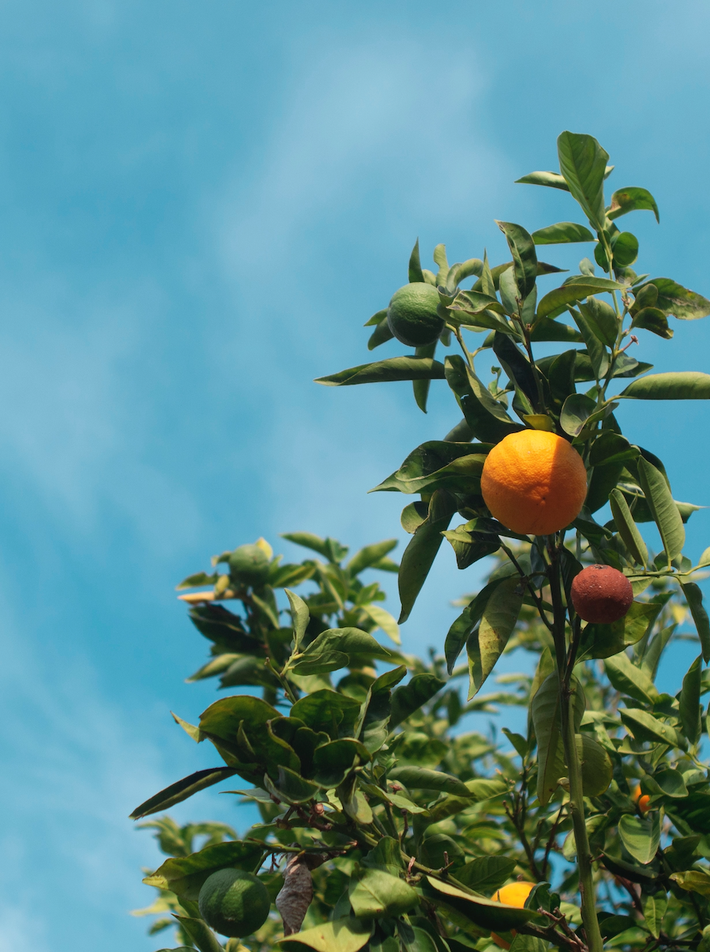
The greatest fine art of the future will be the making of a comfortable living from a small piece of land
Abraham Lincoln
69

Slide 70


follow our journey
Website Here
www.ethical-food.eu

