Slide 1
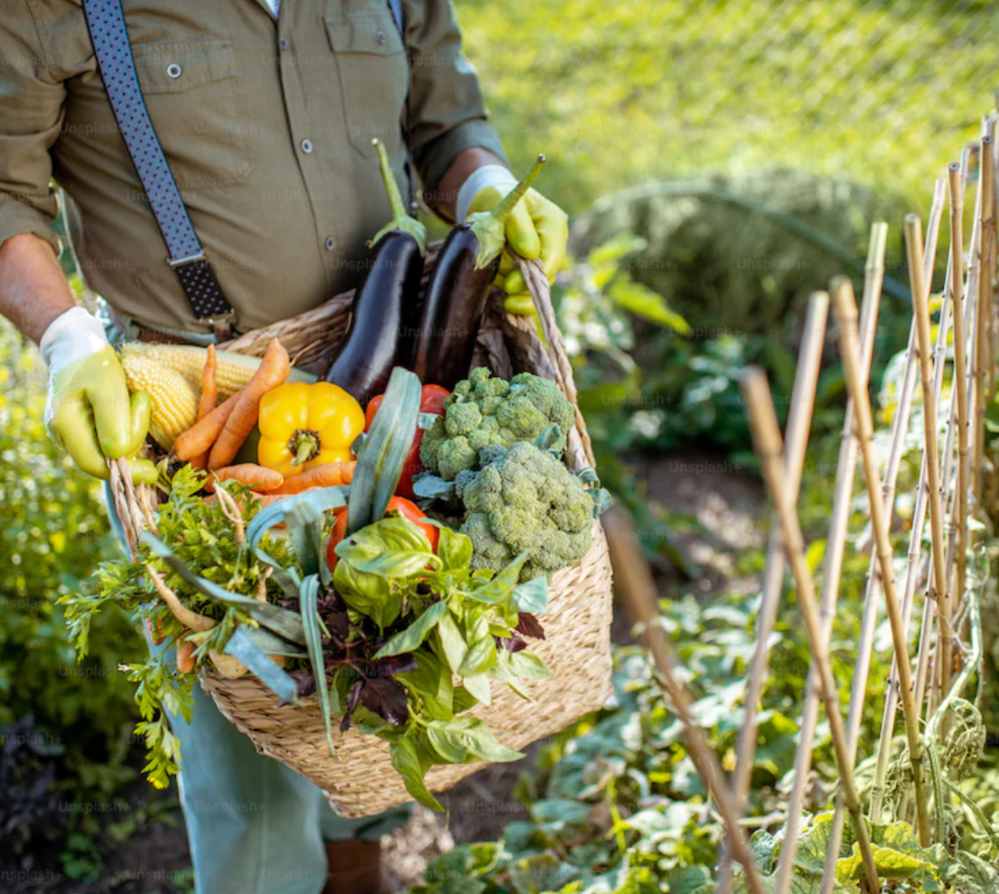
INNOVATING ETHICAL FOOD ENTREPRENEURSHIP MANUAL
June 2023
PR2 Manual
By
Devon Butterfield
BIA Innovator Campus

Slide 2
contents
How to use this interactive guide ………………………………………………………………..….. 3
01
Introduction to Ethical Food Business ….…………………………………………………..… 4
02
The Concept of Ethical Food Business ………………………………………………………… 8
03
Market Research for the Ethical Food Business …………………..…………… 11
04
Ethical Business Models and Business Plans ………………………………..……… 14
05
Registering Your Business and Protecting Your Intellectual Property …………………………………………….…………… 19
06
Financial Planning and Fundraising for the Ethical Food Business ………………………………………………………………………….…… 29
07
Supply Chain Management and Sustainability ……………………..…………… 37
08
Human Resources Planning …………………………………………………………………………………… 46
09
Marketing and Branding your Ethical Food Business ………………… 55
10
Legal and Regulatory Considerations ………………………………………………..………… 59
11
Conclusion and Future Trends ……………………………………………………………………….…… 64
Reference ……………………………………………………………………………..…………………………………………………… 68
2

Slide 3


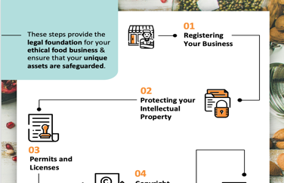
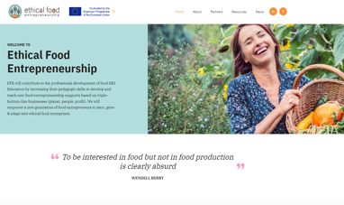
How To Use This Interactive Guide
The EFE Innovating Ethical Foods Entrepreneurship Manual is a comprehensive and dynamic resource designed to empower aspiring entrepreneurs and industry professionals in the realm of Ethical & Sustainable Food Businesses and Innovation. This manual serves as an indispensable and interactive guide, offering a wealth of practical insights, case studies, and a variety of useful tools and templates. Follow the guide below to get the most from your experience.
Interactive Content is Identified in this Manual by using Icons
CLICK
Click to View
TO VIEW
TOP TIP
To return to the compendium - use the click to go back option in your browser
FAST AND EASY NAVIGATION
Jump to a case study of choice by clicking on the interactive table of contents
Click to go back

Slide 4









Partners
The Ethical Food Entrepreneurship initiative unites partners from Finland, Turkey, Portugal, Ireland, and Denmark, encompassing diverse expertise in fields such as food science, technology, innovation, knowledge transfer, entrepreneurship training, and digital learning. Together, these partners share a common goal: to develop innovative training tools and strategies that prioritize sustainability and ethical practices within the food industry for both Higher Education Institutions (HEIs) and Vocational Education and Training (VET) bodies.
Through the collaboration of six partners across five countries, we harness substantial advantages to create a collection of internationally relevant educational resources. These resources are designed to swiftly reach the market while making a lasting impact on the European Union's food sector by educating the upcoming cohort of ethical food entrepreneurs.
For additional information, you can explore the graphic below, which provides links to the websites of all our partners. While the guide's creation was a joint effort involving Antalya Bilim University and Instituto Politécnico de Bragança, every partner contributed to the guide's content and case studies from their specific regions: Finland, Turkey, Portugal, Ireland, and Denmark.
MEET OUR TEAM
FINLAND
TURKEY
PORTUGAL
www.revalorise.eu
IRELAND
IRELAND
DENMARK

Slide 5
01
Introduction

Slide 6

01
Introduction
Welcome to the Ethical Food Entrepreneurship Manual, a comprehensive resource designed specifically for food entrepreneurs who are passionate about building and growing ethical food businesses.
This manual is created with the understanding that the food industry plays a significant role in shaping our society, economy, and environment. It recognises the increasing demand from conscious consumers who seek sustainable, responsible, and ethically-produced food options.
As a food entrepreneur, you possess a unique opportunity to make a positive impact on the world through your business. Whether you are starting a new venture or diversifying into the ethical food sector, this manual will serve as your go-to guide, providing invaluable insights, practical guidance, and proven strategies to help you navigate the complexities of building an ethical food business on a European level.

Slide 7


Why is this Manual Tailored for Food Entrepreneurs?
Building a successful food business is no easy feat. It requires a deep understanding of the food industry dynamics, consumer preferences, evolving trends, legal frameworks, and the specific challenges and opportunities inherent in the ethical food sector. This manual is specifically designed for food entrepreneurs like you who are committed to incorporating ethics, sustainability, and social responsibility into every aspect of their business. and overcome challenges.
What Makes the Ethical Food Entrepreneurship Manual Unique?
This manual stands out as the first comprehensive resource designed exclusively for food entrepreneurs in the ethical food sector. It goes beyond generic business guides and addresses the specific challenges, strategies, and best practices relevant to building an ethical food business. By focusing on key areas such as market research, ethical business models, legal considerations, financial planning, HR support, and marketing, this manual provides you with a holistic understanding of the ethical food business landscape.
What to Expect from this Manual?
This manual acts as the first comprehensive resource designed exclusively for entrepreneurs. In this manual, we will take you on a step-by-step journey, providing in-depth insights, practical tips, and real-world examples to guide you in developing and growing your ethical food business. Each chapter is carefully crafted to address a crucial aspect of your entrepreneurial journey, ensuring that you have the knowledge and tools necessary to make informed decisions and overcome challenges.
Food for People – Planet – Profit

Slide 8

Throughout this manual, you will find:
01
Clear definitions and explanations of key concepts and practices related to ethical food businesses.
02
Case studies and success stories from established ethical food entrepreneurs, offering inspiration and practical insights.
03
Actionable strategies and step-by-step guidance to help you implement ethical practices into all aspects of your business.
04
Considerations and resources specifically tailored to the European context, taking into account regional regulations, consumer preferences, and market dynamics.
As a food entrepreneur, you have the power to create positive change by building an ethical food business that aligns with consumer values, contributes to a sustainable future, and sets new standards for the food industry. This manual is your comprehensive resource, designed to empower you with the knowledge, skills, and strategies needed to start, diversify, and succeed in the ethical food sector.
By embracing the principles of sustainability, fair trade, organic production, humane animal treatment, and social responsibility, you can create a business that not only thrives economically but also makes a meaningful impact on people, animals, and the planet. Now, let's embark on this exciting journey together and unlock the immense potential of ethical food entrepreneurship!

Slide 9
02
The Concept of Ethical Food Business

Slide 10

02
The Concept of Ethical Food Business
An ethical food business places a strong emphasis on moral and value-based principles in all aspects of food production, distribution, and consumption. It considers the social, environmental, and ethical implications of food choices and aims to promote fairness, justice, and responsible practices.

Slide 11
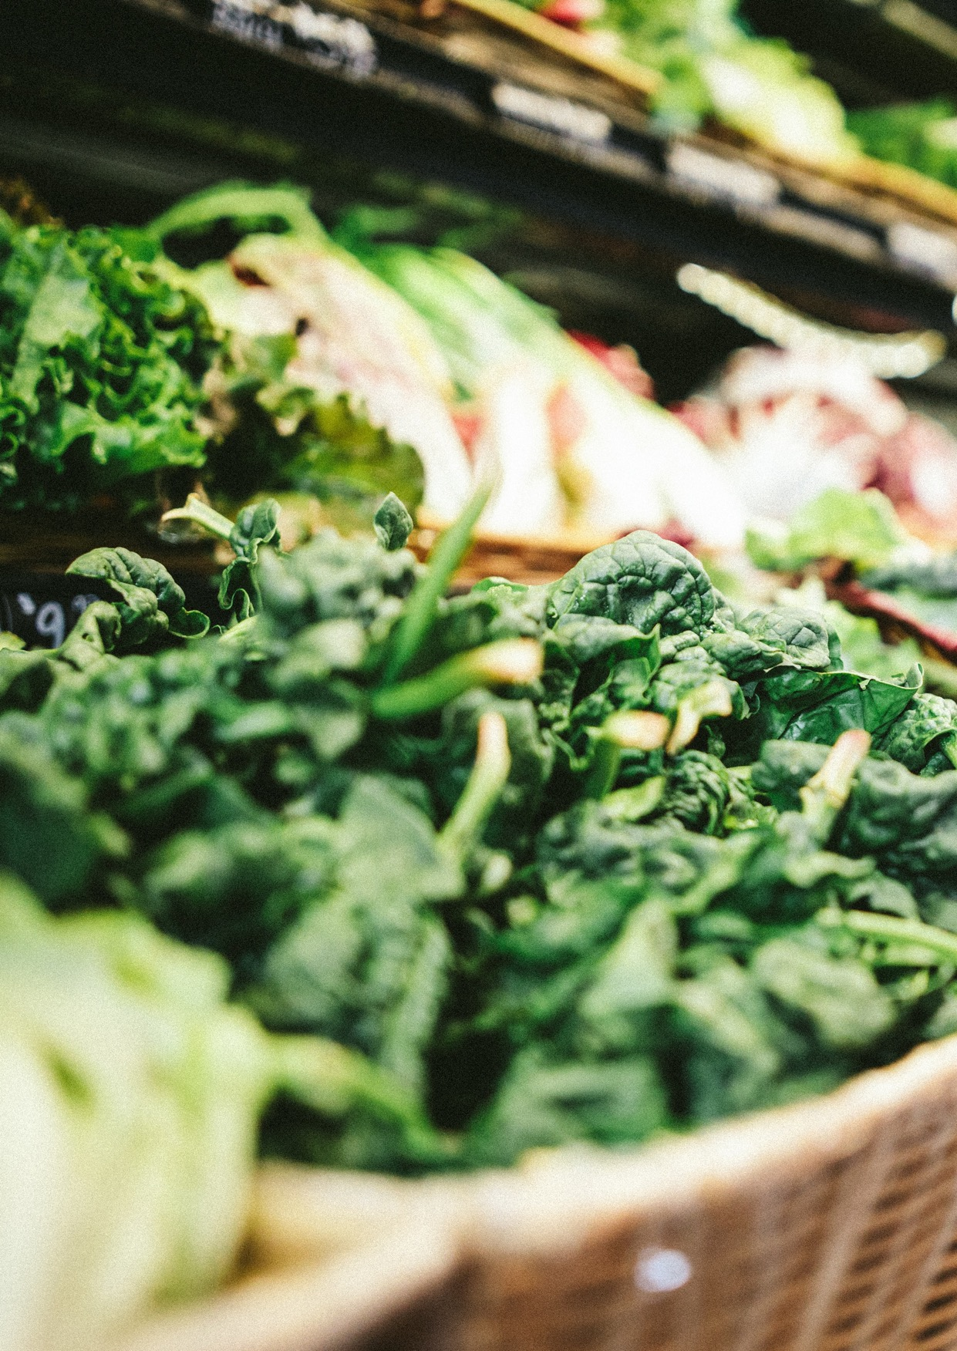
Natural Food Resources
Refers to ingredients and products that are derived from the earth without significant human intervention or processing. These resources are obtained directly from nature, such as fruits, vegetables, grains, and meats that are minimally altered from their original state. Embracing natural food resources in an ethical food business involves sourcing ingredients that are free from excessive chemicals, genetic modifications, and harmful production practices, thus promoting a healthier and more sustainable food ecosystem.
Food Production
Food production refers to the process of growing, harvesting, processing, and preparing various types of food items for consumption. It involves the cultivation of crops/livestock, and the utilization of manufacturing and packaging techniques to transform raw ingredients into finished food products. Ethical considerations in food production encompass employee rights, hygiene, labelling, packaging, traceability of raw materials, production and minimizing environmental impacts throughout the entire production chain.
Logistics
Logistics within the context of an ethical food business refers to the systematic management of the movement, storage, and distribution of food products and related resources. It involves ensuring that products are sourced, transported, and stored in a sustainable and responsible manner, considering factors such as environmental impacts like carbon emissions, livestock transportation, and efficient supply chain operations. Ethical logistics in a food business seeks to minimize waste, promote transparency, and uphold social and environmental values throughout the entire process.
Marketing
Marketing entails transparent and accurate labelling to provide consumers with honest information about the product's origin, ingredients, and production methods. Avoiding greenwashing is crucial, ensuring that environmental and sustainability claims are authentic and substantiated, maintaining the trust of environmentally-conscious consumers. Settings fair pricing and striving for affordability promotes equitable access to ethically produced food, aligning the business with principles of social responsibility and inclusivity.
Responsible Consuming
Advocating for ethical consumerism, where customers are encouraged to make mindful choices that prioritise sustainability, animal welfare, and social impact. This involves transparent communication about sourcing, production methods, and the overall environmental and social footprint of products. Leveraging media to benefit society involves using marketing and communication channels to educate, inform, and inspire consumers toward more conscious and informed consumption habits.
Food for People – Planet – Profit

Slide 12
03
Market Research for the Ethical Food Business

Slide 13

03
Market Research for the Ethical Food Business
In the rapidly evolving world of ethical food businesses, understanding your target market and staying ahead of industry trends is crucial for success.
This is where conducting market research tailored specifically to the ethical food sector becomes vitally important. By gaining insights into consumer preferences, competitive landscape, and market growth trends, you can make informed decisions, develop effective strategies, and create products and experiences that resonate with your target audience.

Slide 14
Identifying Target Customer Segments:
Creating Customer Personas: Develop detailed customer personas that represent your target audience. Consider demographics, psychographics, values, behaviours, and preferences. This will help you understand their motivations, needs, and purchasing patterns, enabling you to tailor your products and marketing efforts accordingly (Passikoff 2003).
Conducting Surveys, Interviews, Observational Studies: Use surveys, interviews and observational studies to gather data directly from potential customers. Ask questions that reveal their attitudes towards ethical food, their purchasing habits, and their preferences. This primary research will provide valuable insights to refine your business strategies.
Secondary Research: Utilise existing market research reports, industry publications, and online resources to gather information on consumer trends, market size, and growth projections. This data will complement your primary research and provide a broader understanding of the ethical food market.
Understanding the Competitive Landscape:
SWOT Analysis: Conduct a SWOT analysis to assess your competitors' strengths, weaknesses, opportunities, and threats. Identify what sets your ethical food business apart from conventional competitors and other ethical food businesses. Use this analysis to inform your marketing positioning, product differentiation, and competitive strategy.
Competitor Research: Gather information on your competitors' products, pricing, distribution channels, marketing strategies, and customer reviews. Analyse their online presence, social media engagement, and customer feedback to gain insights into their strengths and weaknesses (Passikoff 2003).
Predicting Market Growth Trends:
Tracking Industry Trends: Stay up-to-date with industry trends by monitoring industry publications, attending conferences and trade shows, and following key influencers and thought leaders. Identify emerging trends in ethical food, sustainability, health and wellness, and consumer behaviour that may impact your business.
Analysing Market Data: Analyse market data, such as sales figures, market share, and growth rates, to gain a deeper understanding of the current state and future potential of the ethical food sector. Use statistical techniques and data visualisation tools to identify patterns and make data-driven predictions.
Emerging Opportunities: Identify emerging opportunities within the ethical food sector, such as the increasing popularity of plant-based diets, the demand for sustainable packaging solutions, or the growth of online food delivery services. Assess these opportunities in terms of market demand, feasibility, and alignment with your business goals.

Slide 15
04
Ethical Business Models and Business Plans

Slide 16
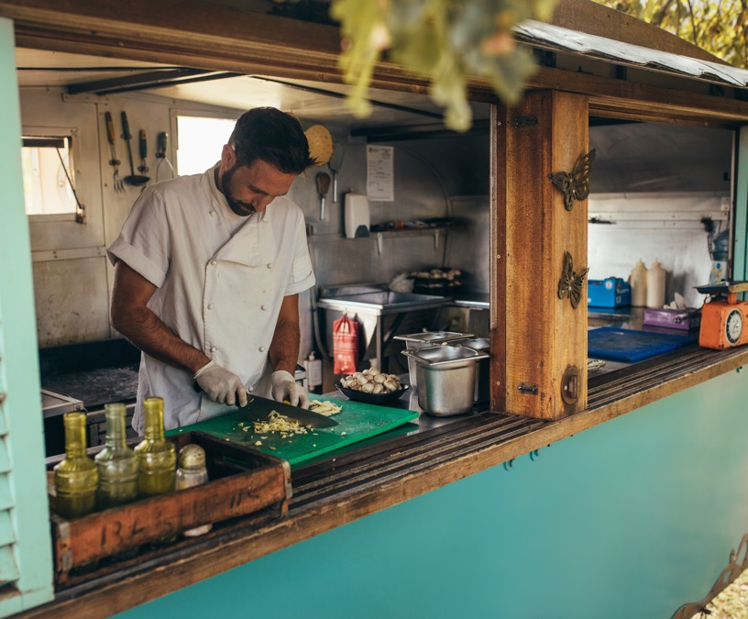
04
Ethical Business Models and Business Plans
In this chapter, we take you through the process of choosing a suitable business model and creating a compelling business plan.
Ethical Business Models: Not every business model fits an ethical food business. Choosing the right model involves considering various factors such as your target market, product range, scalability, and ethical goals Webster 2023).
01
Direct-to-Consumer (D2C)
Let's explore some of these business models more deeply, highlighting their unique characteristics, strengths, weaknesses, and alignment with ethical practices in the food industry
02
Subscription Services
03
Cooperative Models
04
Social Enterprises
05
Fair Trade

Slide 17
01
Direct-to-Consumer (D2C)
In a D2C model, businesses sell products directly to end consumers, eliminating the need for intermediaries such as retailers or wholesalers. This model allows businesses to control their entire customer experience, from product development to sales and customer service.
Pros
Greater control over branding, customer relationships, and profit margins. This model also enables traceability and transparency, essential elements for ethical businesses.
Cons
Requires substantial resources to handle all aspects of the supply chain and can be challenging to reach a wide customer base without the distribution channels provided by retailers.
02
Subscription Services
Subscription models provide a recurring, reliable revenue stream by offering customers regular deliveries of products. This model is increasingly popular in the food industry, including meal kits, specialty foods, and even fresh produce deliveries.
Pros
Provides a steady revenue stream and customer loyalty. It can also reduce waste by enabling better demand forecasting.
Cons
Retention can be a challenge if the product or service doesn't continually meet or exceed expectations. This model may also limit impulse or one-off purchases.
03
Cooperative Models
Cooperative businesses are owned and operated by a group of individuals for mutual benefit. In the food industry, this could be a group of farmers selling collectively or a consumer grocery cooperative.
Pros
Promotes equality, shared decision-making, and community development. Profits are typically reinvested in the business or distributed among members.
Cons
Decision-making can be slower due to the democratic process. Initial setup can be challenging due to the need for a committed group of founding members.

Slide 18

04
Social Enterprises
A social enterprise is a business that aims to maximise social impact alongside profits. In the food industry, this might involve employing disadvantaged groups, donating a portion of profits to food-related causes, or sourcing from small-scale farmers at fair prices.
Pros
Contributes to social good, which can attract customer support and even command premium prices. May also qualify for certain grants or social investment funds.
Cons
Balancing the dual mission of profit and social impact can be challenging. It may also require substantial resources to measure and report on social impact.
05
Fair Trade
Fair Trade businesses commit to paying fair prices to producers in developing countries, promoting sustainable farming practices, and improving social conditions
(DeCarlo & DeCarlo (2011)
Pros
Ensures fair treatment of producers and contributes to sustainability, attracting ethically-minded consumers.
Cons
The process of getting certified can be lengthy and costly. Consumers may also be confused by the various fair trade labels and certifications.
Choosing the right business model for your ethical food business will depend on your specific goals, resources, and the needs of your target customers. Regardless of the model you choose, maintaining a commitment to ethical practices will be key to your success in this sector.
Food for People – Planet – Profit

Slide 19

Creating an Ethical Business Plan
A business plan is a vital tool that helps you outline your business's future trajectory and secure funding.
Key components of an ethical business plan:
Executive Summary: This is a brief overview of your business, including your mission statement, product or service, and basic information about your company's leadership team, employees, and location (Tiffany & Peterson 2022).
Company Description: This section provides detailed information about your business, what it offers, and the problems your business solves.
Market Analysis: Here you'll detail your target customers, information about your competition, and any strategic opportunities in the market.
Organisation and Management: This outlines your business's organisational structure, ownership information, and profiles of your management team.
Service or Product Line: Here you'll describe your product or service, its benefits to potential customers, and any product lifecycle details.
Marketing and Sales Strategy: This details how you plan to attract and retain customers. Ethical communication.
Funding Request: If you're seeking funding, this section is where you specify your current funding requirements and future funding needs over the next five years. We consider ethical funding options.
Financial Projections: This section aims to convince the reader that your business is stable and will be a financial success, and yet ethically responsible.
Each of these sections should not just reflect your business's practicalities but also your ethical vision. The business plan must emphasise how sustainability and ethical practices are integrated into all aspects of your business, not as an add-on, but as a core part of operations.

Slide 20
05
Registering Your Business & Protecting Your Intellectual Property

Slide 21

Registering Your Business & Protecting Your Intellectual Property
05
In this chapter, we navigate through the intricate process of registering your business and protecting your intellectual property.

Slide 22

01
These steps provide the legal foundation for your ethical food business & ensure that your unique assets are safeguarded.
Registering Your Business
02
Protecting your Intellectual Property
03
Permits and Licenses
04
Copyright
05
Registering a trademark
07
06
Patents in the Food Industry
Trade Secrets
Food for People – Planet – Profit

Slide 23
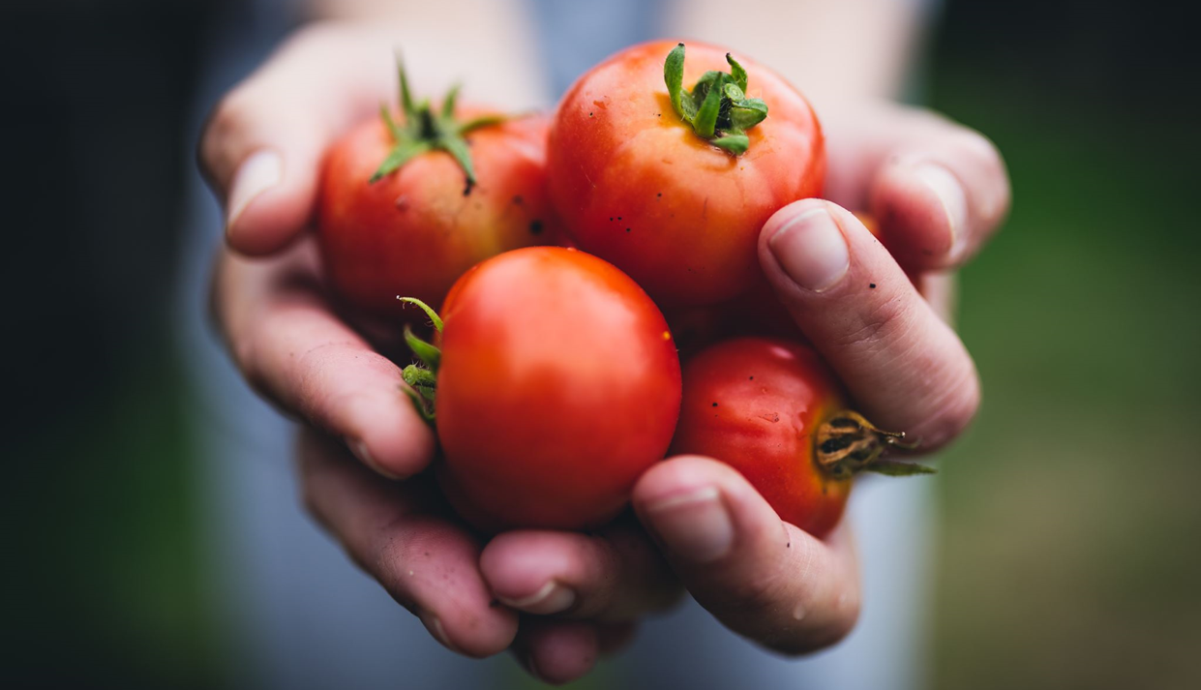
01
Registering Your Business
Business registration makes your business a distinct legal entity and is a prerequisite to operating officially. However, the process can be complicated, as it varies by country within Europe, and sometimes even within regions of the same country.
The general steps involved include:
Choosing a Business Name: You need to decide on a name for your business that aligns with your brand and vision and also complies with local naming regulations (Europa 2021).
Choosing a Legal Structure: Depending on your plans and the size of your business, different legal structures may be appropriate, such as sole proprietorship, partnership, limited liability company (LLC), or corporation.
Registration Process: You'll learn how to submit your business registration forms, including information on necessary documentation, associated fees, and the expected timeline.
Obtaining Licenses and Permits: The food industry is heavily regulated. We'll guide you through the process of identifying and obtaining the necessary licenses and permits to operate your business legally. This may include health permits, food handler permits, and potentially alcohol licenses.

Slide 24
02
Protecting Your Intellectual Property
Your recipes, branding elements (like logos and trade names), and proprietary processes are critical assets of your ethical food business. Protecting these ensures that others cannot use them without your permission.
The process for registering a food business in Europe varies somewhat depending on the specific country, but I can provide a general overview that should apply broadly. Here's a typical process:
Understanding the Legal Requirements: Before you begin, familiarise yourself with the local and European Union (EU) regulations that apply to food businesses. This includes food safety, packaging and labelling, waste management, and animal welfare regulations. If your business involves importing or exporting food, you'll also need to understand the customs regulations.
Preparation of Necessary Documents: Typically, you will need a business plan, proof of identity, proof of address, and details about your business premises and operations. This could include floor plans, equipment details, and your food safety management procedures based on Hazard Analysis and Critical Control Point (HACCP) principles. If you plan to serve alcohol, you will also need a liquor license.
Application Submission: Find out where to submit your application. This could be a local or national government department, such as the Environmental Health Service or a similar agency. Some countries or regions allow online applications.
Payment of Fees: There will likely be a fee for registering your business. The amount can vary, so check with the relevant agency. Be prepared to pay this fee at the time you submit your application.
Inspection: Once your application is submitted and the fees are paid, an environmental health officer may inspect your premises to ensure it meets food safety standards. They will also review your food safety management procedures.
Await Approval: If your application and premises meet all the requirements, you will receive your registration or license. The timeline can vary, but generally, you should allow several weeks to several months.
EUIPO is the European Union Intellectual Property Office responsible for managing the EU trademark and the registered Community design
www.euipo.europa.eu
Remember to renew your registration or license as required, and to notify the relevant agency of any significant changes to your business. Failure to do so can result in penalties.
Please note that the specifics might differ depending on the country in Europe, so it's essential to check the local regulations and seek advice from local business support services or a legal advisor.
As the European Union has stringent and comprehensive regulations concerning food safety and standards, non-compliance can lead to serious consequences (Hall (2023).
Before starting the process, we would recommend consulting with local resources or contacting the relevant local authority for accurate information about the necessary steps, documents, and fees. Remember, this process can take some time, so be sure to factor it into your business planning (IPOI 2022).
Opening a food business often involves obtaining a variety of licenses and permits to comply with local, regional, and national regulations. It's important to do this well in advance of your planned opening, as the process can take several weeks or even months (Kusturovic 2020).

Slide 25
03
Permits and Licenses
A guide on identifying and obtaining the necessary permits and licenses:
Business License: This is the standard license to operate a business in your location. The process of obtaining a business license varies by jurisdiction, so check with your city or county's business licensing office. This process usually involves completing an application, paying a fee, and possibly undergoing a background check.
Employer Identification Number (EIN): In many countries, you'll need to obtain an EIN (or the equivalent) for tax purposes. In Ireland it can be found on the top left corner of your Tax Clearance Certificate. It will contain either 8 or 9 characters, which may include letters and numbers ie.0000000A
Food Service License: For example, in Ireland, notification of a food business should be made to the HSE Environmental Health Service before the business starts operating, including where the business is operated from home. A separate notification must be submitted for each food business being notified.
This can be done through our online portal or by contacting the local Environmental Health Office where the food business is located. There is no fee for submitting a food business notification to the HSE Environmental Health Service. The food business notification details provided to the HSE must be accurate and kept up-to-date.
Liquor License: If you plan to serve alcohol, you'll need a separate license for that. The specifics vary widely by location, but you can expect a thorough review process that may include a public hearing, background check, and substantial fees. Remember that serving alcohol comes with additional responsibilities, like ensuring that staff are trained not to serve minors or visibly intoxicated patrons. Here’s a link on how to apply for a license
Sign Permit: If you plan to put up a sign for your business, you may need a separate permit for that. Check with your local zoning office.
Building Health and Safety Permits: Depending on your location and the nature of any remodeling you plan to do, you may need permits related to fire safety, building health codes, and zoning.
Music License: If you plan to play music in your establishment, you may need a license from a music rights organisation.
A European Union trade mark (EUTM) grants you exclusive rights in all current and future Member States of the European Union through a single registration, filed online. It is valid for 10 years and can be renewed indefinitely, for subsequent periods of 10 years.
www.euipo.europa.eu/apply-for-a-trade-mark
This is not an exhaustive list and you may require additional permits and licenses depending on your location and the specifics of your business. Be sure to do thorough research, and don't hesitate to seek legal advice if you're unsure about anything.
The process for obtaining these licenses and permits usually involves completing an application, paying a fee, and undergoing an inspection or review process. Be sure to keep track of when each license or permit needs to be renewed. Operating without the necessary licenses or permits, or letting them expire, can result in fines and possibly being shut down.
Always remember, the local chamber of commerce or a small business development centre can be a valuable resource when navigating this process.

Slide 26
04
Copyright
Copyright is a type of intellectual property protection that can be very important for food businesses. In Europe, copyright laws protect original works of authorship, including literary, dramatic, musical, artistic, and certain other intellectual works.
For a food business, copyright can protect:
Marketing Content: Any original written content you produce for marketing purposes, such as ad copy, blog posts, articles, or social media posts, can be protected by copyright. This prevents others from using your content without your permission.
Website: The content on your website, including text, photos, and original graphics, can also be protected by copyright. This extends to the layout and structure of your website, as long as it's sufficiently original.
Packaging: Any original text or graphics on your product packaging can be protected by copyright.
Here's what you need to know about copyrighting these materials:
Automatic Protection: In the European Union, copyright protection is automatic and does not require registration. As soon as an original work is created and fixed in a tangible medium (like being written down or saved on a computer), it is protected by copyright. However, it may be necessary to register your copyright if you wish to bring a lawsuit for infringement.
Marking Your Work: It's a good practice to include a copyright notice on your works. This usually includes the word "copyright" or the copyright symbol (©), the year of first publication, and the name of the copyright owner. For example: © 2023 Your Business Name. This isn't legally required in most European countries, but it can deter infringement and can make it easier to win a lawsuit if someone infringes your work.
Duration of Copyright: In the European Union, copyright generally lasts for 70 years after the death of the author. If the author is a business, copyright lasts for 70 years from the date of publication (Kusturovic 2020)
Enforcing Your Rights: If someone uses your copyrighted work without your permission, you can take legal action against them. This can involve sending a cease-and-desist letter, filing a lawsuit, or reporting the infringement to a website or online platform.
Remember, copyright does not protect ideas, only the expression of those ideas. For example, you can't copyright a recipe, but you can copyright a specific written description or illustration of the recipe.
For more detailed advice, especially if you're dealing with a complex situation or large amounts of money, you should consult with a lawyer or a professional specialised in intellectual property law.

Slide 27
05
Registering a trademark
Registering a trademark for your food business in Europe can protect your brand name, logo, slogan, or other identifying marks. This can prevent others from using similar marks that could confuse customers. Here's a step-by-step guide to registering a trademark in the European Union (EU) through the European Union Intellectual Property Office (EUIPO):
Understand What Can Be a Trademark: Trademarks can include words, logos, shapes, colours, sounds, or any combination of these. The most important factor is that they must be distinctive and capable of distinguishing your goods or services from those of other companies.
Research Existing Trademarks: Before applying for a trademark, you should conduct a thorough search to make sure your desired trademark isn't already in use or registered by another company. This can be done through EUIPO's eSearch plus database.
Prepare Your Application: To register a EU trademark, you'll need to prepare the following:
A clear representation of your trademark. This could be an image if your trademark is a logo or a combination of words and graphics.
A list of goods or services that your trademark will represent, categorised by the Nice Classification, which is an international classification of goods and services for the purposes of trademark registration.
File Your Application: The application for an EU trademark can be submitted online through EUIPO's website. You can file the application yourself or hire a trademark attorney to do it for you.
Pay the Fee: After submitting the application, you'll need to pay the application fee. The basic fee covers one class of goods or services. There are additional fees for each additional class you want to include in your application.
Examination by EUIPO: Once your application is submitted and the fee is paid, EUIPO will examine your application. This includes checking that it meets the formal requirements and that the mark is distinctive and not descriptive or misleading. EUIPO will also check that it doesn't conflict with existing trademarks.
Opposition Period: If your application passes the examination, it will be published in the EU Trade Marks Bulletin. Other trademark owners then have three months to file an opposition if they believe your trademark would infringe on their rights.
Registration: If no oppositions are filed, or if any oppositions are resolved in your favour, your trademark will be registered. You will receive a certificate of registration, and your trademark will be published as registered in the EU Trade Marks Bulletin.
Please note that a EU trademark gives protection in all EU member states. If you only want protection in a specific country, you should apply for a national trademark in that country.
This is a general guide, and the exact process may vary depending on the specifics of your business and your trademark. If you're unsure about any part of this process, it may be worth consulting with a trademark attorney. Remember that a registered trademark is a valuable asset that can protect your brand and your business.

Slide 28
06
Trade Secrets
Trade secrets are a valuable form of intellectual property that involve information, such as formulas, practices, processes, designs, instruments, or patterns, that have economic value because they are not generally known or easily ascertainable. This can include unique recipes or proprietary processes in a food business. In Europe, the protection of trade secrets is governed by the Trade Secrets Directive (EU 2016/943).
Here's how you can protect your trade secrets in the Europe:
Identify Your Trade Secrets: Clearly identify and document the information that you consider to be trade secrets. This could be your unique recipes, proprietary cooking or manufacturing processes, or even your customer list or marketing strategies. The information should be valuable to your business, not generally known, and not easily discoverable by others in the industry.
Implement Security Measures: To qualify as trade secrets, the information must be subject to reasonable steps to keep it secret. This could include:
Physical Security Measures: Secure the locations where the information is kept, such as using locks or access controls.
Digital Security Measures: Use strong passwords, encryption, firewalls, and other IT security measures to protect digital information. Regularly backup and update your systems.
Limit Access: Only provide access to the information on a "need-to-know" basis.
Confidentiality Agreements: Employees, contractors, suppliers, and anyone else who has access to the trade secrets should sign confidentiality agreements. These agreements should clearly define the information that is considered confidential, the obligations of the party receiving the information, and the potential penalties for breach of the agreement.
Training: Regularly train your staff on the importance of trade secrets and how to protect them. Make sure they understand the potential consequences of revealing trade secrets.
Monitor and Enforce: Regularly review your security measures and update them as necessary. If you believe that a trade secret has been stolen, consult with a lawyer to explore your options. Under the Trade Secrets Directive, you may be able to take legal action to stop the use or disclosure of the trade secret and to seek compensation.
Remember, while a trade secret can be protected indefinitely as long as it remains secret, once the information becomes publicly known, the protection is lost.
Therefore, it's crucial to maintain the secrecy of the information. If you're unsure about any part of this process, it may be worth consulting with a lawyer or an expert in intellectual property law.

Slide 29
07
Patents in the food industry
Patents are indeed less common in the food industry compared to other forms of intellectual property protection like trademarks or copyrights. However, they can still be highly relevant, particularly in cases where a company has developed an innovative food processing method, a unique food composition, or even a novel food packaging solution. A patent gives the owner the exclusive right to prevent others from making, using, selling, or importing the patented invention.
Here are a few examples of when seeking a patent might be relevant in the food industry:
Novel Food Processing Methods: If your business has developed a new method of processing food that is not obvious to others in the industry, this could potentially be patentable. This could include a novel method of preserving food, a unique way of extracting certain components from food, or an innovative cooking technique.
Unique Food Compositions: If your food business has created a unique composition of ingredients that results in a product with new properties, this could potentially be patentable. This might be relevant, for example, in the development of food substitutes or products tailored to special diets.
Innovative Food Packaging Solutions: If your business has developed a novel food packaging solution, this could also potentially be patentable. This could include containers that extend the shelf life of food, unique single-serving packages, or sustainable packaging solutions.
However, it's important to note that obtaining a patent can be a complex and costly process, requiring a thorough patentability search and a well-written patent application. The process usually involves the following steps
Patent Search: Before applying for a patent, a thorough search should be conducted to ensure that your invention is new and not obvious in light of what is already known.
Patent Application: If your invention appears to be novel and non-obvious, the next step is to prepare a patent application. This usually involves drafting a detailed description of the invention, along with claims that define the scope of the protection sought.
Examination: Once the patent application is submitted, it will be examined by the patent office. The examiner will check whether the invention meets the requirements for patentability, and may require amendments to the application.
Grant: If the patent application is approved, the patent will be granted, giving the owner the exclusive right to prevent others from exploiting the patented invention for a period of time, typically 20 years from the filing date of the application.
While the potential benefits of obtaining a patent can be significant, it's also important to consider the costs and time involved. It's also crucial to keep in mind that a patent requires making the details of the invention public, which may not be desirable in all cases. It's often advisable to consult with a patent attorney or a patent agent when considering seeking patent protection for an invention.

Slide 30
06
Financial Planning and Fundraising for the Ethical Food Business

Slide 31

06
Financial Planning and Fundraising
01
Steps to Financial Planning and Fundraising
Budgeting and Forecasting
02
Securing Investment
03
Securing Grants
04
Securing a Loan
Ensuring financial viability is one of the most crucial steps in establishing your ethical food business. This chapter is dedicated to covering the financial considerations and resources that are unique to the ethical food sector.
05
Alternative Methods of Fundraising
Food for People – Planet – Profit

Slide 32

01
Budgeting and Forecasting
Budgeting and forecasting are crucial aspects of any business, especially in the food industry where margins can often be thin and costs can be unpredictable. Here's a detailed look at how to prepare your initial budget and financial forecast:
Initial Budget
The first step in launching a successful food business is to determine how much it's going to cost to
get it off the ground. This involves identifying all the potential costs you'll need to cover.
Here are some categories to consider:
Sourcing Ingredients: The cost of raw materials or ingredients is one of the main costs in the food industry. It's important to research and list out all the potential suppliers, their prices, and delivery fees.
Production Costs: These include the costs associated with producing your product, such as labour, utilities, rent for the production space, and equipment maintenance and depreciation.
Packaging: You'll need to budget for packaging materials, which may include boxes, labels, bags, etc. Remember, if you’re adopting a sustainable approach, biodegradable or reusable packaging might be more expensive.
Marketing: This includes costs for advertising, public relations, promotional materials, website development, and social media management.
Overhead Costs: These are costs that don't directly contribute to the creation of the product but are necessary for running the business. They include items like rent, utilities, insurance, and salaries for administrative staff.
Financial Forecast
Once you've identified and estimated your costs, you should create a financial forecast. This involves
making reasonable projections for your revenue and expenses.
Here's how:
Sales Forecast: Estimate the number of units you expect to sell on a monthly basis and multiply that by the price per unit to get your total expected sales revenue. It can be helpful to make a conservative estimate and an optimistic estimate so you can prepare for different scenarios.
Expense Forecast: Using the categories mentioned above, estimate your monthly expenses. Make sure to factor in any seasonal fluctuations or one-time costs.
Profit/Loss Projection: Subtract your total expected expenses from your total expected sales revenue. This will give you a projection of your net profit or loss.
Financial Management: How to create a financial forecast for your business

Slide 33

01
Budgeting and Forecasting
Ethical Considerations
As an ethical food business, there are some additional costs you may need to consider:
Fair-Trade Ingredients: If you plan to use fair-trade ingredients, these may be more expensive than conventional ingredients. However, they can also be a selling point for your business.
Sustainable Packaging: Sustainable or biodegradable packaging is often more expensive than traditional packaging, but it can help you appeal to environmentally conscious consumers.
Living Wages: If you're committed to paying your employees a living wage, this could increase your labour costs. However, it can also result in lower turnover and higher morale among your staff.
Incorporating these ethical considerations into your budget and financial forecast can not only help you run your business in line with your values but also position your brand in a unique way that resonates with your target audience. Be sure to highlight these elements in your marketing and customer communication.
Remember that your initial budget and financial forecast are just that - forecasts. They will almost
certainly change as your business grows and develops, and that's okay. The important thing is to keep monitoring your finances, adjusting your budget as necessary, and making informed decisions to keep your business on track.

Slide 34
02
Securing Investment
When it comes to securing investment, preparation and a compelling story are key. Here's a breakdown of how to attract investors to your ethical food business:
Preparing a Compelling Pitch
Your pitch is your chance to show investors why they should believe in your business. Here's what to focus on:
Unique Selling Points: Clearly articulate what makes your business unique. In the case of an ethical food business, this could be your commitment to sustainability, your use of fair-trade ingredients, or your innovative product.
Business Potential: Investors want to see that your business has the potential for substantial growth. Demonstrate this by showing market research, customer testimonials, or early sales successes.
Financial Projections: Investors will want to see that you have a solid understanding of your finances. Show them your sales forecasts, projected profits, and a clear plan for how you will use their investment to grow your business. More information here
Maintaining a Strong Ethical Focus
While you need to show that your business is financially viable, it's equally important to demonstrate your commitment to your ethical values. Show investors how your ethical practices contribute to your business success. This could include consumer trends towards ethical products, your strong customer loyalty, or your positive relationships with suppliers.
Understanding Different Types of Investors
Different investors have different priorities, so it's crucial to understand who you're pitching to. Here
are a few types of investors you might encounter:
Angel Investors: These are wealthy individuals who invest their personal money into start- ups. They often bring their industry expertise and network and may be more willing to take a risk on an innovative concept.
Venture Capitalists (VCs): VCs are firms that invest other people's money. They generally look for more mature companies that are already generating revenue, and they typically expect a higher return on their investment.
Impact Investors: These are investors who seek to generate both financial return and positive social or environmental impact. They might be particularly interested in your ethical food business. More information here
When approaching each type of investor, tailor your pitch to their interests and priorities. For angel investors, emphasise your innovation and potential for growth. For VCs, focus on your revenue and plans for expansion. For impact investors, highlight your social and environmental impact.
In all cases, be prepared to answer tough questions and be open to feedback. Remember, investors are not just providing capital; they're also becoming partners in your business. You'll want to find investors who believe in your vision and who you can work with effectively.

Slide 35
03
Securing Grants
Securing grants can provide significant financial support for your ethical food business, and unlike investments, grants usually don't need to be paid back. Here's a guide on how to approach the grant application process:
Identifying Potential Grant Opportunities
Various organisations offer grants to promote sustainability, local agriculture, social
entrepreneurship, and other aspects related to ethical food business. Here are a few places to look for grant opportunities:
Government Agencies: Many countries, regions, and local municipalities offer grants for small businesses, especially those that contribute to local economic development or address social or environmental challenges.
Not for profit Organisations: Numerous not for profits offer grants for initiatives related to food sustainability, food security, and social justice.
Corporate Grants: Some corporations provide grants as part of their corporate social responsibility programs. They may focus on specific areas like sustainable agriculture, waste reduction, or healthy food access.
Understanding the Application Requirements
Each grant will have its own set of requirements, which may include:
Eligibility Criteria: These can range from the size and type of your business, to the purpose of the grant funding, to the geographic area where your business operates.
Application Process: This typically includes filling out an application form and providing supporting documentation. It may also involve interviews or presentations.
Use of Funds: Most grants require that you use the funds for a specific purpose related to the grant's objectives. You'll need to demonstrate how you plan to use the grant money in your application.
Crafting a Compelling Grant Proposal
Your grant proposal is your chance to show the grant-giving body why your business deserves the
grant. Here are a few tips:
Follow the Guidelines: Carefully read the application guidelines and make sure your proposal complies with all requirements.
Tell Your Story: Explain the mission of your ethical food business, the problem you're addressing, and how your business is making a difference. Make it clear why your business aligns with the objectives of the grant.
Demonstrate Impact: Provide concrete evidence of your business's social or environmental impact. This could be through data, case studies, testimonials, or other forms of evidence.
Budget Proposal: Detail how you plan to use the grant funds and how this will help your business grow or achieve its goals. Be realistic and transparent.
Proofread: Make sure your proposal is well-written, clear, and free of typos or errors.
Applying for grants can be a time-consuming process, but the potential rewards make it a worthwhile endeavour for many ethical food businesses. Just remember that it's often a competitive process, so it's important to put your best foot forward in your application.

Slide 36
04
Securing a Loan
Securing a loan can provide an immediate influx of cash to help you grow your ethical food business. However, loans do come with the obligation of repayment, often with interest. Here's a guide on how to approach securing a loan:
Understanding Different Loan Options
There are a several different types of loans available to small businesses. Here are a few that might be relevant:
Traditional Bank Loans: These are typically the first type of loan businesses think of. They often have lower interest rates, but can be harder to qualify for, especially for startups or small businesses without a solid financial track record.
Microloans: Microloans are small loans often offered to startups or very small businesses that might not qualify for larger loans. They're typically offered by not for profit organisations or specialised lenders, rather than traditional banks.
Green Loans: These are loans specifically designed to support businesses that contribute to environmental sustainability. They may come with lower interest rates or other favourable terms to encourage green business practices.
Evaluating Loan Options
When evaluating different loan options, there are a few key factors to consider:
Interest Rates: This is the cost of borrowing money. Lower interest rates mean lower overall costs, but they're often associated with more stringent qualification requirements.
Repayment Terms: This includes the length of the loan and the frequency and amount of payments. Longer terms can result in lower monthly payments but higher total costs due to the longer period of paying interest.
Qualification Requirements: These are the criteria you need to meet to qualify for the loan. They may include credit score, business revenue, years in operation, and the use of loan funds.
Collateral: Some loans require collateral, which is an asset you pledge to secure the loan. If you fail to repay the loan, the lender can take the collateral.
Understanding the Application Process
Applying for a loan typically involves the following steps:
Preparation: Gather all necessary documents, such as financial statements, business plans, tax returns, and any other information the lender requires.
Application: Fill out the application form provided by the lender. Be thorough and accurate in providing the requested information.
Approval: If your application is approved, the lender will provide a loan offer, including the amount, interest rate, and repayment terms. Review this carefully before accepting.
Repayment: Once you accept the loan, you'll need to start making regular repayments as per the agreed-upon terms.
Remember, taking out a loan is a significant commitment. It's important to thoroughly evaluate all your options and make sure you understand the terms of the loan before proceeding. It can be helpful to consult with a financial advisor or a loan officer to help guide you through the process.

Slide 37

05
Alternative Methods of Fundraising
Apart from traditional fundraising methods like securing investments, loans, or grants, there are several alternative methods of fundraising that can be particularly suitable for ethical food businesses. Here's an overview:
Crowdfunding
Crowdfunding is a method of raising capital through the collective effort of friends, family, customers, and individual investors. This approach taps into the collective efforts of a large pool of individuals and leverages their networks for greater reach and exposure. Platforms like Kickstarter and Indiegogo are popular for product-focused businesses, while GoFundMe is often used for community-based and cause-oriented campaigns.
Community Share Offerings
In some regions, community share offerings are a way to raise funds by offering ownership stakes to members of the local community. This approach aligns with the principles of many ethical food businesses, as it promotes local involvement and supports the local economy. Shares are typically sold at a relatively low cost to encourage broad participation. Investors become part-owners of the business and may receive benefits like discounts or voting rights.
Partnerships
Forming strategic partnerships with other ethical businesses or organisations can provide various resources and support, including funding. For example, a larger, more established business might invest in a smaller ethical food business as part of its corporate social responsibility strategy. Or an organisation focused on sustainability or food security might provide funding or other resources to support a business that aligns with its mission. Such partnerships can be mutually beneficial and help to strengthen the overall impact of the ethical food sector.
Remember, each fundraising method comes with its own set of considerations and potential challenges. It's important to think through which method aligns best with your business model, values, and long-term goals before making a decision. It may also be beneficial to combine several methods to diversify your sources of funding and reduce risk.

Slide 38
07
Supply Chain Management & Sustainability

Slide 39

07
Supply Chain Management & Sustainability
This chapter will provide you with a comprehensive guide to establishing and managing a supply chain that aligns with your ethical & environmental commitments
01
Local & Seasonal Sourcing
02
Relationships with Ethical Suppliers
03
Transportation & Logistics
04
Reducing Waste
06
05
Journey of Starting & Growing your business
Maintaining Sustainability
Building a sustainable and ethical supply chain is vital to an ethical food business.
Food for People – Planet – Profit

Slide 40
01
Local & Seasonal Sourcing
Emphasising local and seasonal sourcing is not only an ethical choice but also one that can add unique value to your food business. Here's how you can approach this:
Click to find Cream of the Crop In our compendium
Identifying Local Suppliers
Farmer's Markets and Local Producers: These are great places to start looking for fresh, seasonal ingredients. Establishing relationships with farmers and other local producers can ensure a steady supply of high-quality ingredients.
Food Cooperatives and Local Distributors: These entities often source from local farmers and can offer a wider range of products, making it easier to get everything you need in one place.
Working within Seasonal Constraints
Seasonal Menus: Consider creating a menu that changes with the seasons, allowing you to highlight the freshest, most flavourful ingredients at any given time of the year.
Preservation Techniques: Pickling, canning, freezing, and other preservation methods can help extend the shelf life of seasonal ingredients, allowing you to use them year-round.
Innovation: If a particular ingredient isn't available, see it as an opportunity to try something new rather than a setback.
Communicating the Value of Local Sourcing to Customers
Customers appreciate transparency and love to know where their food comes from. Here's how to effectively communicate your local sourcing:
Storytelling: Share the stories of the farmers and producers you work with. This can help customers feel more connected to your food and to the local community.
Education: Use your platform to educate customers about the benefits of local sourcing, such as reducing carbon footprint, supporting local economies, and enjoying fresher, more flavourful food.
Marketing: Highlight your local sourcing in your marketing materials. This can help attract customers who share your values and are willing to pay a premium for locally sourced products
Remember, sourcing locally and seasonally can be challenging but it's also an opportunity to create a unique food experience that's grounded in your local community and the rhythms of the natural world.

Slide 41
02
Relationships with Ethical Suppliers
Building strong relationships with ethical suppliers is key to the sustainability and consistency of your supply chain. Here's how you can approach this process:
Evaluating Potential Suppliers
Environmental Policies: prioritise suppliers who demonstrate a commitment to minimising their environmental impact. This can include things like sustainable farming practices, waste reduction efforts, and energy-efficient operations (info, N.B. 2022)
Labour Practices: Ethical suppliers should also have fair labour practices, which can include providing living wages, ensuring safe and healthy working conditions, and respecting workers' rights.
Quality Standards: Consistent, high-quality products are essential. Assess potential suppliers based on the quality of their goods, their reliability, and their ability to meet your specific needs.
Negotiating Contracts
Once you've identified potential suppliers, the next step is to negotiate the terms of your
relationship. Here are a few things to consider:
Price: While it's important to negotiate a fair price, remember that suppliers also need to cover their costs and make a profit. Paying a fair price can help ensure that your suppliers are able to maintain their ethical practices.
Volume and Frequency: Agree on how much you'll be purchasing and how often. Ensure that these terms align with your business needs as well as the supplier's capacity. Negotiating supplier contracts
Delivery Terms: Establish when and how deliveries will be made. Consider factors like your storage capacity and the shelf life of the products.
Payment Terms: Determine when and how you'll pay for the goods. Late payments can strain relationships and may even put smaller suppliers at risk.
Building Mutually Beneficial Relationships
A strong, long-term relationship with a supplier is not just about transactions; it's about partnership.
Here's how to cultivate such relationships:
Open Communication: Regular, open communication can help both parties understand each other's needs and constraints. It also helps to address any issues promptly before they escalate.
Flexibility: Be willing to adjust your terms as circumstances change. This can help build trust and demonstrate that you see the relationship as a partnership, not just a business transaction.
Support: Show interest in your suppliers' success. This can involve promoting their products, providing constructive feedback, or even helping them connect with other potential buyers.
By nurturing strong relationships with ethical suppliers, you can ensure a steady supply of high-quality, ethically produced goods, while also contributing to a more sustainable and fair food system.

Slide 42
03
Transportation & Logistics
Transportation and logistics can indeed have a significant environmental impact, making it an important area to focus on for any business that's committed to sustainability. Here's how you can manage your logistics sustainably:
Low-Emission Transportation
One of the key areas to focus on is reducing the carbon emissions associated with transporting your
goods. Some strategies include:
Efficient Vehicles: Consider using vehicles that are energy-efficient or use alternative fuels. Electric vehicles or hybrids are a good choice if available and practical for your needs.
Public Transportation and Bicycling: For local deliveries, consider using public transportation or bicycles. These methods are low-cost, low-impact, and can often navigate urban areas more efficiently than cars.
Carpooling and Shared Freight Services: Sharing transportation with other businesses can help reduce your carbon footprint, as well as cost.
Optimising Delivery Routes
By planning your routes efficiently, you can reduce the amount of time and fuel used for deliveries. Consider the following:
Route Planning Software: There are various software tools available that can help you plan the most efficient routes for deliveries.
Off-Peak Deliveries: Delivering during off-peak times can help reduce the time spent idling in traffic, thereby reducing fuel consumption and emissions.
Consolidating Shipments
Consolidating shipments means sending out fewer, larger deliveries, rather than many smaller ones. This can significantly reduce the overall impact of transportation. Here are a couple of things to
consider:
Inventory Management: Efficient inventory management can help you consolidate shipments without running out of stock. This might involve using forecasting software to predict demand, or setting up automatic reorders when inventory levels get low.
Collaboration: Collaborate with other businesses, especially those in your vicinity or on your route, to consolidate shipments and share the environmental benefits.
By focusing on sustainable logistics, you can significantly reduce your business's carbon footprint, which aligns with your commitment to ethical and sustainable practices. Plus, many of these strategies can also help save money in the long term, making them good for both the planet and your profit.

Slide 43
04
Reducing Waste
Reducing waste in your supply chain is crucial to sustainability and is aa assurance of ethical business practices. Here's how you can implement waste reduction strategies:
Buying in Bulk
Purchasing in bulk can help reduce the amount of packaging waste associated with your ingredients and supplies. However, when considering this strategy, balance must be maintained between the benefit of reduced packaging and the risk of overstocking, which might lead to spoilage and increased food waste.
Using Reusable Packaging
Opt-in for reusable packaging wherever possible. This not only applies to the packaging of your final product but also to the containers used for transporting ingredients and supplies.
Returnable Packaging: Consider implementing a system where suppliers take back packaging for reuse. This requires coordination with suppliers but can significantly reduce waste.
Consumer Incentives: For consumer packaging, consider offering a discount or other incentive for customers who return their packaging for reuse.
Click to find Helsinki Mills In our compendium
Just-In-Time Inventory System
A just-in-time (JIT) inventory system involves ordering supplies as close as possible to when they're actually needed. This reduces the need for storage and decreases the risk of spoilage or other types of waste (Day et al. 2004).
Inventory Management Software: Use software to track inventory levels and forecast demand. This can help you make more accurate ordering decisions and reduce the chance of overstocking or running out.
Reliable Suppliers: The JIT system relies on suppliers that can deliver quickly and reliably. Cultivating strong relationships with your suppliers can help make this system work effectively.
Waste Management Practices
Develop a comprehensive waste management plan. This should involve:
Composting: For food businesses, composting can be a highly effective way of managing organic waste.
Recycling: Ensure that any unavoidable waste is recycled wherever possible.
Waste Reduction Goals: Set goals for waste reduction and track your progress over time. This can help keep your waste reduction efforts on track and can also be a good selling point for customers.
Click to find Regnum Hotel In our compendium
By implementing these strategies, you can significantly reduce the environmental impact of your business, while also potentially saving money. Remember, reducing waste often involves careful planning and a willingness to innovate, but the benefits are well worth the effort.

Slide 44
05
Maintaining Sustainability
Continuous improvement is indeed critical for maintaining a sustainable supply chain. Here's how you can monitor and enhance the sustainability of your supply chain:
Establishing Key Performance Indicators (KPIs)
Start by establishing KPIs that reflect the sustainability goals of your supply chain. These could include metrics related to waste reduction, energy use, greenhouse gas emissions, fair trade practices, or any other aspect of sustainability that is important to your business. Make sure the KPIs are measurable and tied to your business operations.
Regular Monitoring and Reporting
Implement a system for regularly tracking these KPIs and reporting on your performance. This might involve data collection methods like surveys, audits, or automated data tracking systems. Regular reporting can help keep everyone in your business informed about your sustainability performance and can also demonstrate your commitment to sustainability to customers and other stakeholders.
Setting Targets and Implementing Improvements
Based on your performance tracking, set targets for improvement and develop strategies to achieve these targets. This could involve things like investing in more efficient equipment, implementing new waste reduction practices, or working more closely with your suppliers to improve their sustainability performance.
Engaging Stakeholders
Keep your employees, suppliers, and customers informed about your sustainability goals and progress. Engaging these stakeholders can help build support for your sustainability efforts and can often lead to new ideas for improvement.

Slide 45


05
Maintaining Sustainability
Continuous improvement is indeed critical for maintaining a sustainable supply chain. Here's how you can monitor and enhance the sustainability of your supply chain:
Seeking External Certification
Consider seeking certification from a recognised sustainability standard. This can provide an external validation of your sustainability performance and can help increase trust with customers.
Continuous Learning and Adaptation
www.origingreen.ie
Sustainability is a rapidly evolving field, and it's important to stay informed about new developments and best practices. Participate in industry networks, attend conferences or webinars, and seek out opportunities for professional development in this area.
Remember, the goal of sustainable supply chain management is not just to reduce your environmental impact, but also to create a system that is resilient, ethical, and capable of delivering long-term value for your business and all of its stakeholders.

Slide 46
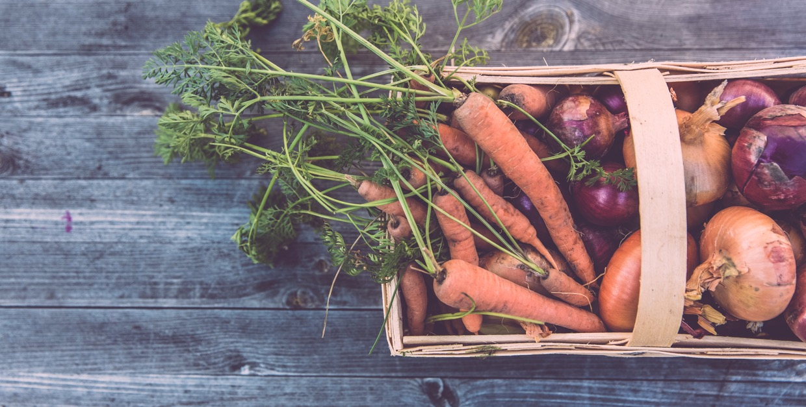
06
Journey of Starting & Growing your business
As an ethical food entrepreneur, navigating the journey of starting and growing your business goes beyond the financials. Your dedication to sustainability and ethical sourcing plays a significant role in shaping your business model and strategies.
Sourcing locally and seasonally is a cornerstone of this approach. Not only does it minimise your carbon footprint by reducing the distance food travels from farm to plate, but it also supports local
economies and farmers. It brings fresh, seasonal produce to the forefront, adding value to your product offerings. Understanding local suppliers, working with seasonal availability, and communicating this ethos to your customers forms the crux of this strategy.
Building relationships with ethical suppliers is equally vital. Your business is only as ethical as its supply chain. Thus, aligning with suppliers who adhere to responsible environmental policies, fair labour practices, and quality standards is non-negotiable. Negotiating contracts and nurturing these relationships ensures a sustainable and consistent supply chain that echoes your business's ethical values.
Managing logistics sustainably further bolsters your commitment to reduced environmental impact. Selecting low-emission transportation methods, optimising delivery routes, and consolidating shipments help cut down carbon emissions, ensuring your supply chain stays green.
Reducing waste in your supply chain is another critical aspect of sustainability. Implementing strategies such as bulk buying, using reusable packaging, and following a 'just-in-time' inventory system not only minimise waste but can also lead to substantial cost savings.
Continuous monitoring and improvement ensure your supply chain remains resilient and sustainable. Establishing KPIs, setting targets, tracking progress, and implementing improvements help you stay on top of your sustainability game. It makes your supply chain robust and adaptable to changing scenarios and expectations.

Slide 47
08
Human Resources Planning

Slide 48
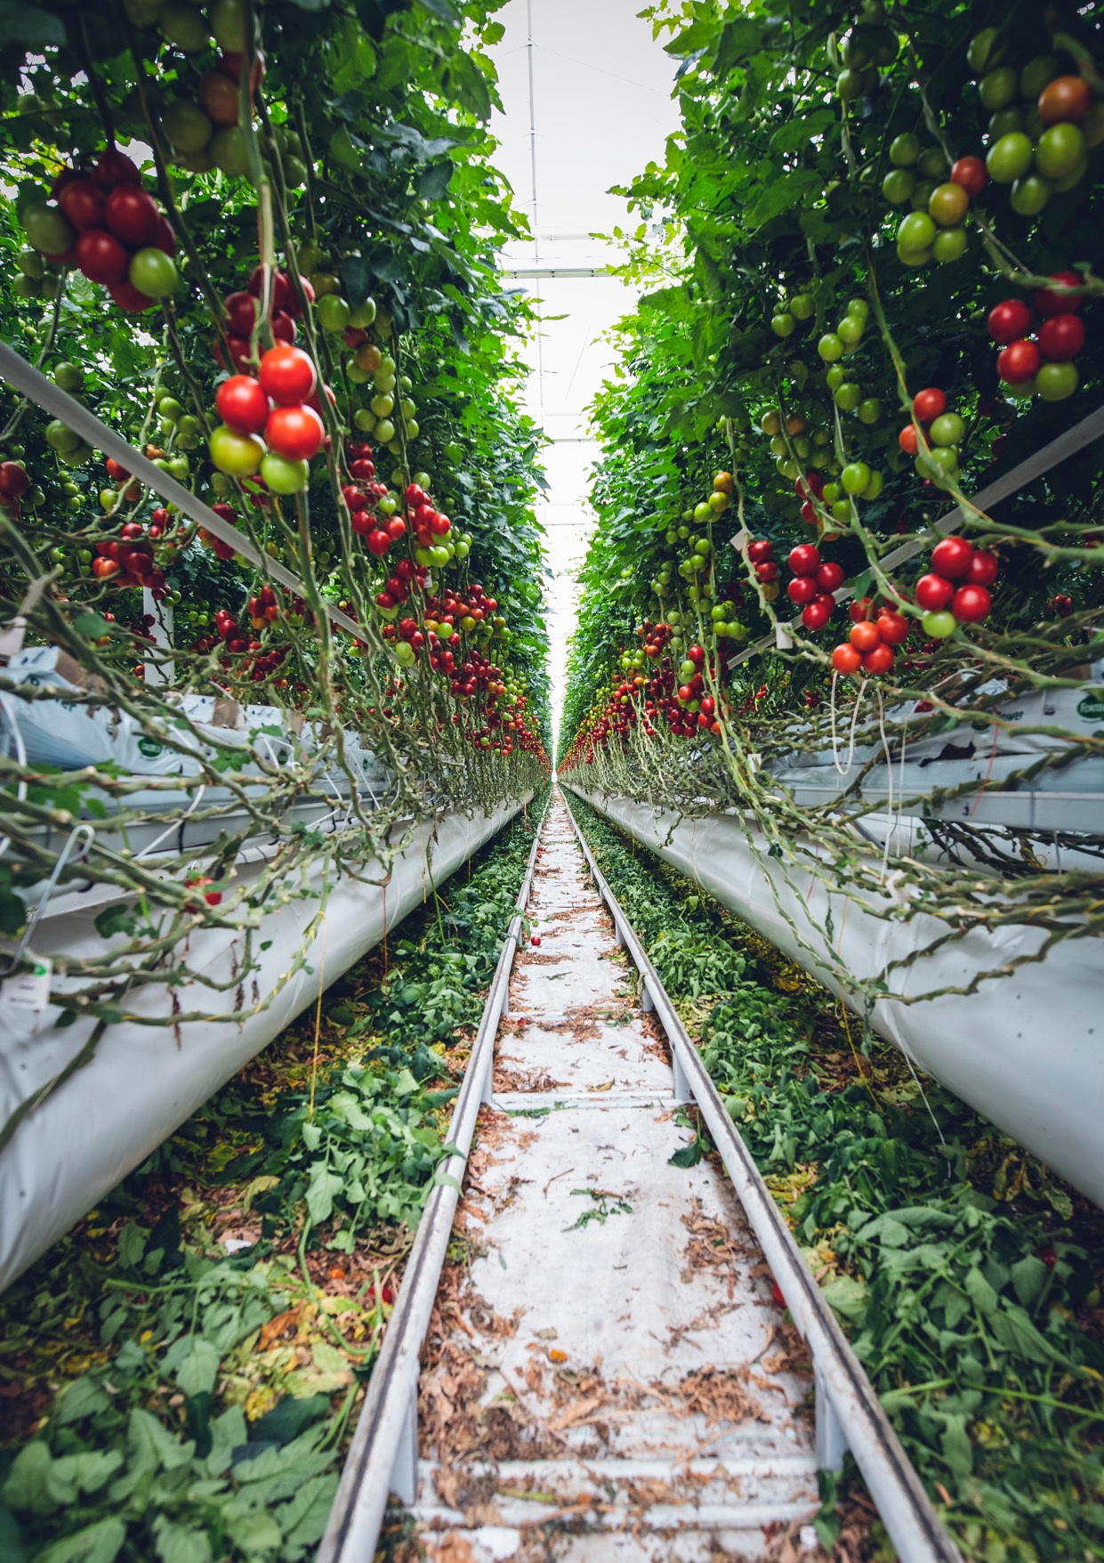
08
Human Resources Planning
People are the heart of any business, and in an ethical food business, your team plays a crucial role in
embodying and promoting your ethical vision.
01
Recruitment Process And Strategies
02
Fair & Legal Labour Practices
03
Strategies to Build an Ethical Work Culture
04
Ethical Human Management Strategies
05
Enhance Employee Retention & Satisfaction
Food for People – Planet – Profit

Slide 49
01
Recruitment Process And Strategies
Attracting and selecting the right talent is crucial for building an ethical food business that aligns with your values. Here's a more detailed exploration of the recruitment process and strategies to attract individuals who share your ethical mission:
Applicant’s Interview Notes Form
Crafting Job Descriptions
Highlight Ethical Values: Clearly articulate your business's ethical values and mission in the job description. Emphasise aspects such as sustainability, fair trade, organic practices, animal welfare, or community involvement.
Describe Impactful Work: Showcase the meaningful work and positive impact employees can have by joining your ethical food business. Highlight how their contributions can make a difference in promoting sustainability, social responsibility, and ethical practices.
Required Skills and Qualifications: Alongside technical skills and qualifications, include desired attributes that reflect your companies ethical values, such as a passion for sustainability, knowledge of organic farming practices, or experience in fair trade initiatives. State that you are looking for likeminded team members who agree with your ethical values.
Assessing Values Compatibility in Interviews
Behavioural Questions: Ask candidates open-ended questions that elicit responses about their personal values and ethics. For example, inquire about their experience with sustainable practices, how they handle ethical dilemmas, or their commitment to social responsibility.
Scenarios and Case Studies: Present hypothetical scenarios or real-life ethical dilemmas that are relevant to your industry. Assess how candidates approach and resolve these situations, paying attention to their decision-making process and alignment with your ethical values.
Reference Checks: Contact references provided by the candidates and inquire about their ethical conduct, values, and commitment to sustainability and social responsibility.
Promoting Diversity and Inclusion
Unbiased Job Advertisements: Ensure that your job advertisements use inclusive language and avoid discriminatory criteria. This promotes diversity and attracts candidates from a wide range of backgrounds.
Diverse Candidate Sourcing: Actively seek out a diverse pool of candidates by exploring different recruitment channels, digital HR websites, job fairs, engaging with diverse professional networks, and partnering with organisations focused on promoting diversity and inclusion.
Fair and Transparent Selection Process: Create a structured and unbiased selection process, including diverse interview panels, standardised evaluation criteria, and objective scoring methods to minimise unconscious biases. More information here on fair selection.
Offering Equal Opportunities: Provide equal opportunities for career growth and development to all employees, regardless of their background, race, sex, religion etc. Implement policies and practices that foster inclusivity and ensure fair treatment at all levels of the organisation.
By following these strategies, you can attract ethical talent that shares your values, ensuring your team is aligned with your mission and committed to promoting sustainability, social responsibility, and ethical practices within your food business. This will contribute to a positive work culture, strengthen your brand's reputation, and drive your business's success (Lucy et al. 2023)

Slide 50
02
Fair & Legal Labour Practices
Treating employees fairly is not only a legal obligation but also a cornerstone of running an ethical food business. This section explores important elements of fair labour practices that align with your ethical mission:
Providing Living Wages
Fair Compensation: Ensure that your employees receive fair compensation for their work. This includes providing wages that are above the legal minimum and that meet or exceed industry standards. Consider conducting periodic salary reviews to ensure that wages remain competitive and fair.
Cost of Living: Take into account the cost of living in the regions where your business operates. Adjust wages accordingly to provide employees with a salary that allows them to meet their basic needs and maintain a decent standard of living.
Ensuring Safe Working Conditions
Health and Safety Standards: Comply with health and safety regulations to create a safe working environment. Regularly assess and mitigate workplace hazards, provide necessary safety equipment and training, and establish protocols for reporting and addressing workplace incidents or accidents.
Ergonomics and Well-being: Promote employee well-being by considering ergonomic principles in workspaces, providing adequate breaks, and fostering a healthy work-life balance. Encourage employees to prioritise their physical and mental health.
Respecting Workers' Rights
Labour Laws and Non-Discrimination Policies: Familiarise yourself with and comply with labour laws, including regulations related to working hours, overtime, holidays, and leave entitlements. Implement and enforce non-discrimination policies that promote diversity and equality within your workplace (EU Charter of Fundamental Rights 2023)
Employee Representation: Respect employees' right to organise and form labour unions or other representative bodies, if applicable. Encourage open communication and create channels for employees to express concerns or voice suggestions.
Providing Opportunities for Growth and Development
Training and Skill Development: Offer training programs and opportunities for employees to enhance their skills and knowledge. This can include workshops, seminars, cross-training, or financial support for further education.
Career Advancement: Establish a clear career development framework that provides employees with growth opportunities within your business. Encourage internal promotions and offer mentorship or coaching programs to support employees' professional development.

Slide 51

02
Fair & Legal Labour Practices
Treating employees fairly is not only a legal obligation but also a cornerstone of running an ethical food business. This section explores important elements of fair labour practices that align with your ethical mission:
Going Beyond Minimum Requirements
Employee Benefits: Consider offering additional benefits that go beyond legal requirements. These may include health insurance, retirement plans, paid parental leave, or flexible working arrangements.
Workplace Culture: Foster a positive and inclusive workplace culture that values open communication, collaboration, and respect. Recognise and reward employee contributions and create opportunities for employee engagement and participation in decision-making processes.
By implementing fair labour practices, you create an environment where employees feel valued, respected, and motivated. This leads to higher employee satisfaction, productivity, and retention. Your commitment to fair labour practices not only aligns with your ethical mission but also enhances your reputation as an employer and strengthens your business in the long run.

Slide 52
03
Strategies to Build an Ethical Work Culture
Building a strong and ethical work culture is essential for fostering a supportive environment that aligns with your food business values. Here's a more detailed elaboration on strategies to build an ethical work culture
Implementing Ethical Training Programs
Orientation for your Ogranisational Culture: Conduct regular ethics training sessions to educate employees about the ethical principles and values that guide your food business. This helps create a shared understanding and commitment to ethical behaviour throughout the organisation.
Code of Conduct: Develop a comprehensive code of conduct that outlines expected ethical standards and behaviours. Communicate the code clearly to all employees and ensure they have access to it. Provide training on the code and reinforce its importance through ongoing discussions and reminders.
Encouraging Open Communication
Transparent Communication Channels: Create a culture of transparency by establishing open communication channels. Encourage employees to share ideas, concerns, and feedback without fear of retribution. Implement regular team meetings, suggestion boxes, and anonymous reporting mechanisms to facilitate open dialogue.
Active Listening: Practice active listening to ensure that employees feel heard and valued. Actively seek and consider employee input, ideas, and perspectives when making decisions that impact the business and the work environment.
Recognising and Rewarding Ethical Behaviour
Ethical Performance Metrics: Establish key performance indicators (KPIs) that include ethical considerations. Recognise and reward employees who consistently demonstrate ethical behaviour in their work, such as promoting sustainability, adhering to fair trade practices, or going above and beyond to ensure social responsibility.
Employee Appreciation Programs: Implement employee recognition programs that acknowledge and appreciate ethical behaviour. This can include awards, certificates, public recognition, or other incentives that celebrate employees who exemplify the ethical values of the organisation.
Leading by Example
Leadership Alignment: Ensure that leaders and managers embody the ethical values of the business and serve as role models for employees. Leaders should consistently demonstrate ethical behaviour, make decisions with integrity, and communicate the importance of ethical practices throughout the organisation.
Ethical Decision-Making Frameworks: Develop clear ethical decision-making frameworks and guidelines that help employees navigate complex situations. Encourage employees to seek guidance and support from leadership when faced with ethical dilemmas, fostering a culture of integrity and ethical decision-making.
By implementing these management strategies, you create an environment that fosters ethical behaviour, open communication, and employee empowerment. This leads to a motivated and engaged team that shares the company's ethical values, contributes to a positive work culture, and ultimately enhances the success and sustainability of your ethical food business.

Slide 53
04
Ethical Human Management Strategies
Managing your team effectively is essential for maintaining a happy, motivated, and ethical workforce in your food business. Here's a more detailed elaboration on management strategies tailored for ethical food businesses:
Participative Decision-Making
Collaborative Approach: Foster a culture of participative decision-making where employees are involved in the decision-making process. Encourage them to contribute ideas, provide feedback, and participate in problem-solving discussions. This not only enhances employee engagement but also ensures diverse perspectives are considered, leading to more ethical and well-informed decisions.
Empowerment and Ownership: Delegate authority and responsibility to employees, empowering them to take ownership of their work and contribute to the success of the business. Provide autonomy within defined boundaries, allowing them to make ethical decisions aligned with the company's values.
Transparent Communication
Open and Honest Communication: Maintain open lines of communication throughout the organisation. Foster a culture where employees feel comfortable expressing their thoughts, concerns, and suggestions. Encourage two-way communication, active listening, and timely feedback to build trust and transparency.
Regular Updates and Meetings: Conduct regular team meetings to share updates, progress, and goals. Use these opportunities to reinforce the company's ethical values, discuss ethical challenges or dilemmas, and encourage open dialogue among team members.
Conflict Resolution and Ethical Behaviour
Ethical Conflict Resolution: Establish a clear framework for resolving conflicts that aligns with your ethical values. Encourage employees to address conflicts directly and respectfully, promoting open dialogue and finding mutually beneficial solutions. Mediation or facilitation techniques can be employed to navigate complex conflicts while upholding ethical principles.
Ethical Decision-Making Support: Provide guidance and support to employees when faced with ethical dilemmas. Encourage them to consult with managers or leaders, and provide resources or training to enhance their ethical decision-making skills. Ensure that ethical considerations are prioritised in conflict resolution processes.
Promoting Work-Life Balance
Flexible Work Arrangements: Accommodate work-life balance by offering flexible work arrangements, such as flexible hours, remote work options, or part-time arrangements. This supports employee well-being and helps maintain a positive work-life balance, contributing to their overall satisfaction and productivity.
Promoting Self-Care: Encourage employees to prioritise self-care and mental well-being. Provide resources and initiatives, such as wellness programs, stress management training, or employee assistance programs, to support their holistic well-being .

Slide 54

05
Enhance Employee Retention & Satisfaction
Retaining your valuable team members in the long term is crucial for the success and stability of your ethical food business. Here's a more detailed elaboration on strategies to enhance employee retention and satisfaction:
Providing Fair Compensation
Competitive Salaries: Ensure that your employees receive competitive salaries that align with industry standards and reflect their skills, experience, and contributions. Regularly review and adjust salaries to remain competitive and fair.
Performance-Based Incentives: Consider implementing performance-based incentives, such as bonuses or profit-sharing plans, that reward employees for their exceptional performance and contributions to the business's ethical goals.
Recognition and Appreciation
Regular Feedback and Recognition: Provide regular feedback to employees, acknowledging their accomplishments and contributions. Recognise their efforts through formal and informal means, such as verbal praise, written appreciation, or employee recognition programs. Celebrate ethical achievements and milestones within the organisation.
Opportunities for Growth and Development
Career Development Plans: Work with employees to create individualised career development plans that align with their interests, strengths, and aspirations. Provide opportunities for learning, training, and skill enhancement to support their growth within the organisation.
Promotion from Within: Whenever possible, promote from within the organisation to demonstrate the opportunities for advancement and professional growth. This fosters a sense of loyalty and motivates employees to stay and progress within the company.

Slide 55

05
Enhance Employee Retention & Satisfaction
Retaining your valuable team members in the long term is crucial for the success and stability of your ethical food business. Here's a more detailed elaboration on strategies to enhance employee retention:
Foster a Sense of Purpose
Clearly Communicate Ethical Mission: Continually reinforce and communicate the ethical mission and values of your food business to all employees. Connect their daily work and tasks to the broader purpose and positive impact of the business. This creates a sense of meaning and fulfilment in their roles.
Employee Engagement Initiatives: Involve employees in decision-making processes, seek their input on important matters, and encourage them to contribute ideas that align with the company's ethical mission. This involvement fosters a sense of ownership and belonging, strengthening their commitment to the organisation.
Work-Life Balance and Well-being
Flexible Work Arrangements: Offer flexible work arrangements that accommodate employees' personal needs and responsibilities. This includes options such as flexible hours, remote work, or compressed workweeks. Supporting work-life balance promotes employee well-being and satisfaction.
Employee Wellness Programs: Implement wellness programs that promote physical, mental, and emotional well-being. Offer resources such as fitness initiatives, mindfulness sessions, access to counselling services, or wellness challenges. These initiatives demonstrate a commitment to employee well-being and contribute to a positive work environment.
By implementing these strategies, you create an environment where employees feel valued, engaged, and motivated to contribute to your ethical food business's success. This leads to higher employee satisfaction, productivity, and ultimately, improved employee retention. Retaining top talent fosters continuity, knowledge retention, and a positive organisational culture, setting the stage for long-term growth and sustainability.

Slide 56
09
Marketing & Branding your Ethical Food Business

Slide 57

09
Marketing & Branding your Ethical Food Business
In this chapter, we delve into the specifics of marketing and branding for your ethical food business. Highlighting your ethical commitments while appealing to your target market requires a
distinctive approach.

Slide 58
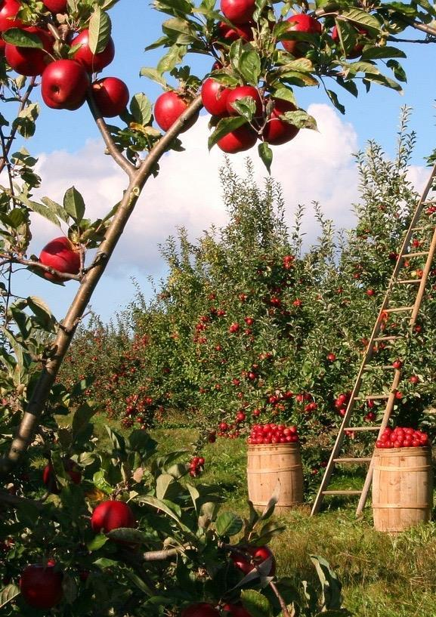
Here's a more detailed elaboration on the key topics covered in this chapter:
Creating a Powerful Brand Identity
Defining Your Brand Values: Clearly articulate the values and ethical commitments that define your business. These values will serve as the foundation for your brand identity and shape how you communicate and connect with your target audience (Kotler 2016).
Visual Identity: Develop a visually compelling brand identity that aligns with your ethical mission. This includes designing a distinctive logo, selecting appropriate colour palettes, typography, and imagery that convey your brand's personality and values.
Crafting a Compelling Brand Story: Tell your brand story in a way that resonates with your audience and conveys your ethical journey. Highlight the passion, purpose, and values that drive your business. Incorporate storytelling techniques to create an emotional connection with consumers. For more tips and techniques check out Module 5 in our Online Course
Storytelling for your brand
Identifying Your Unique Narrative: Identify the key aspects of your ethical food business that set you apart. Share your story of how you started, your commitment to sustainability, fair trade, or other ethical practices, and the positive impact you aim to make.
Engaging Content Creation: Create compelling content that communicates your ethical journey, showcases your sourcing practices, highlights the stories of your suppliers and partners, and conveys the care and dedication you put into your products. Utilise various mediums such as written content, videos, social media posts, or in-person events to engage with your audience (Kotler 2016).
Transparency
Sourcing and Supply Chain Transparency: Provide detailed information about the origins of your ingredients, the practices and standards you adhere to, and any certifications or labels you hold. Share stories and images that demonstrate your commitment to ethical sourcing and production.
Operational Transparency: Share behind-the-scenes insights into your operations, such as production processes, packaging choices, waste management strategies, and community initiatives. Communicate openly about the challenges you face and the steps you are taking to overcome them.
Food for People – Planet – Profit

Slide 59
Marketing Strategies
Content Marketing: Create valuable and informative content that educates and engages your audience on ethical food practices, sustainability, and related topics. Utilise blog posts, articles, videos, and infographics to establish your expertise and build trust with your target market. (Day et al. 2004)
Social Media Marketing: Leverage social media platforms to connect with your audience, share your brand story, and engage in conversations about ethical food practices. Use visually appealing content, user-generated content, and storytelling to build an authentic and loyal following.
Influencer Partnerships: Collaborate with influencers who align with your ethical values and have a relevant audience. Partnering with influencers who share your passion for sustainability and ethical practices can amplify your brand's reach and credibility.
Event Marketing and Community Outreach: Participate in relevant industry events, trade shows, and community initiatives to raise awareness of your brand and engage with your target audience. Sponsor or host events that promote sustainable food practices or support local communities.
Certifications and Labels: Highlight relevant certifications and labels that validate your ethical practices. Clearly communicate the meaning and significance of these certifications to your audience, showcasing your commitment to transparency and responsible business practices.
Customer Engagement and Loyalty
Building Genuine Relationships: Interact with your customers through various channels and touchpoints, such as social media, email newsletters, or in-store experiences. Respond to their inquiries, feedback, and reviews promptly and genuinely. Personalise your communication to make customers feel valued and connected to your brand (Kotler 2016).
MARKETING STRATEGY TEMPLATE:
Looking at the Objectives, Segments, Positioning, & Programs to help develop your marketing strategy
Food for People – Planet – Profit

Slide 60
10
Legal and Regulatory Considerations

Slide 61

10
Legal and Regulatory Considerations
This chapter offers a comprehensive overview of the legalities of running an ethical food business, including food safety regulations, labour laws, and certification requirements.
We'll also cover how to stay abreast of evolving policies and regulations to ensure your business remains compliant. This chapter offers an in-depth look into the legal and regulatory landscape that governs the
operation of ethical food businesses. Understanding these legalities will not only help you avoid penalties but also build trust with your customers and stakeholders.

Slide 62

01
Food Safety Regulations: Compliance with food safety regulations is crucial for any food business. We'll delve into the specific European food safety regulations that you need to comply with, including hygiene standards, food handling and storage procedures, and allergen labelling requirements.
Labour Laws: We'll outline the major labour laws relevant to your business, including minimum wage regulations, working time directives, anti-discrimination laws, and health and safety requirements. Ensuring fair treatment of your employees is not only a legal obligation but also aligns with your ethical business values.
Certification Requirements: Certifications such as organic, fair trade, or carbon neutral can enhance your business’s credibility. We'll discuss the process of obtaining these certifications, the standards you need to meet, and how to maintain your certification over time.
Data Protection Laws: In the digital age, data protection laws are increasingly relevant. We'll explain how to ensure that your customer data collection and processing methods comply with the General Data Protection Regulation (GDPR).
Environmental Laws: As an ethical food business, complying with environmental laws and regulations is crucial. We'll discuss waste management regulations, packaging regulations, and other
relevant environmental laws.
Staying Up-to-Date: Laws and regulations evolve over time, and it's important to stay abreast of any changes that could affect your business. We'll share resources and strategies for staying informed
about legal and regulatory updates.
02
03
04
05
06
For information check out Module 2 in our Online Course

Slide 63

This chapter offers a comprehensive overview of the legalities of running an ethical food business, including food safety regulations, labour laws, certification requirements, data protection laws, environmental laws, and staying up-to-date with legal and regulatory changes.
Here's a more detailed elaboration on the key topics covered in this chapter:
Food Safety Regulations
European Food Safety Regulations: Explore the specific food safety regulations in Europe that are relevant to your ethical food business. Understand the requirements for hygiene standards, food handling and storage procedures, traceability, and allergen labelling. Ensure that your business is compliant with these regulations to guarantee the safety and quality of your products (European Commission 2019).
Labour Laws
Minimum Wage and Working Time Directives: Familiarise yourself with minimum wage regulations and working time directives in your target countries. Understand the legal requirements for employee contracts, working hours, overtime, breaks, and annual leave. Complying with these laws demonstrates your commitment to fair treatment and supports your ethical values
Anti-Discrimination Laws: Understand anti-discrimination laws and ensure that your business practices adhere to them. Prohibit any form of discrimination in the workplace, including based on race, gender, age, disability, or sexual orientation. Promote diversity and equality within your workforce (EU Charter of Fundamental Rights 2023)
Health and Safety Requirements: Comply with health and safety regulations to create a safe working environment for your employees. Implement necessary safety measures, provide appropriate training, and maintain records of safety procedures. Regularly assess and update your health and safety protocols.
Certification Requirements
Organic, Fair Trade, and Other Certifications: Explore the certifications relevant to your ethical food business, such as organic, fair trade, or carbon neutral certifications. Understand the requirements, standards, and processes involved in obtaining and maintaining these certifications. Implement practices that align with these standards to enhance your business's credibility (Europa 2020).

Slide 64

Here's a more detailed elaboration on the key topics covered in this chapter:
Data Protection Laws
General Data Protection Regulation (GDPR): Ensure that your data collection and processing practices comply with the GDPR regulations. Implement proper data protection measures, obtain consent for data usage, and protect customer privacy. Establish procedures for data breach response and ensure proper handling of personal data (EU Charter of Fundamental Rights 2020).
Environmental Laws
Waste Management and Packaging Regulations: Comply with waste management regulations by implementing appropriate recycling and waste disposal practices. Adhere to packaging regulations, such as using sustainable and recyclable materials. minimise environmental impact throughout your supply chain.
Staying Up-to-Date
Monitoring Legal and Regulatory Changes: Stay informed about evolving laws and regulations that affect your ethical food business. Monitor government websites, industry publications, and regulatory bodies for updates. Engage with industry associations and networks to stay informed about changes and best practices.
Seeking Legal Advice: Consult legal professionals specialising in food law or business law to ensure compliance and seek guidance on specific legal issues. They can help you navigate complex regulations and provide tailored advice for your ethical food business.

Slide 65
11
Conclusion & Future Trends

Slide 66

11
Conclusion & Future Trends
As we conclude this manual, it's essential to look forward and consider the future landscape of the ethical food business sector.
Here's a more detailed elaboration on the key topics covered in this chapter:
01
Emerging Trends
02
Challenges
03
Opportunities
04
Staying Ahead
05
Maintaining Your Ethical Commitment

Slide 67
01
Emerging Trends
Transparency and Traceability: Consumers increasingly demand transparency in the food industry. Embrace technologies that enable traceability and provide clear information about the sourcing, production, and impact of your products.
Plant-based and Lab-grown Foods: The demand for plant-based and lab-grown foods continues to grow. Explore opportunities to innovate and offer alternative protein sources that align with ethical and sustainable values.
Circular Economy Approaches: Embrace circular economy approaches by reducing waste, implementing recycling and upcycling practices, and creating closed-loop systems within your supply chain.
Digital Innovations: Embrace digital technologies to enhance your business operations and customer experience. This includes online ordering, e-commerce platforms, mobile apps, and digital marketing strategies.
02
Challenges
Price Competition: Price competition in the food industry can pose a challenge for ethical food businesses. Find ways to communicate the value of your ethical practices to customers, allowing them to understand why your products may have a higher price point.
Regulatory Changes: Stay informed about evolving regulations that may impact your business operations. Be prepared to adapt your practices to ensure compliance and maintain your ethical standards.
Sourcing Difficulties: Sourcing ethical and sustainable ingredients can sometimes be challenging. Establish strong relationships with suppliers and explore alternative sourcing options to ensure a consistent supply of high-quality ingredients.
Consumer Scepticism: Some consumers may be sceptical of ethical claims made by businesses. Ensure transparency, provide evidence of your ethical practices, and engage in open communication to build trust with your customers.
03
Opportunities
Product Innovation: Explore opportunities for product innovation by developing new ethical and sustainable food products or improving existing ones. Consider incorporating unique ingredients, exploring new flavours, or addressing specific dietary needs.
Niche Markets: Identify and target niche markets that align with your ethical values. Cater to specific dietary preferences, such as vegan, gluten-free, or organic, or focus on specific geographic regions or cultural niches.
Partnerships and Collaborations: Seek partnerships and collaborations with like-minded businesses, suppliers, or organisations. Collaborative efforts can amplify your impact, expand your reach, and provide access to new markets.
Growth in New Geographic Markets: Consider expanding your operations to new geographic markets that have a high demand for ethical and sustainable food products. Conduct market research to understand local preferences and adapt your strategies accordingly.

Slide 68

04
Staying Ahead
Continuous Learning: Stay informed about the latest trends, innovations, and best practices in the ethical food sector. Attend industry conferences, participate in webinars, and engage with industry associations to stay ahead of the curve.
Networking and Collaboration: Build a strong network of industry professionals, suppliers, and fellow ethical food entrepreneurs. Collaborate, share insights, and learn from each other's experiences to collectively drive the growth of the sector.
Seeking Feedback: Regularly seek feedback from your customers, suppliers, and employees. This feedback can help you identify areas for improvement, understand changing consumer preferences, and refine your ethical practices.
Adapting to Consumer Preferences and Regulations: Continuously assess and adapt your business practices to align with evolving consumer preferences and regulatory environments. Stay flexible and open to change to meet the expectations of your target market.
05
Maintaining Your Ethical Commitment
Core Values and Mission: Keep your ethical vision and mission at the heart of your business. Regularly revisit and reinforce your core values to ensure that all aspects of your operations align with your ethical commitment.
Ethical Supply Chain Management: Continuously evaluate and improve your supply chain to ensure ethical sourcing, fair trade practices, and sustainability. Build long-term relationships with suppliers who share your values.
Engaging Stakeholders: Engage with your stakeholders, including customers, employees, suppliers, and local communities. Communicate your ethical initiatives, involve them in decision-making processes, and listen to their feedback and suggestions.
Final Words of Advice
Starting and running an ethical food business is not without its challenges, but the potential rewards—both financial and societal—are immense. Stay committed to your ethical mission, embrace innovation, and continuously adapt to the changing landscape. Remember that your impact goes beyond profitability, as you contribute to a more sustainable and responsible food industry.
We hope you have a clear vision of the future landscape of the ethical food business sector and how you can continue to succeed and make a positive impact through your business. This knowledge supported by our open-access course, should equip you with the insights needed to navigate the path ahead and continue your journey as a successful ethical food entrepreneur.
Food for People – Planet – Profit

Slide 69
References

Slide 70
References
Day, G.S., Reibstein, D.J. and Gunther, R. (2004) Wharton on dynamic competitive strategy. New York: Wiley.
DeCarlo, J. and DeCarlo, J. (2011) Fair Trade and how it works. New York: Rosen Pub.
Devteam, T.C. (2023) What is just-in-time inventory management?, TrueCommerce. Available at: https://www.truecommerce.com/blog/what-is-just-in-time-inventory-management/ (Accessed: 20 September 2023).
European Commission (2019) General Food Law, Food Safety. Available at: https://food.ec.europa.eu/horizontal-topics/general-food-law_en (Accessed: 02 September 2023).
EU Charter of Fundamental Rights (2020) Data Protection, Privacy and new technologies, European Union Agency for Fundamental Rights. Available at: http://fra.europa.eu/en/themes/data-protection-privacy-and-new-technologies (Accessed: 20 September 2023).
EU Charter of Fundamental Rights (2023) Article 21 - Non-discrimination, European Union Agency for Fundamental Rights. Available at: http://fra.europa.eu/en/eu-charter/article/21-non-discrimination (Accessed: 01 September 2023).
Europa (2020) Organics at a glance, Agriculture and rural development. Available at: https://agriculture.ec.europa.eu/farming/organic-farming/organics-glance_en (Accessed: 02 September 2023).
Euipo (2020) Euipo, EUIPO. Available at: https://www.euipo.europa.eu/en (Accessed: 10 March 2023).
Hall, A. (2023) How to protect intellectual property in 5 different ways, Copyrighted.com. Available at: https://www.copyrighted.com/blog/protect-intellectual-property (Accessed: 06 February 2023).
info, N.B. (2022) Negotiating supplier contracts. Available at: https://www.nibusinessinfo.co.uk/content/negotiating-supplier-contracts (Accessed: 01 September 2023).

Slide 71
References
Intellectual Property Office of Ireland (no date) Why protect your IP, IPOI. Available at: https://www.ipoi.gov.ie/en/understanding-ip/getting-started-with-intellectual-property/why-protect-your-intellectual-property-/ (Accessed: 10 March 2023).
Kotler, P. (2016) Marketing management Vol 3. Harlow: Pearson.
KUSTUROVIC, A. (no date) E-learning centre of the European Patent Academy, IP RIGHTS IN FOOD INDUSTRY. Available at: https://ecourses.epo.org/pluginfile.php/79460/mod_label/intro/IP_rights_and_the_food_industry.pdf (Accessed: 10 March 2023).
Lucy, D., Mason, B., Sinclair, A., Bosley, A. and Gifford, J. (2023). Fair selection: An evidence review. Practical summary and recommendations. London: Chartered Institute of Personnel and Development.
Passikoff, R. (2003) Predicting Market Success. Wiley.
Tiffany, P. and Peterson, S. (2022) Business plans. Hoboken, NJ: John Wiley & Sons, Inc.
Unknown (no date) Starting a business in the EU: Registration & Support, Your Europe. Available at: https://europa.eu/youreurope/business/running-business/start-ups/starting-business/index_en.htm (Accessed: 10 March 2023).
Webster, J. (2023) Council post: How ethical business tactics can improve profitability, Forbes. Available at: https://www.forbes.com/sites/forbesfinancecouncil/2023/02/14/how-ethical-business-tactics-can-improve-profitability/ (Accessed: 06 September 2022).

Slide 72

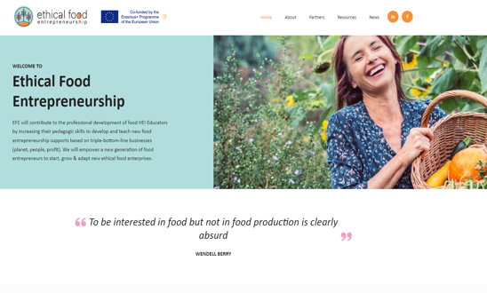

Website Here
Click to View
www.ethical-food.eu
follow your journey

