Slide 1
^{A model for tackling bullying}
Iris Sundelin
TURVA –project coordinator
iris.sundelin@sasky.fi

Slide 2
About TURVA-project
The TURVA project is a project funded by the National Board of Education and coordinated by the SASKY Municipal Education and Training Consortium.
The objectives of the project are to prepare the contingency plan of the consortium of educational institutions, action cards for crisis situations and to improve crisis communication. In addition, the project will create models and develop the response to bullying and racism.

Slide 3
Content
1. Trends in bullying
2. Anti-bullying work is a process
3. A safe study environment and network
4. The pattern of the absence of bullying and its stages

Slide 4
Trends in bullying
Quantitatively variable at different stages of the school path
Girls vs. Boys
Bullying at online
Special groups include
Trend:
Bullying has decreased
Source: THL School Health Survey 2021

Slide 5
Anti-bullying work is a process
The best intervention is the preventive and community work of the school community
If bullying occurs in a group, preventive work will also be stepped up while other measures are taken
For the bullied, the support of other students plays a fundamental role in coping with the experience
Laws and norms
Tacking
care
Monitoring
Individual support/care
Prevention
Lähde: Opetushallitus Kiusaamisen vastainen työ koulussa ja oppilaitoksissa 2020

Slide 6
A safe study environment and cyberbullying
The teacher should also address online bullying, which
Happens during school hours
School-related activities and
Involving students from the school
Tackling cyberbullying at school can be challenging because school staff may not be informed about cyberbullying and staff may not be familiar with the digital platforms used by children and young people.
Mental safety
Social security
Physical security
pedagogical security
Safe use of digital platforms
Ensuring safety is a common task for all!

Slide 7
"Plans are nothing; planning is everything“ Dwight D. Eisenhower The plan describes in concrete terms the modus operandi + action plan
Student participation is central to the
· bullying is a group phenomenon!
Ensuring safety is the responsibility of all adults in the educational institution
Utilising multidisciplinary know-how
Student welfare services provide
Expertise in the content and implementation of plans
Individual support
If necessary, direct them to external services
Part of everyday safety culture and care
· Characteristics of bullying, such as repetition, affect practices
· The operating model changes and develops with needs, situations and experiences
· A good approach is based on information on the prevalence of bullying in the community

Slide 8
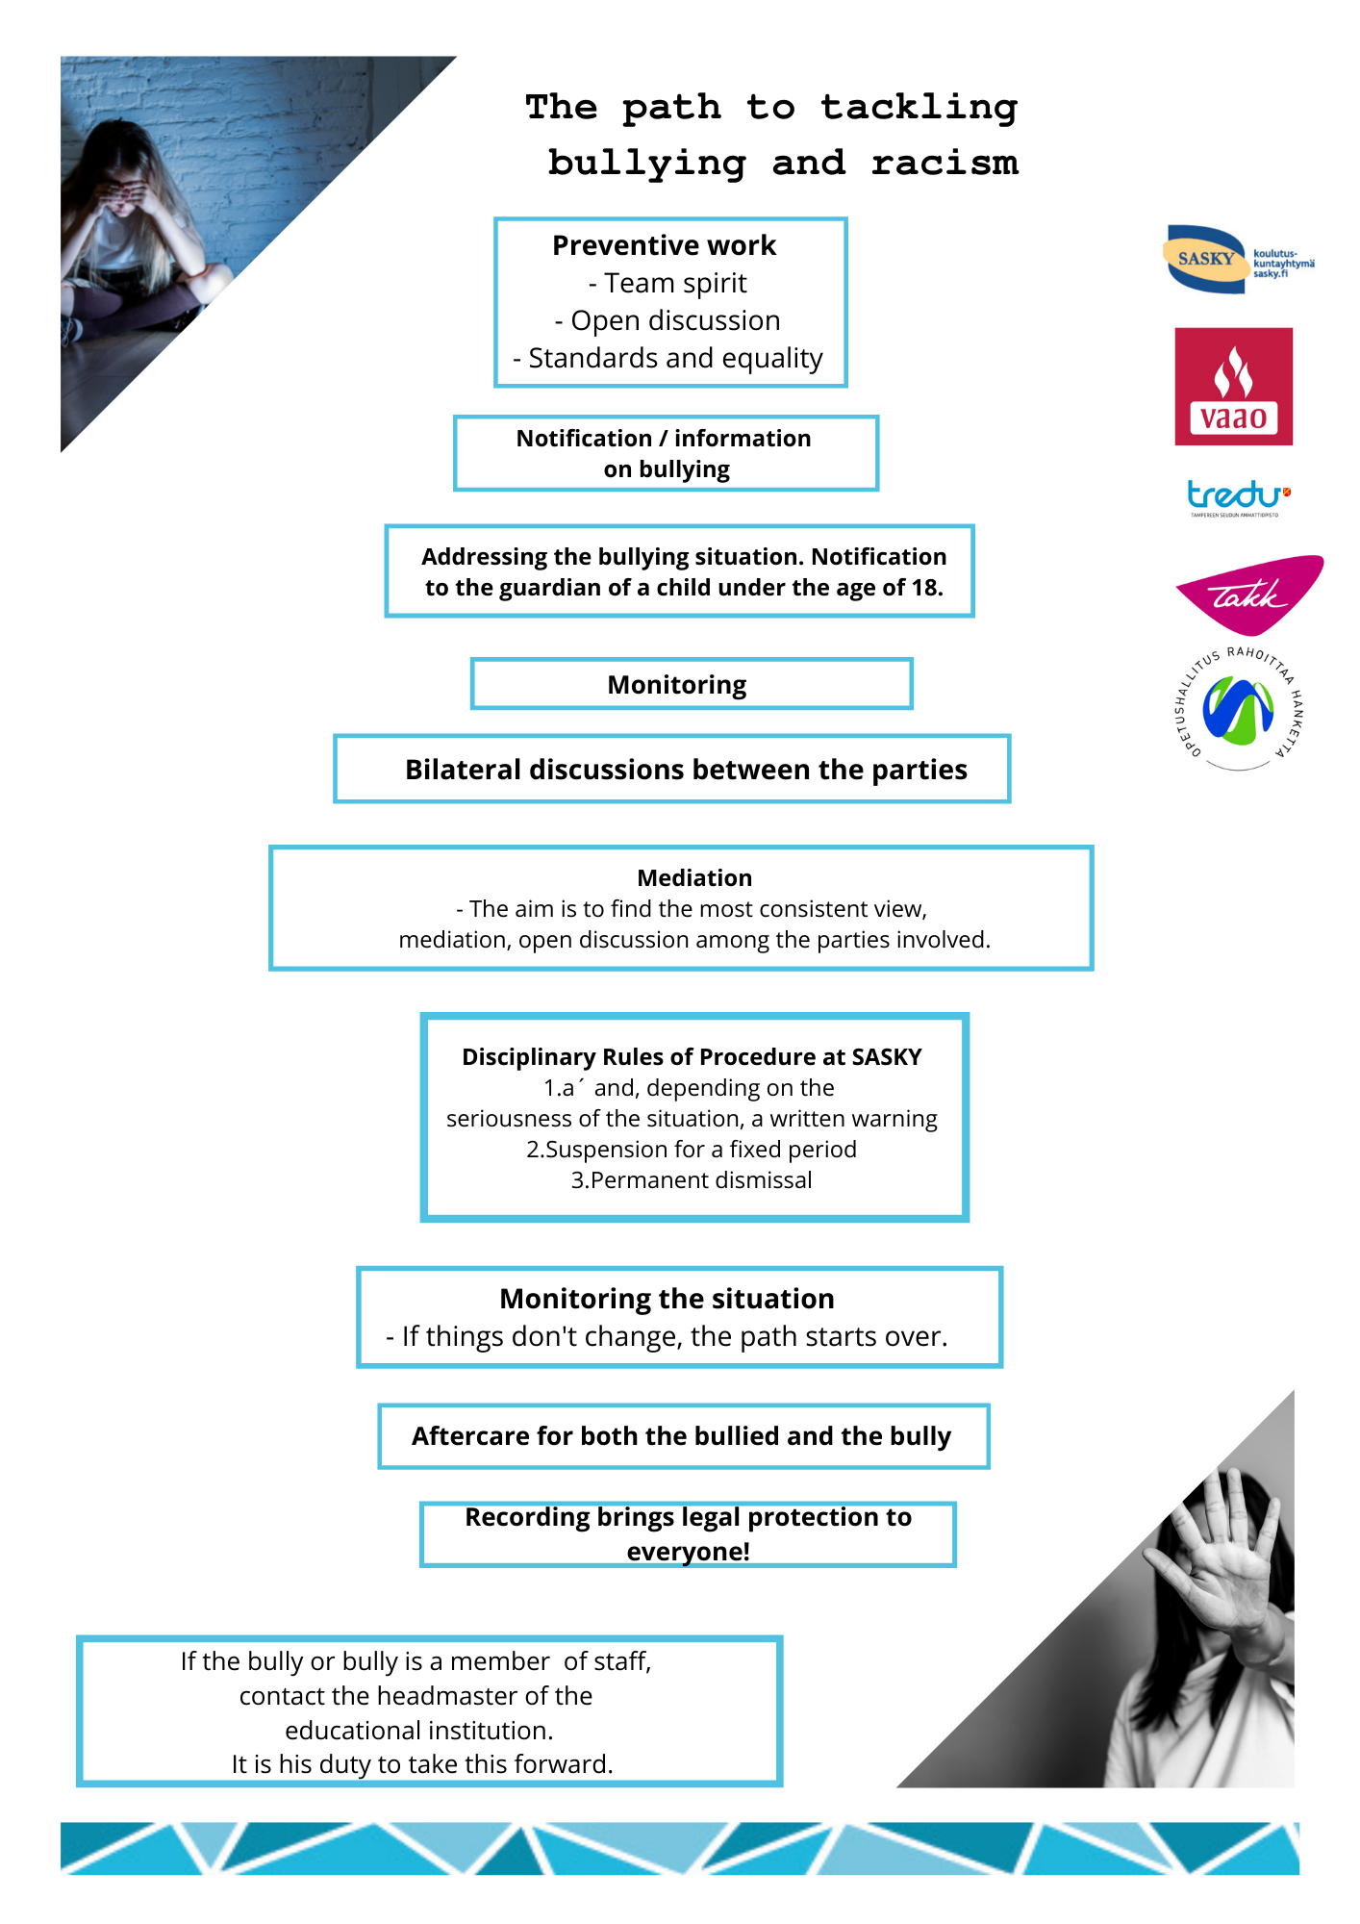
Model of lack of bullying
Assembled and updated based on Sasky's current bullying absence model and rules of order
In addition, the basis is OPH's publication On Anti-Bullying at School and Educational Institutions (2020)
Assembled with the project network
In addition to the model, tasks in the Professional Work Capacity Certificate for national use

Slide 9
Preventive work
Preventive work means
Looking to the future
Early intervention
Reducing later problems
Everyone's everyday work and utilising their own skills
Silent signals and their detection
The ability to see the whole educational institution as a whole
Examples of preventive work in an educational institution include:
Honest awareness of bullying and admitting it is a starting point for preventing bullying
Open conversation
Participation
Understanding and developing group dynamics
Grouping and maintaining the spirit of us
Grouping should be done throughout the school year, not just at the beginning of the school year. From the point of view of group dynamics, grouping should be done whenever there are changes in a group.
Emotional and interaction skills
Community and individual student welfare
Information on policies and common rules; students, guardians, staff

Slide 10
Information makes it possible to intervene
A safe operating culture creates trust - > the importance of the spirit of us
Encourage students to report observed/encountered activities
The project makes it easier to report bullying: a Webropol survey that provides a link to Wilma, etc. and do e.g. Qr codes from the link, which can also be used to report bullying anonymously.
https://link.webropolsurveys.com/S/07300C402EB15CCB

Slide 11
Coversations
There is also part of taking care of a safe study environment
Not based on student volunteering – the educational institution must act and the situation must be clarified
Implemented in accordance with the educational institution's operating model (part of the student welfare plan?)
Confidential discussion to identify the situation and consult all parties

Slide 12
Mediation
Operating model for solving bullying situations
Mediation is a clear approach to:
School staff members and pupils trained as mediators help the parties themselves to find a solution to their conflict.
The parties are allowed to give their views on what happened, describe their feelings and consider different solutions.
By following the model, progress will be made to an agreement that will be monitored. Mediation will address mind-boggling behaviour as early as possible.
Students trained in peer mediation, i.e. peer mediators, mediators mediators mediate conflicts between their peers, i.e. other pupils, as early as possible.
Peer mediators act as facilitators who do not have the power to give penalties or make decisions, but help the parties themselves to find a solution to the situation so that the conflict no longer continues or recurs.

Slide 13
Monitoring is necessary
Bullying as a phenomenon is characterized by its repetition
When it comes to stopping bullying, monitoring is essential
It is a good idea to pay attention to student interaction at different stages of the study day
Systematic monitoring helps break the bullying cycle and detect hidden norms.

Slide 14
Logging creates legal protection
Recording of processing steps is part of good administrative practice.
The student and his/her guardian (under 18 years of age) have the right, as a party, to receive information on confidential documents concerning him or her.
If bullying or other activities lead to the customer relationship of student welfare, child welfare or police services, previous information on the measures taken is needed

Slide 15
Reporting
Bullying at an educational institution or on the way (including violence and harassment)
Guardian of an underage student
The need for child welfare?
The need for social care?
Suspected sexual offences to the police (+child welfare)
An offence against life or health, for which the maximum sentence is min. 2 years in prison -> police (+child welfare)
In unclear situations, child welfare and the police can always be consulted anonymously
Notification to the authorities;
If bullying cannot be stopped by the educational institution's own means
Safety issues
Especially in more serious situations, the educational institution has the right/in acute situations to report the situation to the author

Slide 16
Means of disciplinary action and intervention in the event of bullying
'Penalties for breaches of the Rules of Procedure shall be in accordance with the provisions of the Act on Vocational Training (531/2017) and the regulations adopted on the basis of it. The educational institutions of the SASKY Educational Consortium ensure a safe and good physical, mental and social learning and working environment for all. The disciplinary measures related to breaches of the ordinance are described in more detail in the SASKY Consortium's plan for the use of disciplinary measures and the procedures related to them." – Sasky Rules of Order
A written warning - disrupting teaching - behaves violently or threateningly - behaves fraudulently or otherwise violates the order of the educational institution or other study environment
Temporary expulsion from an educational institution or dormitory, up to 3 months
Temporary expulsion from the institution, up to 1 year or dormitory for more than 3 months or for remaining studies.

Slide 17
Bullying can be a crime
There are situations where bullying against a student is so serious or long-lasting that it meets the hallmarks of a crime
If you suspect a crime, you can ask the police for advice on the matter.
Anyone involved in a bullying situation may commit a crime; acting as an accomplice, donor or instigator are also punishable acts
Bullying can fulfil the hallmarks of many different crimes
Discussing bullying as a crime and the decriminalisation of the student's own actions in bullying situations will help students understand how serious the issue of bullying is.
More information on bullying as a crime on the Victims' Update pages www.riku.fi

Slide 18
Thanks!

