Slide 1
Preparedness plan at vocational education 9.5.2022
Safety coordinator Pasi Huhtala _

Slide 2
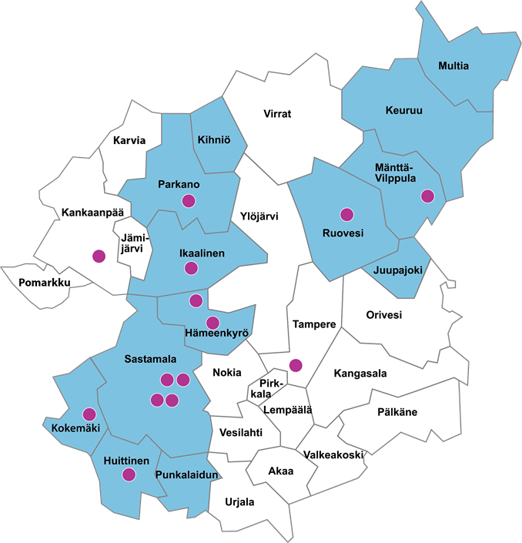
SASKY Municipal Education and Training Consortium 1 January 2022
13. largest vocational education and training provider
Vocational Institute Iisakki
Huittinen Vocational and Entrepreneurial College
Ikaalinen School of Business
Ikaalinen School of Crafts and Arts
Innovation Centre Voimarinne
Karkun School of Household and Social Affairs
Mänttä Region Training Centre
Tampere Vocational College for Services 1 January 2017
Tyrvää School of Crafts and Arts
Vammala Vocational School
Apprenticeship and working life services
Extended apprenticeship training
Labour market training
Prison education
Providers of general education
Petäjä Academy
Pirkanmaa Adult School
Ikaalinen High School 1.1.2020
Ruovesi Upper Secondary School 1.8.2016
Upper Satakunta Music Institute
Vankila-
opetus /
Vilppulan
vankila
Voimarinne
www.voimarinne.fi

Slide 3
SASKY Municipal Education and Training Consortium in numbers in 2022
Students in total approx. 7400
Vocational education min. 3324
Approximately 600 employees
o teachers approx. 70%
Operating income approx. EUR 42 million
Properties approx. 100,000 m2
o approx. 100 different properties
Strong service and development function in working life
3% of TAMK => 5.9% => 8.98% ownership
Notes:
3

Slide 4
TURVA-project
OPH has awarded a grant of €169,500 to the project
Total approved net expenditure is €226,000
OPH grant 75%
Own grant 25%
Project promoters:
Administrator: SASKY Municipal Education and Training Consortium
Partner schools: VAAO, TAKK and Tredu
Project Manager: Pasi Huhtala
Project coordinator: Iris Sundelin

Slide 5
Main objectives of the project
The following three main objectives were set for the project:
1. Identification, preparedness of phenomena affecting safety.
2. Increasing safety expertise, improving crisis communication approaches and developing a coherent safety culture.
3. Developing a model of numbness in bullying.

Slide 6
Preparedness plan at vocational education
Preparedness for emergency conditions is based on the Emergency Powers Act (1552/2011). According to Article 4 of the Emergency Powers Act, the authorities may be entitled, in exceptional circumstances, to exercise only those powers which are necessary and proportionate to protect the population, to safeguard the livelihoods of the population and the economy of the country, to maintain the rule of law, fundamental rights and human rights, and to safeguard the territorial integrity and independence of the kingdom.
The contingency plan aims to ensure that tasks are carried out as smoothly as possible in all safety situations. In normal circumstances, incidents and exceptional circumstances, the focus of safeguarding operations is on preventing, combating, managing and recovering from various threats with the resources available. In addition to preparedness planning, the measures used include various advance preparations and readiness exercises.

Slide 7
Preparedness plan
Total area of prepareding risks
Municipal law
Normal time
Incident time
Emergency
Main area
Principle of continuity
Good preparedness
Weak preparedness
Preparedness plans

Slide 8
Process of planning
10. Brief and train
your staff
11. Test
Implementation
12. Maintain, read, modify
9. Spread out
8. Use your plan
1. Name group for planning
7. Make an agreement and finish
Planning
and
consultation
6. Writing
2. Risk analysis
5. Plan working styles, consultation,
cooperation
3. Use the risk analysis
as part of planning
4. Name Goals
https://www.pelastusopisto.fi/wp-content/uploads/2017/02/34760_kunnan_valmiussuunnitelman_yleisen_osan_malli_ja_ohje_sen_kayttoon_netti.pdf

Slide 9
National risk assessment
It is a good idea to follow finland's national risk assessment published by the Ministry of the Interior in the strategic guidelines of the contingency plan.
Finland's national risk assessment is carried out every three years. The risk assessment identifies the various risks to people, the environment, property and
critical systems and services that public authorities must prepare for in their operations.
In connection with the update of society's security strategy in 2017, it was decided to expand the national risk assessment to serve contingency and preparedness planning more broadly. In the future, the risk assessment will cover all threat models taken into account in society's security strategy. Risks are also assessed from the perspective of adaptation to climate change.
Kansallinen riskiarvio 2018

Slide 10
Satakunta regional risk assessment
On the basis of the national risk assessment, a cross-administrative risk assessment at regional level has been carried out. A special feature of the Region of Satakunta in the risk aspect is the Olkiluoto nuclear power plant, which imposes requirements on the preparedness of the province. Another special feature can be the significant flood risk areas of the province in Pori and Huittinen. Based on the potential for damage, pori can be considered the country's most significant flood risk area. The province of Satakunta also has a significant number of sites that pose a major accident hazard in accordance with the Seveso III Directive (hazardous substances), partly due to strong expertise in metal processing in the province.
SATAKUNNAN ALUEELLINEN RISKIARVIO

Slide 11
Risk assessment for Southwest Finland
The region has some features that are highlighted in Southwest Finland compared to the rest of the kingdom. They are factors that are not risks in themselves, but whose impact on operations must be taken into account. One of the factors is the archipelago of the region, whose geography poses its own challenges to logistics, for example, in the form of ferry traffic and seasonal weather conditions. The population of the archipelago also depends on the seasons: in the summer, the number multiplies thanks to leisure residents. Information and other activities shall take into account the bilingualism of the region. Agriculture in Southwest Finland is of great importance for food production in the whole country.
VARSINAIS_SUOMEN RISKIARVIO

Slide 12
Strategic preparedness plan in SASKY Municipal Education and Training Consortium
The main objective of the SASKY Municipal Education and Trainingn Consortium is to ensure the safety and well-being of students and staff in different special situations by acting purposefully and efficiently, utilising all the resources and resources of the consortium of educational municipalities and its partners.
The means of managing incidents in a consortium of educational municipalities is to maintain up-to-date information on resources and resources and to ensure that the persons responsible, other personnel and other resources of the organisation are responsible, other personnel and other resources, so that the management, communication and maintenance of the real-time situational picture are as successful as possible, up-to-date and efficiently.

Slide 13
Strategic preparedness plan
Strategic contingency plan preparedness planning establishes management systems and operating principles that enable the joint municipal authority's management team and the various organisations of the joint municipal authority, as well as the cooperation authorities, to operate in such a way that the maintenance of the vital functions of the consortium in various disturbances and exceptional circumstances of normal conditions is ensured.
Preparedness for disturbances and exceptional circumstances in normal circumstances consists of the contingency plan of the consortium of educational municipalities (the so-called general part), the contingency plans of the various result units/educational institutions of the consortium of educational municipalities, businesses and organisations responsible for service production, and the rescue plans of the various units.

Slide 14
Vital and critical functions and threats to them
The strategic guidelines related to the safety of the SASKY Municipal Education and Training Consortium follow the Finnish National Risk Assessment 2018 published by the Ministry of the Interior.
1. Terrorist act or terrorism against an educational institution
2. Serious violence against a group of persons
3. Movement of large crowds
4. Severe pandemic
5. Information security risk
6. Serious road accident
7. Serious rail accident
8. Serious disruption to energy supply
9. Rapidly generated flooding
10. Nuclear power plant accident in the surrounding area
11. Serious chemical or explosion accident
12. Serious air traffic accident

Slide 15
Thoughts? Thank you!

