Slide 1



Am I fooled?
Do I fool others?
Learning material for students in Universities of Applied Sciences for identifying false and fake information
By Kaisa Puttonen, Leena Elenius, Riitta-Liisa Karjalainen (2023 updated 2025)
English version by Kaisa Puttonen and Hanna-Riina Aho

Slide 2
Introduction
Internet is a relevant source of information in studies. Information resources are often useful and easily accessible. Openness makes it is easy to publish information, social media makes it simple to share. Artificial intelligence tools produce both real and hallucinated information. Thus, all users should be critical of the information they find. You must use truthful information in studies and working life.
The purpose of this learning material is to help you realize:
how you relate to information on the Internet
how false and fake information might be presented
how we can be misled.
The themes are: 1) news 2) pictures and videos 3) numbers and statistics 4) scholarly articles
Each theme is divided into three sections: 1) orientation 2) theory 3) learn more and test.

Slide 3
What do these mean?
HYBRID INFLUENCE ACTIVITIES = Politically motivated planned action aimed at achieving one's own goals using different, complementary means and utilizing the weaknesses of the target
MISINFORMATION = False information shared uninteded. Happens easily in social media.
DISINFORMATION = Produced false information, deliberately spread
INFORMATION INFLUENCE ACTIVITIES =
Systematic actions designed to influence public opinion, people’s behaviour and decision-makers and, through this, the functions of society. The methods of influence include dissemination of false or misleading information, exertion of pressure, and manipulative use of information that is in itself correct. (VNK)
MALINFORMATION = Correct information deliberately spread causing harm
Types of misinformation and disinformation. UNHCR

Slide 4
Consider these realted to AI
Are there errors and inconsistencies in the content by AI?
Is the output contradictory to general information?
Does the text contain inexact or odd terms?
Are there details which can’t be verified from credible sources?
Does the output lack logic or justification?
Is the information too general and vague?
Does the information differ significantly from the user’s expectations or questions?
Does the answer by AI coincide with the question’s scope and details?

Slide 5
News

Slide 6
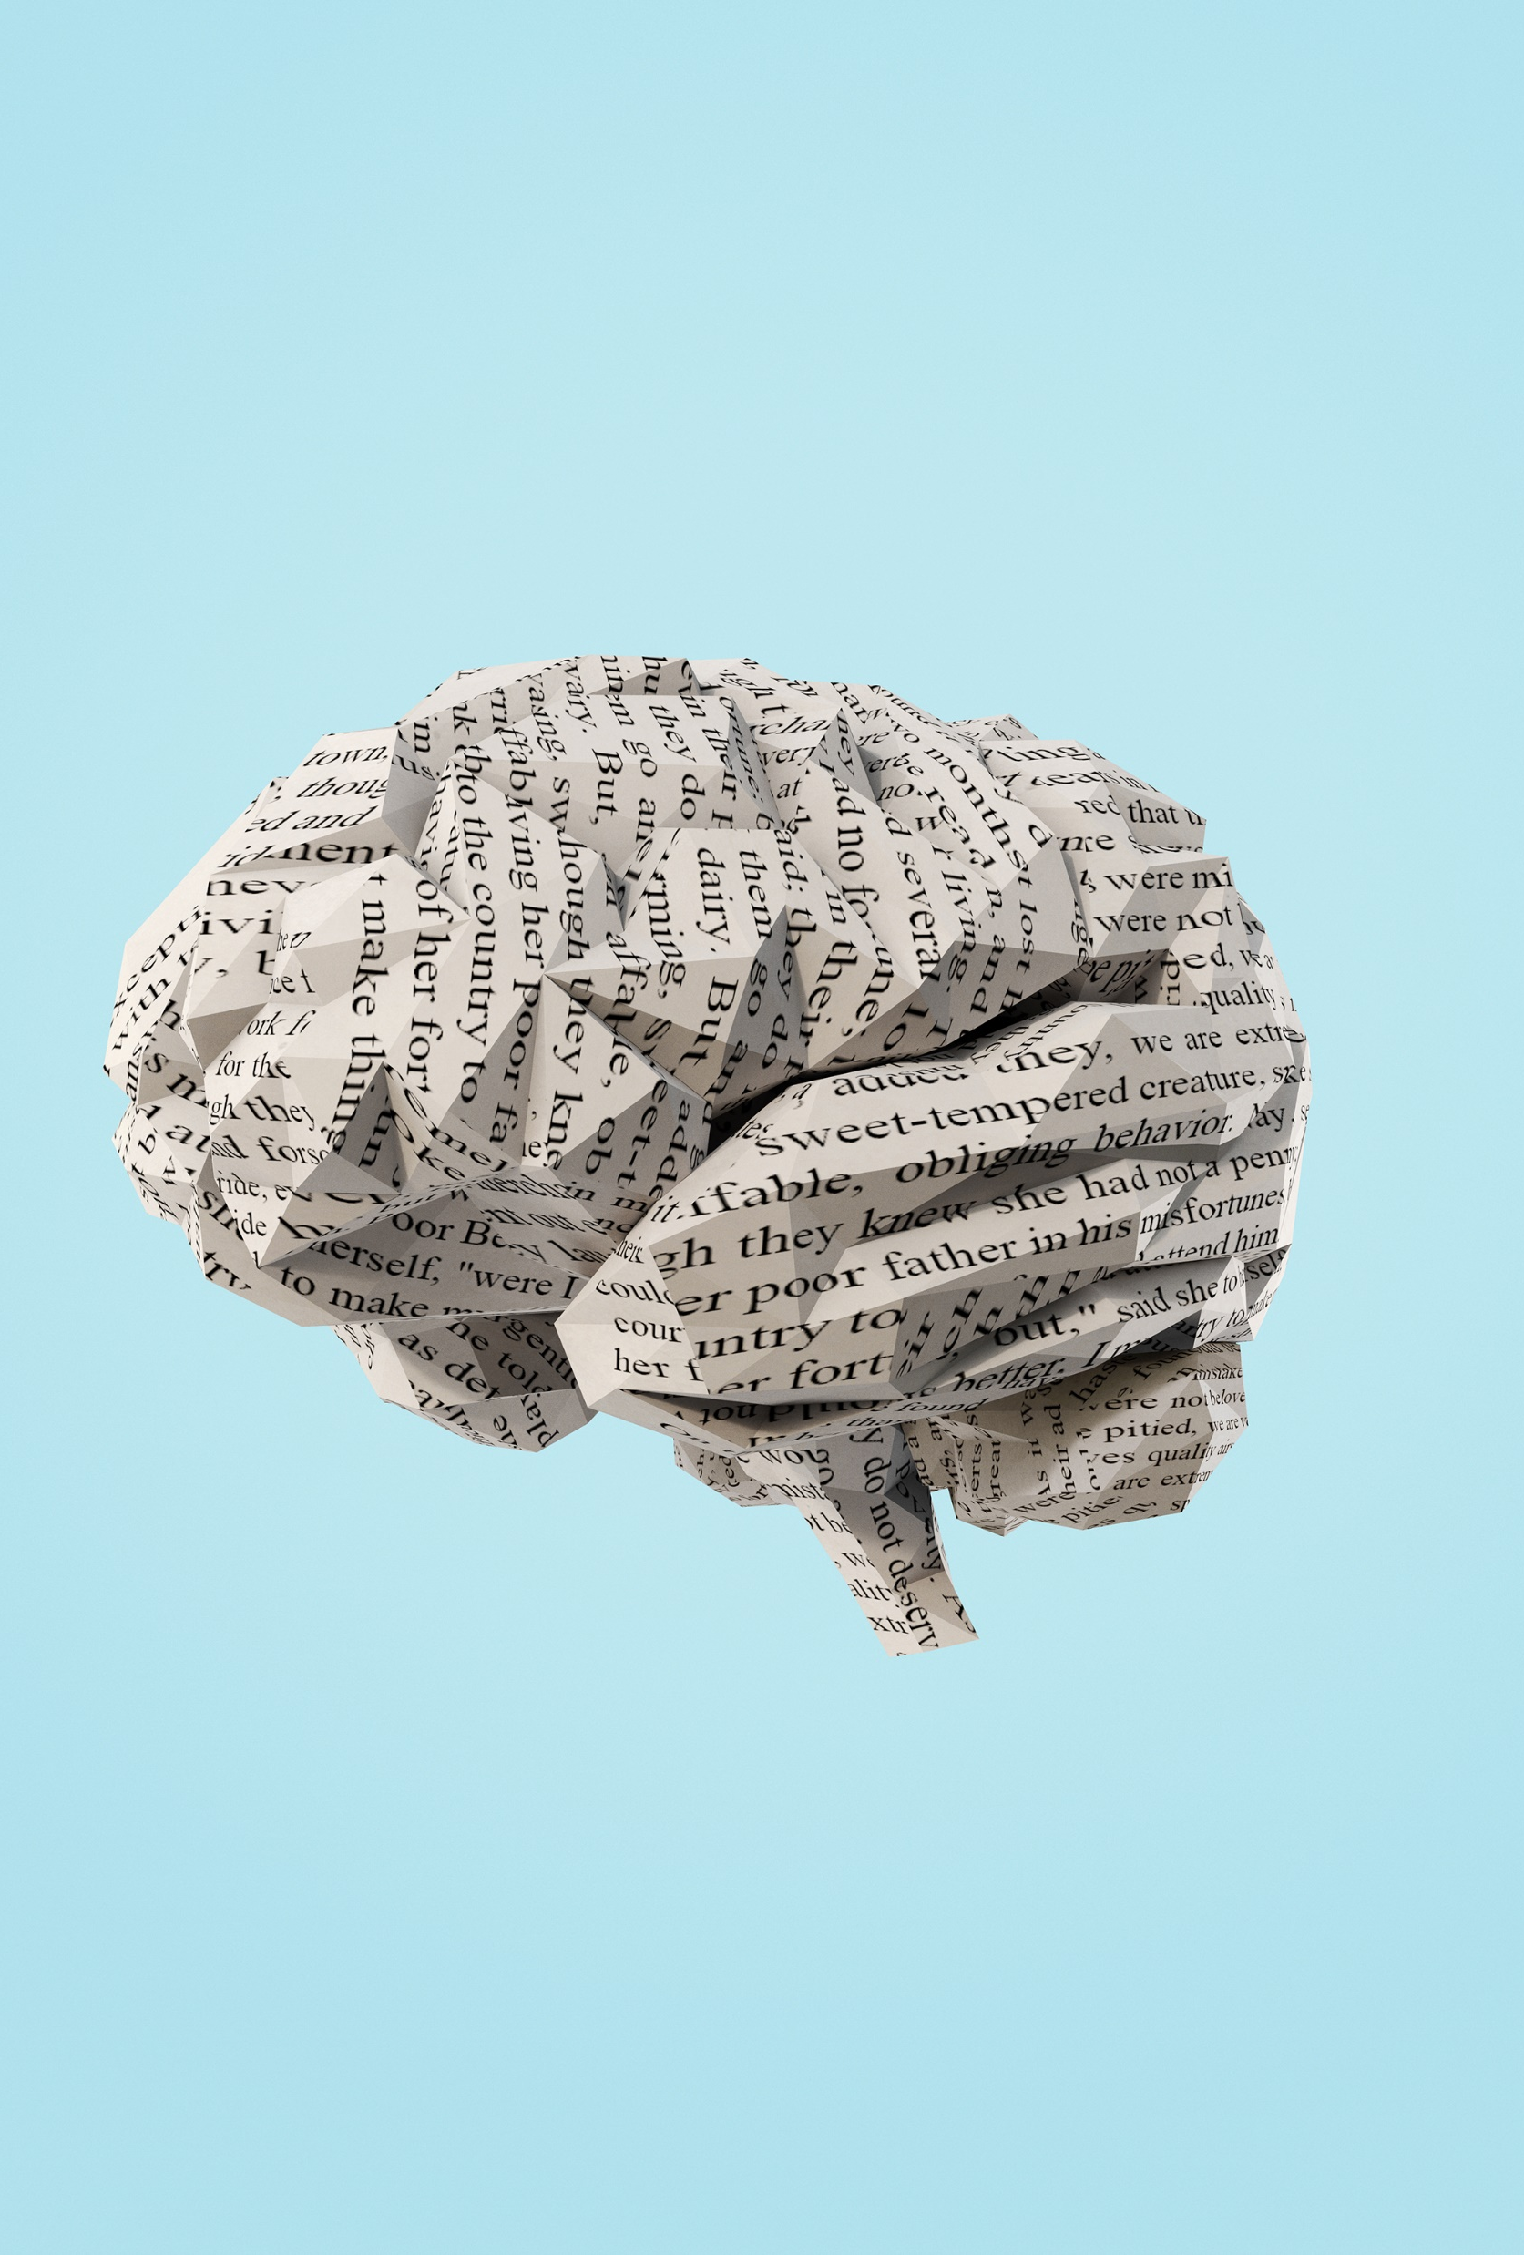
Orientation – How do you react?
I see an eye-catching headline on Facebook and immediately share it.
I have read an article about the health effects of a particular diet. I will share the article as the research results are according to my point of view.
I read in a health magazine a claim that it is healthier to drink water that has been overnight in a glass than water just from the tap. I am eager to tell everyone only the claim without explanations.
I read about burglars. I see a suspicious looking van in front of my home. I'll give everyone the description of the car.
How did it go? Did you react this way? Think again. It is your responsibility that misinformation isn’t spread.

Slide 7
What catches your attention?
The information flow doesn’t stop. We choose consciously as well as unconsciously the information we take in. Choosing is constant also in studying and completing learning tasks.
Interpretation of information is influenced by:
Emotions – our own and those transmitted to us
Cognitive biases, for example, the information reinforces our way of thinking, we trust what we hear first, we consider an expert in a particular field to be an expert in all fields
The source distributing the information
Yaqine Saada. Cognitive Bias, Why You're rightfully Wrong. TEDx ClearLakeHighschool. (Video 14:11 min, opens in YouTube)

Slide 8
What catches your eye in the news?
It is important in your studies as well as at work to follow what is going on. General and professional sources offer us current information. The latter is relevant when you keep up to date in your own field. When using the information sources, note:
News is updated, changed and rewritten by the editorials – do you have the latest version?
News is summarized and referred to in various ways according to one’s interest – evaluate who is distributing the piece of news and how it is referred to.
News is shared in social media – do you pause a moment and look closely before sharing?
A study by Reuters Institute (2024) reveals that Finns have a high trust rate for the Finnish news. The overall trust rate 69 % is the highest among the countries surveyed. An interdisciplinary project by University of Helsinki (2020) coincides with this, and states that the most defining characterstics of Finnish audiences is critical trust.

Slide 9

Learn more and test (1)
Beauvais, C. Fake news, why do we belive it? Joint Bone Spine, 4, 2022
How does fake news spread? BBC Bitesize
Look for these signs to identify information online. Finnish Institute for Health and Welfare, 2023
Test
What is fake news? Quiz BBC Bitesize
Can you spot the signs of fake news? Quiz BBC Bitesize
Test your media literacy skills. The Finnish Society on Media Education

Slide 10
Pictures and videos

Slide 11
Orientation – How do you act?
I am posting to Instagram about the treatment of animals in an animal hotel and using pictures I found on the net.
I was surprised to see in Tikotok an expert in traffic safety claim that seat belts are actually dangerous.
I was so excited to see a picture, which seemed to be incredible news that I shared it immediately in my WhatsApp group.
A newscaster talks strange things on a video, I react: how can the newscaster think in that way?
How did it go? Did you act the same way? Think again. Pictures are not always true, use them correctly and don't spread misinformation.

Slide 12
Visual literacy and interpretation
Visual communication is effective. Images raise a wide range of feelings and memories. The history of interpreting images and symbols is much longer than interpreting text. We register images instantly in a blink, whereas reading text is linear.
The current information overload consists mostly of an image flow. Our interpretation is affected by personal and cultural aspects. For example, the interpretation of colors varies by culture.
Publishers of images want to call our attention and raise issues important for them. Images are a tool to influence.
In general, you should pay attention to the picture’s colors, body language and positioning of elements.

Slide 13
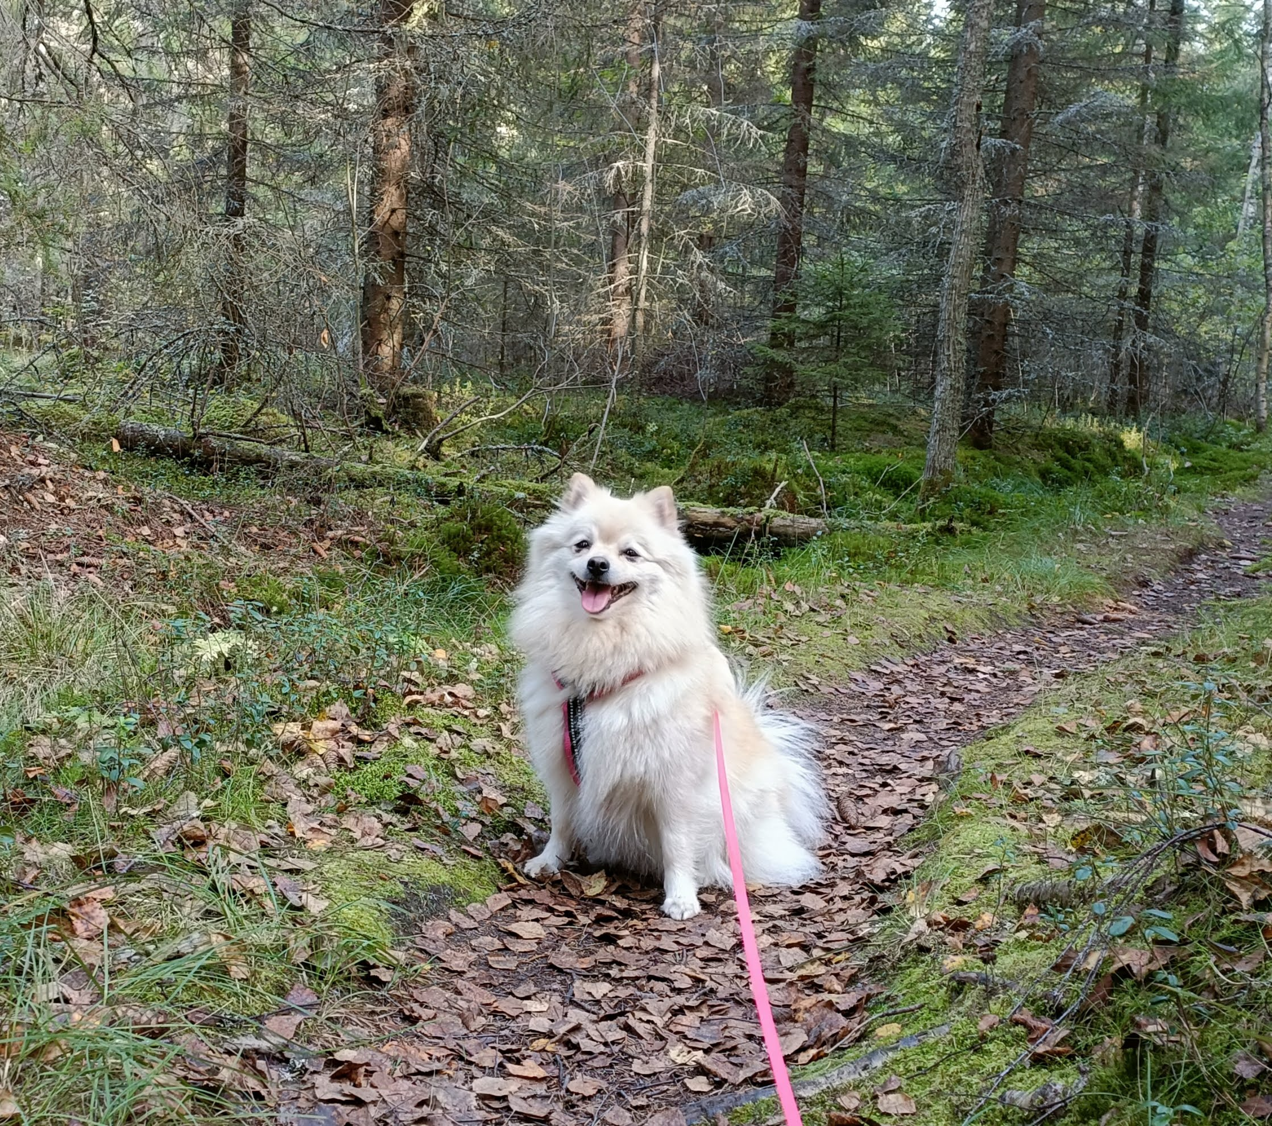
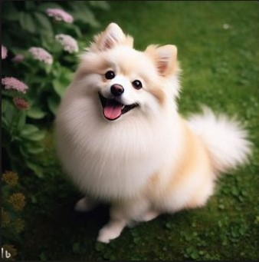
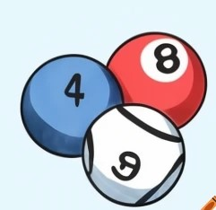
What do you see?
Cultural interpretation of colors, examples:
Red in Western countries means love, in Japan danger.
White in Western countries refers to purity and innosense, in Japan to sorrow and funerals.
Blue in Western countries means power, sea and maskulinity, in Japan unhealthy things.
Which dog sniffes the forest?

Slide 14
Can you really belive what you see in an image or a video?
Visual information, like images, graphs, and videos, is an information source in studies. This way of presenting information is growing rapidly.
AI produces images too. These images are based on algorithms, which in turn are based on a vast number of images on the net. AI creates images according to the entered words and tries to match the image to these words as closely as possible.
It is very easy to create credible images for different purposes.
It is also easy to manipulate with images. Consider:
  Is it intentional to influence by sharing visual information?
  Does the image and text go together? Find out if the image has been used elsewhere. For example, Google reverse image search is a tool you can use to check where the image has been used and uncover similar or duplicate images.

Slide 15
Does an image or video make you suspicious?
It is dificult to spot deepfakes, which are AI generated images, videos, or audio of real or non-existent people. These can spread mis- and disinformation.
You should pay attention to features that seem wrong, unnatural movement or voice, and blurry spots. A British study on deepfakes and disinformation was also reported by Independent.
There are computer programmes, which detect deepfakes. An example of a free online platform is DeepFake-o-meter.
Below are points to consider:
  How do you react when you see an image or video? We share easily if there is a strong emotional response.
  Who is the actual publisher?
  Does the picture or image seem modified, does it have something extra?
  What is the purpose of the picture or video?

Slide 16
Learn more and test (2)
Color symbolism. Wikipedia
Newman, E.J. & Schwarz, N. Misinformed by images: How images influence perceptions of truth and what can be done about it. Current Opinion in Psychology, 2024
Swatton, P. & Leblanc, M. What are deepfakes and how can we detect them? The Alan Turing Insitute, 2024
What's going on in this picture? The New York Times
Test
Which Face Is Real? Jevin Vest & Carl Bergström
Quiz: AI or real? Bitesize, BBC

Slide 17
Numbers, statistics, and how to present them

Slide 18
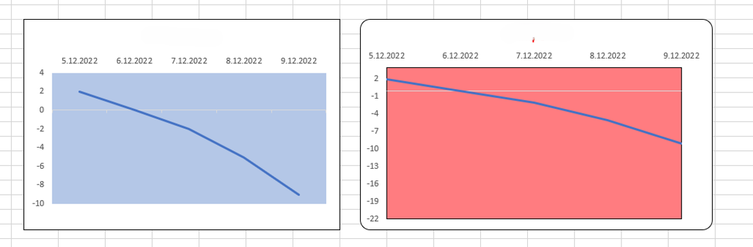
Orientation – How do you interpret?
Compare these graphs presenting a five-day observation period. Which of the graphs shows how the temperature cools faster?
Temperature Temperature
How did it go? Did you notice that the temperature drops in the same with in both graphs?

Slide 19
Numbers require special reading skills
Many terms refer to number reading skills. The terms are overlapping. The core in all of them is that readers understand what numbers mean in a certain context and are able to use them in a meaningful way.
  statistical literacy
  numeracy
  numerical literacy
  quantitative literature
'Statistical literacy' refers to critically thinking about numbers and statistics as evidence in arguments.
Numeracy is about interpreting numerical information (like tables, charts, diagrams, graphs) and understanding, evaluating, solving problems with numbers. It overlaps with terms numerical literacy and quantitative literacy.

Slide 20
Numerical information in studies and work
You need numerical literacy skills in your studies because all kinds of information is available in numerical form.
Statistical data and trends are often explained using graphs, charts, and tables.
Learn to read, interpret and evaluate this data also as part of your research literacy skills.
In working life, numerical data is interpreted and used in different situations, for example, to evaluate business activities or develop services.
The public sector gathers statistical data, which is accessible on the net (Open data).
Also working life organizations may publish statistical data openly.

Slide 21
Why do we need statistics?
Jukka Hoffrén: Statistics are needed to support decision-making. Nowadays we live in an information society. In the past, what mattered was the amount of labor and the amount of capital. They were the most important factors of production.
In the information society, information and statistics are the most important building blocks for creating wealth and prosperity in this country.
"A modern and complex society like Finland would be impossible to manage without statistics.
Without statistics, our image of society would be blurred and hazy. Statistics provide a framework that allows us to see the complexity of the whole."
Translated from: Tiedosta tulevaisuus -podcast: Tilastotiedon merkitys yhteiskunnassa (The future from information -podcast: the importance of statistics in society”) by Statistics Finland (soundcloud.com)
Translated from: Pärnänen, A. Mitä jos ei olisi tilastoja. Tieto & Trendit (“What if there were no statistics. Information & Trends”. 23.10.2022.

Slide 22
Do you interpret numerical data correctly?
When you read numerical or statistical data, can you find out…
When using statistics in your assignments, make sure that…
How was the numerical data collected?
How comprehensive is the sample?
Who collected the data, for example, a company, reasearch institue or student?
The statistics are up-to-date (latest!).
The statistics are applicable to your topic.
Conclusions drawn in the assignment/thesis are justified by numbers.

Slide 23
Learn more and test (3)
Anyaosah, A. & Scott, A. The dangers of statistics out of context. The Cypress, 2023.
Using statistical evidence. BBC Bitesize.
Test
Statistics Finland offers a wide range of statistical data and other information. Take a look at the pages.

Slide 24
articles

Slide 25
Orientation – What do you do?
You are in a hurry. You must hand in an assignment, but it lacks a few scholarly articles as references. You decide to google for articles.
I choose the article from the first result page. No need to look further.
I choose based on the title as it sounds nice.
I won’t take the time to look when the article is published or what is said about the author.
I’ll glance at the abstract, but not at the structure or reference list.
I’ll use ChatGPT because it produces articles fast.
How did it go? Is this the way you work? Think again. It is your responsibility to choose quality articles.

Slide 26
Scholarly articles
Scholarly articles are good information sources for assignments.
Students find articles from their university library’s services.
Open Access (OA) publishing has become more common alongside the library’s provision. OA means that scholarly articles are freely available online.
AI-powered scholarly article search tools are developing constantly.
Scientific articles have a specific structure, which might vary slightly between disciplines.
The structure is IMRD: introduction, methods, results, discussion and a reference list.
Learn more about the structure of a quality article (video by Wordvice Editing services 4:22 min, opens in YouTube).

Slide 27
What do you trust? Are all so called scholarly articles quality ones?
Not everything online is reliable. Always evaluate your article before choosing. Check:
You can evaluate an information source with the TRAAP-test (timeliness, relevance, authority, accuracy, purpose).
Learn more about TRAAP from a video ‘Evaluating information sources’ (Australian National University Library, 3:55 min, opens in YouTube)
Date – When was the article published, or last updated?
Author – Who is the author? What information is there about them?
Publisher – Who published the content, and where?
Purpose – What is the author’s motive? Is the presentation objective?
Content – Opinion or based on research? Is the text poorly written? Are there references?
Structure – Does the article follow IMRD (look at previous slide)?

Slide 28
Open Access (OA) publishing – freely online
Most OA scholarly articles are of high quality and trustworthy.
Unfortunately, openness has brought an unwanted phenomenon: predatory journals.
They entice to publish in the journal with promises of quick publishing and no requirements on the text.
Predatory journals don’t meet the requirements of scholarly publishing.
You might run into these so called “scholarly journals”.
Have doubts if: there are spelling mistakes, information about the author is scarce, references are missing.
Find out about the journal:
  Google the journal and read what is discussed. Untrustworthy publishers/journals are noticed quickly in the science community.
  Directory of Open Access Journals (DOAJ) lists quality OA scholarly journals. Even though it doesn’t cover all, it’s a handy tool for checking.
  JUFO portal is a service for information on scholarly publishing. It is maintained by the Federation of Finnish Learned Societies.

Slide 29
Evaluate journals
Scientific journal
Predatory journal
Articles are scholary peer reviewed and the publishing process is long
The journal's background information can be checked
The editorial board has experts in the journal's field
The publishing process is open
Articles are published instantly, and there is scarce or none evaluation.
There is none or very little information about the journal, for example ISSN-number.
The editorial board doesn't have experts in the journal's field or there is no information.
Information about the publishing process is lacking.

Slide 30


AI in scholarly information retrieval
Artificial intelligence (AI) based search tools for scholarly information evolve rapidly. The tools retrieve articles among millions of scholarly articles. There are both free and paid versions of AI tools. Your university library might offer a paid version with better search features. Examples of tools are (2025) Elicit, Keenious, Research Rabbit, Semantic Scholar.
ChatGPT, and other similar generative tools, produce new text based on huge amounts of saved text and a statistical model. You can’t use ChatGPT as a reference.
AI tools in searching for scholarly articles
search with natural language or keywords
search among millions of scholary articles
results mainly articles
results from known sources
results really exist
tools for evaluating search results
Generative AI tools
search with natural language
responses based on training material entered into the language model
responses are text generated by AI
sources unknown
can hallucinate information or sources
no tools for evaluating the text

Slide 31
Learn more and test (4)
Dihydrogen monoxide parody
PA. A blogger fooled three scientific journals into pubishing a fake Star Wars -themed paper. Jersey Evening Post, updated 2022.
Tools for identifying predatory journals. University of Turku, news, 2023.
What is scientific information? University of Jyväskylä.
Test
Choose an interesting topic and search for an OA article from Google Scholar.
Look at the journal's name. Can you find it from DOAJ or JUFO?

Slide 32
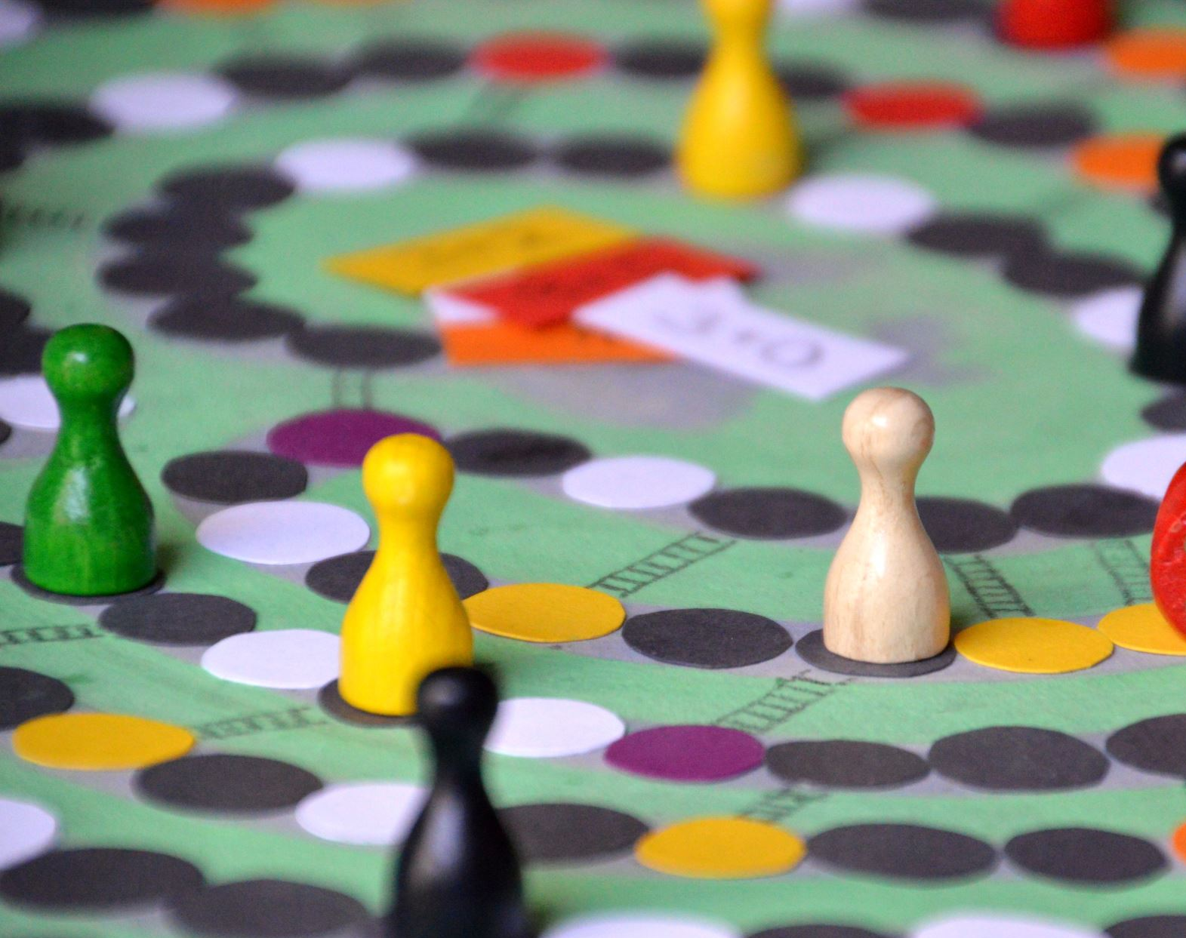
Congratulations!
Congratulations on completing the learning material.
You have acquired information, which you can use in today’s environment where false and fake information travels fast. You have also learnt about tools, which help you evaluate information so that it is trustworthy and based on facts.
We hope your critical thinking skills have become better and that you are ready to apply these skills in practice.

Slide 33
Tips for further reading
Castillo, D.R., Siwei, L. & Miletti, C. 2024. Truth-Seeking in an Age of (Mis)Information Overload. SUNY Press. CC BY-NC-ND (Opens with Thorium Reader)
Farmer, R. 2022. Visual Literacy and Fake News : Gaining a Visual Voice. Studies in Enhanced Learning
Greifender, R. & al. 2020. The Psychology of Fake News - Accepting, Sharing and Correcting Fake News . Routledge. CC-BY-NC-ND
Lares, S. 2024. How Finnish News Actors Perceive and Combat Visual Disinformation. Master's thesis, Aalto Univeristy
Seitz, P., Eisenegger, M. & Bergman, M.M. 2023. Fighting Fake Facts. Multidisciplinary Digital Publishing Institute. CC BY-NC-ND
World Econmic Forum. 2024. Global risks 2024: Disinformation Tops Global Risks 2024 as Environmental Threats Intensify

Slide 34
Material by
Kaisa Puttonen, Laurea University of Applied Sciences, Finland
Riitta-Liisa Karjalainen, Kajaani University of Applied Sciences, Finland
Leena Elenius, Seinäjoki University of Applied Sciences, Finland
Hanna-Riina Aho (Centria University of Applied Sciences), Finland
Translation by: Kaisa Puttonen and Hanna-Riina Aho

