Slide 1


Green Standards Framework
Lasse Okkonen, Karelia UAS
lasse.okkonen@karelia.fi

Slide 2
Contents
Background
Organisational environmental management
Product-based approaches to environmental management
  EcoDesign
  Life Cycle Analyses
  Ecolabelling
Thematic approach: Carbon footprint
Tools and methods

Slide 3
Background
This material establishes 3 ECTS nugget giving overall understanding of the green business framework basing on the voluntary standards
The content is organised as follows:
  Introduction of organisation and product based approaches on environmental management and interlinked standards
  Assignments that provide student opportunity to get more in-depth to the content of the standard and their applications
  Tool package that provides introductionary descriptions of various tools (systems, certificates, labels, softwares), and source linkages. This is supporting material that can be utilised in completing the tasks, or later on in other studies.

Slide 4
Learning objectives
Student knows the standard framework related to the environmental management, including environmental management systems, life-cycle analyses and its applications, and standards for addressing the climate change.
Student can position and identify the standards and related tools to the broader framework of sustainable management
Student knows methods and tools available for different sectors and assess their suitability for different end-user needs

Slide 5
Contents
The standard framework for environmental management, including ISO standards for community, organisation and product levels:
  Environmental management systems
  Life Cycle Analyses
  EcoDesign
  Ecolabelling
  Green house gas reporting and carbon footprint
Assignments that introduce the standards and their applications, allowing also sector specific case analyses.

Slide 6
The Green Standards Framework applied in this course
Environmental management systems
ISO 14001
ISO 14004
Life Cycle Analyses
ISO 14040
ISO 14044
Carbon Footprint
ISO 14067
Environmental management systems – Incorporating EcoDesign
ISO 14006
Environmental Labelling
ISO 14020
ISO 14021
ISO 14024
ISO 14025
Source: SFS.fi

Slide 7
A. Organisational environmental management
A.1. Environmental Management Systems

Slide 8
Why to have environmental management system?
Does the company have duties that are related to the environmental legislation/administration?
Do the stakeholders have expectations concerning the environmental issues?
Does the company want to improve its environmental performance?
Are there resource challenges (time, resources..) for the environmental management?
Are the environmental objectives unclear compared to the other objectives?
If yes, the environmental management system might be useful for the company

Slide 9
Potential benefits of the environmental management system
Better performance
Meeting the mandatory requirements
Preventing the pollution
Saving natural resources
New customers and markets
Better efficiency – cost efficiency, competitive advantage
Image toward stakeholders, such as investors, customers, partners
Improved consciousness
Better work safety
Other?

Slide 10
Principles of the environmental management systems
Plan
- Environmental Policy
- Environmental Aspects
Legal Requirements
Objectives and Targets
Environmental Management Programme
Do
- Structure, responsibility
- Training
- Communication
- Env. Management Documentation
- Document Control
- Operational Control
- Emergency Preparedness
Check/Correct
- Monitoring/Measurement
- Non Conformance/Corrective/Preventive Action
- Records
- Audits
Act/Improve
- Management Review
The foundations of the environmental management systems are in quality management and continuous improvement (Deming Cycle, PDCA)
Total Quality Management (TQM):
  System understanding and development
  Statistical methods to understand development needs
  Involvement of the whole work community to identify and solve problems together
  Comprehensiveness: quality, safety, risk management, economy, environmental management
  Inclusion increases cooperation and commitment to the continuous improvement
Source: Weiss & Bentlage 2006. Environmental Management Systems and Certification.

Slide 11
Environmental Reviewing: establishing the background for environmental management system
The basis is on organisational environmental management (ISO 14001 /14004 on Environmental Management Systems)
Main stages of the process are here simplified as follows:
  Business description
    This can be supported e.g. by SCOT, (Strengths, Challenges, Opportunities, Threats) –analyses
  Stakeholder analyses
    Who are the stakeholders and what do they expect
  Identifying the environmental aspects and impacts
  Analyses of the legislation and mandatory requirements
  Environmental programme
  Environmental policy
  Implementation, communication and marketing

Slide 12
Business description
Business description – and current development phase
Products, services and processes
Any existing, or aspirations, for environmental management (systems, standards, labels, routines)
→ Understanding the business cases is essential for any further development activities

Slide 13
SCOT –analyses
Enterprise/organisation should be aware of external and internal issues that affect to its environmental performance and management
For this purpose, SCOT (Strengths, Challenges, Opportunities, Threats) –analyses, is an easy to use tool
It can include also any risks related to business and its operations, and thus causing danger to the health, safety and environment

Slide 14
Stakeholder analyses
According to ISO 14001, organisation should understand the needs and expectations of interested parties (= stakeholders)
For stakeholder analyses, following questions can be applied:
  Who are the key stakeholders and their relation to company? (Customers, suppliers, collaborates, authorities, competitors, NGO’s, media, public etc).
  What are the opportunities of environmental / sustainable development with those stakeholders? (e.g. savings, cooperation, markets)
  Does the company have expectations to its stakeholders in environmental issues?
  How the cooperation with each stakeholder group is managed (documents, contracts, audits, marketing messages etc.)?

Slide 15
Identifying the environmental aspects and impacts
Environmental aspect is operation that may cause positive or negative environmental impacts
Environmental impact is either positive or negative change resulting from the operation. It could be for instance, acidification, eutrophication of waters, change in air quality, soil degradation, ozone layer depletion, global warming etc.

Slide 16
Identifying the environmental aspects and impacts
The main environmental aspects and impacts related to the business and its products and services (previous, current, potential future impacts):
  Resources (materials and energy) consumed/produced
  Emissions and waste (to air, ground, water, waste, energy, noise, dust, odour etc.)
  Are there any potential risks / accidents that could create harmful environmental impacts of danger to health/safety? How is / should the risk be avoided?
Notice: Consider also positive impacts!

Slide 17
Criteria for assessing the significance of environmental impacts
After identifying the environmental impacts, also their importance should be considered. ISO 14001 gives businesses and organisations freedom to find most suitable methods for this.
Following exemplar criteria for assessing the significance of environmental impacts can be utilised:
 | Severity
1 | Limited impact
2 | Local impact
3 | Regional impact
4 | Significant national/international impact
5 | Not acceptable
 | Likelihood
1 | Very seldom
2 | Seldom
3 | Occasionally
4 | Often
5 | Very often

Slide 18
Assessing the significance of environmental impacts – an exemplar table
Operation | Environmental aspect | Quantity Indicator | Environmental impact | Severity | Likelihood | Total (severity* likelihood)
Logistics | Oil leakage | X litres | Negative impact on ground in area of ground-water protection | 5 | 3 | 15
Renewable energy production | Reduced GHG emissions | X kWh produced. CO₂ eqv. emissions | Positive climate impact through reduced emissions | 2 | 5 | 10
n | n | n | n | n | n | n
If the company/organisation has interest to investigate environmental impacts of its products and services in more detail, life cycle approach (following the ISO 14040 / 14044 standards) can be applied

Slide 19
Analyses of legislation and mandatory requirements
Environmental management includes identification, access and understanding of the environmental legislation, requirements and commitments related to company
  All operations that require environmental permissions or statements are also relevant environmental aspects.
  Knowledge about any policy changes/ legislation can provide a significant business advantage

Slide 20
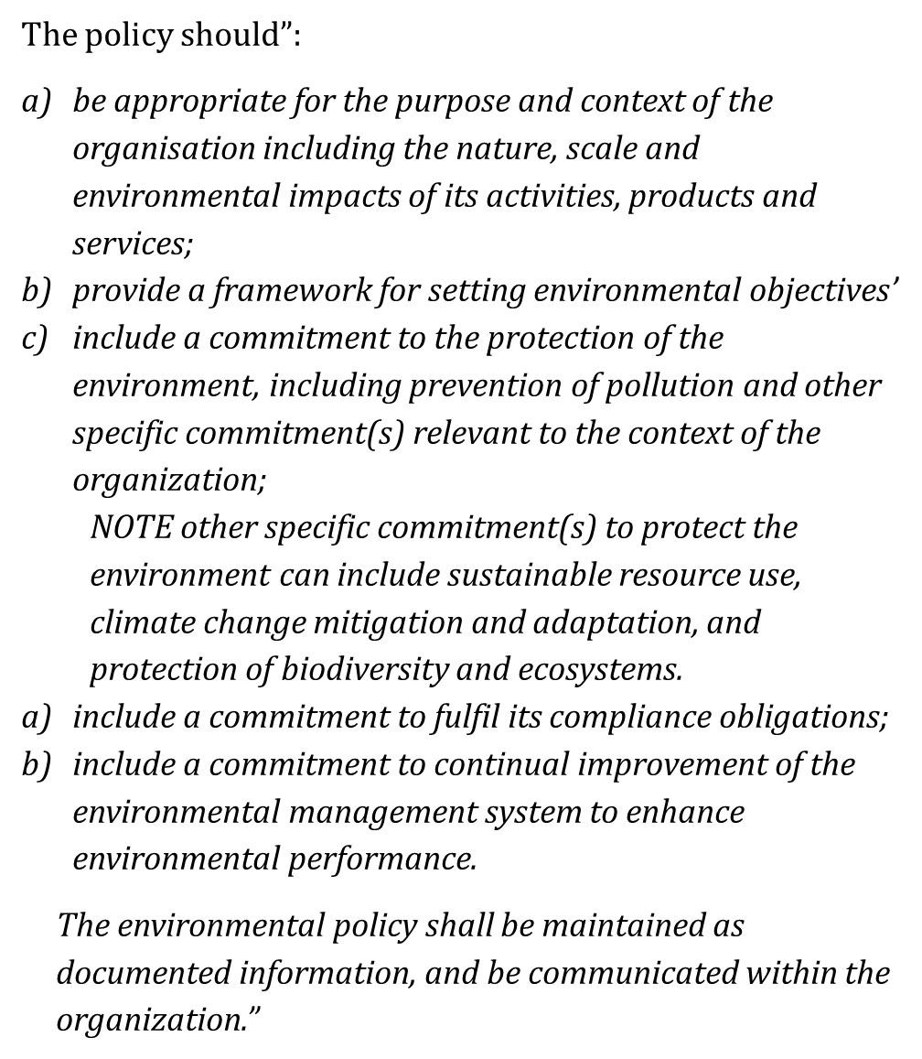
Environmental policy
Appropriate for the purpose
Commitment to the environmental issues, mandatory requirements and continuous improvement
Adopted from ISO 14001

Slide 21
Environmental programme: defined objectives, roles and responsibilities
Basing on the environmental review, the environmental programme defines the goals and objectives and their implementation activities and responsibilities
  Goals/objectives that company could commit to?
  For instance: waste reduction, emission reduction, energy efficiency, risk prevention, renewable energy use
  Activities to reach those goals/objectives?
  For instance: training, communications, investments in efficiency, monitoring
  The roles, responsibilities and schedule for the activities

Slide 22
Environmental programme table – from policy and objectives into concreate implementation activities
Environmental policy | Energy saving
Environmental objective/goal | Minimizing the use of energy in production processes
Indicator | Reducing the use of energy by 10% or X kWh annually
Responsibility: | Production manager
Activity | Operation | Schedule | Person responsible
 | Reducing air-leakages from compressors LED lights | Feb 2020 Nov 2020 | n.n. n.n.
Resources: | x €’s budgeted
Follow-up: | 1/2021, team meeting

Slide 23
Adoption
Depending on the business needs and objectives
The potential of coordinated environmental management at the company: is there interest and potential to develop toward environmental management system or adoption of green standards?
What are the key messages related to environmental performance of the company (and its products/services), to whom are they targeted, and could those be utilised in green marketing?
  These can be more generic about Social/Environmental Responsibility, or specific related to certain processes (Clean-Tech) or characteristics of the products/services.

Slide 24
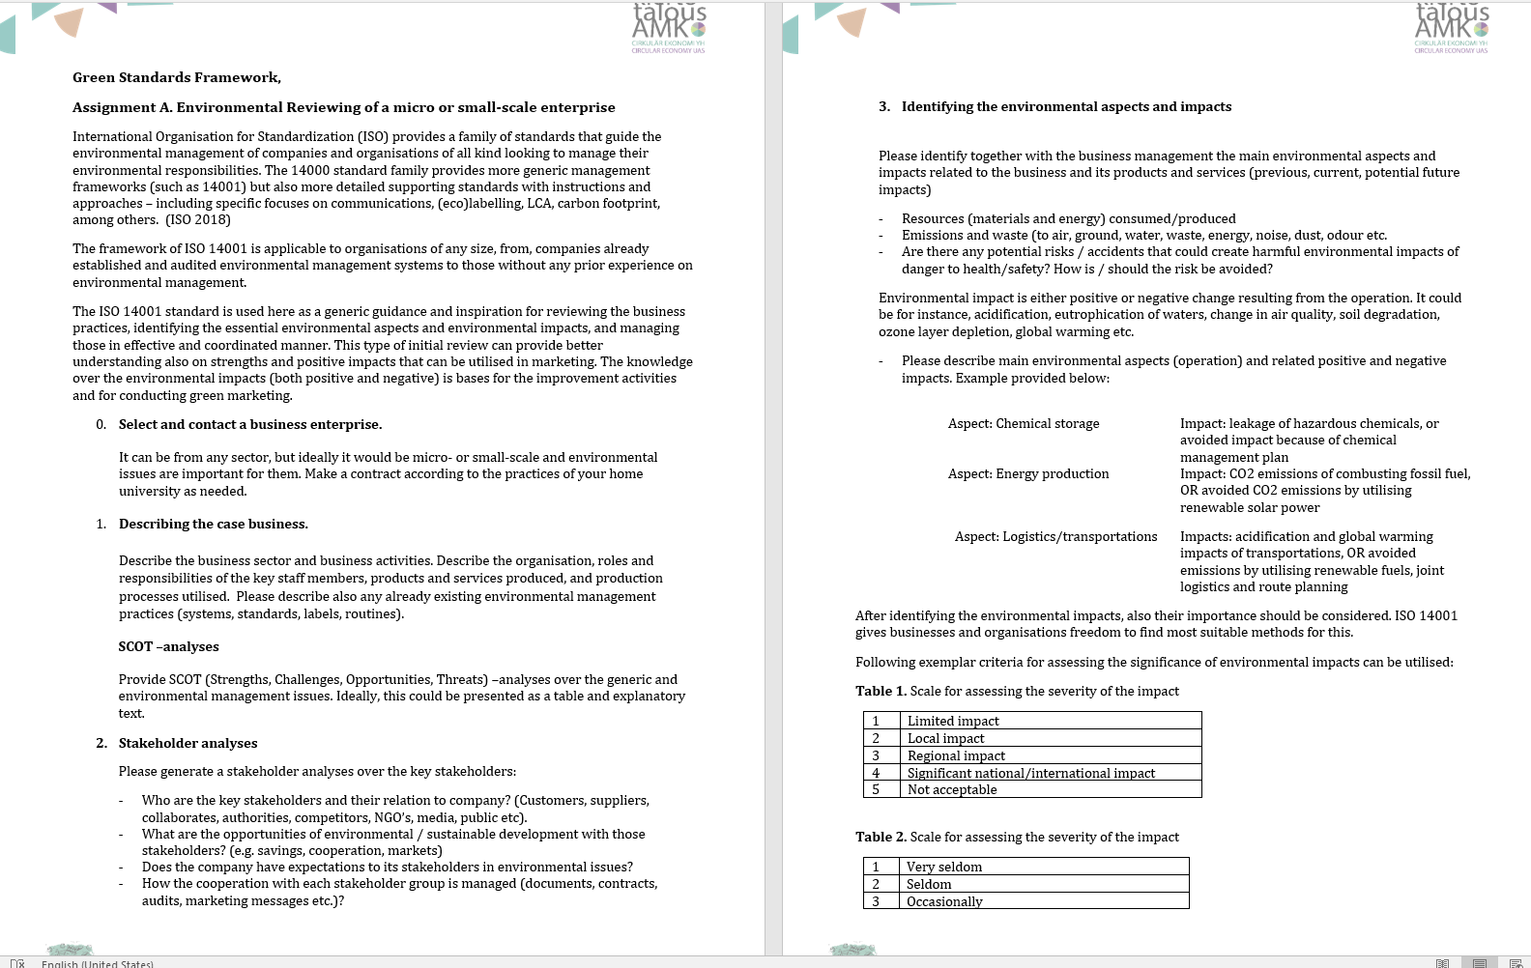
Assignment: Environmental reviewing of a micro- or small-scale enterprise
Attachment A.
This assignment is comprehensive case –based learning on environmental management topics in level of micro or small-scale enterprises. When completed in detail and collaboration with working life partner, It equals to 3 ETCS study content.

Slide 25
B. Product-based approaches to environmental management
B.1. EcoDesign

Slide 26
Product–based approaches
Companies can strive toward environmentally better development by improving their organisational environmental management, but also by developing production processes, products and services.
Eco-design and design for the environment (Brezet &Van Hamel 1997) refer to the strategies on how to develop more sustainable products and services. The focus is at holistic development of the new concepts with less environmental burden.
For the product -based approaches life cycle method and tools are applicable.
LCA theory and method provide opportunities to investigate the life-cycle impacts of products, services, and processes. In addition, associated products (consumables), and other consumption during the lifetime should be identified and its impact modelled.
Ecolabelling applies LCA methods in systematic manner to verify and communicate environmental impacts of the products and services
In this section, we introduce these approaches and standards providing guidance for their adoption in practice.

Slide 27
EcoDesign strategies
EcoDesign strategies (Brezet & Van Hamel 1997) detail approaches for improving the sustainability of both products and services in systematic manner, including:
  Product component level
  Product structure level
  Product systems level, and
  Innovation of new more sustainable concepts
EcoDesign strategies can be analysed and developed by applying the EcoDesign Strategy wheel, called also as LiDS (Life Cycle Design Strategy) wheel. It can be applied together with the EcoDesign Checklist.

Slide 28
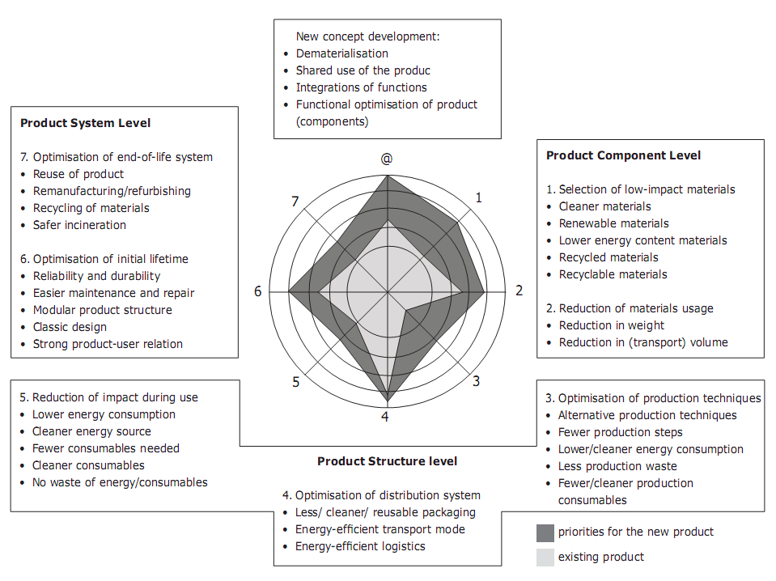
The EcoDesign Strategy Wheel, LiDS (Life-Cycle Design Strategy)
LiDS does not provide information on the specific environmental impacts but is “a strategy tool for evaluating environmental trade-offs between two similar or evolutionary designs.” (University of Michigan, cited in Solid Works Sustainability 2019).
This type of more comprehensive strategy approach reveals trade-offs, or problem displacements: for instance mixing of recycled (secondary) materials with virgin (primary) materials may effect on the product recyclability, and sometimes also cause additional environmental challenges.
(Brezet and van Hemel, 1997; Origin: The Industrial Engineering Wiki 2019, Cc-by-nc-sa-3.0)

Slide 29
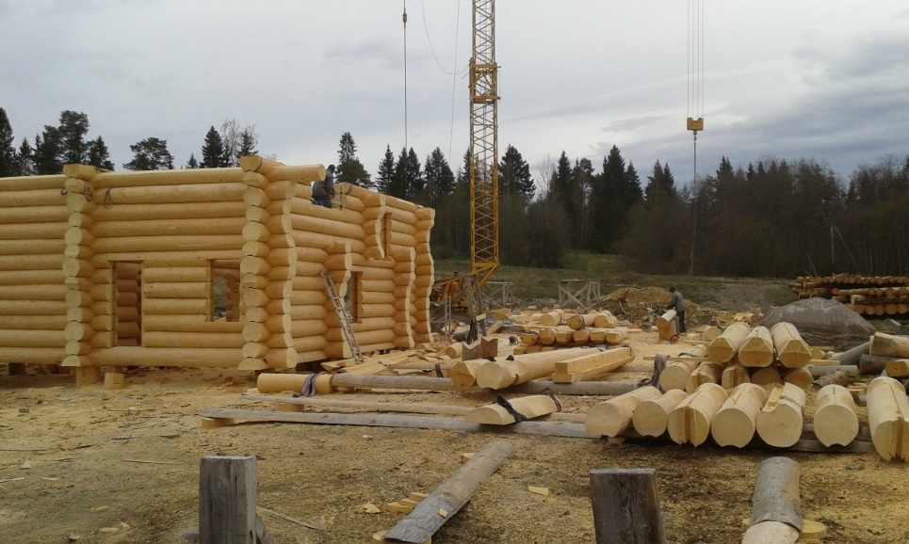
EcoDesign strategies
Product component level:
  Selection of materials with lower environmental impacts: cleaner materials, renewable materials, lower energy content materials, recycled materials and recyclable materials
  Reduction of materials usage: reduction in weight, reduction in volume (e.g. transports)
  Optimising the production technologies: finding alternative (more sustainable) production techniques, fewer production steps, lower energy consumption and waste generation, fewer and cleaner consumables (other products needed during the use).
Okkonen, L. / Karelia UAS

Slide 30
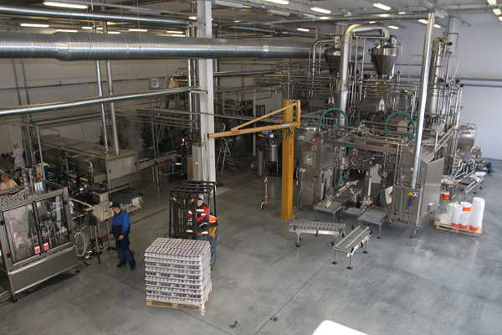
EcoDesign strategies
Product structure level:
  Optimising the distribution systems: less packaging, more efficient transportations and logistics
  Reduction the impact during the use of the product: energy efficiency, use of cleaner energy sources, less consumables needed, cleaner consumables, avoiding the waste and consumables
Okkonen, L. / Karelia UAS

Slide 31
EcoDesign strategies
Product systems level:
  Optimising the initial lifetime of the product: production of reliable and durable products, improving the product maintenance and repair, modular product structures, classic (attractive) designs, and creation of stronger product-user relations
    Do you have a product that you find a classic design, attractive and with you have strong product-user relation? That product might have longer life-time, and cause less environmental burden, compared to other products.
  Optimising end-of-life systems: product reuse, remanufacturing/refurbishing, material recycling, utilisation as energy through incineration

Slide 32
EcoDesign policy and legislation
The European Union has established a set of rules and requirements for energy labelling and the EcoDesign
In content, the focus is especially on energy-related products
The main policy/legislation documents are:
  EU's Energy Labelling framework Regulation (EU)2017/1369)
  EU's Ecodesign Directive (2009/125/EC)
  EU's Ecodesign Working Plan 2016-2019 (COM/2016/0773)
The energy-efficient products regulation includes both energy labelling and ecolabelling legislation
This is established for 26 product groups. See the product groups and legislations here.
In addition, there are voluntary agreements for other product categories

Slide 33
Assignment:
Choose one tangible product from the industry sector you find interesting
Get familiar with the product and processes along its life cycle
Please analyse the environmental strengths and challenges related to the product by using the Ecodesign strategy questions (EcoDesign checklist). Provide a one-page summary of your analyses.
You may also visualise your findings as indicative LiDS Wheel or other graphic presentation.

Slide 34
B. Product-based approaches to environmnetal management
B.2. Life-Cycle Analyses

Slide 35
Life Cycle Analyses – A method for ecological product/service development
The life cycle analysis or LCA is an approach to estimate the environmental impact of a product or service throughout its lifecycle
Both products and services can have severe, and surprising, environmental impacts
In LCA environmental impacts are identified and analyzed from ”cradle to grave” or “cradle-to-cradle”, covering the whole production chain
Identification of environmental impacts
Re-designing products and services to decrease their negative impacts
Can be made in different levels of detail, e.g. a screening analyses points the direction where to analyze in more detail
Allows comparisons
Requires cooperation along the production chain (often complex networks hard to trace)

Slide 36
Life Cycle Analyses – A method for ecological product/service development
Life cycle approach has gained increased role in green design and marketing as it enables identifying different types of environmental impacts of the products and services, and also establish metrics for the overall impacts.
The analyses are guided through ISO standards 14040 (principles and framework) and 14044 (requirements and guidelines).
The analyses can be utilised for instance for applying ecolabels, environmental product declarations, environmental management systems or in development of strategies / green marketing
The main steps of the analyses are as follows (ISO 14040):
  Defining the goal and scope
  Life Cycle Inventory (LCI)
  Life Cycle Impact Analyses
  Interpretation

Slide 37
The life-cycle analyses typically have following steps (ISO 14040)
Defining the goal and scope:
Including the functional unit of analyses (e.g. product with certain dimensions and defined use), target audience and objectives of the study.
This definition includes also system boundaries, i.e. what is included/excluded from the analyses. The approach varies depending on the objectives.
Life Cycle Inventory (LCI):
Including detailed inventory of the input and outputs (e.g. materials, production processes, transportations, use of fuel and other energy, and waste and emission outputs). The resulting inventory table provides data for the further analyses of the impacts.

Slide 38
The life-cycle analyses typically have following steps (ISO 14040)
Life Cycle Impact Analyses (LCIA):
Utilises data from the inventory to analyse environmental impacts related to the product life cycle. Through the steps of classification, categorisation, normalisation and weighting, it is possible to establish end-point impact analyses, where different types of environmental impacts are compared and single impact end-point metric is established.
Alternatively, mid-point methods can be applied without normalisation and weighting of the impacts, which results in single indicators, such as climate impact or eutrophication impact.
As the LCA is an approach with several optional methods for different purposes, it is important to defined the objectives and choose the methodology accordingly.
Interpretation of the results:
In this stage the results of the analyses are utilised to make conclusions and recommendations over the results (depending on the goal and scope). This phase includes also analyses of result reliability/sensitivity

Slide 39
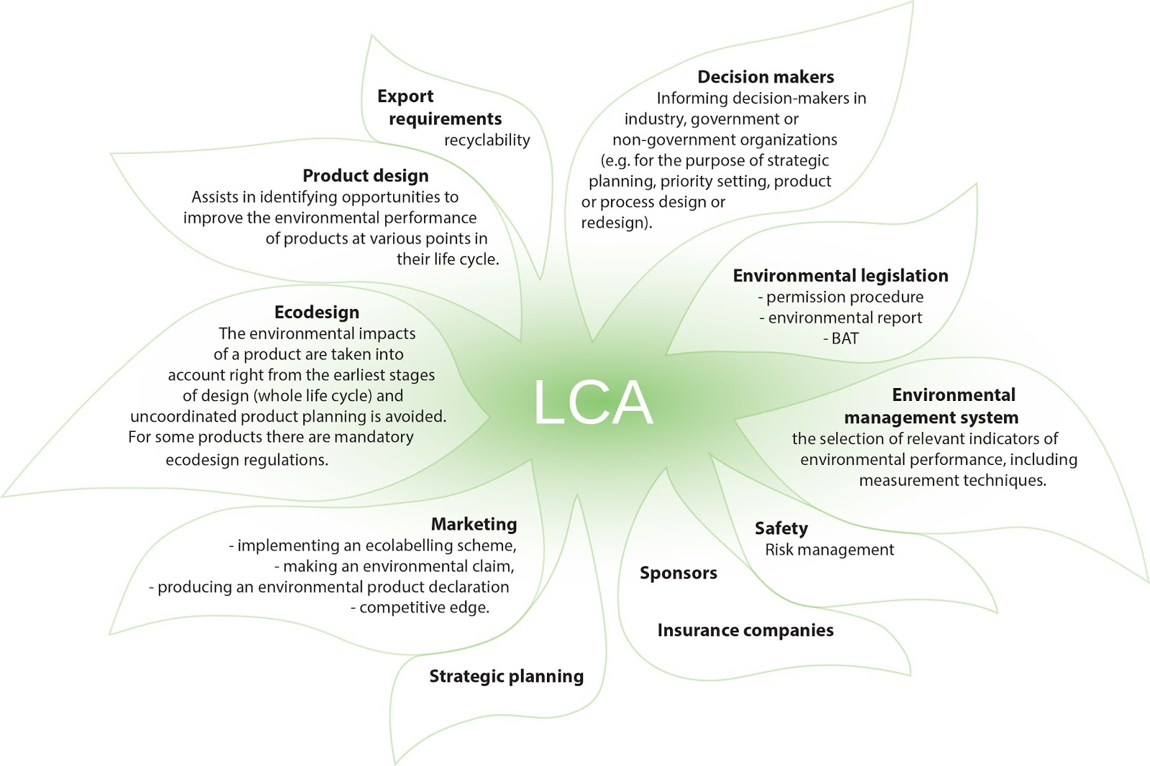
Application of the LCA results
Kontturi 2016, adapted from Tonteri 1998; ISO 14040.

Slide 40
Assignment: Getting familiar with the LCA Standard (ISO 14040)
Getting familiar with LCA standard
Upload the licenced standards (SFS-EN ISO 14040 and SFS-EN ISO 14044 ) via your university e-library services. Remember to follow the licence terms and not to distribute the standards in any other use. Establish full-text answers to following questions. Please avoid repeating the standard text but use your own text to describe the content.
What are the key characteristics of life cycle assessment?
For which purposes you can use LCA?
What does goal and scope definition mean in LCA?
Define life cycle inventory analyses and life cycle impact assessment
Present shortly reporting and critical evaluation of the LCA

Slide 41
Assignment: Getting familiar with the LCA studies
Getting familiar with the LCA studies
Find a study report applying the LCA methods. You might use e.g. Google Scholar or your organisation e-library/databases. Select a study you find interesting or close to your own field.
  Find out what has been the goal and scope of the study. What has been the functional unit of the analyses, e.g. a certain product, component, amount of product/a, hour of service..
  How has the product system defined? What has been included / excluded from the analyses and why?
  What kind of inventory data has been collected for the analyses? Inventory data can include e.g. raw materials, energy consumptions, emissions (to water, ground and atmosphere), needed other processes (transportations) and other products.
  What kind of impacts have been analysed and by which methods? Do these present overall environmental impacts of some specific environmental impact?
  How have the results being interpreted? Do you agree / disagree with the main findings of the study.

Slide 42
B. Product-based approaches to environmental management
B.3. Environmental Labelling

Slide 43
Why ecolabelling?
General concern about the environmental impacts
It was realised that this concern can be translated into a market advantage for certain products → number of labels and environmental claims emerged: there are over 3000 different types of labels
  Products are often described as ”recyclable”, ”eco-friendly”, ”green”, ”low-energy”, ”recycled content”
  There is evident need to have established criteria and system for providing ecolabels

Slide 44
Why environmental labelling?
Labelling attracts consumers with environmental awareness
Labelling also confused as there many labels and declarations
  Have you been confused with different labels? Please give an example.
Without reliable and verified practices consumers could be mislead → there has been need to standardise the practices and requirements
This need of credibility and impartiality led to establishment of both public and private organisations that provide third-party (external) labelling services
These services take place as national and multinational programmes / schemes that award ecolabels

Slide 45
Environmental labelling – ISO definitions
ISO has standardized environmental labelling practices (ISO 14020 series)
These are voluntary procedures
TYPE I environmental label = Ecolabel
TYPE II self declaration claim and very wide in its application. It deals with all environmental claims voluntarily made for products.
TYPE III environmental declaration, i.e. provides verified environmental data or indicator based on Life Cycle Analyses

Slide 46
Environmental labelling – three types of labels
Various labelling systems have emerged:
  There are also hybrids of ecolabelling, including narrower focus as normal ecolabelling programmes: single sector/industry, only one environmental issue (energy saving, carbon emission etc.), or only one or some parts of the life cycle (product manufacturing, use, or recycling)
  These are often called as ISO-like labels
  At same time, some Type I labels have expanded beyond the environmental aspect toward overall corporate social responsibility

Slide 47
Ecolabellig
Goal of the ecolabelling according to ISO (International Organization for Standardization):
"...through communication of verifiable and accurate information, that is not misleading, on environmental aspects of products and services, to encourage the demand for and supply of those products and services that cause less stress on the environment, thereby stimulating the potential for market-driven continuous environmental improvement". (GEN, Global Ecolabelling Network 2019)
Information, directing the demand toward environmentally-friendly products

Slide 48
What is an Ecolabel
An ecolabel is a label identifying overall environmental performance of a product (good or service) within a certain product category, and its based on life cycle approach
An ecolabel is voluntary, independent, and reliable
It is comprehensive i.e. takes account different environmental aspects
It is based on impartial third party verification (in contrast to self-styled labels or own producer’s claims), and sound scientific evidence
It is meant for products that meet established environmental leadership criteria, i.e. are distinctive in environmental performance in their product category (https://www.globalecolabelling.net/eco/eco-friendly-products-by-category/)
GEN, Global Ecolabelling Network. 2004. Introduction to Ecolabelling.

Slide 49
What is an Ecolabel
It is generic, i.e. suitable for most of the sectors (most popular ones are food, appliances, household products, paper – i.e. “consumer products”)
It has standardised principles: Environmental labels and declarations. Type I environmental labelling. Principles and procedures (ISO 14024:2018)
In ecolabelling programmes, the product categories (e.g. batteries, recharged batteries) and ecolabelling criteria are defined by an independent organisation with an advisory group
  Criteria development are typically based on life cycle reviews (so the correct environmental aspects are considered)
  Review includes life-cycle from raw materials extraction, manufacture, distribution, use, disposal/re-use
  Key differentiating parameters - such as toxicity, energy use, GHG emissions - are then used for the criteria development
  Attending companies need to provide product information for verification, and if approved, pay for the permission to use the label for a certain period
  Label applies only to the verified products
GEN, Global Ecolabelling Network. 2004. Introduction to Ecolabelling.

Slide 50
Objectives of ecolabelling
Protecting the environment
Policy instrument for environmental protection
Directs consumption to environmentally better alternatives
Promotes resource efficiency; improves reuse and recycling
Encourages ecosystem protection, maintaining biodiversity, and proper management of chemicals in products
Encouraging environmentally positive innovations and leaderships
Ecolabelling offer market opportunities: market niche for environmentally better products, positive corporate image, marketing advantage
Criteria are typically set to award top performers – not all – in product category
Incremental raising of standards leading toward improved products and services
Building consumer awareness
In some market areas ecolabel is already one of the selection criteria among the consumers – in other less advanced market areas it is a tool to raise environmental awareness
GEN, Global Ecolabelling Network. 2004. Introduction to Ecolabelling.

Slide 51
Principles for ecolabelling
Voluntary participation
  Open access
  Potential industry participants can request also development of ecolabelling categories and criteria for their products
Compliance with legislation
  Full compliance with all environmental and other relevant legislation
  This approach acknowledges, and does not challenge, legislations in different jurisdictions
  Ecolabelling should not cause any trade barriers
Consideration of fitness for purpose and level of overall performance
  Product should meet also other quality requirements in reasonable level, so the ecolabel product should also have comparable quality and performance in relation to its alternatives
GEN, Global Ecolabelling Network. 2004. Introduction to Ecolabelling.

Slide 52
Principles for ecolabelling
Scientific and engineering principles
  Life cycle analyses: both theory and methods, and scientific reliable procedures
Criteria must distinguish leadership
  Distinguishing leadership segment of a product category from the rest of the category
Criteria must be credible, relevant, attainable and measurable/verifiable
  Considering the whole life-cycle, thus keeping the procedures possible also for smaller companies
Independence
  Operator should be independent of any commercial interests; this applies also to the panels defining the product categories/criteria
  Balanced representation of different stakeholders in panels (industry, environment, academia, consumers, NGO’s, administration)
GEN, Global Ecolabelling Network. 2004. Introduction to Ecolabelling.

Slide 53
Principles for ecolabelling
Open and accountable process
  Process must be transparent
  It can be observed, monitored, questioned
  Good quality management system is recommended
  Public criteria and their review, inclusion of stakeholders in criteria development
Flexibility
  Programmes must operate “business-like”
  Cost efficiency
  Responding quickly to market changes and technology development
  This requires reviews, updating of product categories and criteria, and considerations of market and technology developments
Consistence with the ISO standards (ISO 14020 series)
  Provides better legitimacy and soundness
GEN, Global Ecolabelling Network. 2004. Introduction to Ecolabelling.

Slide 54
Assignment: Get familiar with some of the ecolabels and their contents
Select an ecolabel or an environmental label (generic or sectoral)
  Provide short description of the label and its main characteristics
  Find out what it requires to have it? (Criteria)
  Describe the application process
  Provide internet link to the Programme / Scheme providing the Label
  Find three examples of products/services using the Label
You may find examples via Global Ecolabelling Network or from the tool package at the end of this presentation.

Slide 55
C. Thematic approach: Carbon footprint

Slide 56
Key concepts
Carbon Footprint: The amount of CO₂e released into the atmosphere as a result of the activities of a particular individual, organisation or community
  Carbon = GHG emissions as CO₂ equivalent
  Footprint = metaphor for the total global warming impact of these gases with GWP 100a
Carbon Offsets: Compensating emissions produced by funding an equivalent carbon saving elsewhere
Carbon neutral: Having a net zero carbon footprint by balancing emissions released with an equivalent amount sequestered, avoided or offset

Slide 57
Carbon neutrality
transparency
GHG Emission inventories / calculations
Emission compensations (offsetting)
GHG Emission reduction/mitigation
Carbon neutral = CO₂ net emissions are 0
Adapted from: Ahola & Seppälä 2014

Slide 58
Carbon neutrality
Carbon neutrality has become widely established in companies’ public relations, media and public debate. However, its content and scope varies a lot.
The term carbon neutrality is still often defined by a common usage as there are no internationally accepted rules for using the claim of carbon neutrality.
Carbon neutrality means zero net greenhouse gas emissions to atmosphere, and it can be achieved by measuring emissions, reducing them as much as possible and compensating the residual emissions.
The lack of transparency, especially in outlining the organizational boundaries and main indirect emissions, measurement of emissions, efforts to achieve internal emission reductions, and the type of offsetting for residual emissions, have all affected the credibility of carbon neutrality claims.
However, it has become already very important to the companies’ public relations and reputation. In practice, carbon neutrality is often seen as inspirer to new business.
The Finnish Environmental Centre SYKE 2017

Slide 59
Organisational carbon footprint calculations
For instance: PAS 2060 Specification for the demonstration of carbon neutrality (British Standarding Institute). This standard sets out the requirements for achieving and demonstrating carbon neutrality
The specification defines a consistent set of measures and requirements for entities (e.g. organisations, governments, communities, families, individuals) to demonstrate carbon neutrality for a product, service, organisation, community, event or building.
According to PAS 2060, The carbon footprint measurements should include 100% of Scope 1 and Scope 2 emissions, plus all Scope 3 emissions that contribute more than 1% of the total footprint.
→ DIRECT ORGANISATIONAL + VALUE-CHAIN EMISSIONS
The weakness is the lack of life-cycle emissions of the products and services

Slide 60
Carbon footprint of products - ISO 14067
ISO has published standard: ISO 14067:2018 Greenhouse gases -- Carbon footprint of products -- Requirements and guidelines for quantification, which supports carbon footprint calculation and also communication of the results
Based on Life Cycle Analyses – both theory and method
  Analyses are based on defined product systems, inventory data (materials, processes, other products…), and validated LCA impact assessment methods (e.g. IPCC GWP100a)
LCA standards ISO 14040, ISO 14044
Links to quantification of environmental labels and declarations (ISO 14020, ISO 14024, ISO 14025)
Instructions how to generate partial carbon footprint analyses
Instructions and requirements of communicating carbon footprint results

Slide 61
Assignment:
The Greenhouse Gas Protocol provides guidance for calculation and reporting the corporation value chain GHG emissions
Please select an industrial production sector you find most interesting
Get familiar with the report on corporate GHG accounting, and define following concepts:
  SCOPE 1 Direct emissions
  SCOPE 2 Indirect emissions
  SCOPE 3 Indirect emissions in both downstream and upstream of the value chain
  Please provide examples of each from the production sector you have chosen for this study
  Which of the emissions are most challenging to quantify? How could they be analysed in reliable manner?

Slide 62
Discussion - How to become carbon neutral?
Awareness of your own consumptions and generation of GHG emissions
  Housing (heat, electricity, water, consumables)
  Transportations
  Products and services consumed (use, re-use, recycling, disposal)
Identifying and utilising emission reduction opportunities
  Change of behavior, reduction of consumption (energy and material efficiencies)
  Extend the life-cycle: Reuse, recycle, share…
  Renewables instead of non-renewables, recyclables instead of non-recyclables
  Services instead of products (with certain preconditions)
  Choosing the products and services that cause less GHG emissions (but be aware of problem displacements – other environmentally harmful impacts!)

Slide 63
Discussion - How to become carbon neutral?
Compensation of the remaining emissions
  In compliance market, companies, governments, or other entities buy carbon offsets in order to comply with caps on the total amount of carbon dioxide they are allowed to emit. (achieving compliance with obligations of Annex 1 Parties under the Kyoto Protocol, and of liable entities under the EU Emission Trading Scheme.)
  In voluntary market, individuals, companies, or governments purchase carbon offsets to mitigate their own greenhouse gas emissions from transportation, electricity use, and other sources.
  For instance: purchasing carbon offsets to compensate for the greenhouse gas emissions caused by personal air travel. Many companies offer carbon offsets as an up-sell during the sales process so that customers can mitigate the emissions related with their product or service purchase (such as offsetting emissions related to a vacation flight, car rental, hotel stay, consumer good, etc.)

Slide 64
C. Tool package for implementing green standards
(Based on: Okkonen, L. 2019. Compendium of Assessed Digital Tools. D2M Project)

Slide 65
Tools for sustainable business planning
Tool | Description | Address
THE IMPACT CANVAS | A tool for identifying positive and negative direct, indirect and systemic impacts related to the company's products and processes. This could be applied as part of the environmental reviewing. | https://www.threebility.com/sustainability-impact-canvas
THE SUSTAINABLE BUSINESS MODEL CANVAS | In-depth consideration of the business model sustainability by integrating sustainability aspect the business planning/development process (adopted tool from Osterwalder's business model canvas). | https://www.threebility.com/sustainable-business-model-canvas
THE SUSTAINABLE BUSINESS INNOVATION GAME | An innovation game based on 38 sustainable business model case examples. This can be used to raise new ideas, and in education, for instance. | https://www.threebility.com/sustainable-business-model-game
THE DIGITAL PRODUCT ETHICS CANVAS | Identifying the ethical risks of digital products to the individual and society. This could complement the social impact analyses, for instance. | https://www.threebility.com/digital-product-ethics-canvas
THE SUSTAINABILITY SWOT ANALYSES | Adapted SWOT tool to assess environmental risks and directing actions toward improvements. | https://www.threebility.com/sustainability-swot-analysis
THE SUSTAINABILITY BALANCED SCORECARD | A comprehensive framework translating company’s strategic objectives into a set of performance measures. The balanced scorecard is a management system motivating improvements in product, process, customer, and market development. | https://www.threebility.com/sustainability-balanced-scorecard

Slide 66
Tools for environmental management systems
Tool | Description | Address
ISO 14001 TOOLBOX, SELF-ASSESSMENT | Tis is an on-line tool basing for assessing compliance of ISO 14001:2004 Environmental Management System against the requirements of new ISO 14001:2015 standard. This is done "chapter by chapter, clause by clause". | https://int.lead.bureauveritas.com/en/environment-digital-tools
INTELEX ENVIRONMENTAL MANAGEMENT | A comprehensive environmental management system software with several subtools for performing in relevant subareas of EHSQ -program. | https://www.intelex.com/products/environment
CORITY ENVIRONMENTAL MANAGEMENT | A software to streamline and standardize environmental management in company, identify and manage risks and carry out proactive environmental management. | https://www.cority.com/solutions/environmental-management/
QUENTIC ENVIRONMENTAL MANAGEMENT SYSTEM | Quentic is environmental management systems solution that complies with ISO 14001 and 50001 standards. | https://www.quentic.com/environmental-management-system/
VELOCITY EHS: ENVIRONMENTAL SOFTWARE | Environmental management software covering different environmnetal impacts, such as air emissions, water quality and waste compliance. | https://www.ehs.com/solutions/environmental-management-software/
MY EASY ISO | A software to automate and implement the ISO-based quality, environmental and energy management operations. | https://www.capterra.com/p/149424/MyEasyISO/

Slide 67
Tools for Life Cycle Analyses & EcoDesign
Tool | Description | Address
ECODESIGN+ | A software to calculate LCA-based Product Carbon Footprint and to carry out EcoDesign. | https://www.ecodesign-company.com/en/
ONE CLICK LCA | Easy and fast life cycle software to calculate carbon footprint and life cycle costs especially for buildings. | https://www.oneclicklca.com/
SIMAPRO | A world-leading LCA software package for developers, product managers and education. | https://simapro.com/
GABI | LCA modelling and reporting software, content databases with intuitive data collection and reporting tools. | https://www.gabi-software.com/nw-eu-english/index/
AIR.E | A software for LCA, including also sub tool for carbon footprint calculations. | https://www.solidforest.com/en/index.html
GRANTADESIGN | Material intelligence with solutions for material knowledge, selection, data, properties data, and educational pack. | https://grantadesign.com/
ECO-BAT | Eco-Bat is an eco-balance tool enabling quick LCA of a building. | http://www.eco-bat.ch/
CCALC | Carbon calculating/footprinting tools, including additional support/training products. | http://www.ccalc.org.uk/

Slide 68
Tools for Life Cycle Analyses & EcoDesign
Tool | Description | Address
MAKERSITE | Makersite is a software to utilise integrated data and tools for collaboratively analysing, improving and reporting on product compliance, cost and sustainability in a standard complying manner. | https://www.makersite.de/
ECODEX | A solution for communicative LCA and EcoDesign activities to create more sustainable products. | https://www.selerant.com/eco-design/
LCA4WASTE | This is a decision support tool focusing especially for resource use and waste management in energy intensive industries and in dedicated waste treatment processes. | https://www.ethz.ch/content/specialinterest/baug/institute-ifu/esd/en/downloads/lca4waste.html
LCA CALCULATOR | "The LCA Calculator is fast, user-friendly, life cycle analysis software, that helps designers and engineers to understand, analyse and compare environmental impacts of their products to help make ‘greener’ design decisions. " | https://www.lcacalculator.com/
PACKAGESMART | PackageSmart is an easy-to-use LCA software especially for packaging design. | https://www.earthshiftglobal.com/software/packagesmart
EARTHSMART | Flexible, web-based LCA tool for analysing the complete product life-cycles / product systems. | https://www.earthshiftglobal.com/

Slide 69
Certificates and labels - Verifying the sustainability

Slide 70
Green certificates and labels – Type-I-II-III Ecolabels
Tool | Description | Address
BLUE ANGEL | The Blue Angel in a German type-I comprehensive Ecolabel setting high standards for environmentally sound product design in number of product categories | https://www.blauer-engel.de/en
EU ECOLABEL | The EU Ecolabel is a type-I comprehensive ecolabel for consumer non-food products and services which generally have a significant impact on the environment. It is based on Life Cycle Assessments. | http://ec.europa.eu/environment/ecolabel/
NORDIC SWAN | Comprehensive type-I Ecolabel of Nordic countries covering approximately 60 product groups. | http://www.nordic-ecolabel.org/
EPD | Environmental Product Declaration, EPD, provides relevant, verified and comparable information to meet various customer and market needs. (based on ISO 14025 and EN 15804 standards). | https://www.environdec.com/
LUOMU (AURINKOMERKKI) | Finnish national label for organic products meeting the requirements of EU organic regulations and administrated by the Finnish authority. | https://www.ruokavirasto.fi/yritykset/elintarvikeala/luomutuotteet/markkinointi-ja-merkinnat/aurinkomerkki/
Other, please find: https://globalecolabelling.net/

Slide 71
Green certificates and labels – Other “ISO-like” Labelling
Tool | Description | Address
ASC | The Aquaculture Stewardship Council (ASC) offers standards for aquaculture and for the seafood chain of custody | https://www.asc-aqua.org/
BAP | A third-party aquaculture certification program that improves the environmental, social and economic performance of the aquaculture supply chain, and aims at growing the global supply of responsibly farmed seafood. | https://bapcertification.org/
BASF | BASF is a large-scale chemical coroporation that has developed a label for products that have been evaluated by an Eco-Efficiency Analysis. | https://www.basf.com/fi/en.html
BLUE FLAG | Ecolabelling for beaches, marinas, and sustainable boating toursim operators. | https://www.blueflag.global/
BREEAM | "BREEAM is sustainability assessment method for masterplanning projects, infrastructure and buildings. It recognises and reflects the value in higher performing assets across the built environment lifecycle, from new construction to in-use and refurbishment." | https://www.breeam.com/
CARBON TRUST STANDARDS | A third-party verified organisational label for measuring and reducing carbon, water and/or waste, or supply-chain CO2 emission reductions/management. | https://www.carbontrust.com/home/

Slide 72
Green certificates and labels – Other “ISO-like” Labelling
Tool | Description | Address
ECO ENERGY | "EKOenergy is an international non-profit ecolabel for energy (renewable electricity and renewable gas). In addition to being renewable, the energy sold with the EKOenergy label fulfills additional sustainability criteria and finances projects that combat energy poverty." (www.ekoenergy.org) | https://www.ekoenergy.org/
ENERGY STAR | The Energy Star is a label for energy efficiency, including products, homes, buildings and industrial plants. | https://www.energystar.gov/
FSC | Forest Stewardship Council provides certifications for the Forest management and The Chain of Cusotody (i.e. products are handled correctly at every stage of production). | https://www.fsc.org/
GEO CERTIFIED | GEO Certification is a comprehensive certification for golf facility operations, golf development and renovation, and golf tournaments. | https://sustainable.golf/vision/action/certification
GOOD ENVIRONMENTAL CHOISE "BRA MILJÖVAL" | Swedish Society for Nature Conservation (SSNC) provides its own eco-label, Good Environmental Choice, for several types of products | https://www.naturskyddsforeningen.se/in-english
GREEN GLOBE | "The Green Globe certification is a structured assessment of the sustainability performance of travel and tourism businesses and their supply chain partners." | https://greenglobe.com/

Slide 73
Green certificates and labels – Other “ISO-like” Labelling
Tool | Description | Address
GREEN GUARD | Certification helps manufacturers to create and buyers to identify such interior products and materials that have low chemical emissions into indoor air during product usage. | http://greenguard.org/en/CertificationPrograms/CertificationPrograms_indoorAirQuality.aspx
GREEN SEAL | Green Seal is a non-profit organisation developing life-cycle-based, multi-attribute standards, and certifying products and services. | https://www.greenseal.org/
LEED | Leadership in Energy and Enviornmental Design (LEED) is globally most commonly used green building rating system. | http://leed.usgbc.org/leed.html
LUOMULIITTO | A label for the Finnish organic products. Applicable to be used together with the EU Organic Logo. | http://www.luomuliitto.fi/luomutuotanto/leppakerttumerkki/
MSC | Marine Stewardship Council is a non-profit organisation providing labelling to support sustainable fishing (seafood, chain of custody and seaweed). | https://www.msc.org/home
ON-PACK RECYCLING LABEL | "The On-Pack Recycling Label scheme aims to deliver a simple, consistent and UK-wide recycling message on retailer and brand packaging2. | https://www.oprl.org.uk/about-oprl/
PEFC | "PEFC (Programme for the Endorsement of Forest Certification) is an international forest certification system promoting ecologically, socially and economically sustainable forestry throughout the world." | https://pefc.fi/english/
THE EU ORGANIC LOGO | The EU Organic logo informs the consumers that the products are produced according to the organic production regulations by the EU | https://ec.europa.eu/info/food-farming-fisheries/farming/organic-farming/organics-glance/organic-logo_en

Slide 74
Green certificates and labels – Social responsibility, ethical labelling and environmental management systems
Tool | Description | Address
B CORPORATION | B Corporations use the power of business to solve social and environmental problems. They apply the "highest standards of verified social and environmental performance, public transparency, and legal accountability to balance profit and purpose" (https://bcorporation.net/about-b-corps) | https://bcorporation.net/
EARTHCHECK | Amoung the world-leading scientific bechmarking, certification and advisory bodies for tourism. Can be applied in regional/destination certification. | https://earthcheck.org/
ECOCOMPASS | Environmental certificate for small and medium size enterprises and events | https://ekokompassi.fi/en/
FAIRTRADE | The fairtrade standards are designed to tackle poverty, and empower producers (incl. Local farmers and workers). It involves both producers and the traders. | https://www.fairtrade.net/
GREEN OFFICE | WWF certificate to improve the sustainability of workplaces/offices | https://wwf.fi/en/green-office/
GRI | GRI is a global standard for sustainability reporting. | https://www.globalreporting.org/standards

Slide 75
Green certificates and labels – Carbon offsetting
Tool | Description | Address
ATMOSFAIR | Carbon management and offsetting services | https://www.atmosfair.de/de/
GOLD STANDARD | Gold Standard certification is for carbon offset projects both in the voluntary and compliance environmental markets. | https://www.goldstandard.org/
PLAN VIVO | Plan Vivo projects support smallholders and communities by selling Plan Vivo Certificates. One Plan Vivo Certificate represents the long-term sequestration or reduction of one tonne CO2e, as well as other ecological and social/community benefits. | http://www.planvivo.org/
SOUTH POLE GROUP | Sustainability consulting, data solutions, platforms, offsetting services, among others | https://www.southpole.com/
VCS (VERRA) | "The VCS Program is the world’s leading voluntary program for the certification of GHG emission reduction projects". Verra has also several other green certification services. | https://verra.org/

Slide 76
Sources
Ahola, K. & Seppälä, J. 2014. Osa 1: Hiilineutraalisuus käsitteenä. Teoksessa Seppälä, J. (toim.) Suomen ilmastopaneeli. Kohti hiilineutraalia yhteiskuntaa, 8–30.
Brezet H, Van Hamel C, Ecodesign: A promising approach to sustainable production and consumption, Paris: UNEP, 1997.
Global Ecolabelling Network. 2004. Introduction to Ecolabelling. Global Ecolabelling Network Information Paper. Available at: https://globalecolabelling.net/assets/Uploads/intro-to-ecolabelling.pdf.
Global Ecolabelling Network. 2019. Global Ecolabelling Network. Available at: https://globalecolabelling.net/.
Greenhouse Gas Protocol. 2013. Technical Guidance for Calculating Scope 3 Emissions. Supplement to the Corporate Value Chain (Scope 3) Accounting & Reporting Standard. http://www.ghgprotocol.org/sites/default/files/ghgp/standards/Scope3_Calculation_Guidance_0.pdf
ISO 14021:2016. Environmental labels and declarations - Self-declared environmental claims (Type II environmental labelling). Available at: https://www.iso.org/standard/66652.html.
ISO 14024:2018. Environmental labels and declarations -Type I environmental labelling - Principles and procedures. Available at: https://www.iso.org/standard/72458.html.
ISO 14025:2006. Environmental labels and declarations. Type III environmental declarations. Principles and procedures. International Organization for Standardization. Available at: https://www.iso.org/standard/38131.html.
ISO 14001:2005. Environmental Management Systems. Requirements with Guidance for Use. Available at: https://www.iso.org/standard/60857.html
ISO 14040:2006. Environmental Management – Life Cycle assessment – Principles and Framework. Available at: https://www.iso.org/standard/37456.html.

Slide 77
Sources
Kontturi, A-M. 2016- Utilization of the life cycle analysis in the product marketing: Case Kero hirsirakennus Oy. Available at: http://urn.fi/URN:NBN:fi:amk-2016092614561.
Okkonen, L. 2019. Compendium of Assessed Digital Tools. D2M Project. Unpublished.
PAS 2060. 2014. Specification for the demonstration of carbon neutrality. Lontoo: The British Standards Institution.
Renvall, J. 2015. Alustava ympäristökatselmus. Harjoitustyön ohje. Karelia-amk.
SYKE. Suomen Ympäristökeskus. 2017. Climate Guide. https://ilmasto-opas.fi/en/.
The Industrial Design Engineering Wiki. 2019. Available at: http://wikid.io.tudelft.nl/WikID/index.php/Main_Page.
Tonteri, H. 1998. Metallituotteiden elinkaariarviointi. Tekninen tiedotus, MET-julkaisuja nro 7/98. Helsinki: Metalliteollisuuden Kustannus Oy.
Van Hemel, C.G. 1995. The LiDS wheel. In Ecodesign, A promising approach to sustainable production and consumption, Brezet, H. and Van Hemel, C.G. (1997). UNEP: Paris.
Weiss & Bentlage 2006. Environmental Management Systems and Certification.

