Slide 1
Hyperspectral Imaging
Tapani Alakiuttu

Slide 2
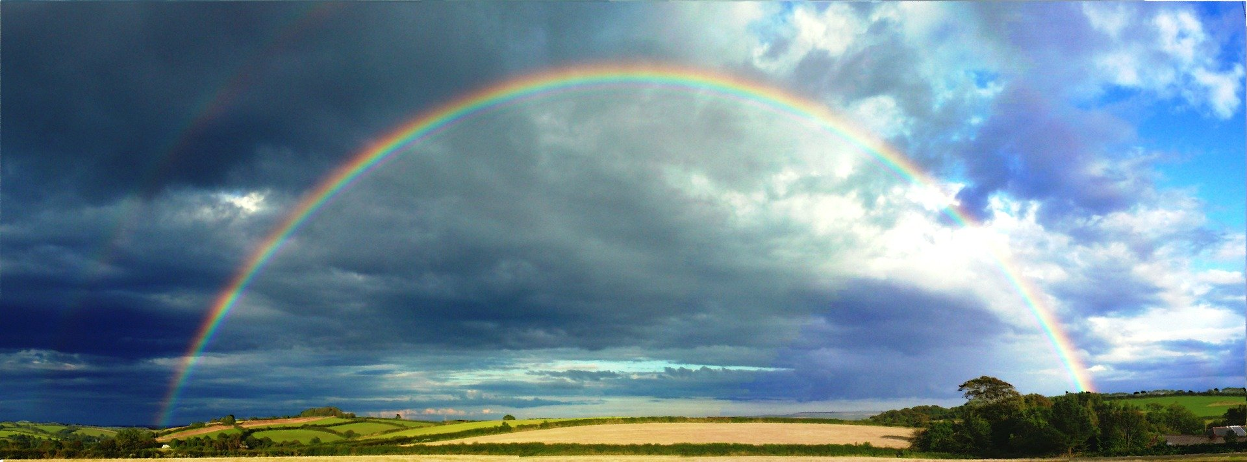
Have you ever observed the rainbow on a rainy day? This beautiful phenomenon where raindrops act as millions of small prisms makes an important characteristics of sunlight visible. Sunlight consists of electromagnetic waves with many different wavelengths, some of which in the rainbow we can see as colors.
Sunlight consists of electromagnetic waves with many different wave lengths. Some of which we can see on rainbow as colours.

Slide 3
Content
Spectral Image Basics
Benefits of Spectral Imaging
Data Acquisition
Application Example
Other Applications
Video Content

Slide 4
Spectral Image Basics

Slide 5
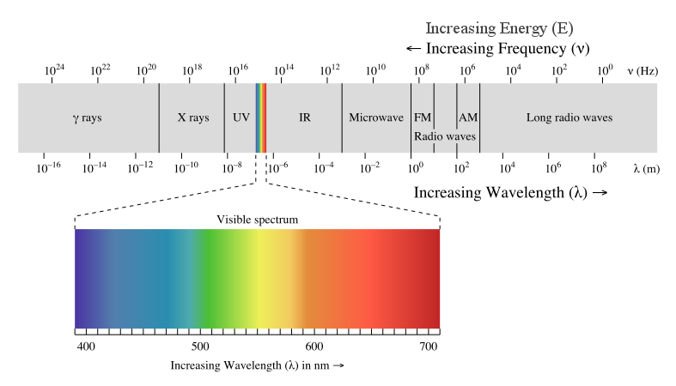
The Electromagnetic Spectrum
source: http://en.wikipedia.org/wiki/File:EM_spectrum.svg
author: Philip Ronan
We can see only very small part of it with our human eyes. Roughly between 400 and 750 nano meters.
On the lower end of the spectrum it extends to ultra violet and on the other end above red it extends to the infra red region of the spectrum

Slide 6
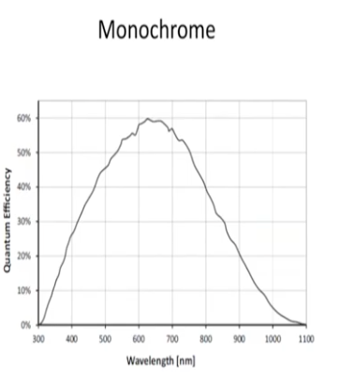
The Visible Spectrum – The World is Grey
If we have only one receptor in a visible range, we would see the world in different shades of grey.
We would not see different colour because we would not be able to differentiate different colours.
This would be a pretty boring world.

Slide 7
The Visible Spectrum – Human Vision
Human visual system has three so called cones: a short cone (S), medium cone (M) and long cone (L).
Because of this three receptors we can see colours. Our brain brings this together.
Colour imaging sensor works pretty much the same way

Slide 8

Spectral Imaging Basics - Overview
 | Monochrome | RGB | Multispectral | Hyperspectral | Spectroscopy
Spatial Information | yes | yes | yes | yes | no
Band Numbers | 1 | 3 | 2 - 10 | >10 | continuous
Spectral Information | No | limited | Yes | Yes | Yes

Slide 9
Benefits of Spectral Imaging

Slide 10
Benefits of Spectral Imaging
Monochrome
More information

Slide 11
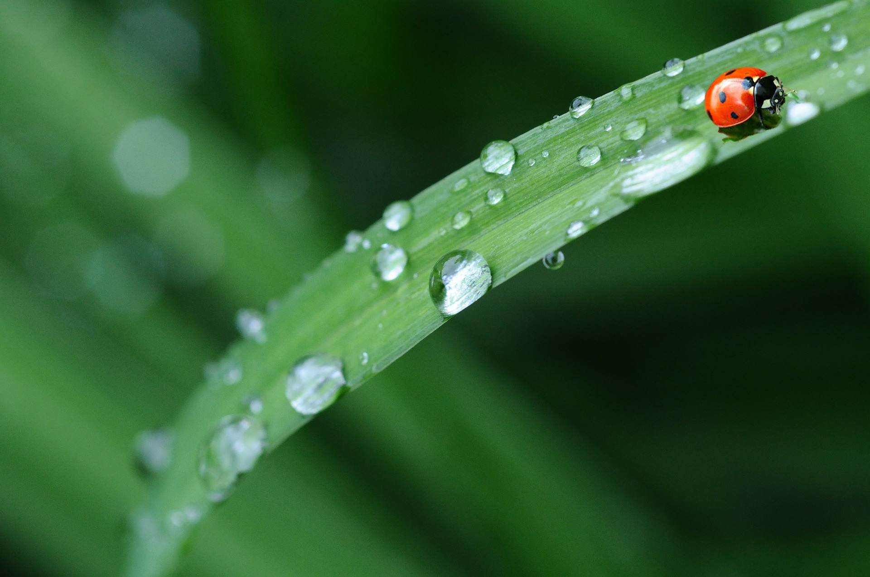
Benefits of Spectral Imaging
The more spectral data, the more information
Differentiation of material
Identification of material characteristics
Determination of water content
Material composition

Slide 12
Data Acquisition

Slide 13
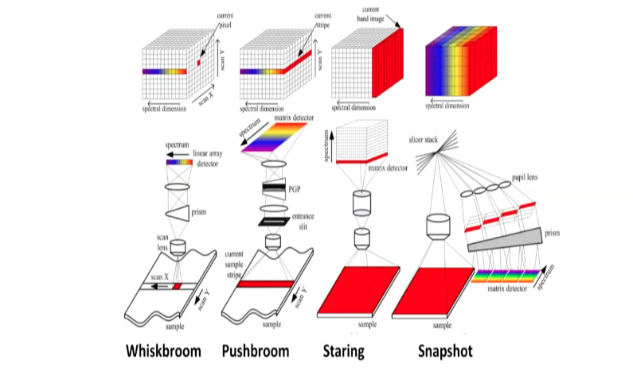
Hyperspectral Imaging Data Acquisition
Whiskbroom: Observe region pixel by pixel like using whiskbroom for cleaning floor and then extracting spectral information to line sensor. Not used much anymore.
Pushbroom: Observe one line at a time. Scan the sample line by line or the sample itself moves under this line. Nyperspectral data cube is build.
Staring: Take sample picture by picture with different filter.
Snapshot: With one shot spatial and spectral information. Requires quit sophisticated arrangement of mirrors and lenses.

Slide 14
Application Example

Slide 15
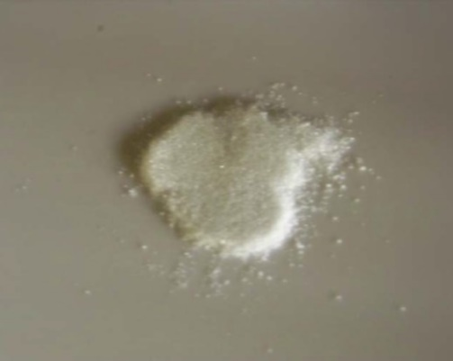

Application Example – 3 White Powders
Three different powders. Just by looking it is not possible to distinguish any.
Source:
Optotechnik und Bildverarbeitung (OBV)
Christian Günther
Frank Friehl
Prof. Dr. Heckenkamp

Slide 16
Application Example – 3 White Powders
Use Spectral Information
Sodium
Carbonate
Sodium
Carbonate
Source:
Optotechnik und Bildverarbeitung (OBV)
Christian Günther
Frank Friehl
Prof. Dr. Heckenkamp

Slide 17
Application Example – 3 White Powders
Use Spectral Information
Sodium
Carbonate
Sodium
Carbonate
Natron
Natron
Source:
Optotechnik und Bildverarbeitung (OBV)
Christian Günther
Frank Friehl
Prof. Dr. Heckenkamp

Slide 18
Application Example – 3 White Powders
Use Spectral Information
Powdered
Sugar
Sodium
Carbonate
Powdered Sugar
Sodium
Carbonate
Natron
Natron
Source:
Optotechnik und Bildverarbeitung (OBV)
Christian Günther
Frank Friehl
Prof. Dr. Heckenkamp

Slide 19
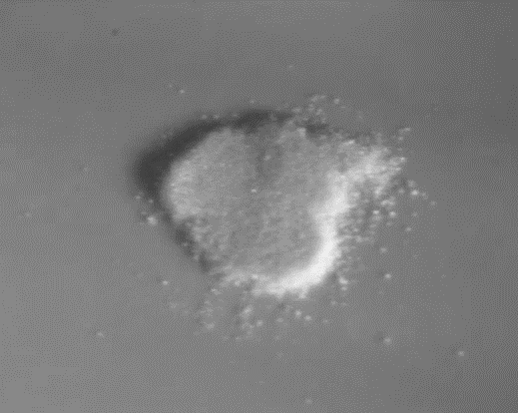
Application Example – 3 White Powders
Typically curves are
uninteresting in the
visible range but
come more
interesting in IR-range.
Sodium carbonate:
Spectrum is pretty
flat over wide range
of wave lengths
Natron: Flat in the
beginning but drops
suddenly after 1000 nm.
Sugar: Flat in the beginning
but more interesting
above 1000 nm.
We have spectral data each of the material recorded.
Powdered
Sugar
Sodium
Carbonate
Monochrome
X
Natron
Powdered Sugar
Sodium
Carbonate
Source:
Natron
Optotechnik und Bildverarbeitung (OBV)
Christian Günther
Frank Friehl
Prof. Dr. Heckenkamp

Slide 20
Application Example – 3 White Powders
Powdered
Sugar
Sodium
Carbonate
Monochrome
This is an interesting characteristics of many materials. We don't see very interesting spectral curve in the visible range but if we look at the infrared spectral range curves come very interesting and we start to be able to separate materials. This would not be possible if we just look the visible range.
If we look at those powders in regular monochrome sensor, as expected we can't differentiate them. All curves are pretty much flat in this region, which means that the sensor is quit saturated.
X
Powdered Sugar
Natron
Sodium
Carbonate
Natron
Source:
Optotechnik und Bildverarbeitung (OBV)
Christian Günther
Frank Friehl
Prof. Dr. Heckenkamp

Slide 21
Application Example – 3 White Powders
Powdered
Sugar
Sodium
Carbonate
Color (RGB)
If we take a colour imager and try to differentiate the powders with three RGB-filters, we still not see any distinguish possible.
X
Natron
Powdered Sugar
Sodium
Carbonate
Natron
Source:
Optotechnik und Bildverarbeitung (OBV)
Christian Günther
Frank Friehl
Prof. Dr. Heckenkamp

Slide 22
Application Example – 3 White Powders
Consider Infrared
Powdered
Sugar
Sodium
Carbonate
Powdered Sugar
Sodium
Carbonate
Natron
Natron
Source:
Optotechnik und Bildverarbeitung (OBV)
Christian Günther
Frank Friehl
Prof. Dr. Heckenkamp

Slide 23
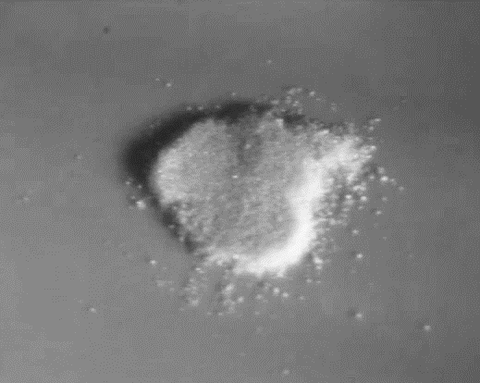
Application Example – 3 White Powders
SWIR
SWIR
If we take short wave infrared camera SWIR-camera, we hope to be able to distinguish them, but it is not possible.
Reason for this is that at the lower part of SWIR all signals are very high. All three substances are able to saturate the signal.
What can we do now?
Powdered
Sugar
Sodium
Carbonate
X
Powdered Sugar
Natron
Sodium
Carbonate
Source:
Natron
Optotechnik und Bildverarbeitung (OBV)
Christian Günther
Frank Friehl
Prof. Dr. Heckenkamp

Slide 24
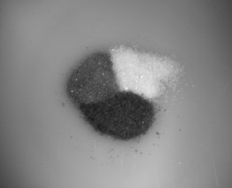
Application Example – 3 White Powders
Choose bandpass filter
SWIR
We take a very narrow bandpass at 1650 nm with width only 35 nm.
Suddenly the picture changes
SWIR
Powdered
Sugar
Sodium
Carbonate
ü
Natron
Source:
Optotechnik und Bildverarbeitung (OBV)
Christian Günther
Frank Friehl
Prof. Dr. Heckenkamp

Slide 25
Application Example – 3 White Powders
SWIR
We are now able to distinguish the three powders quit clearly.
Sodium carbonate has still quit strong signal and is quit saturated.
Powder sugar is somewhere between the two other substances, we see as grey.
Natron drops a lot and is seen as black.
You don't always need to observe the whole spectrum. Sometimes it can be enough if you know exactly what you want to do the substances you want to separate it is possible to use just one filter.
Powdered
Sugar
Sodium
Carbonate
ü
Natron
Source:
Optotechnik und Bildverarbeitung (OBV)
Christian Günther
Frank Friehl
Prof. Dr. Heckenkamp

Slide 26
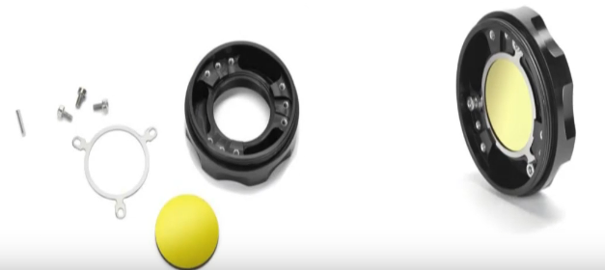
Sometimes a filter is all it takes
SWIR
You don't always need to observe the whole spectrum. Sometimes it can be enough if you know exactly what you want to do the substances you want to separate it is possible to use just one filter.
Depending on task, one filter can be enough
Can be a small and robust solution for easy integration
A hyperspectral solution reduced to one relevant bandpass
Powdered
Sugar
Sodium
Carbonate
ü
Natron
Source:
Optotechnik und Bildverarbeitung (OBV)
Christian Günther
Frank Friehl
Prof. Dr. Heckenkamp

Slide 27
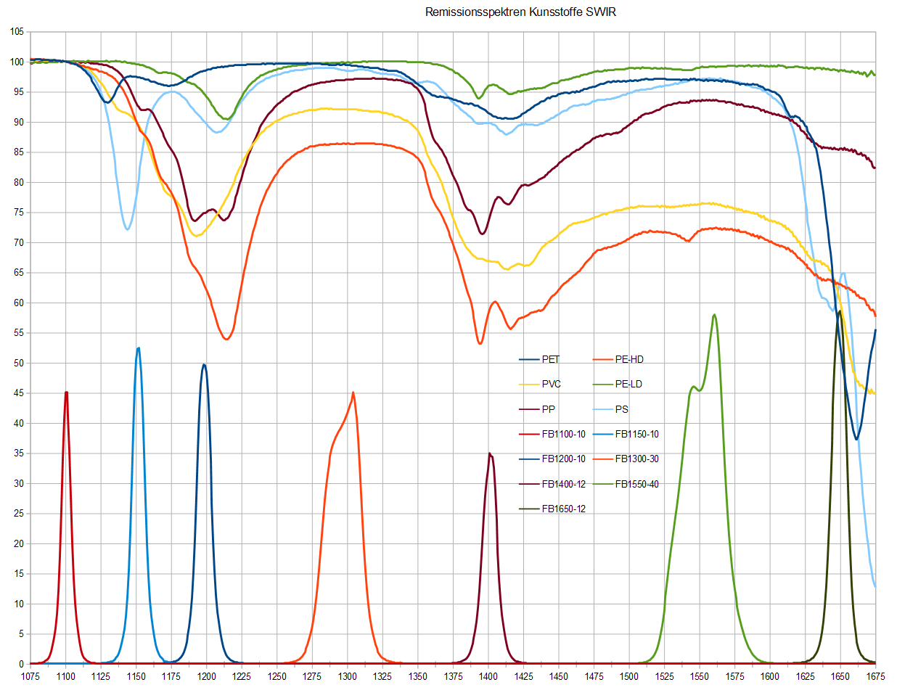
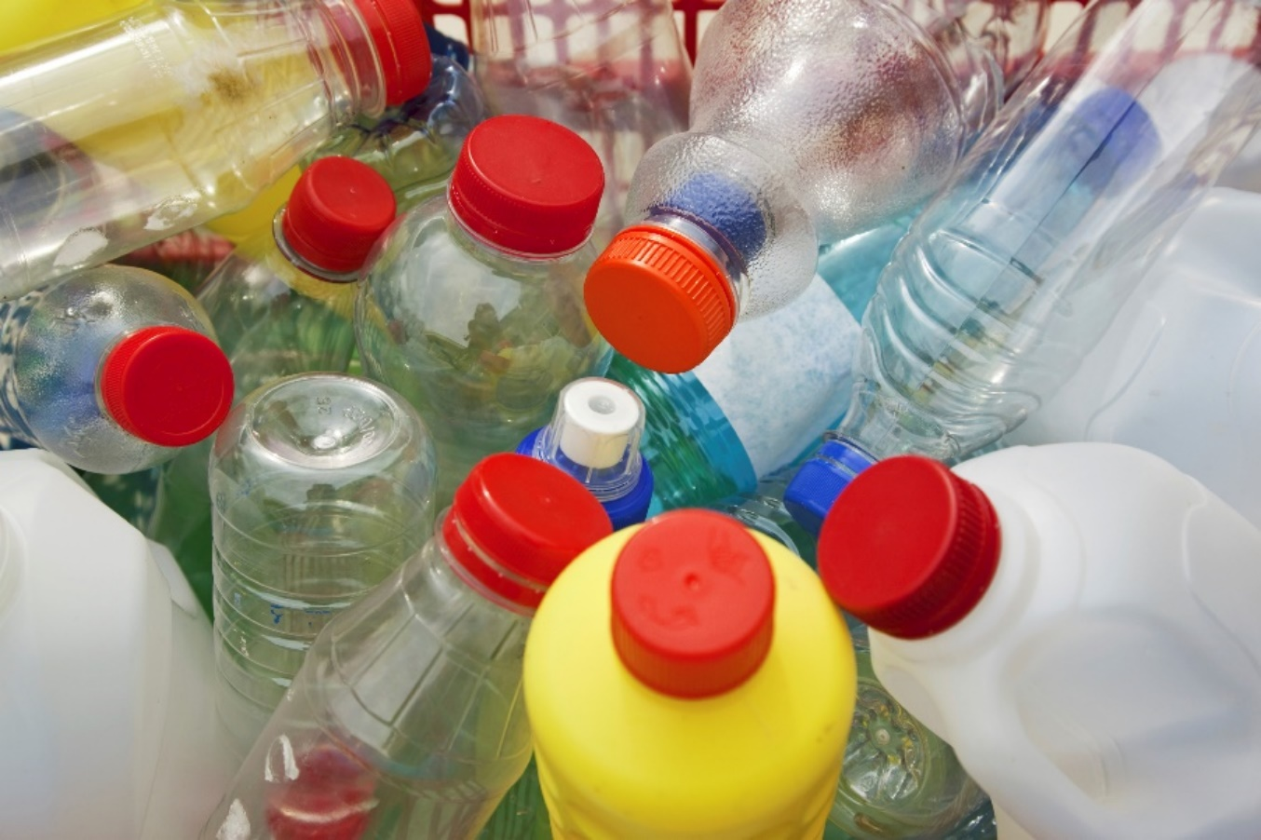
And sometimes a multi/hyperspectral solution is require
Identification of recyclable plastics
Separation of Recyclable Plastics
Spectral curves of different plastics. Here it would not possible to use just one filter to differentiate. Curves are too similar. Here we could use for example seven filters and we could be able to distinguish quit many of the plastics.
It's always very specific how many filters are needed.
Spectral Remission [%]
Wavelength [nm]
Source:
Optotechnik und Bildverarbeitung (OBV)
Frank Friehl
Prof. Dr. Heckenkamp

Slide 28
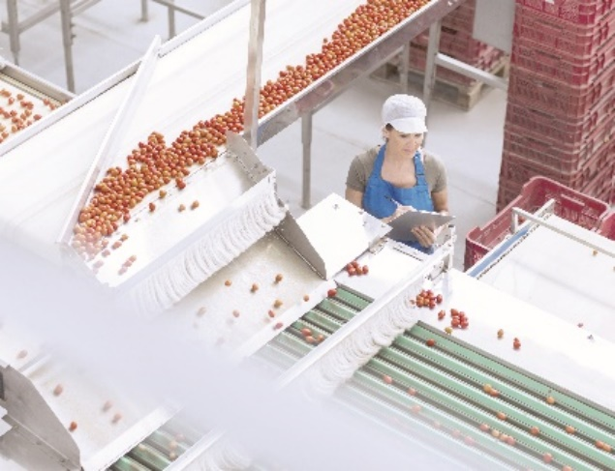
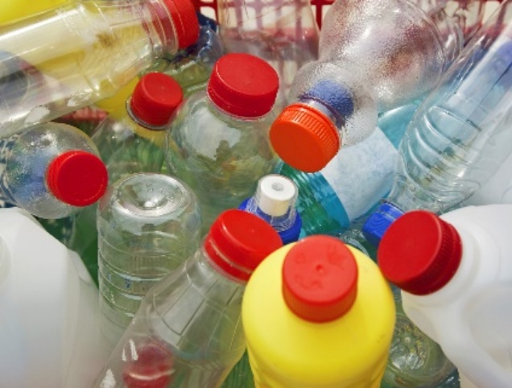
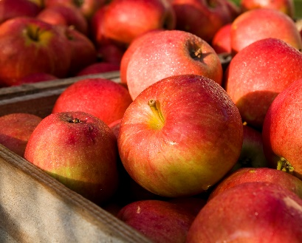
Other applications
Food sorting
Detection ripeness
Detection of impurities, foulness
Recycling
Separation of plastics
Waste separation
Separation of building materials
Agriculture/Farming
Detection of moisture content
Detection of nutriens

Slide 29
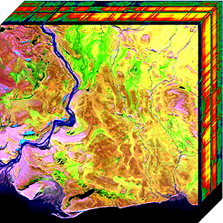
Other applications
Aerial sensing
Mineralogy
Reconnaissance
Space exploration

Slide 30
Video Content

Slide 31
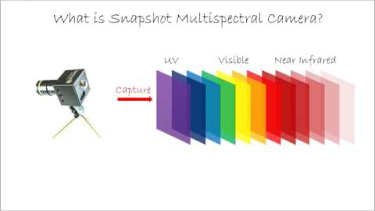
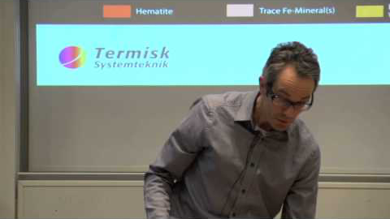
Video content
Multispectral Camera Technology by Spectral Devices Inc.
Multi- and hyper-spectral imaging by Mittuniversitetet

Slide 32
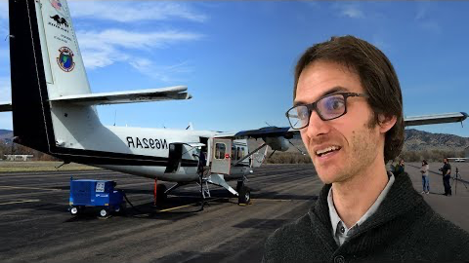
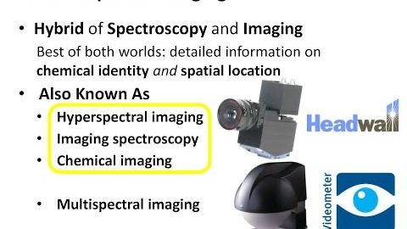
Video Content
Introduction to Hyperspectral Remote Sensing by NEON Science
Multispectral and Hyperspectral Imaging for Plant Science by Analytik Ltd

Slide 33
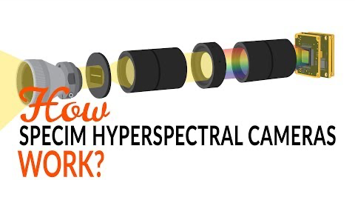
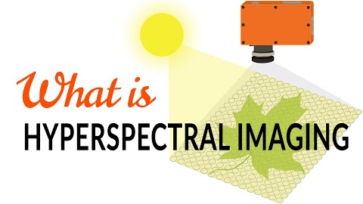
Video Content
How Specim line scan hyperspectral cameras work
What is hyperspectral imaging - Tutorial

Slide 34
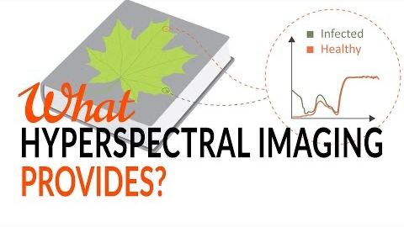

Video Content
What Hyperspectral Imaging provides - Tutorial
How to to know the right wavelength range

Slide 35
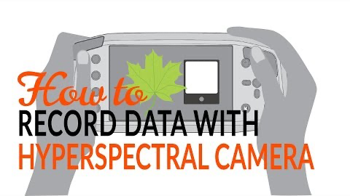
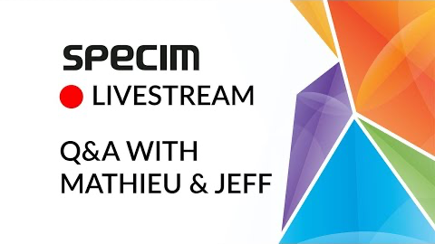
Video Content
How to record data with hyperspectral camera - Tutorial
Sorting food with hyperspectral imaging

Slide 36
Video Content
Sorting plastics with hyperspectral imaging
How to to know the right wavelength range

