Slide 1


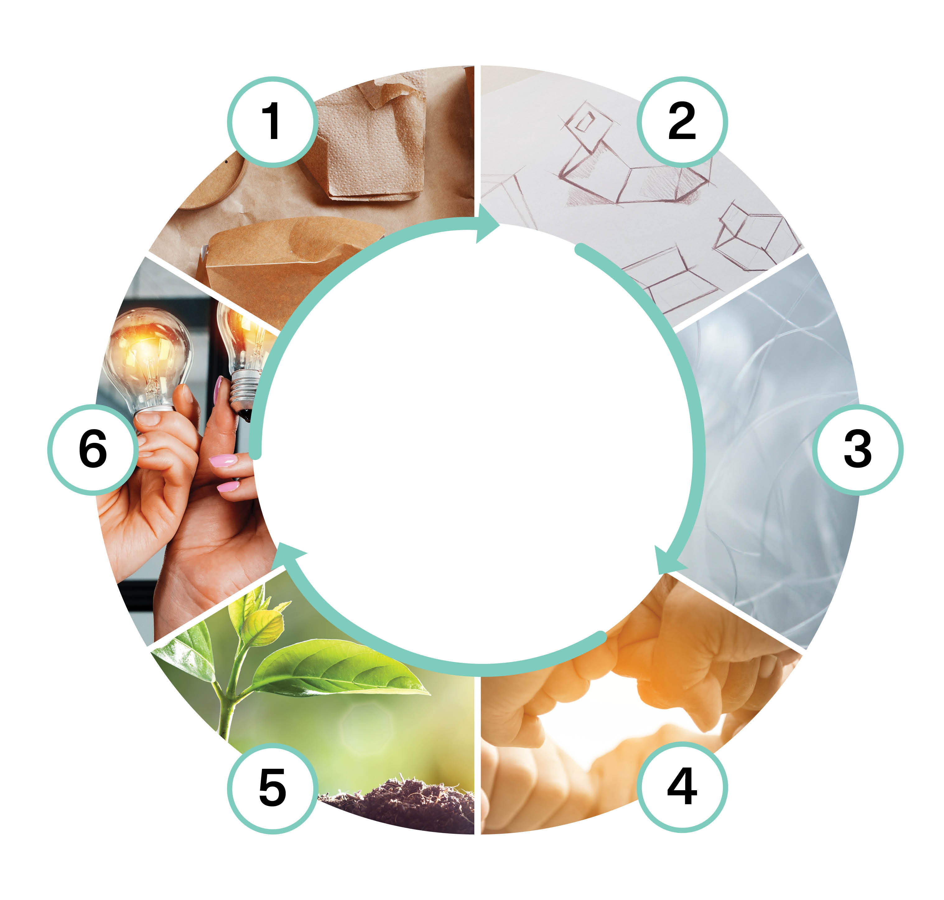

Innovation challenge (5 cr)
Implementation of the course as part of the Packaging Value Chain Circular Economy Expert -training (30 cr)
Markus Jähi
This work is licenced under Creative Commons ByAttribution-Non-commercial-Share-alike 4.0 licence https://creativecommons.org/licenses/by/4.0/

Slide 2
Content
testing innovation techniques
principles of design and innovation management, creative thinking
innovation project in small groups
Key questions:
How different innovation tools can be used when planning and innovating new packaging solutions in line with the CE principles?
How can creative thinking be supported?
What is the importance of cooperation for the creation of innovations?
What is innovation that considers stakeholders and how does it support success?

Slide 3
Learning outcomes
Student
knows how to innovate sustainable solutions in the field of packaging in a team
is able to consider the entire value chain when innovating and developing solutions
understands the importance of a circular economy approach in innovations

Slide 4
Assessment criteria (1/2)
PASS
knows how to innovate sustainable solutions in the field of packaging in a team, presents justified solution options together with the team
develops their interaction skills, knows how to give and receive feedback actively and interactively.
acquires new information and considers the entire value chain when innovating and developing solutions
applies the acquired knowledge, understands the circular economy approach in innovations
understands the importance of their own and the company's development activities in the development of circular economy-based innovations

Slide 5
Assessment criteria (2/2)
FAIL
does not manage the assigned tasks with guidance
does not know how to act as a member of a group
does not take responsibility for their performance

Slide 6
Pedagogical approach
Max 30 students
The implementation of the course includes one face-to-face meeting of 7–8 h and two online meetings of 2–3 h
Knowledge is built communally and independently: communal project learning, working in networks and individual learning flexible of time and place
The course consists of project work in a team, individual assignments, familiarization with background materials, giving peer feedback to another team, and presenting the student’s own project work. Online sessions include supervision discussions. The course is designed to be completed in 5–6 weeks.

Slide 7
Learning assignment descriptions
Introduction to ideation methods
Ideation and definition of evaluation criteria
Idea evaluation and commercialization planning
Peer review
Familiarization with background materials

Slide 8
1. Introduction to ideation methods (1/2)
Individual assignment: search for information on different ideation methods for new products or services.
Based on this, select one method that interests you and learn more about it. Write a short essay-type text about the method in the discussion area of ​​the learning platform. Answer the following questions:
Which method is it and why did you choose it?
How does the method work and how is it used, e.g. what kind of parts or steps does it include, what kind of supporting material is needed, what should the group of participants be like and/or how much time is required to use it?
What kind of use is the method especially suitable for and what are its benefits? What are the challenges associated with the method?
Add a link to at least one online source that explains the method in more detail.

Slide 9
1. Introduction to ideation methods (2/2)
Familiarize yourself with at least two other methods in the discussion area and give feedback on what was particularly interesting about the presented methods.
The total length of the answer is 300-400 words.

Slide 10
2. Ideation and definition of evaluation criteria (1/3)
Description of the project work:
In the project, new circular economy solutions are innovated for a real company.
The work is conducted in two stages:
The first stage focuses on the beginning of the innovation process and testing of different ideation methods, also a set of criteria is designed to evaluate ideas produced
The second stage focuses on the evaluation of ideas and the planning of commercialization (see section 3)
The focal firm can be a group member's own workplace/firm or otherwise interesting company that will be analyzed from outside.
The solutions to be innovated should in some way renew or develop the packaging value chain, but this can happen in many ways, e.g. by renewing products, services, processes, materials and/or business models.
The form of the exercise is a slide set (e.g. PowerPoint). The work requires searching and using source material, e.g. company, industry, competitor, technology, or customer information that supports the conclusions of the work.

Slide 11
2. Ideation and definition of evaluation criteria (2/3)
Content of the 1st stage of the project work:
Search information about the focal firm and describe the current state of the company's business (e.g. business idea, products and services, resources and know-how, applied circular economy business models). After this, think about what are the challenges and opportunities of the company's innovation activities at the moment.
Get to know different ideation methods. Familiarize yourselves with methods shared in the individual assignment.
Try at least three different ideation methods in a group and use them to generate at least 25 new ideas.
List and group the ideas you have produced.
Describe the ideation methods you chose and how you applied them in practice. What worked well? What didn't work?

Slide 12
2. Ideation and definition of evaluation criteria (3/3)
Draw up a criteria table that you would use to evaluate the ideas you have produced. Make use of the content of the different study courses completed and relating lecture materials in a versatile manner.
The table should have at least six criteria and it should show the name of each criterion, detailed criterion description, evaluation scale and description of information needed for the evaluation.

Slide 13
2. Idea evaluation and commercialization planning (1/2)
Content of the 2nd stage of the project work:
Think about what different sources of information you need in order to evaluate ideas and select some of them for further development. Take into account the evaluation criteria you identified in the 1st stage and think more broadly about the commercialization of ideas and business model planning.
After that, draft a list of what you think are the most important sources of information and also add links to online sources. A good list has at least 10–15 sources of information.
Evaluate the ideas you produced in the 1st stage and choose and list the 5 best ideas. Also describe how you did the assessment in practice.
Then, work on the five ideas you have chosen. Refine the concepts so that you can describe for each idea the so-called value proposition.
The value proposition should be a concise, textual description that presents what the solution (innovation) is about, who it is aimed at (customer segments), what are its customer benefits and what is unique about it (i.e. differentiates it from competitors).

Slide 14
2. Idea evaluation and commercialization planning (2/2)
Choose the most potential idea and design a business model for it, using the business model canvas introduced in the Circular economy and business study module.
Fill your canvas by first placing your designed value proposition in the center of the canvas, then fill in the right side, then the left side and finally the bottom. Pay special attention to the key elements of the circular economy and finally highlight the three key elements of the business model.
Finally, consider what kind of commercialization path would be suitable for your solution. Revise the two paths from the readings of the previous study module (A: test and validate and B: vision and road map) and describe how these should be used in implementing your innovation.
Reflection: evaluate your own success in the project work in terms of the final result and teamwork, what went well, what could have been done differently?

Slide 15
3. Peer review
Get to know the other group's project work assigned to your group.
Based on this, discuss your observations in the group and then compile common answers for the collaboration platform:
Summarize in one sentence an overview of the work you have reviewed (overall feedback)?
Highlight three things that you think were particularly interesting and/or innovative in the work and give a brief explanation as to why?
What would you have liked to know more about?
How was the versatility and quality of the source material used and how was the material utilized in the work?
How was the clarity, consistency and quality of the work?
Did anything else come up in the discussion that you would like to highlight in particular?

Slide 16
4. Familiarization with background materials
The Innovation challenge brought together different parts of the entire Packaging value chain circular economy expert studies.
In the project work, the reading materials of all study courses and especially the following materials should be used:
Vehkaperä ym. 2013. Innostu ja innovoi: käsikirja innovaatioprojektiopintoihin [Get inspired and innovate: a handbook for innovation project studies]
Sitra. 2022. Kestävää kasvua kiertotalouden liiketoimintamalleista [Sustainable growth from circular economy business models]
Varma. 2021. Testaa ja kehitä liikeideaasi Business Model Canvas -työkalun avulla [Test and develop your business idea using the Business Model Canvas tool]
Strategyzer. N.d. Business Model Canvas Explained. YouTube video (2min, 20 sec)

Slide 17
The training was funded by EU’s The Recovery and Resilience Facility (RRF), that is the centrepiece of NextGenerationEU. The funding was awarded by SECLE (The Service Centre for Continuous Learning and Employment). It promotes the development of competences of working-age population and the availability of skilled labour. It is steered by the Ministry of Education and Culture, as well as the Ministry of Economic Affairs and Employment.

