Slide 1
Innovative Wood-Based Materials and Products Hydrogels, 3D-Printed Materials, Adhesives and Nutrition
Otto Långvik
otto.langvik@novia.fi
Novia UAS
14.10.2020

Slide 2
Learning outcomes
The student is introduced to basic concepts and definitions regarding wood as a material and the utilization of these materials.
The student identifies different options of how wood can be utilized for new and innovative applications.
The student is introduced to some innovative applications via some case studies.

Slide 3
Implementation
4 x 2h lectures
After each lectures independent work with two home assignments and a weekly test
Lecture slides
Additional material
Language: English

Slide 4
Wood, i.e. lignocellulosic biomass, is a readily available, renewable and sustainable feedstock that can be utilized for innovative materials and products.
A suitable picture here would e.g. be a photo describing a typical Nordic conifer forest in sunshine.
Search for example the pixabay web pages for photo 3410836
https://pixabay.com/ search for
Picture credits: Pixabay, https://pixabay.com/sv/photos/tr%C3%A4d-forest-skogen-s%C3%B6kv%C3%A4g-solljus-3410836/

Slide 5
Content
Background Main components of wood (=lignocellulosic) biomass: polysaccharides and lignin.
Hydrogels What is a hydrogel? What is a hydrogel made of? How can we make hydrogels from Wood? One commercial example of a hydrogel.
3D-printed materials What are the most common printing techniques? What are the material properties needed for 3D printing? What materials and applications are available for 3D printing?
Adhesives Adhesives based on phenolic resins, wood based lignin and other components originating from nature.
Wood as Food Wood based materials with nutritional value. Food from wood?! Utopia or reality? What can we eat? What is healthy to eat? Is this something new? (e.g. carbohydrates, CMC and vanillin).

Slide 6
Background

Slide 7
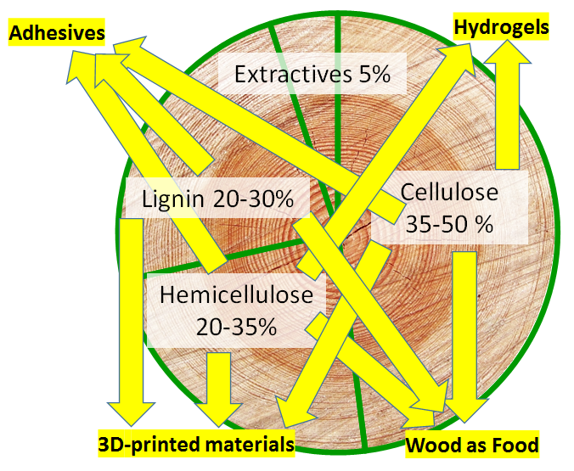
Wood Components
Component | Softwood [%] | Hardwood [%]
Cellulose | 35 – 45 | 35 – 50
Hemicelluloses | 22 – 30 | 20 – 35
-Glucomannans | 11 – 17 | 1 – 4
-Xylans | 6 – 8 | 15 – 25
Lignin | 25 – 30 | 20 – 25
Extractives | 5 | 5
Picture: Otto Långvik

Slide 8
Lignocellulosic biomass and Green Bioeconomy
Wood, i.e. lignocellulose, based materials that are hot topics in academic and industrial research:
Microfibrillated cellulose
Nanocellulose
Lignin
and partly also
Hemicellulose?!
Variation of Cellulose DP
(DP = degree of polymerization)
DPs between 300 – 15 000 are available
Plants normally produce 7 000 – 15 000
Cotton 15 000
Spruce 7 000
Picture describing plant cell wall and how hypothetically the polymer material structures within the plant cell wall are constructed. Also the cellulose microfibril and glucose chain structure. A link to similar picture https://public.ornl.gov/site/gallery/originals/Fig2_Cellulose_Structure_a.jpg

Slide 9
Polymers and polysaccharides, general
Monomer – A single molecular entity that can be combined with other, often identical, units to form a larger chain type, branched or cross-linked entity. [A substance composed of monomer molecules*]
Polymer – Can include identical or different monomer units, e.g. carbohydrates, amino acids, often organic molecules, combined together. Examples: cellulose, PET (=plastic bottles) and DNA strain. [A substance composed of macromolecules*]
Monosaccharide – The smallest possible repeating unit of a sugar molecule (carbohydrate), i.e. a sugar monomer. [A term which includes aldoses, ketoses and a wide variety of derivatives. Derivation includes oxidation, deoxygenation, introduction of other substituents, alkylation and acylation of hydroxy groups, and chain branching.*]
Polysaccharides – A specific group of polymers were several monosaccharide units are combined forming chains of carbohydrates. Examples: cellulose and chitin. [Compounds consisting of a large number of monosaccharides linked glycosidically. This term is commonly used only for those containing more than ten monosaccharide residues. Also called glycans.*]
* IUPAC Gold Book - https://goldbook.iupac.org/

Slide 10
Cellulose
Cellulose is the most common biomaterial on earth. Cellulose is a polysaccharide where the repeating unit is cellobiose, a disaccharide that is constructed of two glucose units.
Picture describing wood structure from meter, cm, mm, µm, nm and molecular scale. Link to a similar picture: https://weidmannfibertechnology.com/wp-content/uploads/2016/12/Aufbau-Holz-neu-1.jpg
Molecule structures: Otto Långvik
References material: Herbert Sixta, Fibres in Wood Matrix Handbook of Pulp, 1, 59, 2006
R. Patt et al., Vom Holz zum Papier Physik unsere Zeit, 23, 129-136, 1992

Slide 11
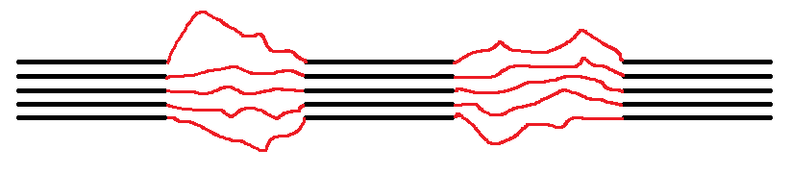
Cellulose
The carbohydrate units in cellulose are D-glucose. These are connected to each other with β(1→4) linkages.
This structure gives rise to very specific and strong hydrogen bonds between the polymer chains.
The hydrogen bonding networks induce crystal and amorphous regions in the fibrils.
Crystalline regions
Amorphous regions
Picture: Otto Långvik

Slide 12
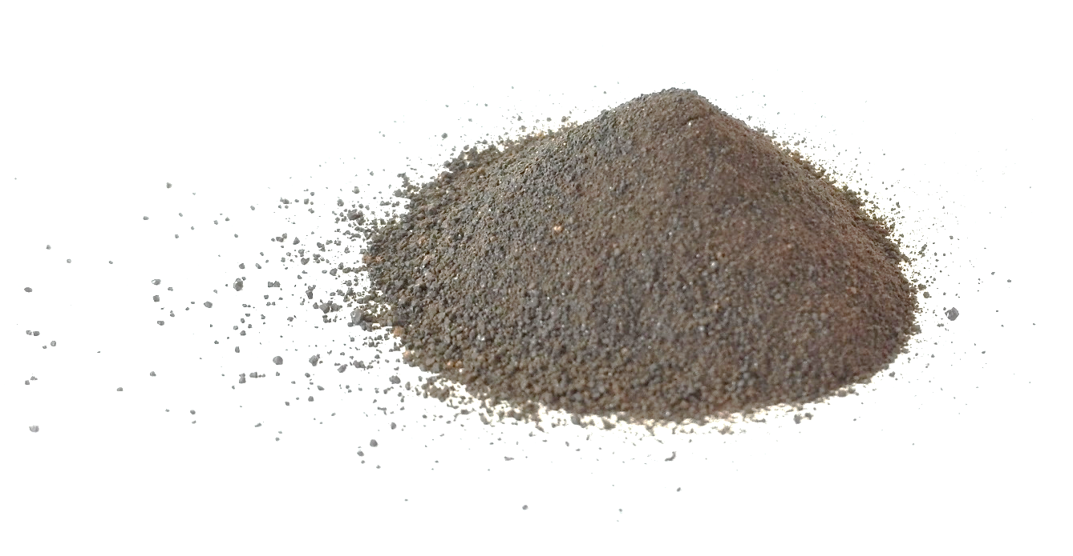
Lignin
Picture and molecule structures by Otto Långvik
Picture describing the structure of lignin.
Link to the picture:
https://upload.wikimedia.org/wikipedia/commons/thumb/e/ee/Lignin_structure.svg/1024px-Lignin_structure.svg.png
The lignin picture in Wikipedia is a CC licensed picture.
GFDL ver. 1.2 or CC-by-sa ver. 2.5, 2.0, and 1.0 lub Public Domain (PD)
Lignin is a complex organic polymer material. Lignin is the key to structural materials supporting the tissues of vascular plants and specific algae. One can say that lignin is the backbone, the skeleton, of plants.
The lignin polymers are very important in the formation of cell walls in wood and bark. Lignin deliver rigidity to the structures. Lignin is also quite resistant towards rotting or decomposition.
Chemically, lignins are cross-linked phenolic polymers.

Slide 13
Hydrogels

Slide 14
Hydrogels, general
Hydrogels are being used in technical applications where their especially huge capacity to absorb water is valuable.
A hydrogel can absorb water 50, or even up to 100, times its dry weight.
Hydrogels are used as absorbent materials, e.g. in diapers.
More advanced and developed absorbents are constantly emerging (medical applications, water purification, cosmetics, medical, etc…).
The hydrophilicity of the polymer network is due to the presence of hydrophilic groups such as -NH₂, -COOH, -OH, -CONH₂, - CONH -, and -SO₃H.
Hydrogels can be made of both natural biopolymers or synthetic materials.

Slide 15
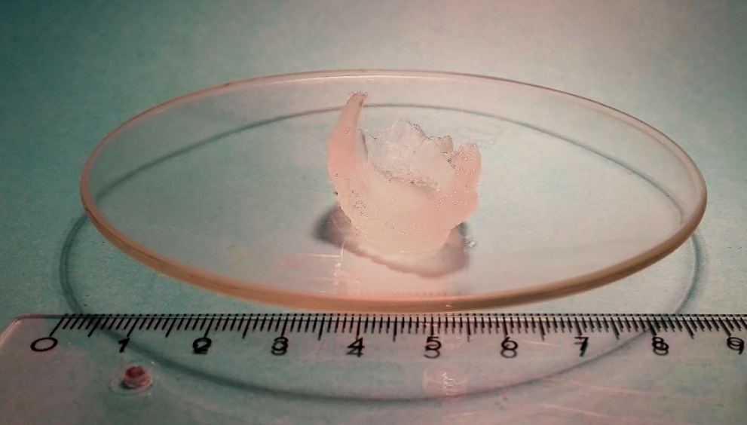
Hydrogels
Definition of hydrogel:
A gel in which the swelling agent is water.*
Notes:
The solid matrix component of a hydrogel is usually a crosslinked polymer network.
A hydrogel in which the network component is a colloidal network may be referred to as an aquagel.
A hydrogel can be made of many different polymeric
constituents and can take many different shapes and forms.
Picture: Otto Långvik
* IUPAC, Gold Book, https://doi.org/10.1351/goldbook.HT07519

Slide 16
Hydrogel swelling in water…
Picture describing the swelling of a hydrogel is found in “Johan Gadolin Process Chemistry Centre”
at Åbo Akademi University
Annual Report 2015-2016
on page 30
Design of Hemicellulose-based Hydrogels for Wastewater Treatment
Daniel Dax, Chunlin Xu, Stefan Willför
Link:
http://web.abo.fi/instut/pcc/Annual%20report%202015-2016%20web1.pdf

Slide 17
How can you make a hydrogel?
Figures describing the synthesis of hydrogels are found in e.g.:
E. Caló, V.V. Khutoryanskiy - European Polymer Journal 65 (2015) 252–267
Link:
https://www.sciencedirect.com/science/article/pii/S0014305714004091
Figures 1 and 2

Slide 18
Hydrogels from Wood
Hemicellulose
Hemicelluloses are regarded to act as compatibilizers between the hydrophilic cellulose fibrils and the hydrophobic and more complex lignin structures in wood.
Hemicelluloses are the component in the wood with the biggest capacity to bind water due their amorphous and hydrophilic nature. This property can be captures and utilized if a hemicellulose feedstock is processed further to a hydrogel.

Slide 19
Hydrogels from Wood
Cellulose
A traditional pulping process produces a non water soluble cellulose fraction. Nevertheless, when cellulose is processed further the affinity to water can be increased by different methods and completely new types of properties are obtained.
Example of two different nano structured cellulose materials:
Micro fibrillated cellulose MFC
Cellulose nano crystals CNC

Slide 20
Where and how can wood-based hydrogels be used?
Similar to the synthetic analogues:
In technical applications as adsorbent materials.
In chemicals/materials, e.g. cosmetics
Due to the Bio-compatibility in biomedical applications:
Contact lenses
Tissue engineering scaffolds
Drug delivery
Cell culture media (UPM: Growdex®)
Novel applications
3D printing

Slide 21
What is growth media
There are two major types of growth medias or applications used. One is for cell cultures and the other is for microbiological purposes.
The microbiological cultures are used e.g. to grow microorganisms e.g. bacteria or fungi. The most common growth media for microorganisms are nutrient broths and agar plates. Agar is a natural polysaccharide found as a supporting structure in the cell walls of certain species of algae. Some organisms require specialized environments due to complex nutritional requirements.
Cell culture is used to study cell related phenomena and for applications in biology and biochemistry. The cell culture is intended for specific cell types derived from plants or animals. Examples of such things are:
Interactions between cells and bacteria or viruses
(viruses require a growth medium containing living cells)
How cells react to pharmaceutical compounds
Sometimes specialized media can be needed for microorganism or cell culture growth.

Slide 22
Nanocellulose
Guidelines for 3D cell culture use
​GrowDex consists of cellulose nanofibrils dispersed in ultra-pure water. GrowDex is a natural, ready to use hydrogel that mimics the extracellular matrix (ECM), supporting cell growth and differentiation with consistent results. No cross- linking step is needed. The product is sterile and can be readily used in various cell culture applications.
Recovering your cells or organoids post culture is a one step process with our GrowDase™ enzyme. GrowDase treatment preserves the 3D structure and does not harm the cells.
Web pages and pictures describing the commercial hydrogel described here to left are found behind the link below.
Link:
https://www.upmbiomedicals.com/for-life-science/growdex-hydrogels/growdex/
Dry content of nanocellulose hydrogel typically approx 1 wt% (max. ~2 wt%)

Slide 23
Additional Material
B. Thomas, M. C. Raj, Athira K. B., Rubiyah M. H., J. Joy, A. Moores, G. L. Drisko, C. Sanchez Nanocellulose, a Versatile Green Platform: From Biosources to Materials and Their Applications Chemical Reviews 2018, 118, 11575–11625
https://pubs.acs.org/doi/10.1021/acs.chemrev.7b00627
X. Shen, J. L. Shamshina, P. Berton, G. Guraucd, R. D. Rogers Hydrogels based on cellulose and chitin: fabrication, properties, and applications Green Chemistry 2016, 18, 53–75 https://pubs.rsc.org/en/content/articlelanding/2016/GC/C5GC02396C#!divAbstract
N.Alam, S. Islam, L. P. Christopher Sustainable Production of Cellulose-Based Hydrogels with Superb Absorbing Potential in Physiological Saline ACS Omega 2019, 4, 9419–9426
https://pubs.acs.org/doi/abs/10.1021/acsomega.9b00651

Slide 24
3D Printed Wood-Based Materials

Slide 25
Different 3D printing techniques
Different 3D printing technologies are e.g.:
Binder Jetting (BJ)
Material Jetting (MJ)
Photopolymer Jetting (PJ)
Electron Beam Melting (EBM)
Fused Deposition Modeling (FDM)
Power Bed Fusion (PBF)
Sheet Lamination
Laser Melting (LM)
Laser Sintering (LS)
Material Jetting (MJ)
Photopolymer Jetting (PJ)
Vat Photopolymerization
Direct Energy deposition
Stereolithography (SL)
Hybrid Processes (HP)
https://makingoftomorrow.com/3d-printing-of-cellulosic-materials/
NOTE! In order to be able to watch the video you need to register!
Length: 45 min + 15 min Qs and As

Slide 26
Fused Deposition Modeling (FDM)
FDM is also known as Fused filament fabrication (FFF)
Introduction video:
https://youtu.be/WHO6G67GJbM
Picture describing the printing technique is found e.g. in:
R. Jerez-Mesa, J.A. Travieso-Rodriguez, X. Corbella, R. Busqué, G. Gomez-Gras Finite element analysis of the thermal behavior of a RepRap 3D printer liquefier Mechatronics 2016, 36, 119-126
What polymers are mentioned in the video?
What is critical property of these polymers?

Slide 27
Thermoplastic polymers
What are the traditional 3D-printed materials made of and what are the suitable printing techniques for such materials? What are the raw-material properties needed?
Definition of Thermoplastic elastomer: “Elastomer comprising a thermoreversible network.”*
Thermoplastic behaviour of a material mean that a polymer can be melted and stiffened several cycles.
Examples of Thermoplastic materials used for FDM are e.g.:
ABS
Polycarbonate
PLA, poly lactic acid
Ultem [Polyetherimide (PEI) and Polyether ether ketone (PEEK)]
* IUPAC Gold Book - https://goldbook.iupac.org/

Slide 28
3D Printed Wood-Based Materials?
Questions:
Are there wood composite filaments available for FDM 3D printers?
Are there readily available biomaterials available for 3D printing?
Can cellulose be 3D-printed?
Answers:
Yes
Yes
Yes
Read and study the additional material

Slide 29
The Wood-Based Raw-Materials for 3D-printing
Which of the three main components in wood are suitable to be used for 3D printing?
Principally all three main components can be used. Cellulose(i.e. nanocellulose), hemicellulose and lignin.
What is required for the wood components to be used for 3D printing?
In order to keep the 3D structure of the in wood component originally applied in the printing process it is often necessary to add some cross linking agents to the matrix.
Read and study the additional material

Slide 30
Additional Material
Useful web material:
Remember to watch the video → https://makingoftomorrow.com/3d-printing-of-cellulosic-materials/
Research publications:
4 A. Le Duigou, M. Castro, R. Bevan, N. Martin 3D printing of wood fibre biocomposites: From mechanical to actuation functionality Materials & Design 2016 96, 106-114,
https://doi.org/10.1016/j.matdes.2016.02.018
5 W. Xu, X. Wang, N. Sandler, S. Willför, C. Xu Three-Dimensional Printing of Wood-Derived Biopolymers: A Review Focused on Biomedical Applications ACS Sustainable Chemistry & Engineering 2018 6 , 5663-5680
https://pubs.acs.org/doi/abs/10.1021/acssuschemeng.7b03924
6 Gilberto Siqueira et al. Cellulose Nanocrystal Inks for 3D Printing of Textured Cellular Architectures Adv. Funct. Mater. 2017, 27, 1604619
https://onlinelibrary.wiley.com/doi/full/10.1002/adfm.201604619

Slide 31
Adhesives

Slide 32
Adhesives, background
Adhesives are substances or chemicals that hold materials together in a functional manner by a close contact surface attachment.
Adhesives or glues originating from the Nature are nothing new. In medieval times texts were decorated with gold leafs that were bonded to the paper by egg white and wooden objects were bonded together with glues from fish, horn or cheese.
The technology of animal and fish glues advanced rapidly during the 18th century. Examples of the later development are rubber- and nitrocellulose-based cements. Those were introduced in the 19th century.
Many of the old and traditional adhesive techniques are based on protein-based materials (often collagen). In contrast theo those techniques the modern glues are often based on organic monomers that are polymerized when cured.

Slide 33
A modern classification of adhesives
Search and clarify the modern classification of adhesives. One helpful source is for example the web pages of “European Phenolic Resins Association” https://epra.eu/en/

Slide 34
Phenolic resins
Basic information on phenolic resins is found for example here: https://epra.eu/en/phenolic-resin/application-areas/adhesives/

Slide 35
Why phenol? Why not lignin?
Phenol is widely used in resin chemistry because of its high reactivity.
Numerous technical adhesives are still based on the ‘phenol formaldehyde resin’ technology.
The aromatic moieties of lignin resemble the phenols structure, especially the para coumaroyl-structure (i.e. the para hydroxy structure).
The Kraft pulping process alters the native lignin structure and increase the condensation resulting in more C-C couplings, decreasing the reactivity of the lignin material.
There are adhesives partially based on wood and lignocellulosic components on the market.

Slide 36
Phenol formaldehyde resin
The reaction of formaldehyde and phenol:
-results in “branching” i.e. crosslinking and gives thus a rigid and durable material
The reactions of lignin with formaldehyde is somewhat limited due to occupied reactive sites for the
The structure and basic information of bakelit is found for example in:
https://en.wikipedia.org/wiki/Phenol_formaldehyde_resin

Slide 37
Lignin
Compare the structures of bakelite and phenol with the structure of lignin.
Less accessible reactive sites
Several reactive sites
Picture and molecules: Otto Långvik

Slide 38
Lignin
From sulfite pulping
Lignin is removed from wood pulp as water soluble lignosulfonates, for which many applications have been proposed. They can for example be used as dispersants, humectants, emulsion stabilizers and sequestrants in water treatment.
From kraft pulping
Lignin removed from the kraft process is usually burned for its fuel value. Nevertheless, two commercial processes exist to remove lignin from black liquor: LignoBoost (Valmet) and LignoForce (Canada).
Lignin possess the potential to become a renewable source of aromatic compounds for the chemical industry.

Slide 39
Lignin adhesives
Large scale isolation of lignin is ongoing:
Search the web for both the of Stora Ensos and UPM Kymmenes commercial alternatives.
Adhesives based on lignin originating from wood can be used in several different types of blends and formulations. Nevertheless fully, 100%, biobased glue applications are still scarce and are often in the need to be improved in order to fully replace modern fossil based applications. This can be studied using the additional material (see next slide)

Slide 40
Other sticky materials in Nature
The resins originating from wood are often used for their sticky properties, a.k.a. tackiness
Most plant resins are composed of terpenes. A terpenoid is an isoprene derivatives. Diterpenoids are constructed of two isoprene units and triperpenoids of three isopreneunits.
Specific components are alpha-pinene, beta-pinene, delta-3 carene, and sabinene, the monocyclic terpenes limonene and terpinolene, and smaller amounts of the tricyclic sesquiterpenes, longifolene, caryophyllene, and delta-cadinene.
Some resins also contain a high proportion of resin acids. A resin acid include a carbocyclic acid functionality.
Rosins on the other hand are less volatile and consist, inter alia, of diterpenes.
A common feature for resins is that they are tacky, sticky and adhere tings together. Nevertheless, applications of resins as glues are limited due to the aging of resins the adhesion features are degrading.
Other natural isoprene is e.g. natural rubber with the main constituent cis-polyisoprene, is still used for some technical purposes due to its special properties.

Slide 41
References / additional material
Nanofibrillar networks enable universal assembly of superstructured particle constructs Sci. Adv. 2020, 6, eaaz7328 DOI: 10.1126/sciadv.aaz7328.
Book Chapter: Lignin-Based Adhesives and Coatings T. A. Khan, J.-H. Lee, H.-J. Kim Lignocellulose for Future Bioeconomy 2019, 153-206 https://doi.org/10.1016/B978-0-12-816354-2.00009-8 .
R. J. Li et al. A lignin-epoxy resin derived from biomass as an alternative to formaldehyde-based wood adhesives Green Chem. 2018, 20, 1459-1466 .
R. Repo et al. Fully quantitative carbon-13 NMR characterization of resol phenol–formaldehyde prepolymer resins Polymer 2004, 45, 33–38 .
H. Pan et al. Synthesis of polymers from organic solvent liquefied biomass Renew. Sust. Energ. Rev. 2011, 15, 3454– 3463 .
A. Effendi et al. Production of renewable phenolic resins by thermochemical conversion of biomass Renew. Sust. Energ. Rev. 2008, 12, 2092–2116 .

Slide 42
Wood as Food

Slide 43
Wood as Food
Nature has provided us throughout our entire human history with numerous materials with various nutritional values and health benefits.
Sustainable food, utopia or reality? What can we eat? What is healthy?
Are there any new innovations within this field?
Has wood and wood based components been used as food earlier and are they still in use?
Here a picture of food ingredients obtained from the forest is highly suitable.

Slide 44
Carbohydrates
The different carbohydrate materials are owning various nutritional values depending on their chemical composition and structure.
Often monosaccharides are more easily accessible for digestion and interaction than the polymeric materials.
The polysaccharides are regularly first hydrolysed, if possible, and secondly available to be absorbed and digested as nutrients.
Human gut is able to hydrolyse the starch polymer (α-linkages) but not the cellulose polymer (β-linkages) because of the different 3D-structure of the glycosidic bond.

Slide 45
Carboxymethyl cellulose
Carboxymethyl cellulose (CMC), sometimes called cellulose gum, is a cellulose derivative where –OH groups are functionalized with carboxymethyl groups (-CH2-COOH) using a simple and effective chemical reaction utilizing an acetic acid derivative (mono-chloroacetic acid).
CMC is often used as its sodium salt, sodium carboxymethyl cellulose.
The functional properties of CMC depend on three things:
the degree of substitution of the cellulose structure (i.e., how many of the hydroxyl groups have taken part in the substitution reaction)
as well as the chain length of the cellulose backbone structure
the degree of clustering of the carboxymethyl substituents.
CMC is used in food under codes E466 or E469 as a viscosity modifier or thickener and to stabilize emulsions in various products including ice cream
CMC have also many other more technical applications

Slide 46
Carbohydrate sweetness
Several of the carbohydrates present in nature, including the carbohydrate fractions in wood are utilized as sweeteners. The relative sweetness of some polyols derived from wood polysaccharides
Fructose
Saccharose
Maltose
Glucose
Galactose
Lactose
Increasing sweetness

Slide 47
Lignin to Vanillin
Vanillin can be, directly after menthol, the aroma compound with the second largest production volume globally.
Here you can study the “Borregaard” concept of the biorefinery and productions of e.g. Vanilline → look e.g. the following video https://youtu.be/nyEu2KJRBeY
Numerous journal articles are discussing the isolation of vanilline from wood-based lignin. Here one revie you can start with:
Vanillin Production from Lignin and Its Use as a Renewable Chemical / ACS Sustainable Chem. Eng. 2016, 4, 35−46

Slide 48
Additional material:
LUKE (Natural Resources Institute Finland) is currently running a project that has the goal to “Transform Wood into Food” LINK.
The project objective is to use saw dust and make high-quality single cell protein for fish feed.

Slide 49
Assignments

Slide 50
Assignment 1 - Biomass
Search the web and browse in scientific articles and define if A), B) or C) below is closest to the annual net growth of cellulose on the earth. Include all biological cellulose sources such as algae, wood, other plants, bacteria etc…
A) 20 000 000 tons / year
B) 200 000 000 000 tons /year
C) 200 000 000 000 000 tons / year
Hint:
The mass of the water in the Baltic sea is approx. 21 000 000 000 tons
The mass of the water in the pacific ocean is approx. 710 000 000 000 000 000 tons
The mass of the planet earth is approx. 5 900 000 000 000 000 000 000 000 tons

Slide 51
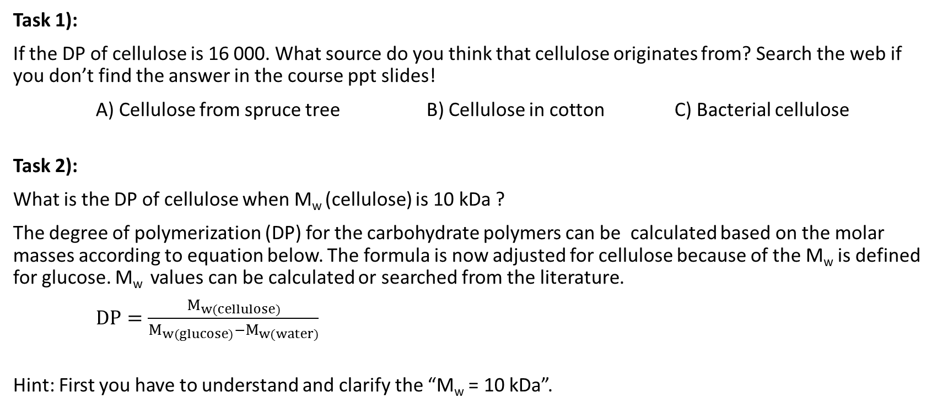
Assignment 2 - Cellulose
Task 1):
If the DP of cellulose is 16 000. What source do you think that cellulose originates from? Search the web if you don’t find the answer in the course ppt slides!
A) Cellulose from spruce tree B) Cellulose in cotton C) Bacterial cellulose
Task 2):
What is the DP of cellulose when M_{w} (cellulose) is 10 kDa ?
The degree of polymerization (DP) for the carbohydrate polymers can be calculated based on the molar masses according to equation below. The formula is now adjusted for cellulose because of the M_{w} is defined for glucose. M_{w} values can be calculated or searched from the literature.
$DP=\frac{M_{w(cellulose)}}{M_{w(glucose)}−M_{w(water)}}$
Hint: First you have to understand and clarify the “M_{w} = 10 kDa”.

Slide 52
Assignment 3 – Nanocellulose
Read the two first chapters in the additional material 1, see link on slide 21.
Write your own explanation describing the difference between CNC and NCF.
The length of your text should be between 300 and 500 words.
Figures and schemes may be included.

Slide 53
Assignment 4 - Hydrogel:
Check the definition of hydrogel and aerogel fron IUPACS good book?
A) What is the difference of hydrogel and aerogel?
B) Can hydrogels be used in the production of aerogels? Explain your answer.

Slide 54
Assignment 5 - MFC:
Our assumption is that the yield of Kraft pulp from dry wood is approximately 40%. Let’s assume that the yield of a chemical treatment, tempo oxidization, of cellulose is 80% after isolation. This gives roughly a 25 to 30 % over all yield of MFC, after all separation and isolation processes.
Your task is to calculate the total net sales value of hydrogel produced from one timber trunk.
The timber trunk used was a big one. It’s weight was 2 500 kg, dry content 60%. The cellulose content in the wood is 40%. The chemical treatment yield is 80%. It is important to note that the dry content in the hydrogel is 1wt%. Let’s assume that the medium list price for the hydrogel is 50 €/2.5 ml, approx. 20 €/g. This is very close to the actual market price of UPM Grow Dex hydrogel.
Use e.g.: https://www.sciencedirect.com/science/article/pii/S0079670017302757
https://shop.upmbiochemicals.com/categories/c9ed648e-af71-4257-8885-2cb21bf56fbf

Slide 55
Assignment 6 – 3D printing:
Open the additional material 5 (slide 28). The publication includes on page 5665 an overview of five different 3D printing techniques. The techniques are illustrated on the previous page.
Which and why of these techniques do you find most interesting and beneficial?
Hint: to make your task more simple. Choose first one specific type of item to print and study the different benefits/drawbacks for the various printing techniques for this specific item/material.
Write your answer and your own opinions, including figures, on one A4 page.

Slide 56
Assignment 7 – Adhesives:
Compare lignin and phenol? List at lest five properties, e.g.: structural, chemical or physical, that are different.
Describe some of the main difficulties with lignin processing? Help can be found in the additional material 8, slide 39.
Explain the meaning of the term “crosslinking” in polymer chemistry.
Text assignment:
Clarify if phenol is fully replaceable with lignin in a formaldehyde type resin. Explain and motivate you answer (200 to 300 words).

Slide 57
Assignment 8 – Wood as Food:
Starch and cellulose nutritional value
Explain the structural difference of the glycosidic bonds and why cows and other ruminants are able to digest grass and hay but humans are not able to do so.
Your answer should be 200 to 300 words long and preferably include figure(s).

Slide 58
Assignment 9 – Wood as Food:
a) CMC, i.e. Carboxymethyl cellulose is widely used in several normal consumer applications.
What field of consumer applications is in everyday use.
Choose one field of consumer applications and list at least five individual products within that filed where CMC is used in.
b) List the E codes available for the polyols (those that are underlined) originating from normal carbohydrates:
Fructose → Mannitol,
Maltose → Maltitol,
Glucose → Sorbitol,
Lactose → Lactitol,
and give one product example for each polyol.

Slide 59
The end of the presentation

