Slide 1
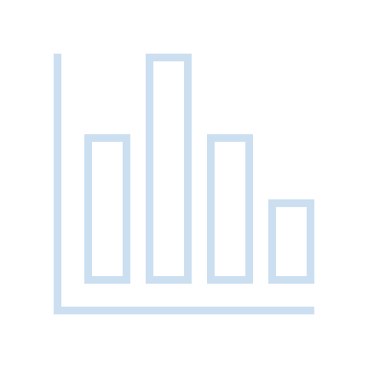
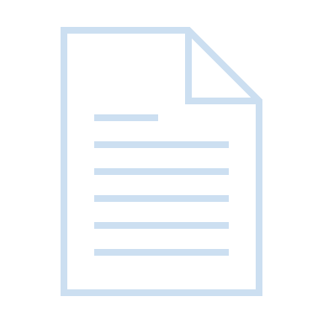
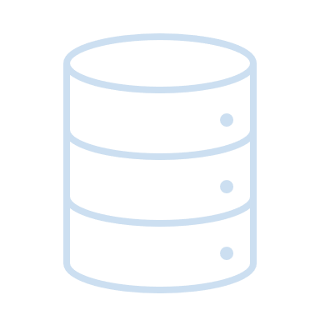
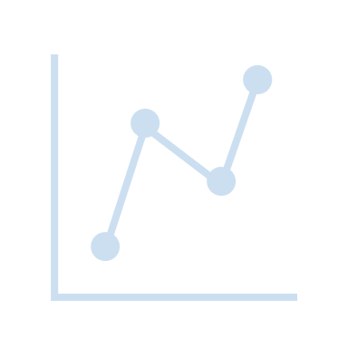
This presentation is a part of Aalto University’s webinar series on Research Data Management & Open Science
Autumn 2021
This work is licensed under a Creative Commons Attribution 4.0 International License.

Slide 2
Introduction to research data management (RDM)
Lucie Hradecká, Dr Kati Laakso, Dr Essi Viitanen Research Services
05.10.2021

Slide 3
Content
What is RDM and what is research data
Why RDM is important
What are the requirements from funders and publishers on RDM
RDM lifecycle
What services Aalto provides for research data management

Slide 4
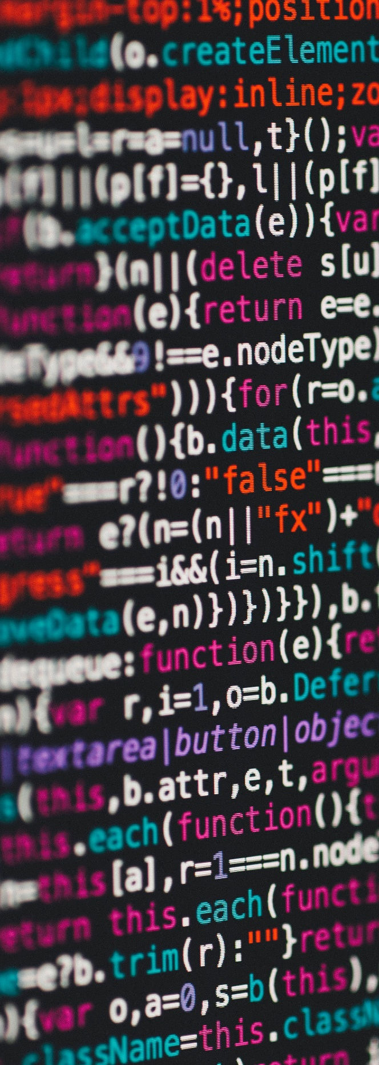
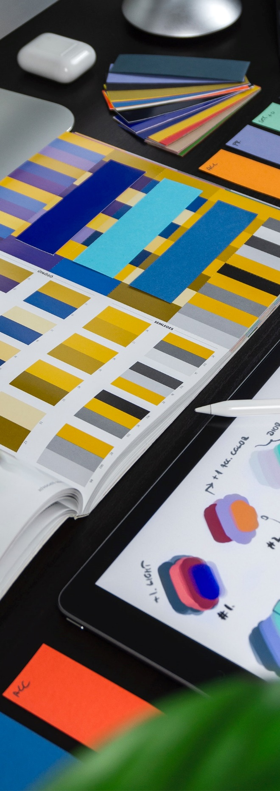
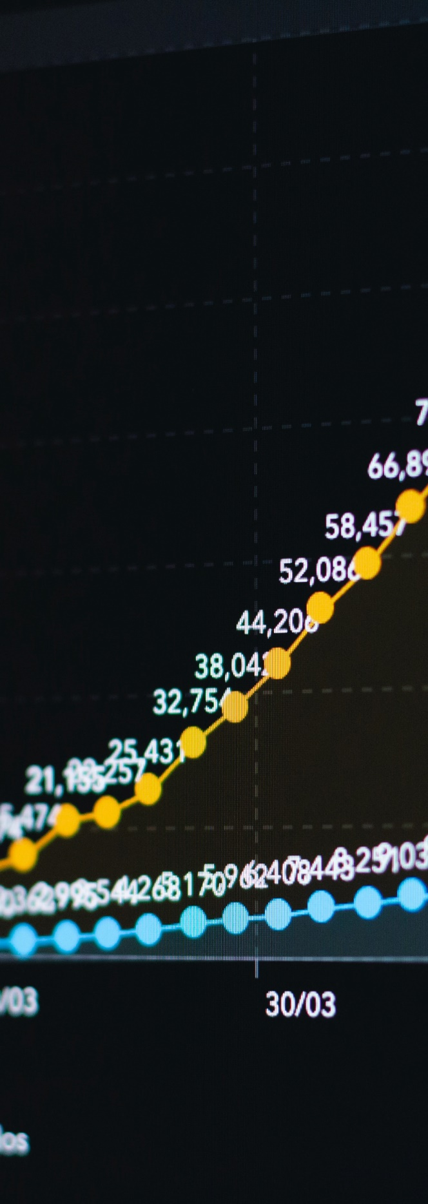
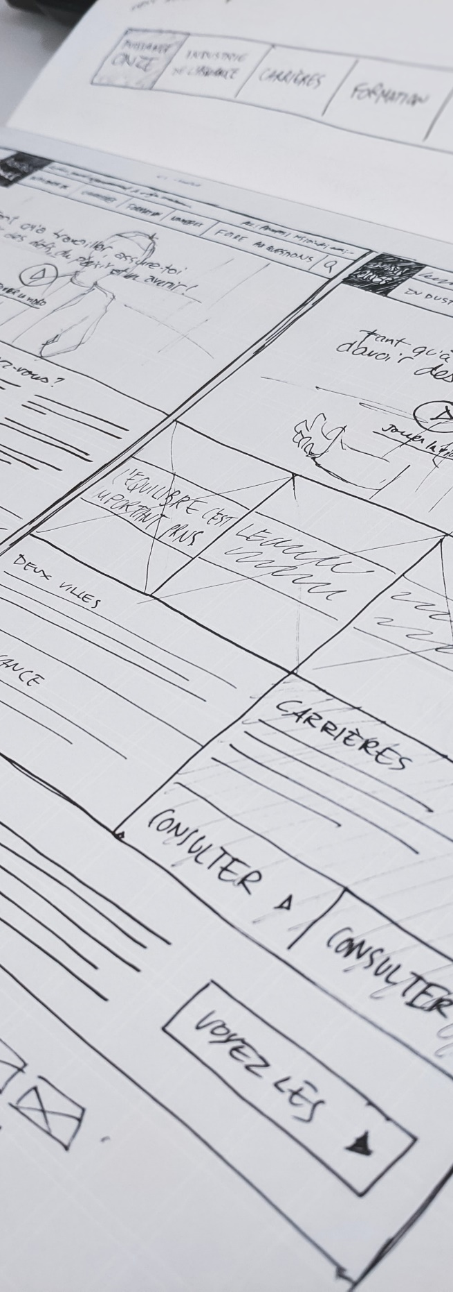
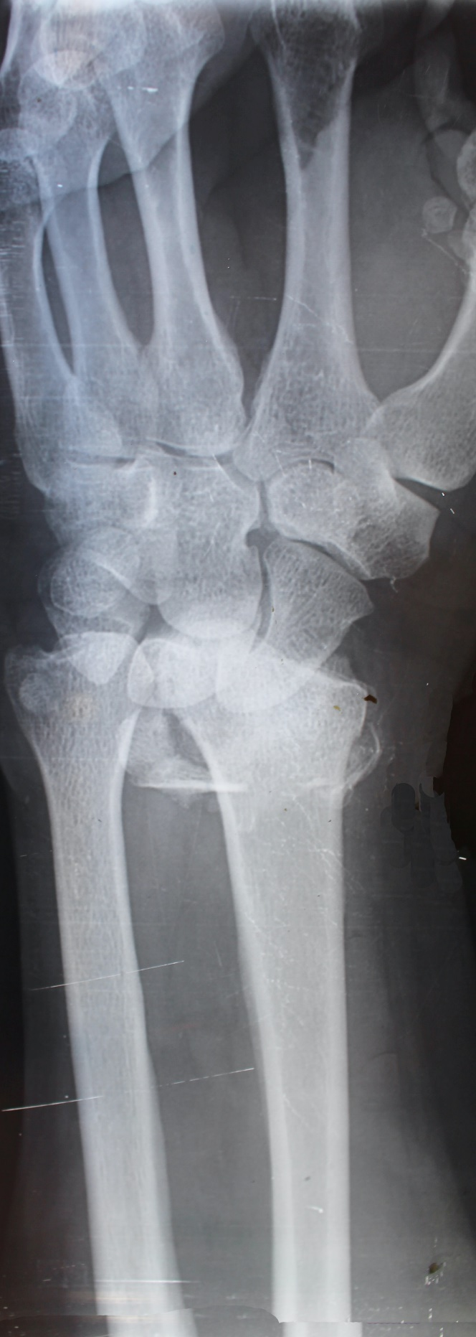
Types of research data
Code, medical data, drawings, statistical models, production processes…

Slide 5
Research Data
is any information that has been collected, observed, generated or created to validate research findings.

Slide 6
Research Data Management
(RDM)
refers to the organization, storage, sharing, and preservation of research data.
Data management practices depend on:
How the data will be generated and what analyzing methods will be used.
What instruments and software will be employed.

Slide 7
Why is RDM important?
It leads to more efficient research practices that will save time for research.
Helps you and your colleagues find, understand and communicate about the data.
Improves transparency and possibilities to verify and reproduce the research results.
Enables the re-use, sharing and opening of data.
Necessary knowledge and skills required in research, scientific and technical organisations and in the companies.

Slide 8
Open Data requirements
Most funders foster open data and good data management practices
It is recommended to open the data always when possible
If you can't open your data, it is recommended that you open at least the metadata
Some journals also demand open data
Academy of Finland and EU Horizon requirements
Data management plan → shows that you can manage your data
Be prepared to publish your data if there are no justified reasons to keep it closed, e.g. data obtained from a company and no right to open it
You will meet these demands by following the Aalto Open Science and Research Policy and Aalto RDM guidelines

Slide 9
The lifecycle of data
Plan
Consider ethics & legal issues
Organize & document
Store & Share
Publish
Report & Archive

Slide 10
Plan
Plan

Slide 11
DMP
(data management plan) describes what kind of data you will generate and how you will handle and manage it.
Write the plan alongside with your research plan before you generate/collect the data.
Pay special attention to the legal and ethical issues if you will
Use/generate personal data
Obtain data from external sources, e.g. companies
Aim at inventions/patents
Why write a DMP?
The plan helps you to be systematic in managing your data and it will save your time.
The funders require plans. Check their guidelines in advance.
Plan

Slide 12
Questions a DMP should answer
Update the plan during the project
What your data is about?
What is the general subject and range or scope?
How will you generate/obtain and process/analyze your data?
How will you describe your data?
What methods you will use? Read-me-file, code-book…?
How will you describe and organise your data?
What are the ethical and legal aspects you should consider and how will you take them into account ?
How will you store and share your data?
Are you going to open your data?
If you open the data, how will you do that?
When you will open the data?
If you don’t open your data what are the reasons?
Plan

Slide 13
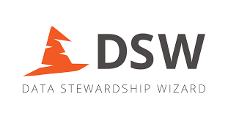
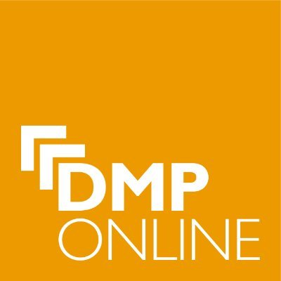
Resources available
Data management planning tools: DMPTuuli Finnish funders’ and general templates
DS Wizard bank of RDM questions
DMP Online by the Digital Curation Centre
Argos by OpenAIRE
Aalto data management planning (DMP) guidelines follow the guidelines and benefit from the DMP templates on the page
DMP review service at Aalto: Send your DMP to researchdata@aalto.fi
Plan

Slide 14
Consider ethics & legal issues
Consider ethics & legal issues

Slide 15
Special data types
Personal data & Sensitive data
Personal data includes information that identifies a person directly or indirectly: name, ID number, location data, IP address, one or more factors specific to the physical, psychological, genetic, cultural or social identity of a natural person
Personal sensitive data: racial or ethnic origin, political opinions, religious or philosophical beliefs, or trade union membership, genetic data, biometric data, data concerning health or data concerning a person's sex life or sexual orientation
Confidential data
E.g. the data is obtained from company and it covers commercial interests and trade secrets.
Take account of the data collection and handling practices based on legislation, agreements and ethical guidelines, e.g., to protect the research participants rights and respect the ownership of data.
Consider ethics & legal issues

Slide 16
Working with personal/ sensitive/ confidential data
Before collecting...
Plan the life cycle of personal data handling.
If you will collect sensitive personal data get an ethical pre-review.
Clarify the procedures you should use to inform research subjects about their rights.
Collecting, storing and sharing...
Use secure online data collection methods.
Use storing and sharing services that suit personal data and enable secure sharing.
Define who has the right to access the data.
Publishing...
Check that you can publish your data.
Prepare your data for publishing, e.g. use anonymizing and pseudonymization methods.
Define access rights in the repository so that they suit to your data.
If you cannot publish the data, you may publish the description of your data.
Consider ethics & legal issues

Slide 17
Guidance on Ethics & Legal issues
Aalto guidelines to meet the ethical and legal requirements.
Handling of personal data,e.g. informing research participants and General guide on personal data and ethics.
Contact Research and Innovation Services’ lawyers and other experts for guidance.
Benefit from the guidelines provided by Finnish Social Science Data Archive (e.g. Anonymization and minimizing the collection of personal information).
The guides and help ensure compliance with legal and ethical rules
EU’s General Data Protection Regulation – GDPR and the Finnish Personal Data Act.
All European Academies, ALLEA’s Code of Conduct for Research Integrity
The Finnish National Board on Research Integrity (TENK)
Responsible conduct of research
Ethical principles of research with human participants and ethical review in the human sciences
Consider ethics & legal issues

Slide 18
Organize & Document
Organize & Document

Slide 19
Why Organize & Document?
Will you understand your data in ~5 years?
Will the group leader understand your data (not even in 5 years, but now)?
Will someone else be able to continue the project in the future based on your data and documentation/metadata?
Ensure that you and others can find, use, and properly cite your data by naming and organizing your data wisely and describing them well
Good documentation decreases the risk of false interpretation of the data
Documenting practices are specific to the field and data
Organize & Document

Slide 20
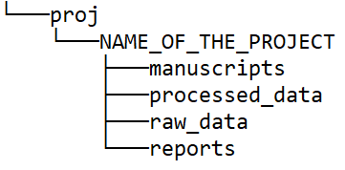
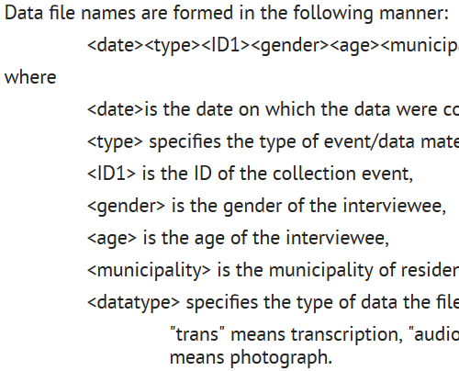
Organize
Folder structure
Develop a logical directory/folder structure
Name folders appropriately.
Separate ongoing and completed work.
Schedule the time when you clean the unnecessary files from folders.
Use consistent file naming conventions
Use meaningful names
Decide which elements should be first to facilitate file finding
Agree on elements: date, experiment name, method, project identifier, version, subset, source identifier etc.
Make a supplementary document describing the naming and structures of folders and files.
File name
2020-04-30_SimulationsCuF_REP_Mikhail_v.1
Supplementary documents
Organize & Document
Example source: Mikhail Kuklin/ Aalto

Slide 21
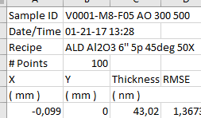
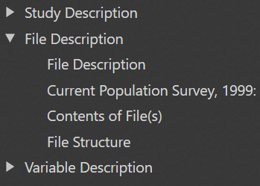
Places for document info
Information included within data files
Variable names in a spreadsheet.
Descriptive headers or summaries.
Descriptive information at the beginning of interviews.
Supplementary documentation
Code book guidance for social, behavioral, and economic sciences by DDIniative. DDI metadata standard.
Readme file example by the Cornell University.
Lab notebooks, e.g. Aalto eNotebook
Metadata standards
The basic bibliographic information about data on data repositories/ archives to upload the data: (title, creators,…)
Disciplinary specific standards to describe data, e.g. DDI, cultural heritage, crystallographic data.
General standards to describe research activity, exchanging, identifying and for general description of research outputs.
Organize & Document

Slide 22
Store & Share
Store & Share

Slide 23
Storing and Sharing
Things to consider:
Is your data being backed up?
Who has access to the data?
Is your data stored safely and securely?
Is it a safe and secure way to share the data?
Check the detailed instructions about the security level of services: Quick guide to information classifications and services
Store & Share

Slide 24
Aalto Network Drive
Large, fast, secure, and backed up
The best place to save working data in Aalto
Like folders in your computer but more secure
Aalto account needed
Remote access with VPN
To get a folder for your group or more space, contact servicedesk@aalto.fi
Suitable for personal and confidential data.
Personal storage space (home.org.aalto.fi)
No sharing
Available to everyone on Aalto workstation.
Departmental storage space (work.org.aalto.fi)
Allows sharing inside department, e.g. share with the supervisor.
Research groups’ storage space (teamwork.org.aalto.fi)
Allows sharing within Aalto
Help: ITS servicedesk & service descriptions for more details.
Storage services for research data
Store & Share

Slide 25
Aalto Cloud Services
Microsoft Teams
Collaboration tool: web meetings, file sharing, etc.
Cloud storage Microsoft OneDrive, Google Drive and Dropbox
Easy sharing of non-confidential data
Use Aalto account to get more space and features.
eDuuni
An e-work and collaboration service environment.
Suitable for personal and confidential data.
Examples:
Interview data containing personal sensitive information or confidential data obtained from a company cannot be stored and shared via cloud services. Solution: Aalto network drives
Experimental data from the lab can be stored and shared via cloud services
Store & Share

Slide 26
Publish
Publish

Slide 27
Publishing your data
Open data is stored and published in a data repository/archive.
Data in the repositories is available to anyone to find and reuse.
The owner of the data decides how open the data will be: open to all; embargoed; open by request
The owner of the data decides what license to use to open the data, e.g. CC license.
WHY PUBLISH Your DATA?
Published data can be re-used easily by others.
Only published data is an independent research output like the scientific article is.
Published data can be cited giving credits to the creators and other contributors.
Citation advantage: Your article gets more citations if you link open data to it
Typically, the funders require open data. Also some journals demand open data.
Publish

Slide 28
Repositories
General repositories cover different types of data and research outputs, e.g.:
Zenodo; European; covers mainly measurement, computational data, code; Aalto guide & ”Upload a dataset” video by Clemens Icheln/ELEC.
EUDAT services; European; Aalto guide.
Fairdata services; National services to store, describe and publish data; Aalto guide.
Domain specific repositories are planned for the specific data type, e.g.
Cambridge repository for crystallographic data
The Finnish Social Science Data Archive - FSD
Catalogue of repositories: http://re3data.org/
FSD
Publish

Slide 29
Examples of published Aalto datasets
Industrial Innovation in Transition - coded interview data (BIZ, Zenodo)
Maps of subjective feelings (Codes, SCI, Zenodo)
USPEX 9.4.4/CRYSTAL17 interface (CHEM, Zenodo)
(Digital) Humanities and Media Labs Around the World (ARTS, Zenodo)
Simulated Self-user Shadowing for Mobile Phone Antennas at 28 GHz and at 60 GHz (ELEC, Zenodo)
Metsähovi Radio Observatory public solar database (ELEC, Fairdata services)
Data from: Forest loss in protected areas and intact forest landscapes: a global analysis (ENG, Dryad)
ActiveAge data (ENG, Zenodo)
Publish

Slide 30
Report your data in ACRIS
Send the link to your published data e.g. in Zenodo to researchdata@aalto.fi and the information about your data will be added to ACRIS, research information system of Aalto
Special case: only the description (metadata) of personal/confidential data will be published -> a requirement in the Academy of Finland funded projects
WHY?
Ensures that your data can be identified like your articles
Maximizes the visibility of your data
You can easily include the data to your CV
The data will be linked to the related articles in ACRIS, and other available research outputs
Publish

Slide 31
Subtitle: Archive
Archive

Slide 32
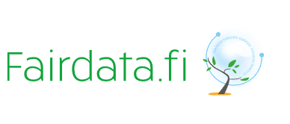
Archive
Concerns the most significant and valuable research data
Data will be archived for a very long period – for decades or centuries
The selection should follow guidelines and criteria, e.g. scientific and/or historical value, uniqueness
The national service for long term preservation in Finland provided by CSC: https://www.fairdata.fi/en/fairdata-pas/
More information: http://www.digitalpreservation.fi/en
Archive

Slide 33
Training available
Themes of upcoming training:
Data Management Plans
Handling of Personal Data
Introduction to Github
Sharing research data through a repository
Working with Restricted Datasets
Data Anonymization
Legal Aspects of Research Data
How to Store Research Data
Making your research/code reproducible and reusable
Academic publishing: PlanS and overlay journals
Further information on RDM trainings and events including previous webinars and materials
RDM Guidelines & other materials: https://www.aalto.fi/RDM

Slide 34
Help available
Data Agents (researchers who advise on research data management)
Raise awareness on RDM
Help figure out where to store your data safely
Advise on where to publish your data (data repositories)
Promote open data and research
Help devise Data Management Plans (DMP) for funders such as Finnish Academy
Are available to help on Zoom Wednesdays 13-14 Email RDM questions to researchdata@aalto.fi Data agents, IT experts, Legal Counsels, Information Specialists

Slide 35
References
Images
Slide 1: Jan Antonin Kola at Unsplash
Slide 4 left to right: Markus Spiske at Unsplash, Cara Shelton at Unsplash, Balazs Ketyi at Unsplash, Kobu Agency at Unsplash, Sigmund at Unsplash
Slide 7: Wonderlane at Unsplash

Slide 36
Thank you!
aalto.fi/en/open-science-and-research

