Slide 1
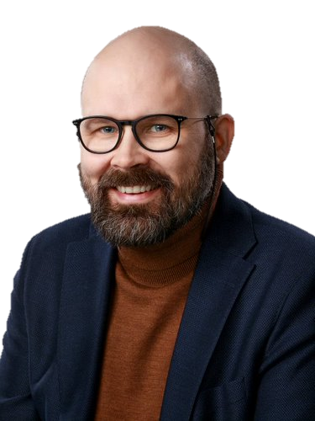
History of Technology Enhanced Learning
Dr. Jari Laru, University Lecturer, Technlogy Enhanced Learning Research Unit for Learning & Educational Technology Faculty of Education University of Oulu

Slide 2
Four views into History of TEL
View 1:Exploring four decades of research in Computers & Education.
View 2: Bridging learning theories and technology-enhanced environments: A critical appraisal of its history
View 3: Four stages of research on the educational use of ubiquitous computing
View 4: Preparing for the digital university: A review of the history and current state of distance, blended, and online learning.

Slide 3
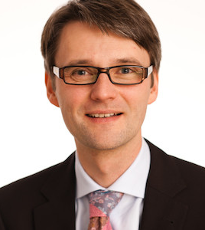
View 1:Exploring four decades of research in Computers & Education.
Zawacki-Richter, O., & Latchem, C. (2018). Exploring four decades of research in Computers & Education. Computers & Education, 122, 136-152.
https://distance-educator.com/exclusive-interview-with-olaf-zawacki-richter-is-professor-of-educational-technology-at-the-university-of-oldenburg-germany/

Slide 4
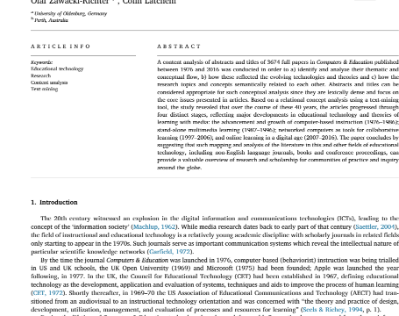
View 1: Exploring four decades of research in Computers & Education.
Zawacki-Richter, O., & Latchem, C. (2018). Exploring four decades of research in Computers & Education. Computers & Education, 122, 136-152.

Slide 5
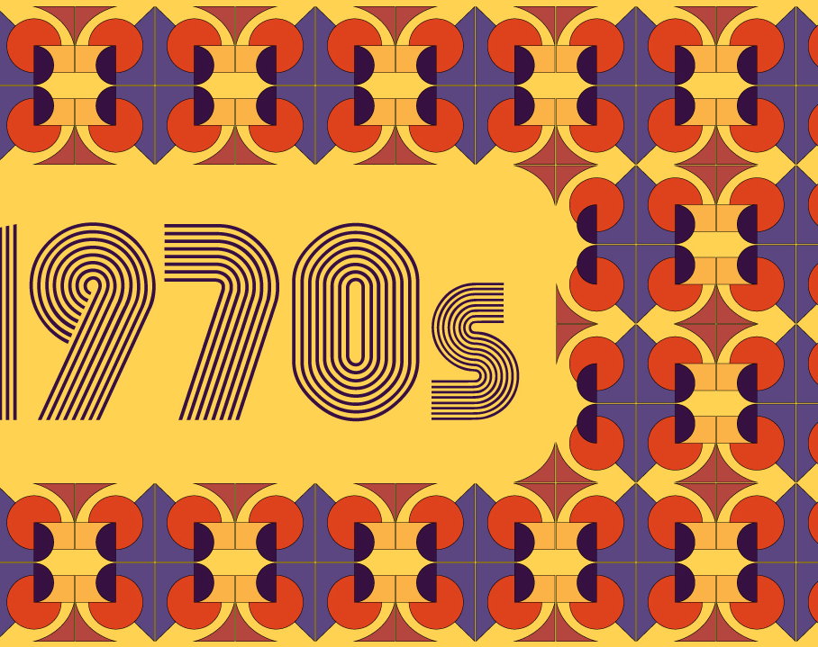
Journal of Computers and Education was launched in 1976
It’s relatively young academic discipline with scholarly journals in relatedfieldsonly starting to appear in the 1970s.

Slide 6
Four decades of research
The advancement and growth of computer-based instruction (1976–1986)
Stand-alone multimedia learning (1987–1996)
Networked computers as tools for collaborative learning (1997–2006)
Online learning in a digital age (2007–2016)
Zawacki-Richter, O., & Latchem, C. (2018). Exploring four decades of research in Computers & Education. Computers & Education, 122, 136-152.

Slide 7
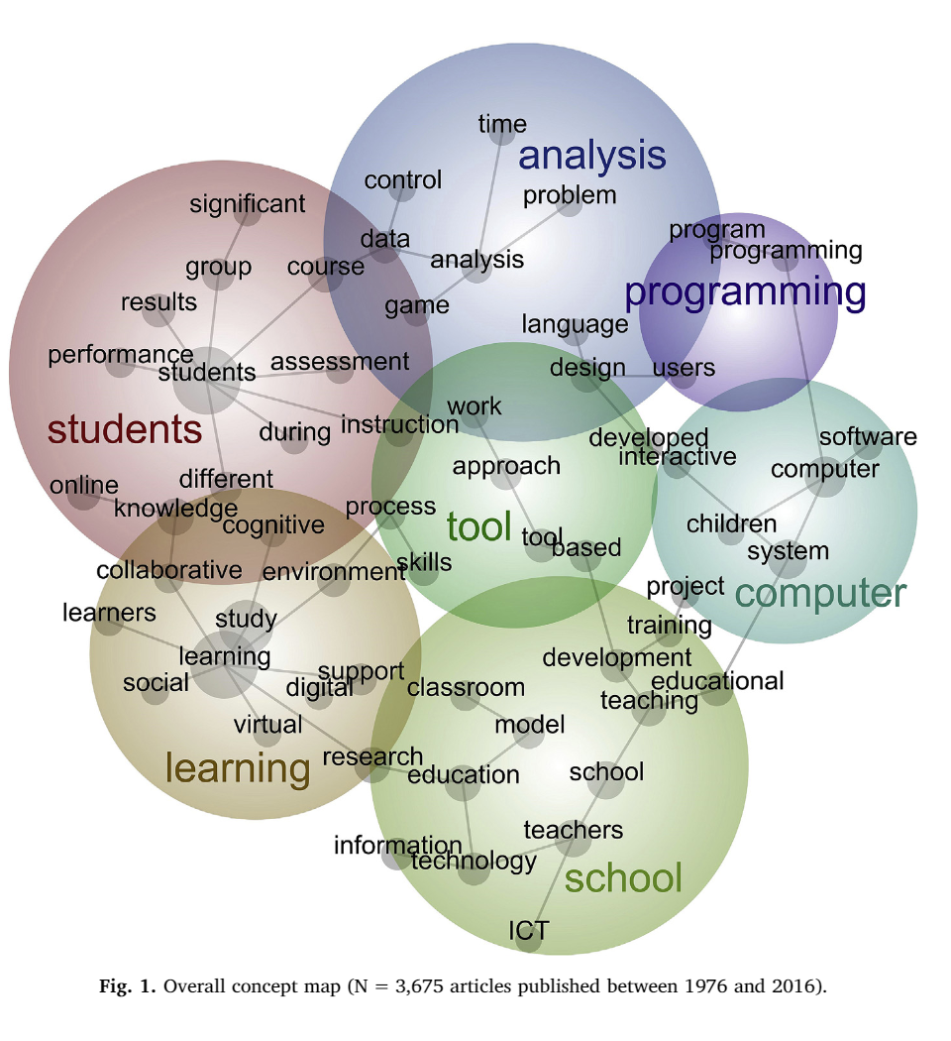
Concept map for the time period between 1976 and 2016
Zawacki-Richter, O., & Latchem, C. (2018). Exploring four decades of research in Computers & Education. Computers & Education, 122, 136-152.
Zawacki-Richter, O., & Latchem, C. (2018). Exploring four decades of research in Computers & Education. Computers & Education, 122, 136-152.

Slide 8
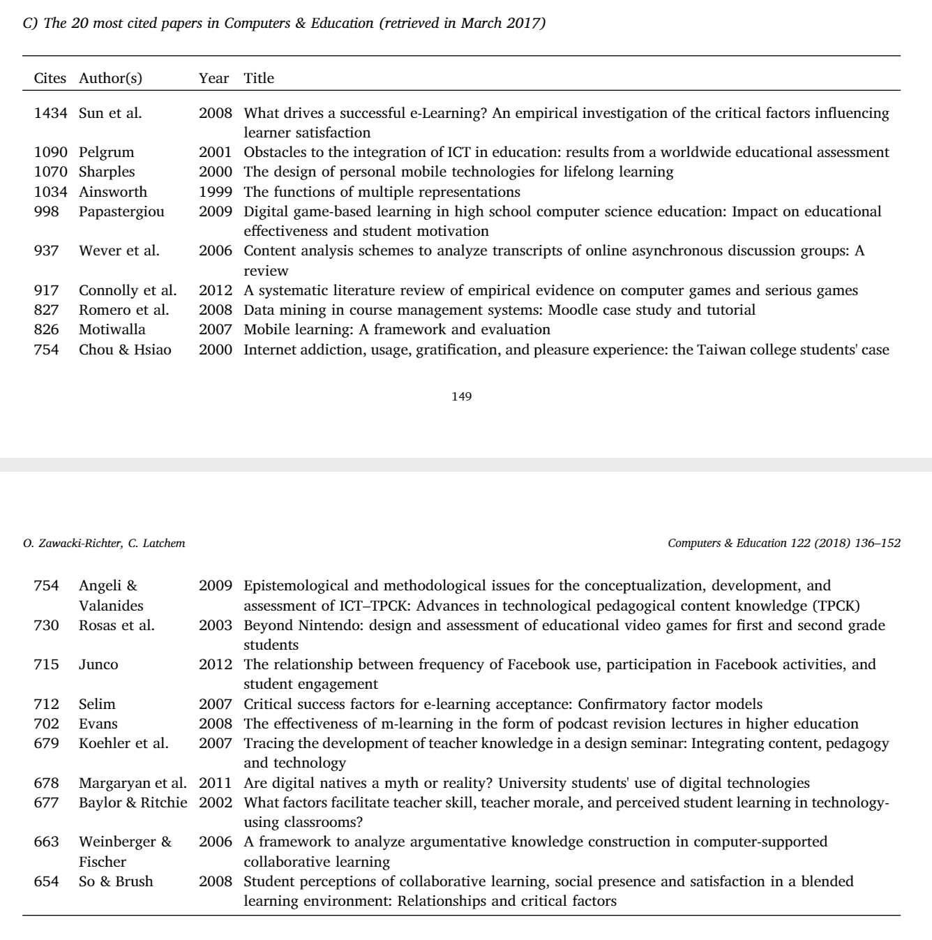
20 most cited papers in Computers & Education
Zawacki-Richter, O., & Latchem, C. (2018). Exploring four decades of research in Computers & Education. Computers & Education, 122, 136-152.

Slide 9
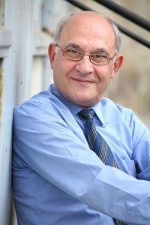
View 2: Bridging learning theories and technology-enhanced environments: A critical appraisal of its history
Lowyck, J. (2014). Bridging learning theories and technology-enhanced environments: A critical appraisal of its history. In Handbook of research on educational communications and technology (pp. 3-20). Springer, New York, NY.

Slide 10
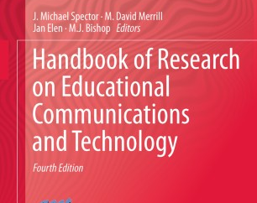
View 2: Bridging learning theories and technology-enhanced environments: A critical appraisal of its history
Lowyck, J. (2014). Bridging learning theories and technology-enhanced environments: A critical appraisal of its history. In Handbook of research on educational communications and technology (pp. 3-20). Springer, New York, NY.

Slide 11
Lowyck’s observations about links between tech and learning theories
Observation 1: Evolutions in Society and Education Have Influenced the Selection and Use of Learning Theories and Technologies
Observation 2: Learning Theories and Technologies Are Situated in a Somewhat Vague Conceptual Field
Observation 3: Learning Theories and Technologies Are Connected and Intertwined by Information Processing and Knowledge Acquisition
Observation 4: Educational Technologies Have Shifted Learner Support from Program or Instructor Control Toward More Shared and Learner Control
Observation 5: Learning Theories and indings Represent a Fuzzy Mixture of Principles and Applications

Slide 12
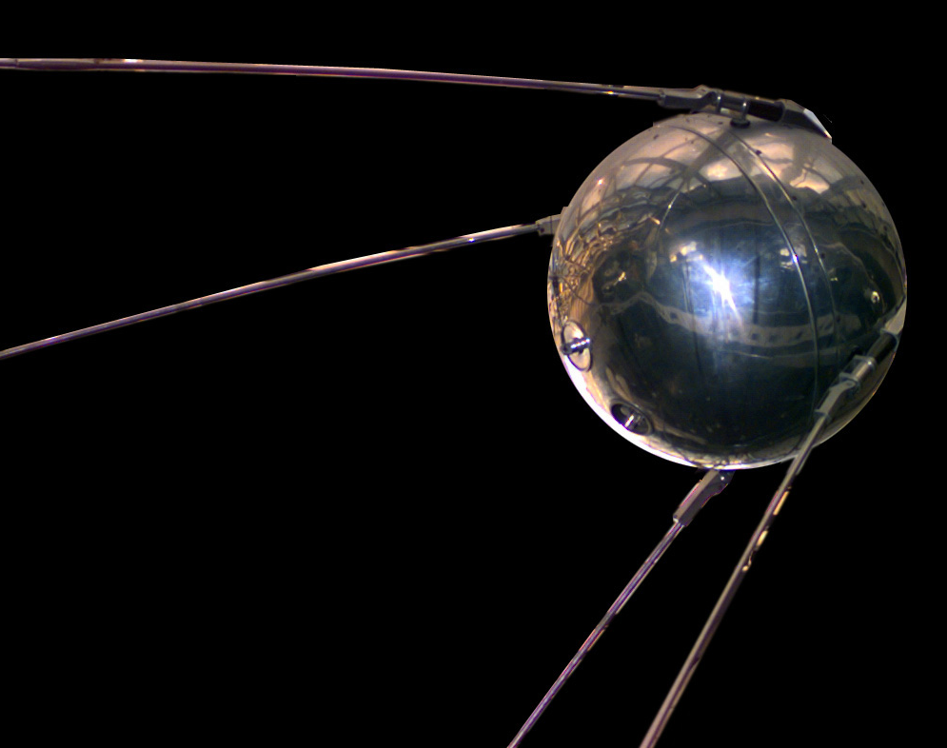
Sputnik shock 1950’s
Observation 1: Evolutions in Society and Education Have Influenced the Selection and Use of Learning Theories and Technologies
Western societes aimed ait improving education quality especially in mathematics and science to compensate supposed failure
Skinner: teaching machine
Computer Aided Instruction (CAI): computers to offer individualized instruction
Behaviorist approaches: display component, response component and feedback component of instruction (Cagne, 1974)

Slide 13
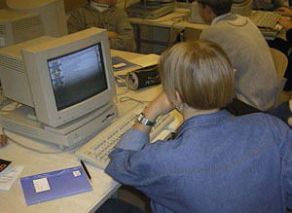
1980’s cognitive orientation
Observation 1: Evolutions in Society and Education Have Influenced the Selection and Use of Learning Theories and Technologies
Western governments were struggling with increasing worldwide competition in commerce
Common understanding of complex issues, deep learning, complex skillsfullnes instead of mere subject-matter delivery was perceived as a strategic approach
=> Micro-worlds, cognitive tools, instructional programans AND network connectivity

Slide 14
Observation 2: Learning Theories and Technologies Are Situated in a Somewhat Vague Conceptual Field
Learning theories, technology and their interlinking fields are dependent on specific research traditions, historical artifacts, idiosyncratic frameworks, technology-based functionalities and pragmatics, which necessarily leads to divergence.
technology allows for methods that would not otherwise be possible..
Educational technology involves a broad variety of modalities, tools, and strategies for learning (Ross, Morrisson, & Lowther, 2010).

Slide 15
Observation 3: Learning Theories and Technologies Are Connected and Intertwined by Information Processing and Knowledge Acquisition
The socio-constructivist perspective and the distributed character of knowledge have influenced computer use since about 1990.
CSCL (computer supported collaborative learning) serves groups of learners who co-construct knowledge in a given subject-matter context and aim at goals that are externally provided.
CSCL technology is used to present or stimulate a problem for study, helping to situate it in a real-world context, mediate communication within and across classrooms, provide archival storage for the products of group work, or enable learners to model their shared understanding of new concepts (
Computer-supported intentional learning environment (CSILE) and its extension Knowledge Forum are instances of CSCL that encourage structured collaborative knowledge-building instead of focusing on individual learning tasks (Scardamalia & Bereiter, 1994).Koschmann, 1996).
https://technologyandteachingandlearning.wordpress.com/scardamalia/

Slide 16
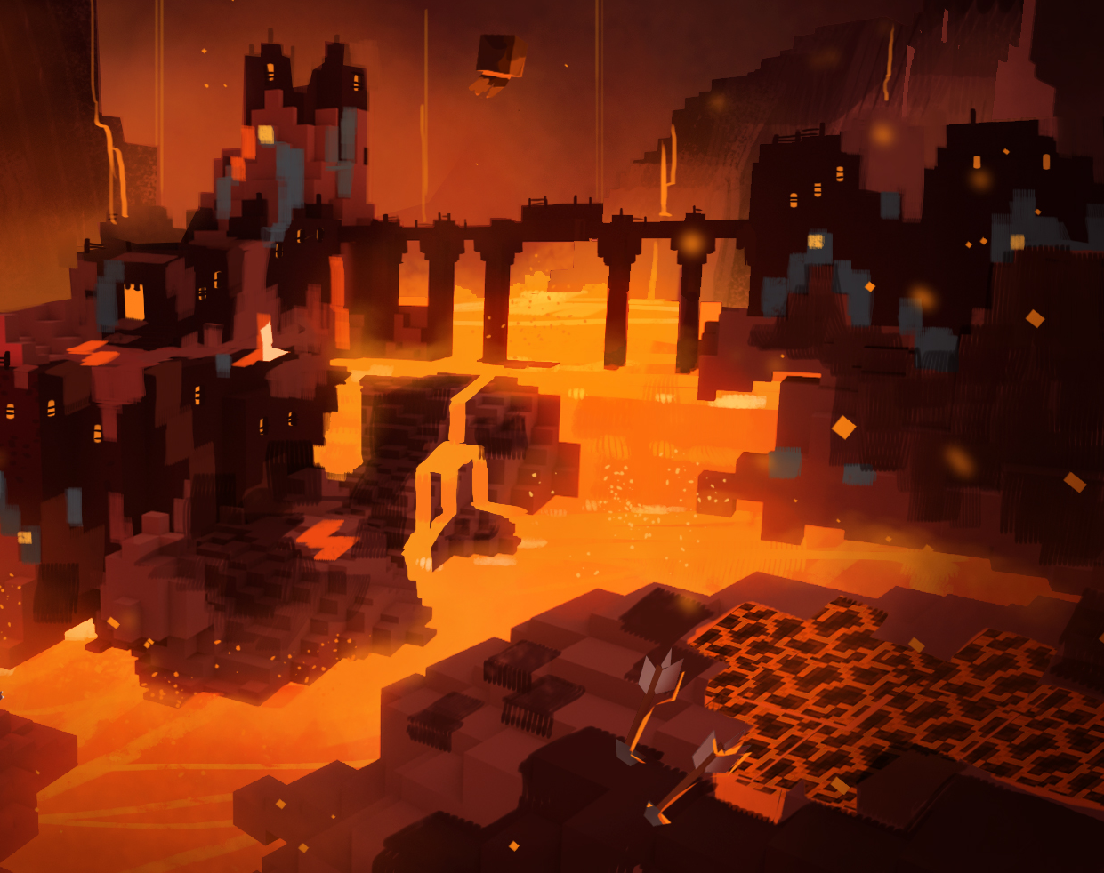
Observation 4: Educational Technologies Have Shifted Learner Support from Program or Instructor Control Toward More Shared and Learner Control

Slide 17
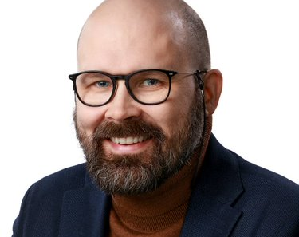
View 3: Four stages of research on the educational use of ubiquitous computing
Laru, J., Näykki, P., & Järvelä, S. (2014). Four stages of research on the educational use of ubiquitous computing. IEEE Transactions on Learning Technologies, 8(1), 69-82.

Slide 18
View 3: Four stages of research on the educational use of ubiquitous computing
Laru, J., Näykki, P., & Järvelä, S. (2014). Four stages of research on the educational use of ubiquitous computing. IEEE Transactions on Learning Technologies, 8(1), 69-82.

Slide 19
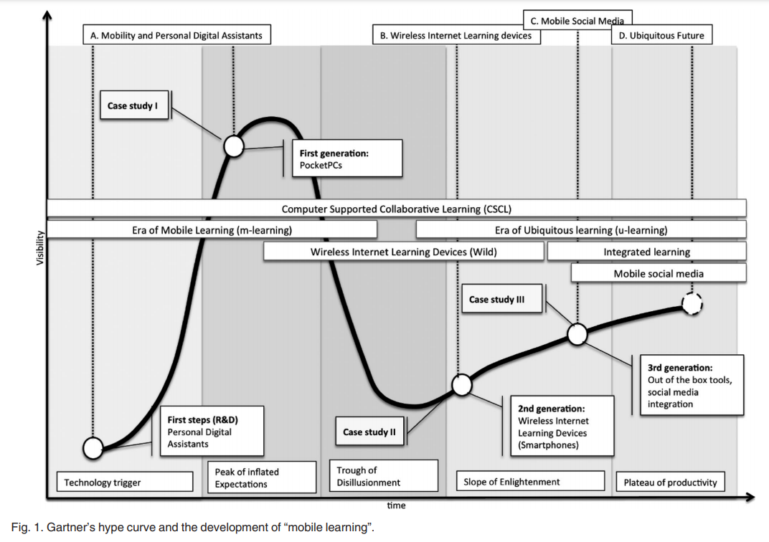
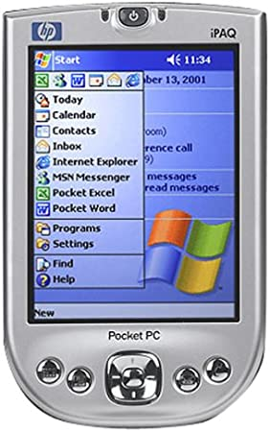
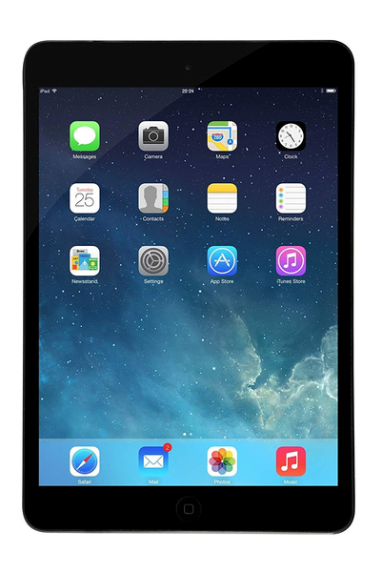
~2000
~2010

Slide 20
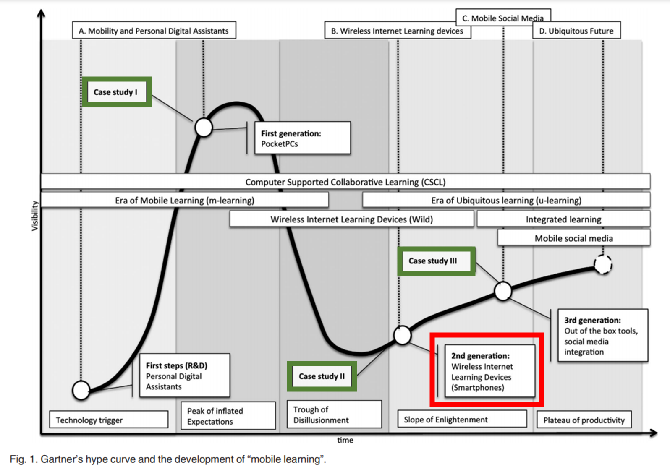
..WILD Application level affordances..
Augmenting physical space with information exchanges
Leveraging topological space, of two distinct kinds
Aggregating coherently across all students participating individually
Conducting classroom performances
Act becomes artifact

Slide 21
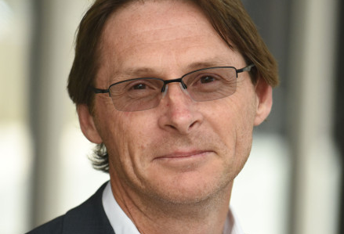
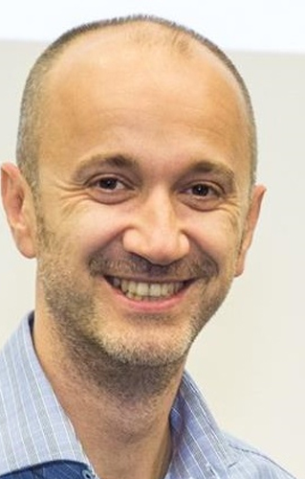
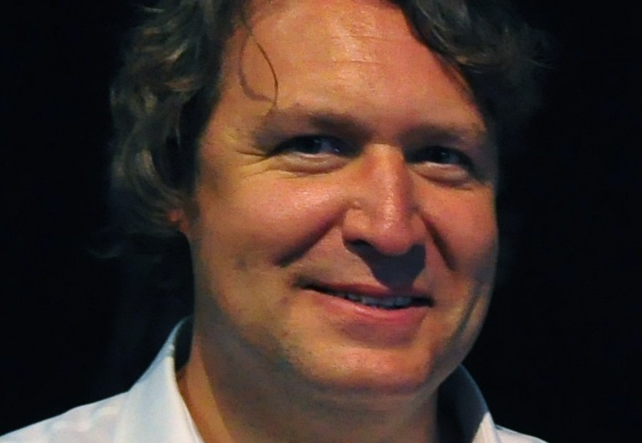
View 4: Preparing for the digital university: A review of the history and current state of distance, blended, and online learning.
Siemens, G., Gašević, D., & Dawson, S. (2015). Preparing for the digital university: A review of the history and current state of distance, blended, and online learning.

Slide 22
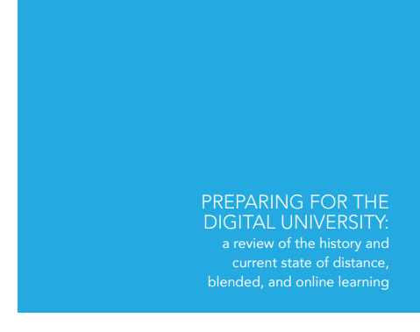
View 4: Preparing for the digital university: A review of the history and current state of distance, blended, and online learning.
Siemens, G., Gašević, D., & Dawson, S. (2015). Preparing for the digital university: A review of the history and current state of distance, blended, and online learning.

Slide 23
This book is good future outlook with views into past
Siemens, G., Gašević, D., & Dawson, S. (2015). Preparing for the digital university: A review of the history and current state of distance, blended, and online learning.

Slide 24
Additional material 1:
History of Educational Technology presentation: https://www.slideshare.net/fvsandoval/history-of-educational-technology

