Slide 1
Service Design & Circular Economy
Henna Knuutila & Riikka Kulmala, Turku University of Applied Sciences
2.11.2020

Slide 2
Content
Course description
Course Structure
Learning objectives
Course evaluation
Description of the course modules
Pre-assignment (1 ECTS)
Introduction to Service Design (2ECTS)
Introduction to Circular Economy (2 ECTS)
Circular Economy & Service Design Project (5 ECTS)

Slide 3
Course Description
Upon successful completion of the course, you have an increased professional knowledge of tools and concepts relevant in building circular economy business models and an appreciation and motivation for working towards a circular economy. You can skillfully work according to service design process and use service design and lean service creation tools and methods to implement circular business models and can act as a valuable part of a team.
The module will start with pre-assignment that will give an introduction to the topics and main concepts in the area.
The Module has three courses:
Orientation to service design & circular economy (1ECTS)
1. Introduction to Service Design (2 ECTS)
2. Introduction to Circular Economy (2 ECTS)
3. Practical work (Project) (5 ECTS)
Each module will be assessed separately.

Slide 4
Learning objectives
After this Service design & Circular economy module student: 1. is able to use service design process and methods in circular economy assignment given in the project part of the course. 2. is able to use circular economy business models in practice. 3. is able to develop customer-/user oriented services and products according to principles of circular economy. 4. is able to use methods of service design in co-creation.

Slide 5
Description of the course modules

Slide 6
Pre-assignment
The pre-assignment will provide an introduction to service design in context of circular economy.
Aim of the pre-assignment is
1) to get oriented to the topic of Circular Economy and Service Design and
2) to get understanding of customer-focused design thinking approach and
3) get acquainted with central concepts in the area.
This pre-assignment is composed of Three topics:
Topic1 : Circular Economy: A) Terms and definitions and B) Me as a consumer
Topic 2: Empathic Design
Topic 3: Innovative Customer Groups
This pre-assignment consist three tasks:
Report (1A) and lifestyle test (1B) related to Topic 1
Test (Quiz) contains 15 multiple choice questions related to Topic 2 and 3.
In order to pass the pre-assignment section, you have to do tasks 1A and 1B and get at least 50% from the Quiz.

Slide 7
Introduction to Service Design 1/2
Introduction to Service design -module is completed as an individual task.
After completing the section "Introduction to Service Design", the student will
name the phases of service design project
explain the main (basic) concepts of service design
recognize the central principles of service design
know why tools of service design is used in different phases of service design project.
be able to name at least two (2) suitable service design tools that can be used in different phases of service design project.

Slide 8
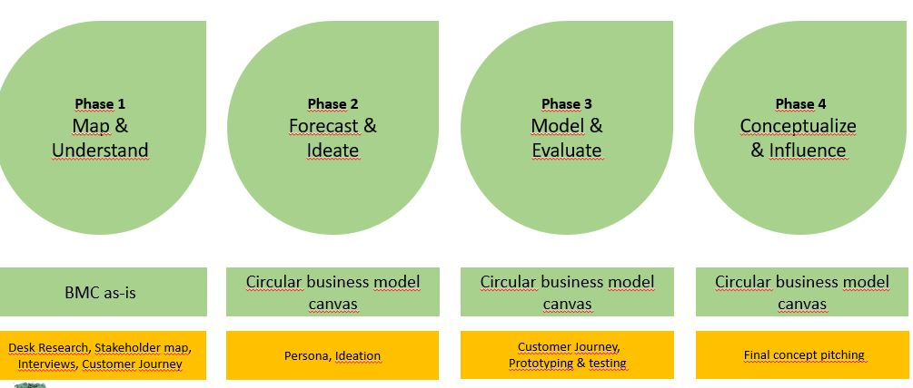
Introduction to Service Design 2/2
. Introduction to Service design section follows the following phases:
Introduction to Service Design will focus in theory of service design process and tools.
Quiz (multiple choice test) is included in each phase and will summarize and finish each phase.
In order to past this module, a student need to get at least 50% of the test points

Slide 9
Introduction to Circular Economy
In this course you will learn the basic principles of Circular economy. You will also learn circular economy model and benefits of circular economy as well as understant circular economy business models
In this course will will use material from Circular.now https://mooc.helsinki.fi/course/view.php?id=118
After getting acquainted with Circular.now introduction material, do the exam (test) and the social media task.
1.Test
(Multiple choice question).
2.Social media task.
The purpose of this exercise is to monitor circular economy discussions in social media (Twitter, Facebook and Linkedin, etc.) for 2 weeks. Pick up topics that interest you in conversations. List 3 most interesting people and 3 most interesting companies. Write why you think these are interesting. Write what you learn from monitoring and conversation. For this two-week period, please remember to ask at least three questions to get answers to your questions.

Slide 10
Service Design & Circular Economy Project
Circular Economy & Service Design project is a team assignment
Objective is to develop a circular economy service concept including a business model
Project includes 4 service design development phases and related project tasks:
1 Map & Understand
2. Forecast & Ideate
3. Prototype & Validate
4. Consept & Influence
Learning Objectives:
Apply service design process and methods in circular economy case
Apply circular economy business models in practise
Develop customer-oriented products, concepts and services for circular economy
Utilize service design methods in co-creation

Slide 11
discussions with the stundents after the video and the article (3h)
what did we learn about the basic concepts
circular economy
Human development
SDGs
dicussion on how do these topics come across in your own study field
discussion: why would these topics be of interest to me personally, to Finland or globally?
discussion: what things should everyone on my study field learn about these issues?

Slide 12
learning diary by the students (14h)
questions recommended for the learning diary
a list of hours spent on the different parts of the course
what were my expectations on the topic?
what did I learn?
what did I not learn?
why was the video made and by whom? Pros and cons of the video?
why was the article made and by whom? Pros and cons of the article?
what would I now tell about the topic to my friends?
what would I like to learn more?

