Slide 1
Secondary products in construction
A PBL approach

Slide 2
Introduction
Please read before the first tutorial the following materials:
Read from the web page of European Union about Construction Products Regulation (CPR) (link: https://ec.europa.eu/growth/sectors/construction/product-regulation_en )
Please familiarize yourself for the following terms
Declaration of Performance and CE marking
Harmonised standards
European assessment document
See also FAQ’s
See also EOTA pages https://www.eota.eu/en-GB/content/home/2/
Find out the national approval methods in Finland
Notes:
For teacher: It is important that students know the basic of the CE marking and understand that alternative procedures may be required when secondary products will be taken in use

Slide 3
Secondary products
What are secondary products in construction?
Secondary product means a product made from recycled material. For example products made from recycled glass or insulation materials. It is usually consuming less raw materials and energy than making a product from virgin raw material
Recycled product means a product that is recycled as a product or material for a new building

Slide 4
Secondary products
Preference in recycling
Use as such
Use as a secondary product
Use as material
Use as energy
(Waste)
The challenge is to go up in preference order!

Slide 5
Introduction - tasks
Answer to the following questions:
What are the key points of the regulation?
What documents are used to specify the requirements for construction products?
Describe the process for European Technical Assessment (ETA).
Does ETA apply for secondary products in the construction? Give some examples.
When national approval can be applied? Give examples.
What are the national approval methods in Finland/in your country?
What are the responsibilities of different stakeholders?
Is it possible to use a recycled product without CE mark for construction?
Notes:
Suomeksi ohjeita löytyy myös https://www.ym.fi/fi-FI/Maankaytto_ja_rakentaminen/Lainsaadanto_ja_ohjeet/Rakennustuotteita_koskeva_lainsaadanto
ks. Myös Tukes http://www.rakennustuoteinfo.fi/

Slide 6
PBL procedure
First Tutorial
Starting Point
Brainstorming
Processing of ideas
Learning needs
Definition of an assignment
Between first and second tutorial students will study the assignment individually
Second Tutorial
Sharing the Learning
Visualized Summary
Notes:
For teacher: you will guide students through the tutorial. You should avoid your interference as much as possible. Guidance is required if the discussion will not start, it will go out of scope or the procedure is not followed.

Slide 7
PBL roles
Chairman: one of the students is the chairman, who will lead the discussion
Secretary: one of the students is the secretary, who will make the notes during brainstorm and processign of ideas
Observer: a student who observes the group activities during tutorials, makes notes of observations and gives oral feedback of each group member’s activity
New student roles for each tutorial
Teacher is the tutor, who observes also, gives guidance if necessary and gives feedback at the end of the tutorial

Slide 8
First tutorial
Please select students to the roles
Starting point presentation

Slide 9
Starting points for first tutorial
Choose one of the following cases
Notes:
You may choose one starting point for each PBL session. In the following there are several starting points according to construction material species. You may also create a starting point of your own that interests you.
Present a case for starting the tutorial. The aim is to have ideas how and where to use recycled material as secondary products for construction or other fields. What is required during demolition to recycle materials? What are the pros and cons? The self-study task could for example consist of the requirements for the waste material, what processing does it require, where it could be used to enhance the recycling, who could receive the demolition waste, who could process the waste and how it should be expressed in demolition plans.

Slide 10
Case Building Boards
Saint-Gobain Finland Oy manufactures plasterboard for construction. The company has developed a process to recycle gypsum boards to manufacture new boards by using partly externally recycled gypsum material. At the moment about 20 % of the raw material is recycled. There are some purity requirements for the material. The company is planning to increase the proportion of recycled material in its raw material.
Notes:
For teacher: find out what are the requirements for the recycled raw material and how could they be fulfilled in the building or demolition site better than today. What would it require and how could it be developed? You may find more information from the web pages of the above mentioned company.

Slide 11
Case Foam Glass
Foamglass material consists of light pebbles made from recycled glass
Also foam glass boards may be manufactured
Material is used both infrastructure and housebuilding
It can be recycled further as such
Foamglass material has also insulating properties
Raw material for foam glass production is an issue
Notes:
For teacher: find a picture from foam glass

Slide 12
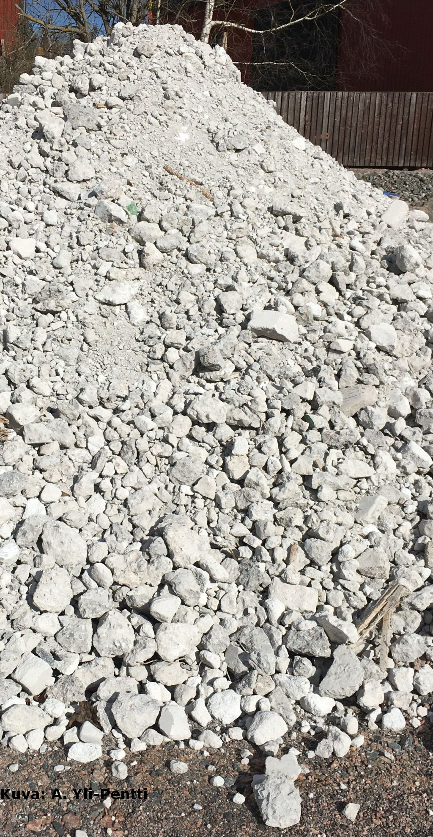
Case Concrete
Concrete manufacturing causes about 7 % of world CO₂ emissions
Demolition material may be recycled
Crushing and use in infrastructure and soil construction
Using as raw material in concrete production
Using as raw material in cement production?
Using as stone material in a building site
Solving practical problems require good coordination during demolition design

Slide 13
Brainstorming
Participants create ideas based on the starting point
Secretary will write them down on whiteboard. No argumentation nor criticism at this stage.
Chairman will check that the ideas will be registered and understood correctly

Slide 14
Processing of Ideas
The group members make a systematic inventory of the ideas and proposals created during brainstorm
Now it is time for argumentation and critical discussion
Each member will choose 1-3 subjects for further processing

Slide 15
Learning needs
The group will select the most popular subjects for common processing. Vote if necessary.
Please discuss what the group already knows about those topics and what are the biggest shortages of knowledge that need more to learn

Slide 16
Learning assignments
At the end of first session the PBL group will formulate the learning goals defined in the previous step as a learning assignment
The group will decide in what form they are going to return the answer for the assignment
The assignment will be formulated as a question (or question + subquestions)
Everyone will study the assignment individually
Tutor will guide the group about information sources

Slide 17
Feedback
The observer gives fedback for each group member individually
The activities of the tutor will also be evaluated
Feedback is given on performance and participation in the tutorial
Do not evaluate individuals or their identity
After feedback of the observer the other members may comment
When you already have done PBL-cycles with the group, you may agree before the cycle what you will observe

Slide 18
SELF-STUDY
You should study and report the PBL assignment before second tutorial. You should also read the reports of other members before second tutorial.
Notes:
Students should do the study mostly individually, however gathering of information may be done in pairs or small groups. Everyone should get the basic information. Suitable information sources are lectures, rehearsals, books and other learning material, internet sources, interviews etc.

Slide 19
Second tutorial

Slide 20
Sharing the learning
Report the learning assignment and study other students reports before the tutorial
Select students to the roles for the second tutorial
Share the learning by discussing the outcome of the learning assignments
Each student gives highlights of their answer
Discussion after highlights; argumentation and reasoning is important
Secretary will write down the main points of discussion

Slide 21
Visualized Summary
The group will summarize the learning outcome and agree the way to visualize the results
The connection of the outcome to the starting point and problem is important
Visualization may be used to modeling
Notes:
A summary may be a chart, mind-map etc. Also a technical model or process chart may be used. Visualization helps memorizing the subject.

