Slide 1







Taking neurodiversity into account in daily general upper secondary school teaching

Slide 2
Structure of the material and greetings from the authors
This material was produced during the 2024–2025 school year by a multidisciplinary working group in a project focusing on support for learning in general upper secondary education funded by the Finnish National Agency for Education. The material is part of the implementation of the support for learning reform. The aim of the material is to help general upper secondary school subject teachers to support the comprehensive wellbeing and learning of different learners.
The themes highlighted in the material, such as interaction, peer relationships and the development of clear teaching practices, support the learning of all students, but are of particular benefit to neurodivergent students.
The material is structured around five different introductory videos, the content of which is briefly summarised on slide 3.
Examples of how to use the material can be found on slides 89–92.
We hope that the material gives you insights and inspires fruitful discussion!
Best regards,
Teija Ekholm, school social worker; Sanna Kattelus-Mäkisalo, project planner;
Arja Kuisma, special educational needs teacher; Kati Leinonen, project planner; Maria Mattsson, psychologist; Saila Sutela, psychologist; and Elina Viljavuori, specialist

Slide 3
Introductory videos and material - catering for different types of learners
Introductory video | Content of the material
Neurodiversity in the work of subject teachers Slide 5 | Neurodiversity The role of the teacher in learning and wellbeing SchoolWell study Supporting a safe group environment Multidisciplinary cooperation within schools Neuropsychiatric coaches in general upper secondary school Activity cards for teachers
General upper secondary school students' thoughts for subject teachers Slide 29 | The support for learning reform and accessibility The importance of peer relationships School and study engagement Activity cards for students Tips for grouping
The neuropsychological perspective Slide 47 | A brain-friendly lesson plan A sensory-friendly learning environment Brain-friendly assessment and support for emotional regulation
The importance of cooperation with networks and guardians Slide 63 | Cooperation with networks Cooperation with guardians Example cases to support your work
Thoughts from experts by experience for subject teachers Slide 78 | The study ability model Comprehensive wellbeing; the Wellbeing together model Character strengths and noticing the good The benefits of physical activity and the mini-intervention model for promoting physical activity
Appendices slide 88 and the pedagogy of hope slide 94 | The pedagogy of hope underpins both the support for learning reform and the content of this material.
Notes:
Sarkainasetukset materiaalin sisällön kohdalla

Slide 4
Part 1 Neurodiversity in the classroom
The aim of this part is to help you identify what is meant by neurodiversity and how it can manifest in the classroom.
The material also aims to share good practices in teaching and interdisciplinary cooperation that have been found to be effective from the perspective of neurodiversity.

Slide 5



in Finnish with English subtitles
in Finnish with English subtitles
Supporting questions for the introductory video slide 6
Tips, examples and material to support teaching
Co-teaching and pedagogical discussion structure (special educational needs teacher and subject teacher) slides 21–22
Activity cards for teachers slides 23–27
Introductory video Neurodiversity in the work of subject teachers (in Finnish with English subtitles)
Information
Neurodiversity slides 7-11
The role of the teacher in learning and wellbeing slides 12–14
The SchoolWell study slide 15
Supporting a safe group environment slides 16–17
Multidisciplinary cooperation within schools slide 18
Neuropsychiatric coaches in general upper secondary school slide 19
Subject teaching supported by a special educational needs teacher slide 20
Topical links (can be added by the facilitator)
For example
ADHD Association in Finland: Aikuisen arki toimimaan (“Making everyday life work as an adult”)
Neuromoninaisuutta tukemassa – Työkaluja kouluympäristön kehittämiseen – (“Supporting neurodiversity – Tools for developing the school environment”)
Autism Finland: Autismi eri elämänvaiheissa (“Autism at different stages of life”)

Slide 6
Supporting questions for the introductory video
How does neurodiversity manifest in your classroom?
How do you identify and take into account the different skills and needs of students?
What does structure mean in your teaching?
How do you acknowledge students’ successes and encourage them to study?
Who can you turn to for support when it comes to supporting students?

Slide 7
Neurodiversity
No two brains are exactly alike, and there is no such thing as an average brain, so in a sense, all people are neurodiverse.
Neurodiversity is always relative to the environment; before modern times, a person with ADHD could have been a great hunter, for example, and not had any behavioural problems.
However, the demands of modern society can cause problems: moving quickly from one place to another, concentrating and adapting to new situations.
Nowadays, there is also talk about attention deficit trait, or ADT. ADT can be caused by things like a busy everyday life, the demands of studies or work and heavy use of smart devices. ADT is not a medical diagnosis.
Neurodivergent people usually stand out because their brains and nervous systems work differently from what the environment expects.

Slide 8
Neurodiversity – terminology and concepts
Neurotypical
The person’s brain structure and nervous system are typically developed.
There is usually no great variation in the person’s behaviour from one situation to another.
Neurodivergent
Divergence in brain function and the nervous system.
Developmental and congenital characteristics and syndromes.
Almost everyone has neurodivergent traits that do not cause challenges or do not meet diagnostic criteria.
ADT attention deficit trait
ADHD, autism spectrum disorder, specific or extensive learning difficulties, dyslexia, Tourette's, schizophrenia, epilepsy

Slide 9
Neurodiversity and adolescence
Adolescence is always a turbulent time, but for neurodivergent individuals, the challenges may be greater or manifest differently.
Hormonal, social and brain developmental changes → harder to regulate emotions, motivation and stress.
Social needs: emphasis on individuality vs. similarity with others.
Maturation can be slower in some areas.
The wellbeing of neurodivergent individuals is affected by the environment and context; in a typical educational setting, their difficulties may be more pronounced.
Awareness can support the needs of neurodivergent students and help them to analyse their strengths despite difficulties.

Slide 10
How can neurodiversity manifest during lessons?
Difficulties with executive functions: planning, starting, progressing through tasks
Concentration: restless behaviour or, on the other hand, daydreaming
Time management: difficulties anticipating things, leaving things to the last minute, being late
Circadian rhythm: variations in arousal, staying up at night, difficulties sleeping
Working memory: forgetfulness, slowness, automation difficulties ("I forgot again")
Emotion regulation: anxiety, nervousness, accepting criticism, over-interpreting other people
Sensitivity to stress and need for support

Slide 11

Strengths associated with neurodivergence can include
good memory for things that the person is interested in
eye for details
strong sense of justice
thoroughness
in-depth knowledge of interests
loyalty to friends
richness of ideas
excitement
efficiency when they find “their own thing"
ability to focus intensely and for long periods on matters that interest them
love of animals
benefit from structure and guidance.

Slide 12
The role of the teacher in learning and wellbeing
The relationship between learning and wellbeing is reciprocal
Wellbeing supports learning.
Pedagogical solutions that promote high-quality learning also contribute to students’ wellbeing.
Source: SchoolWell, YOUNG programme factsheet 2025 (in Finnish)
Teacher-student interaction is worth investing in → wellbeing and malaise are "contagious" in socio-educational interactions between students, between a teacher and their students and between teachers.
Examples:
In one study, the support provided by a teacher was linked to students' study motivation and overall satisfaction with life.
Another study found that a sense of belonging is particularly strong among students who perceive their relationship with teachers as being good and who believe that teachers
care
are empathetic and fair
help sort out problems.
E.g. Pietarinen et al. 2022; Allen et al. 2018; Pyhältö 2024

Slide 13
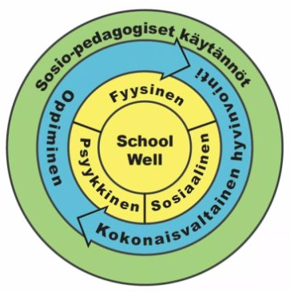
The relationship between learning and comprehensive wellbeing is reciprocal
Pedagogical solutions that promote students’ learning also contribute to their wellbeing.
Wellbeing supports learning, and patterns of thinking and behavioural models that support wellbeing can be learned.
Source: SchoolWell, helsinki.fi/schoolwell
Notes:
Upotetaan toivon pedagogiikka

Slide 14
The most effective means of supporting wellbeing
Quality of interaction
Socio-emotional skills and belonging, peer relations, teacher-student relationship
Taking breaks and increasing physical activity
Study skills and inclusive and activating teaching
Concentration and calming down skills

Slide 15
SchoolWell study
When we examine wellbeing at school, we must first accept that
Students come to school bringing with them their whole life, its challenges and resources, and wellbeing is made up of many different aspects of life.
School is a place of education where students are meant to learn, and teachers' core competences are centred around education and facilitating and supporting learning. Learning can not only promote and support wellbeing – it can also undermine it.
School is also a place of intense interaction, where wellbeing is contagious. At its best, supporting comprehensive wellbeing also means supporting teachers' wellbeing at work.

Slide 16
Safe space and respectful interaction
Building socio-emotional and physical safety, a sense of belonging and positive interaction...
Respectful interaction is about being considerate, receptive, accepting and present – in all encounters.
Noticing the good in every person helps with respectful interaction.
Teachers, principals and other school staff play an important role in modelling respectful interaction for students.
More/better
learning outcomes and motivation to learn
Less/fewer
mental health problems
psychosocial wellbeing
happiness
self-esteem
prosocial behaviour
psychological functioning
bullying
risk behaviour such as substance abuse, vandalism and aggression
anxiety
depression
Sources: Pyhältö, K. 2024; Aktan-Collan, K. 2019

Slide 17
Guidelines for a safer community
See the ThingLink on guidelines for a safer community here.
The teacher...
goes over the common policies of the general upper secondary school with the group,
intervenes in inappropriate behaviour in class,
encourages participation: creates space for different voices and perspectives,
creates safe interactions: uses respectful, clear and compassionate language, and
takes into account different learners: differentiates instruction and promotes a variety of learning styles.
How does safety affect learning?
Motivation and engagement increase when students feel safe to participate.
Social safety promotes community cohesion and fosters a culture of learning.
Making mistakes is allowed, which contributes to deeper learning.
Student's cognitive capacity is freed up, improving thinking skills and memory.
Notes:
Elina muuttaa ThingLink-tekstin

Slide 18
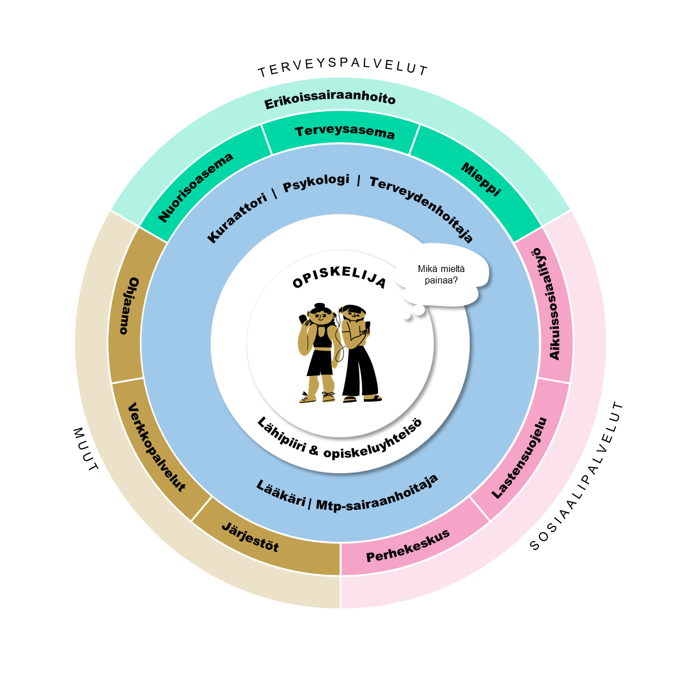
Multidisciplinary cooperation
Do not hesitate to ask for help with issues that you are unsure about from
special educational needs teachers,
student welfare staff and
colleagues.
If necessary, organise a multidisciplinary meeting.
You can consult anonymously. To consult by name, you need the student's consent.
Link to a description of student welfare services (in Finnish).
Trained neuropsychiatric coaches working in general upper secondary schools (slide 19)
Notes:
Elina muuttaa ThingLinkin hyperlinkiksi

Slide 19
Neuropsychiatric coaches in general upper secondary school
The City of Helsinki’s educational institutions have trained neuropsychiatric coaches (solution-focused neuropsychiatric coach, 30 credits, special educational needs teachers and school social workers).
The ways in which the competence of neuropsychiatric coaches can be leveraged include
consultation (observations and concerns about student behaviour, study progress, concentration....)
planning support measures together
co-teaching lessons (special educational needs teacher/school social worker, themed lessons)
staff meetings (raising awareness)
parents' evenings (information for guardians, tips for supporting young people at home)
subject group meetings, special educational needs teacher.
A list of trained neuropsychiatric coaches is provided on slide 95.

Slide 20
Subject teaching supported by a special educational needs teacher
The support for learning in general upper secondary education project carried out during the 2024–2025 school year involved developing forms of cooperation between a special educational needs teacher and a subject teacher. The project produced the support material Yhteisopetus – tukea oppimiseen (“Co-teaching – support for learning”) for starting and developing this cooperation.
Special educational needs teachers can provide pedagogical support to subject teachers in the planning and implementation of support. The Strukturoidut pedagogiset keskustelut (“Structured pedagogical discussions”) material produced in the project can be implemented under the direction of a special educational needs teacher. The material also serves as a checklist for subject teachers in the planning and implementation of instruction.

Slide 21
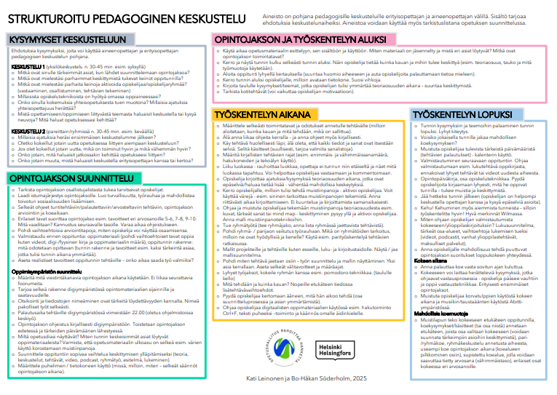
Structured pedagogical discussion
Link to the material (in Finnish)!

Slide 22
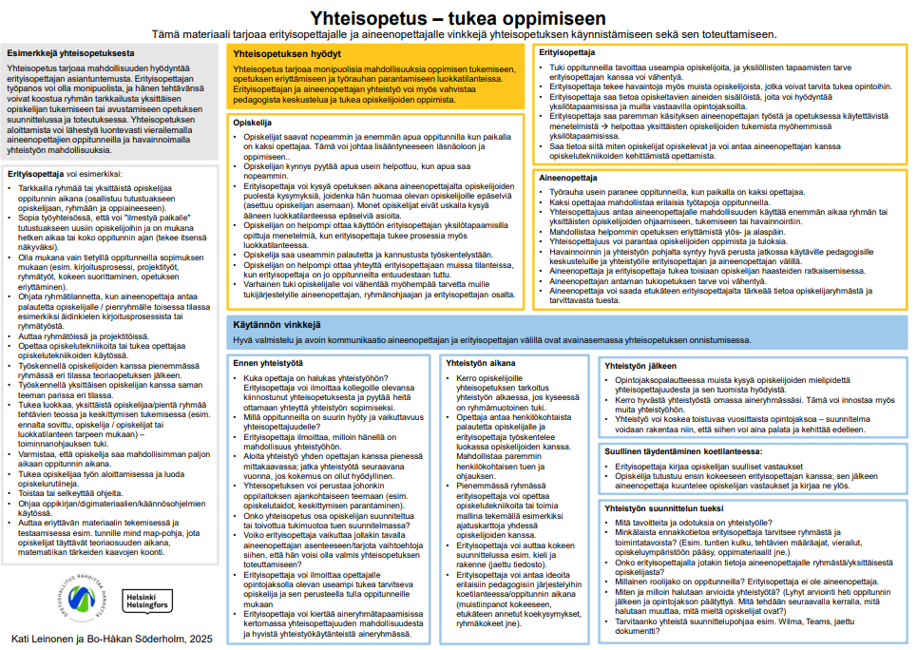
Co-teaching – support for learning
Link to the material (in Finnish)!
Notes:
Elina yhdistää ja laittaa kuvat ”samaan diaan” allekkain.

Slide 23



Activity cards for teachers
Instruction during lessons
Always mark the lesson structure and timetable on the board.
Short work cycles, try different approaches with the group, such as the Pomodoro Technique (clock on the board).
Check homework.
Tell the students when to take notes and activate them.
Use colour codes. For example, blue means that you need to take notes.
Give the students enough time to write.
No listening and writing at the same time.
Provide a model for note-taking techniques. Encourage students to use mind maps, pictures and keywords when taking notes.
During theory sections, encourage students to write down questions or thoughts about things that are unclear or that they want to know more about – this will reduce interruptions. Also allow questions at an appropriate point during the lesson.
Walk around in the classroom also during instruction.
Make use of multichannel teaching methods.
Teija Ekholm and Arja Kuisma, partly adapted from material by Bo-Håkan Söderholm and Kati Leinonen, 2025

Slide 24


Activity cards for teachers
During lessons
Positive interaction
Interact with and listen to students, notice their concerns.
Pay conscious attention to students’ positive behaviour and give warm and genuine feedback about it.
Pay attention to the tone of communication. Use positive expressions, such as “could you please lower your voice, thank you.”
Encourage and praise students (thumbs-up gestures, good notes in Wilma)
Build belief and trust in students’ abilities.
Create effective interaction. Make sure the message gets through. Make eye contact yourself.
Try to give as little negative feedback as possible and only address the essentials.
Teija Ekholm and Arja Kuisma, partly adapted from material by Bo-Håkan Söderholm and Kati Leinonen, 2025

Slide 25

Activity cards for teachers
During lessons
Always mark the lesson structure and timetable on the board.
Walk around the classroom during the lesson and make sure everyone gets started.
Give clear instructions. Not too many instructions at once. Also write the instructions on the board.
Check homework.
Activate students. Tell them when to take notes.
Make use of multichannel teaching methods.
Teija Ekholm and Arja Kuisma, partly adapted from material by Bo-Håkan Söderholm and Kati Leinonen, 2025

Slide 26


Activity cards for teachers
At the end
of a lesson
Return to the questions and themes of the lesson at the end of the lesson and provide a short summary.
Could you give a couple of mock exam questions at the end of each lesson?
Remind students of important upcoming dates (assignment deadlines).
Preparation for the next lesson. Instruct students to prepare via e.g. a textbook reading assignment, short preparatory assignments and videos.
Teach and remind how to use a calendar.
Stay for a while after the lesson, because it is easier for students to talk to the teacher and ask questions about things that are unclear.
Give praise! For previous lessons as well.
Good notes in Wilma.
A study journal as part of study technique. Ask students to write down briefly what they feel they learned from the lesson. This supports memory and concentration.
Teija Ekholm and Arja Kuisma, partly adapted from material by Bo-Håkan Söderholm and Kati Leinonen, 2025

Slide 27




Activity cards for teachers
Before and during an exam
Types of exams
making an exam cheat sheet in advance during a lesson
providing exam questions (or some of them) in advance and only including some of them in the exam (helps draw attention to the important areas)
providing two concepts during/after each lesson, some of which are included in the exam
pair exam
group discussion on a given topic
several exams over the course of a study unit (splitting the exam subject area into parts)
smaller exam subject area for some students to allow them to achieve a specific grade
different paths to different grades: what students need to know to achieve a certain grade.
You can include leading questions in an exam
guide the answering process
the student gets going and learns answering technique
useful especially for the first study units.
Ways to prepare for an exam include
using a study plan
outlining the main areas
providing options to support reading (e.g. videos, podcasts, old matriculation exam questions).
Submitting the exam
Do not let students submit the exam until after the agreed time and encourage them to try.
Teija Ekholm and Arja Kuisma, partly adapted from material by Bo-Håkan Söderholm and Kati Leinonen, 2025

Slide 28
Part 2 Students' perspectives on support needs in general upper secondary school
The aim of this part is to help you reflect on students' needs, various teaching methods, the accessibility of teaching and support for social engagement and peer learning.
The video does not focus specifically on the needs of neurodivergent young people, but rather has students discuss the topic of support in general. However, reflecting on accessible education benefits neurodivergent students in particular.

Slide 29

Supporting questions for the introductory video
slide 30
Topical links (can be added by the facilitator)
The Haluan mukaan (“I Want to Join in”) guide (in Finnish)
Introductory video General upper secondary school students' thoughts for subject teachers (in Finnish with English subtitles)
Tips, examples and material to support studies
Activity cards for students slides 37–42
Tips for group building slides 43–45
Information
The support for learning reform and accessibility slides 31–33
The importance of peer relationships slide 34
School and study engagement slide 35–36

Slide 30
Supporting questions for the introductory video
Share your own best memory of a good learning experience.
What are the best practices in your own teaching for promoting:
social engagement, peer learning, inclusion, safety, concentration, assignment completion?
What good methods do you have for taking into account environmental factors (lights, sounds, clarity of teaching)?
What do you think are good ways to support students' individual needs?
What ideas did the video give you for your own teaching?

Slide 31
Everyday education accessible to everyone and the support for learning reform
The support for learning reform gives the subject teachers of general upper secondary schools a more pronounced role in the implementation of support for learning. The reform is based on identifying and addressing support needs in teaching at an early stage.
Taking into account the diversity of learners in everyday teaching is the best possible support for learning.
Taking neurodiversity into account in the planning of teaching methods and learning environments benefits all learners and reduces the need for remedial teaching and individual arrangements.

Slide 32
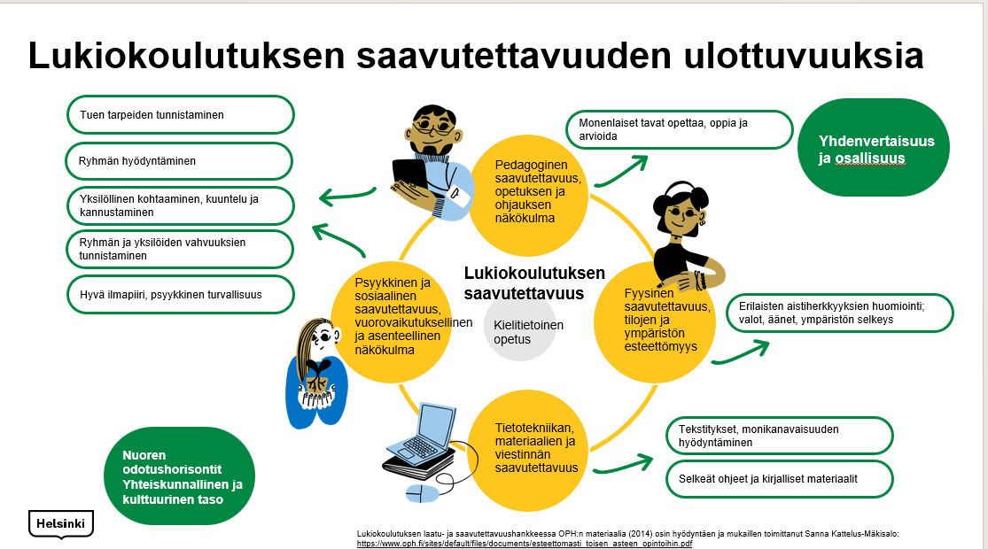

Slide 33
Benefits of different aspects of accessibility
Benefits of multichannel teaching
The use of multiple senses quickly generates lasting learning and facilitates the acquisition of skills.
We remember 5% of what we read, but 95% of what we do with our senses and our body. Making use of this also supports visual, auditory and kinesthetic learners in different ways.
How can teachers take into account different types of sensory defensiveness?
identifying sensory defensiveness
modifying the environment and using assistive devices, such as headphones
providing a sensory-friendly space where possible
preparation
offering a choice regarding participation.
Benefits of a safe space (slides 16-17)
Sources: University of Lapland, mielenterveystalo.fi

Slide 34
The importance of peer relationships
The relationship between learning and wellbeing is reciprocal
Wellbeing supports learning.
Pedagogical solutions that promote high-quality learning also contribute to students’ wellbeing.
Source: SchoolWell, see e.g. YOUNG programme factsheet 2025 (in Finnish)
It is worth investing in students’ peer relations.
Utilising a wide range of participatory teaching methods (including peer learning and group discussions) and putting effort into building the group atmosphere and peer relations increases study engagement.
Engaged students:
Better
learning outcomes
empathy skills
Experience less
loneliness
anxiety
behavioural problems
Sources: Pyhältö, K. 2024

Slide 35
The concept and importance of school and study engagement
The concept of school and study engagement can be used to examine both the individual's perception of their environment and various community-based measures that can support this perception.
The concept of engagement can be used to examine emotional experiences, such as enthusiasm or immersion in one's studies (Salmela-Aro & Read 2017), and the perceived meaningfulness of school studies, which includes positive experiences of peer relationships and interaction with teachers, for example.
Kouluun ja opintoihin kiinnittymisen tukeminen oppivelvollisuusikäisten koulutuksissa (“Supporting study engagement in education for students at compulsory education age”)

Slide 36
How subject teachers can support study engagement
Creating a good in-class atmosphere and an open and interactive culture of discussion.
Continuous group building (does not need to happen through play, can be linked to your subject).
Taking students' preferences into account when planning teaching, where possible.
Being flexible, supportive, relaxed and fair and having a sense of humour.
Fiia Söderholm, M.Ed, doctoral dissertation 6 June 2025: Fatigue increases and study engagement decreases during general upper secondary school studies – more attention should be paid to targeting support | University of Eastern Finland (news post in Finnish)

Slide 37


Activity cards for students
Improving listening
during lessons
Do not hesitate to ask the teacher for clarification if you didn’t hear or understand a point or question.
Reflective listening strategy: model instructions or rules in your mind in a way you can understand.
Choose a seat where it's easiest for you to concentrate on listening.
Teija Ekholm and Arja Kuisma, 2025

Slide 38









Activity cards for students
Getting stuck and overconcentration
Identify risk situations
Use time limits
Rotate tasks
Monitor yourself and your actions
Ask for help from others
Teija Ekholm and Arja Kuisma, 2025

Slide 39
Activity cards for students
Maintaining alertness
Monitor your concentration. If you notice that your concentration has wavered, consciously regain it.
Do one thing at a time.
Remove distractions from view.
Take notes while you study.
Write down things that distract you.
Eliminate background noise.
Hold an exercise session or break while studying.
Maintain a regular circadian rhythm.
Do things in small chunks.
Teija Ekholm and Arja Kuisma, 2025

Slide 40

Activity cards for students
Executive functions
Limit the number of things on display
Make studying fun
Enlist the help of your loved ones to help you study
Remember routines and rules
Rank things in order of importance
Trust yourself and that you will succeed
Make use of maps and retention methods
Do things a little at a time
Teija Ekholm and Arja Kuisma, 2025

Slide 41




Activity cards for students
Things that contribute to learning
Drawing and colouring
can help you focus on teaching.
External and tactile aids, such as stress balls,
enhance learning.
TO DO lists help you get things done. They also make it easier to monitor your progress.
Completing tasks and marking them as completed helps you to see that your learning is progressing.
Writing notes by hand helps concentration (notebooking in class, writing and drawing).
Writing notes by hand helps concentration (notebooking in class, writing and drawing).
Exercise sessions in your own seat. Even small movements help learning.
A rocking stool/ gym ball/having a standing
place in the classroom
help you concentrate.
Teija Ekholm and Arja Kuisma, 2025

Slide 42



Activity cards for students
Motivation and getting things started
1.
Set goals and deadlines.
Make the goal visible.
Start somewhere.
Think of successes.
Split tasks into parts.
Start somewhere.
Think of successes.
Split tasks into parts.
2.
3.
Identify and exploit motivators.
Ask for feedback.
4.
Reward yourself.
Challenge yourself.
Teija Ekholm and Arja Kuisma, 2025

Slide 43
Group building cards
Three things
You will need: an item that can be safely grabbed.
Preparations: write down themes related to the topic of study or use the themes on the reverse side.
Instructions: in this game, teams compete to see who can come up with three (3) things related to the given theme first.
Divide into competing groups.
Place the item to be grabbed between the groups. The person running the game gives the theme.
Have your group decide together which three (3) things you will say and then have one of you grab the item before the other groups.
The team that grabs the item first and says three things that fit the theme gets a point.
Three things
Name three
Name three...
things you can find on the beach environmentally friendly actions
ways to use a cardboard box things found in fairy tales
ways to piss off your teacher famous inventors
dinosaur species genres of music
ways to feel proud of yourself things to do during rainy weather
parts of plants string instruments
reactions to good news things you can eat with a spoon
acts of courage ways to help a stranger
historic events things you do invisibly
conspiracy theories things in a magician's hat
question in a job interview learning techniques
ways to praise someone mobile phone apps
ways to cover oily hair
Group building cards: Sirkku Selkosmaa (school social worker)

Slide 44
Group building cards
Categories
Categories
Categories
Categories
You will need: pens and paper.
Preparations: write down categories related to the topic of study or use the categories on the reverse side.
Instructions: in this game, groups compete to see which group can come up with the most words that fit a given category in a set amount of time.
Divide the students into small groups and ask each group to pick a person to write down things for the group.
The game consists of rounds with different amounts of time.
For example, 1st round 20 seconds, 2nd round 45 seconds and 3rd round 60 seconds.
The instruction for the first round could be "You have 20 seconds to write down colours," for example.
The group that writes down the most correct words/terms/names in the given time wins.
The categories can also be categories for which there are no correct answers. The answers can be used to stimulate discussion.
Weather Animals starting with the letter A
Diseases European capitals
Jewellery Asian countries
Languages Family members and relatives
Emotions Beverages (not brands)
Cutlery Indigenous peoples
Holidays Ways to show kindness
Desserts Ways to spend your free time
Ball games Things to do in nature
Dances People to talk to when you're feeling down
Genres of music Ways to comfort someone
Shoes Reasons for throwing up
Authors Free things
Group building cards: Sirkku Selkosmaa (school social worker)

Slide 45
Bingo
Group building cards
Likes reality TV Name: | Has at least two siblings Name: | Likes pineapple on pizza Name: | Birthday in the same month Name:
Has read a novel this year Name: | Has done martial arts as a hobby Name: | Is left-handed Name: | Writes a diary Name:
Likes horror films Name: | Lives outside Helsinki Name: | Has broken a bone at some point Name: | Has played in a team Name:
Plays an instrument Name: | Has an unusual hobby Name: | Has won something Name: | Has an animal at home Name:
Group building cards: Sirkku Selkosmaa (school social worker)

Slide 46
Part 3 The neuropsychological perspective
The aim of this part is to provide you with an overview of the nervous system and brain-friendly learning. Together, we will reflect on the importance of a brain-friendly learning environment and share related good practices.

Slide 47

Information
The most effective means of supporting wellbeing in general upper secondary school slide 49
Brain-friendly lesson plans and effective studying slides 50–53
Supporting a sensory-friendly learning environment slides 54–57
Brain-friendly assessment and the importance of positivity slides 58–61
Supporting questions for the introductory video slide 48
Lukio-opetus ja aivojen salat
Topical links (can be added by the facilitator)
Isomäki, H., Aivot käyttöön koulussa (“Using your brain in school”)
The sensory accessibility survey can be used together to make the sensory accessibility of the learning environment visible.
Price, J. & Romualdez, A. M. (2024). ‘It just feels unnatural being here’: Autistic secondary school students' experiences of sensory sensitivities in the school environment: https://osf.io/preprints/osf/pks8t_v1
Alanen, L., Järvinen, A. & Keski-Rahkonen, A. (2025). Miksi tunnesäätelyn vaikeudet olisi tärkeä huomioida osana adhd:n oirekuvaa ja hoitoa? (“Why is it important to consider emotional regulation difficulties as part of ADHD symptoms and treatment?”) | Psykologilehti magazine
Notes:
Helin kysymykset: vireystila
Mentalisaatio; omat toiveet ja tarpeet, kiinnostuksen kohteet
Ali- ja ylivrittyneisyys samaan aikaan
Yhteistyö ja dialogi metodina; mentalisaatio;
Kokeilu ja rohkeus

Slide 48
Supporting questions for the introductory video
How do I consider the building of a brain-friendly lesson plan in my teaching?
How does my classroom reflect a sensory-friendly learning environment?
What is brain-friendly assessment, and how do I support students’ emotional regulation in class?
How do I strengthen students’ resilience in my teaching?

Slide 49
The most effective means of supporting wellbeing in general upper secondary school
Quality of interaction
(socio-emotional skills and belonging, peer relations, teacher-student relationship)
Taking breaks and increasing physical activity
Study skills and inclusive and activating teaching
Concentration and calming down skills
Source: Pyhältö, K. 2024
Notes:
Tiivistetysti, toimivimmat hyvinvoinnin tukemisen keinot ovat pedagogisia:
Vuorovaikutuksen laatu
Sosioemotionaaliset taidot ja kuuluminen
Vertaissuhteet
Ope-opiskelijasuhde
Tauot ja fyysisen aktiivisuuden lisääminen
Opiskelutaidot ja osallistavat ja aktivoiva opetus
Keskittymisen ja rauhoittumisen taidot
Tehokkaimmat interventiot ovat niitä, jotka toimivat oppilaitoksen rakenteissa ja osana pedagogisia prosesseja eikä irrallisina projekteina tai kursseina.
Lisää SchoolWell-hankkeesta voi lukea heidän nettisivuiltaan tai tilannekuvaraportista.

Slide 50
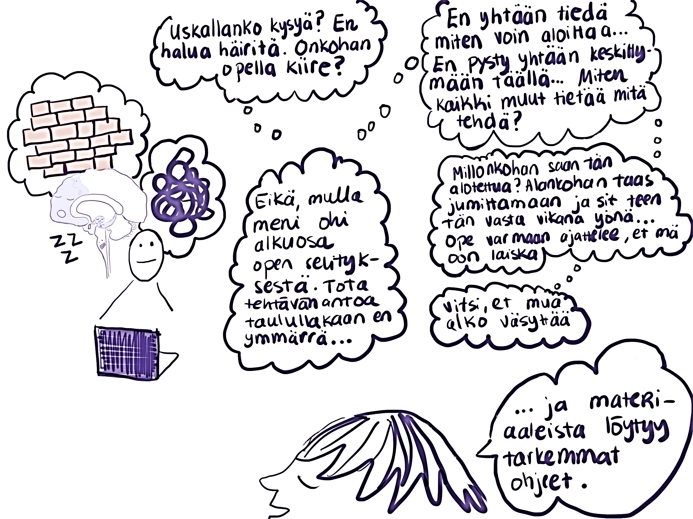
Brain-friendly lesson plans and effective studying 1/4
Image: Maria Mattsson, 2025
Notes:
ennakointia, strukturointia, aistiystävällisyyttä, sosiaalisesti turvallista ympäristöä, vahvuuksiin keskittymistä sekä stressiherkkyyttä ja kuormittumista. Näistä asioista löytyvät usein syyt lapsen käyttäytymisellä reagoimiseen. Koulun aikuisten tehtävänä on miettiä yhdessä oppilaan ja hänen perheensä kanssa, miten oppilasta voidaan tukea niin, että hän voi käyttää vahvuuksiaan hyväksi ja oppia uusia asioita kuormittumatta liikaa. Yhteistyössä aikuiset voivat auttaa lasta tai nuorta löytämään hyvinvointiaan lisäävät yksilölliset ratkaisut arkeen.

Slide 51
Brain-friendly lesson plans and effective studying 2/4
Students may find it difficult to regulate their level of arousal and concentrate in class → moving around, talking out loud, looking out the window.
When a student’s resources are spent on regulation, they may be slower to take in important information than their peers.
Difficulties in understanding assignments: → a student may interpret an assignment from many different angles, become fixated on the detailed meanings of words and be overwhelmed by their options for getting started.
A student may have or feel as though they have limited ways of effectively regulating stress during lessons.
Learning and managing your own behaviour are difficult in a hyperaroused state.
Notes:
ennakointia, strukturointia, aistiystävällisyyttä, sosiaalisesti turvallista ympäristöä, vahvuuksiin keskittymistä sekä stressiherkkyyttä ja kuormittumista. Näistä asioista löytyvät usein syyt lapsen käyttäytymisellä reagoimiseen. Koulun aikuisten tehtävänä on miettiä yhdessä oppilaan ja hänen perheensä kanssa, miten oppilasta voidaan tukea niin, että hän voi käyttää vahvuuksiaan hyväksi ja oppia uusia asioita kuormittumatta liikaa. Yhteistyössä aikuiset voivat auttaa lasta tai nuorta löytämään hyvinvointiaan lisäävät yksilölliset ratkaisut arkeen.

Slide 52
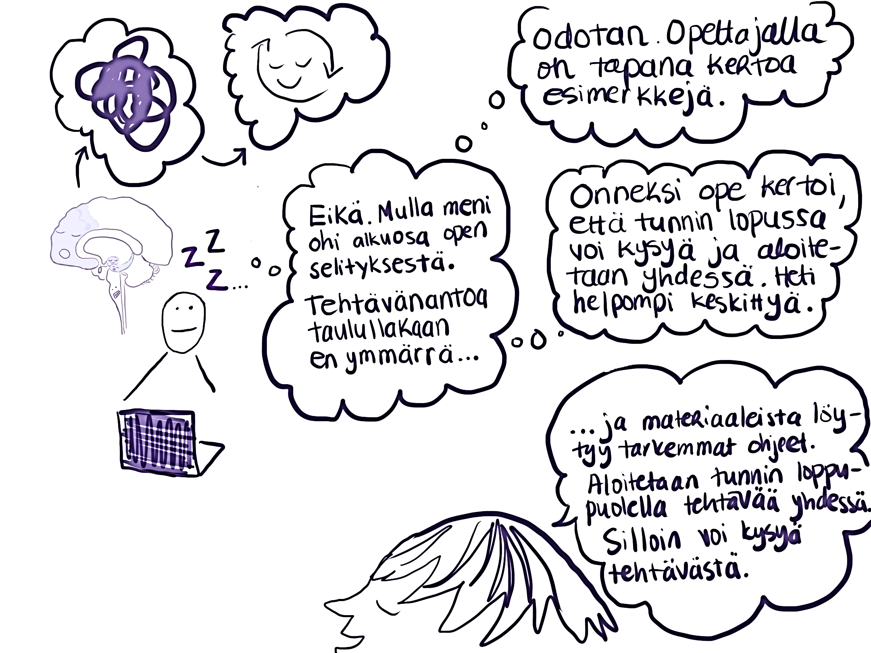
Brain-friendly lesson plans and effective studying 3/4
Image: Maria Mattsson, 2025
Notes:
ennakointia, strukturointia, aistiystävällisyyttä, sosiaalisesti turvallista ympäristöä, vahvuuksiin keskittymistä sekä stressiherkkyyttä ja kuormittumista. Näistä asioista löytyvät usein syyt lapsen käyttäytymisellä reagoimiseen. Koulun aikuisten tehtävänä on miettiä yhdessä oppilaan ja hänen perheensä kanssa, miten oppilasta voidaan tukea niin, että hän voi käyttää vahvuuksiaan hyväksi ja oppia uusia asioita kuormittumatta liikaa. Yhteistyössä aikuiset voivat auttaa lasta tai nuorta löytämään hyvinvointiaan lisäävät yksilölliset ratkaisut arkeen.

Slide 53
Brain-friendly lesson plans and effective studying 4/4
Structuring and clarity can help students regulate their level of arousal and stress.
By discussing an assignment with students and offering the opportunity for clarifying questions, you create a shared understanding of the purpose of the assignment and a sense of certainty about how to proceed.
Students learn to share their thoughts out loud and to trust in collaboration.
By starting larger sets of tasks together, the teacher facilitates successful experiences of regulating arousal and getting started. At the same time, they can help students learn study skills and strategies.
Notes:
ennakointia, strukturointia, aistiystävällisyyttä, sosiaalisesti turvallista ympäristöä, vahvuuksiin keskittymistä sekä stressiherkkyyttä ja kuormittumista. Näistä asioista löytyvät usein syyt lapsen käyttäytymisellä reagoimiseen. Koulun aikuisten tehtävänä on miettiä yhdessä oppilaan ja hänen perheensä kanssa, miten oppilasta voidaan tukea niin, että hän voi käyttää vahvuuksiaan hyväksi ja oppia uusia asioita kuormittumatta liikaa. Yhteistyössä aikuiset voivat auttaa lasta tai nuorta löytämään hyvinvointiaan lisäävät yksilölliset ratkaisut arkeen.

Slide 54
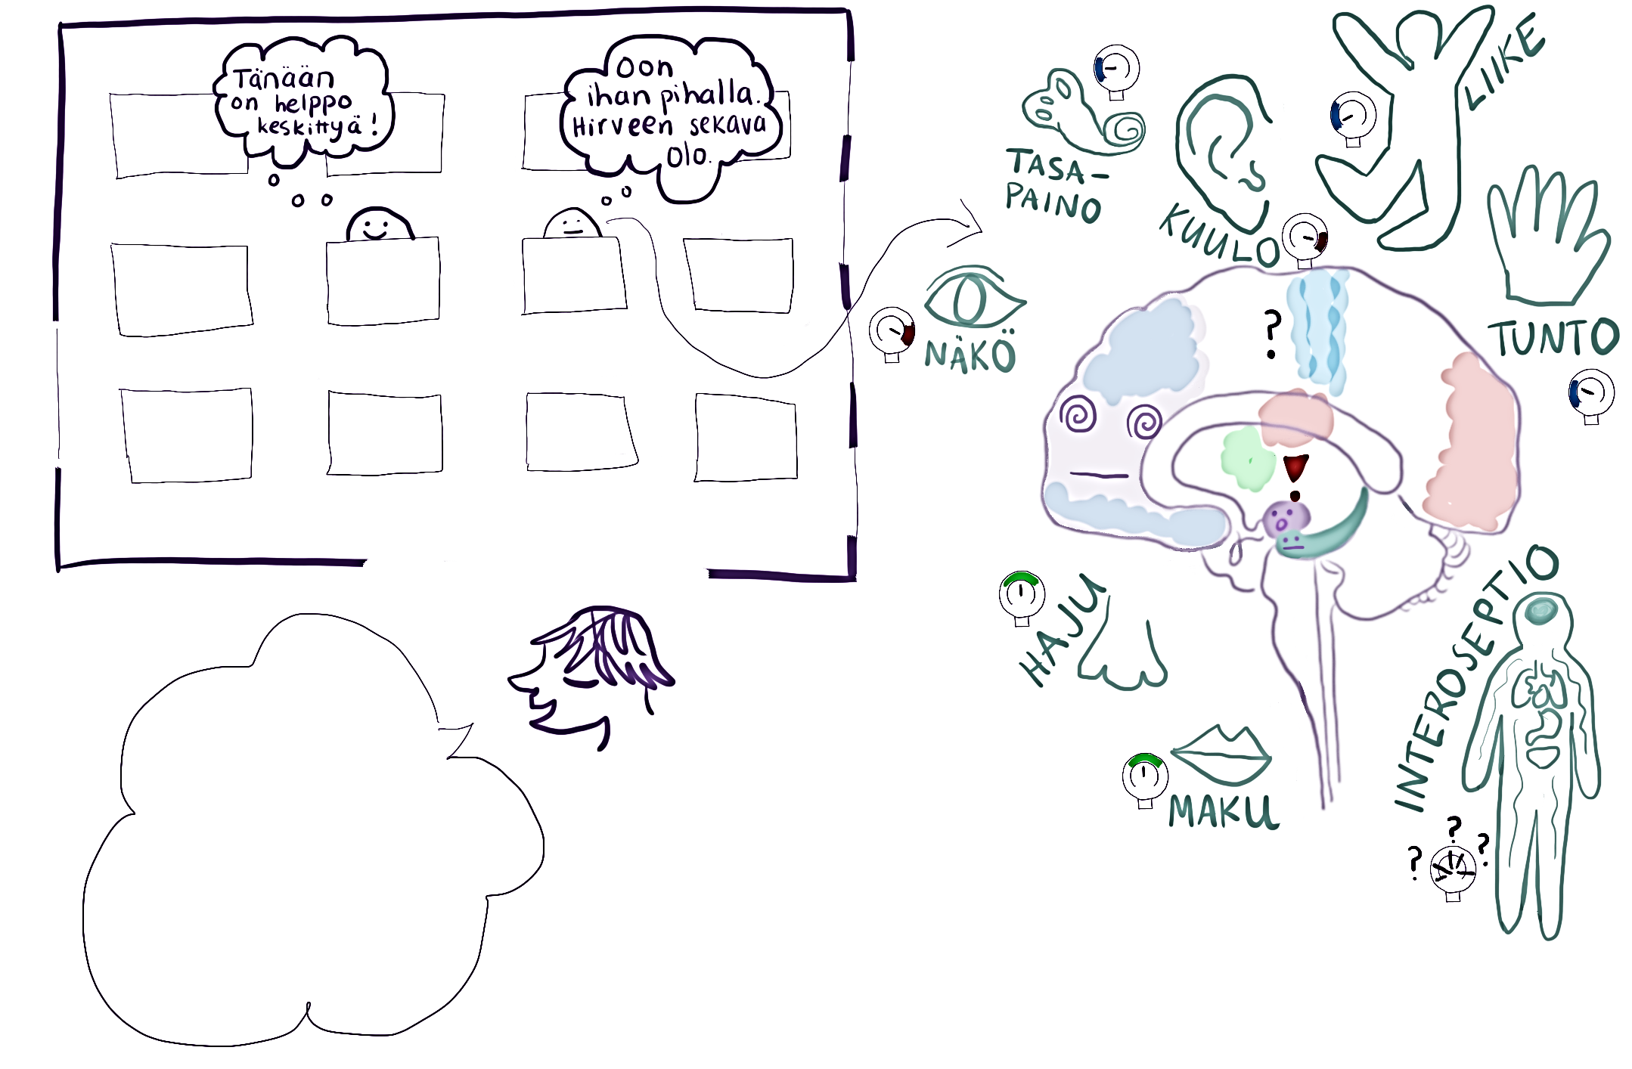
A sensory-friendly learning environment 1/4
Image: Maria Mattsson, 2025
Notes:
Aistiystävällinen oppimisympäristö 1/4

Slide 55
A sensory-friendly learning environment 2/4
Students process the sensory information from the environment and their bodies in a variety of ways. In addition to being balanced, different senses can be both overloaded and underloaded at the same time.
While one student can ignore the sound and movement caused by things like moving chairs or opening doors, another student may be constantly struggling with having to shift their attention.
A student may find it difficult to sit still because their senses of movement and balance crave input.
Students' senses of sight work differently in different situations; some pay attention to details, others to the big picture.
When overloaded, it can be difficult for a student to shift their attention away from a buzzing light, whereas when relaxed it does not distract them.
The sensory friendliness of the learning environment can make a big difference to a student’s wellbeing and learning ability. The constant seeking of sensory balance can take a lot of resources from a student and, in the long run, lead to exhaustion.
For a young person with autism, for example, sensory balance is a prerequisite for feeling safe, learning, interacting and thriving.

Slide 56
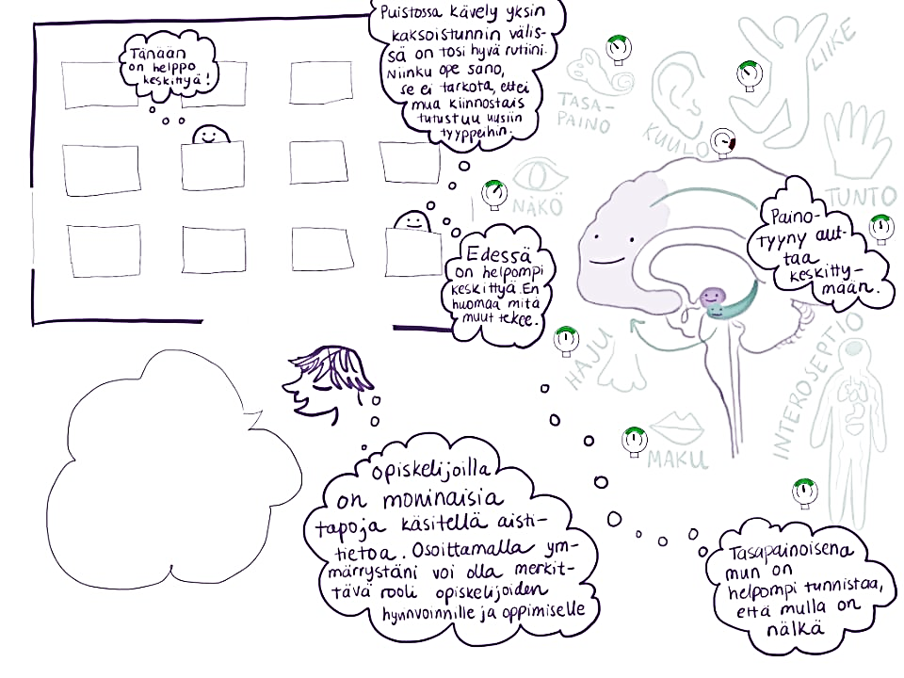
A sensory-friendly learning environment 3/4
Image: Maria Mattsson, 2025

Slide 57
A sensory-friendly learning environment 4/4
Teachers can demonstrate understanding of neurodivergent ways of processing sensory information and awareness of the stress factors specific to the learning environment. They can encourage students to be aware of their own condition and to use assistive devices, for example.
Especially during adolescence, it can be difficult for neurodivergent individuals to behave in ways that promote their personal wellbeing if they differ from those of others. Teachers can normalise breaks spent alone or the use of a visual barrier in matriculation examinations, for example.
Predictability and routines can help regulate sensory load. Teachers can pace lessons so that students know when they can use tools to regulate their sensory load.
Variation promotes the activation of different senses and can contribute to the sensory balance of a neurodiverse group.
Teachers can also serve as examples by using sensory regulation tools in class or by giving examples of their own.

Slide 58
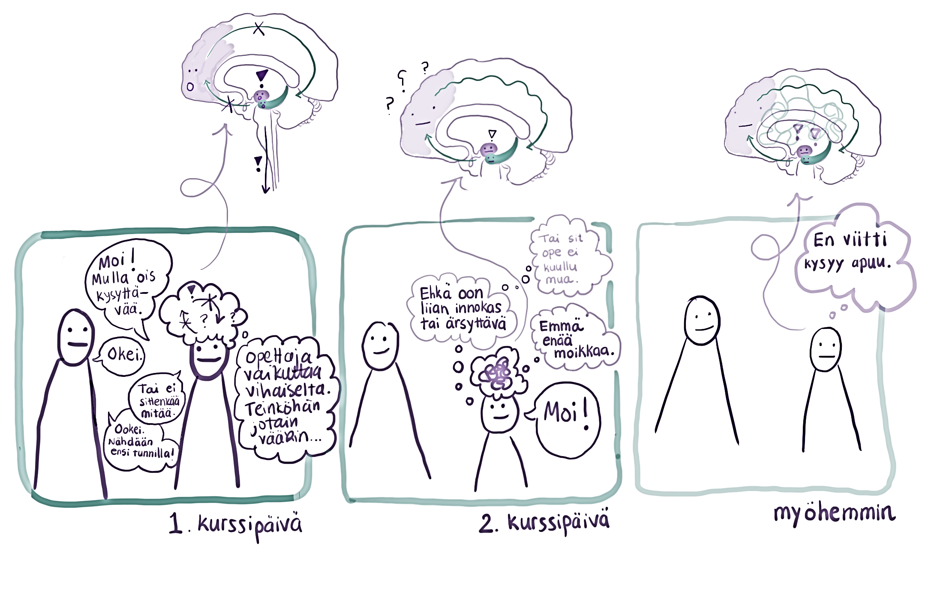
Brain-friendly assessment and the importance of positivity 1/4
Image: Maria Mattsson, 2025
Notes:
Aivoystävällinen arviointi ja myönteisyyden merkitys 1/4

Slide 59
Brain-friendly assessment and the importance of positivity 2/4
Assessment of learning can provoke a variety of reactions and interpretations from students. Adolescents are also sensitive to social judgement and prone to impulsivity.
Interacting with a subject teacher can make a student feel like they are being assessed. This can lead to the student interpreting neutral expressions and a firm tone of voice as dismissive, triggering a stress reaction in the student.
Neurodiverse ways of interpreting assessment affect students’ ways of directing attention and flexibility in changing the focus of attention. For example, a student may interpret an exam week exam as a threat and the only important part of a course. This can lead to them focusing all their attention on preparing for the exam and maintaining a constant state of stress throughout the study unit.

Slide 60
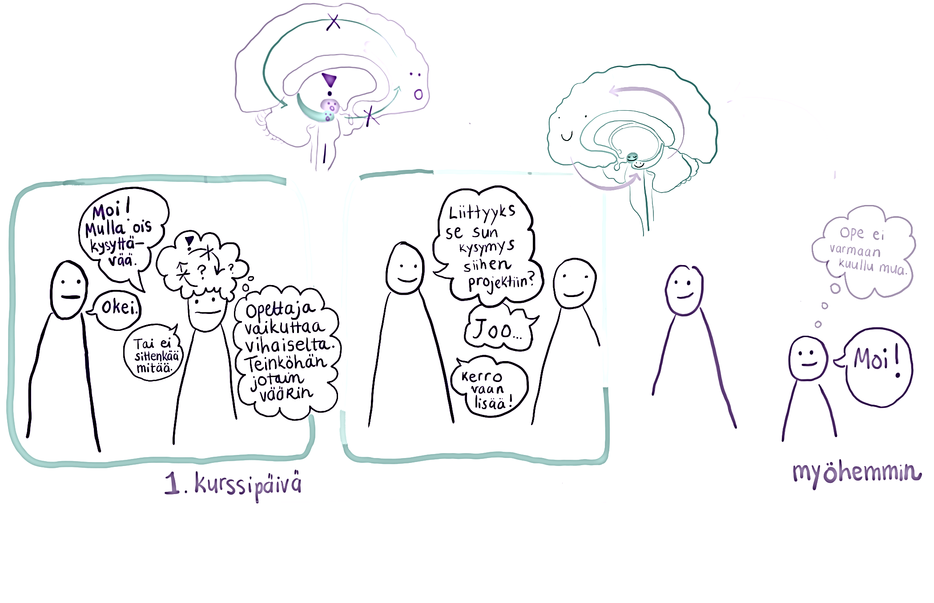
Brain-friendly assessment and the importance of positivity 3/4
Image: Maria Mattsson, 2025

Slide 61
Brain-friendly assessment and the importance of positivity 4/4
Awareness of neurodiverse ways of dealing with assessment and being assessed can help subject teachers understand student behaviour.
Emphasise positivity and openness → this can help students to broaden the focus of their attention away from mistakes and to practice mental flexibility. Over time, the students learn to trust the teacher and their goodwill.
Focusing attention on the learning process, leveraging mistakes and discussing things together are helpful ways of promoting nervous system safety, the various strengths of the group, curiosity and the joy of learning. → Being an object of assessment takes a back seat and learning rises to the forefront. → A relaxed student is better equipped to function and form positive peer relationships.
Teachers can encourage students to complete credits related to their own interests.
Resilience and dealing with disappointment → disappointments are also part of assessment and, when handled correctly, build resilience.

Slide 62
Part 4 Importance of cooperation with networks and guardians
The aim of this fourth part, which focuses on example cases, is to support discussion among subject teachers on cooperation with networks and guardians and to share successes and good practices related to cooperation.

Slide 63
Supporting questions for the introductory video slide 64
Topical links (can be added by the facilitator)
For example
www.lukihero.fi
Introductory video
Importance of cooperation with networks and guardians (in Finnish with English subtitles)
Information
Cooperation with networks slide 65
Cooperation with guardians slide 66
Tips, examples and material to support teaching
Example cases and supporting questions slides 67–76

Slide 64
Supporting questions for the introductory video
What cooperation partners do you know or can you use in your subject from the perspective of differentiation, who do you ask students to turn to? (students who are talented/interested, students who need support)
Do you have experiences of good cooperation meetings/cooperation with networks outside the school? What made it good?
In what situations do you feel that cooperation with guardians is necessary?
Share your experiences of good cooperation with guardians and related structures and practices.

Slide 65
What kind of cooperation with networks can a subject teacher engage in?
Subject teachers can engage in cooperation with the different networks of students in a multidisciplinary meeting that actors from outside the school can also be invited to attend, for example.
You can engage in cooperation with networks on the following themes, for example:
mental health
learning
loneliness prevention and social contacts
support for life management and executive functions.
Guiding a student to networks can
contribute to improving the student's mental wellbeing and thereby enhance learning
help the student to become more engaged in their studies
strengthen the student's perception of inclusion and being seen.
Cooperation with networks and guardians benefits neurodivergent students in particular!

Slide 66
Benefits of cooperation with guardians
In 2023–2024, three workshops were organised for the guardians of Helsinki's general upper secondary school students to develop cooperation with guardians. In the workshops, guardians stressed that they feel that engaging in cooperation with teachers in upper secondary education is really important in helping them support young people in facing challenges and highlighting their strengths.
The discussions highlighted that guardians valued the following in particular
accessibility and ease of communication
opportunities to meet teachers face-to-face if necessary
access to information on subject content and assessment
information on general upper secondary education and its activities/structures
up-to-date information on absences and learning challenges
information about missing assignments or a sudden drop in academic performance
information on successes and positive feedback!
up-to-date information on the daily operation of the school and its phenomena.
Cooperation with networks and guardians benefits neurodivergent students in particular!

Slide 67
CASES 1–4: benefits of cooperation with networks and guardians’ thoughts

Slide 68
Tips for studying the cases
You can study the example cases in small groups, in subject-specific teams or independently before a joint event.
Each case is accompanied by supporting questions to help you share successes, reflect on challenges and highlight subject-specific observations in a shared discussion.

Slide 69
CASE 1: From a non-speaking boy to a professional speaker
We had a full-term, normal-weight boy following a normal pregnancy. The baby was a quiet observer and learned things normally, but at the age of two had still not spoken a word, even though we always read a lot to the children in our family. At his three-year check-up, the maternity and child health clinic nurse took note of his lack of speech. Despite thorough specialised health care examinations, no cause for his delayed speech could be found. However, the boy was recommended a special daycare group for children who were deaf or had severe speech delays. Olli's first language was Finnish Sign Language.
At the start of school, Olli's vocabulary was at the level of a 3–4-year-old, and he started school as a pupil with special needs. In practice, he did not receive any special support because the special educational needs teacher had to spend all of their resources on supporting the other children who were more vocal and difficult to socialise. In lower secondary school, Olli was a quiet, inconspicuous, adaptable and polite teenager who was liked by his teachers, but his learning challenges were overlooked. We parents persisted in raising our concerns and eventually the school's special educational needs teacher recommended HERO. HERO's special educational needs teacher found no evidence of dyslexia, but said that they had seen similar children in their long career. They arranged a meeting with the school's special educational needs teacher and Olli’s class teacher, which resulted in Olli being given the opportunity to study some subjects with the help of the special educational needs teacher in a small group, which Olli said was "the best time of his whole school life." Without HERO, he would not have been provided with the opportunity to receive special needs education and take exams in small groups because he lacked an acceptable diagnosis. At the end of primary and lower secondary school, the special educational needs teacher recommended that Olli take the advanced mathematics syllabus in general upper secondary school. This surprised us parents. We had never noticed his mathematical talent due to focusing only on his reading challenges.
Olli continued his studies in general upper secondary school, where his studies and concentration were supported by activities, different learning methods, movement and music. A young maths teacher sparked his interest in mathematics: the teacher became Olli's idol, sparring partner, support and inspiration. Several nights I found my son solving math problems late into the night while I was trying to get him to sleep and off the phone. In his last year of general upper secondary school, Olli told his maths teacher that "I'd like to be a maths teacher like you one day!" and the teacher's magic words "you can!" sealed his future.
Today, Olli is studying at university to become a mathematics teacher. I believe that Olli will become a great teacher: he is empathetic and understanding of different learners. That is his special strength. In 2017, the term developmental language disorder was officially recognised. It will be included in the new International Classification of Diseases (ICD 11), which is due to be adopted by 2026. It will help future children get help and support with learning difficulties.

Slide 70
Questions to think about – CASE 1
Do you think it is important to know the causes of learning challenges? How does that affect the organisation of teaching and support?
How do you approach a student who you notice is struggling with their studies?
Who could you engage in cooperation with when you notice a student struggling?

Slide 71
CASE 2: Elia – talented and supported
Elia sits at the end of the third row, a familiar seat where he can see the board without having to meet anyone's gaze. In maths class, Elia comes alive – the differential equation on the chalkboard makes his fingers twitch with excitement. The teacher has noticed that Elia solves problems in a way that often goes beyond the curriculum. “Genius," the teacher once said. That felt good.
The teacher gave Elia and his parents a tip about maths coaching provided by an external network, which could be useful and fun for Elia. It opened the door to a whole new world – and most importantly, to friends. Friends who share a passion for mathematics. In this crowd, there is no need to explain oneself. There's plenty to talk about, even if it doesn’t always seem like it in the school corridors.
But in mother tongue class, Elia sits at the same seat – and in a completely different world. When the teacher asks the class to analyse song lyrics, Elia stares at the blank page for hours. He knows what he is thinking, but doesn't know how to write it. His thoughts don't turn into words, sentences break before they are finished. Structures and rules that others take for granted seem like a foreign language to Elia. Sometimes Elia manages to get something down on paper – like three pages of in-depth analysis – but the feedback says that the text lacked an introduction, had no paragraph structure and was not really in line with the assignment. No one can see how much energy he spends just remembering to bring all the supplies that he needs with him or staying still, even with the classroom lights and air conditioning humming like a buzzsaw in his head. Teachers see his brilliance in maths, but in mother tongue his grades are often disappointing. Not because Elia isn't trying – but because his brain is operating on a different frequency.
One day, the mother tongue teacher stays to talk with Elia after class. "Do you want to try doing the next writing assignment by discussing it first and then building a text together?" Elia nods. It feels fair – not that he should change, but that someone is meeting him halfway. The teacher also guides Elia to get additional support from the special educational needs teacher for his writing process. Thanks to the encounter with the teacher and individual support, Elia experiences success in a challenging subject and successfully passes the necessary mother tongue study units.
Talent does not exclude the need for support. Neurodivergent students can excel in one area and still need concrete, individual help in another. Equality in learning does not mean providing everyone with the same support – but rather providing the right kind of support at the right time.

Slide 72
Questions to think about – CASE 2
What kind of materials for differentiating up and down are available in your subject? (learning materials, videos, software, podcasts, magazines, articles, etc.)
What kind of hobbies (school activities, coaching and hobby groups) related to your subject are there that students could be encouraged to participate in/you could try out with students?
What forms of support are available in your subject?

Slide 73
CASE 3: Letter from a guardian to a general upper secondary school teacher
As the guardian of two neurodivergent young people, I would like to say to teachers that there is no one type of neurodivergent young person. In our household, we have two very different adolescents with different needs, whose general upper secondary school studies are as different as night and day. Neurodivergent young people have individual needs like all young people, but compared to others, their needs may be more pronounced.
From the point of view of a guardian, the transition from basic education to upper secondary education is accompanied by a significant change in communication. There is all this talk about independence, initiative and responsibility. I wish teachers would keep in mind that neurodivergent general upper secondary school students often need more support in these areas than their peers. Because of this, it would, in my experience, still be very important in general upper secondary school to communicate via Wilma and inform the guardian about exams, relevant dates and any assignments that their child forgets to submit, for example.,
A neurodivergent young person may have particularly low self-esteem and it can be challenging for them to recognise their own strengths. As a guardian, I would like subject teachers to also share positive feedback via Wilma and inform me about my children’s successes. My experience is that it is really empowering and important for a young person that the feedback comes from the teacher and also reaches their guardian. The guardian has a complete picture of the young person and is able to integrate the feedback into their speech, thus strengthening the young person's self-esteem and self-image. Of course, it is important for the teacher to also give direct and immediate feedback to the young person!
You are doing really important work!
R. Guardian of neurodivergent young people

Slide 74
Questions to think about – CASE 3
What kind of things do you communicate to guardians in Wilma?
How could I increase the amount of personalised positive feedback?

Slide 75
CASE 4: A parent’s story
Valo was diagnosed with autism spectrum disorder in primary school, and there's plenty to gripe about in terms of the support received or not received there. Since Valo entered general upper secondary school from a flexible basic education class, many of the special support matters were already very clear to us, such as the fact that we needed to immediately contact the special educational needs teacher and the school social worker. In addition to this, Valo has been able to see a school psychologist. Valo’s records indicate that they have special needs, and that information is accessible to all teachers so that Valo does not have to go over it with each teacher.
Valo is given extended time to take exams and can make use of special arrangements for seating, headphones, etc., if necessary. So all these structural support measures have, in my opinion, been handled in an exemplary way. Then, of course, there are teachers who simply don't understand what neurodivergence means. They don't look at the records in the system, and then you end up having to discuss things like why Valo “refuses" to sit in the middle of the class. Understanding and paying attention to the records would be really important for Valo's learning and wellbeing.
However, on average things are really well-managed and as a guardian I am grateful for the support and understanding. It's really important!

Slide 76
Questions to think about – CASE 4
How can I find out about a student's support needs at the start of a study unit?
When do I review a student's special arrangements?
Do you think that the information available in Wilma on students’ support needs is sufficient?
Is it clear to you how and why the support measures used by subject teachers are recorded in Wilma?

Slide 77
Part 5 Practical tips from experts by experience
The aim of this part is to help you understand that we are not talking about a homogeneous group, but rather a variety of characteristics and needs. The introductory video sheds light on the everyday life of neurodivergent young people and supports joint reflection. Subject teachers play an important role in supporting students' future skills!
The materials in Part 5 provide information on strengths-based thinking and various models for comprehensive wellbeing and ability to study to serve as a basis for discussion. The models help to understand young people in a comprehensive way.
Identifying and highlighting strengths is particularly important for neurodivergent adolescents!

Slide 78


Tips, examples and material to support teaching
Structured pedagogical discussion
Activity card for identifying strengths slide 81
Supporting questions for the introductory video slide 79
Information
Character strengths and noticing the good slide 80
The study ability model slides 82–83
The Wellbeing together model slides 84–85
The benefits of physical activity and the mini-intervention model for promoting physical activity slides 86–87
Introductory video
Thoughts from experts by experience for subject teachers (in Finnish with English subtitles)
Topical links (can be added by the facilitator)
For example
ADHD Association in Finland: Aikuisen arki toimimaan (“Making everyday life work as an adult”)
Kela: Oma Väylä rehabilitation

Slide 79
Supporting questions for the introductory video
What kinds of thoughts did the video evoke?
What actions do you take to support learners' level of arousal and concentration during lessons?
What kind of lessons do I like as a teacher? What comes naturally to me?
What kind of lessons do students seem to enjoy?
What good ways do you have to acknowledge students' strengths?

Slide 80

Character strengths and noticing the good
Identifying and supporting strengths of character focuses attention on competence and successes, the personal strengths of each learner.
The leveraging of character strengths is linked to academic performance and wellbeing.
The identification, leveraging and development of character strengths can be taught and supported.
According to a study carried out in primary education, it seems that character strength teaching benefits pupils with intensified or special support needs in particular. These pupils were found to be:
more persistent, empathetic and interested in school work
less aggressive.
The supporting of character strengths can be easily started by consciously noticing the good and articulating it.
Identifying and highlighting strengths is particularly important for neurodivergent adolescents!
E.g. Tang et al. 2019; Vuorinen 2022

Slide 81

Activity cards for teachers
Think about your own strengths and how you leverage them in your work
What strengths are needed in your subject?
Do you use any methods to identify strengths in your teaching?
How can different hobbies support the studying of your subject?
Tips
Have students discuss their strengths and interests at the beginning of the study unit, for example.
You can also identify strengths using Padlet or Mentimeter to highlight the collective strengths of the group.
Keep a list of strengths on display to make them easier to articulate!
Consult with and make use of student welfare to identify strengths and find methods.

Slide 82
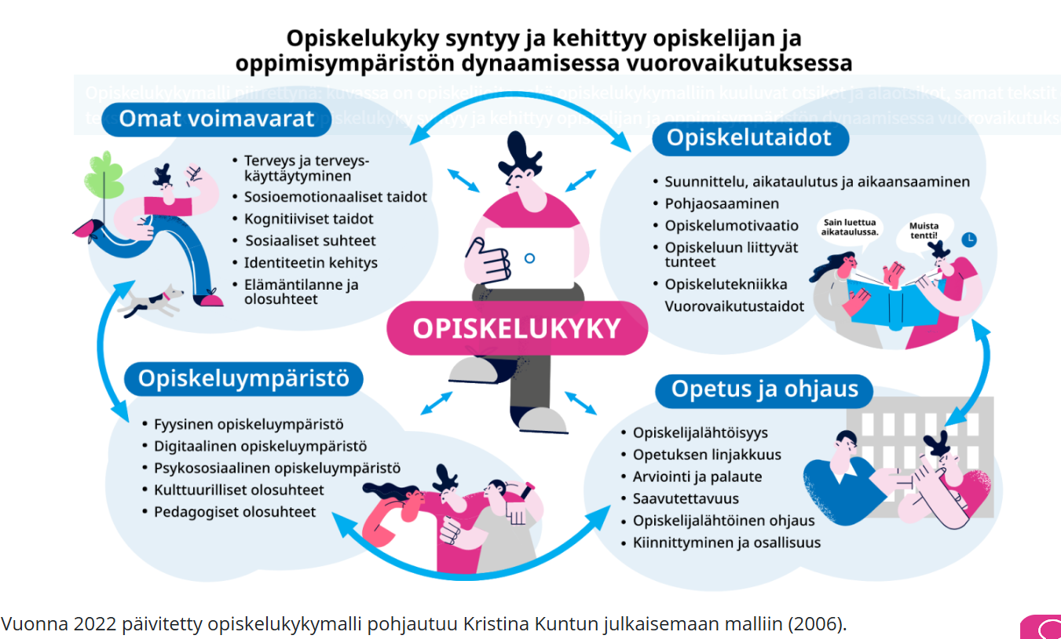

Slide 83
The study ability model
Students’ resources
Vary according to life circumstances.
The work ability and level of arousal of neurodivergent students can vary a great deal over the course of the day.
An insufficient level of arousal can lead to increased absenteeism, difficulty concentrating and challenges with executive functions.
Social stress may not be visible during lessons, but after the school day the student may be too tired to do anything, which can lead to them not doing their homework.
The window of tolerance – ADHD Association in Finland’s online course platform (in Finnish)
Teaching and guidance
Interaction, notice the good, encouragement, student-oriented guidance, group engagement, clear lesson structure, multi-channel teaching
Criteria for good guidance
Flexibility of the learning environment
supports students' learning and increases their sense of safety (spaces, seating arrangements, methods that support concentration)
Kouluun ja opintoihin kiinnittymisen tukeminen oppivelvollisuusikäisten koulutuksissa (“Supporting study engagement in education for students at compulsory education age”)
Study motivation, milestones
Allow student-centred course objectives, timetabling and immediate feedback to support students’ study progress.
Multichannel learning methods support all students and help with arousal regulation and learning.
Notes:
Kesken

Slide 84
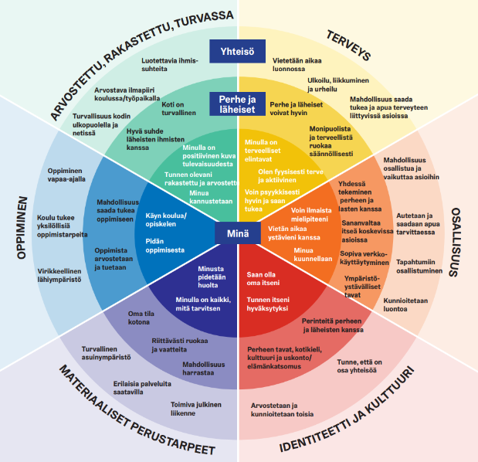


The Wellbeing together model

Slide 85
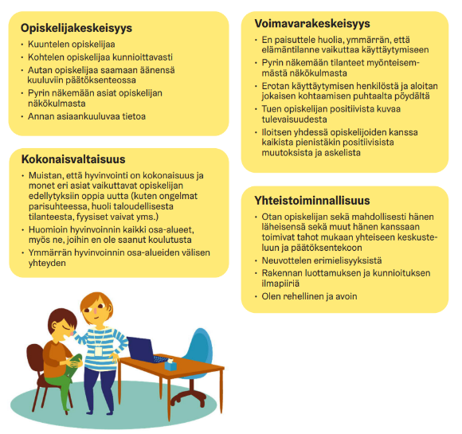
Wellbeing together model poster for working with students

Slide 86
Physical activity increases learning ability
Learning and cognitive functions
Physical activity during lessons supports learning in many ways and is associated with better classroom behaviour.
Source: Syvänoja S, Kartomaa M, Jaakkola T, Pyhältö K, Tammelin T. Liikkuminen ja oppiminen – tilannekatsaus, Lokakuu 2012 (“Physical activity and learning – situation report, October 2012”). Finnish National Agency for Education.
Schools have trained staff to talk about the benefits of physical activity and exercise.
As a subject teacher, you can support these discussions alongside your lesson work. It is important that staff recognise the elements of promoting physical activity and communicate the theme to students in the same way.
Those who perform the worst in assignments benefit the most
Even five-minute exercise sessions increase students’ level of arousal and concentration.
From the perspective of neurodivergent young people, exercise breaks and promoting physical activity are particularly important for supporting arousal regulation and mental wellbeing!
Source: Droiette et al.
Notes:
Elina stilisoi

Slide 87
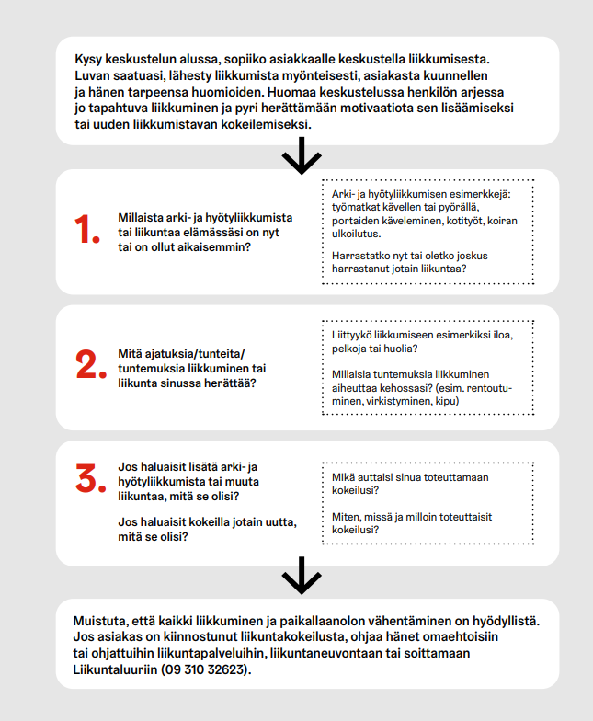
Mini-intervention to promote physical activity
Lighter physical activity also has health benefits, particularly for sedentary people.
The mini-intervention model for promoting physical activity is built around questions that can be used to bring up the topic of physical activity in a short amount of time during interactions as part of the discussion of other topics and to support the client’s motivation to increase their level of physical activity.
Record the mini-intervention to promote physical activity as completed in the client or patient information system.
Source: Mini-intervention to promote physical activity model Helsinki (PDF) (in Finnish)
87
Notes:
Riina: rehtori johtaa ammattilaiset ottamaan puheeksi liikkumisen

Slide 88
Appendices
Notes:
Nämä loppuun

Slide 89
How to use this material 1
Learning café
Set up workstations with computers that have the selected introductory videos open.
In small groups, go from workstation to workstation and discuss the introductory videos with the help of the supporting questions.
Once the groups have been to all the workstations, you can raise a few key points for joint discussion.
If you want, you can ask teachers to familiarise themselves with the introductory videos and information slides in advance.
The facilitator can look up topical links for those interested in the topic.
Notes:
Nämä loppuun

Slide 90
How to use this material 2
Studying the example cases
Print out some of the example cases in advance and apply the learning café model described on the previous slide, for example.
As you work, record your observations and good practices either on a computer or on paper.
At the end, have everyone take turns highlighting some of the observations recorded during the work.

Slide 91
How to use this material 3
Working in subject-specific teams
Choose a video together and discuss the video from the perspective of your subject with the help of the supporting questions.
In addition to videos, you can discuss the use of the activity cards or the example cases presented in the material.
You can also ask teachers to familiarise themselves with the introductory videos and information slides in advance and then discuss them together.

Slide 92
How to use this material 4
Working with the activity cards and models presented in the material
Print out the activity cards and models for supporting comprehensive wellbeing and study ability.
Discuss the ways in which the cards and models can be used and their role in everyday teaching.

Slide 93
Links to support for learning materials
Utilisation of digital materials: translation, simplification, text to speech (in Finnish) Haluan mukaan (“I Want to Join in”) guide for teachers and instructors (in Finnish) Co-teaching in general upper secondary school – support for learning (in Finnish) University of Lapland: the benefits of accessibility (in Finnish) Supporting students with sensory defensiveness | Mielenterveystalo.fi (in Finnish) Self-care programme for children with neuropsychiatric traits (in Finnish) Sensory accessibility survey making the sensory accessibility of our learning environment visible together Design and architecture education | Finnish National Agency for Education.
Movement in learning posters

Slide 94
Pedagogy of hope - hel.fi The pedagogy of hope underpins both the support for learning reform and the content of this material.

