Slide 1
PLASTICS ON THEIR WAY
CIRCULAR ECONOMY
Maarit Korhonen, Mira Huhtala
TAMK Bioproduct and Process Technology

Slide 2
Preface
1 cr about circular economy of plastics
Maarit Korhonen& Mira Huhtala, TAMK
KiertotalousAMK
https://kiertotalousamk.turkuamk.fi/opintojaksot/

Slide 3
Preface
The aim of this material is to help students to understand the circular economy of plastics.
This teaching material focuses on the processing of polymer products, the making and use of plastic products, the effect of them on environment, reuse and recycling or extermination by taking circular economy in account in every stage.
Plastics on Their Way starts with the planning and making of polymer materials from the monomers and ends to think ways how to use the materials as efficient as possible. At all the stages the present practices are questioned and made attempts to find more environmentally friendly alternatives. The starting point is to use materials and energy so that as small amount of waste as possible would be created. In addition, the waste and energy could utilize as material of some other product or other energy form in the future.
The teaching material has been used as one part of Polymer Chemistry and Composites course. Material contains links to the articles and books which deal circular economy of plastics. Moreover, it includes many questions and a final task. The idea is that students search answers to questions both at home and in the lessons and take a final task in the end of the course.

Slide 4
Introduction of the following material
This material is purpose to use in Polymer Chemistry and Composites courses. This is one part of them (1 credit).
The material includes questions (you can find in the following slides), references and a final task and a test.
Before starting with this material, students have studied the basics of polymer chemistry and polymer chemistry lab methods.
The material includes quite common issues about polymers’ circular economy, so that the students can study it indipendently as well.
The purpose of this material is to help students to understand the circular economy of plastics.
In the end of this part students will plan a plastic product by taking account circular economy and take a final task.

Slide 5
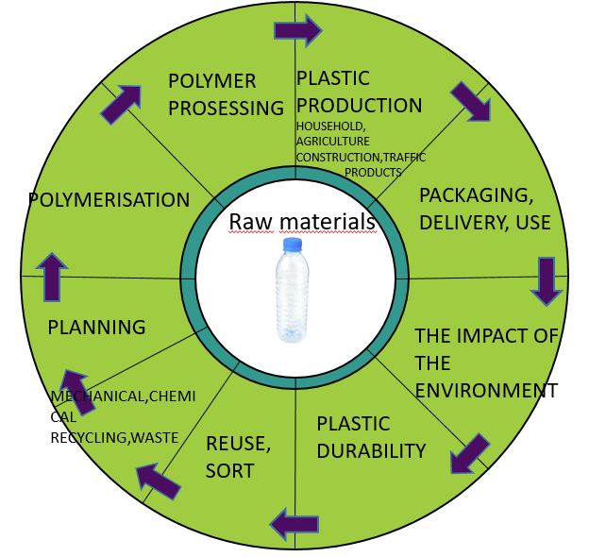
Plastics on their way
General information about polymers
Polymerisation and polymer processing
Plastic products
Packaging, delivery, use
THE Impact on environment, plastic durability
Reuse, mechanical and chemical recycling, waste, planning

Slide 6
Pretasks
How do you determine circular economy of plastics?
What types of plastics do you use in your everyday life?
How long can you utilize your plastic bags, bottles etc.
How could you change your habits so that plastic and composite waste problem would become smaller?

Slide 7
One case of plastics’ and composites circular economy
Björqvist, I. 2018. The Effect of Mechanical Recycling for Processability of HDPE, Bioproduct and Process Technology. TAMK. Final thesis http://urn.fi/URN:NBN:fi:amk-201905067893
Video about mechanical recycling
https://www.youtube.com/watch?v=zO3jFKiqmHo&feature=youtu.be
https://www.youtube.com/watch?v=I_fUpP-hq3A&feature=youtu.be

Slide 8
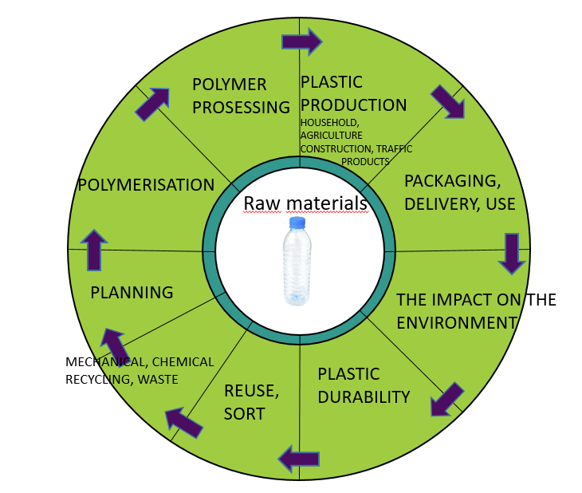
Reduce&reuse&recycle before burning

Slide 9
Tasks 1 General information about polymers
1.1. Tell on your own words the principles of plastic production'.
1.2. Why the circular economy of plastics is important?
1.3. Tell about the amount of waste plastic globally.
1.4. What does mean the life cycle of plastics?
1.5.Make a list about the most used thermoplastics and thermosets.
1.6. How thermoplastics and thermosets differ from each other?
1.7. How the recycling of thermoplastic polymers differs from the recycling of thermosets?
1.8. How the recycling of composites differs from the recycling of thermosets?
1.9. What are the effects of waste polymers on the environment?
References that helps you to give your answers:
https://www.plasticseurope.org/en/about-plastics/what-are-plastics
https://www.plasticseurope.org/application/files/6315/4510/9658/Plastics_the_facts_2018_AF_web.pdf​
https://www.plasticseurope.org/en/resources/publications

Slide 11
Tasks 2 Polymerization
2.1. What are the most important polymerization reactions?
2.2. How the following polymers can be produced?
2.2.1.HD-PE, LD-PE, PET, PA, PTFE, PVC
2.2.2.Polyurethane, Polyesters, Phenol-formaldehyde, Vinyl-esters
2.3. Write the chemical reactions of the previous polymers

Slide 13
Tasks 3 Polymer processing
3.1. Explain the following polymer processing methods: extrusion, moulding methods, thermoforming/ vacuum forming.
3.2. Tell about the differences between the polymerization processes of thermoplastic, thermosets and composites.
3.3. How can we minimize the waste of natural resources in polymerization processes?
3.4. How can we reduce and reuse waste by thinking about circular economy?
3.5. Tell about the effects of processing on the structures of polyethylene
https://www.slideshare.net/vshastiraja/polymer-processing
Björkqvist, I. 2018. The Effect of Mechanical Recycling for Processability of HDPE, Bioproduct and Process Technology. TAMK. Final thesis http://urn.fi/URN:NBN:fi:amk-201905067893

Slide 15
Tasks 4 Plastic products: household, agriculture, construction, traffic
4.1. Tell about the applications of polymers in the household, agriculture, construction and traffic
4.2. Tell about the advantages and disadvantages of plastics in packaging material
4.3. Compare advantages and disadvantages of plastic and paperbags
4.4. How can be planned packaging material so that increase the possibilities of recycling?
4.5. Compare between the use of plastics, mulch and glass in agriculture
4.6. How do additives effect on the possibilities of recycling?
4.7. How can be produced longer life-time and safer polymer product?
4.8. How can we avoid polluting the environment by plastics waste in agriculture, transport, home, civil engineering etc?
Scott,G.1999. Polymers and the Environment. The Royal Society of Chemistry.

Slide 17
Tasks 5 Packaging, delivery, use
5.1. How can you take account circular economy on packaging?
5.2. How can you take account circular economy on delivery?
5.3.How can you take account circular economy on the use of plastics?
Scott,G.1999. Polymers and the Environment. The Royal Society ofChemistry.

Slide 19
Tasks 6 Impact of environment, plastic durability
6.1. Tell about the environmental effects on plastics and rubbers?
6.2. Tell about the effect of pollutants, exposure of light, temperature and humidity on plastic materials.
6.3. How the effect of previous issues for plastics can be estimated? What are the problems with estimations?
6.4. What does mean polymer durability?
6.5. How polymers durability could be estimated?
6.6. What do mean aerobic and anaerobic degradation of polymers? Tell about the circumstances.
6.7. What does mean peroxidation degradation? Tell about the circumstances.
Scott,G.1999. Polymers and the Environment. The Royal Society of Chemistry.

Slide 21
Tasks 7 Impact of environment, plastic durability
Explain:
7.1. Mechanical recycling
7.2. Chemical recycling
7.3. Biological recycling
7.4. Find from the Internet 2-3 examples about the cases of polymers mechanical recycling processes.
http://search.ebscohost.com/login.aspx?direct=true&AuthType=cookie,ip,uid&db=nlebk&AN=496077&site=ehost-live&scope=site&authtype=sso&custid=s4778523&ebv=EB&ppid=pp_114
https://www.ncbi.nlm.nih.gov/pubmed/28823699
http://www.uusiomuovi.fi/fin/kuluttajalle/household_packaging_recycling/
Scott,G.1999. Polymers and the Environment. The Royal Society of Chemistry.

Slide 22
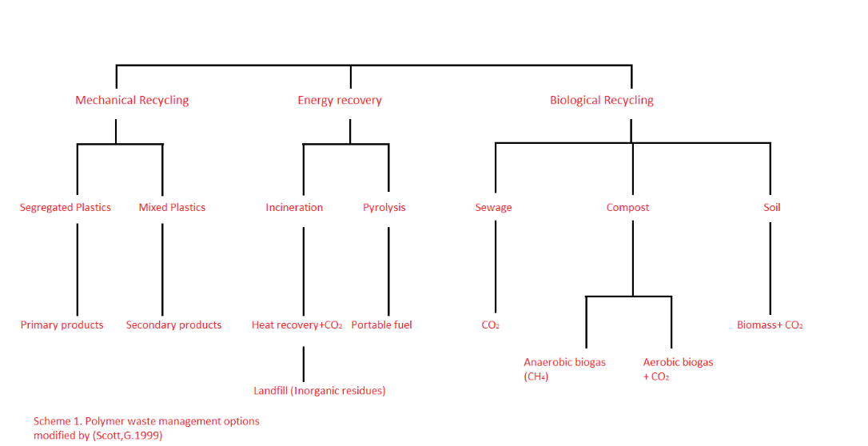

Slide 24
8. Final task
8.1. Plan a plastic product by taking account circular economy.
http://www.uusiomuovi.fi/fin/yritykselle/kierratyskelpoinen_muovipakkaus/
http://hdl.handle.net/10138/167421
https://issuu.com/suomenymparistokeskus/docs/syke_policybrief_4s_mikromuovi_fi_w/4
https://oceanservice.noaa.gov/facts/microplastics.html

Slide 25
References 1/2
Björkqvist, I. 2018. The Effect of Mechanical Recycling for Processability of HDPE, Bioproduct and Process Technology. TAMK. Final thesis http://urn.fi/URN:NBN:fi:amk-201905067893
Scott,G.1999. Polymers and the Environment. The Royal Society of Chemistry.
http://hdl.handle.net/10138/167421
https://issuu.com/suomenymparistokeskus/docs/syke_policybrief_4s_mikromuovi_fi_w/4
https://oceanservice.noaa.gov/facts/microplastics.html
https://www.ncbi.nlm.nih.gov/pubmed/28823699
http://www.uusiomuovi.fi/fin/kuluttajalle/household_packaging_recycling/

Slide 26
References 2/2
ttp://search.ebscohost.com/login.aspx?direct=true&AuthType=cookie,ip,uid&db=nlebk&AN=496077&site=ehost-live&scope=site&authtype=sso&custid=s4778523&ebv=EB&ppid=pp_114
https://www.slideshare.net/vshastiraja/polymer-processing
ttps://www.iso.org/obp/ui/#iso:std:iso:472:ed-4:v1:en
http://www.tsk.fi/tepa/fi/
http://www.uusiomuovi.fi/fin/yritykselle/kierratyskelpoinen_muovipakkaus/
Lisää teksti napsauttamalla

