Slide 1
Resource scarcity
We have finite amount of natural resources.
Can we use them infinitely?
Asseri Laitinen
Vaasa University of Applied Sciences

Slide 2
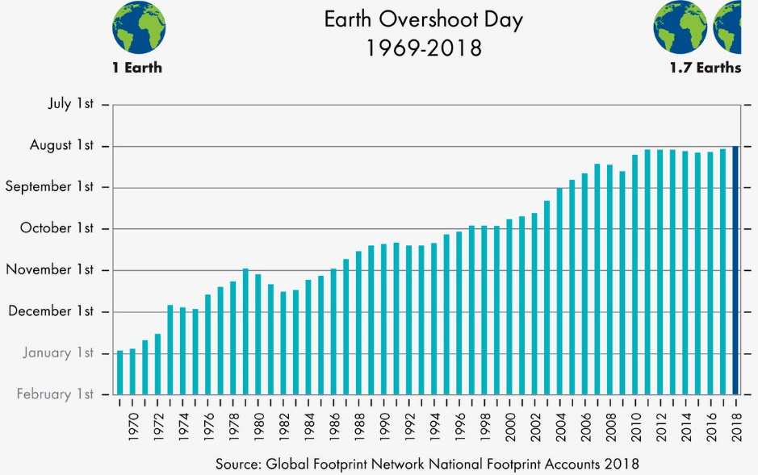
Resource scarcity
We use 1,7 Earths at the moment
Population 10 billoin in 2050
2.5 billion new middle-class people until 2030
China, India, Africa
https://commons.wikimedia.org/wiki/File:Earth_Overshoot_Day_1969-2018.jpg
Notes:
collapsing fisheries, diminishing forest cover, depletion of fresh water systems, and the build up of carbon dioxide emissions

Slide 3

Which resources are running out?
List at least 5 resources whose reserves have critically lowered in last 100 years?

Slide 4
Which resources are running out?
Fossil fuels
Fertilizers (phosphorus, etc.)
Minerals (silver, copper, nickel, etc.)
Clean water
Food
Forests
Clean air
Nutritious soil
Biodiversity

Slide 5
Use of natural resources
The environmental problems or lack of resources has always created development
= Technologic Evolution
Ozone depletion => new halocarbon-free coolants for refrigerators etc. (instead of banning the use of refrigerators)
CO₂-emissions from vehicles => electric vehicles
From electric bulbs to LED lights

Slide 6
Instead of banning or degrowthing, the consuming is enabled other way
The problem is that there’s no carbon-, material- or energy-free option
wind, solar, hydro don’t have direct emissions to air
but through mining of raw materials, infrastructure,
construction etc.
Even though we shift to renewable or other low-carbon energy
sources, we can’t increase our energy use infinitely
Source: https://www.ipcc.ch/site/assets/uploads/2018/02/ipcc_wg3_ar5_annex-iii.pdf

Slide 7
Instead of banning or degrowthing, the consuming is enabled other way
The ”quality” of mobile phones
has improved (the mass has
decreased => less raw materials
used), but the quantity
of phones is increasing almost
exponentially
The material save we win by
smaller phones, we lose by having
more phones in the globe
Source: https://www.technologyreview.com/2010/11/29/198753/the-mobile-device-is-becoming-humankinds-primary-tool-infographics-feature/

Slide 8
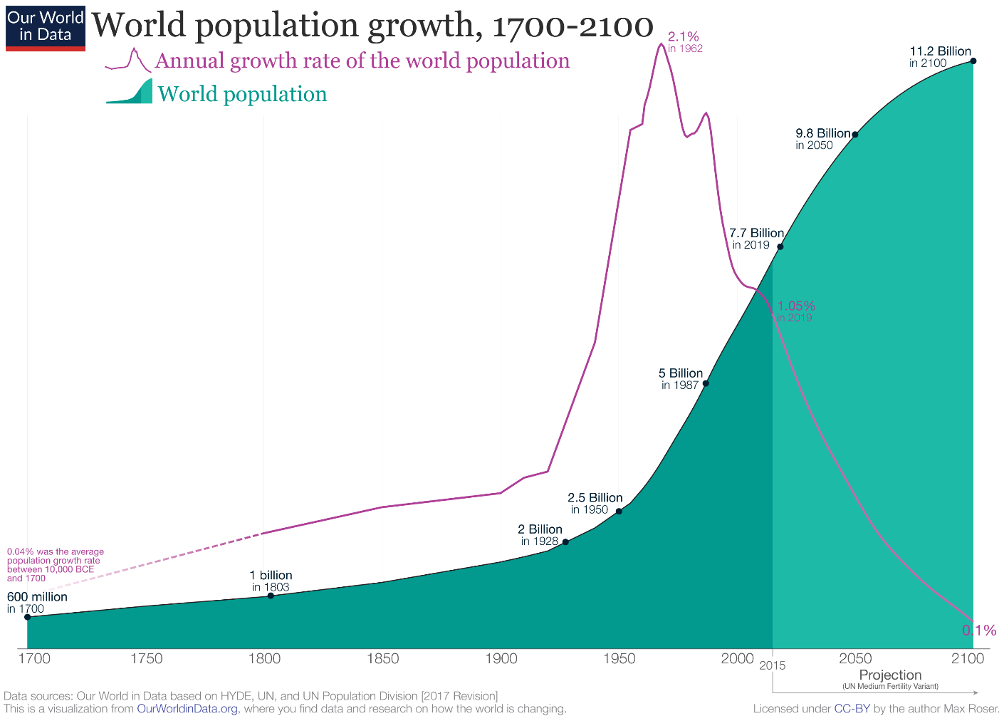
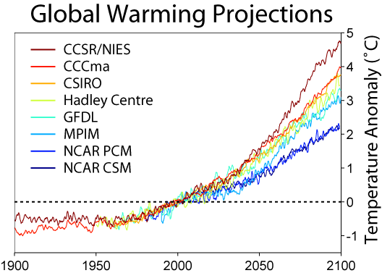
Do we have enough time to wait for the techno-evolution to happen?
Increasing world population
Climate change
Resource scarcity
The use of better technologies is not enough, unless we decouple our natural resource use from consuming
https://commons.wikimedia.org/wiki/File:Global_Warming_Predictions.png
https://commons.wikimedia.org/wiki/File:World_Population_Growth_1700-2100.png

Slide 9
Use of natural resources
The domestic extraction in Finland has been stable for 40-50 years
Nevertheless, hidden flow imports (mining, energy use in manufacture, transportation, etc.) has increased hugely
The production and use of raw materials happens in developing countries (Hidden flow imports)
Only the material load (mass) of the end product (Manufactured imports) can be seen in Finland’s statistics
http://www.stat.fi/til/kanma/2016/kanma_2016_2017-11-16_tie_001_fi.html

Slide 10
Hidden flow imports
Production and use outside Finland
Exports
Manufactured imports
Hidden flow exports
Domestic extraction
Unused extraction
Finnish use of natural resources

Slide 11
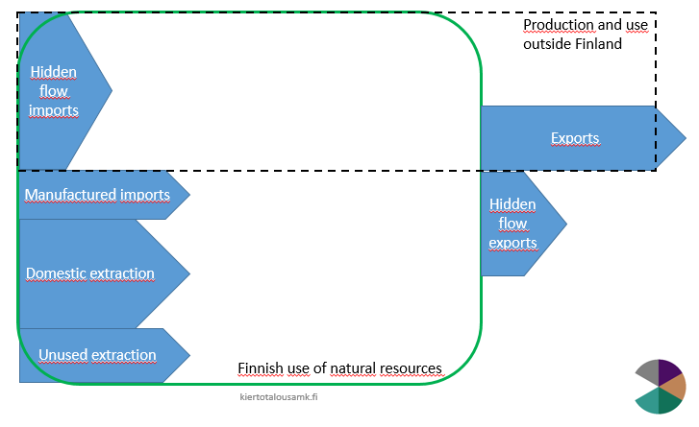
The question is how to allocate national use of natural resources
The balance between hidden flow exports and imports is not clear
Finland imports
Fuels & chemicals
Electronics
Machinery
Metals & metal products
Vehicles
Finland exports
Chemicals & fuels
Paper & cardboard
Metals & metal products
Electronics
Machinery

Slide 12
Fossil fuels

Slide 13
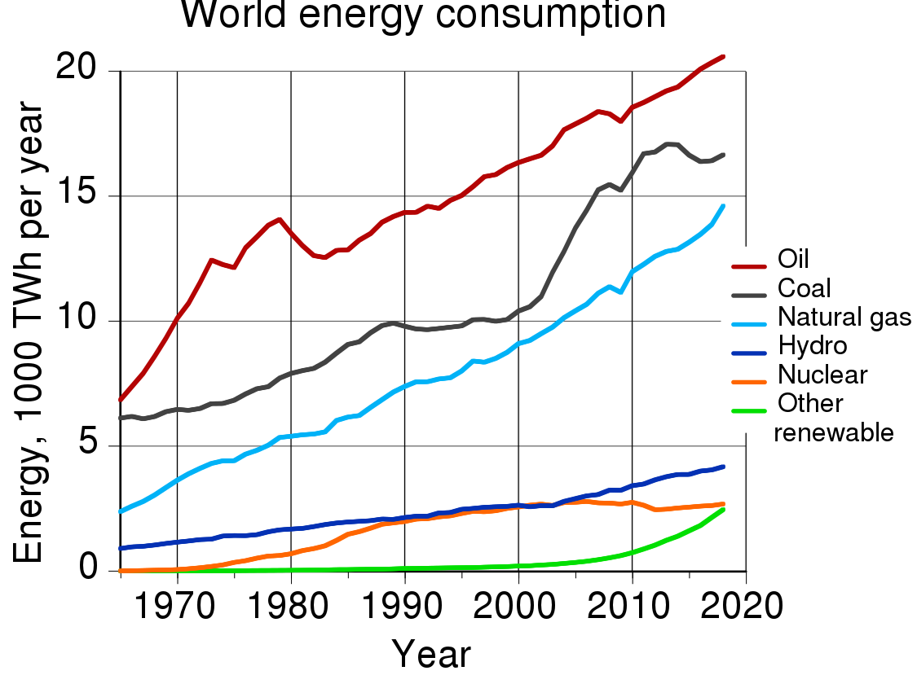
World energy production
13 865 Mtoe
(million tonnes oil equivalent)
Fossil fuels 85 %
Nuclear 4 %
Hydropower 7 %
Renewables 4 %
=> Still most of the energy use is supplied by fossil fuels
Figure source: https://commons.wikimedia.org/wiki/File:World_energy_consumption.svg
Notes:
Öljy 4330=
Maakaasu 3140=
Hiili 3840
Ydin 580
Hydro 890
UE 360

Slide 14
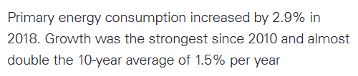
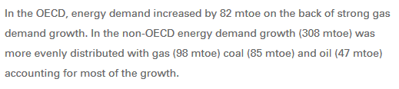
World energy production
https://www.bp.com/en/global/corporate/energy-economics/statistical-review-of-world-energy/primary-energy.html
Notes:
Öljy 4330=
Maakaasu 3140=
Hiili 3840
Ydin 580
Hydro 890
UE 360

Slide 15
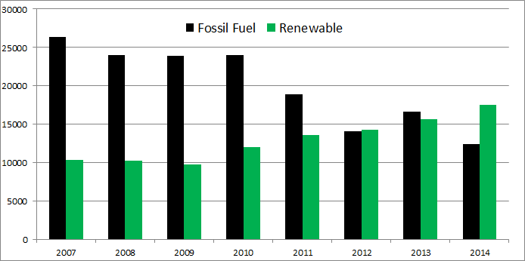
Even though huge amounts of renewables are being installed every year,
global energy demand is increasing faster than the growth of renewables is meaning that fossil based energy capacity is installed more than renewables
(in electricity production renewables dominates already today)
Energy use is estimated to peak in 2040s, 2050s
Notes:
https://www.mckinsey.com/~/media/McKinsey/Industries/Oil%20and%20Gas/Our%20Insights/Peak%20energy%20peak%20oil%20and%20the%20rise%20of%20renewables%20An%20executives%20guide%20to%20the%20global%20energy%20system/Peak-energy-peak-oil-and-the-rise-of-renewables-vF.ashx

Slide 16
Estimates of fossil fuels reserves
IPCC:
“coal reserves are likely to last around 100 years at current rates of production”
“the peak in conventional oil production is imminent or has already been passed”
“Unconventional oil resources are larger than those for conventional oils. Large quantities of these in the form of shale oil, heavy oil, bitumen, oil (tar) sands, and extra-heavy oil are trapped in sedimentary rocks in several thousand basins around the world.”
“natural gas reserve additions have consistently outpaced production volumes and resource estimations have increased steadily since the 1970s”
“The global natural gas resource base is vast and more widely dispersed geographically than oil.”
https://www.ipcc.ch/site/assets/uploads/2018/02/ipcc_wg3_ar5_chapter7.pdf
Notes:
https://www.ipcc.ch/site/assets/uploads/2018/02/ipcc_wg3_ar5_chapter7.pdf

Slide 17
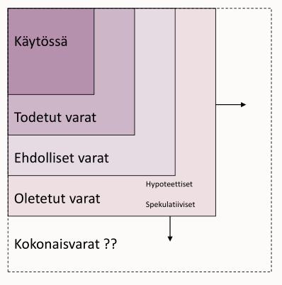
Natural resource reserves
In use
Established
Over 90 % probability that the reserves can be recovered under existing operating conditions
Probable
Can be used in future if comes technically or economically viable (at least 50 % probability)
Possible
Unproven reserves (10 % confidence level of recovery)
In use
Established
Probable
Possible
Total reserves?

Slide 18
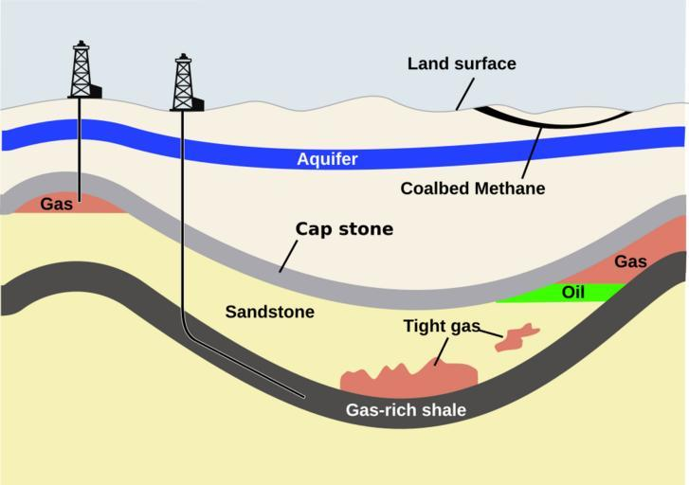
Resource scarcity
Absolute scarcity
Scarce reserve that can’t meet the demand
Relative scarcity
Reserve that can’t be utilized at current circumstances
Can become exploitable if new technology emerges or if fuel prices change
Shale gas and oil, arctic oil
https://snappygoat.com/s/?q=bestof%3AMethane+Hydrate+phase+diagram.jpg+BadJPEG+en+graphic+developed+based+on+data+from+Physical+Chemical+Characteristics+of+Natural+Gas+Hydrate%3B+Book+Series+Coastal#f07464c2a8068f058eaa42eda64fb59664b7dc86,0,5.

Slide 19
EROI
Energy Return on (Energy) Invested = ERO(E)I
= energy output that we get out of fuel related to the amount of energy consumed in extracting, refining etc. the raw energy source to a fuel
Notes:
Alussa öljy sisältää 100 MJ, mutta ketjun edetessä ulossaatava energia vähenee. EROI ei kuitenkaan vertaa 100 MJ 20,5 MJ:een, vaan jalostamiseen käytettyä energiaa 20,5 MJ:en.

Slide 20
EROI
EROI value for oil has decreased hugely since the beginning of the modern era
Profitability ratio 6:1
Modern society needs
EROI value of
10:1
See Figure 1 in page 1873 in Guilford M. C. et al. 2011: A New Long Term Assessment of Energy Return on Investment (EROI) for U.S. Oil and Gas Discovery and Production
Notes:
Guilford M. C. et al. 2011: A New Long Term Assessment of Energy Return on Investment (EROI) for U.S. Oil and Gas Discovery and Production

Slide 21
EROI in a society
Min. EROI required Activity
1.1 : 1 Extract oil
1.2 : 1 Refine Oil
3 : 1 Transportation
5 : 1 Grow Food
7-8 : 1 Support Family of Workers
10 : 1 Education
12 : 1 Health Care
14 : 1 Arts and other culture
Lambert, J.; Lambert, G. Life, Liberty, and the Pursuit of Energy: Understanding the Psychology of Depleting Oil Resources; Karnak Books: London, UK, In preparation.
Notes:
http://energyskeptic.com/2013/2012-global-eroi/
https://therationalpessimist.com/2013/04/07/one-reason-we-struggle-to-grow-energy-return-on-investment-eroi/
If you’ve got an EROI of 1.1:1, you can pump the oil out of the ground and look at it. If you’ve got 1.2:1, you can refine it and look at it. At 1.3:1, you can move it to where you want it and look at it. We looked at the minimum EROI you need to drive a truck, and you need at least 3:1 at the wellhead. Now, if you want to put anything in the truck, like grain, you need to have an EROI of 5:1. And that includes the depreciation for the truck. But if you want to include the depreciation for the truck driver and the oil worker and the farmer, then you’ve got to support the families. And then you need an EROI of 7:1. And if you want education, you need 8:1 or 9:1. And if you want health care, you need 10:1 or 11:1.

Slide 22
”Fossil society”
It’s difficult to substitute fossil fuels
Fossil fuels have some overwhelming features
Energy content, energy density, stability in storaging and transportation, reliability, multi-function
Infrastructures are built to use oil and other fossil fuels
Transportation, heat and electricity
Notes:
Energiatiheys: UE:t vaativat suuren maa-alan tuotettua energiaa kohti (tuuli, aurinko)

Slide 23
”Fossil society”
Subsituting oil with e.g biofuels produces a lot of loss
Earth has used millions of years and optimal conditions (pressure) to make ”perfect” fuel as oil, coal and natural gas
Should some of the functions in our societes be allowed to use fossil fuels also in future?
Aviation, agriculture, some industries (e.g. coke in iron making)

Slide 24
Fertilizers

Slide 25
Fertilizers
Phosphorus and nitrogen most important nutrients in food production
Recycling of nutrients is low
Ends up to lakes and seas from agriculture or to landfills or incineration from human wastewater
Resources are declining but the consumption is increasing

Slide 26
Phosphorus
Only resource for phosphorus is phosphate rock
Known phosphate rock reserves will last at least 250 years at today’s consuming rates.
Phosphorus fertilizer production consumes fossil fuels 7,7 GJ / t-P
Sources:
U.S. Geological Survey, 2019: Mineral commodity summaries 2019
Meers, 2016: EIP-AGRI Focus Group How to improve the agronomic use of recycled nutrients (N and P) from livestock manure and other organic sources?
Clark W. Gellings, Kelly E. Parmenter, 2004: ENERGY EFFICIENCY IN FERTILIZER PRODUCTION AND USE , in Efficient Use and Conservation of Energy, [Eds. Clark W. Gellings, and Kornelis Blok], in Encyclopedia of Life Support Systems (EOLSS)
Notes:
U.S. Geological Survey, 2019: Mineral commodity summaries 2019
Meers (2016): EIP-AGRI Focus Group How to improve the agronomic use of recycled nutrients (N and P) from livestock manure and other organic sources?
Clark W. Gellings, Kelly E. Parmenter, (2004), ENERGY EFFICIENCY IN FERTILIZER PRODUCTION AND USE , in Efficient Use and Conservation of Energy, [Eds. Clark W. Gellings, and Kornelis Blok], in Encyclopedia of Life Support Systems (EOLSS),

Slide 27
Nitrogen
N fertilizer is produced via Haber-Bosch –process
Combines nitrogen from atmosphere (N₂) and hydrogen from natural gas (CH₄) to form ammonia, NH₃
Requires 1090-1250 m³ CH₄ / t-NH₃
Consumes fossil fuels 35.2-40.5 GJ / t-NH₄⁺
Notes:
Meers (2016): EIP-AGRI Focus Group How to improve the agronomic use of recycled nutrients (N and P) from livestock manure and other organic sources?
Clark W. Gellings, Kelly E. Parmenter, (2004), ENERGY EFFICIENCY IN FERTILIZER PRODUCTION AND USE , in Efficient Use and Conservation of Energy, [Eds. Clark W. Gellings, and Kornelis Blok], in Encyclopedia of Life Support Systems (EOLSS),
“Producing ammonia is a very energy intensive process; it requires about 1090 to 1250 m³ of natural gas to produce 1 metric ton of anhydrous ammonia (35 000 to 40 000 ft³ natural gas per short ton). In 1999, over 15 million metric tons (17 million short tons) of ammonia were produced in the United States, with almost 90% of that going to the fertilizer industry. This amount corresponded to about 3% of total US natural gas production.

Slide 28
Nutrient recycling
Manure
Wastewater sludges
Food waste
Crop residues
Anaerobic digestion one working option
Products: energy (vehicle gas or heat&electricity) & fertilizer
Nutrients are more soluble so that plants can utilize them more effectively
They are not washed away that easily from the field by rainwater

Slide 29
Water

Slide 30
Freshwater

Slide 31
Most of the water is consumed by food and goods
= WATER FOOTPRINT
Check figure in:
http://one-europe.net/user/files/Briefs/waterfootpriint.jpeg
Notes:
http://one-europe.net/user/files/Briefs/waterfootpriint.jpeg

Slide 32
Colours of water
Black
Grey
Green
Blue
Dyke: C. 1992: From Entropy to Economy. A Thorny Path. Advances in Human Ecology
Notes:
Veden värit (Dyke: C. 1992: From Entropy to Economy. A Thorny Path. Advances in Human Ecology (1).)

Slide 33
Black water
Contains excrement or other hazardous matter for example from industry
Expensive, challenging and/or dangerous to clean
Forming of black water should be avoided
Dry toilets
Internal cycle of water in factories
Notes:
Veden värit (Dyke: C. 1992: From Entropy to Economy. A Thorny Path. Advances in Human Ecology (1).)

Slide 34
Grey water
Shower, laundry, dish
Contains no hazardous/toxic compounds
Black and grey water can be collected separately to save water reserves
Grey water could be re-used e.g. to irrigation
https://greenlightonline.co.za/?attachment_id=8401
Notes:
http://recoverwater.com/

Slide 35
Full-scale (12 000 inhabitants) separate black and grey wastewater treatment in Qingdao, China
+ Can help to protect water bodies in areas where clean water resources are insufficient
+ nutrient load in effluent lowers
Use of wastewater treatment chemicals increases
Use of energy increases
+ Compared to seawater desalination, clean water can be produced at lower energy use
https://iwaponline.com/jwrd/article/6/4/466/28849/First-implementation-of-a-SEMIZENTRAL-resource

Slide 36
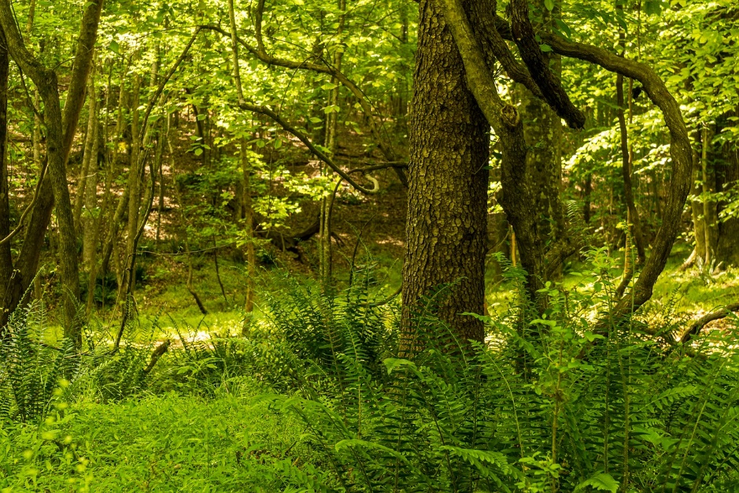
Green water
”Soil water”
Soil moisture formed by rain water
Used by plants
https://pixabay.com/fi/photos/kev%C3%A4%C3%A4ll%C3%A4-mets%C3%A4ss%C3%A4-p%C3%A4iv%C3%A4nvalossa-mets%C3%A4-5109813/

Slide 37
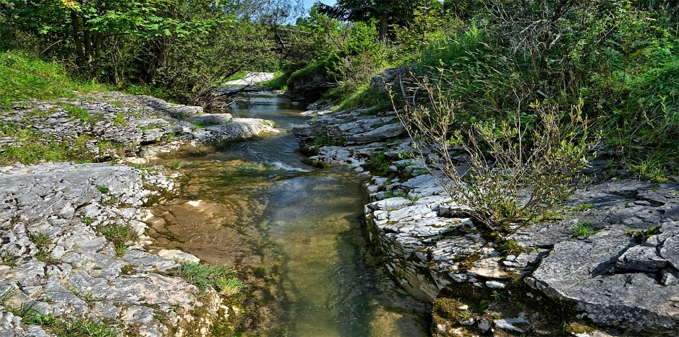
Blue water
Clean, usually drinkable water
Ground water, springs, lakes, ponds
The water used in urban areas can be sescribed as blue-green or blue-grey water
(as the groundwater, water from lake is cleaned using chemicals by drinking water treatment plants)
https://pixabay.com/fi/photos/stream-vesi-vuoret-3645734/

Slide 38
Black
Grey
Green
Blue
Harder to produce
Harder to clean up
Notes:
Energeettisesti helpompaa tuottaa mustaa kuin sinistä vettä
Termodynamiikan laki (entropia):
Sekoittaminen helpompaa kuin erottaminen!
Silti moderni yhteiskunta käyttää paljon energiaa tehdäkseen puhtaasta vedestä mustaa
”Puhtaanapito”

Slide 39
Minerals

Slide 40

Minerals
Mineral = naturally occurring, inorganic solid chemical compound
Consists typically of several different elements
~ 100 minerals have economical value
Formed as a result of geological processes
Geological cycles too slow to be renewable
https://pxhere.com/en/photo/498453

Slide 41
Minerals in future energy production
Non-carbon energy production will increase the use of rare metals
Solar panels
Wind turbines
Batteries
Power grid
Nuclear power plants
Lighting

Slide 42
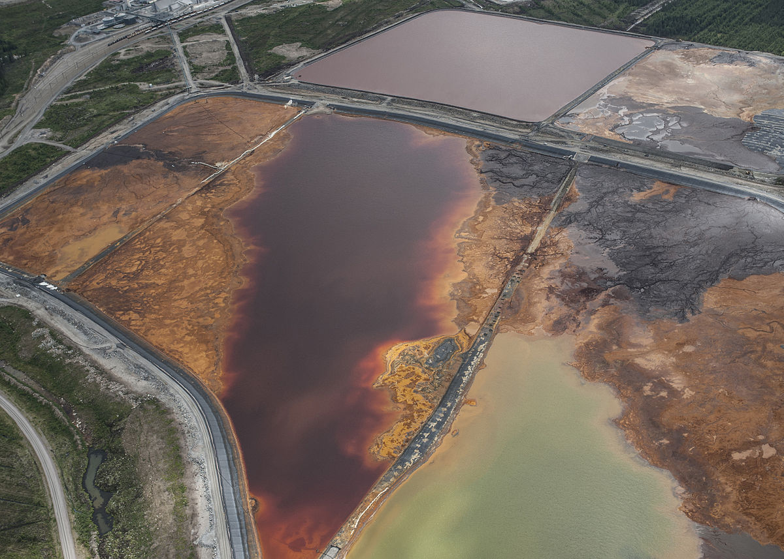
Minerals in the future
Geopolitical questions
Environmental and societal impact of mining industry
Landfills as new mines
Figure: Talvivaara mine, Sotkamo, Finland
https://commons.wikimedia.org/wiki/File:Kipsisakka-altaat_laittomassa_tilassa_-_Ilmakuva_2013_(9709939955).jpg

Slide 43
Food industry

Slide 44
Food industry
~ 800 million malnourished
><
~ 600 million overweighted
There is enough food in the world but it’s not distributed evenly
The amount of malnourished is declining
Notes:
Aliravitsemus: https://www.wfp.org/hunger/stats
Ylipaino: https://www.scientificamerican.com/article/world-s-obese-population-hits-641-million/
https://www.cnbc.com/id/100893540

Slide 45
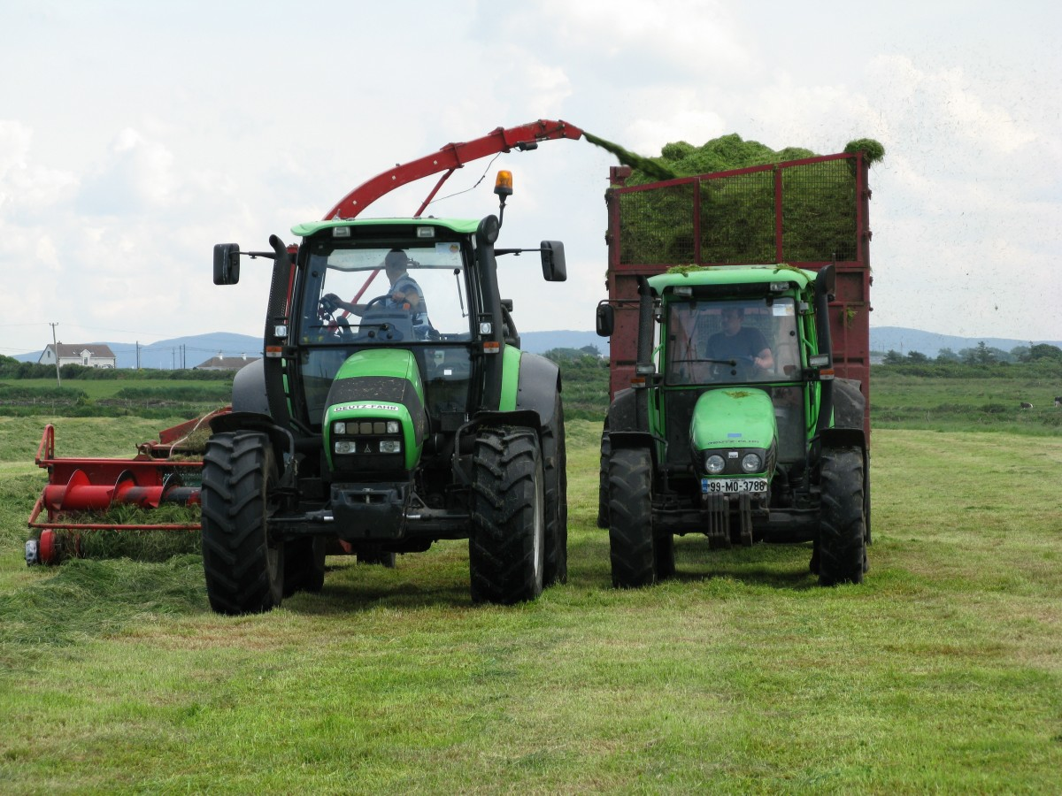
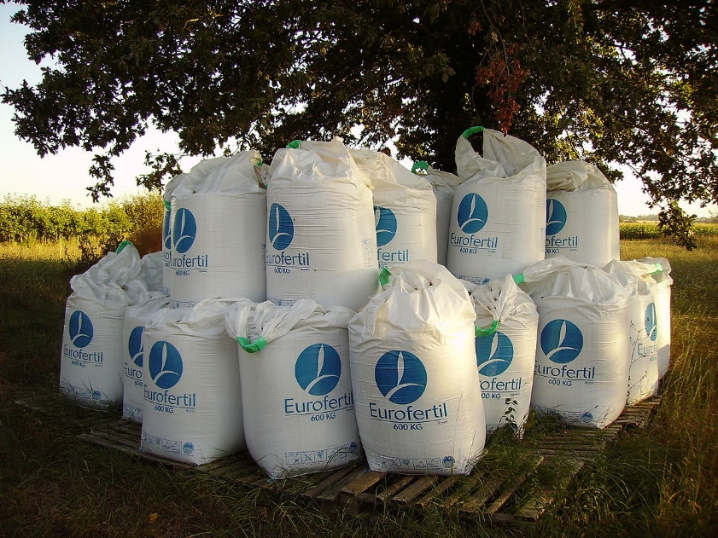
Food industry
So far, food industry has grown faster than
the world population
More powerful farming techniques
Uses a lot of fossil fuels
Artificial fertilizers
Increased farmland area
Forest cuttings
Plant biotechnology, refinement, GMO
https://pxhere.com/en/photo/911922
https://commons.wikimedia.org/wiki/File:Flexible_intermediate_bulk_containers-Fertilizer.jpg

Slide 46
Food industry
Food production is extremely fossil intensive
Soil preparation, fertilizing, unrooting weeds, harvesting, transportation
Very low EROI
=> A lot of energy is consumed to produce eatable calories for humans
Food is still unique
You can’t eat solar energy or oil

Slide 47
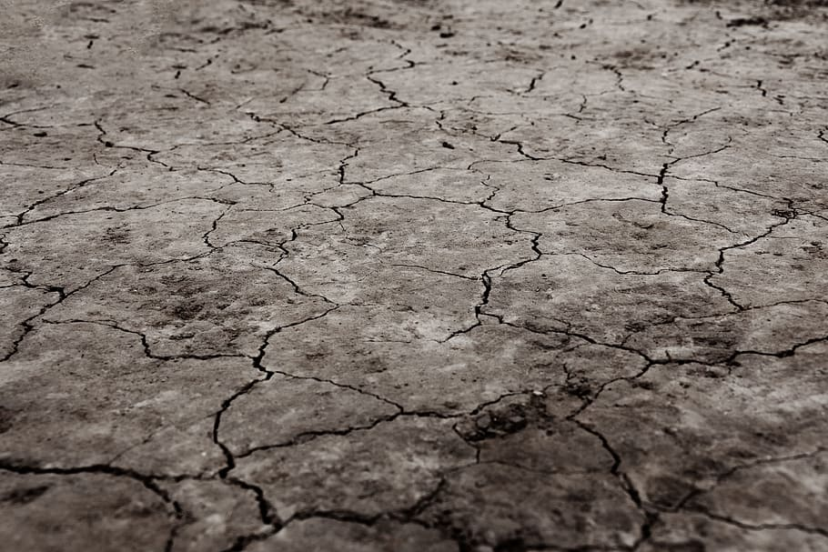
Challenges in future food production
Fossil fuel dependence
Climate change
Droughts, rainstorms, floods
Sustainability of animal protein, food transportation through continents
Erosion and soil degradation
Decreasing of fishery stock
https://www.pxfuel.com/en/free-photo-obpmw

Slide 48
Challenges in future food production
Decreasing of fossil feritilizer resources and increasing of price
Population growth
Bioenergy production

Slide 49
Biodiversity in food production
Wheat, rice, corn, potato, sweet potato, barley and cassava produces 75 % of human diet
It’s important to secure the variety of food crop genome to make plants survive in new conditions in the changing climate
Notes:
Ville Lähde: Niukkuuden maailmassa

Slide 50
Gene technology
Gene modifiying
Modifying ”natural” genome of species by bringing new genes and genotypes from other species
Gene editing
Editing species’ own gene by bringing new genes from other species varieties
Genes are not brought from other species
Traditional plant breeding
Cross breeding, mutation (radiative, chemical), haploidy
Notes:
There’s a debate going on whether to make gene EDITING easier by distinguishing it from gene MODIFYING

Slide 51

GMO
The desired plant features can be developed
Tolerance to certain pests or methorological phenomena (heat, drought)
Golden rice
Contains beta-carotene (A-vitamine)
that lacks e.g. in India and Africa
https://commons.wikimedia.org/wiki/File:Golden_Rice.jpg

Slide 52
Fishery overexploitation
~1/3 of world’s fish stocks are overfished
Aquaculture causes eutrophication, feed imports and low-value fishes using as a feed
Notes:
https://www.hs.fi/tiede/art-2000005890237.html
https://wwf.fi/kalaopas/Mihin-WWF-n-Kalaopasta-tarvitaan--2549.a

Slide 53
Meat production
8-15 % global GHG emissions
25-32 % water-use
Comparing to eg. transportation 13 %
Efficiency of meat ~10 – 20 %
5-10 kg feed / kg meat
However, livestock can transform materials non-edible for human (grass, etc.) to edible meat (and still produce recyclable nutrients via manure)
ftp://ftp.fao.org/docrep/fao/010/a0701e/a0701e03.pdf
Notes:
https://www.researchgate.net/publication/283528658_Livestock_and_the_Environment_What_Have_We_Learned_in_the_Past_Decade?fbclid=IwAR37PhNwChFbKDDv0BOBy-1YELYpDDdhvg1HP9STIKHj1Whzqyvlq-rDR2E (8-18 %)
TACKLING CLIMATE
CHANGE THROUGH
LIVESTOCK (14,5 %)

Slide 54
Soil
~1/3 of fertile soil has disappeared in just 40 years by soil erosion and toxication
The quality and erosion-durability of soil can be enhanced by
Crop rotation
Cover crops
Moderate/light preparation of soil or no soil preparation at all
http://grantham.sheffield.ac.uk/soil-loss-an-unfolding-global-disaster/

Slide 55
Others

Slide 56
Forests
Pre-industrial era:
Home
Food, medicine
Firewood
Industrial era:
Source of raw materials for
construction, paper, energy, etc.
Post-industrial:
Multipurpose forest use
Raw materials
Tourism, relaxation, healthiness
Biodiversity

Slide 57
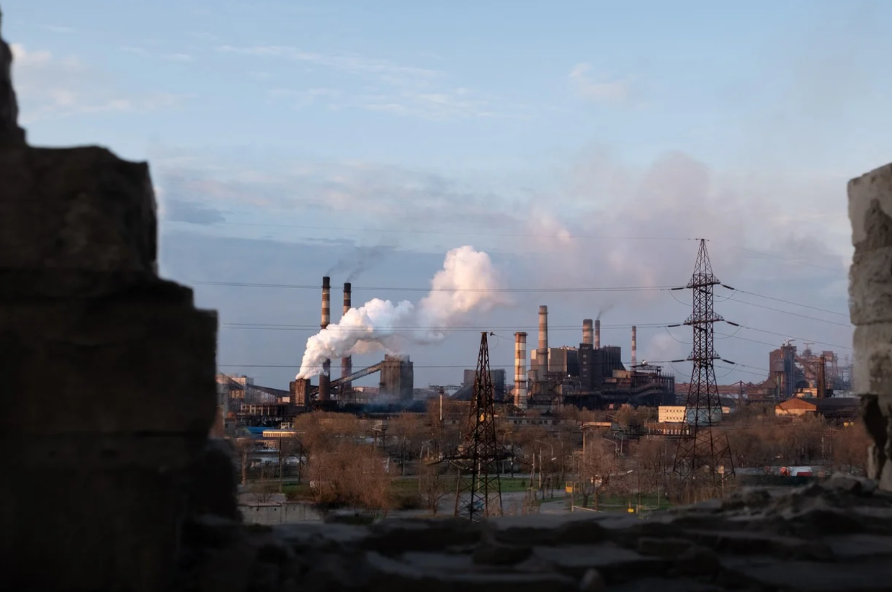
Clean air
WHO: 1/8 of yearly deaths (~7 million out of ~55 millions) is caused by air pollutions
https://cdn.pixabay.com/photo/2020/04/22/09/11/air-pollution-city-5076746_1280.jpg

