Slide 1
Resilient & green communities
In this lecture:
Urban resilience
Green cities

Slide 2
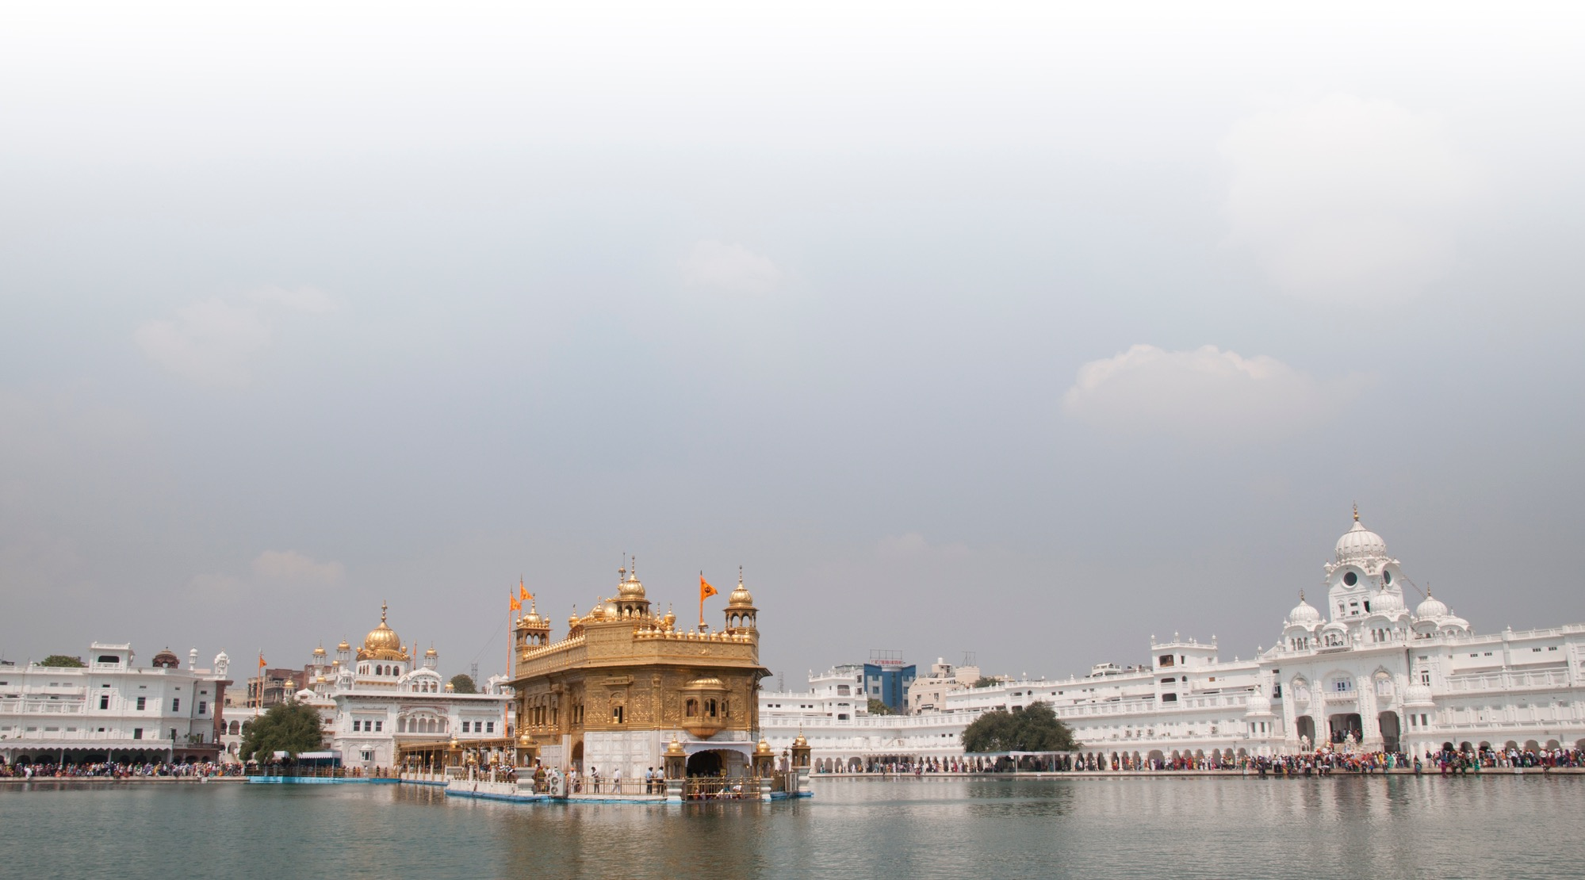
Resilience
Resilient cities (Prof. Jeffrey Sachs, SDG Academy)
https://www.youtube.com/watch?v=v8u9BJDuIrY
SDG Academy: Sustainable cities – Urban resilience
https://www.youtube.com/watch?v=YoyCCwqTXp4
Case: Resilience Academy, Tanzania
https://www.youtube.com/watch?v=ehVOhpv4meA
Notes:
Photo of Amritsar, India. (Photo: Pentti Viluksela CC BY)

Slide 3
Urban resilience – UN Habitat
The ability of any urban system to maintain continuity through all shocks and stresses while positively adapting and transforming towards sustainability.
Range of natural and human-made shocks and stresses:
earthquakes
flooding
rapid immigration
cyber-attacks, etc.
Additional challenges:
rapid urbanization
climate change
political instability, etc.

Slide 4
Disaster risk reduction (DRR)
United Nations Office for Disaster Risk Reduction
https://www.undrr.org/
Sendai Framework for DRR
https://www.undrr.org/implementing-sendai-framework/what-sf
The Sendai Framework and the SDGs
https://www.undrr.org/implementing-sendai-framework/sf-and-sdgs

Slide 5
Sendai framework for DRR United Nations 2015
Outcome: reduction of disaster risk and losses in lives, livelihoods and assets
personal, business, communities, countries
Goal: Prevent disaster risk through appropriate measures and actions to strengthen resilience
Priorities:
understand risks
strengthen governance to manage risk
invest in resilience
improve preparedness and rebuild better
7 targets
lower disaster mortality
lower no. of people affected
lower economic losses
lower infrastructure damage
better DRR strategies
better international cooperation
better information systems

Slide 6
Task 1
Analyse the resilience of your home city/community (or the city/community of your Assignment):
What kind of resilience threats or risks can be identified?
Are there strategies, plans, activities for risk reduction and preparedness?
How is your community/city working together with citizens and other stakeholders to improve resilience?

Slide 7
EBRD: Green city
https://www.ebrdgreencities.com/
Objectives:
To preserve the quality of environmental resources (air, water, land, ecosystems) and manage them sustainably
To mitigate and adapt to climate change and its risks
To ensure that environmental policies and activities are improving the social and economic welfare of citizens

Slide 8
Green City Index
by the Economist Intelligence Unit
report from 2012
covers 120 cities around the world
European cities report:
search: european-green-city-index.pdf
Green city indicators (eight sectors, 30 indicators):
https://www.researchgate.net/figure/EIUs-The-Green-City-Index_tbl1_320334509

Slide 9
Task 2
Analyse your home city/community (or the city/community of your Assignment) in terms of the indicators presented on the previous page.
Which of the eight sectors of the circle are on good level, which are not so good?
Comment the situation in your city related to Transport and Environmental governance. Has the situation improved or deteriorated in the recent years? What are the challenges? Are there any good solutions or initiatives?

Slide 10
The Urban Green
by WWF
https://www.youtube.com/watch?v=o86Ut6kAEMQ
Observe:
top leadership commitment
co-operation between various parties
disruptive technologies, ambitious policies

Slide 11
Climate action: Hinku project
https://www.hiilineutraalisuomi.fi/en-US/Hinku
Case: Ii
named ”the greenest town in Europe” in a BBC documentary 2019
https://www.bbc.co.uk/programmes/w3ct03ms

Slide 12
Learning diary questions
Summarize the three main points of this lecture and the videos
half a page
Write your answers to Tasks 1 and 2
a quarter of a page each

