Slide 1


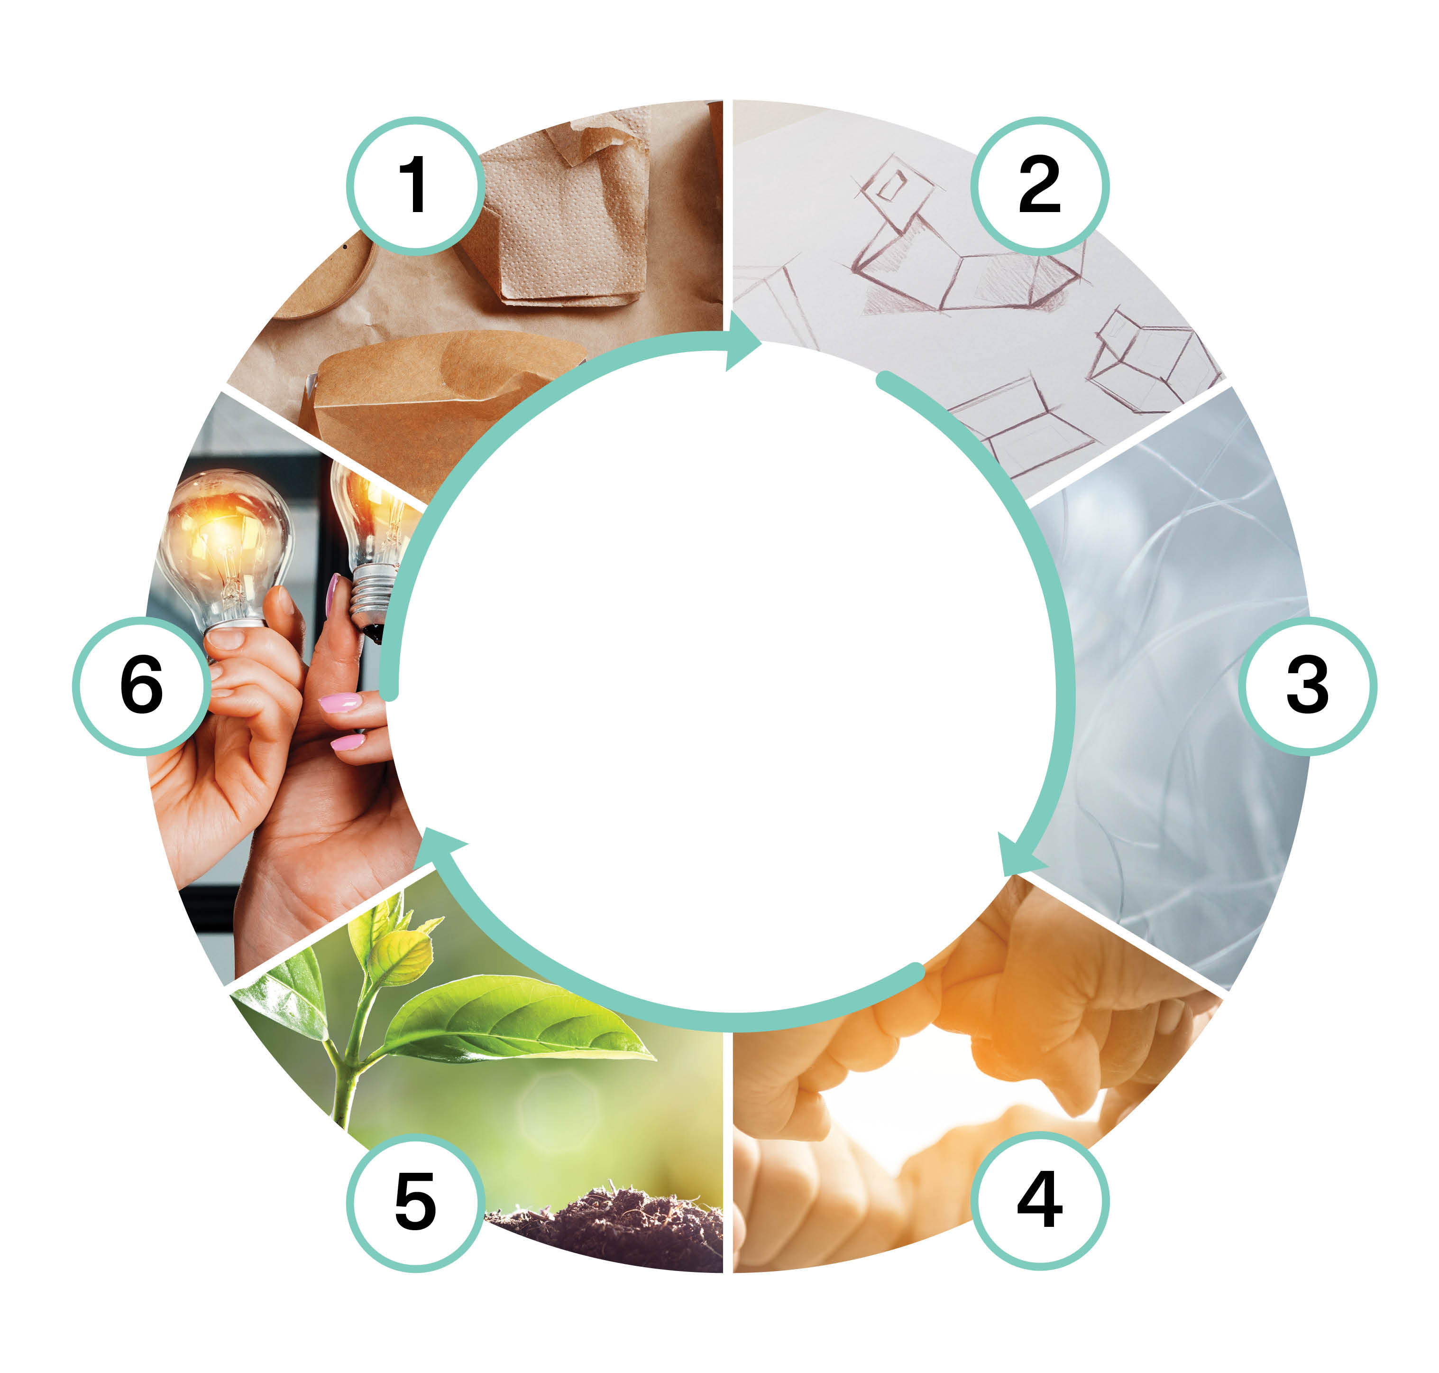

Side Streams' Management and Utilization (5 cr)
Implementation of the course as part of Packaging Value Chain Circular Economy Expert -training (30 cr)
Marita Hiipakka
This work is licenced under Creative Commons ByAttribution-Non-commercial-Share-alike 4.0 licence https://creativecommons.org/licenses/by/4.0/

Slide 2
Content
Potential of the utilization of side streams in various industries, including the packaging industry
Boundary conditions for utilizing side streams
Key questions:
How to identify side streams and their potential for utilization?
What are the benefits of utilizing side streams?
How does the management of side streams contribute to the emergence of industrial symbiosis?
What preconditions does the legislation set for the utilization of side streams?

Slide 3
Learning outcomes
Student
can identify the potential for utilizing side streams from the perspective of the packaging industry and beyond, zero waste
understands the boundary conditions set by legislation for the utilization of materials

Slide 4
Assessment criteria (1/2)
Assessment criteria, satisfactory (1–2)
can identify and name industrial side streams and their utilization opportunities
can name the boundary conditions set by legislation for the utilization of materials
identifies existing operational methods important to the sector in terms of the circular economy, such as industrial symbioses
Assessment criteria, good (3–4)
explains the management of side streams and their utilization potential in packaging materials
compares raw materials, knows how to choose the most suitable one for the application, and justifies their choices
applies the boundary conditions set by legislation for the utilization of materials

Slide 5
Assessment criteria (2/2)
Evaluation criteria, excellent (5)
comprehensively understands the potential of utilizing side streams as part of the circular economy of packaging
examines and evaluates the whole in which the profession operates
evaluates and compares different solution options, creatively combines solutions, or creates new ones
understands the boundary conditions set by legislation for the utilization of materials

Slide 6
Pedagogical approach
Max. 30 students
The implementation example includes one face-to-face meeting of 7–8 hours and two online meetings of 2–3 hours with expert lectures
Knowledge is built communally: Communality, working in networks + self-oriented studies independent of time and place
Course assignment submissions are done mostly independently. Students have an opportunity for communal work and peer feedback through face-to-face and remote meetings, and discussion forums. The course is designed to be completed during a period of 5–6 weeks

Slide 7
Learning assignment descriptions
Identification of side streams and their utilization potential Side stream management and industrial symbiosis Boundary conditions for the utilization of side streams Management and utilization of side streams: a final assignment Reflection

Slide 8
Identification of side streams and their utilization potential (1/4)
The purpose of the assignment is to familiarize yourself with side streams, their identification, and the assessment of their utilization potential in different industries’ and in the packaging value chain’s circularity.
Start the assignment by listening to the podcast Sivuvirtojen ja teollisten symbioosien alkulähteillä (https://soundcloud.com/kohinakampus/sivuvirtojen-ja-teollisten-symbioosien-alkulahteilla?utm_source=clipboard&utm_medium=text&utm_campaign=social_sharing)
Familiarize yourself with the materials generally applicable to the task. Find and use also other resources.
Leppänen, T. et al. 2020. J. Open Innov. Technol. Mark. Complex. 6, 185. https://www.mdpi.com/2199-8531/6/4/185
Orola, A. & Heponiemi, K. (eds.) 2020. Materiaalitehokkuudella vauhtia yritysten vastuulliseen toimintaan. LAB-ammattikorkeakoulun julkaisusarja, osa 8. Lahti. https://urn.fi/URN:ISBN:978-951-827-340-3

Slide 9
Identification of side streams and their utilization potential (2/4)
Brännström, H. et al. 2021. Selvitys metsä- ja agrobiotalouden sivuvirroista. LUKE.
Berg, J. 2016. ETL:n jäte ja sivuvirtaselvitys (Elintarvikeliitto)
Synergiaideoita paperi- ja pakkausteollisuuden sivuvirroista Pirkanmaalla (PITS-hanke) https://urn.fi/URN:NBN:fi-fe2023080392987
Podcast: KASVUtarinoita Kiertotaloudesta: Isojen materiaalivirtojen käsittely ja kierrätys. https://soundcloud.com/user-792254501/kasvutarinoita-kiertotaloudesta-isojen-materiaalivirtojen-kasittely-ja-kierratys?utm_source=clipboard&utm_medium=text&utm_campaign=social_sharing
Teollisuuden sivuvirtojen hyödyntäminen (materiaalitkiertoon.fi) https://www.materiaalitkiertoon.fi/fi-FI/Circwaste/Teollisuuden_sivuvirtojen_hyodyntaminen(48128)
Materiaalitori https://www.materiaalitori.fi/
KiertoaSuomesta http://kiertoasuomesta.fi/

Slide 10
Identification of side streams and their utilization potential (3/4)
Assignment: Create a free-form mapping of your organization's side flows (material flows + other possible side streams) to understand how much and in which processes are they formed. You may narrow down the task appropriately but look at things holistically. You may be able to conduct internal interviews when searching for information. The purpose of this assignment is to focus on various side streams and their utilization/utilization potential (without taking too much of a position on possible restrictions in their use).
With the help of your mapping, you may find the stages/points of your production chain in your organization or its operation, where side streams are formed considerably and where their utilization therefore has a lot of potential for the circular economy. For example, you might find steps where primary materials can be replaced with recycled ones (what kind? You may look for these in the market). You may also consider whether, for example, a material review would promote the use of side streams in your own organization. Or if it has already been conducted, has it led to any actions or effects?

Slide 11
Identification of side streams and their utilization potential (4/4)
For your assignment, write min. a 350-word essay/summary, to which you attach your study as an appendix and where you consider the utilization potential of the side streams you found. What changes would the use of side streams bring to your organization? Would the utilization of side streams be desirable, or is another solution better? How could you promote the identification of side streams? Justify your answers.

Slide 12
Side stream management and industrial symbiosis (1/3)
The purpose of the assignment is to examine examples of industrial symbiosis and eco-industrial parks and their significance in the utilization of side streams. In addition, the aim is to familiarize yourself with zero waste and zero emissions.
Familiarize yourself with the materials generally applicable to the task. Find and use also other resources.
Panel discussion: Teolliset symbioosit kiertotalouden edistäjinä. https://www.youtube.com/watch?v=zCfvV350Cy4
Kansallisen teollisia symbiooseja edistävän toimintamallin (FISS) toteutus ja organisointi. https://teollisetsymbioosit.fi/kansallisen-teollisia-symbiooseja-edistavan-toimintamallin-fiss-toteutus-ja-organisointi/
https://www.sitra.fi/artikkelit/yhdeksan-askelta-ekoteollisuuspuiston-perustamiseen/
Pirkanmaan teolliset symbioosit (PITS) : sivuvirtoja, synergioita ja symbiooseja. 2023. https://urn.fi/URN:ISBN:978-952-7266-79-3

Slide 13
Side stream management and industrial symbiosis (2/3)
Närvänen, A. 2022. Ekoteolliset puistot ja niiden toiminta Suomessa. Saatavissa: https://urn.fi/URN:NBN:fi:tuni-202201101208
Podcast: Onko jätteetön ja päästötön maailma totta vai tarua 80 vuoden päästä? https://soundcloud.com/vttpodcast/onko-jatteeton-ja-paastoton-maailma-totta-vai-tarua-80-vuoden-paasta?utm_source=clipboard&utm_medium=text&utm_campaign=social_sharing
Assignment: Choose a Finnish eco-industrial park or industrial symbiosis [or integrated factory] that you know or are interested in. Present its activities (e.g., environmental values (incl. emissions, waste), economic aspect, products, functionality, ... etc.)
Add to your symbiosis a company (imaginary or existing) that utilizes circular economy principles in its operations (explain how). Justify your choice, why would this company fit into the symbiosis you have chosen? (e.g. justify according to the same criteria as you used to describe your chosen industrial symbiosis). What kind of added value would the company bring to the other actors in the symbiosis, and what about reciprocity?

Slide 14
Side stream management and industrial symbiosis (3/3)
Look at your company and its placement in the symbiosis with a SWOT analysis. Pay attention to things and your company’s competences holistically
Prepare a free-form output of your consideration, where you have justified your choices and the solutions you made, and to which you will include your SWOT. Preferably use at least two external references in your work (remember citing the sources and add a bibliography, hyperlinks are ok)
Submit the output to the Moodle Q&A forum. As an option, you may comment at least one other submission posted in the discussion forum.

Slide 15
Boundary conditions for the utilization of side streams (1/4)
The purpose of the assignment is to examine the role of legislation and regulations, as well as other boundary conditions, in the management and utilization of side streams
Familiarize yourself with the materials generally applicable to the task. Find and use also other resources.
Heponiemi, K. 2020. Hävikki vai hukka – Mikä on sen hinta ja kuka sen maksaa? p. 8–12. https://urn.fi/URN:ISBN:978-951-827-340-3
Waste law 2011/646 (consolidated text), applicable parts. Text in Finnish. https://finlex.fi/fi/laki/ajantasa/2011/20110646
Ministry of the Environment. Waste legislation: end-of-waste. https://ym.fi/en/waste-legislation
Roschier ym. 2023. Kierrätysmateriaalien käyttöosuusvelvoite kiertotalouden edistäjänä VN publications 29. https://julkaisut.valtioneuvosto.fi/bitstream/handle/10024/164785/VN_2023_29.pdf

Slide 16
Boundary conditions for the utilization of side streams (2/4)
Välikangas, H. 2017. Liiketoimintamahdollisuuksien tunnistaminen teollisuuden jätteistä ja sivutuotteista (p. 64–80) https://lutpub.lut.fi/bitstream/handle/10024/135122/Diplomity%F6_Valikangas_Henna.pdf
Nousiainen ym. 2021. Teollisen kiertotalouden haasteet ja mahdollisuudet vuonna 2021. https://f.hubspotusercontent30.net/hubfs/5597538/Teollisen%20kiertotalouden%20haasteet%20ja%20mahdollisuudet%20vuonna%202021-2.pdf
Pajunen ym. 2022. Teollisen kiertotalouden edistäminen Suomessa – toimijat, yhteistyö ja osaaminen. https://www.lapinamk.fi/loader.aspx?id=02b9ade3-5812-4cde-bc8f-078a3052b016

Slide 17
Boundary conditions for the utilization of side streams (3/4)
Assignment: Go back to the assignment in the first section, where you mapped the potential side streams and their utilization potential of your organization. Now look it through the boundary conditions of using side streams. Which factors do you think are challenging for utilizing side stream/side streams and why? Justify your answer. How could you possibly influence this in your own work?
Go back to the assignment in the second section, where you incorporated a company that follows circular economy measures into an industrial symbiosis. Similarly, consider this situation through the boundary conditions of using side streams. Which factors do you think are challenging for utilizing side stream/side streams and/or the implementation of circular economy principles in this company and this symbiosis? Would it be possible to change something? Justify your answer.

Slide 18
Boundary conditions for the utilization of side streams (4/4)
Write a free-form essay (min. 350 words) of your considerations where you have justified your choices and decisions. At the end of your essay, summarize three points that you think are the most critical that can pose challenges to the utilization of side streams. Preferably use at least two external references in your work (remember to cite the sources and add a bibliography, hyperlinks are ok).
Submit the output to the Moodle Q&A forum. As an option, you may comment at least one other submission posted in the discussion forum.

Slide 19
Management and utilization of side streams: a final assignment (1/2)
The purpose of the assignment is to compile a comprehensive summary task related to side streams and their use
You may use the literature and materials introduced in the previous sections of this course. Find and use also other resources.
Assignment: Evaluate your own (or a well-known) organization from the perspective of managing and utilizing side streams. Identify side streams generated in operations and evaluate their utilization potential. Plan how the organization could concretely reduce waste and increase the utilization of side streams, both in production and throughout the organization. Consider whether the formation of waste/loss could be addressed, for example, by digital means (how)? Find out and justify what kind of constraints and boundary conditions you see in the utilization of side streams. Consider how you could utilize industrial symbiosis/symbioses or to improve cooperation in a network of actors to promote the utilization of side streams.

Slide 20
Management and utilization of side streams: a final assignment (2/2)
Based on your reflection and considerations, list concrete measures of actions and compare the ease of implementing the measure with the costs (or effective boundary conditions) it produces. Finally, based on everything you have produced, prepare a short proposal for a roadmap for the utilization of side streams.
In your work, consider the following criteria:
Utilization potential of side streams and zero waste, both in wider industry and as part of the circular economy of packaging
legislation and other boundaries for the utilization of side streams
Individually, in pairs, or in small groups (max 3 people) create a presentation or an essay (min 350 words) where you collect all the parts of the assignment. Add a comparison and your roadmap how to utilize the side streams. Using external sources is recommended (remember to cite the sources and add a bibliography, hyperlinks are ok), but not mandatory.

Slide 21
Reflection
In the final reflection, reflect on your own learning in the light of the themes of the course
Identification of side streams and their utilization potential
Side stream management and industrial symbiosis
Preconditions for the utilization of side streams
In the face-to-face meeting the participants are divided into small groups, where they discuss one theme at a time in a learning café-like manner. Participants collect their reflections by writing them on flipcharts. Finally, the students discuss and comment on the reflections in the summary section.

Slide 22
The training was funded by EU’s The Recovery and Resilience Facility (RRF), that is the centrepiece of NextGenerationEU. The funding was awarded by SECLE (The Service Centre for Continuous Learning and Employment). It promotes the development of competences of working-age population and the availability of skilled labour. It is steered by the Ministry of Education and Culture, as well as the Ministry of Economic Affairs and Employment.

