Slide 1


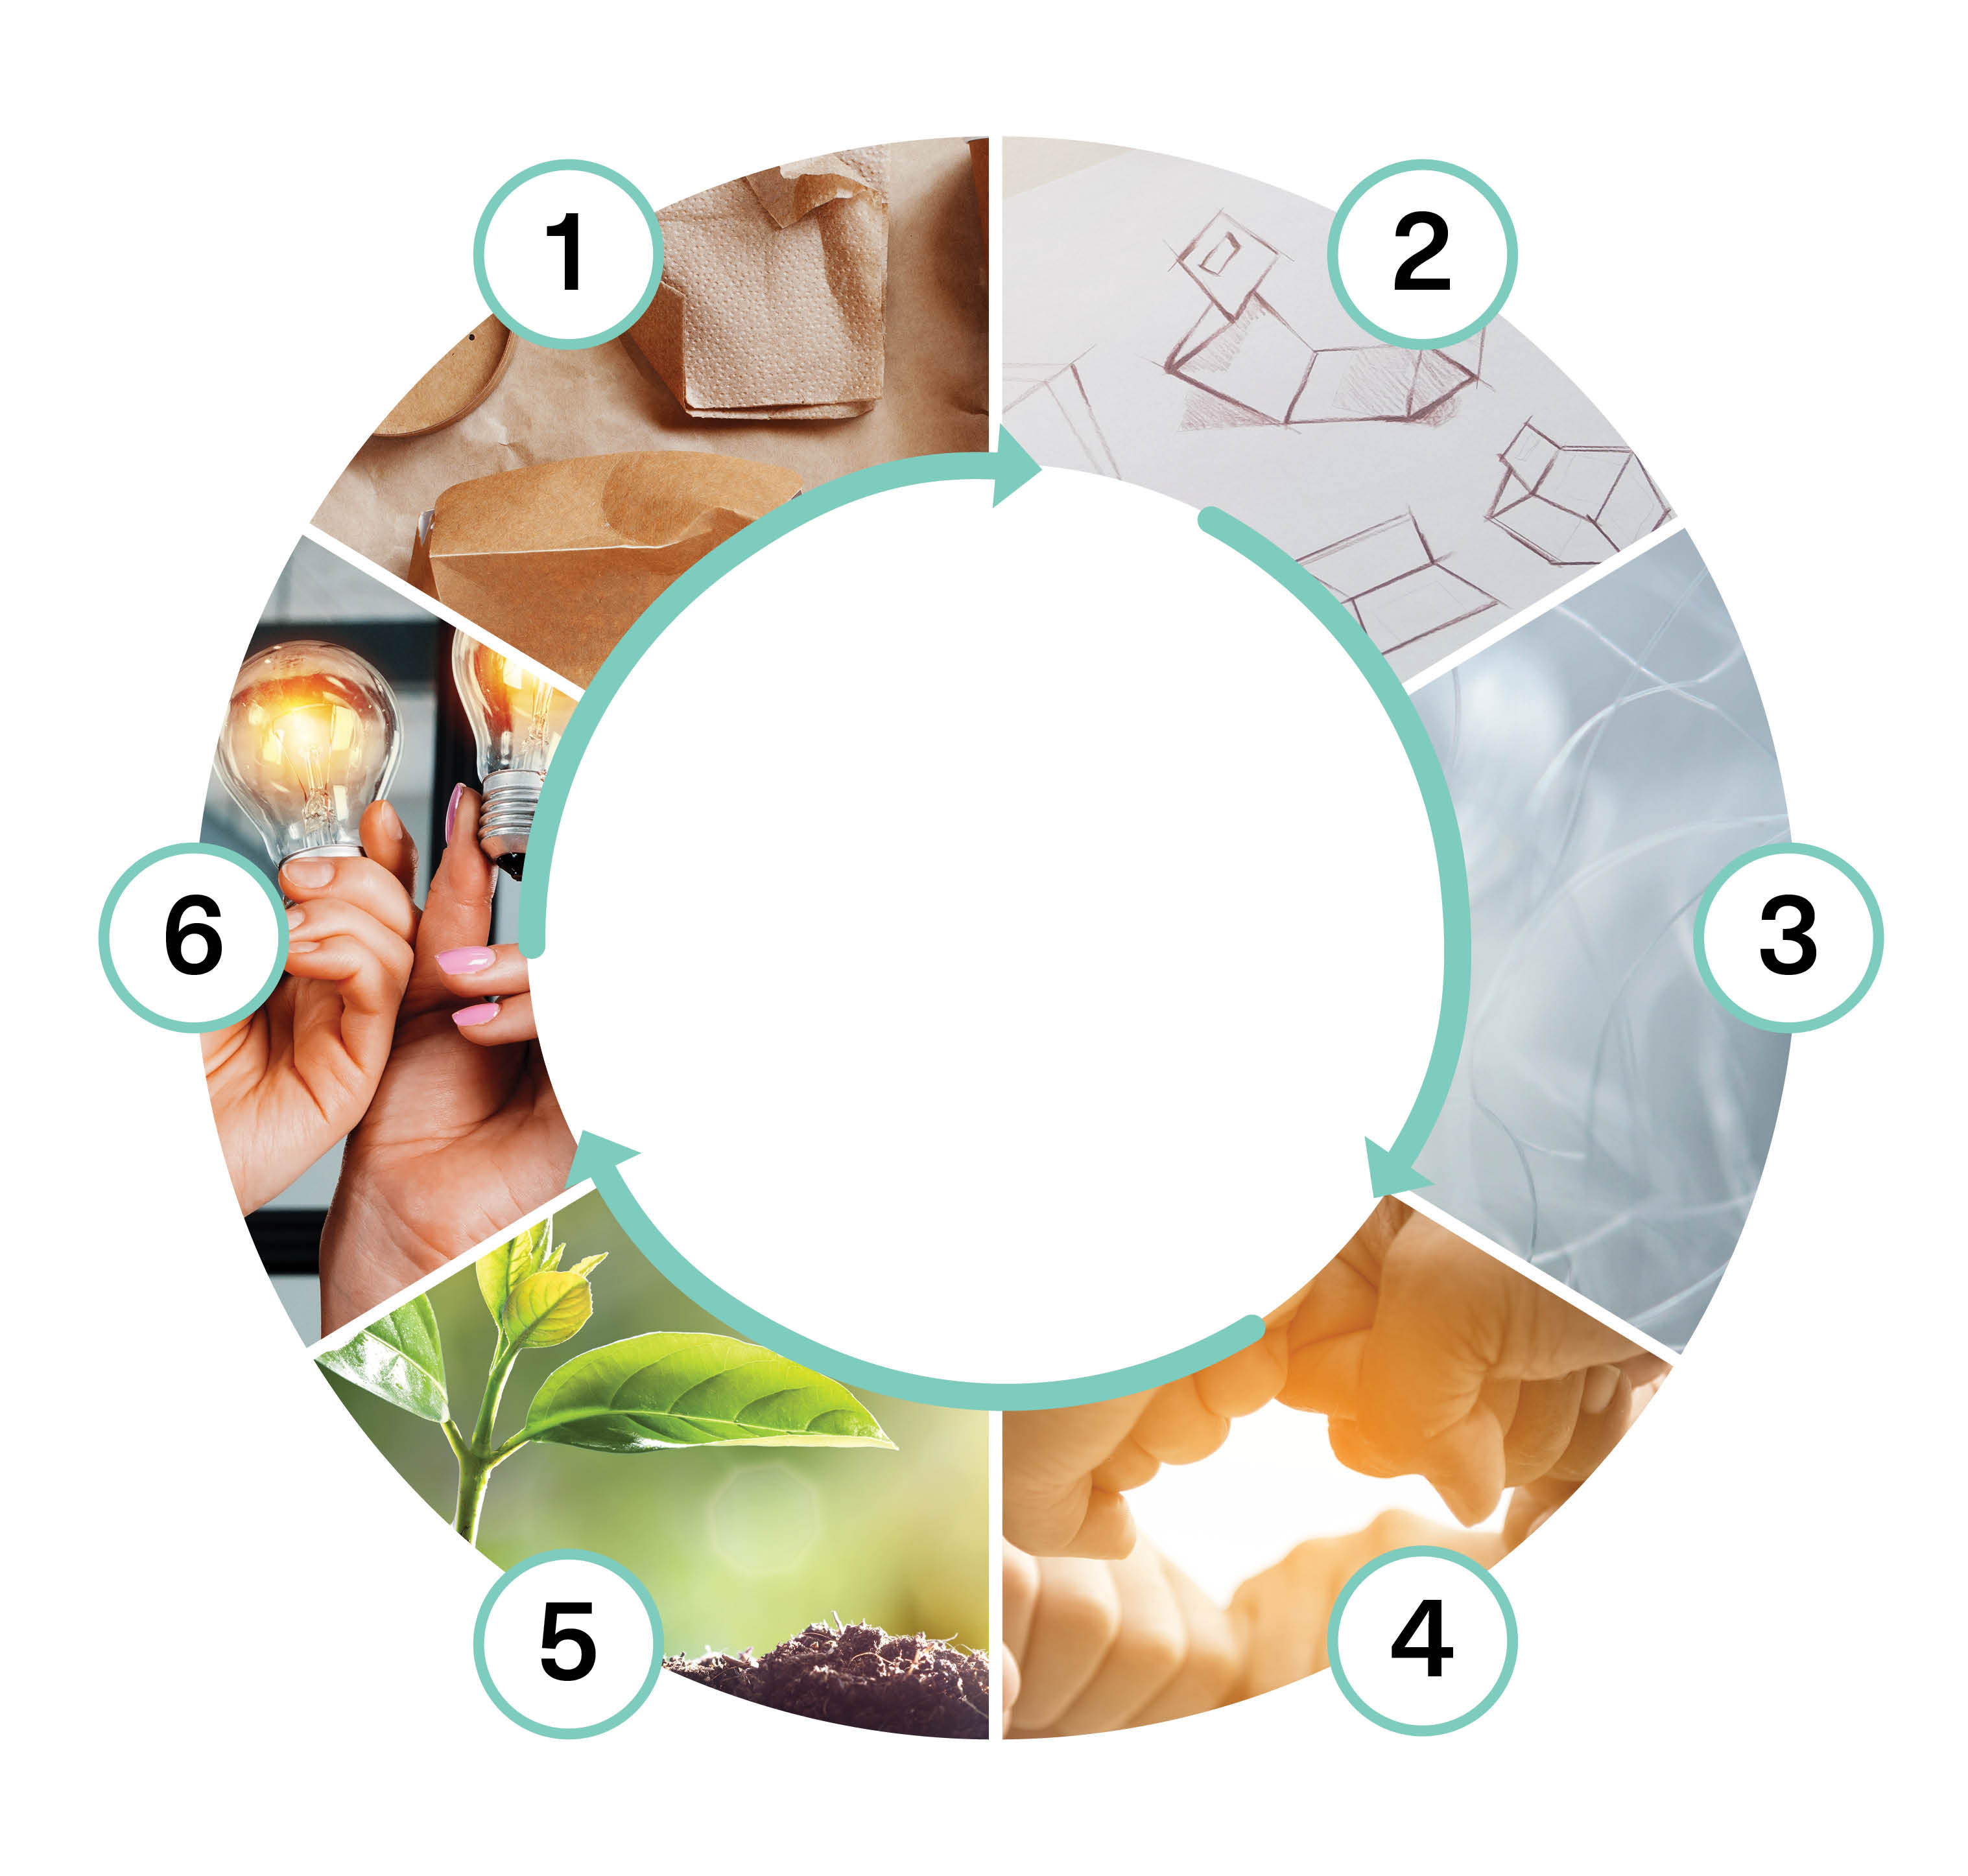

Sustainable Design and Production Processes (5 cr)
Implementation of the course as part of Packaging Value Chain Circular Economy Expert -training (30 cr)
Nina Kukkasniemi
Mika Nieminen
This work is licenced under Creative Commons ByAttribution-Non-commercial-Share-alike 4.0 licence https://creativecommons.org/licenses/by/4.0/

Slide 2
Content
Circular design principles of the packaging solution according to the circular economy
Introduction to LCA calculation and its utilization as a tool
Production processes and circular economy planning
Key questions:
What is the significance of comprehensive understanding of the packaging solution and the product?
What should be considered when designing according to circular economy principles?
What are the possibilities and limitations of LCA calculation?
What kind of methods there are to develop the production process in accordance with the CE principles?

Slide 3
Learning outcomes
Student
evaluates the packaging solution and the product as a whole
can integrate the sustainability into design considering the whole value chain
knows and understands LCA and its possibilities and limitations
knows possibilities and options for processes modernization towards circular economy

Slide 4
Assessment criteria
Assessment criteria, satisfactory (1-2)
recognizes the circular economy goals in the design of the packaging solution, but does not know how to justify his choice
knows the concept and goals of LCA calculation
can name and recognize previously learned methods from the modernization of production processes to the circular economy
Assessment criteria, good (3-4)
knows the principles of circular design and presents justified solution options, gives and receives feedback actively
can observe the packaging solution and the product as a whole and from the perspective of different parties, acts responsibly in the community
considers the entire value chain in design/planning to achieve the sustainable development goals and to solve problems
Assessment criteria, excellent (5)
comprehensively understands the impacts of the circular economy in packaging solution design and processes in development
develops and critically evaluates new packaging solutions and brings one's expertise to the use of the team
analyzes packaging solutions considering the sustainable development and CE principles
critically evaluates the possibilities and limitations of both the measures taken and the LCA calculation when considering packaging solutions

Slide 5
Pedagogical approach
Max 30 students
The implementation example includes one face-to-face meeting of 7–8 hours and two online meetings of 2–3 hours
Knowledge is built communally: Communality, working in networks + self-oriented studies independent of time and place
Course assignment submissions are done mostly independently. Students have an opportunity for communal work and peer feedback through face-to-face and remote meetings and discussion forums. The course is designed to be completed during a period of 5–6 weeks

Slide 6
Learning assignment descriptions
Packaging solution – comparison and evaluation Life Cycle Analysis (LCA) and circular economy Production processes towards a circular economy Design in accordance with the principles of circular economy Reflection

Slide 7
1. Packaging solution – comparison and evaluation
Assignment learning resources
Start the task by listening to the podcasts. Podcasts can be found behind the links:
Circular Design. 2023. Johdatus kiertotalouden suunnittelun strategioihin. https://open.spotify.com/episode/6CTKquLwWK6yjJk8EBy9fq
PAKE. 2023. Pakkausratkaisun suunnittelu kiertotalouteen. https://open.spotify.com/episode/5ns1nGMsUqPlmoy8loTx7z?si=22fb8d119c8d4ceb
European commission. 2021. New circular economy action plan.. https://op.europa.eu/en/publication-detail/-/publication/45cc30f6-cd57-11ea-adf7-01aa75ed71a1/language-en/format-PDF/source-170854112
The purpose of this assignment is to serve as an introduction to the topic. The assignment examines what kind of packaging solutions exist from the perspective of circular economy and how successful the design has been from the perspective of circular economy.

Slide 8
1. Packaging solution – comparison and evaluation
Choose two packagings from your home (or work-related packaging) that you think are, at the time of your choice (so it doesn't matter if the end result is different from what you thought beforehand)
a) a high-quality packaging solution from a circular economy perspective, and also: b) a really bad packaging solution from a circular economy perspective.
Make a comparison where you consider and list what makes or does not make a packaging solution in line with the principles of the circular economy. As much as possible, consider things from the perspective of the different actors in the value chain (who makes and what kind of choices). Evaluate how the packaging solution supports the overall understanding of the packaging and the product combination.
What are your thoughts on the sustainability aspects of the solution? (Keep in mind, however, that a packaging solution that complies with the principles of the circular economy does not necessarily automatically mean a more sustainable solution.)
What kind of an overall picture do you get based on the available information? Think about the big picture, i.e. the solution, not just the packaging (can you find more information about the packaging or product on the brand/producer's website, etc.). List elements such as material, functionality, recyclability, reuse, etc. (remember to use learning resources/materials).
At the end, write a summary assessment of what is easy to find and what you needed more information about.
Share your findings with pictures of the packaging. For example, use the content of podcasts in your reflections. You can also use other materials in your answer (however, make the sources visible). The assignment submission format is free (e.g. power point / pdf. files /video are fine).

Slide 9
2. Life Cycle Analysis (LCA) and circular economy
Start the task by listening to the podcast, Perspectives on Life Cycle Calculations (available only in Finnish) https://projects.tuni.fi/kiertotalousosaaja/podcast-nakokulmia-elinkaarilaskentaan
Life Cycle Assessment (LCA) is a method that can be used to study the effects of a product throughout its life cycle. The life cycle of a product refers to its journey from the designer's desk to the procurement of raw materials and finally the end of the product's life cycle, where the product turns into waste, spare parts, recycled material, etc.
In this exercise, you will familiarize yourself with the life cycle of your chosen product and apply circular economy strategies to the different stages of the product life cycle. The purpose of the assignment is to familiarize yourself with life cycle thinking in particular. Life cycle analysis can also be performed computationally using purpose-designed LCA software (e.g. LCA software). (GaBi and OpenLCA).
The best way to benefit from the task is to do the work in parts, allowing to let your thoughts develop in peace. The most important thing for the success of the task is to familiarize yourself with each stage of the product life cycle. Start the task by choosing the packaging product or type of packaging that interests you specifically.

Slide 10
2. Life Cycle Analysis (LCA) and circular economy
Choose a circular economy strategy that could be applied to the packaging you choose. Circular Strategies cards: https://emf.thirdlight.com/link/35ex5uod70xo-edoub5/@/preview/1?o . For example, the possibilities of extending the life of packaging at different stages of its life cycle.
View the lifecycle of a package by dividing it into different stages of the lifecycle (separate template, slides 11-16). The template has five stages: raw materials production, product manufacturing, packaging and transportation, the use phase of the product, and the end use of the product. Pay attention to the material flows at different stages of the life cycle, incoming and outgoing. Aim for the same at least two input and output streams for each step. The task aims to visualize the life cycle of packaging comprehensively, but there is no need to go into details. In your presentation, analyze what kind of opportunities could be utilized in circular economy strategies at different stages of the packaging life cycle.
Evaluate the opportunities you have identified and their usefulness by using, for example, traffic lights (green - strategy implementation is easy, yellow - strategy implementation is challenging, but implementation is doable, red - strategy implementation is difficult). Be sure to add a brief explanation (e.g. costs, missing technologies, legislation, etc.) after your estimates.
Consider the role of the end user/consumer. What challenges does a particular circular economy strategy have, especially with regard to the role of the end user of the product? For example, if the aim is to improve the life cycle of a product during the design phase, the actions of the end user may nevertheless cause the product to break down prematurely. How can we ensure that packaging ends up in the most appropriate end use at the end of its life cycle? For example, instead of a mixed waste container, it goes into a recycling bin.
After uploading your presentation to the discussion forum, check out at least two other presentations made by the course participants and comment on them briefly and politely, for example. what you found interesting or what thoughts the presentation evoked in you. Assignment template available on slides 11-14

Slide 11

Life cycle description
Name: [FIRST NAME LAST NAME] Product in the assignment: [PRODUCT NAME]
You can customize the template however you want. You can also print the template and scan/photograph the result.

Slide 12
Rawmaterials production
Manufacturing of the product
Packaging and transportations
Use of the product
End-use of the product
Modified from: https://www.circulardesignguide.com/

Slide 13
Evaluate opportunities to make the product more circular

Slide 14
What kind of role does the end user of the product have in terms of the life cycle?

Slide 15
3. Production processes towards a circular economy (1/2)
Start by reviewing the learning resources (next slide). Your task is to interview a representative of working life (preferably an expert external to your organization), prepare at least three questions for them after familiarizing yourself with the proposed materials.
Interview the expert about how they see the need to develop production processes towards a circular economy and green transition, how do the needs relate to packaging solutions and overall responsibility. Who/which stakeholders are needed on board?
Write a summary of the interview. Do not provide identifiable information about the interviewee or the job they represent.
As an alternative to the traditional written interview report, you can also do a video interview. Ask the interviewee for permission to distribute the audio recording to the other students of the course.
N.B! This task does not have to have a direct link to the packaging value chain. The aim of the learning assignment is to learn, find and understand ways and opportunities for modernizing production processes. The discussion and interview will hopefully give rise to thoughts on the importance of overall planning. It is therefore more important to understand the big picture, where the packaging solution is one part.

Slide 16
3. Production processes towards a circular economy 2/2
Study the following sources, which are included as learning resources for this task. Find also sources outside the list (remember to list the sources you have used.)
Antikainen,M., Uusitalo,T.,Kivikytö-Reponen,P. 2018. Digitalisation as an Enabler of Circular Economy. Procedia CIRP, Volume 73.pages 45-49. https://doi.org/10.1016/j.procir.2018.04.027.
Kisu. https://kiertotaloussuomi.fi/taito-ja-tyokalut/digitaaliset-ratkaisut/
Sitra, Deloitte. 2022. Kestävää kasvua kiertotalouden liiketoimintamalleista. Käsikirja yrityksille. https://www.sitra.fi/julkaisut/kestavaa-kasvua-kiertotalouden-liiketoimintamalleista/
Sumter, D., de Koning, J., Bakker, C. and Balkenende, R. (2020). Circular Economy Competencies for Design. Sustainability, 12(4), p.1561. doi:https://doi.org/10.3390/su12041561.
Työ- ja elinkeinoministeriö. 2022. Kiertotalouden digitalisaatio ja ekosysteemit : Nykytila, tavoitearkkitehtuuri ja toimenpiteet https://julkaisut.valtioneuvosto.fi/handle/10024/164500. Read from page 27 onwards 2.4 Digitaaliset teknologiat ja data kiertotaloudessa

Slide 17
4. Design in accordance with the principles of circular economy (1/2)
The task includes two separate assignment submissions. Check out the available learning resources and also make use of the materials and assignment submissions during the course. In the task, take into account the perspective of overall design (not just packaging design).
Individually or in a small group (1-4 students), create a poster or checklist for designing a packaging solution in accordance with the principles of circular economy. (NOTE: all team members return the same file) In addition, each participant in the poster adds an individual item, justified from the perspective of their own views and work, which measures they consider most significant (separate personal assignment submission, only teachers can see the submissions)

Slide 18
4. Design in accordance with the principles of circular economy (2/2)
Learning outcomes:
The student can
examine the packaging solution and product as a whole, understand the overall concept take into account the entire value chain in overall planning in order to achieve the Sustainable Development Goals take into account the possible possibilities/limitations of the PPWR proposal;
Assessment criteria, the student
knows the principles of circular economy planning and presents justified solutions will be able to examine the packaging solution and product as a whole and from the perspective of different operators is able to take into account the sustainability goals of the entire value chain in planning achieve and solve problems (system perspective) will be able to name different ways of designing circular economy solutions

Slide 19
5. Reflection
The aim of reflection is to get a more in-depth learning experience and reflect on how you have built knowledge during the course. Has the course provided new tools or clarified your thoughts that have led to your development as an expert?
Reflect on what you have learned during the course and record a 2-minute 'video podcast'. Start by reviewing the learning objectives of the course one more time.
In the video, highlight 2-3 key things you have learned or, alternatively, things that you have started to pay attention to. In other words, what was the most interesting part of the course for you? Reflect on the matter through the tasks and objectives of the course.
How well did you achieve your (course) learning goals? 2-3 key things you have learned/things that you have started to pay different attention to. What was the most interesting part of the course? How well did you achieve your learning goals?
Tip: For a collaborative learning experience, set the settings in the video submission folder so that students can watch each other's video reflections.

Slide 20
The training was funded by EU’s The Recovery and Resilience Facility (RRF), that is the centrepiece of NextGenerationEU. The funding was awarded by SECLE (The Service Centre for Continuous Learning and Employment). It promotes the development of competences of working-age population and the availability of skilled labour. It is steered by the Ministry of Education and Culture, as well as the Ministry of Economic Affairs and Employment.

