Slide 1

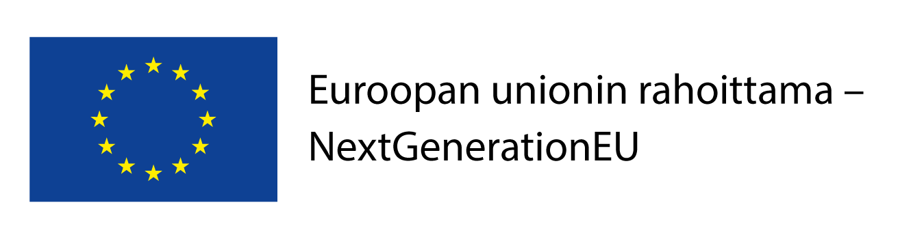
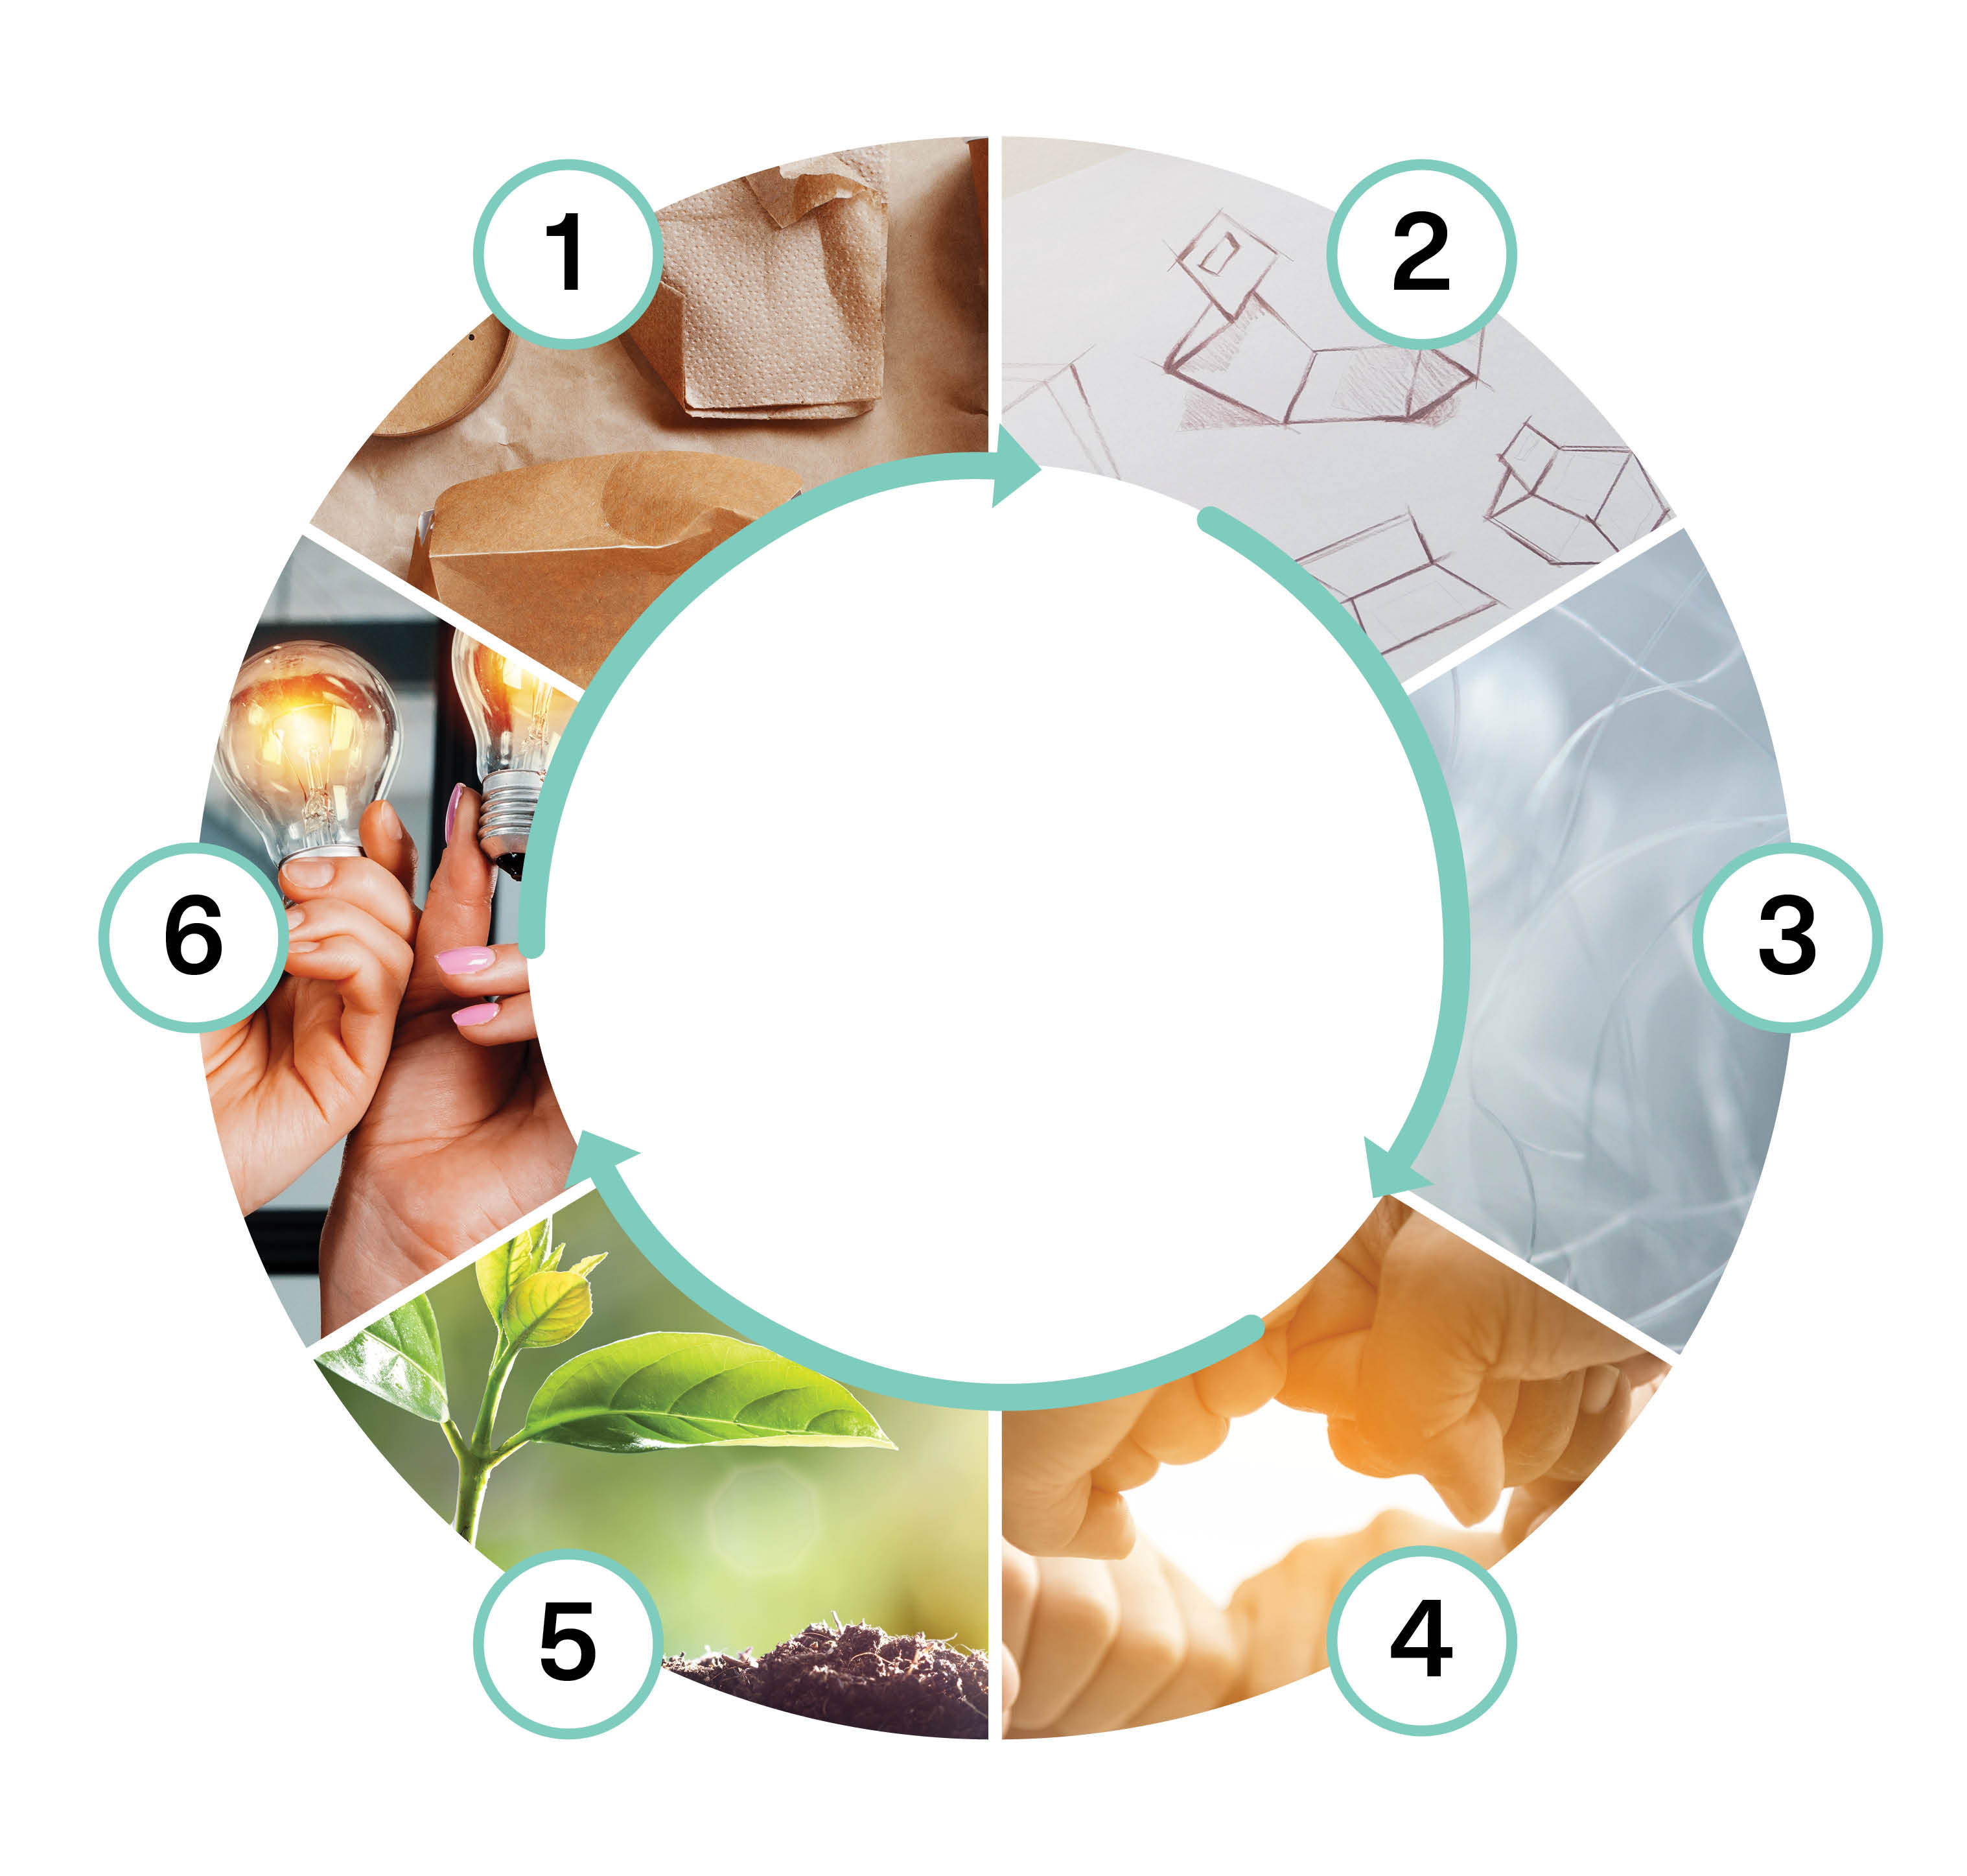

Sustainable Materials and Raw Materials (5 cr)
Implementation of the course as part of Packaging Value Chain Circular Economy Expert -training (30 cr)
Marita Hiipakka, Johannes Jermakka
This work is licenced under Creative Commons ByAttribution-Non-commercial-Share-alike 4.0 licence https://creativecommons.org/licenses/by/4.0/

Slide 2
Content
Packaging and packaging waste regulation (EU)
Reducing the complexity of packaging from the perspectives of the circular economy and different actors
Recyclable and reusable materials
Key questions:
How do legislation and megatrends guide the raw material and material choices of circular packaging solutions now and in the future?
How to identify the limitations and opportunities of the recyclability of materials?
How to apply the Circular Economy Action Plan in material choices?

Slide 3
Learning outcomes
Student
knows the regulations and future goals of packaging in Finland and the EU from the perspective of the circular economy
can assess the limitations of packaging materials and raw materials, as well as their sustainability and environmental impacts
identifies limitations and opportunities in the recyclability of materials
knows the possibilities and limitations of recycled raw materials

Slide 4
Assessment criteria (1/2)
Assessment criteria, satisfactory (1–2)
knows Finnish and EU-level packaging regulations and future goals from the circular economy perspective
can evaluate the limitations of packaging materials and raw materials, as well as their durability, sustainability, and environmental effects
identifies the limitations and possibilities of recyclability of materials
knows the possibilities and limitations of recycled raw materials
Assessment criteria, good (3–4)
explains packaging regulations and future goals in Finland and at the EU level
compares the limitations of packaging materials and raw materials from the CE
recognizes the limitations and possibilities of recyclability of materials, is ready to develop procedures of operation
can describe and evaluate the possibilities and limitations of recycled raw materials

Slide 5
Assessment criteria (2/2)
Assessment criteria, excellent (5)
understands packaging regulations and future goals in Finland and at the EU level from the circular economy perspective, and evaluates different solution possibilities to achieve the goals
analyses and understands comprehensively the limitations of the use of packaging materials and raw materials together with sustainability and environmental impacts
acts responsibly and committedly, considering the requirements and needs of both the community and their own field

Slide 6
Pedagogical approach
Max. 30 students
The implementation example includes one face-to-face meeting of 7–8 hours and two online meetings of 2–3 hours
Knowledge is built communally: Communality, working in networks + self-oriented studies independent of time and place
Course assignment submissions are done mostly independently. Students have an opportunity for communal work and peer feedback through face-to-face and remote meetings and discussion forums. The course is designed to be completed during a period of 5–6 weeks

Slide 7
Learning assignment descriptions
Packaging materials, raw materials and their properties
Recycling technology
Environmental impacts
Legislation and regulation
Sustainable/durable materials and raw materials in packaging solutions
Reflection

Slide 8
Packaging materials, raw materials and their properties(1/3)
The purpose of the assignment is to familiarize yourself with packaging materials and their raw materials and properties from the perspective of the circular economy.
Start the assignment by listening to the podcast ‘Materiaalit ja raaka-aineet’ (https://open.spotify.com/episode/6fbHLFRcdPbiEX7fHT89DP?si=ykg9rQHXSzCq1v_YW7tu3g)
Familiarize yourself with the materials generally applicable to the task. Find and use also other resources:
Lehtinen, Liisa et al. Kestävä pakkaus. Helsinki: Suomen Pakkausyhdistys ry, 2022
European Commission. 2020. New Circular Economy Action Plan. For a cleaner and more competitive Europe. https://op.europa.eu/en/publication-detail/-/publication/45cc30f6-cd57-11ea-adf7-01aa75ed71a1/language-en/format-PDF/source-170854112.
Circular Design Guide. Materials Journey Mapping. 2017. Ideo & EllenMacArthur Foundation. https://www.circulardesignguide.com/post/journey-mapping

Slide 9
Packaging materials, raw materials and their properties (2/3)
Explore the Ellen MacArthur Foundation's Materials Journey Mapping methodology. Read the material and use it as guiding questions for the answer you produce for this assignment. Download the template Safe and Circular Materials Journey Mapping Worksheet (https://emf.thirdlight.com/link/whhb5ynunli-jookrn/@/preview/1?o), which you can use to make the journey of your materials visible.
Choose a packaging product that you are familiar with (e.g. from your own organization) and place it in the middle of the template
Think about and illustrate in the template what you already know or can identify about the materials used in the packaging product, their properties, and the chemicals used
After that, proceed in more detail, point by point, with a material survey (chemical risk assessment and design only as an option). Pay particular attention to the circular economy and sustainability.

Slide 10
Packaging materials, raw materials and their properties (3/3)
Answer the questions:
In what ways could you improve the packaging product to comply with the principles of the circular economy? Justify.
What are your most important stakeholders? Why?
Missing information in your description? What other information would improve your understanding of the product as a whole? Does information flow between stakeholders?
Prepare a free-form output of the whole description (e.g. PowerPoint presentation, mind map, short report) that illustrates/highlights your own thinking and includes the material map that you have prepared. The use of external resources (mark the references as a bibliography) is recommended but not mandatory.

Slide 11
Recycling technology (1/2)
The purpose of the assignment is to familiarize yourself with material flows and recycling techniques for different materials.
Familiarize yourself with the materials generally applicable to the task. Find and use also other resources.
European waste statistics https://ec.europa.eu/eurostat/statistics-explained/index.php?title=Waste_statistics
European packaging waste statistics https://ec.europa.eu/eurostat/statistics-explained/index.php?title=Packaging_waste_statistics
Statistics on world waste production and treatment https://datatopics.worldbank.org/what-a-waste/trends_in_solid_waste_management.html
NC State University knowledge material https://faculty.cnr.ncsu.edu/richardvenditti/downloads/
Harder, J. 2020. Glass Recycling. Current Market Trends. https://www.recovery-worldwide.com/en/artikel/glass-recycling-current-market-trends-3248774.html

Slide 12
Recycling technology (2/2)
UNEP. 2011. Recycling Rates of Metals: A Status Report. https://wedocs.unep.org/20.500.11822/8702
Merrington, A. 2017. https://doi.org/10.1016/B978-0-323-39040-8.00009-2
Write min. a 350-word essay about recycling packaging materials in your field or as part of your own work.
Based on your own work experience, choose the most relevant packaging material or packaging product, explain how the packaging is manufactured, how is it used, and how is it collected and processed after use. Would it be possible to make this packaging or material recyclable so that the material of the packaging used could be used to make new packaging? Would it be desirable, or would some other solution be better?
The use of external resources (mark the references as a bibliography) is recommended but not mandatory.

Slide 13
Environmental impacts (1/3)
The purpose of the assignment is to familiarize yourself with environmental impacts and assessment, as well as with life cycle thinking and life cycle assessment.
Familiarize yourself with the materials generally applicable to the task. Find and use also other resources.
Hauschild, M., Rosenbaum, R., Olsen, S. (eds) Life Cycle Assessment. Springer, Cham. https://doi.org/10.1007/978-3-319-56475-3
Life Cycle Initiative https://www.lifecycleinitiative.org/activities/what-is-life-cycle-thinking/
Ecoinvent https://www.lifecycleinitiative.org/activities/what-is-life-cycle-thinking/
LCA impact categories https://ecochain.com/blog/impact-categories-lca/
SFS-EN ISO 14040 Environmental management. Life cycle assessment. Principles and framework. License required. https://online.sfs.fi/fi/index.html.stx

Slide 14
Environmental impacts (2/3)
Write min. a 350-word essay on the environmental impact of packaging materials on a product or process that is part of your work.
Based on your own work experience, choose the most relevant packaging material or packaging product, and answer the following questions based on it:
Choose a product or process you are familiar with and list its expected environmental impacts in different impact categories. How many categories does the product affect? Is one of the categories more important than the rest? Which category do you think will have the most significant impacts?
Choose a product or process that you are familiar with and collect the factors affecting its life cycle calculation:
Raw materials (main raw materials used in manufacturing, their procurement, environmental impact, renewability, sustainability of procurement, substitution of raw materials)

Slide 15
Environmental impacts (3/3)
Production (where and how manufactured, environmental impact) Transport and distribution (transport distances, several stages of transport in the production chain, environmental impact, how transported) Use (service life and its possible extension) Recycling and disposal (what happens to the product after use, can it be recycled, environmental impact)
Based on your answers, write a summary and an assessment of the environmental impact of the packaging in question. What kind of environmental impact does it have, how do they compare to the environmental impact of its product? How packaging could be developed or modified to reduce the environmental impact of the entire product?
The use of external resources (mark the references as a bibliography) is recommended but not mandatory.

Slide 16
Legislation and regulation (1/3)
The purpose of the assignment is to examine the regulation related to packaging at both EU and national level. Start the section by listening to the podcast Vihreää kehitystä ajavat lainsäädännön ajurit (Circular Design; https://open.spotify.com/episode/6GelUNm8HRxP1wcjFLWDJs?si=47b786ac1c2149f7&nd=1).
Familiarize yourself with the materials generally applicable to the task. Find and use also other resources.
European Green Deal https://www.consilium.europa.eu/fi/policies/green-deal/
SUP Directive 2019/904 https://eur-lex.europa.eu/eli/dir/2019/904/oj
European Commission. 2020. New Circular Economy Action Plan. For a cleaner and more competitive Europe. https://op.europa.eu/en/publication-detail/-/publication/45cc30f6-cd57-11ea-adf7-01aa75ed71a1/language-en/format-PDF/source-170854112

Slide 17
Legislation and regulation (2/3)
Proposal for Ecodesign for Sustainable Products Regulation https://environment.ec.europa.eu/publications/proposal-ecodesign-sustainable-products-regulation_en
Proposal for Packaging and Packaging Waste Regulation COM(2022) 677/3 https://environment.ec.europa.eu/publications/proposal-packaging-and-packaging-waste_en
Proposal for Green Claims Directive https://environment.ec.europa.eu/publications/proposal-directive-green-claims_en
Plastics Roadmap for Finland https://ym.fi/en/plastics-roadmap-for-finland
Green Deals https://ym.fi/en/green-deals
Waste legislation https://ym.fi/en/waste-legislation
SUP directive legislation (in Finnish) https://ym.fi/kertakayttomuovien-kulutuksen-rajoittaminen-lainsaadannolla
Extended producer responsibility https://www.ely-keskus.fi/web/tuottajavastuu/etusivu

Slide 18
Legislation and regulation (3/3)
Winning with new models in packaging. 2019. McKinsey & Company https://www.mckinsey.com/industries/paper-forest-products-and-packaging/our-insights/winning-with-new-models-in-packaging
MINTEL. 2023 Global Packaging Trends https://www.mintel.com/packaging-market-news/global-packaging-trends/
Assignment: Choose a packaging solution related, for example, to your own work (or something else that interests you) and study it holistically from the perspective of both present and future legislation and regulation. You may also include the impact of megatrends and trends in the packaging industry in your examination. How does the future of your packaging solution look from a legislative perspective?
Prepare a free-form output of your discussion (e.g. PowerPoint presentation, mind map, short report) that illustrates/highlights your own thinking. The use of external resources (mark the references as a bibliography) is recommended but not mandatory.

Slide 19
Sustainable/durable materials and raw materials in packaging solutions (1/2)
The purpose of the assignment is to create an overall picture of the raw materials of packaging solutions and materials in the circular economy, considering their recyclability, environmental impacts, sustainability and the effects of legislation and regulation.
The materials suitable for the position have been indicated in the previous assignments. Find and use also other resources.
Assignment: Assess the impact of developments in legislation, materials and recycling technology on your organization or its operations over a ten-year time span. How should processes, products, or operations be developed to meet the changed operating environment of the future? What kind of packaging materials would you, for example, like to favor and how? How should the national recycling system and technology be developed? Try to include concrete suggestions for changes and consider the possibilities and limitations of different materials. Critically evaluate the pros and cons of your proposal.

Slide 20
Sustainable/durable materials and raw materials in packaging solutions (2/2)
Discuss the assignment in a small group with your peers
Write a presentation or essay on the topic individually or in a small group (max 3 people). The use of external resources (mark the references as a bibliography) is recommended but not mandatory.
Consider the following criteria in your answer:
opportunities for the use of packaging materials and raw materials, but also potential limitations, sustainability, and environmental impacts
regulation of packaging and packaging waste and future circular economy objectives (e.g. recyclability and use of recycled raw materials)

Slide 21
Reflection
For the final reflection, consider and collect the answers to the following questions for the last online session:
How did your understanding of packaging materials and their environmental impacts change during the course?
How can you influence packaging and its environmental impact in your work?
What was surprising and new that you got excited about?
In the online session the participants are divided into small groups, where the reflections are discussed and may be supplemented. At the end of the meeting, the participants save their summaries as a short Flip video (max. 2 min). Students can view and comment on the returned video reflections.

Slide 22
The training was funded by EU’s The Recovery and Resilience Facility (RRF), that is the centrepiece of NextGenerationEU. The funding was awarded by SECLE (The Service Centre for Continuous Learning and Employment). It promotes the development of competences of working-age population and the availability of skilled labour. It is steered by the Ministry of Education and Culture, as well as the Ministry of Economic Affairs and Employment.

