Slide 1
Introduction to Sustainable development
Pentti Viluksela
Metropolia
Notes:
Photos in this file by Pentti Viluksela

Slide 2
Sustainable development?
term was developed in United Nations working group led by Gro Harlem Brundtland in 1987
the report “Our common future”
also known as the Brundtland report
“development that meets the needs of the present without compromising the ability of future generations to meet their own needs”
What are these needs and who defines them?

Slide 3
Dimensions of sustainability
Social Cultural
human rights incl. culture, minorities etc.
wellbeing of citizens
Needs of people and societies
Needs of planet Earth
Needs of the economies
Environmental
resources, biodiversity, pollution
human activity vs. natural resources
Economic
long-term stability and wealth of societies and citizens
positive impact of businesses

Slide 4
Hierarchy of sustainability levels
Governance
International, national, regional, local
Environment
Society
Economy

Slide 5
Planet earth
land 149 Mkm²
water 361 Mkm²
total area 510 Mkm²
Suggestion: Insert here a suitable picture, e.g. earth seen from space
Image: NASA
NASA timelapse video

Slide 6
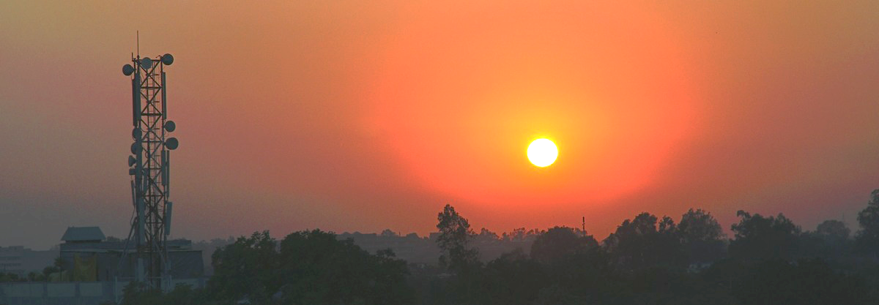
Ecological sustainable development
existence and welfare of humans is completely based on the nature and its functions
biodiversity ensures the operation of ecosystems and the continuity of ecosystem services
Use of natural reources must not exceed the carrying capacity of the planet. Photo: Pentti Viluksela CC BY

Slide 7
Ecosystem services*
= services provided by nature free of charge
Production services
food
medicines
building materials
energy
etc.
Maintenance services
photosynthesis
nutrient cycles
pollination of plants
etc.
Suggestion: Insert here a suitable picture, e.g. earth seen from space
CC BY-NC-SA
etc.
water purification
air purification
erosion prevention
flood prevention
Control services
etc.
esthetic/spiritual experiences
recreation
information
Culture services
*unevenly distributed across the earth!

Slide 8
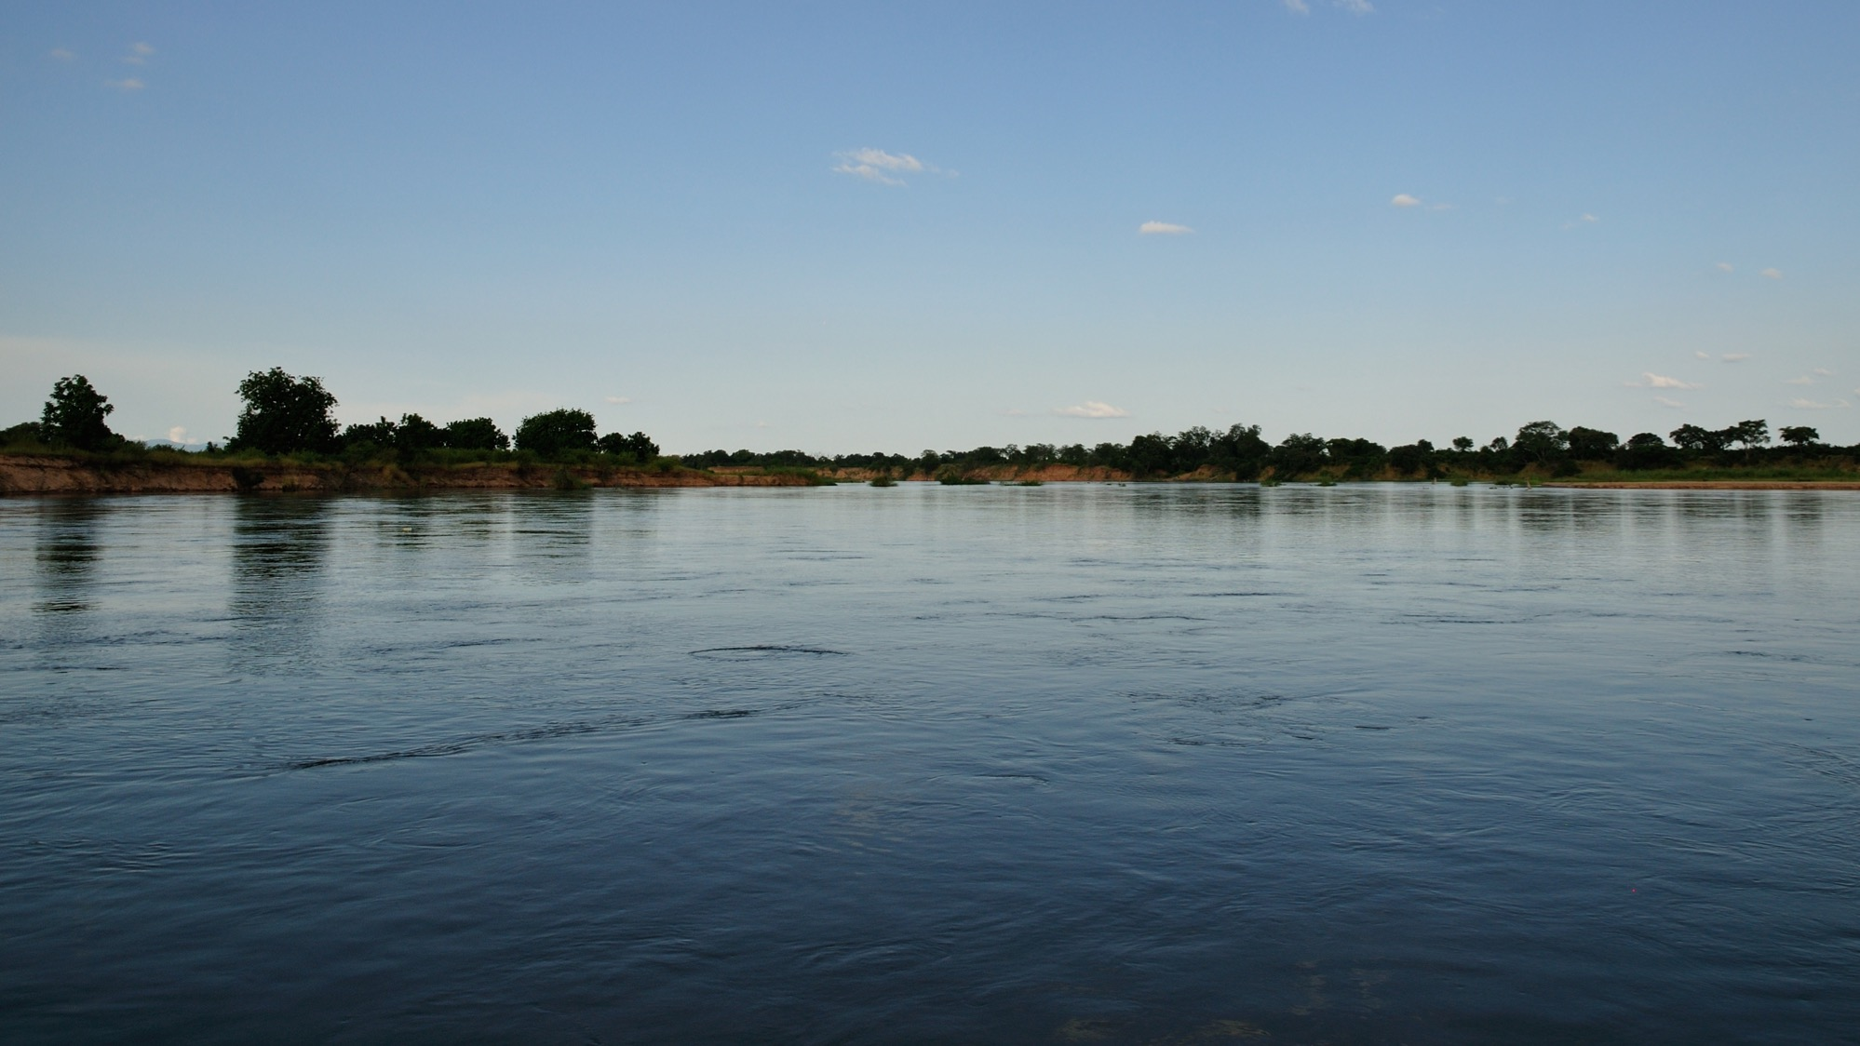
Man is the only species with the ability of both destroying and conserving the planet – engineers have a key role!
Photo: Pentti Viluksela CC BY

Slide 9
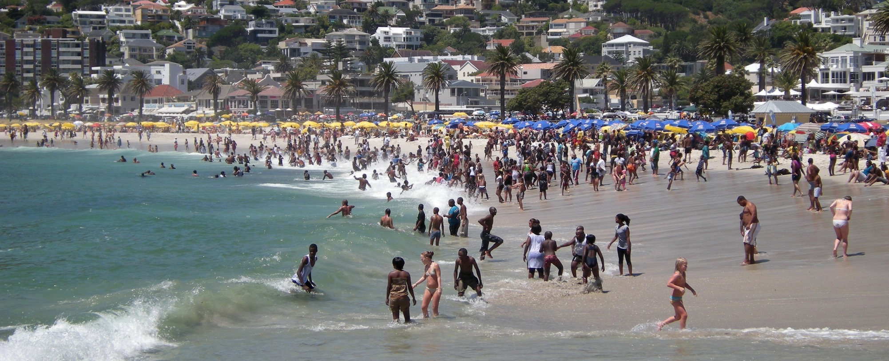
Social sustainable development
Viewpoint: global
Timeframe: present and future generations
Objective: good and happy life for everybody without destroying the planet
Photo: Pentti Viluksela CC BY

Slide 10
United Nations: Universal Declaration of the Human Rights
https://www.un.org/en/universal-declaration-human-rights/
adopted on 10.12.1948
text in 403 languages:
http://www.ohchr.org/en/udhr/pages/introduction.aspx
typographic video: http://www.youtube.com/watch?v=hTlrSYbCbHE

Slide 11
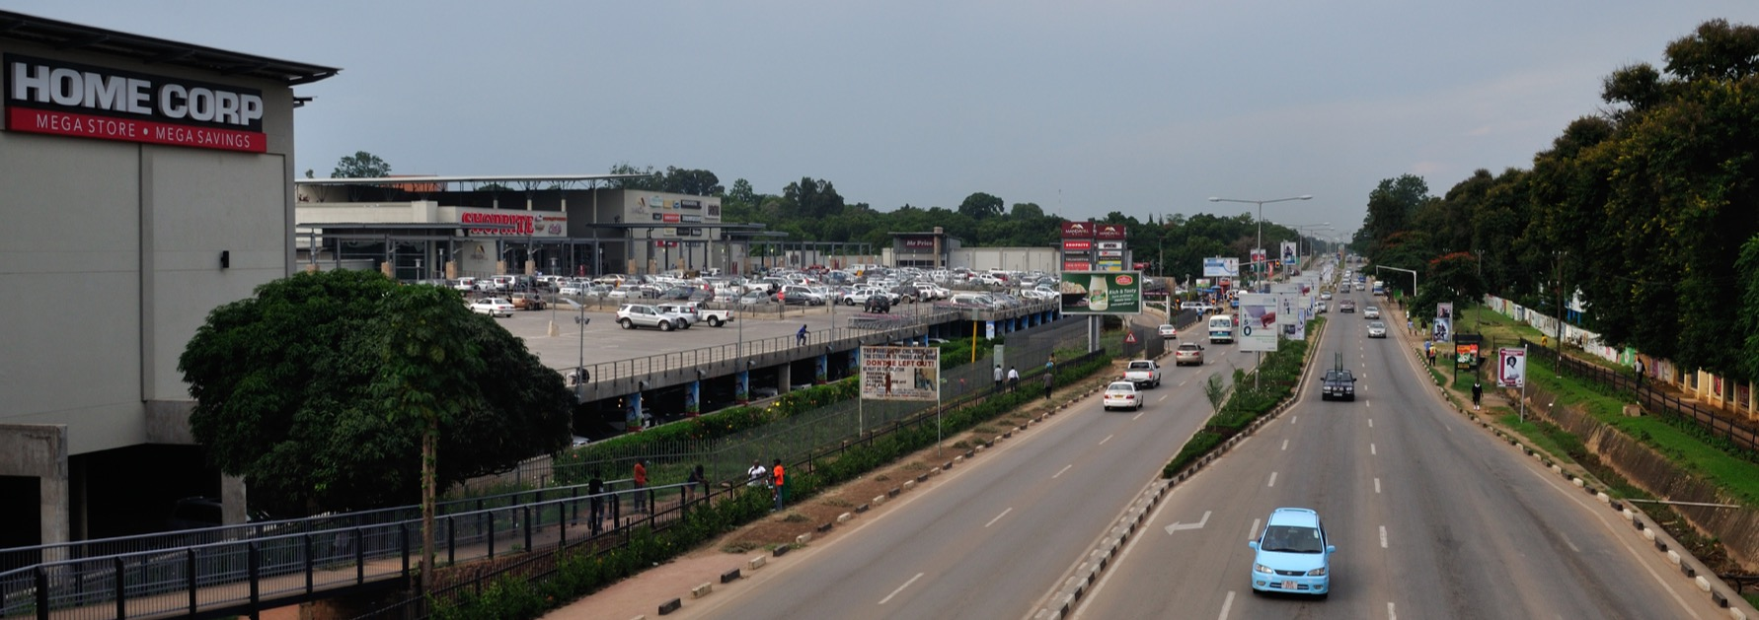
Economic sustainable development
sustainable economic growth
wealth to everybody through sustainable production and consumption
based on the wise use of natural resources (e.g. circular economy)
requires good (corporate) governance and ethical norms and practices
Photo: Pentti Viluksela CC BY

Slide 12
A pessimistic view:
“When money talks, democracy has no voice”
…and neither has nature...

Slide 13
A network of causes and effects — finding compromise between different needs
Suggestion: Insert here a picture of three spheres of sustainability, e.g.
http://globalasiablog.com/2014/02/28/we-need-a-green-world/
www.uitp.org

Slide 14
Case: Talvivaara mine (Finland)
Suggestion: Insert here an aerial photo of the Talvivaara mine site

Slide 15
Talvivaara in the press
https://yle.fi/uutiset/osasto/news/talvivaara_finlands_biggest_environmental_crime_case_returns_to_court/9873349
https://www.sciencedirect.com/science/article/abs/pii/S2214790X16301770
https://yle.fi/uutiset/osasto/news/govt_steps_in_to_save_talvivaara_mining_operations/8209752

Slide 16
Talvivaara: sustainability dimensions
natural resources available
citizens
political decision-making
nature
high unemployment in the area
environmental
damage
vulnerable ecosystems
technical solutions
welfare
tax income used to provide social services
short vs. long term issues
unusually heavy rains
costs/profits
employment opportunities at the mine
municipality
investors’ interests
industry, businesses
state
region

Slide 17
Task 1: Sustainability dimensions
Group work, 5 minutes
What are the major sustainability issues in your sector / business / study field?
Are there any conflicting needs or interests? Any good compromises that need to be made?
Discuss with your group and present a couple of observations.

Slide 18
Energy consumption
Is energy too cheap?
How much energy does a web search consume?
In which functions is the energy consumed?
Where is most energy consumed from a lice cycle perspective?

Slide 19
Oil peak
How can we rebuild oil and fossil energy –based world?
What are the biggest challenges?

Slide 20
Chemicals
Who should monitor and control?
Health problems caused by toxic chemicals are reported from many industrial sectors

Slide 21
E-waste
Who should monitor and control?
Old electronic and electric devices are shipped to poor countries, where they are disassembled, causing health problems

Slide 22
Child labour
In many developing countries, child labour is common: textile industry, cocoa plantations…
What are the alternatives?

Slide 23
Socially irresponsible companies
Neste Oil accused of unsustainable use of palm oil
https://yle.fi/uutiset/osasto/news/greenpeace_neste_oil_among_most_evil_companies/5304673
Fact or fiction abouth the Finnish oil company?

Slide 24
Workers’ rights
Should we boycott these companies?
Many well-known brands, e.g. Nike, Apple, Nokia, have been connected with workers’ rights violations

Slide 25
Are we borrowing from the future generations?
http://www.overshootday.org/

Slide 26
Welfare = consumption? How to solve this formula?
Market economy is based on continuous growth
Earth’s limited resources prevent continuous growth
≠

Slide 27
Decoupling: how to disconnect welfare from the use of natural resources
https://www.sitra.fi/en/blogs/sustainable-development-and-challenges-decoupling/
https://www.researchgate.net/figure/The-two-aspects-of-decoupling_fig1_304898417

Slide 28
Task 2: Decoupling
Group work, 5 minutes
Is decoupling possible? Can we create welfare and well-being while at the same time use less natural resources and less money?
Discuss with your group and present some observations.

Slide 29
Learning diary 1
Please summarize the main points the lecture.
Search the internet for different definitions of sustainable development. Is there any common themes? Which is your favourite?
Write your views on Task 1 and Task 2.
Length of answer max. 1 page.

