Slide 1





FUNDAMENTAL RIGHTS
IN FINLAND
Laura Ahonen 2024
CC BY 4.0

Slide 2


Finland is a democracy
Citizens’ basic rights are based on Finland’s Constitution.
The Finnish Constitution was updated on June 11, 1999.

Slide 3

Equality
Article 6
  Definition: No one may be placed in a different position without an acceptable reason based on gender, age, origin, language, religion, conviction, opinion, health condition, disability, or any other personal reason.
  Law: People are equal before the law.
  Children: Children must be treated equally as individuals, and they must have the opportunity to influence matters concerning themselves in accordance with their development.
  Gender equality must be promoted in societal activities and working life, especially when determining salaries and other terms of employment, as further provided by law.

Slide 4

Right to Life and Personal Freedom
Article 7
  Right to Life and Freedom: Everyone has the right to life, personal freedom, inviolability, and security.
  Prohibition of Cruel Treatment: No one can be sentenced to death, tortured, or treated in a way that violates human dignity.
  Inviolability and Freedom: Personal inviolability cannot be interfered with arbitrarily, and freedom cannot be deprived without a legal basis.
  Legal Safeguards: Courts determine punishments involving deprivation of liberty, and the legality of other deprivations of liberty can be reviewed by a court. The rights of those deprived of liberty are protected by law.

Slide 5
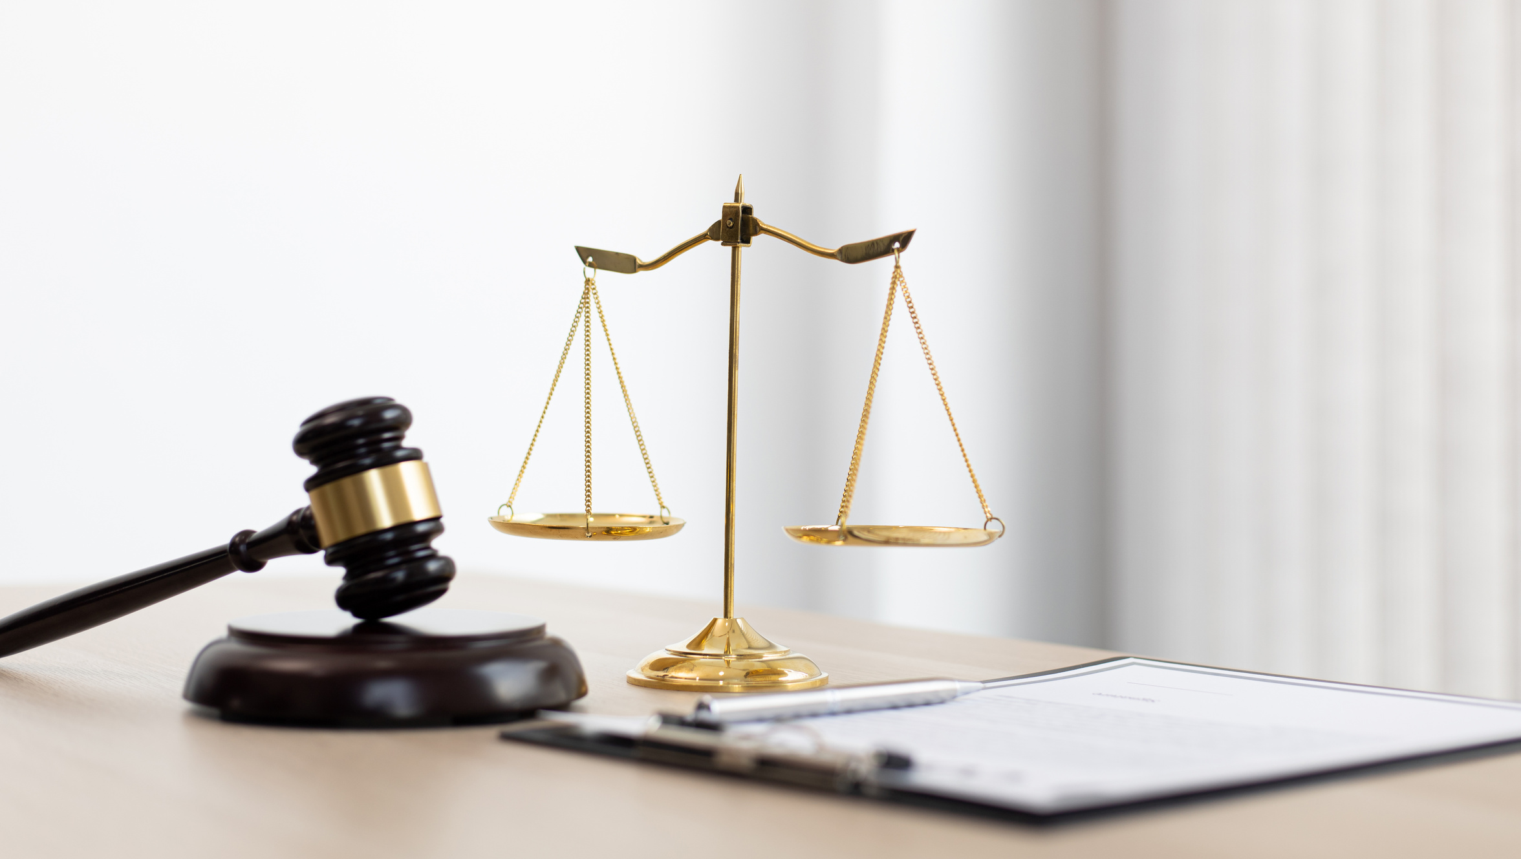
Principle of Legality in Criminal Law
Article 8
  Ex Post Facto Principle: No one can be found guilty of a crime or punished for an act that wasn’t illegal when they committed it.
  No Retroactive Punishment: The punishment for a crime cannot be more severe than what the law allowed at the time the act occurred.

Slide 6

Freedom of Movement
Article 9
  Free Movement: People living in Finland can move and live freely anywhere in the country.
  Leaving Finland: Everyone can leave Finland, but the law may limit this right for certain reasons like court cases, punishment, or national defense duties.
  Entering Finland: Finnish citizens can’t be forced to leave Finland or sent to another country against their will, unless it’s to ensure legal rights and protection.
  Foreigners’ Rights: Foreigners’ entry and stay in Finland are controlled by law. They can’t be sent to a country where they might face harsh punishment or human rights violations.

Slide 7

Right to Privacy
Article 10
  Privacy Rights: Everyone’s private life, honor, and the sanctity of their home are protected.
  Protection of Personal Data: More detailed rules about safeguarding personal data are specified by law.
  Secrecy of Communications: The confidentiality of correspondence, phone calls, and other private communications is inviolable.
  Measures Affecting Home Sanctity: If necessary to protect basic rights or investigate crimes, certain measures affecting the sanctity of the home can be established by law.
  Limitations on Communication Secrecy: In cases involving individual or societal security, trials, security checks, deprivation of liberty, or obtaining information on military activities, communication secrecy may be restricted by law.

Slide 8

Freedom of Religion and Conscience
Article 11
  Freedom of Religion and Conscience: Everyone has the right to practice their religion, express personal beliefs, and decide whether to be part of a religious community.
  No Obligation: No one is required to participate in religious practices that go against their conscience.

Slide 9

Freedom of Expression and Right of Access to Information
Article 12
  Freedom of Expression: Everyone has the right to express themselves freely. This includes sharing and receiving information, opinions, and other communications without prior censorship.
  Restrictions on Pictorial Programs: Laws may limit certain visual programs to protect children.
  Public Documents and Recordings: Documents and recordings held by authorities are public unless specifically restricted by law. Everyone has the right to access public documents and recordings.

Slide 10

Freedom of Assembly and Freedom of Association
Article 13
  Freedom of Assembly: Everyone has the right to organize meetings and demonstrations without needing a permit. They can also participate in these events.
  Freedom of Association: People can form associations without requiring a permit. They can choose to be members or not and participate in association activities.
  Trade Unions and Organizing: The freedom to form trade unions and organize for other interests is also guaranteed.
  Detailed Provisions: Specific rules about exercising freedom of assembly and association are defined by law.

Slide 11
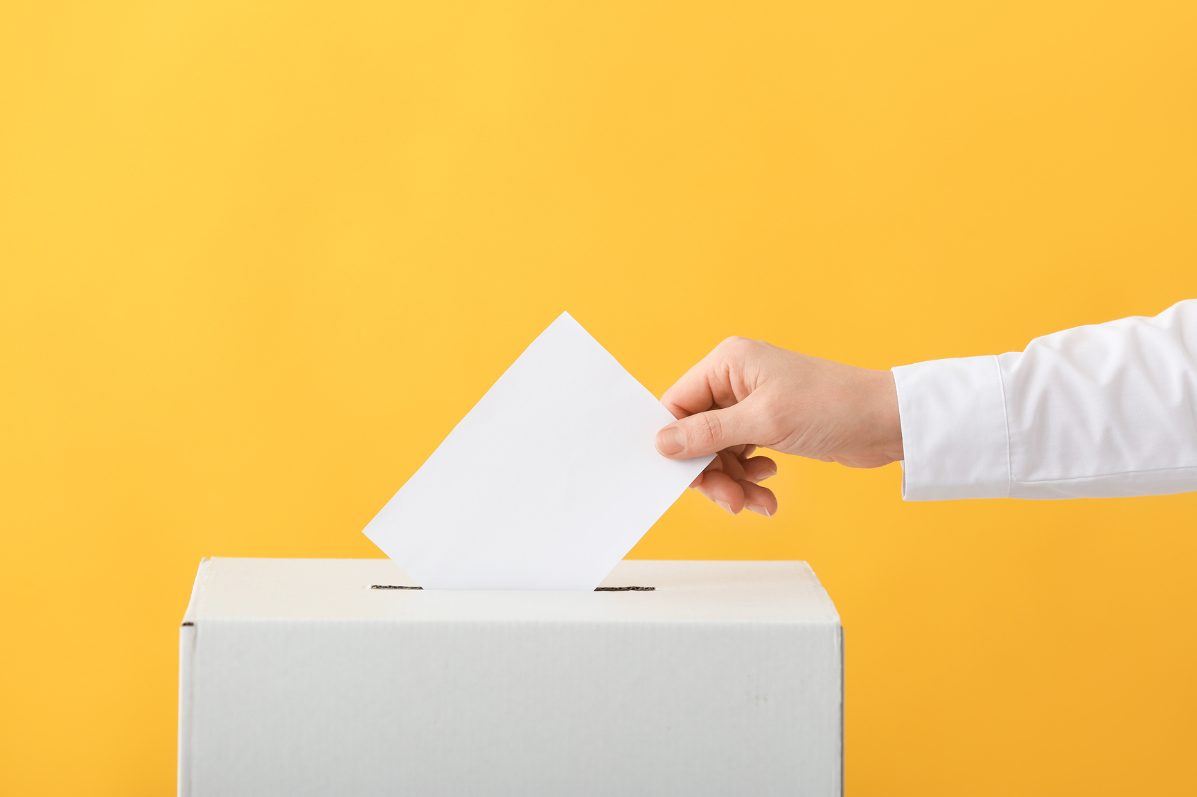
Electoral and Participatory Rights
Article 14
  Voting Rights: Finnish citizens who are eighteen years old can vote in national elections and referendums. Specific rules determine eligibility for running for office in national elections.
  European Parliament Elections: Finnish citizens and other European Union residents in Finland who are eighteen years old can vote in European Parliamentary elections as specified by law.
  Municipal Elections: Finnish citizens and foreign residents permanently living in Finland who are eighteen years old can vote in municipal elections and referendums as provided by law.
  Participation in Society: Public authorities must encourage individual participation in societal activities and decision-making processes.

Slide 12

Protection of Property
Article 15
  Property Protection: Everyone’s property is safeguarded.
  Expropriation Rules: Specific provisions regarding property expropriation for public purposes and compensation are defined by law.

Slide 13

Educational rights
Article 16
  Free of charge: Everyone has the right to basic education without any cost.
  Equal rights: The government ensures equal opportunities for all to access additional educational services based on their abilities and special needs. Economic hardship should not hinder personal development.
  Special note: Freedom of education in science, arts, and higher education is guaranteed.

Slide 14

Right to one’s language and culture
Article 17
  Two official languages: The national languages of Finland are Finnish and Swedish.
  Legal proceedings: Everyone has the right to use their own language (either Finnish or Swedish) in legal proceedings and when dealing with authorities.
  Official documents must also be provided in the individual’s chosen language. Public authorities are responsible for meeting the cultural and societal needs of both Finnish-speaking and Swedish-speaking populations equally.
  The Sami people: as an indigenous group, have the right to maintain and develop their own language and culture. Provisions regarding the use of the Sami language before authorities are specified by law.
  Sign language: Individuals who use sign language or require interpretation or translation assistance due to disability are also protected by legislation.

Slide 15

Right to work and the freedom to engage in commercial activity
Article 18
  Freedom of choice: Everyone can choose their job, work, or business to make money. Criminal activity is prohibited.
  The governments role: The government protects workers. The government also makes sure everyone can work. There are rules for getting job training to help people get jobs.
  Legal protection: If someone loses their job, there must be a good legal reason.

Slide 16
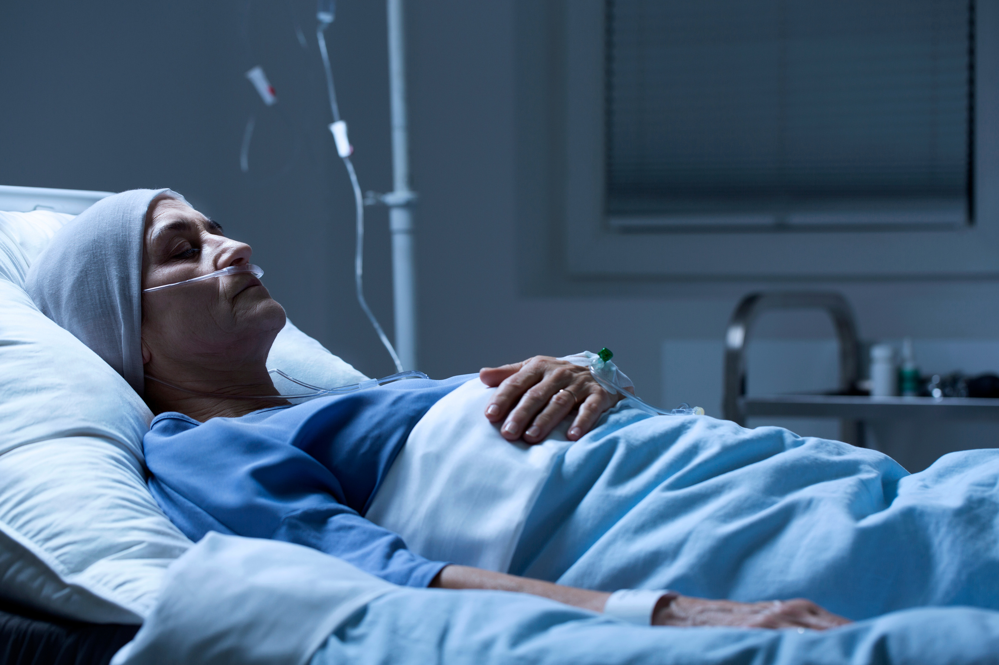
Right to Social Security
Article 19
  Essential support: Individuals who lack the means for a dignified life have the right to receive essential support. This includes basic subsistence during unemployment, illness, disability, old age, childbirth, or loss of a provider.
  Public authorities role: Responsible for providing adequate social, health, and medical services, as well as supporting families to ensure the wellbeing and development of children.
  Living situation: Everyone has the right to housing and the opportunity to arrange their own living situation.

Slide 17
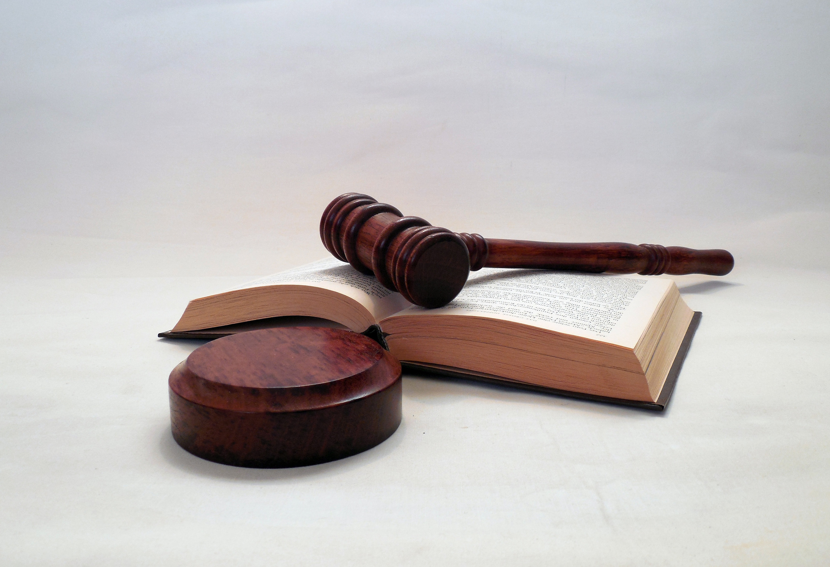
Protection under
the Law
Article 21
  Fair legal process: ensures that everyone has the right to a fair legal process. This includes the right to have their case heard promptly by a competent court or authority.
  Transparent documents: Individuals also have the right to review decisions related to their rights and obligations through an independent legal body. The law specifies provisions related to proceedings’ transparency, the right to be heard, receiving reasoned decisions, and the right to appeal. These safeguards contribute to a fair trial and good governance.

Slide 18

Note!
Basic Rights and Liberties in Situations of Emergency
Article 23
In case of emergency: In Finland, provisions allow for temporary exceptions to basic rights and liberties when there’s an armed attack or other serious threats to the nation.
These exceptions must be authorized by an Act or Government Decree, with specific criteria and limitations. The grounds for these exceptions are defined by law, and Parliament reviews Government Decrees promptly to assess their validity.

