Slide 1







Civic duties and responsibilities
Operating as a member of Society and a Citizen
Laura Ahonen 2024
CC-BY-NC-SA 4.0

Slide 2









Civic duties
Compulsory education
Guardians Duty to take care Children
Duty of national defence
Resque duty
Tax liability
Obligation to comply with the law
Obligation to a name
Responsibility to take care of the Environment

Slide 3


Compulsory education
The Finnish Compulsory Education Act (1214/2020)
Education is compulsory for children aged 7 to 18 years.
The obligation to education ends earlier in case a student completes either vocational upper secondary qualification or matriculation examinations.

Slide 4


Duty of national defense
The Finnish Constitution Act (731/1999)
The Conscription Act (1438/2007)
Every citizen has an obligation to participate in the defense of the country or assist it as specified by law.
Every male Finnish citizen is liable for military service aged 18-60 years.
Military service includes service as a conscript, participation in reservist training, extra service, and service during mobilization, in addition to participation in call-ups and examinations assessing fitness for military service.

Slide 5


Tax liability
The Income tax act (1535/1992)
Finnish citizens are obligated to pay taxes from earned income.
Taxes are paid to the state, municipalities and parishes.
Taxable income in Finland includes property, business, professional and employment income.

Slide 6



Obligation to a name
The Finnish Name Law (946/2017)
Individuals must have a first name, up to four.
A first name must not cause offense, harm, or be clearly unsuitable.
Everyone must also have a surname, which can be changed or combined with another under certain conditions.
Guardians must notify the authorities of a child’s first and surname within specific timeframes after birth.

Slide 7


Guardians Duty to take care Children
The Child Welfare Act (417/2007)
Finland aims to protect children’s rights to a safe growth environment, balanced and well-rounded development, and special protection.
Primary responsibility for a child’s well-being is based on their parents and other custodians.
A child must be provided with good care and upbringing, as well as necessary supervision and care according to the child’s age and developmental level.

Slide 8


Rescue duty
The Criminal code of Finland (39/1889)
Finnish citizens have a duty to assist a person in mortal danger or serious health risk.
Neglecting this duty is considered a criminal act.
The Criminal Code states that if a person knowingly fails to provide or obtain such assistance as can reasonably be expected of them, considering their capabilities and the nature of the situation, they may be guilty of neglecting rescue duty.
The penalty can be a fine or imprisonment for up to six months.

Slide 9
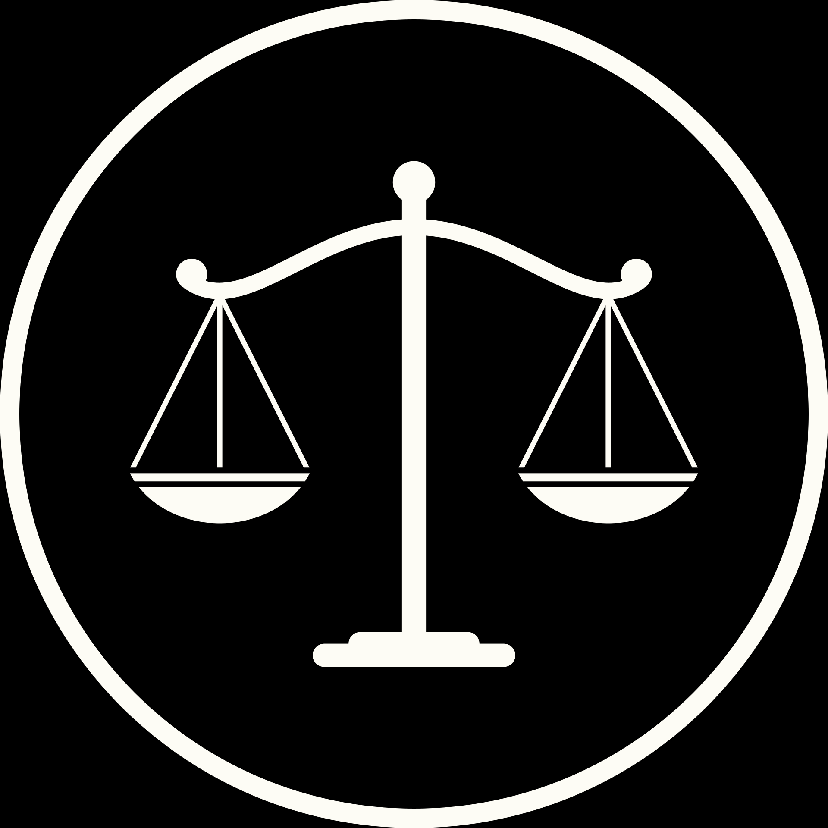

Obligation to comply with the law
The Finnish Constitution Act (731/1999)
Finnish citizens and people living in Finland are obligated to act in accordance with the country’s laws.
The Constitution Act forms the ground to this obligation:
Finland’s constitution safeguards human dignity, individual freedom, and rights.
Public authority belongs to the people, and the exercise of public power must be based on law.
Legislative authority is vested in the Parliament, and executive authority lies with the President of the Republic and the Council of State.
Fundamental rights include equality, the right to life, freedom of movement, and various other rights.
Crimes committed by Finns against each other are subject to Finnish criminal law regardless of the location of the offense.

Slide 10


Responsibility to take care of the Environment
The Finnish Constitution Act (731/1999)
Nature and its biodiversity, the environment and the national heritage are the responsibility of everyone.
The public authorities shall endeavour to guarantee for everyone the right to a healthy environment and for everyone the possibility to influence the decisions that concern their own living environment.

