Slide 1
DevSecOps
Application Security

Slide 2
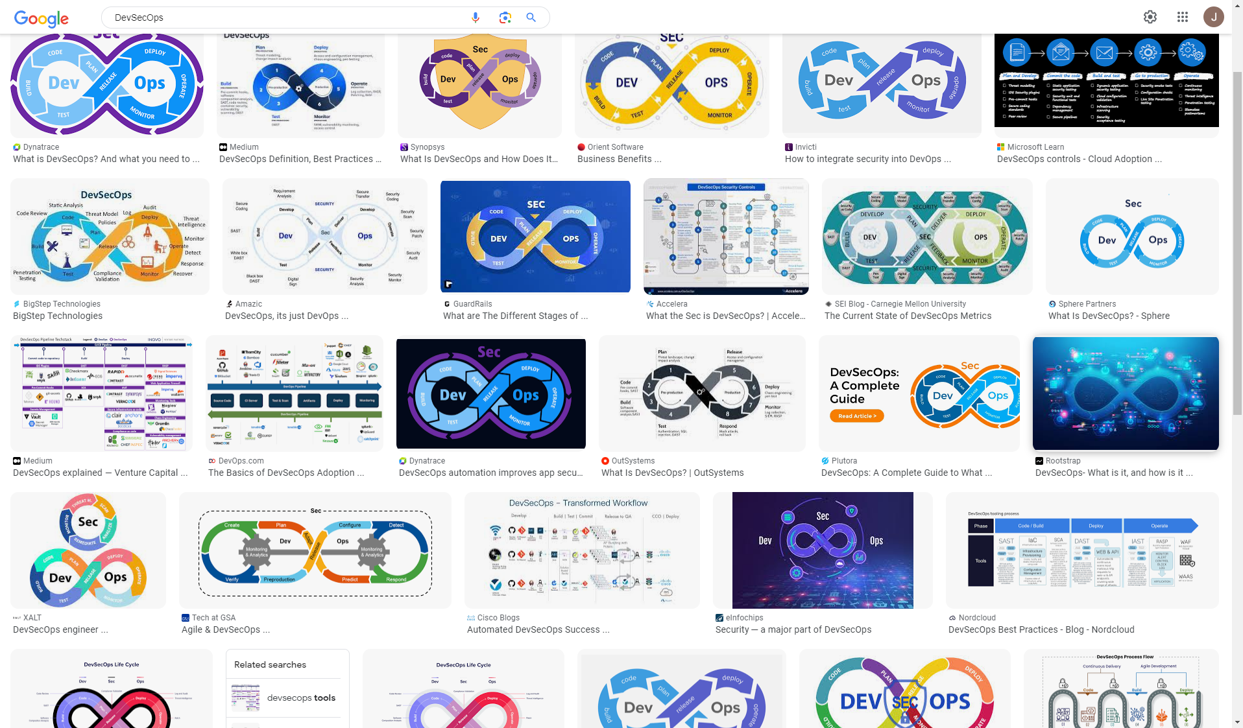

Slide 3
DevOps Cycle
Plan
Code
Build
Test
Release
Deploy
Operate
Monitor
Dev
Ops

Slide 4
So DevOps …
combines Development and Operations
focuses on collaboration and communication
builds automation on every step of software production
has short feedback loops, ideal for example in A/B testing
typically builds on microservice architectures
automates the complexity.

Slide 5
And DevSecOps …
integrates security with all steps of DevOps
Looks at the security of the whole Software Development Lifecycle (SDLC)
automates security
creates consistency and actionable metrics
leads into security by default
SHIFTS LEFT

Slide 6
Security Development Lifecycle
Train
Define Requirements
Test
Design
Implement
Deploy
Monitor
https://www.microsoft.com/en-us/securityengineering/sdl/practices
https://www.microsoft.com/en-us/securityengineering/devsecops

Slide 7
CI/CD
Continuous Integration and Continuous Delivery (or sometimes deployment)
Continuous integration means doing software development in small increments and merging them continually to main repository (or branch)
Continuous delivery means always keeping the software in deliverable state using repeatable process
Continuous Deployment means delivering changes automatically to production
Although definitions may vary.

Slide 8
Pipelines
Automation pipelines enable CI/CD functionality
Pipelines compile, test, package and deploy the code when triggered
Pipelines are either manually triggered or automated using hooks in version control system
Typical platforms for building pipelines include Github Actions, GitLab CI/CD, Jenkins, TeamCity, Bamboo and Bitbucket Pipelines.
Usual setup workflow is to define:
Attachment to SCM
build environments
build stages
build scripts
integration tests
deployment targets

