Slide 1
Waste Management 3 ECTS
Novia
Sustainable Coastal Management

Slide 2

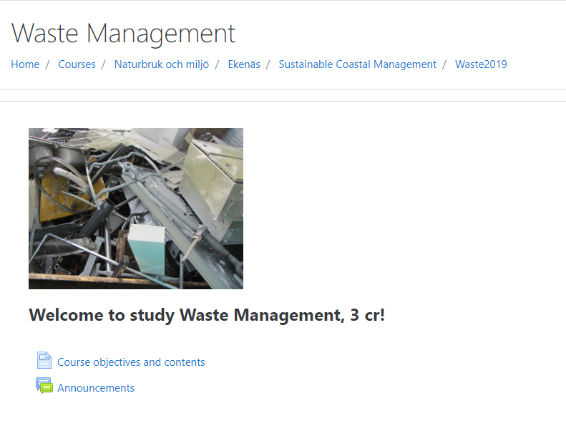
Learning outcomes
The student
Knows the different management and treatment methods of waste in Finland and EU
Understands the hierarchy of waste and the importance of wise resource usage and closing of the loop

Slide 3
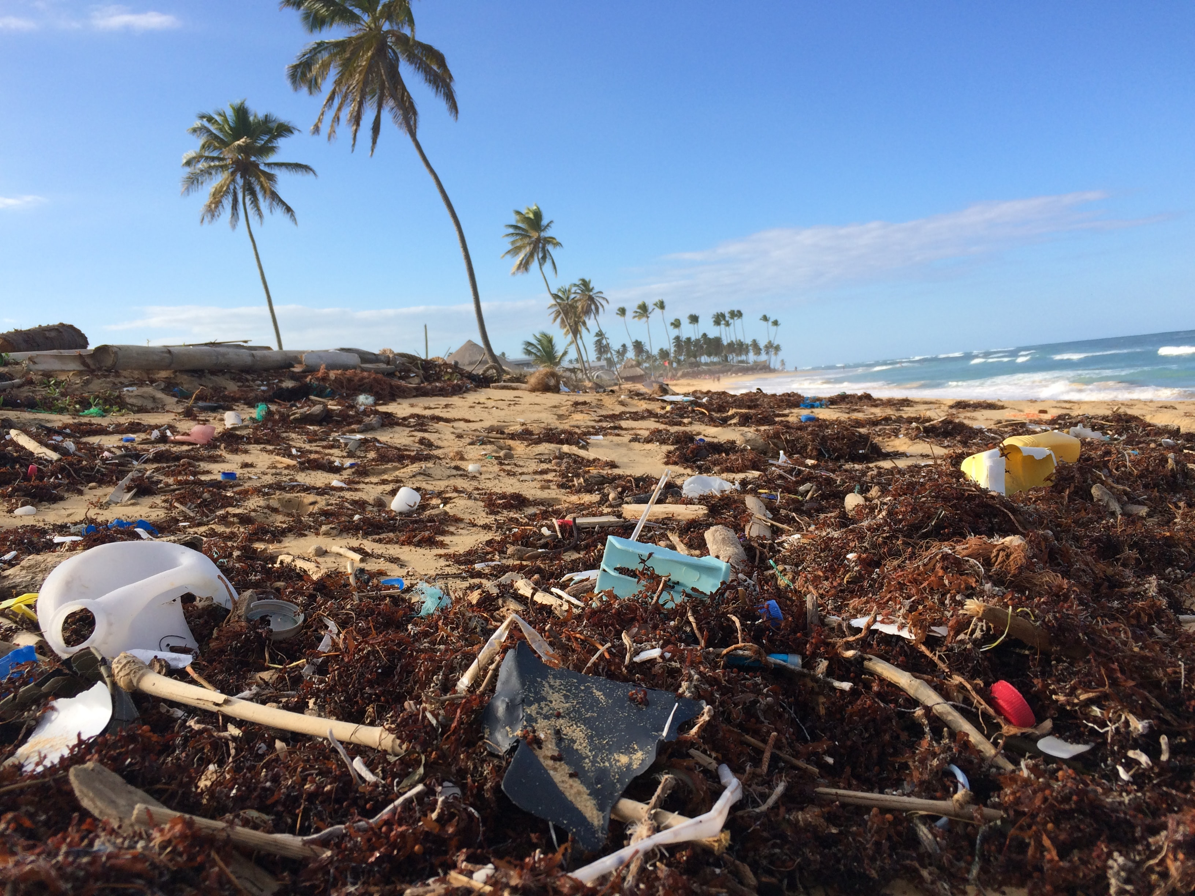
Content
The course is 100 % virtual, which means the student can study at any place where she/he has access to a computer and internet.
The course contains references to publications and websites for information on the different topics dealt with. The topics are: Relation to waste and expectations; Waste reduction; Waste hierarchy; Recycling of paper, cardboard, metal and glass; Plastic and recycling; WEE and hazardous waste; Bio-waste; Textile waste; Landfill and incineration.
Circular economy is an important general concept in all topics
Photo by Dustan Woodhouse on Unsplash

Slide 4
Implementation
Prerequisites: No special prerequisites
Study method: Reading and watching videos, writing assignments, answering a quiz
Implementation/teaching methods: Independent studies online
Teaching language: English
Amount of online study: 100 %
Grading scale: fail/pass (can also be graded e.g. 1-5)
Assessment description: The course is completed only after all required assignments are successfully completed

Slide 5
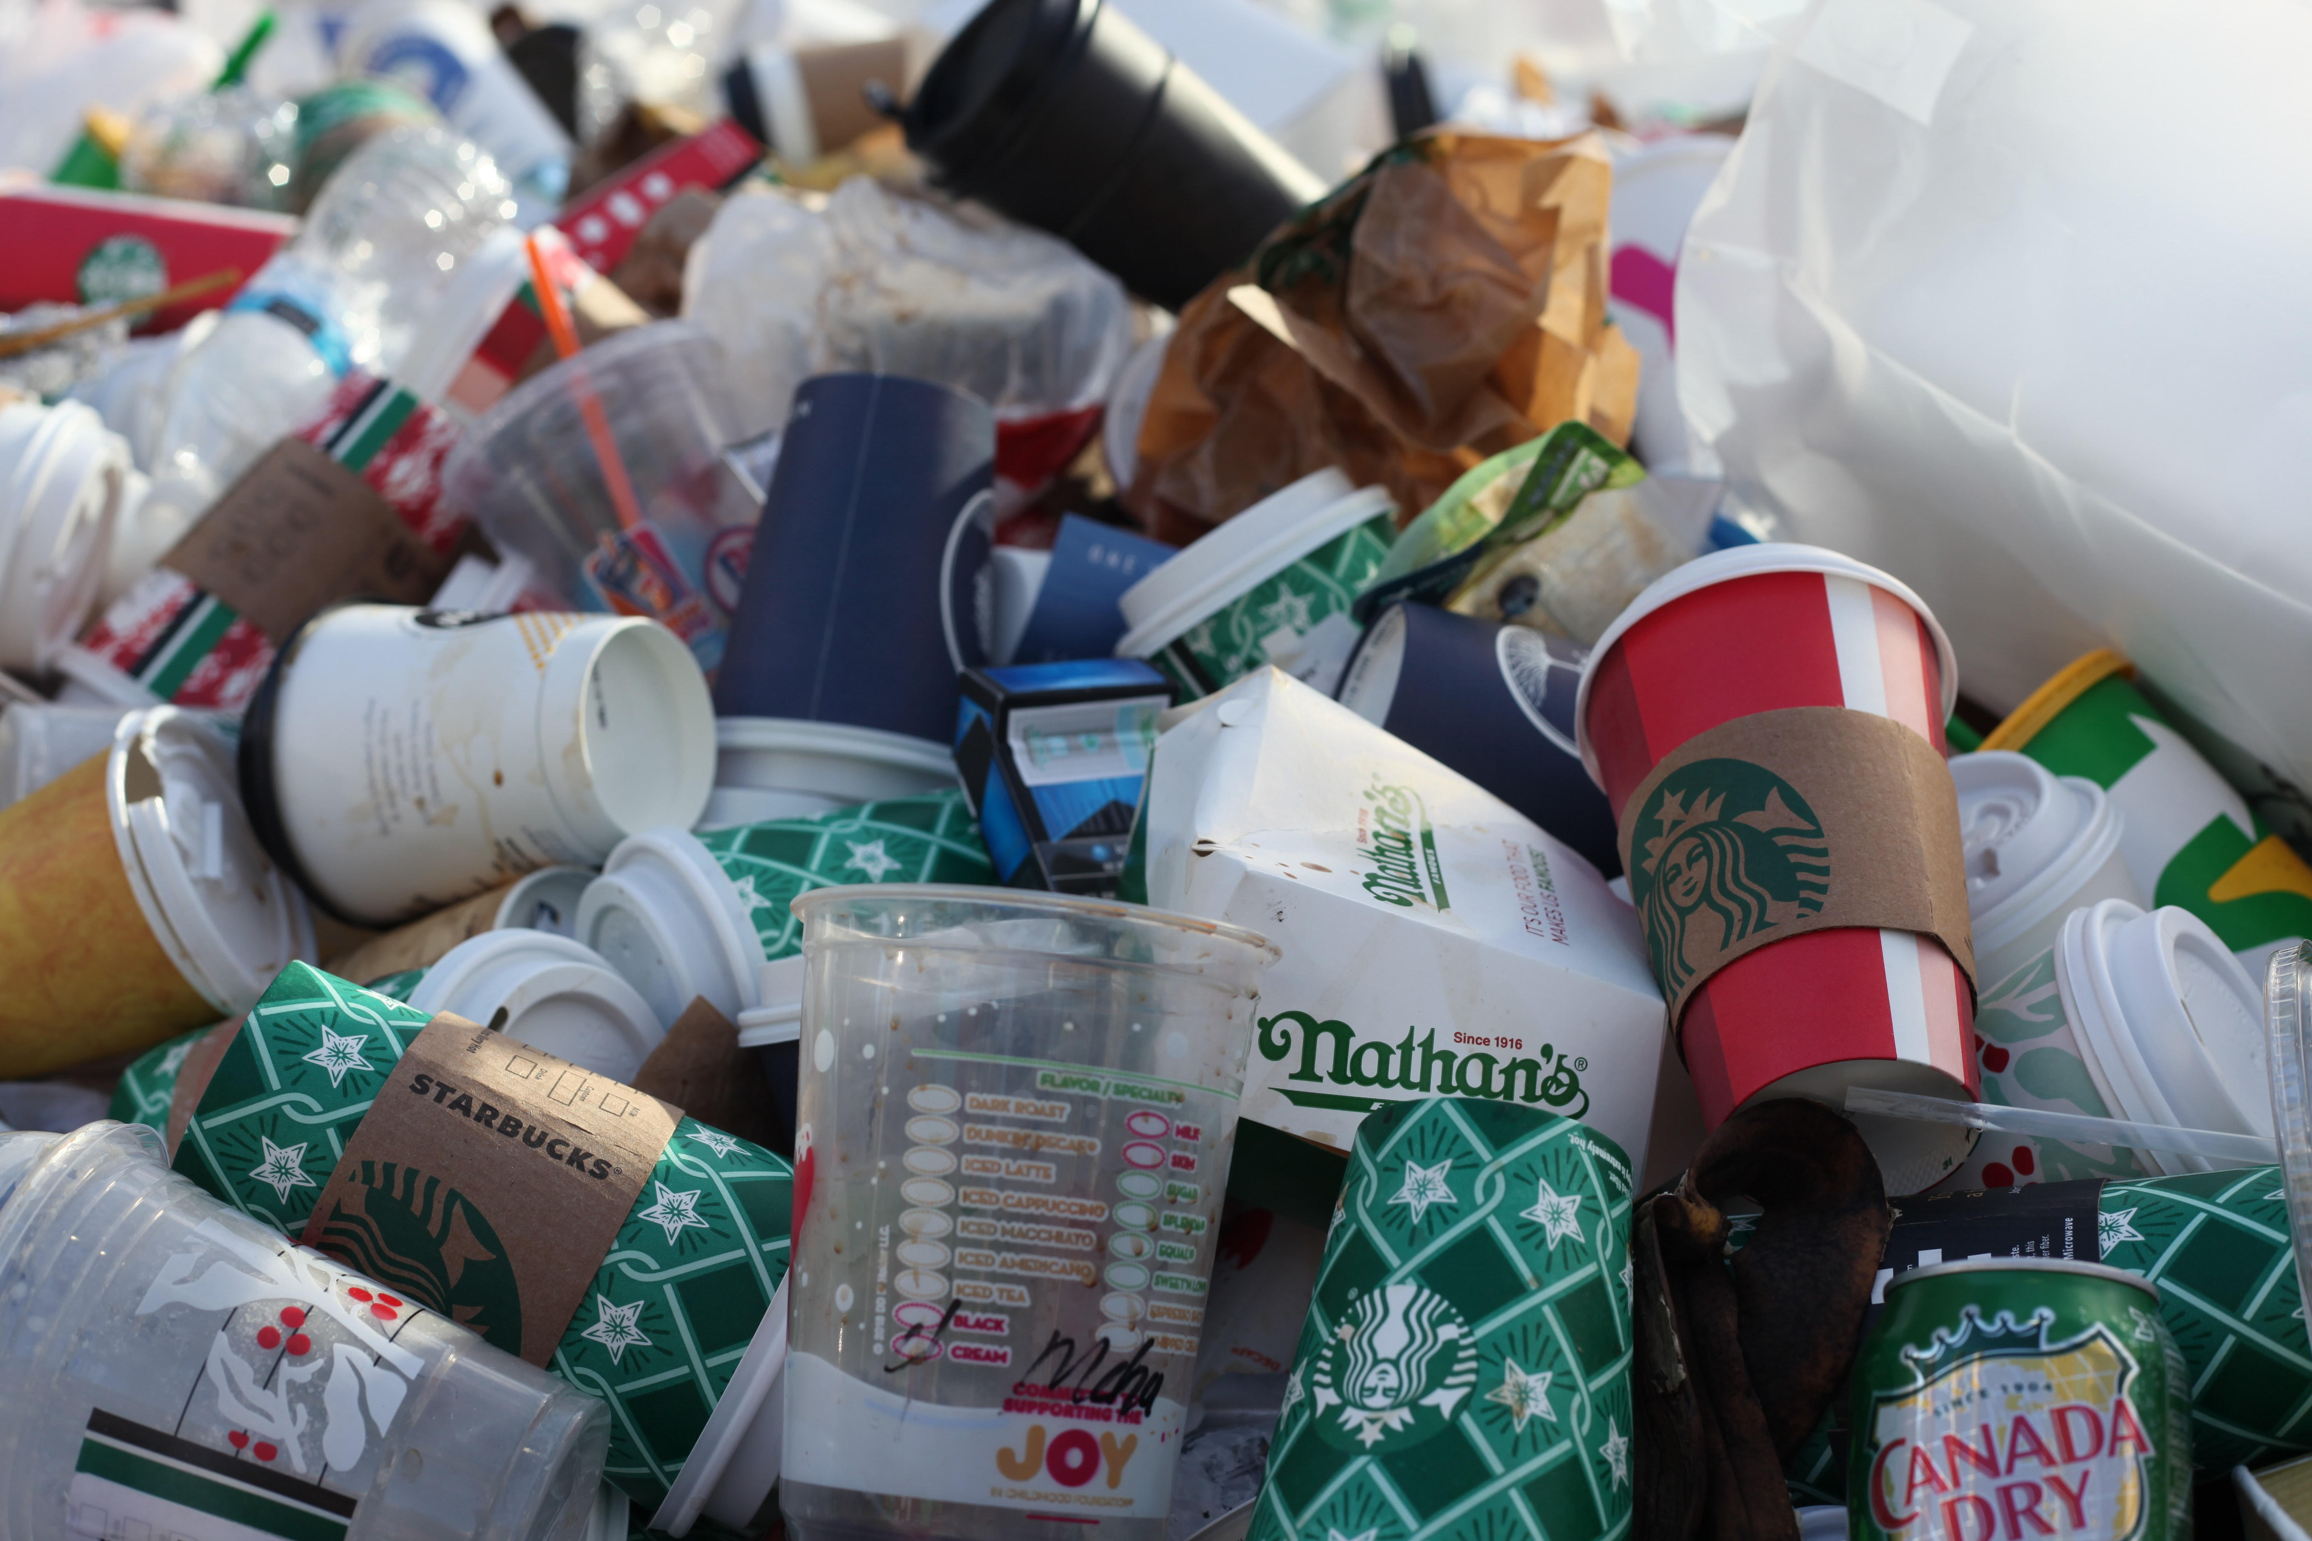
Topic 1 - Relation to waste and expectations
Assignment:
Present yourself. Then describe your relation to waste (can be on an individual level or on a society level) and what your expectations of the course are. Maximum 500 words
Photo by Jasmin Sessler on Unsplash

Slide 6
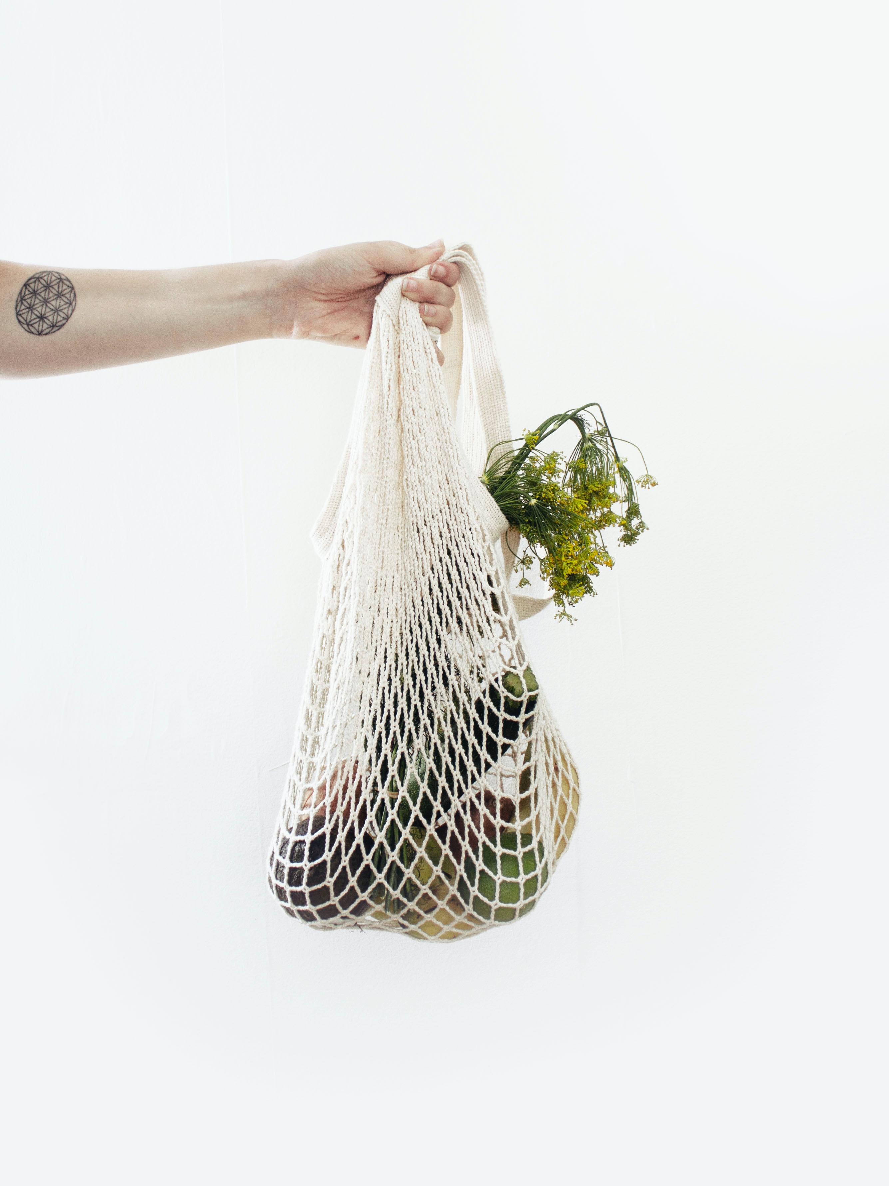
Topic 2 - Waste reduction
Assignment:
Locate background facts and write an essay 4000-5000 characters (N.B. not words!) long. Use references. Write your answer in Word and upload your file in Moodle. You can also upload the answer as an audio file (mp3) or a video if that suits you better. It is the content of facts and your reflections around the theme that is important.
With a certain place of work or your own life in mind, how would you reduce the amount of waste? Note that recycling is not the same as waste reduction.
Photo by Sylvie Tittel on Unsplash

Slide 7
Topic 2 – Background material
https://ec.europa.eu/environment/waste/prevention/index.htm
http://www2.balticuniv.uu.se/bup-3/index.php/chapter-3/3c-measuring-and-managing-resource-flows
Chapter 10: https://uu.diva-portal.org/smash/get/diva2:604269/FULLTEXT01.pdf
http://www2.balticuniv.uu.se/bup-3/index.php/chapter-5/5c-waste-sustainable-end-of-life-of-products
Photo by Sylvie Tittel on Unsplash

Slide 8
Topic 3 – EU Waste hierarchy
Assignment:
Compare the EU's waste principles as they are explained on the EU official web pages in relation to how these principles are implemented in the waste strategy of one EU country. Please read about the waste principles (also called the EU Waste Hierarchy) on the website http://ec.europa.eu/environment/waste/index.htm. After that please read one of the National Waste strategies for UK, Ireland or Finland.
Submit a short statement of your reflections on how the principles are reflected in the strategy by replying to the question:
Is it clearly visible that the strategy is based on EU's three Waste principles?
Please give examples from the text in the national strategy that you have chosen to study (you do not need to read the whole national strategy).

Slide 9
Topic 3 – Background material
EU Waste strategy
https://ec.europa.eu/environment/waste/index.htm
“Resources and waste strategy for England”
https://www.gov.uk/government/publications/resources-and-waste-strategy-for-england
“A Resource Opportunity – Waste management policy in Ireland July 2012”
https://www.dccae.gov.ie/en-ie/environment/publications/Pages/A-resource-opportunity-.aspx
“From Recycling to a Circular Economy”
http://julkaisut.valtioneuvosto.fi/bitstream/handle/10024/160889/SY_01en_18_WEB.pdf?sequence=1&isAllowed=y

Slide 10
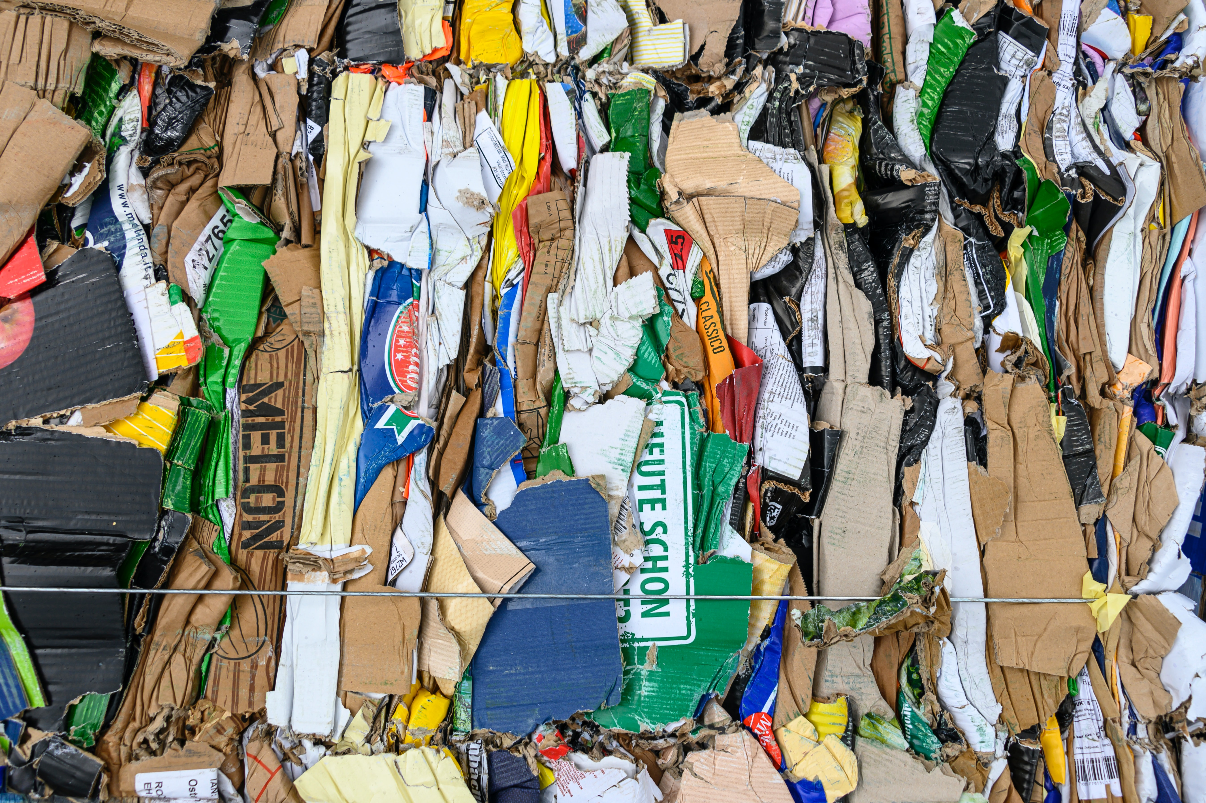
Topic 4 - Recycling of paper, cardboard, metal, glass...
Write a text on three categories of waste. Where should it be brought by the waste producer (e.g. in Ekenäs)
and how does the recycling process go on with the waste?
Describe also what producer responsibility stands for.
The text should contain about 500 words
Photo by Etienne Girardet on Unsplash

Slide 11
Topic 4 – Background material
Recycling in Finland - general information
https://www.infofinland.fi/en/living-in-finland/housing/waste-management-and-recycling
How paper is recycled
http://www.recycling-guide.org.uk/science-paper.html
Metal
https://www.kuusakoski.com/en/global/?nrd=1
Glass
https://www.uusioaines.com/en/
Sorting
https://www.hsy.fi/en/residents/sorting/Pages/default.aspx
Extended Producer Responsibility
https://ec.europa.eu/environment/archives/waste/eu_guidance/introduction.html
Photo by Etienne Girardet on Unsplash

Slide 12
Topic 5 - Plastic and recycling
Watch the following movies:
The great Pacific trash island: http://www.youtube.com/watch?v=en4XzfR0FE8
Plastic in the oceans https://www.youtube.com/watch?v=6HBtl4sHTqU
How Plastic Bottles Are Recycled Into Polyester http://www.youtube.com/watch?v=zyF9MxlcItw
Globe Hope - Recycled Materials - Seatbelt: http://www.youtube.com/watch?v=jiaEWwyQ2q8
Plastic Bag Crochet - CRAFT Video Podcast: http://www.youtube.com/watch?v=1i1W9Mi7jPM&feature=related
The publication:
https://ec.europa.eu/environment/waste/studies/pdf/plastics.pdf
gives you comprehensive information about plastic as a waste.
Please submit a comment (about 500 words) on the usage and recycling of plastic, is there any solution to the problem? Could designed products made of plastic waste be a real solution?
You may divide the answer into different kinds of plastic based on the report's classification.

Slide 13
Topic 6 - WEEE and Hazardous waste
Please answer the six questions below based on information you find on the follow web pages:
http://ec.europa.eu/environment/waste/weee/index_en.htm (WEEE questions), https://www.hsy.fi/en/residents/sorting/instructions/electricalequipment/Pages/default.aspx and https://www.hsy.fi/en/residents/sorting/instructions/hazardouswaste/Pages/default.aspx .
Questions:
1. Which are the most common kinds of hazardous waste?
2. What is problematic with hazardous waste (include collection, management and treatment)?
3. How should you in your household handle hazardous waste?
4. Do you have anything in your flat that will become hazardous waste when you would like to throw it away?
5. What does WEEE stand for?
6. What is problematic with management of WEEE?
Please include the questions into your file. Please submit your answers as a word-file

Slide 14
Topic 7 – Bio waste
You have been assigned the job to study & plan how all the bio-waste in the city "Bio-city" should be collected, managed and treated. "Bio-City" has 100 000 inhabitants and quite a compact structure.
7a: List all of the positive and negative arguments for the two different treatment options for bio-waste.

Slide 15
Topic 7 - continues
7b: Make a recommendation for which type of collection and treatment "bio-city" should choose for their bio-waste. Give arguments that support your recommendation.
You find relevant studies from http://ec.europa.eu/environment/waste/compost/pubs.htm and from sources that you find of your own. Please state the sources in your PM.
7c: Describe how the anaerobic in digestion and aerobic process in composting works.

Slide 16
Topic 8 - Textiles
The Landfill Directive (1999/31/EC) with amendments from 2018 states the following: “Member States shall endeavour to ensure that as of 2030, all waste suitable for recycling or other recovery, in particular in municipal waste, shall not be accepted in a landfill with the exception of waste for which landfilling delivers the best environmental outcome in accordance with Article 4 of Directive 2008/98/EC.”
This concerns also textile waste. If the waste is incinerated instead of landfilled, we don't have the problem with too much biowaste on landfills due to old textiles. But reducing and recycling is a still the more clever way of handling old textiles.
Plan a blog text in Word (about 2000 - 3000 characters; N.B. not words; long) on how to reduce the amount of textile waste and how to recycle it. Please, search information on the Internet or in publications. Mention your references at the end of the text.

Slide 17
Topic 9 – Incineration
Please watch the movies about incineration. Prepare a statement (about 500 words) that is formulated as a letter to the editors, where you will argue fiercely for your point of view, either against or in support of waste incineration.
http://www.youtube.com/watch?v=k741pnJTUh0
http://www.youtube.com/watch?v=F0QdVesasaQ (Please note that the film is made by a community group and all the facts are not reliable
but it is good to fire up discussions, takes 22 sec before it starts)
http://www.youtube.com/watch?v=KwAVZoYUiP0

Slide 18
Topic 10 - quiz

Slide 19
Topic 10(1) - quiz

Slide 20
Topic 10(2) - quiz

